Slide 1
Practical Data Science
Descriptive Statistics

Slide 2
Statistics in DataFrame
df
A B C D F
2013-01-01 0.000000 0.000000 -1.509059 5 NaN
2013-01-02 1.212112 -0.173215 0.119209 5 1.0
2013-01-03 -0.861849 -2.104569 -0.494929 5 2.0
2013-01-04 0.721555 -0.706771 -1.039575 5 3.0
2013-01-05 -0.424972 0.567020 0.276232 5 4.0
2013-01-06 -0.673690 0.113648 -1.478427 5 5.0
df.mean()
A -0.004474
B -0.383981
C -0.687758
D 5.000000
F 3.000000
dtype: float64
df.mean(1)
2013-01-01 0.872735
2013-01-02 1.431621
2013-01-03 0.707731
2013-01-04 1.395042
2013-01-05 1.883656
2013-01-06 1.592306
Freq: D, dtype: float64
Other functions:
std() #Standard deviation
mode() #Mode

Slide 3
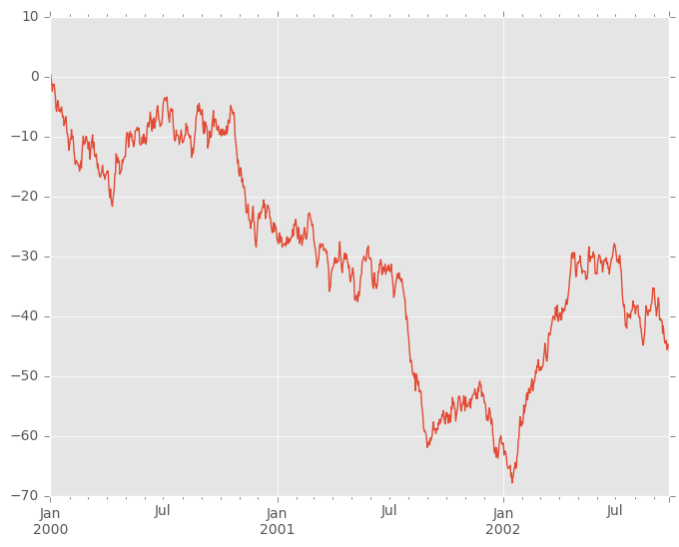
Visualization with DataFrame
ts = pd.Series(np.random.randn(1000), index=pd.date_range('1/1/2000', periods=1000))
ts = ts.cumsum()
ts.plot()

Slide 4
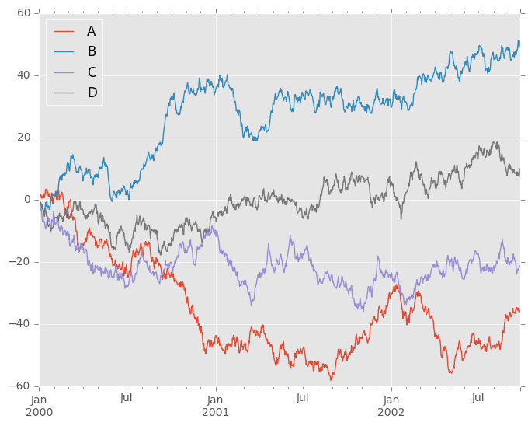
Visualization with DataFrame
df = pd.DataFrame(np.random.randn(1000, 4), index=ts.index, columns=['A', 'B', 'C', 'D'])
df = df.cumsum()
plt.figure(); df.plot(); plt.legend(loc='best')

Slide 5
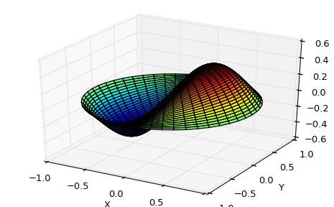
Scipy module
from scipy import special
def drumhead_height(n, k, distance, angle, t):
kth_zero = special.jn_zeros(n, k)[-1]
return np.cos(t) * np.cos(n*angle) * special.jn(n, distance*kth_zero)
theta = np.r_[0:2*np.pi:50j]
radius = np.r_[0:1:50j]
x = np.array([r * np.cos(theta) for r in radius])
y = np.array([r * np.sin(theta) for r in radius])
z = np.array([drumhead_height(1, 1, r, theta, 0.5) for r in radius])
import matplotlib.pyplot as plt
from mpl_toolkits.mplot3d import Axes3D
from matplotlib import cm
fig = plt.figure()
ax = Axes3D(fig)
ax.plot_surface(x, y, z, rstride=1, cstride=1, cmap=cm.jet)
ax.set_xlabel('X')
ax.set_ylabel('Y')
ax.set_zlabel('Z')
plt.show()

Slide 6
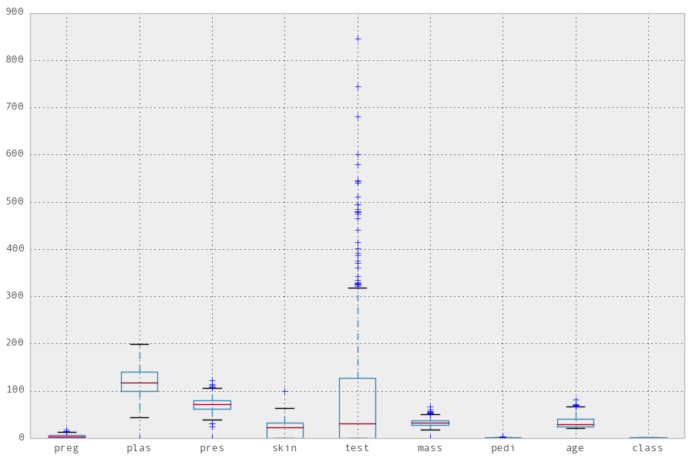
Distributions
import pandas as pd
names = ['preg', 'plas', 'pres', 'skin', 'test', 'mass', 'pedi', 'age', 'class']
data = pd.read_csv('pima-indians-diabetes.data', names=names)
import matplotlib.pyplot as plt
pd.options.display.mpl_style = 'default'
data.boxplot()

Slide 7
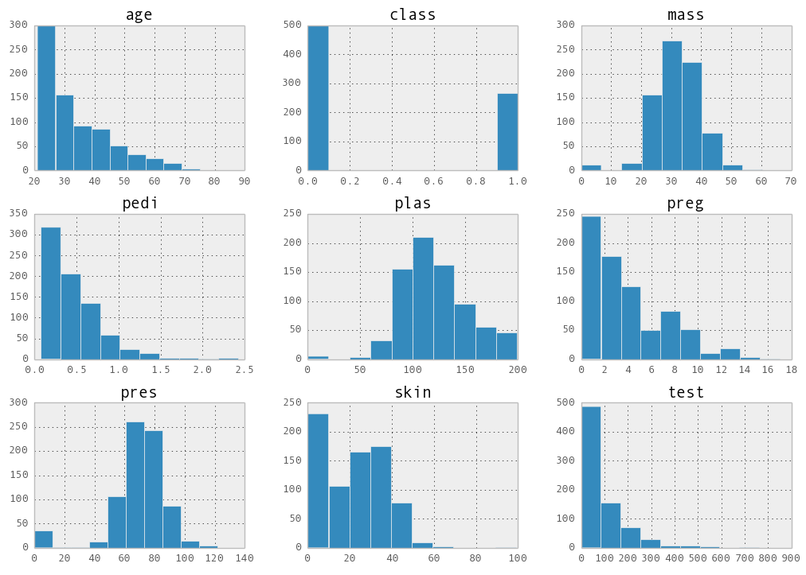
Distributions
data.hist()

Slide 8
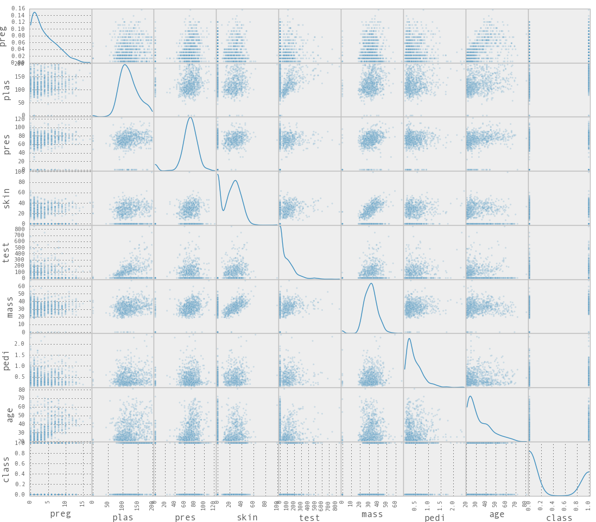
Distributions
from pandas.tools.plotting import scatter_matrix
scatter_matrix(data, alpha=0.2, figsize=(6, 6), diagonal='kde')

Slide 9
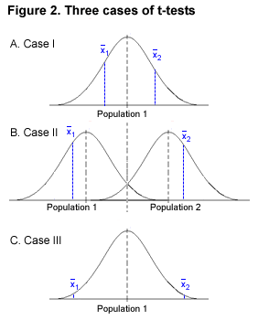
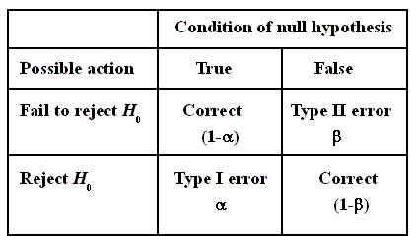
Hypothesis testing

Slide 10

A/B testing

Slide 11
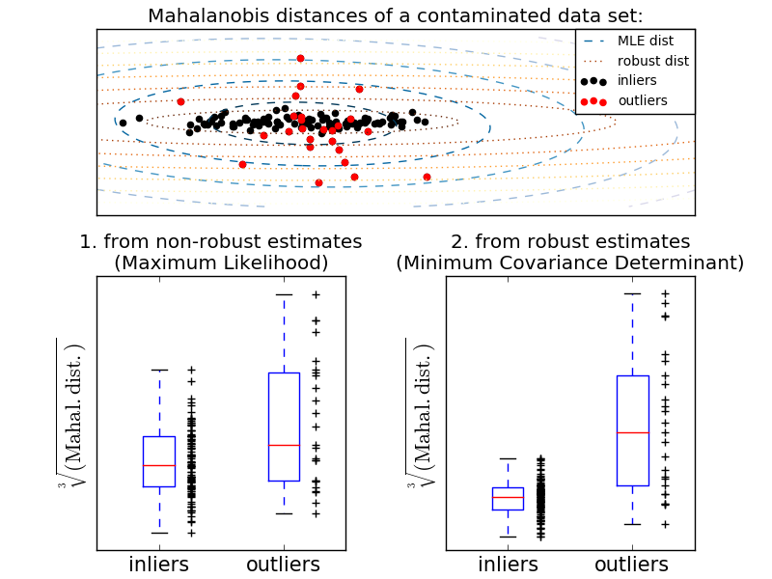
Outliers/Inliers

Slide 12
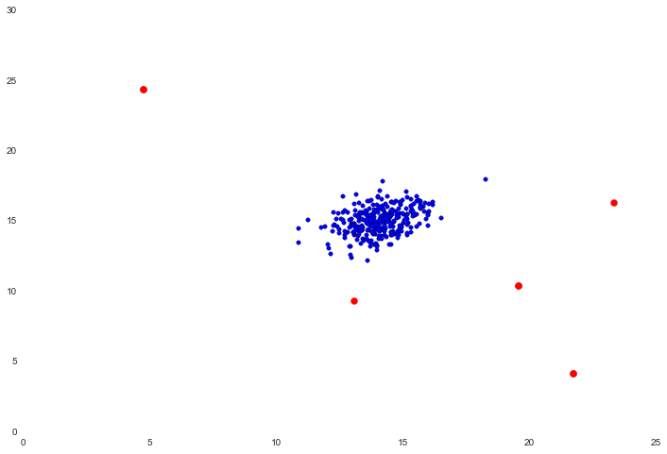
Anomaly detection (static data)

Slide 13
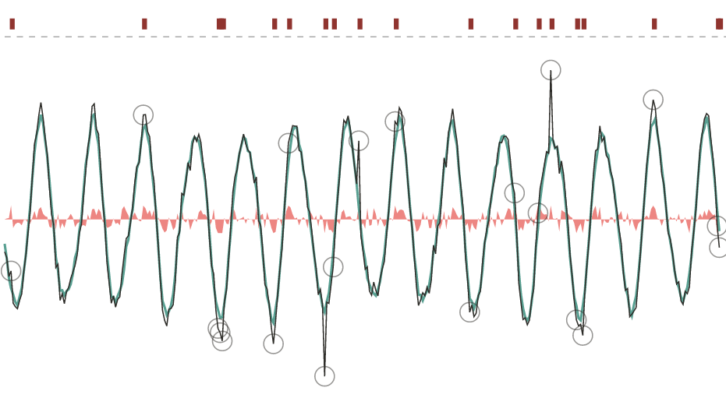
Anomaly detection (time series)

