Slide 1
Practical Data Science
Data Vizualization

Slide 2
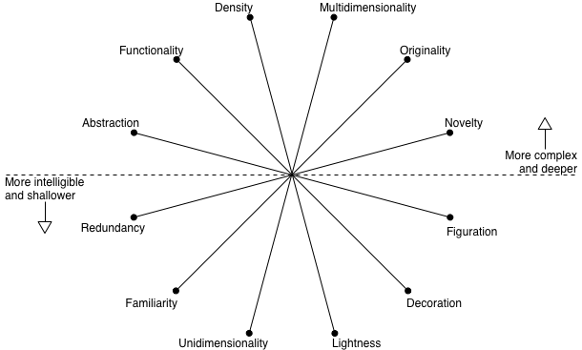
Visualization wheel
Alberto Cairo “The functional art” – Umich Coursera Vizualization with Python

Slide 3
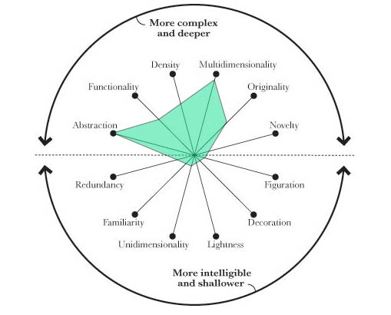
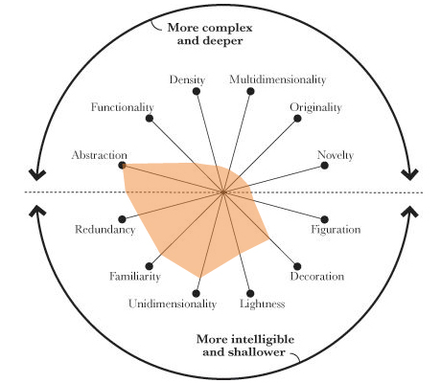
Effect of audience
Colleagues (data scientists, engineers)
Managers
Outside public

Slide 4
Qualities of great visualization
Truthful
Functionality
Beauty
Insightful
Enlightening

Slide 5
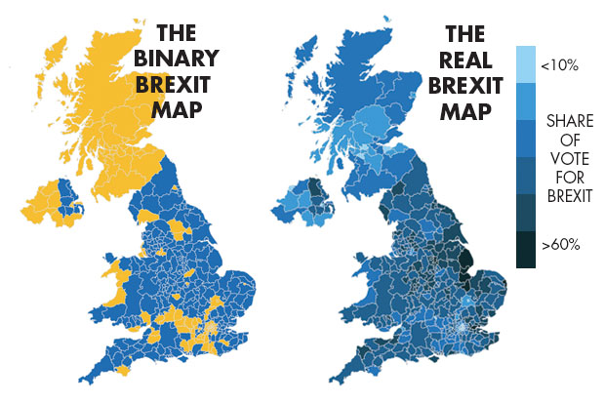
Truthful

Slide 6
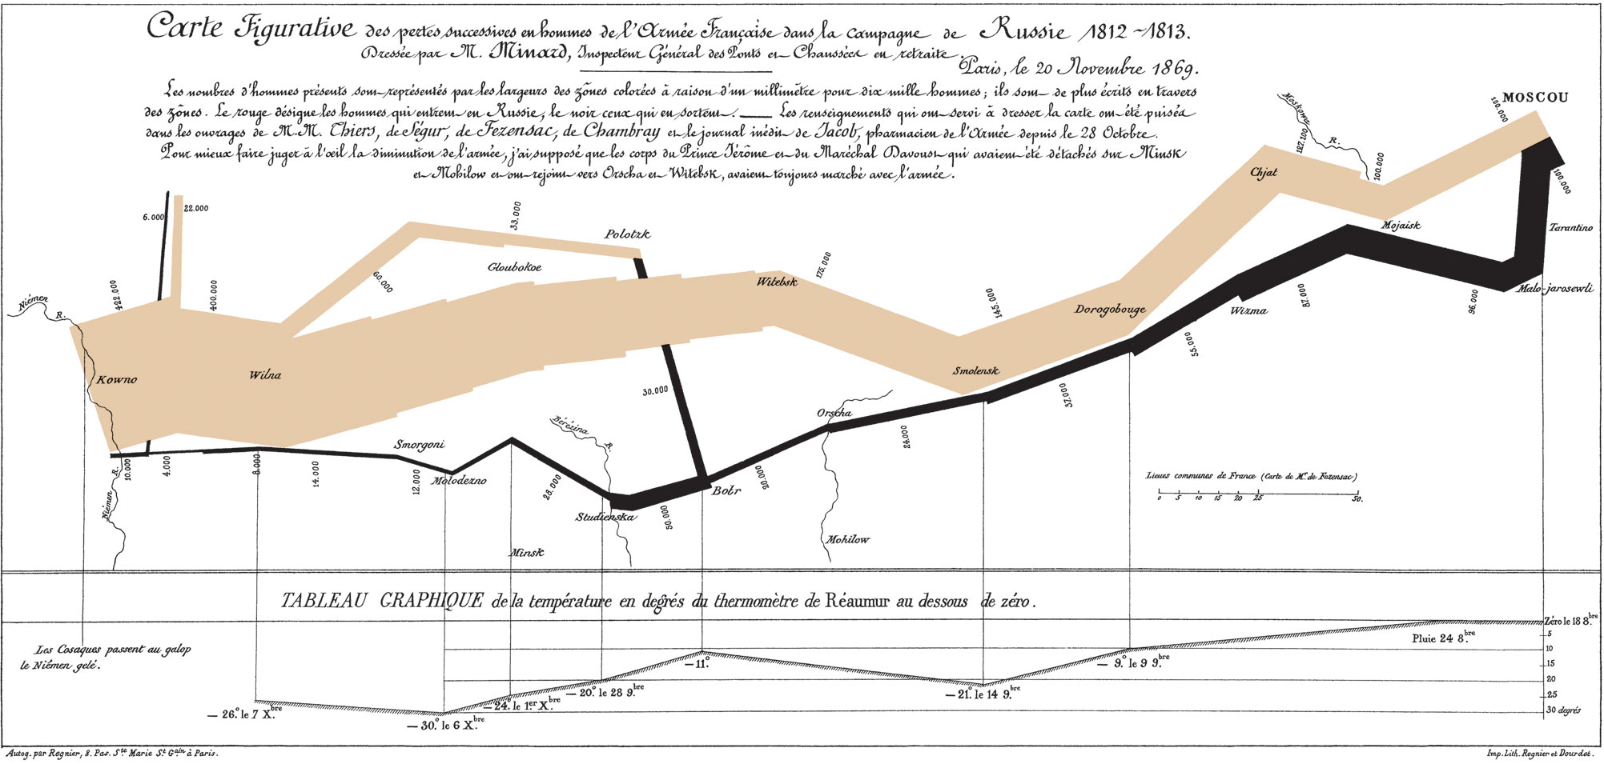
Functionality

Slide 7
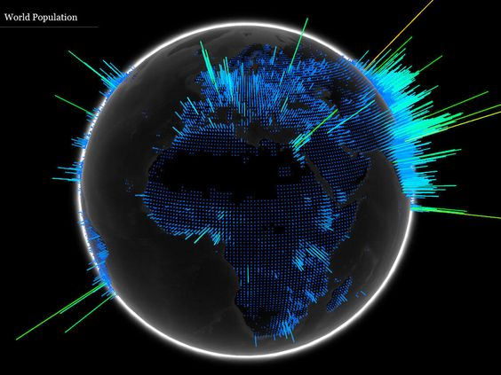
Beauty

Slide 8
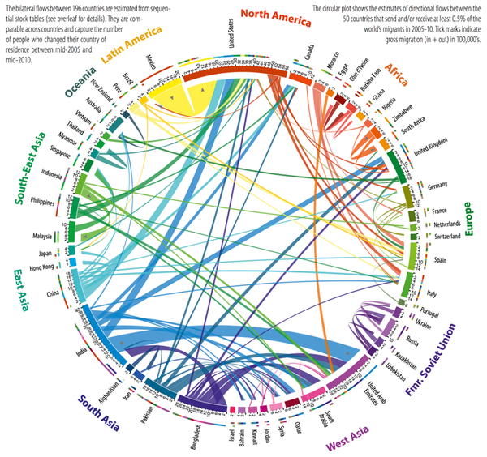
Insightful

Slide 9
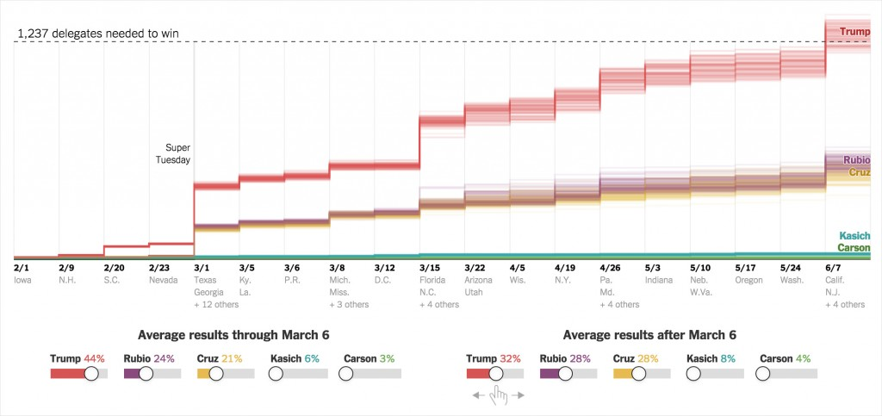
Enlightening

Slide 10
Matplotlib
import matplotlib.pyplot
import pylab

Slide 11
Matplotlib architecture
Compare results

Slide 12
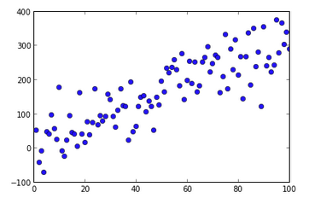
Scatter plot
import matplotlib.pyplot
import pylab
x = [1,2,3,4]
y = [3,4,8,6]
matplotlib.pyplot.scatter(x,y)
matplotlib.pyplot.show()

Slide 13
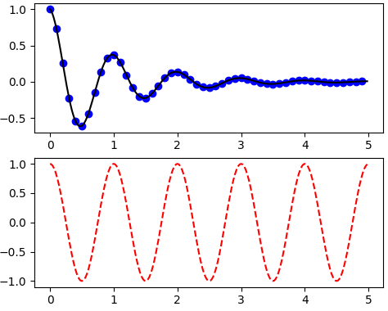
Line plots
import numpy as np
import matplotlib.pyplot as plt
def f(t):
return np.exp(-t) * np.cos(2*np.pi*t)
t1 = np.arange(0.0, 5.0, 0.1)
t2 = np.arange(0.0, 5.0, 0.02)
plt.figure(1)
plt.subplot(211)
plt.plot(t1, f(t1), 'bo', t2, f(t2), 'k')
plt.subplot(212)
plt.plot(t2, np.cos(2*np.pi*t2), 'r--')
plt.show()

Slide 14
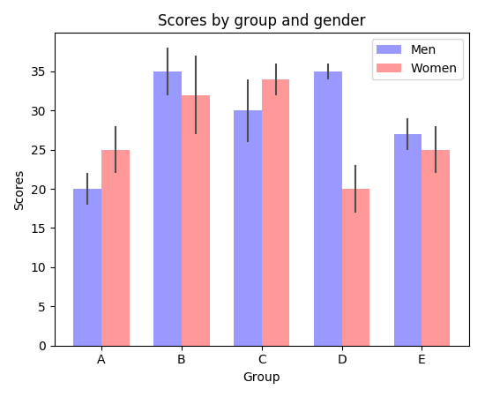
Barcharts

Slide 15
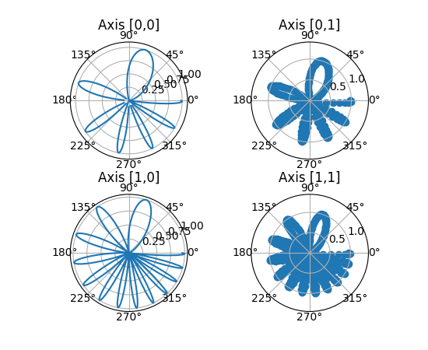
Subplots

Slide 16
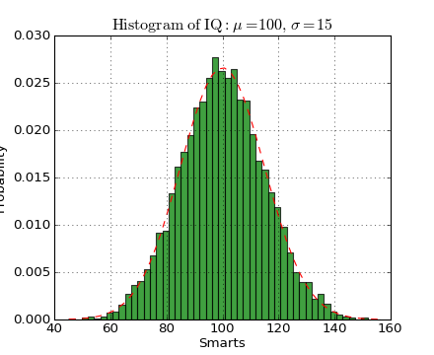
Histograms
#!/usr/bin/env python
import numpy as np
import matplotlib.mlab as mlab
import matplotlib.pyplot as plt
mu, sigma = 100, 15
x = mu + sigma*np.random.randn(10000)
# the histogram of the data
n, bins, patches = plt.hist(x, 50, normed=1, facecolor='green', alpha=0.75)
# add a 'best fit' line
y = mlab.normpdf( bins, mu, sigma)
l = plt.plot(bins, y, 'r--', linewidth=1)
plt.xlabel('Smarts')
plt.ylabel('Probability')
plt.title(r'$\mathrm{Histogram\ of\ IQ:}\ \mu=100,\ \sigma=15$')
plt.axis([40, 160, 0, 0.03])
plt.grid(True)
plt.show()

Slide 17
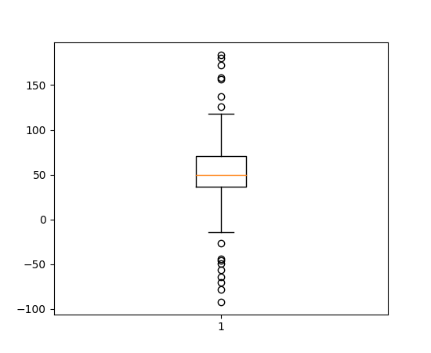
Box plots

Slide 18
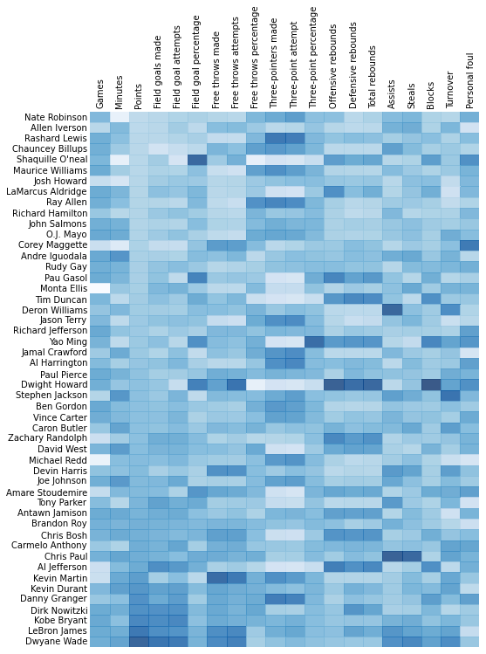
Heatmaps
import matplotlib.pyplot as plt
import pandas as pd
from urllib2 import urlopen
import numpy as np
%pylab inline
page = urlopen("http://datasets.flowingdata.com/ppg2008.csv")
nba = pd.read_csv(page, index_col=0)
# Normalize data columns
nba_norm = (nba - nba.mean()) / (nba.max() - nba.min())
# Sort data according to Points, lowest to highest
# This was just a design choice made by Yau
# inplace=False (default) ->thanks SO user d1337
nba_sort = nba_norm.sort('PTS', ascending=True)
nba_sort['PTS'].head(10)

Slide 19
Animation
https://www.youtube.com/watch?v=N-47e0ZeSjg
import numpy as np
import matplotlib.pyplot as plt
import matplotlib.animation as animation
def update_line(num, data, line):
line.set_data(data[..., :num])
return line,
fig1 = plt.figure()
data = np.random.rand(2, 25)
l, = plt.plot([], [], 'r-')
plt.xlim(0, 1)
plt.ylim(0, 1)
plt.xlabel('x')
plt.title('test')
line_ani = animation.FuncAnimation(fig1, update_line, 25, fargs=(data, l),
interval=50, blit=True)
# To save the animation, use the command: line_ani.save('lines.mp4')
fig2 = plt.figure()
x = np.arange(-9, 10)
y = np.arange(-9, 10).reshape(-1, 1)
base = np.hypot(x, y)
ims = []
for add in np.arange(15):
ims.append((plt.pcolor(x, y, base + add, norm=plt.Normalize(0, 30)),))
im_ani = animation.ArtistAnimation(fig2, ims, interval=50, repeat_delay=3000,
blit=True)
# To save this second animation with some metadata, use the following command:
# im_ani.save('im.mp4', metadata={'artist':'Guido'})
plt.show()

Slide 20
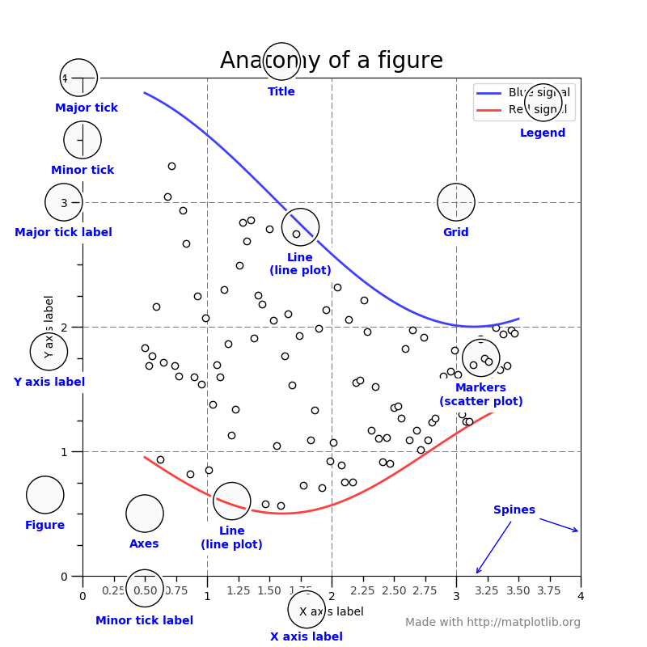
Interactivity

