Slide 1
Practical Data Science
Infographics

Slide 2
Seaborn
Seaborn is a Python visualization library based on matplotlib. It provides a high-level interface for drawing attractive statistical graphics.
Seaborn is just a wrapper around matplotlib. Add styles, makes plotting easier.

Slide 3
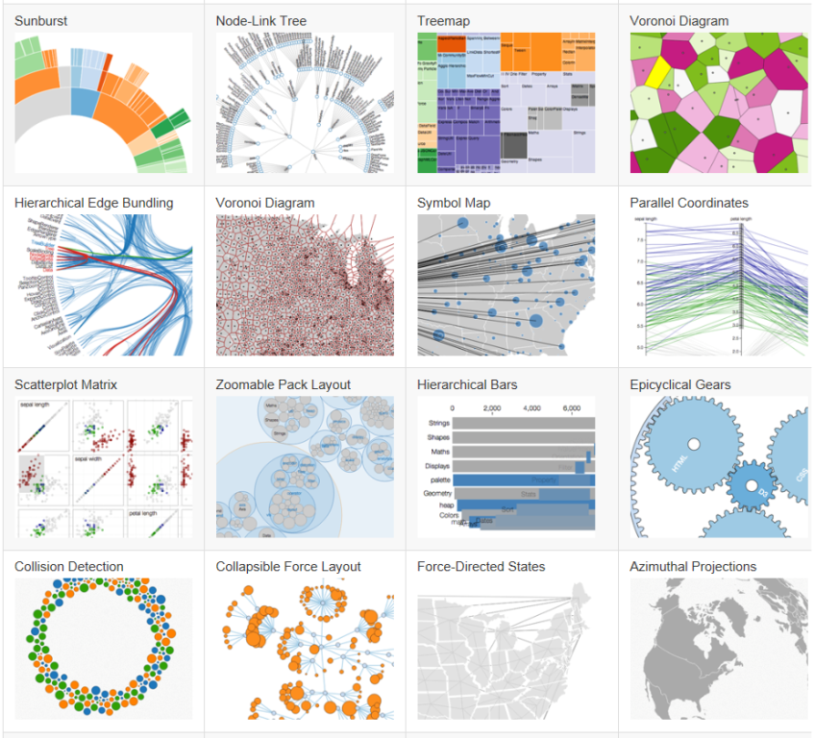
Interactive Infographics with d3.js
D3 stands for Data-Driven Documents
D3.js is a JavaScript library (steep learning curve)
D3 stays on the shoulder of HTML, CSS, Javascript, SVG

Slide 4
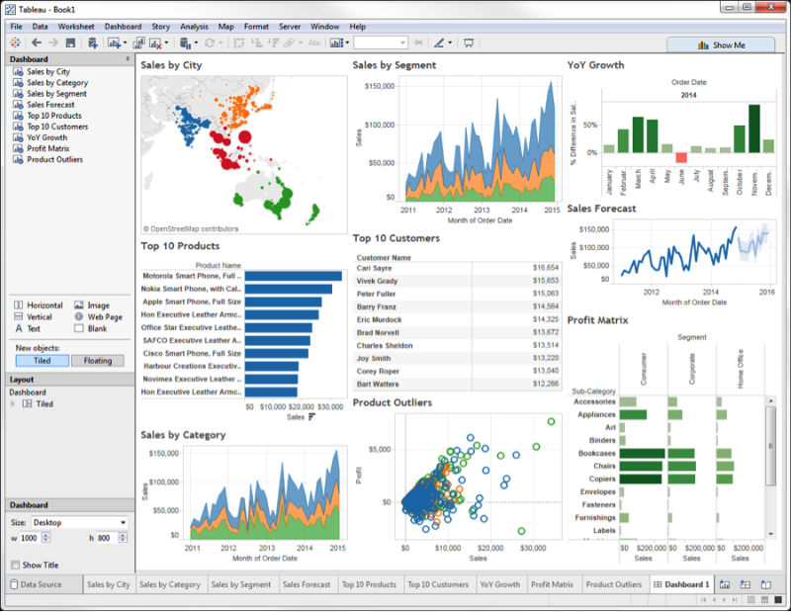
Business Dashboards with Tableau

