Slide 1
Practical Machine Learning
Introduction to Machine Learning

Slide 2
What is Machine Learning (ML)
Arthur Samuel (1959): Machine learning is a field of study that gives computers the ability to learn without being explicitly programmed.
Tom Mitchel (1998): Well posed Learning Problem: A computer program is said to learn from experience E with respect to some task T and some performance measure P, if its performance on T, as measured by P, improves with experience E.
Goal of machine learning:
is to achieve a thorough understanding about the nature of learning process (both human learning and other forms of learning), about the computational aspects of learning behaviors, and to implant the learning capability in computer systems.

Slide 3
Structure of Machine Learning
Machine Learning
Supervised
Unsupervised
Reinforcement
Regression
Classification
Clustering
Anomaly detection
Dimensionality reduction

Slide 4
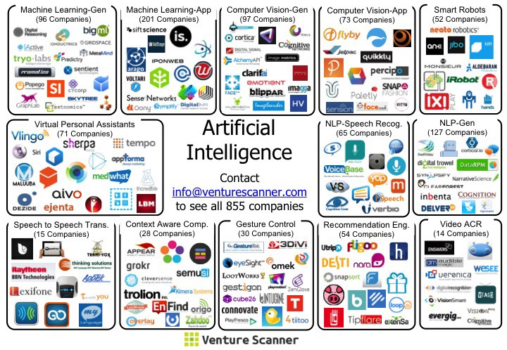
Technologies for ML

Slide 5
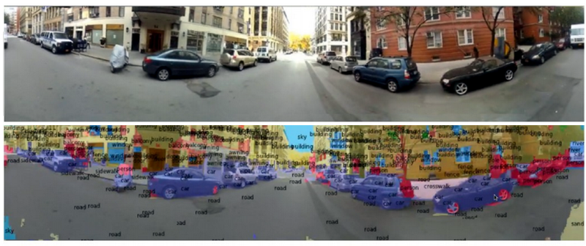
Examples of ML projects
Deep learning:
Computer vision

Slide 6
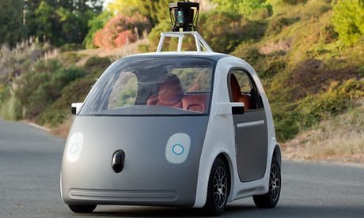
Examples of ML projects
Self-driving cars:
https://youtu.be/bSUrn0lZinU

Slide 7
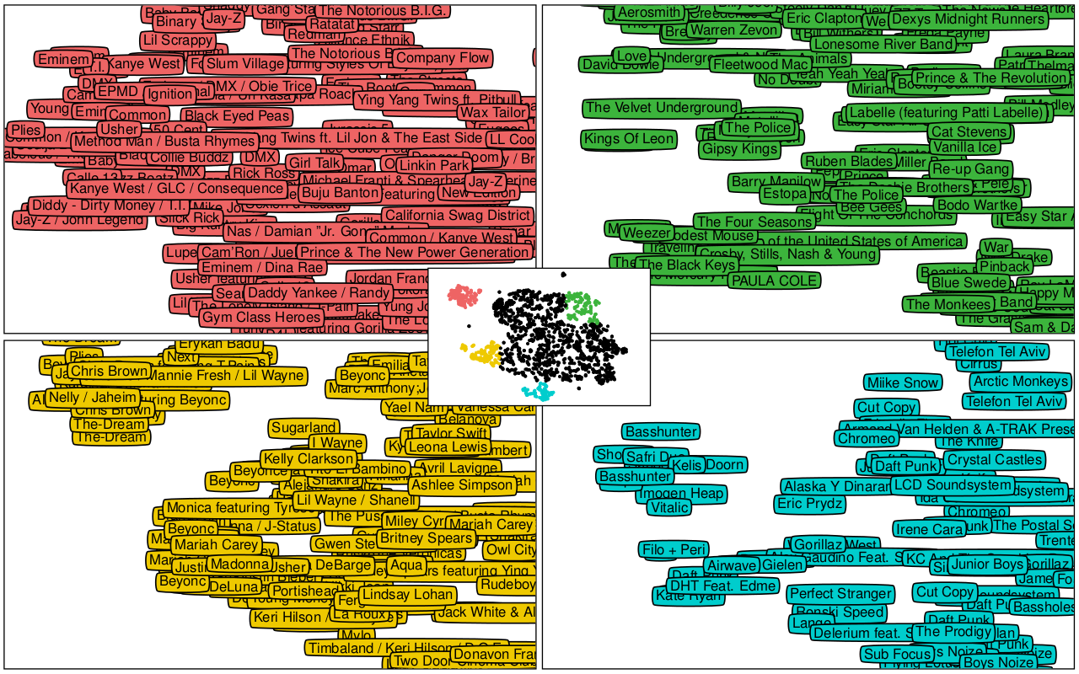
Examples of ML projects
Recommender systems:
Music recommender on Spotify

Slide 8
Where to learn more
Quora
Books:
Programming Collective Intelligence
Introduction to Statistical Learning
Machine Learning for Hackers
Machine Learning by Tom M Mitchell
Learning from Data
Pattern Recognition and Machine Learning
…
Blogs:
KDNuggets - Analytics, Data Mining, and Data Science
SimplyStatistics - http://www.simplystatistics.com
R-bloggers - https://www.r-bloggers.com/
Yhat - ŷhat | Yhat: The Yhat (Pronounced Y-hat) Blog
FastML - FastML
Analytics Vidhya - Home
Edureka - Edureka Blog - Edureka - Discover Learning

Slide 9



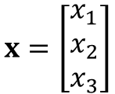
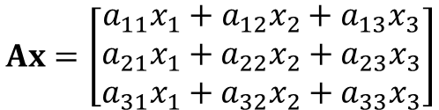
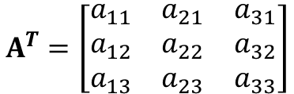
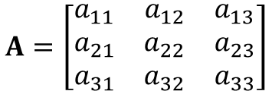

Recap of Linear Algebra
$$x=\left[\begin{matrix}x_{1} \\ x_{2} \\ x_{3}\end{matrix}\right]$$
Vector
Transposition
$$x^{T}=\left[\begin{matrix}x_{1} & x_{2} & x_{3}\end{matrix}\right]$$
columns
$$A^{T}=\left[\begin{matrix}a_{11} & a_{21} & a_{31} \\ a_{12} & a_{22} & a_{32} \\ a_{13} & a_{23} & a_{33}\end{matrix}\right]$$
$$A=\left[\begin{matrix}a_{11} & a_{12} & a_{13} \\ a_{21} & a_{22} & a_{23} \\ a_{31} & a_{32} & a_{33}\end{matrix}\right]$$
rows
Transposition
Matrix
$$Ax=\left[\begin{matrix}a_{11}x_{1}+a_{12}x_{2}+a_{13}x_{3} \\ a_{21}x_{1}+a_{22}x_{2}+a_{23}x_{3} \\ a_{31}x_{1}+a_{32}x_{2}+a_{33}x_{3}\end{matrix}\right]$$
Product
$$x^{T}∙x=x_{1}^{2}+x_{2}^{2}+x_{3}^{2}={\left|x\right|}^{2}$$
L₂ norm (Euclidian distance)
$$\left|x\right|=\sqrt{x_{1}^{2}+x_{2}^{2}+x_{3}^{2}}$$
L₁ norm (Manhattan distance)
$$\left|x\right|=\left|x_{1}\right|+\left|x_{2}\right|+\left|x_{3}\right|$$

Slide 10






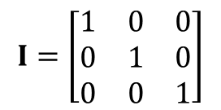





Recap of Linear Algebra
$$b=\left[\begin{matrix}b_{1} \\ b_{2} \\ b_{3}\end{matrix}\right]$$
Linear equation:
$$Ax=b$$
where
where is inverse of
Solution of linear equation:
$$x=A^{−1}b$$
$$A^{−1}$$
$$A$$
$$I=\left[\begin{matrix}1 & 0 & 0 \\ 0 & 1 & 0 \\ 0 & 0 & 1\end{matrix}\right]$$
$$AA^{−1}=A^{−1}A=I$$
where
is identity matrix
$$Ix=x$$
where are eigenvalue and eigenvector of matrix
$$Av=λv$$
$$λ,v$$
$$A$$
To find eigenvalue solve this equation:
$$det\left(A−λI\right)=0$$

