Slide 1
Practical Machine Learning
Linear Regression

Slide 2
What is Linear Regression
Training set:
x (variable, feature, input) | y (output, target, result)
x⁽¹⁾ | y⁽¹⁾
x⁽²⁾ | y⁽²⁾
x⁽³⁾ | y⁽³⁾
… | …
x^{(m)} | y^{(m)}
Goal:
Find a function (h(x)) to approximate result (y) for any given x
Example: given a set of house prices (square foots – price) find a function to predict house price for any other square footage

Slide 3
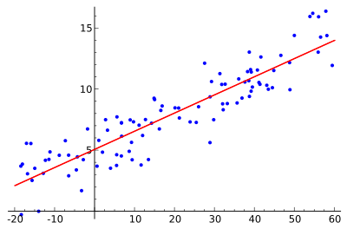







Single variable linear regression
Form of a function for linear regression:
$$h\left(x\right)=w_{0}+w_{1}x$$
Where w₀ and w₁ are parameters of model
$$y^{\left(2\right)}$$
$$h\left(x\right)$$
$$y^{\left(1\right)}$$
$$x^{\left(1\right)}$$
$$x^{\left(2\right)}$$
$$x$$

Slide 4

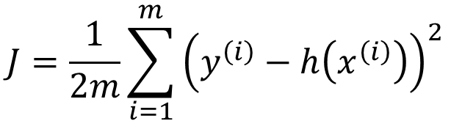
Cost Function
$$J=\frac{1}{2m}\sum_{i=1}^{m}{{\left(y^{\left(i\right)}−h\left(x^{\left(i\right)}\right)\right)}^{2}}$$
Cost function
$$y^{\left(i\right)}−h\left(x^{\left(i\right)}\right)$$

Slide 5
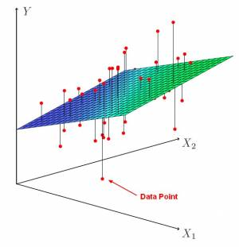
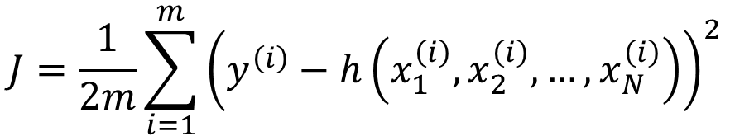
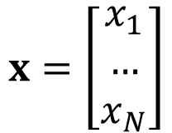

Multiple variables linear regression
$$J=\frac{1}{2m}\sum_{i=1}^{m}{{\left(y^{\left(i\right)}−h\left(x_{1}^{\left(i\right)},x_{2}^{\left(i\right)},…,x_{N}^{\left(i\right)}\right)\right)}^{2}}$$
Cost function
$$h_{w}\left(x_{1},x_{2},…,x_{N}\right)=w_{0}+w_{1}x_{1}+w_{2}x_{2}+…+w_{N}x_{N}=wx$$
$$w=\left[\begin{matrix}w_{1} & … & w_{N}\end{matrix}\right]$$
$$x=\left[\begin{matrix}x_{1} \\ … \\ x_{N}\end{matrix}\right]$$
Where N is the number of features

Slide 6
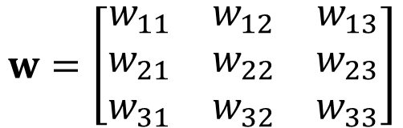
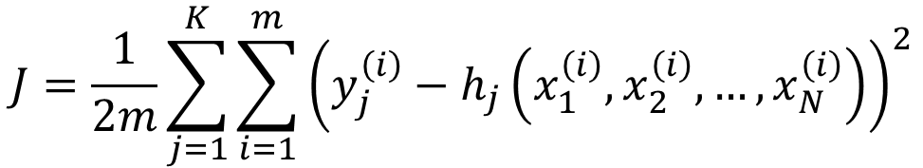
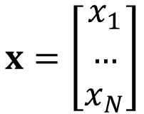
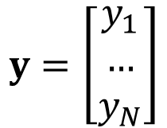
Multivariate Linear Regression
$$J=\frac{1}{2m}\sum_{j=1}^{K}{\sum_{i=1}^{m}{{\left(y_{j}^{\left(i\right)}−h_{j}\left(x_{1}^{\left(i\right)},x_{2}^{\left(i\right)},…,x_{N}^{\left(i\right)}\right)\right)}^{2}}}$$
Cost function
$$w=\left[\begin{matrix}w_{11} & w_{12} & w_{13} \\ w_{21} & w_{22} & w_{23} \\ w_{31} & w_{32} & w_{33}\end{matrix}\right]$$
$$y=\left[\begin{matrix}y_{1} \\ … \\ y_{N}\end{matrix}\right]$$
$$x=\left[\begin{matrix}x_{1} \\ … \\ x_{N}\end{matrix}\right]$$

Slide 7
How to find parameters - optimization
Gradient decent
Monte Carlo
Simulated annealing
Newton-Raphson
Conjugate gradient
BFGS
L-BFGS
…
or
Normal Equation

Slide 8
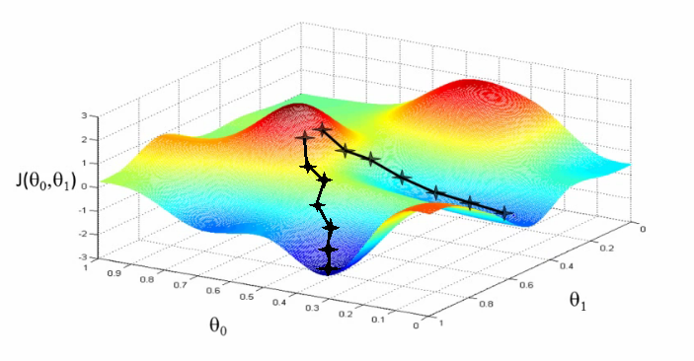

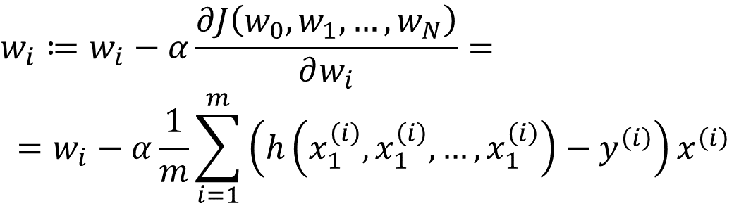


Gradient Decent
Repeat until convergence:
$$w_{i}≔w_{i}−α\frac{∂J\left(w_{0},w_{1},…,w_{N}\right)}{∂w_{i}}=$$
$$=w_{i}−α\frac{1}{m}\sum_{i=1}^{m}{\left(h\left(x_{1}^{\left(i\right)},x_{1}^{\left(i\right)},…,x_{1}^{\left(i\right)}\right)−y^{\left(i\right)}\right)}x^{\left(i\right)}$$
(for linear regression)
$$J\left(w_{0},w_{1}\right)$$
$$w_{1}$$
$$w_{0}$$

Slide 9
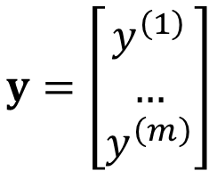

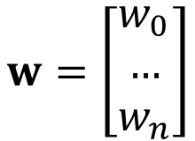
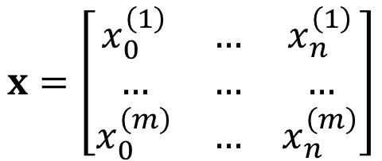
Normal Equation
$$y=\left[\begin{matrix}y^{\left(1\right)} \\ … \\ y^{\left(m\right)}\end{matrix}\right]$$
$$x=\left[\begin{matrix}x_{0}^{\left(1\right)} & … & x_{n}^{\left(1\right)} \\ … & … & … \\ x_{0}^{\left(m\right)} & … & x_{n}^{\left(m\right)}\end{matrix}\right]$$
$$w=\left[\begin{matrix}w_{0} \\ … \\ w_{n}\end{matrix}\right]$$
Normal equation:
$$w={\left(x^{T}x\right)}^{−1}x^{T}y$$
Gradient descent:
Normal equation:
Need to choose α
Needs many iterations
Works well even if n is large
No need to choose α
No need to iterate
Need to compute inverse of a matrix
Slow if n is large

Slide 10
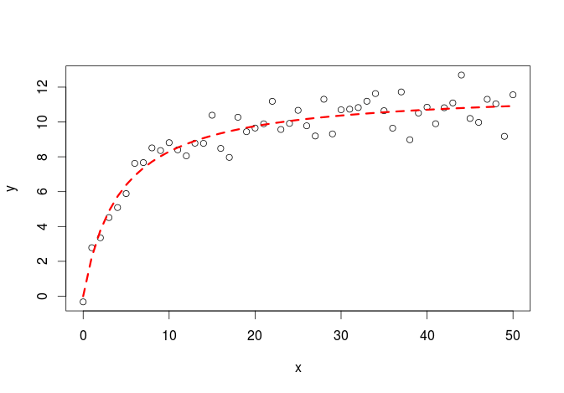
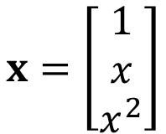
Features Engineering
Feature engineering is the process of using domain knowledge of the data to create features that make machine learning algorithms work. Feature engineering is fundamental to the application of machine learning, and is both difficult and expensive.
$$x=\left[\begin{matrix}1 \\ x \\ x^{2}\end{matrix}\right]$$

