Slide 1
Practical Machine Learning
Overfitting and Regularization

Slide 2
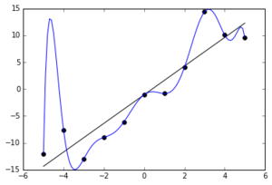
What is Overfitting
In overfitting, a statistical model describes random error or noise instead of the underlying relationship. Overfitting occurs when a model is excessively complex, such as having too many parameters relative to the number of observations.

Slide 3
How to overcome Overfitting
Reduce the number of coefficients
Increase data
Early Stopping
Dropout
Regularization

Slide 4
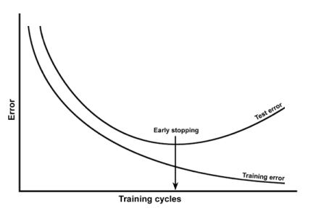


Early Stopping
underfitting
overfitting
$$J_{cv}$$
$$J_{tr}$$

Slide 5
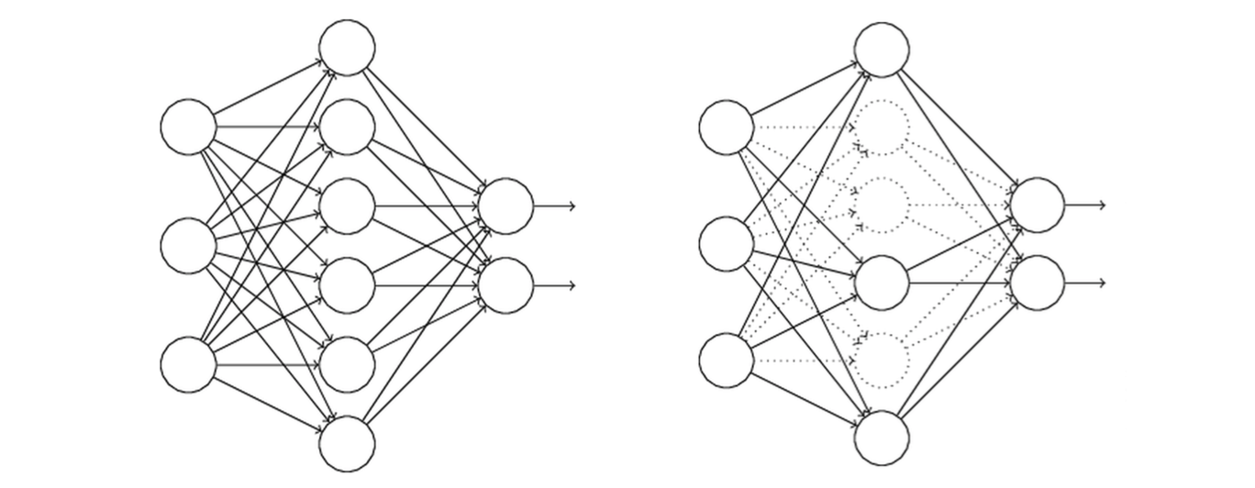
Dropout
$$w=\left[\begin{matrix}w_{1} & w_{2} & w_{3}\end{matrix} \begin{matrix}w_{4} & w_{5} & w_{6}\end{matrix}\right]$$

Slide 6
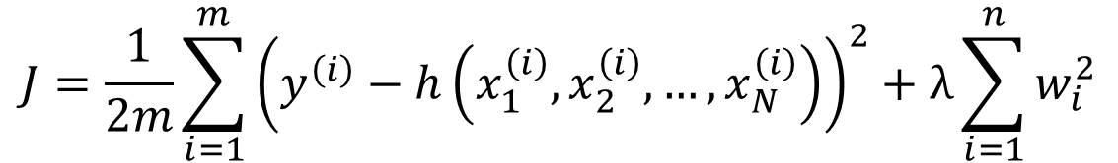
Regularization
Keep all features but reduce magnitude/value of parameters w_{i}.
Works well when we have a lot of features, each of which contributes a bit to predicting y.
$$J=\frac{1}{2m}\sum_{i=1}^{m}{{\left(y^{\left(i\right)}−h\left(x_{1}^{\left(i\right)},x_{2}^{\left(i\right)},…,x_{N}^{\left(i\right)}\right)\right)}^{2}}+λ\sum_{i=1}^{n}{w_{i}^{2}}$$
regularization

Slide 7
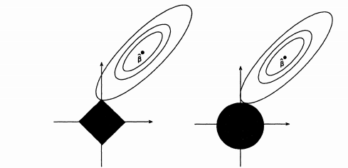


L1 vs L2 regularization
L1 (Lasso) regularization
L2 (Ridge) regularization
$$λ\sum_{i=1}^{n}{\left|w_{i}\right|}$$
$$λ\sum_{i=1}^{n}{w_{i}^{2}}$$
Robust
Unstable solution
Possibly multiple solutions
Favorites sparsity of coefficients
Not very robust
Stable solution
Always one solution
Favorites same magnitude of all coefficients

Slide 8
Train/CV/Test splitting
x (variable, feature, input) | y (output, target, result)
x⁽¹⁾ | y⁽¹⁾
x⁽²⁾ | y⁽²⁾
x⁽³⁾ | y⁽³⁾
x⁽⁴⁾ | y⁽⁴⁾
x⁽⁵⁾ | y⁽⁵⁾
x⁽⁶⁾ | y⁽⁶⁾
x⁽⁷⁾ | y⁽⁷⁾
x⁽⁸⁾ | y⁽⁸⁾
x⁽⁹⁾ | y⁽⁹⁾
x⁽¹⁰⁾ | y⁽¹⁰⁾
training
cross-validation
test
Training set is used to train model. Cross-validation is used to find optimal metaparameter (regularization constant, number of trees in random forest, …). Test set is used to calculate accuracy of the model on a set of data that did not participate in any sort of training.

Slide 9
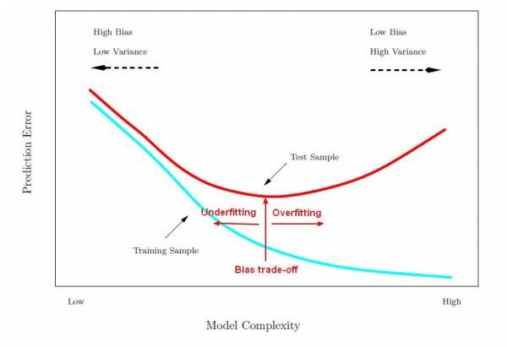
Learning Curves

Slide 10
Bias-variance tradeoff
Training error high?
Bigger model
Train longer
New model architecture
Yes (high bias)
No
Training error high?
More data
Regularization
New model architecture
Yes (high variance)
No
Done

