Slide 1
Practical Machine Learning
Logistic Regression

Slide 2
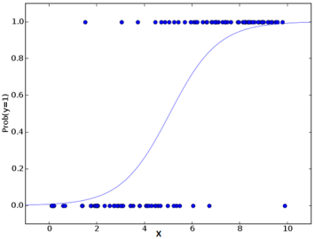
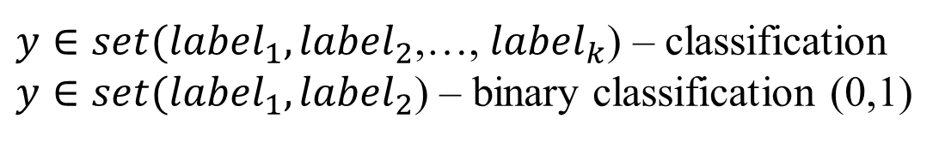
What is Logistic Regression
x (variable, feature, input) | y (output, target, result)
x⁽¹⁾ | y⁽¹⁾
x⁽²⁾ | y⁽²⁾
x⁽³⁾ | y⁽³⁾
… | …
x^{(m)} | y^{(m)}
$y∈set({label}_{1},{label}_{2}$,…, ${label}_{k}$) – classification
$y∈set({label}_{1},{label}_{2}$) – binary classification (0,1)

Slide 3
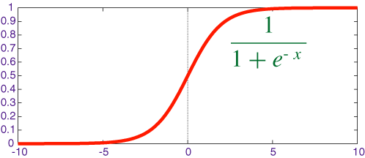
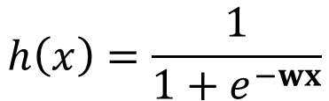
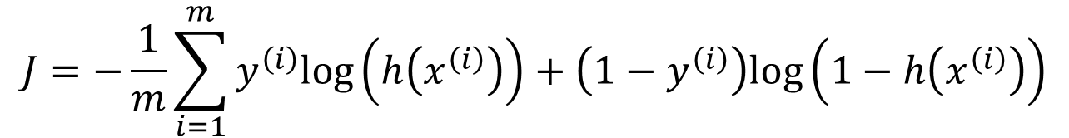
Cost Function
$$h\left(x\right)=\frac{1}{1+e^{−wx}}$$
Form of a hypothesis for logistic regression:
$$J=−\frac{1}{m}\sum_{i=1}^{m}{y^{\left(i\right)}log\left(h\left(x^{\left(i\right)}\right)\right)+\left(1−y^{\left(i\right)}\right)log\left(1−h\left(x^{\left(i\right)}\right)\right)}$$

Slide 4

Multivariate (multiclass) Classification
Output can belong to multiple labels
One-vs-all classification
Binary classification for each class vs all others
On a new input x pick the class i that maximizes
$$\max_{i}{h^{\left(i\right)}}$$

Slide 5
Logistic Skewed Output
1
Result of fitting logistic regression
0

Slide 6
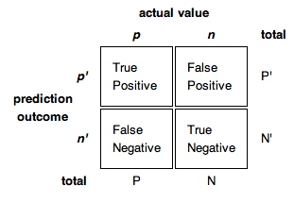
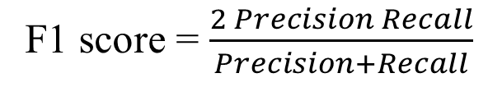
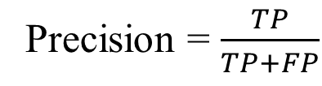
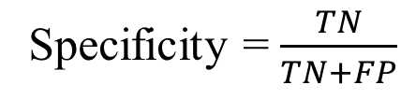
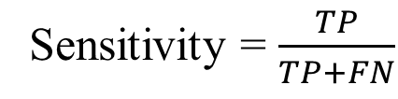
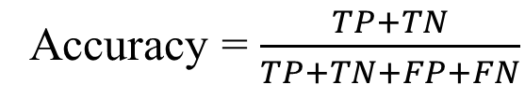
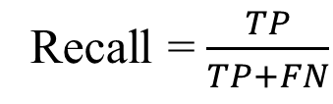
Precision and Recall
Precision = $\frac{TP}{TP+FP}$
Recall = $\frac{TP}{TP+FN}$
Accuracy = $\frac{TP+TN}{TP+TN+FP+FN}$
Sensitivity = $\frac{TP}{TP+FN}$
F1 score = $\frac{2 Precision Recall}{Precision+Recall}$
Specificity = $\frac{TN}{TN+FP}$

Slide 7
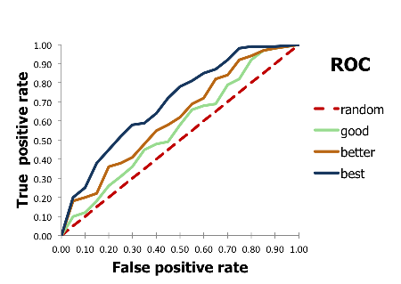
ROC curves
Ideal point
The area between the ROC curve and the no-discrimination line is sometimes preferred (equivalent to subtracting 0.5 from the AUC), and referred to as the discrimination

Slide 8
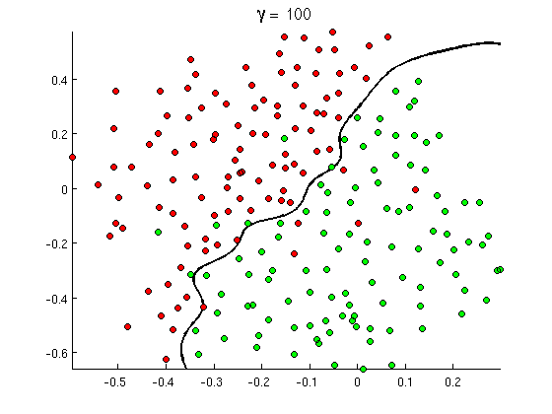
Decision Boundary

