Slide 1
Practical Machine Learning
Support Vector Machines

Slide 2
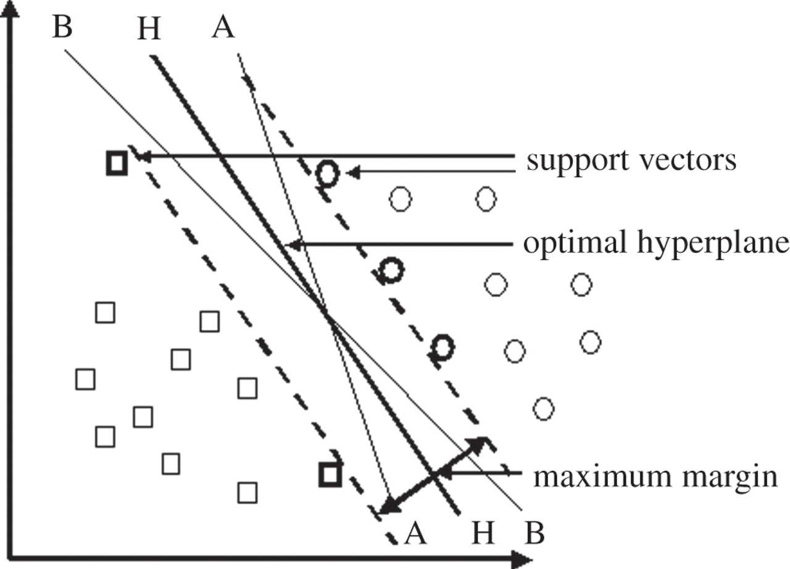
What is Support Vector Machines
High margin classifier

Slide 3
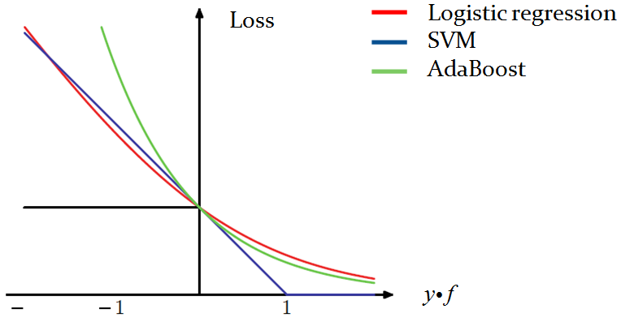





SVM loss function
$$e^{−y^{\left(i\right)}h\left(x^{\left(i\right)}\right)}$$
$$\left[y^{\left(i\right)}f\left(x^{\left(i\right)}\right)<0\right]$$
$$log\left(1+e^{−y^{\left(i\right)}f\left(x^{\left(i\right)}\right)}\right)$$
$$y^{\left(i\right)}f\left(x^{\left(i\right)}\right)$$
$$\max_{}\left(0,1−y^{\left(i\right)}f\left(x^{\left(i\right)}\right)\right)$$

Slide 4

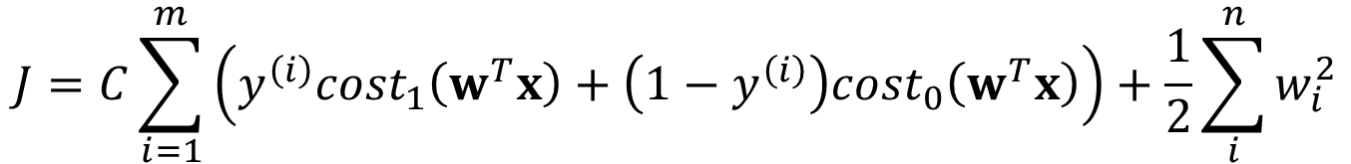


SVM with linear kernel
$$J=C\sum_{i=1}^{m}{\left(y^{\left(i\right)}{cost}_{1}\left(w^{T}x\right)+\left(1−y^{\left(i\right)}\right){cost}_{0}\left(w^{T}x\right)\right)}+\frac{1}{2}\sum_{i}^{n}{w_{i}^{2}}$$
where
$${cost}_{1}\left(f\left(x^{\left(i\right)}\right)\right)=\max_{}\left(0,1−y^{\left(i\right)}f\left(x^{\left(i\right)}\right)\right)$$
$${cost}_{0}\left(f\left(x^{\left(i\right)}\right)\right)=\max_{}\left(0,y^{\left(i\right)}f\left(x^{\left(i\right)}\right)−1\right)$$
$$f\left(x^{\left(i\right)}\right)=w^{T}x$$

Slide 5
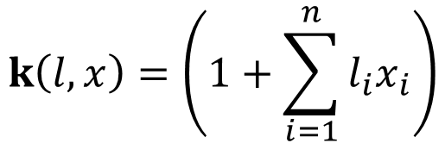


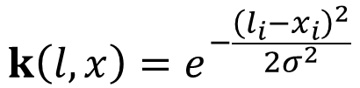
SVM with nonlinear kernel
$$f\left(x^{\left(i\right)}\right)=w^{T}k$$
Polynomial kernel
$$k\left(l,x\right)=\left(1+\sum_{i=1}^{n}{l_{i}x_{i}}\right)$$
Radial Basis function
$$k\left(l,x\right)=e^{−\frac{{\left(l_{i}−x_{i}\right)}^{2}}{2σ^{2}}}$$
Saturating, sigmoid like
$$k\left(l,x\right)=\tanh\left(cl^{T}x+b\right)$$

Slide 6
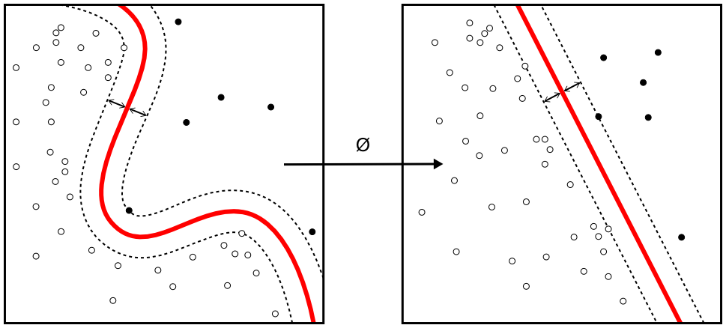
SVM with nonlinear kernel

Slide 7
Advantages of SVM
In high dimensional space Support Vector Machines are very effective.
Even if the number of dimensions is greater than the number of samples it is found to be very effective.
Memory Efficient. It uses a subset of training points (support vectors) as decisive factors for classification.
Versatile. For different decision function we can define different kernel as long as they provide correct result. Depending upon our requirement we can define our own kernels.

Slide 8
Disadvantages of SVM
Need to choose hyper parameters of SVM that will allow for sufficient generalization performance.
Kernel selection can be tricky.
Can be very slow.

