Slide 1
Practical Machine Learning
Decision trees & random forests

Slide 2
What is Decision tree
They are interpretable (not a black box, we can just take it and explain it to others)
Day | Outlook | Humidity | Wind | Rain
D1 | Clouds | Low | Strong | No
D2 | Overcast | High | Weak | Yes
D3 | Sunny | Low | Strong | Yes
D4 | Sunny | High | Strong | Yes
D5 | Sunny | Low | Weak | No
D6 | Sunny | High | Weak | No
D7 | Overcast | High | Strong | Yes
D8 | Sunny | Low | Weak | No
D9 | Clouds | High | Weak | Yes
D10 | Clouds | Low | Strong | No
Predict if it will be raining for this day:
D11 | Yes | High | Strong | ?

Slide 3
Structure of Decision tree
Set of rules (logical formulas):
4/6
Outlook?
Clouds
Sunny
3/2
2/1
Overcast
Humidity?
Wind?
0/2
Rain
High
Strong
Low
Weak
0/1
2/0
0/2
3/0
Rain
No rain
Rain
No rain

Slide 4
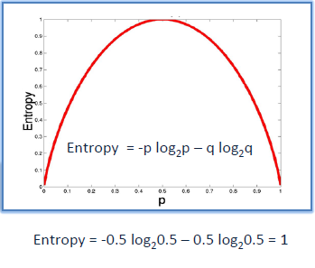

How to train Decision tree
ID3 algorithms:
The best attribute for splitting the examples
Split data
Process to the first splitted data
Repeat 1,2,3 till all data falls in a single category
The measure of uncertainty is entropy:
$$H\left(S\right)=−p_{+}log\left(p_{+}\right)−p_{−}log\left(p_{−}\right)$$
where S is subset of training examples, p₊/p₋ is the % of positive and negative examples in S.

Slide 5
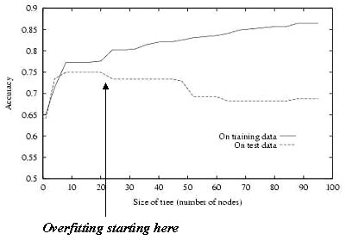
Overfitting
Decision tree is a recursive algorithm, so it will split all data in pure sets, so classify your training examples perfectly. This is not optimal for test data.

Slide 6
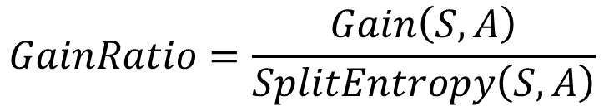
Degenerate splits and gain ratio
Decision tree is biased towards attributes with many values
Day?
D1
D10
1/0
D2
1/0
…
No rain
No rain
0/1
Rain
Won’t work on new data: D11
Use Gain Ratio:
$$GainRatio=\frac{Gain\left(S,A\right)}{SplitEntropy\left(S,A\right)}$$

Slide 7
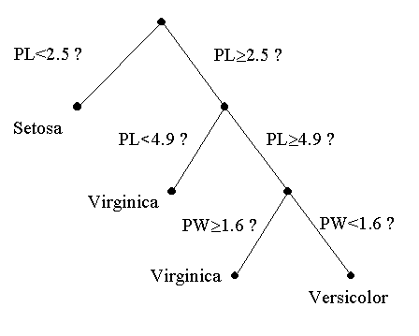
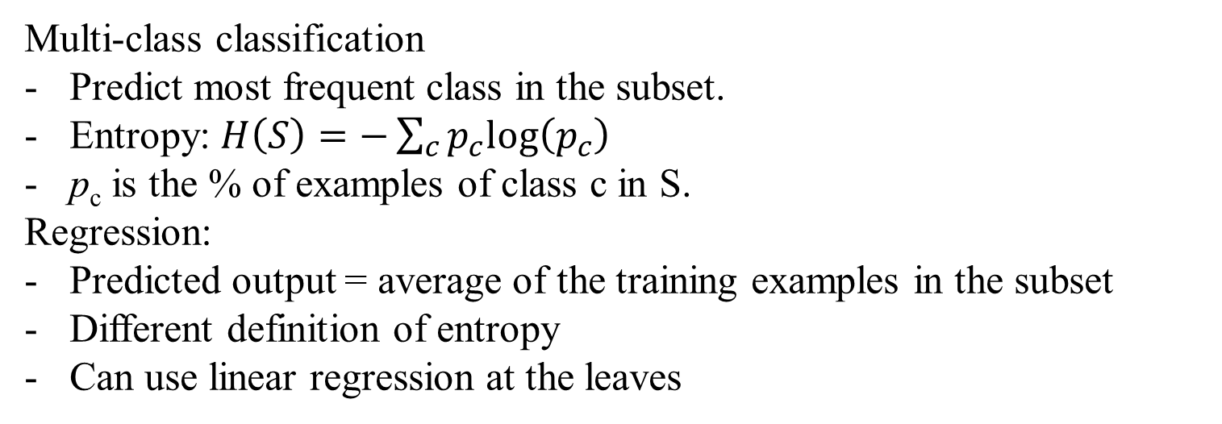
Continuous, Multi-class, Regression
Continuous attributes:
Multi-class classification
Predict most frequent class in the subset.
Entropy: $H\left(S\right)=−\sum_{c}{p_{c}log\left(p_{c}\right)}$
p_{c} is the % of examples of class c in S.
Regression:
Predicted output = average of the training examples in the subset
Different definition of entropy
Can use linear regression at the leaves

Slide 8
Advantages and Disadvantages of DT
Advantages:
Interpretable: managers and stakeholders like them
Easily handles irrelevant attributes
Can handle missing data
Very compact
Very fast at testing time
Disadvantages:
Only axis aligned split of data
Greedy (may not find the best tree)
Exponentially many possible trees

Slide 9
Ensemble learning
Ensemble methods use multiple learning algorithms to obtain better predictive performance than could be obtained from any of the constituent learning algorithms alone. Unlike a statistical ensemble in statistical mechanics, which is usually infinite, a machine learning ensemble refers only to a concrete finite set of alternative models, but typically allows for much more flexible structure to exist among those alternatives.
Common types of ensembles:
Bayes optimal classifier
Bootstrap aggregate (bagging)
Boosting
Bayesian parameter averaging
Bayesian model combination
Bucket of models
Stacking

Slide 10
Random Forest
Grow K different decision trees:
Pick a random subset Sr of training examples
Grow a full ID3 tree Tr
When splitting: pick from d<<D random attributes
Compute gain based on Sr, instead of full set
Repeat for r=1…K
Given a new data point X:
Classify X using each of the trees T₁…T_{K}
Use majority vote: class predicted most often

Slide 11
How to optimize
1. Major metaparameters to improve the accuracy of random forest:
max_features (maximal # of features RF is allowed to try in individual tree)
Increase imporves the performance for training set, but may decrease the performance for test due to diversification and overfitting.
n_estimators (# of trees to build before voting)
Higher → better performance, but slower training
min_sample_leaf
A smaller leaf makes the model more prone to capturing noise
2. Major metaparameters to make model train faster:
n_jobs (# of processors to train RF)
random_state (set to a value for replication)
oob_score (much faster than leave-one-out cross-validation)

Slide 12
Boosting
Boosting is a machine learning ensemble meta-algorithm for primarily reducing bias, and also variance[1] in supervised learning, and a family of machine learning algorithms which convert weak learners to strong ones.
Can a set of weak learners create a single strong learner? A weak learner is defined to be a classifier which is only slightly correlated with the true classification (it can label examples better than random guessing). In contrast, a strong learner is a classifier that is arbitrarily well-correlated with the true classification.

