Slide 1
Practical Machine Learning
Unsupervised learning

Slide 2
Methods of unsupervised learning
Clustering:
k-means
Mixture models
Hierarchical clustering (dendrograms)
Anomaly detection:
Static data
Time series
Neural networks:
Self-organizing map
Adaptive resonance theory

Slide 3
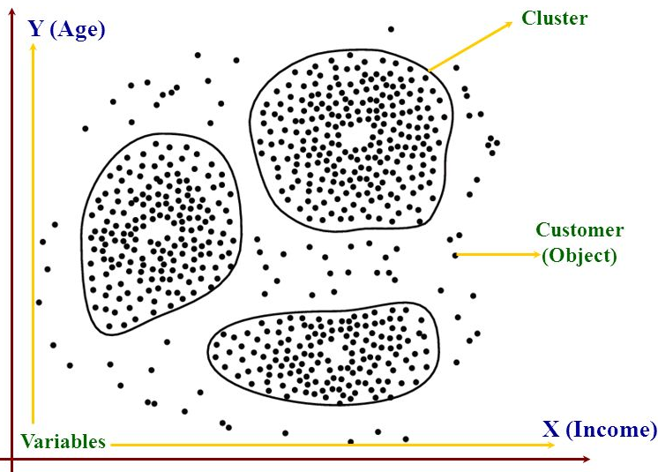
Clustering

Slide 4
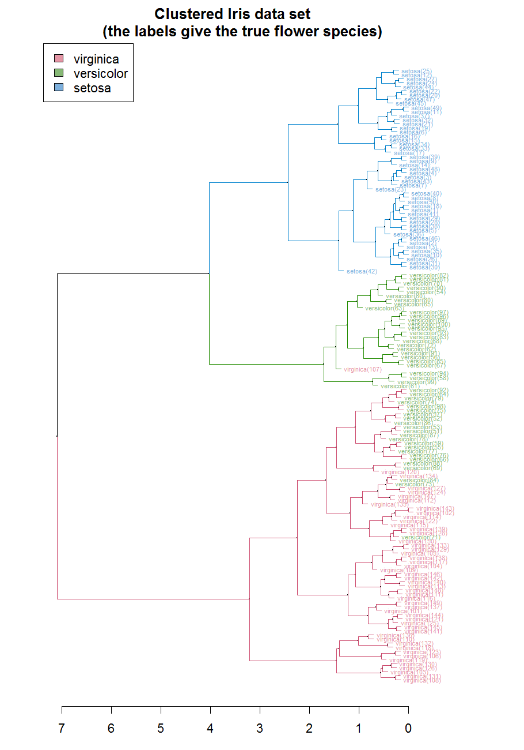
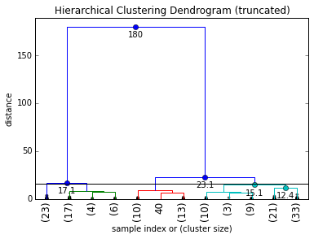
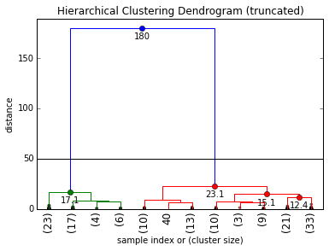
Cluster Dendrograms

Slide 5
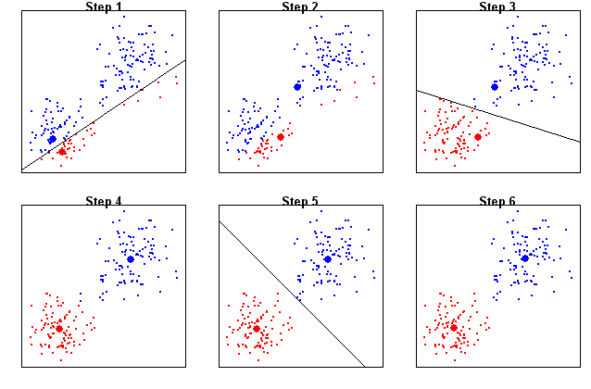
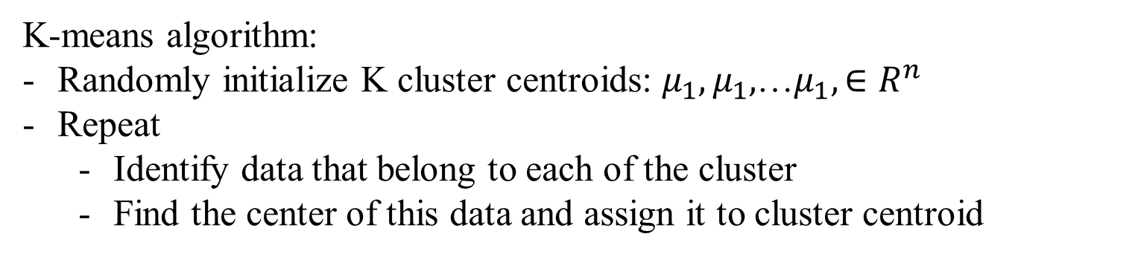
K-means
K-means algorithm:
Randomly initialize K cluster centroids: $μ_{1},μ_{1},$…$μ_{1},∈R^{n}$
Repeat
Identify data that belong to each of the cluster
Find the center of this data and assign it to cluster centroid

Slide 6
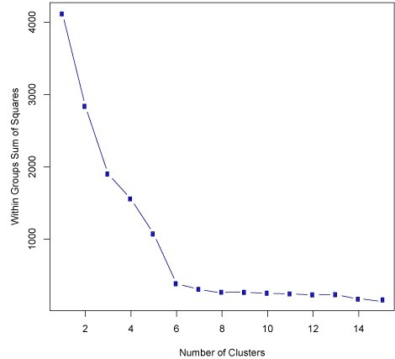
How to choose # of clusters
Elbow curve: optimal number of clusters corresponds to the elbow
If no clear elbow – choose the number of clusters according to your goal (e.g. T-shirt sizes: S, M, L or XS, S, L, XL)

Slide 7
K-means advantages and disadvantages
Advantages:
Much faster than hierarchical clustering if the number of clusters is not big
K-means produce tighter clusters than hierarchical clustering, especially if the clusters are globular
Disadvantages:
Difficult to predict K-value
With global cluster it did not work well
Different initial partitions may result in different final clusters
It does not work with clusters (in the original data) of different size and different density

