Slide 1
Practical Machine Learning
PCA

Slide 2
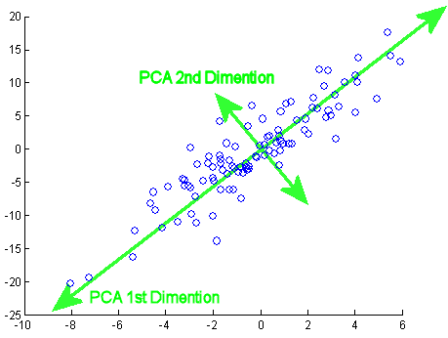
What is PCA
In machine learning and statistics, dimensionality reduction or dimension reduction is the process of reducing the number of random variables under consideration, via obtaining a set of principal variables. It can be divided into feature selection and feature extraction.
Principal Component Analysis (PCA) performs a linear mapping of the data to a lower-dimensional space in such a way that the variance of the data in the low-dimensional representation is maximized.
PCA is used for:
Dimensionality reduction (both feature selection and feature extraction)
Visualization

Slide 3
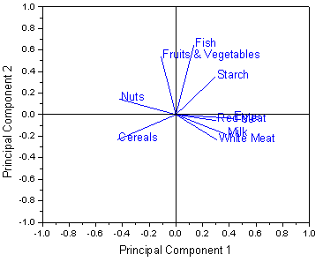
Loading Plot
Loadings plot is a plot of the direction vectors that define the model.
Each loading direction is orthogonal and independent of other directions.

Slide 4
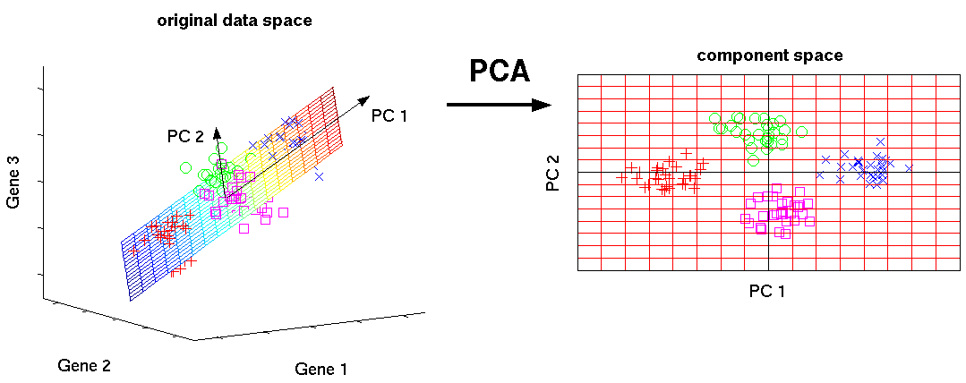
Methods to perform PCA
Eigenvalues of correlation matrix
SVD

Slide 5




Correlation matrix
Covariance matrix (Σ) (also known as dispersion matrix or variance–covariance matrix) is a matrix whose element in the i, j position is the covariance between the i^{th} and j^{th} elements of a random vector.
$$Σv=λv$$
where are eigenvalue and eigenvector of matrix
$$Σ$$
$$λ,v$$
To find eigenvalue solve this equation:
$$det\left(Σ−λI\right)=0$$

Slide 6
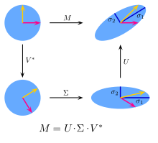

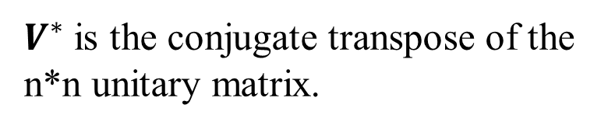
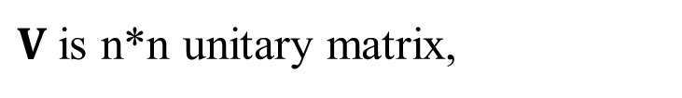
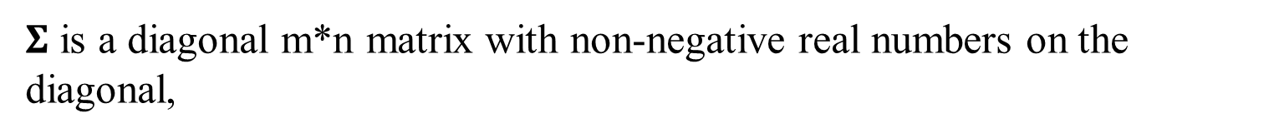

Singular value decomposition
$$M=UΣV^{∗}$$
$U$ is m*m unitary matrix,
$Σ$ is a diagonal m*n matrix with non-negative real numbers on the diagonal,
$V$ is n*n unitary matrix,
$V^{∗}$ is the conjugate transpose of the n*n unitary matrix.

Slide 7
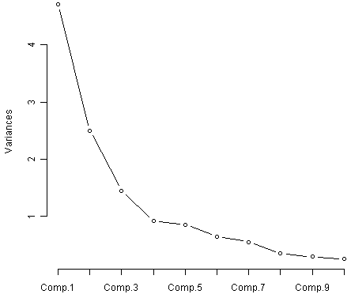
How to choose the number of PC
For example take the number of components to retain 99% of variance.

