Slide 1
Practical Machine Learning
ML Pipeline

Slide 2
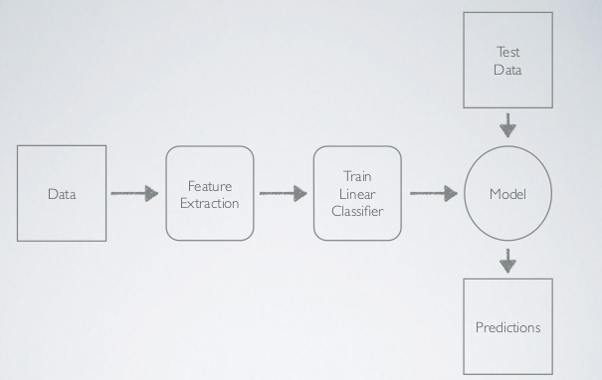
What is ML pipeline?

Slide 3

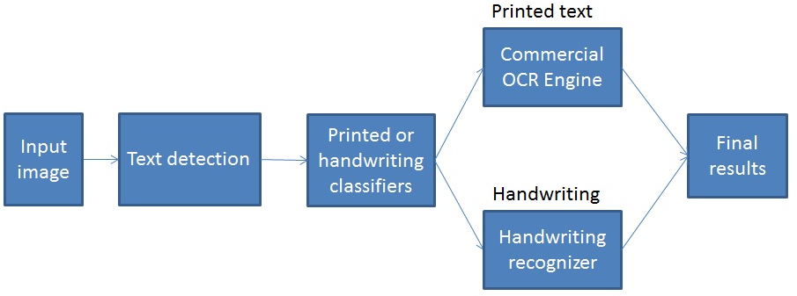
Example of ML pipeline

Slide 4
Error Analysis
To get accuracy of each component of Machine Learning System, test them separately by providing very accurate data.
 | Accuracy
Overall system | 62 %
Text detection | 95 %
Text classification | 99%
Handwritten text recognition | 54%
Printed text recognition | 66%
Need to work first on Text recognition to improve the overall accuracy of the system

Slide 5
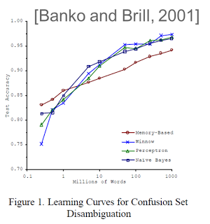
How much data you need
The complexity of Machine Learning algorithm is often less important than the amount of data you use to train the model.

Slide 6
Data augmentation
For pictures:
Random crops on the original image
Translations
Horizontal reflections
Scaling
Simulated background
Color casting
Geometric distortion
For numerical data:
PCA
Auto-encoding
Composite variables

