Slide 1
Practical Machine Learning
Convolutional Neural Networks (CNN)

Slide 2
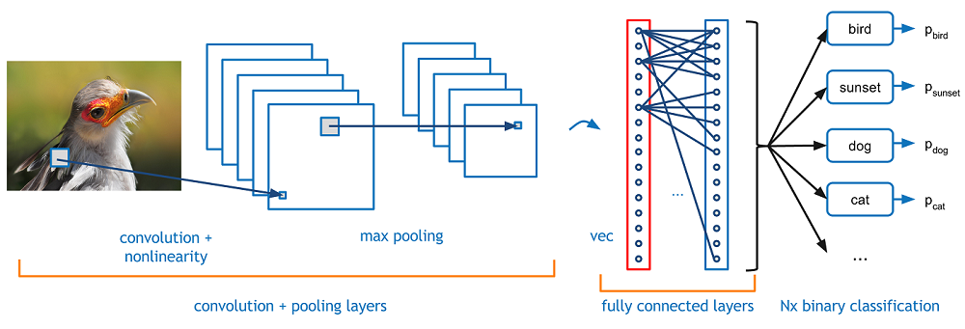
Structure of CNNs
Main elements:
Convolutional layer
Maxpooling layer
Dropout
Relu
Fully connected layer

Slide 3
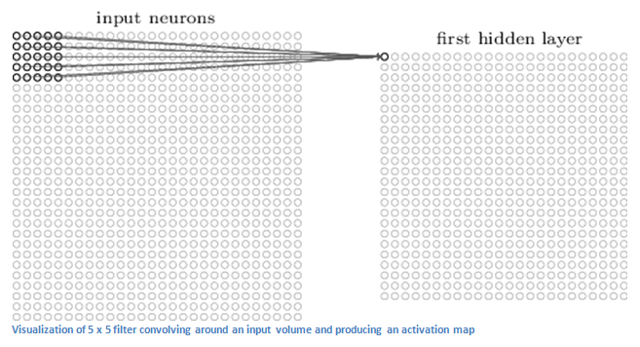
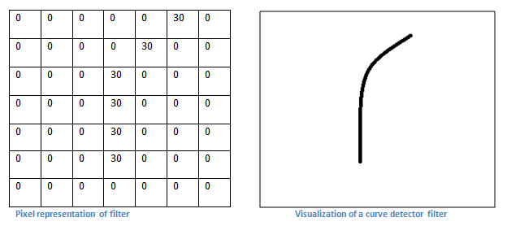
Convolutional layer

Slide 4
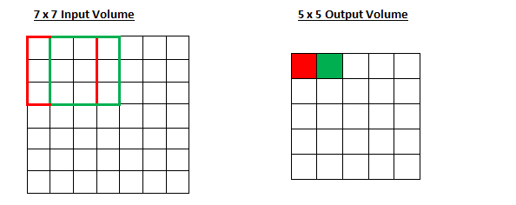
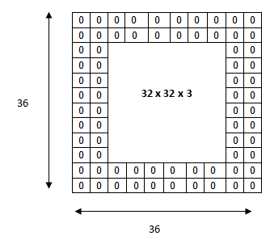
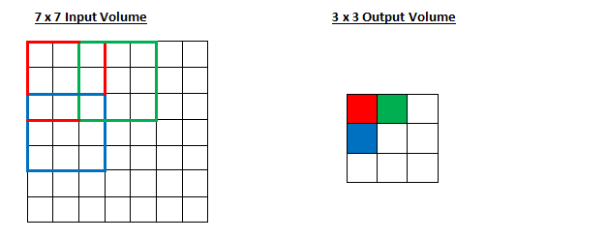
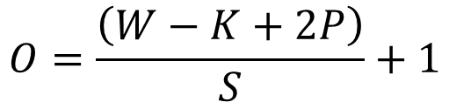
Stride and padding
$$O=\frac{\left(W−K+2P\right)}{S}+1$$
where O is the output height/length, W is the input height/length, K is the filter size, P is padding, S is stride

Slide 5
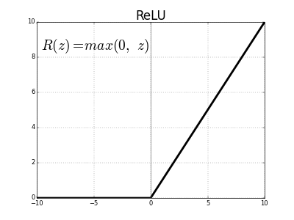
Rectified Linear Units (ReLU) Layer
The purpose of this layer is to introduce non-linearity. It is preferable as gradient is simple to evaluate.

Slide 6
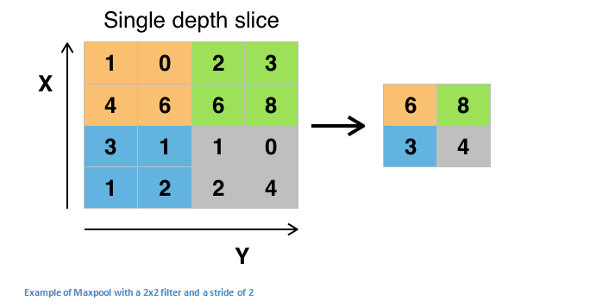
Pooling Layer
Purpose: reduce the number of parameters, avoid overfitting.

Slide 7
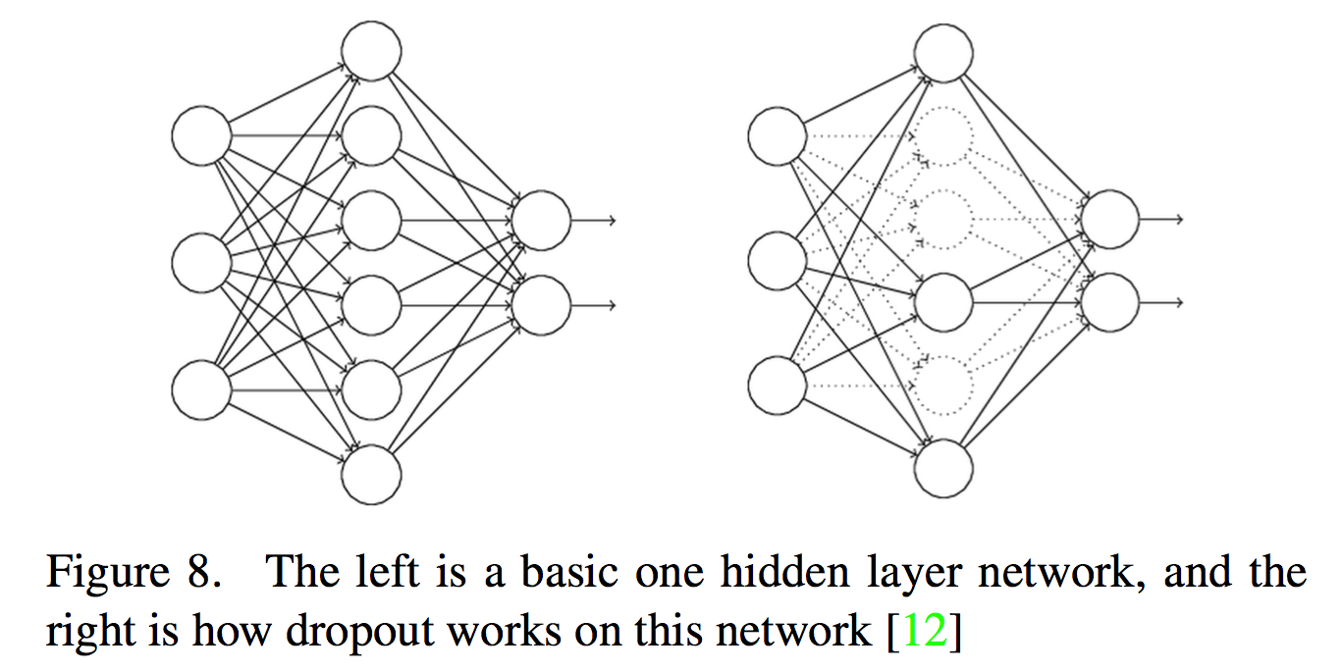
Dropout Layer
Purpose: avoid overfitting. Only applied during training.

Slide 8
Network in Network Layer
A network in network layer refers to a conv layer where a 1 x 1 size filter is used. Effectively, this layer is performing a N-D element-wise multiplication where N is the depth of the input volume into the layer.

Slide 9
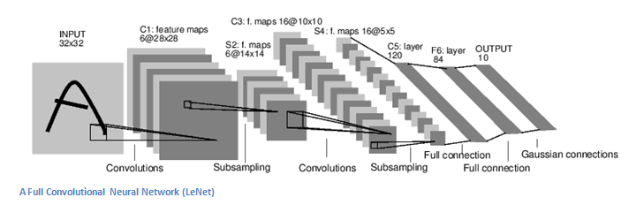
Fully Connected Layer
This layer basically takes an input volume (whatever the output is of the conv or ReLU or pool layer preceding it) and outputs an N dimensional vector where N is the number of classes that the program has to choose from.

Slide 10
Transfer Learning
Transfer learning is the process of taking a pre-trained model (the weights and parameters of a network that has been trained on a large dataset by somebody else) and “fine-tuning” the model with your own dataset.
The idea is that this pre-trained model will act as a feature extractor. You will remove the last layer of the network and replace it with your own classifier (depending on what your problem space is). You then freeze the weights of all the other layers and train the network normally (Freezing the layers means not changing the weights during gradient descent/optimization).

Slide 11
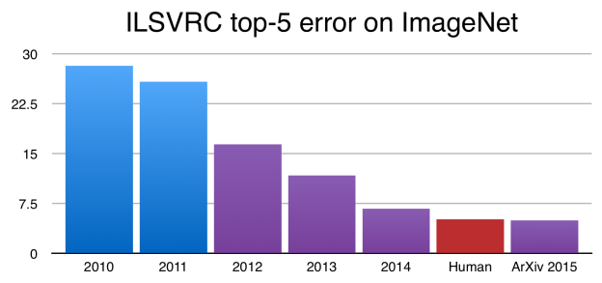
ImageNet Competion
Image classification error of Microsoft ResNet CNN is 3.6% which is better than the average classification error of a human (5%).

Slide 12
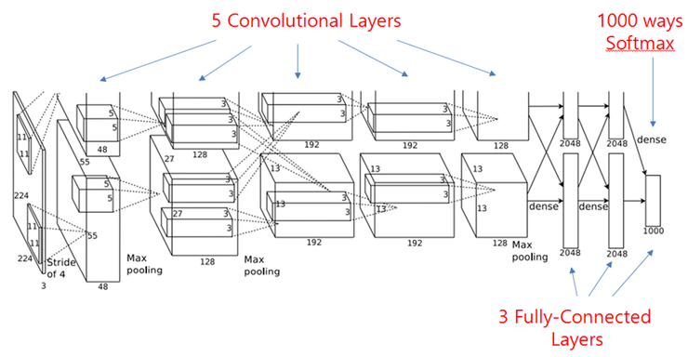
Examples of CNNs
AlexNet (ImageNet winner 2012)

Slide 13
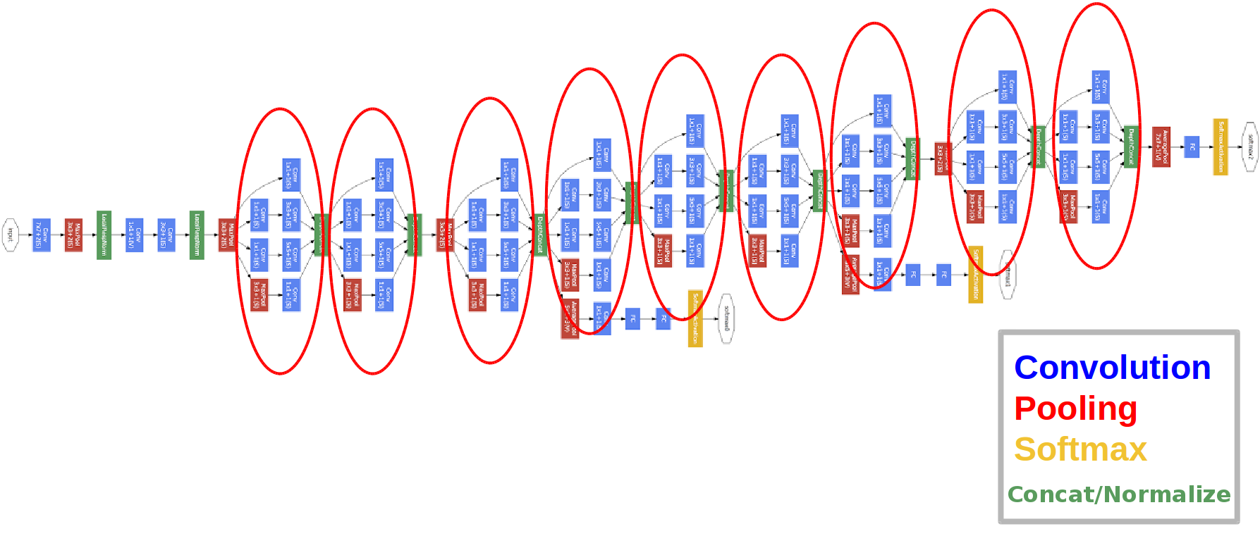
Examples of CNNs
GoogLeNet (ImageNet 2015)

Slide 14
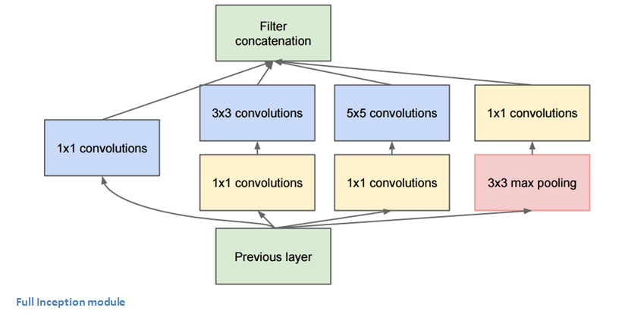
Inception module
Allows to increase the complexity of CNN without increasing the number of coefficients

