Slide 1
Practical Machine Learning
Recurrent Neural Networks (RNN)

Slide 2
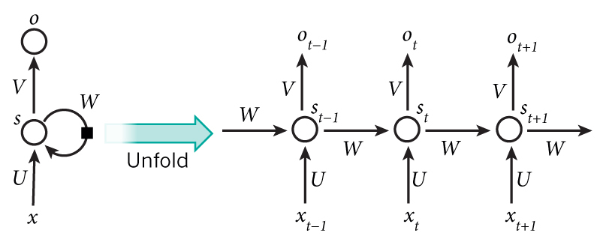
What is RNN

Slide 3
Why need of RNNs
Language modeling and generating text
Machine translation
Speech recognition
Generating image description

Slide 4
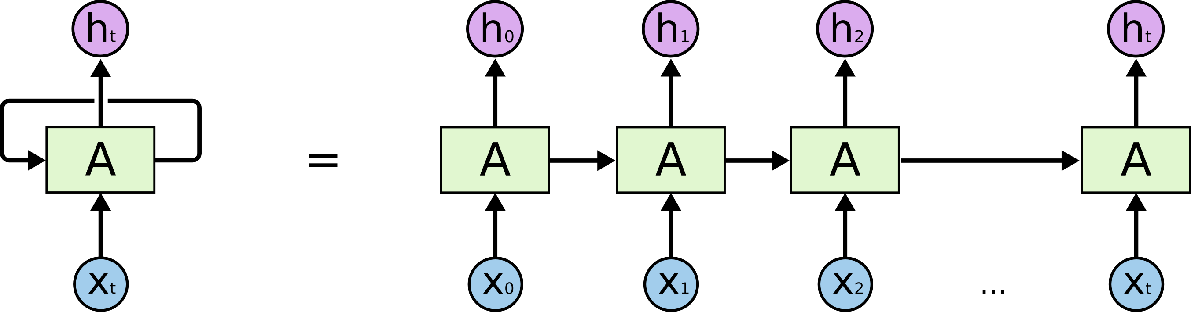
Recurrent Neuron

Slide 5
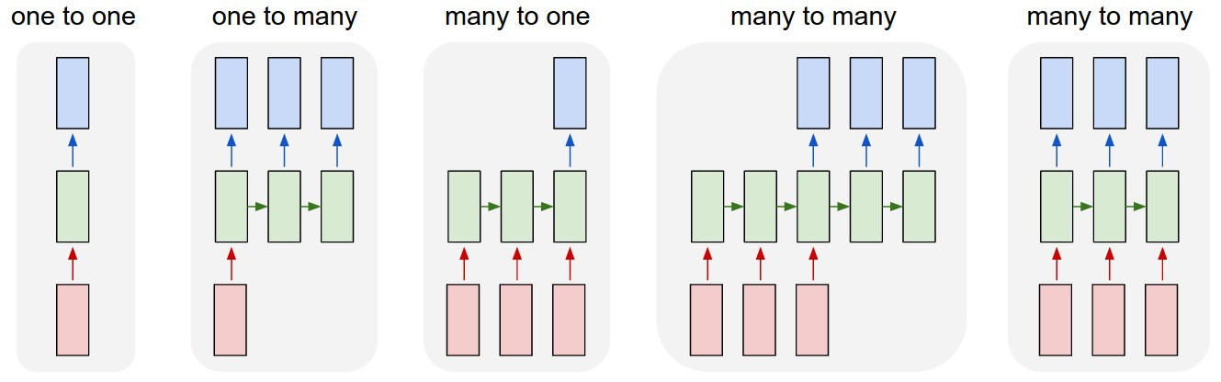
Architecture of RNNs

Slide 6
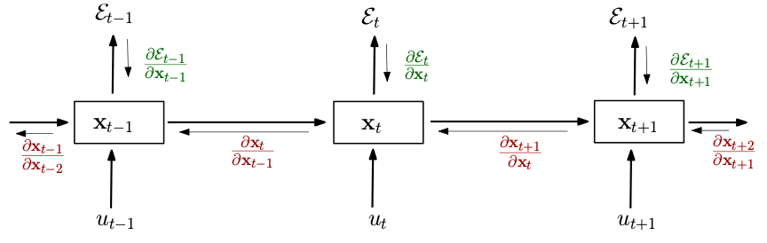
Training RNN

Slide 7
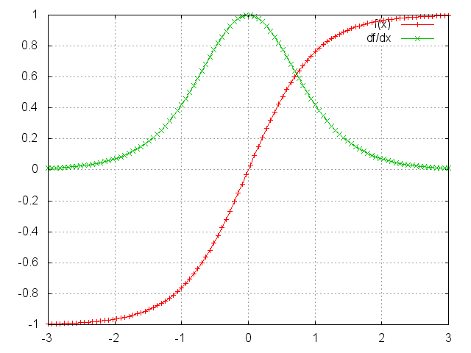
Vanishing and Exploding gradient

Slide 8
How to deal with Exploding gradient
Exploding gradient is easy to diagnose.
Ways to combat it:
Truncated Back Propagation Through Time (BPTT)
Clip gradients at threshold
RMSprop to adjust learning rate (adaptive learning rate algorithms)

Slide 9
How to deal with Vanishing gradient
Harder to detect.
Ways to combat it:
Weight initialization
ReLU activation functions (no vanishing gradients)
RMSProp
LSTM (Long-Short Term Memory), GRU (Gated Recurrent Units – simplified LSTM)

