Slide 1

Interfaces
The last OO concept LV has been missing

Slide 2
The Four Principles of Object-Oriented-Programming
Encapsulation
Abstraction
Inheritance
Polymorphism
Notes:
Encapsulation — private instance variable and public accessor methods.
Abstraction — Using abstract class/Interface we express the intent of the class rather than the actual implementation.
Inheritance — In derived classes we can reuse the code of existing parent classes.
Polymorphism — Means “Many Shapes”, we always has static polymorphism using Polymorphic VIs or now we should throw those out and just use VIMs, but they are still static, at compile time it’s decided what implementation it will use. The dynamic polymorphism is what makes OO so powerful, the rest of the items could be archived in different ways before OO came to LabVIEW.

Slide 3


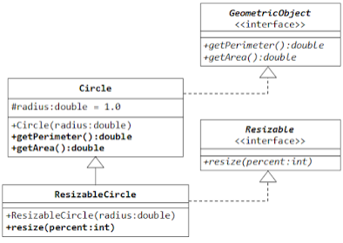
Class vs Interface
Or Abstract class vs Interface
An abstract class allows you to create functionality that subclasses can use or override
An interface only allows you to define functionality, not implement it, which subclasses has to override…
That’s almost true, LV does allow you to have default behaviour in an interface method. (Some OO languages and version has started to support that as well).
A class can only inherit from one parent class, but can inherit from many interfaces.
An interface can inherit from other interfaces but not from classes.

Slide 4
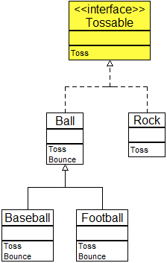
Naming an interface
Could be a Noun just like a class
Or an Adjective, like: Serializable, Cloneable, Iterable
In an interface with adjective name it often ends with ..able and the method is the prefix.

Slide 5
Examples
Periodic trigger
HelpDesk

Slide 6
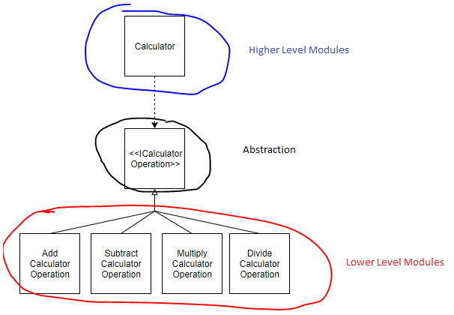
D in Solid
Dependency Inversion Principle
High-level modules should not depend on low-level modules. Both should depend on abstractions.
Abstractions should not depend on details. Details should depend on abstractions.

