Slide 1
Introduction to LabVIEW and MyRIO
John Phillips
people.tamu.edu/~st_jphillips

Slide 2
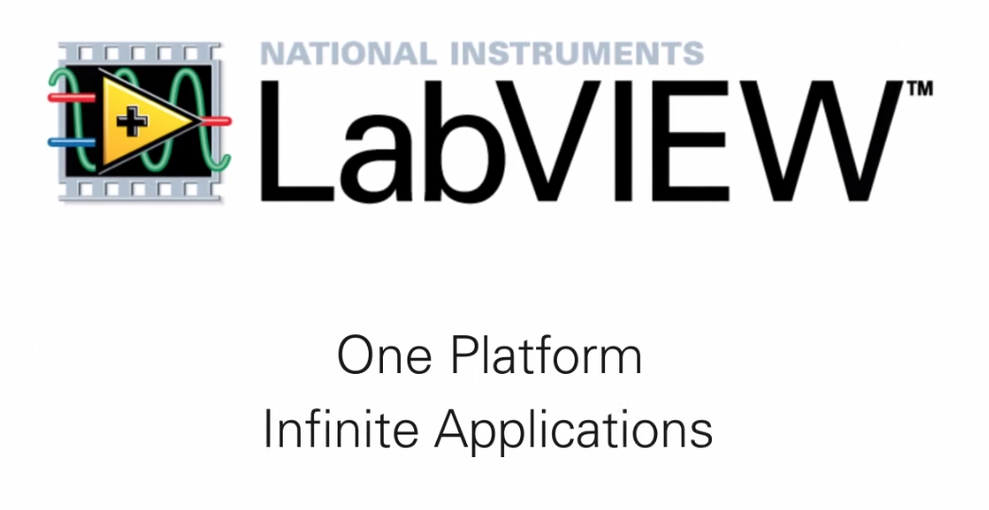

Slide 3

Graphical Programming Platform
Virtual Instrument (VI)

Slide 4
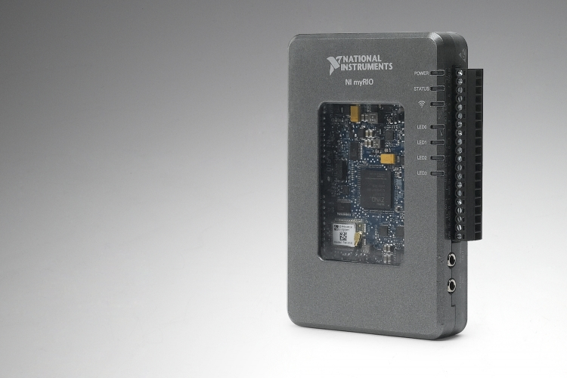
Embedded controller
FPGA
Field Programmable Gate Array

