Slide 1
Chapter 25
Domain
Name
System

Slide 2
25.1 Name Space
Flat Name Space
Hierarchical Name Space

Slide 3
25.2 Domain Name Space
Label
Domain Name

Slide 4
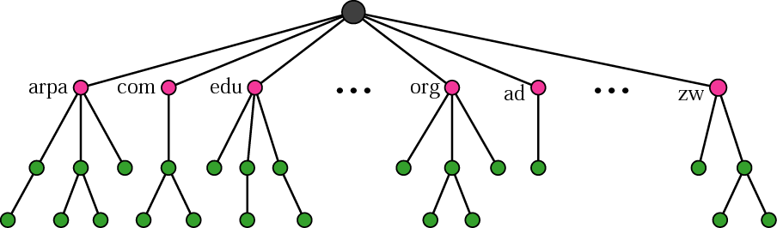
Figure 25.1 Domain name space

Slide 5
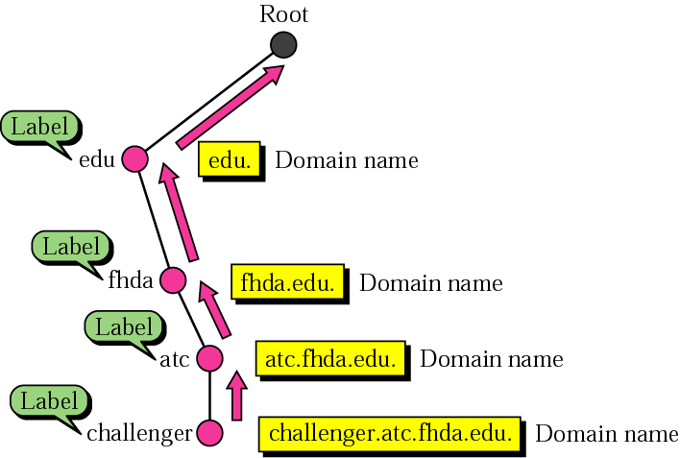
Figure 25.2 Domain names and labels

Slide 6
25.6 DNS Messages
Header
Question Section
Answer Section
Authoritative Section
Additional Information Section

Slide 7
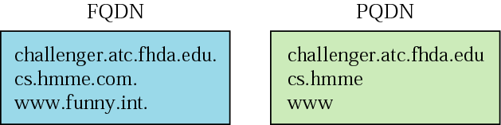
Figure 25.3 FQDN and PQDN

Slide 8
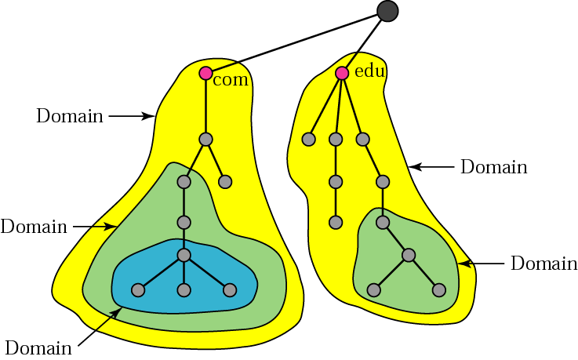
Figure 25.4 Domains

Slide 9
25.3 Distribution of Name Spaces
Hierarchy of Name Servers
Zone
Root Server
Primary and Secondary Servers

Slide 10
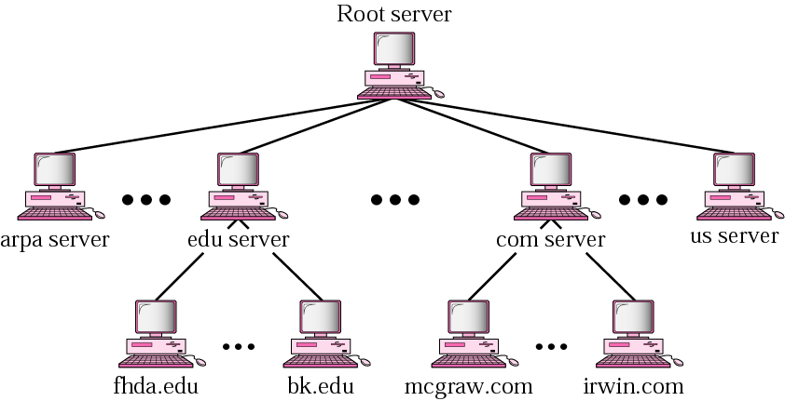
Figure 25.5 Hierarchy of name servers

Slide 11
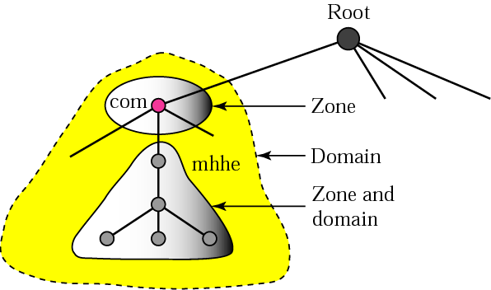
Figure 25.6 Zones and domains

Slide 12

Note:
A primary server loads all information from the disk file; the secondary server loads all information from the primary server.

Slide 13
25.4 DNS In The Internet
Generic Domain
Country Domain
Inverse Domain

Slide 14
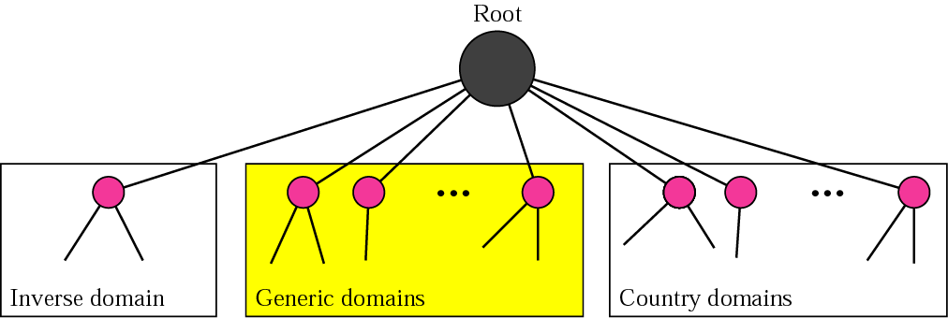
Figure 25.7 DNS in the Internet

Slide 15
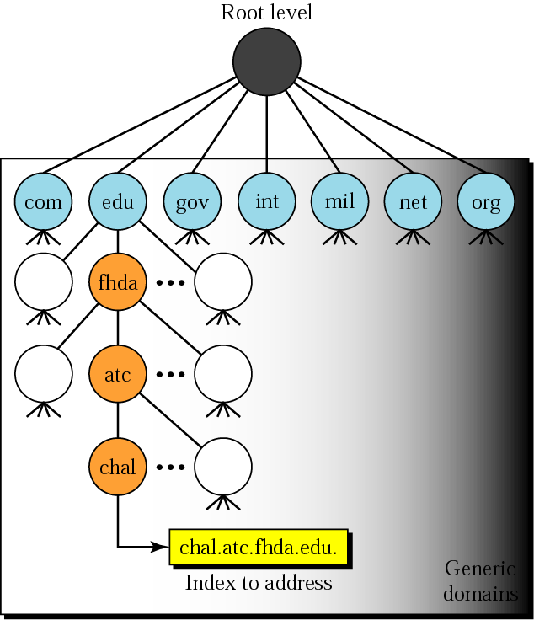
Figure 25.8 Generic domains

Slide 16
Table 25.1 Generic domain labels
Label | Description
com | Commercial organizations
edu | Educational institutions
gov | Government institutions
int | International organizations
mil | Military groups
net | Network support centers
org | Nonprofit organizations

Slide 17
Table 25.2 New generic domain labels
Label | Description
aero | Airlines and aerospace companies
biz | Businesses or firms (similar to com)
coop | Cooperative business organizations
info | Information service providers
museum | Museums and other nonprofit organizations
name | Personal names (individuals)
pro | Professional individual organizations

Slide 18
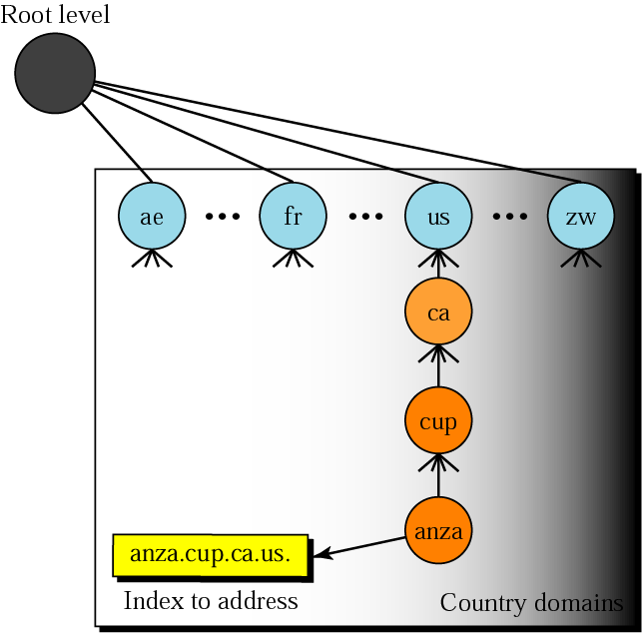
Figure 25.9 Country domains

Slide 19
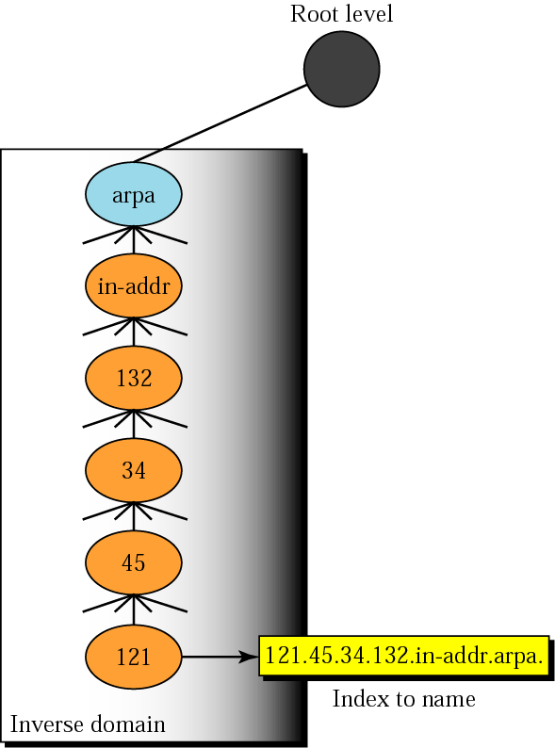
Figure 25.10 Inverse domain

Slide 20
25.5 Resolution
Resolver
Mapping Names to Addresses
Mapping Addresses to Names
Recursive Resolution
Iterative Resolution
Caching

Slide 21
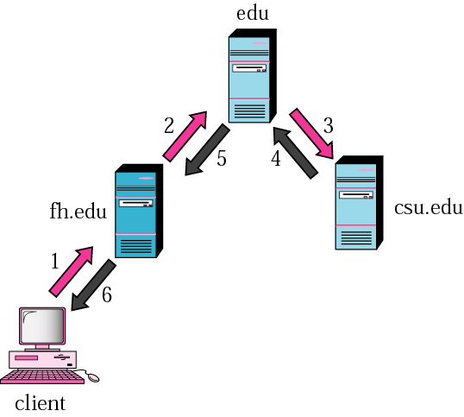
Figure 25.11 Recursive resolution

Slide 22
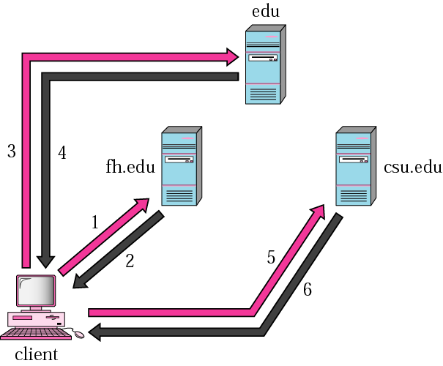
Figure 25.12 Iterative resolution

Slide 23
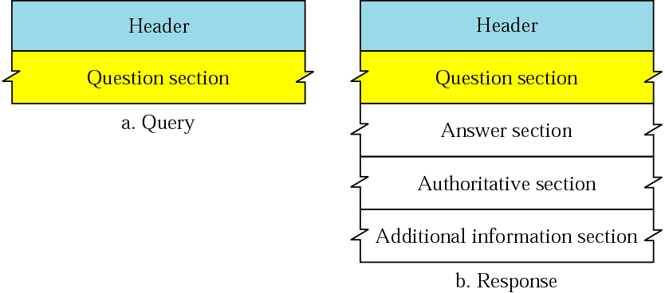
Figure 25.13 Query and response messages

Slide 24
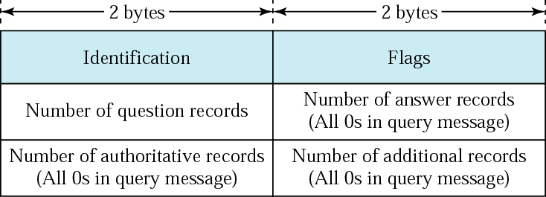
Figure 25.14 Header format

Slide 25
Note:
DNS can use the services of
UDP or TCP,
using the well-known port 53.

