Slide 1
Chapter 2
Network
Models

Slide 2
2.1 Layered Tasks
Sender, Receiver, and Carrier
Hierarchy
Services

Slide 3
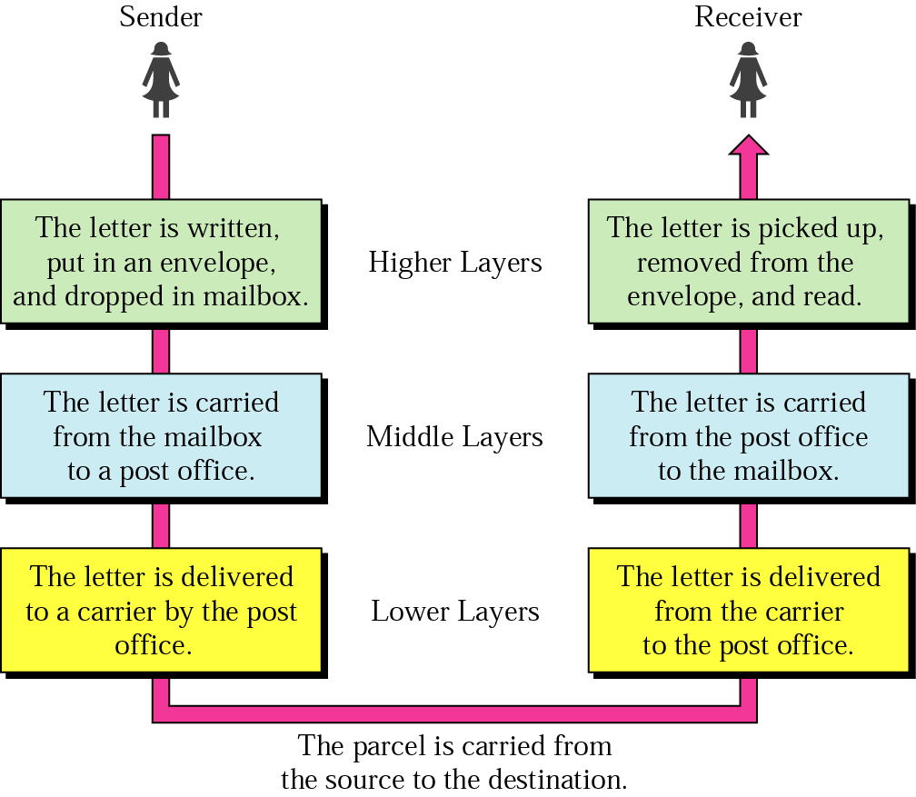
Figure 2.1 Sending a letter

Slide 4
2.2 Internet Model
Peer-to-Peer Processes
Functions of Layers
Summary of Layers

Slide 5
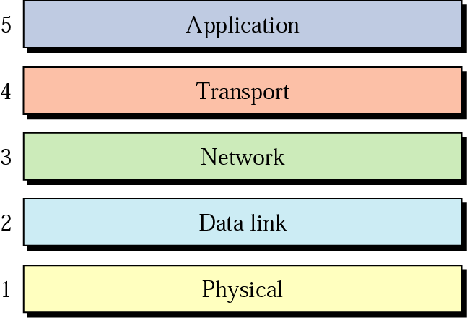
Figure 2.2 Internet layers

Slide 6
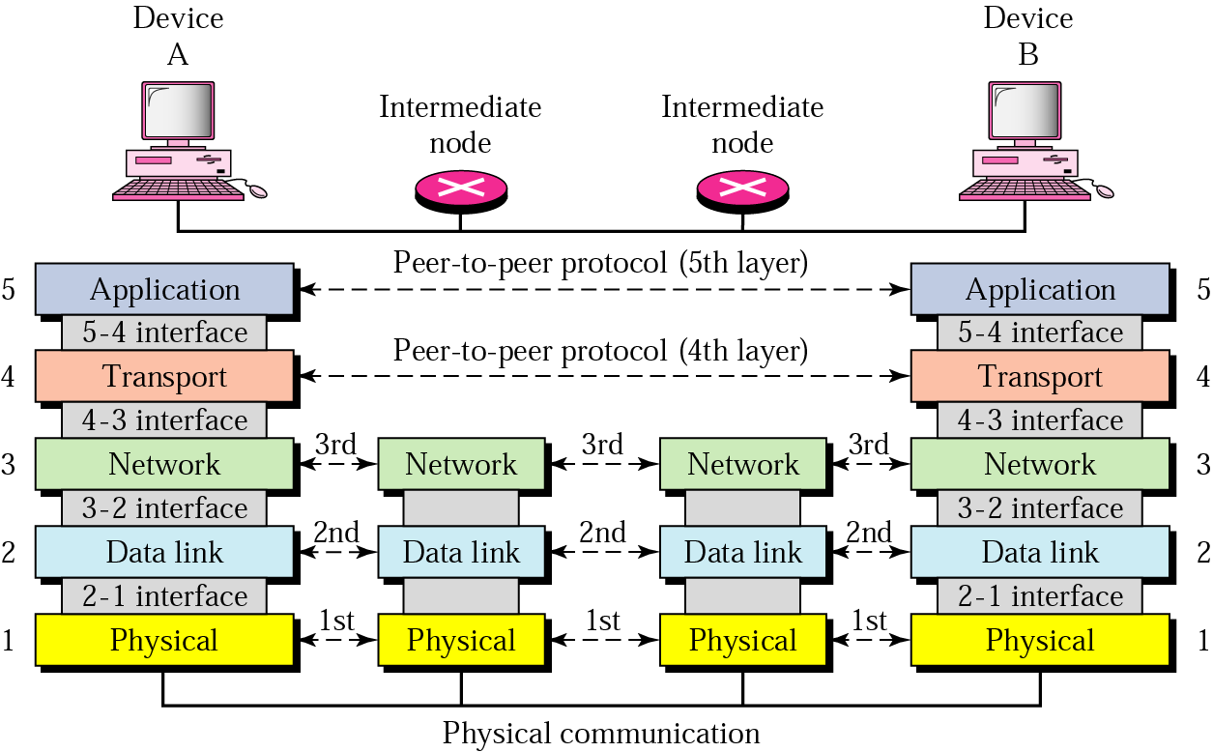
Figure 2.3 Peer-to-peer processes

Slide 7
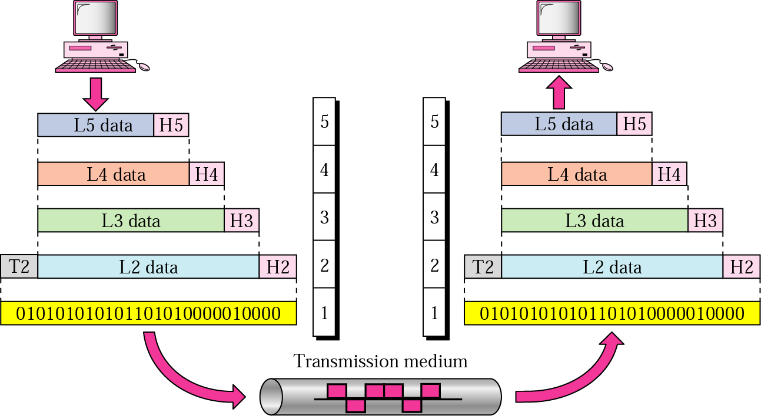
Figure 2.4 An exchange using the Internet model

Slide 8
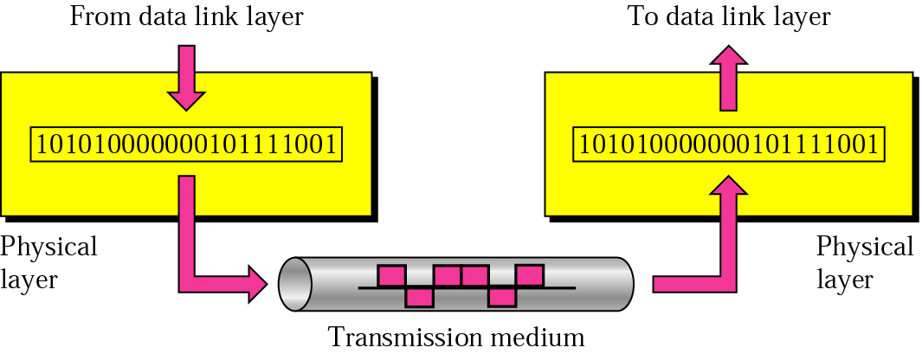
Figure 2.5 Physical layer

Slide 9

Note:
The physical layer is responsible for transmitting individual bits from one node to the next.

Slide 10
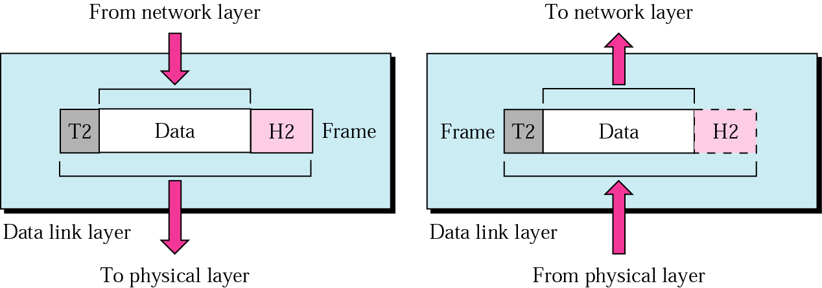
Figure 2.6 Data link layer

Slide 11
Note:
The data link layer is responsible for transmitting frames from
one node to the next.

Slide 12
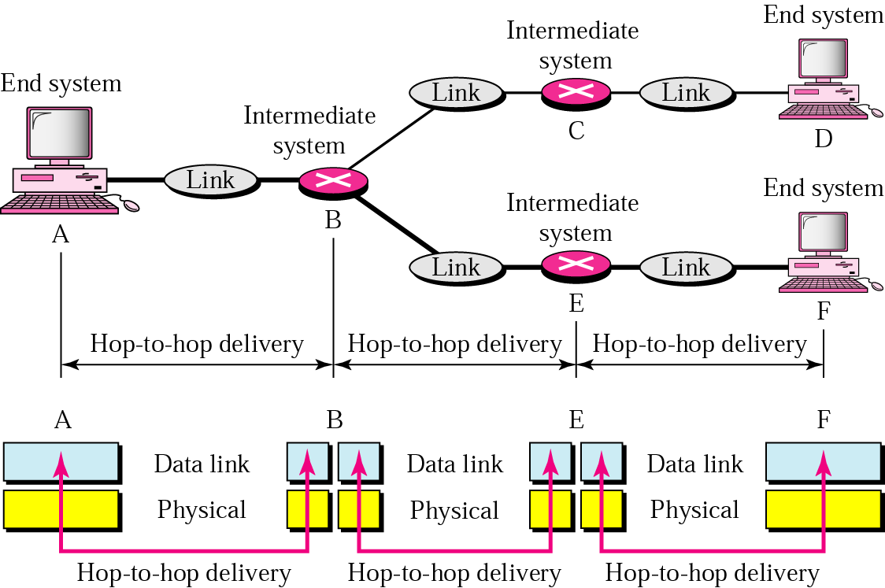
Figure 2.7 Node-to-node delivery

Slide 13
Example 1
In Figure 2.8 a node with physical address 10 sends a frame to a node with physical address 87. The two nodes are connected by a link. At the data link level this frame contains physical addresses in the header. These are the only addresses needed. The rest of the header contains other information needed at this level. The trailer usually contains extra bits needed for error detection

Slide 14
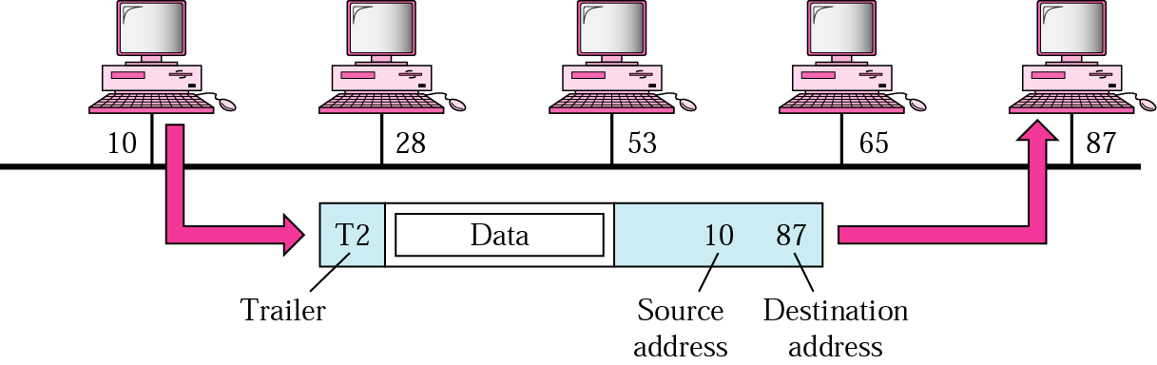
Figure 2.8 Example 1

Slide 15
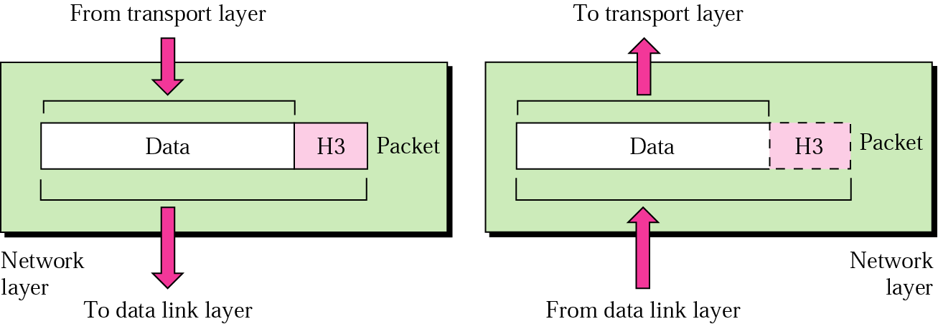
Figure 2.9 Network layer

Slide 16
Note:
The network layer is responsible for the delivery of packets from the original source to the
final destination.

Slide 17
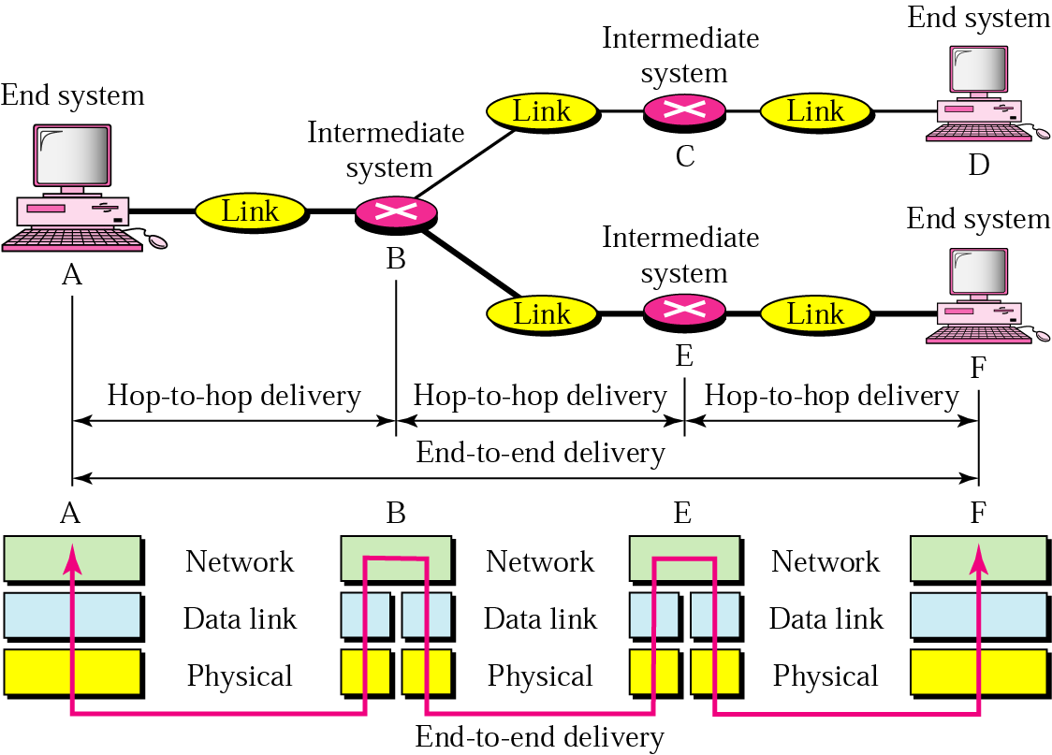
Figure 2.10 Source-to-destination delivery

Slide 18
Example 2
In Figure 2.11 we want to send data from a node with network address A and physical address 10, located on one LAN, to a node with a network address P and physical address 95, located on another LAN. Because the two devices are located on different networks, we cannot use physical addresses only; the physical addresses only have local jurisdiction. What we need here are universal addresses that can pass through the LAN boundaries. The network (logical) addresses have this characteristic.

Slide 19
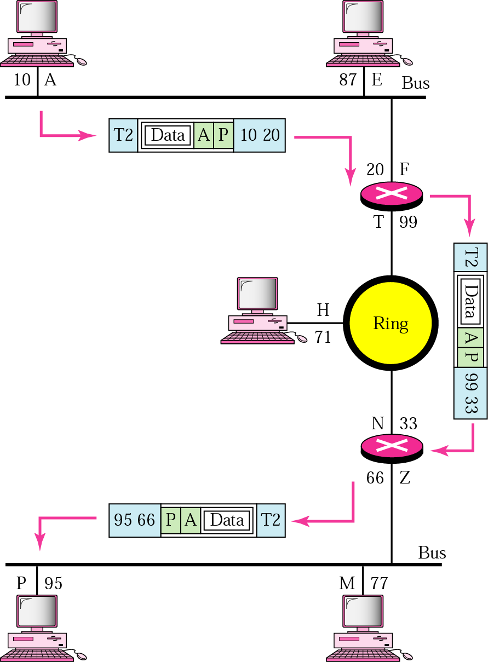
Figure 2.11 Example 2

Slide 20
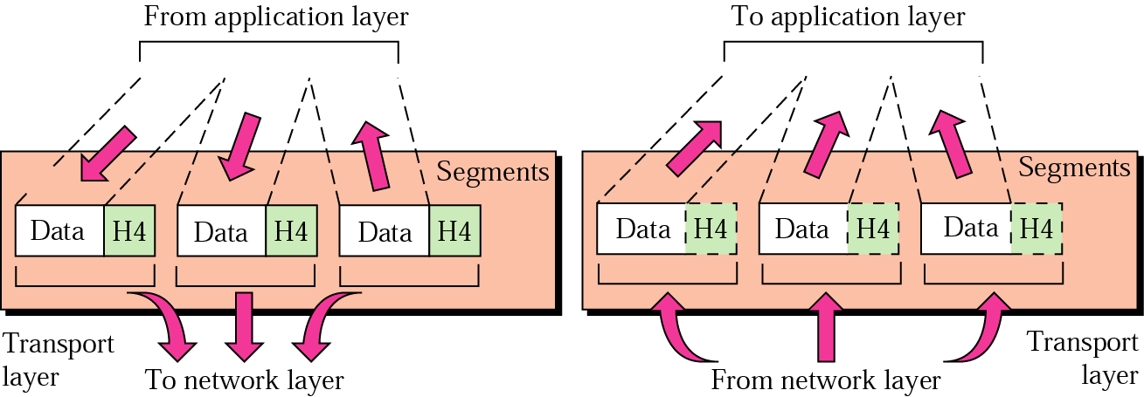
Figure 2.12 Transport layer

Slide 21
Note:
The transport layer is responsible for delivery of a message from one process to another.

Slide 22
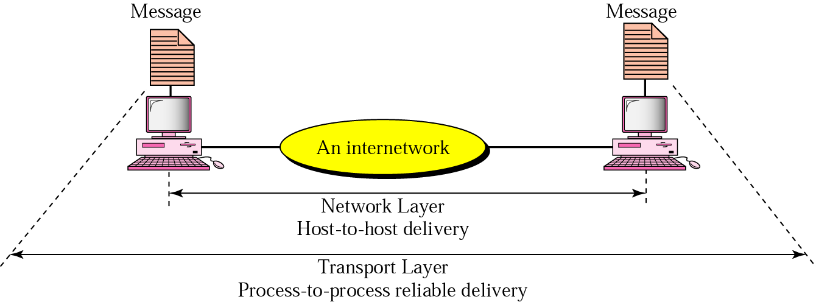
Figure 2.12 Reliable process-to-process delivery of a message

Slide 23
Example 3
Figure 2.14 shows an example of transport layer communication. Data coming from the upper layers have port addresses j and k (j is the address of the sending process, and k is the address of the receiving process). Since the data size is larger than the network layer can handle, the data are split into two packets, each packet retaining the port addresses (j and k). Then in the network layer, network addresses (A and P) are added to each packet.

Slide 24
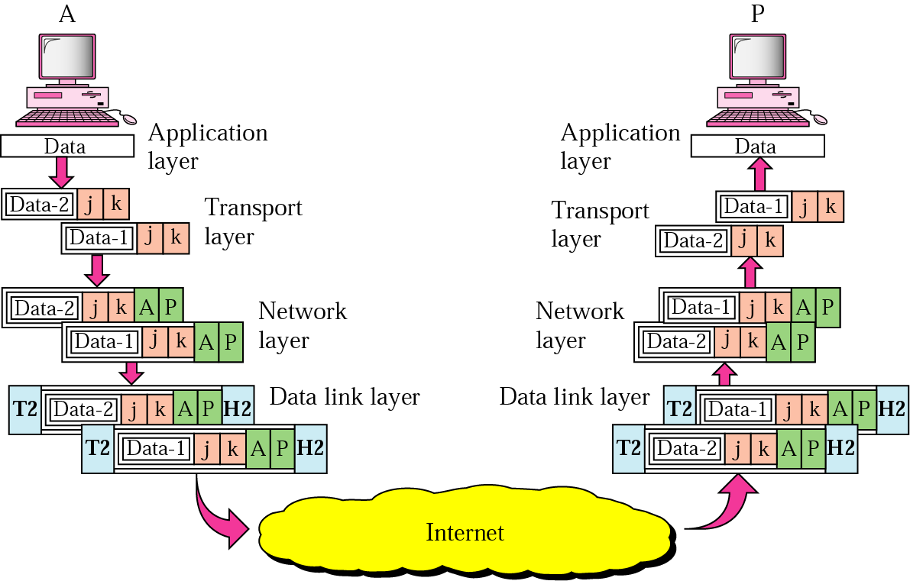
Figure 2.14 Example 3

Slide 25
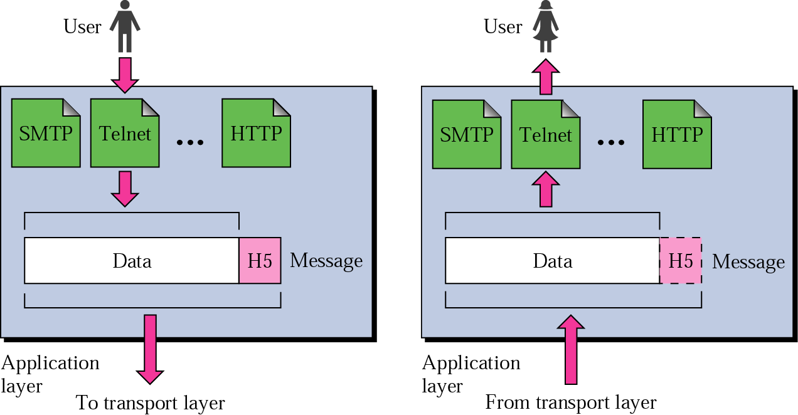
Figure 2.15 Application layer

Slide 26
Note:
The application layer is responsible for providing services to the user.

Slide 27
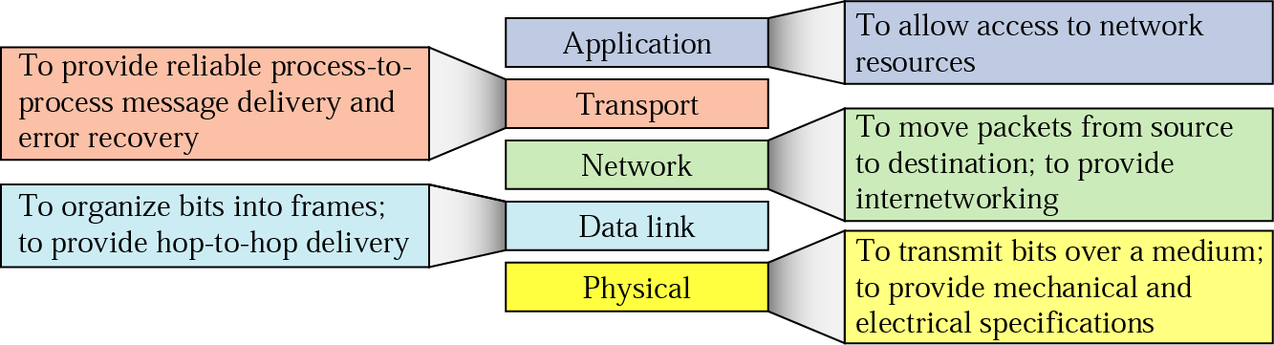
Figure 2.16 Summary of duties

Slide 28
2.3 OSI Model
A comparison

Slide 29
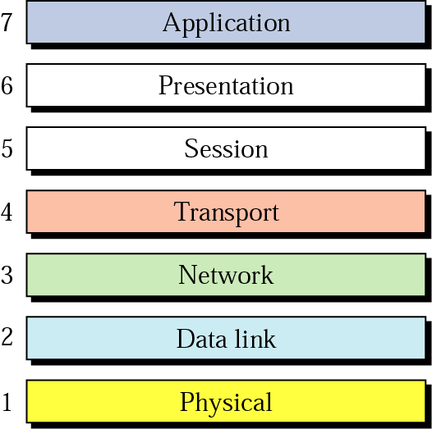
Figure 2.17 OSI model

Slide 30
Note:
The OSI model is briefly discussed in Appendix C.

