Slide 1
Chapter 17
Cellular Telephone
And Satellite
Networks

Slide 2
17.1 Cellular Telephony
Frequency Reuse Principle
Transmitting
Receiving
Handoff
Roaming
First Generation
Second Generation
Third Generation

Slide 3
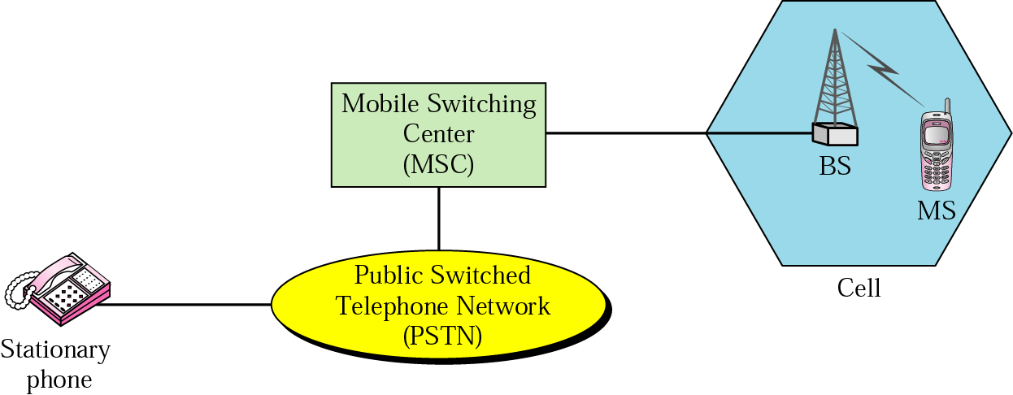
Figure 17.1 Cellular system

Slide 4
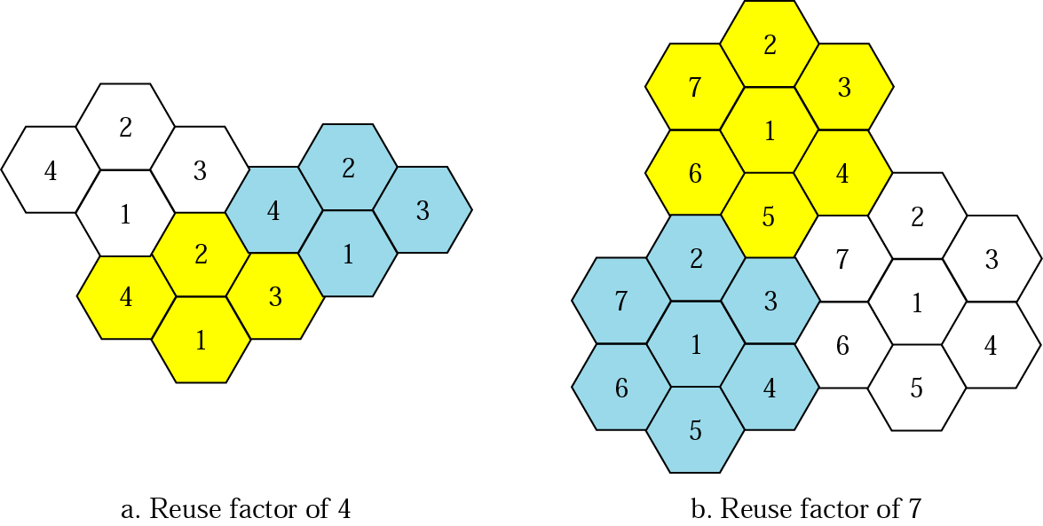
Figure 17.2 Frequency reuse patterns

Slide 5

Note:
AMPS is an analog cellular phone system using FDMA.

Slide 6
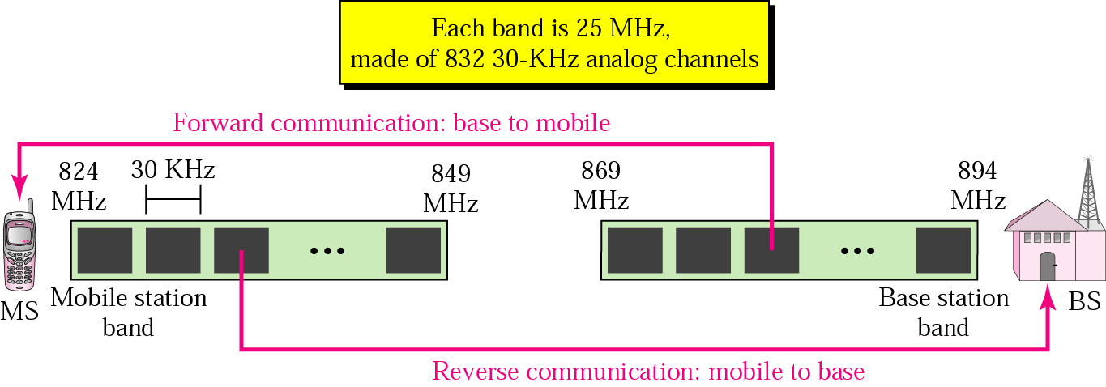
Figure 17.3 Cellular bands for AMPS

Slide 7
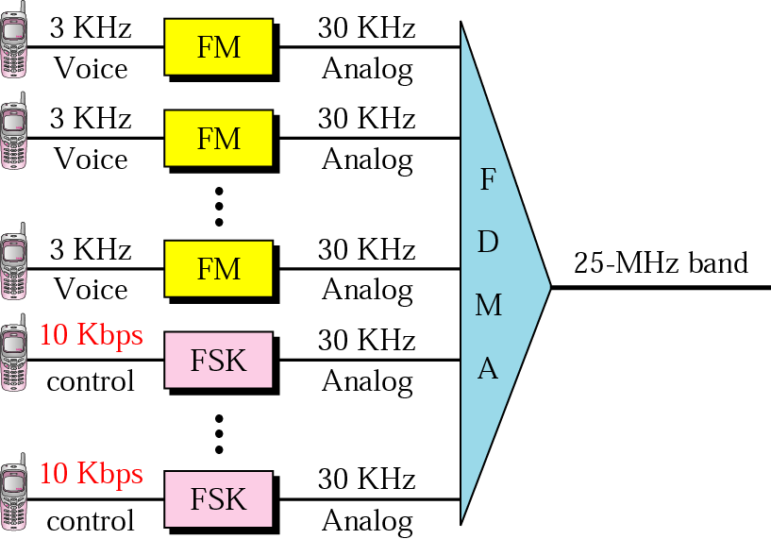
Figure 17.4 AMPS reverse communication band

Slide 8
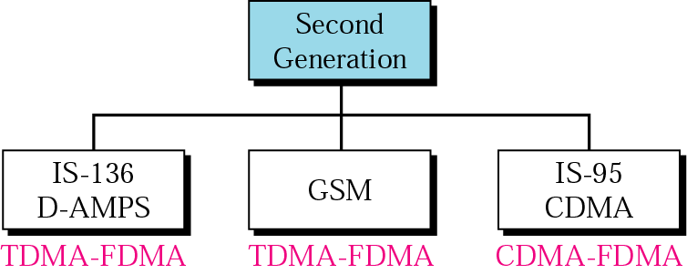
Figure 17.5 Second-generation cellular phone systems

Slide 9
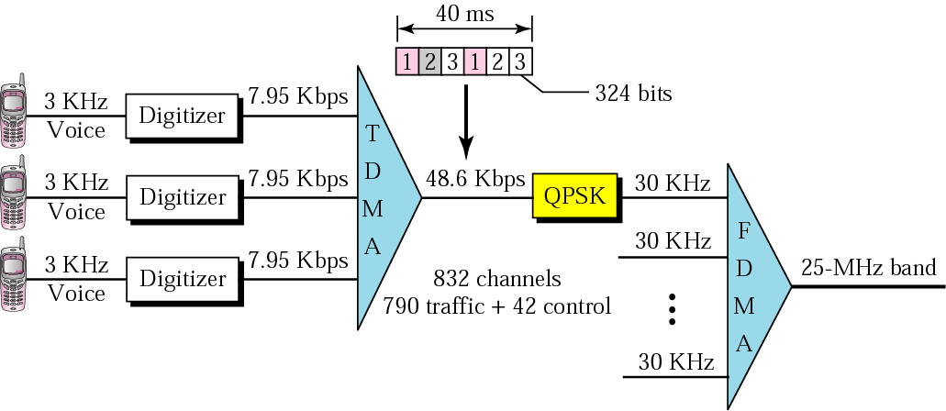
Figure 17.6 D-AMPS

Slide 10
Note:
D-AMPS, or IS-136, is a digital cellular phone system using TDMA and FDMA.

Slide 11
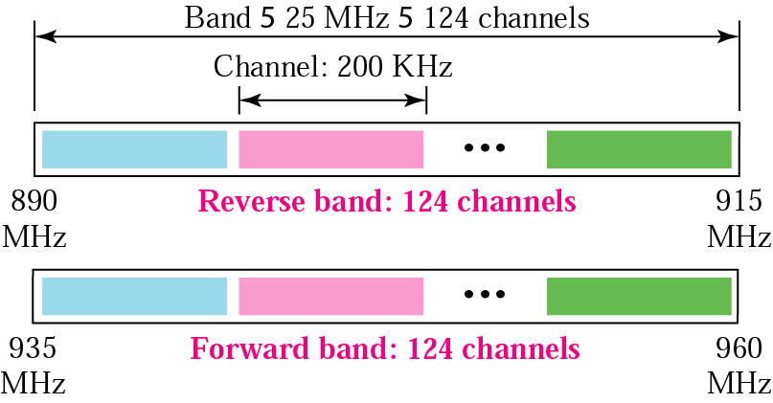
Figure 17.7 GSM bands

Slide 12
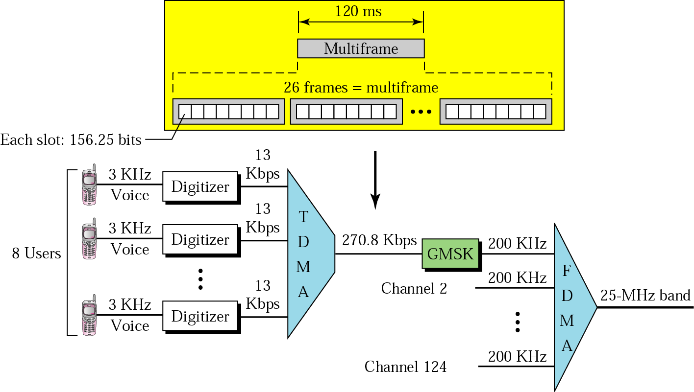
Figure 17.8 GSM

Slide 13
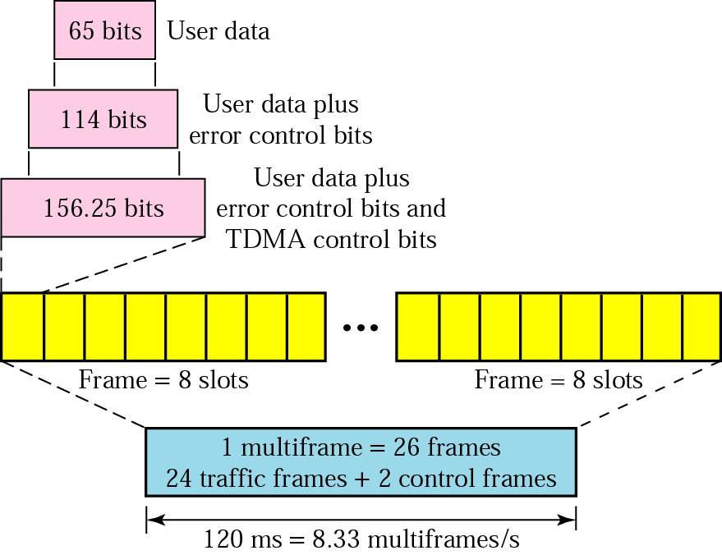
Figure 17.9 Multiframe components

Slide 14
Note:
GSM is a digital cellular phone system using TDMA and FDMA.

Slide 15
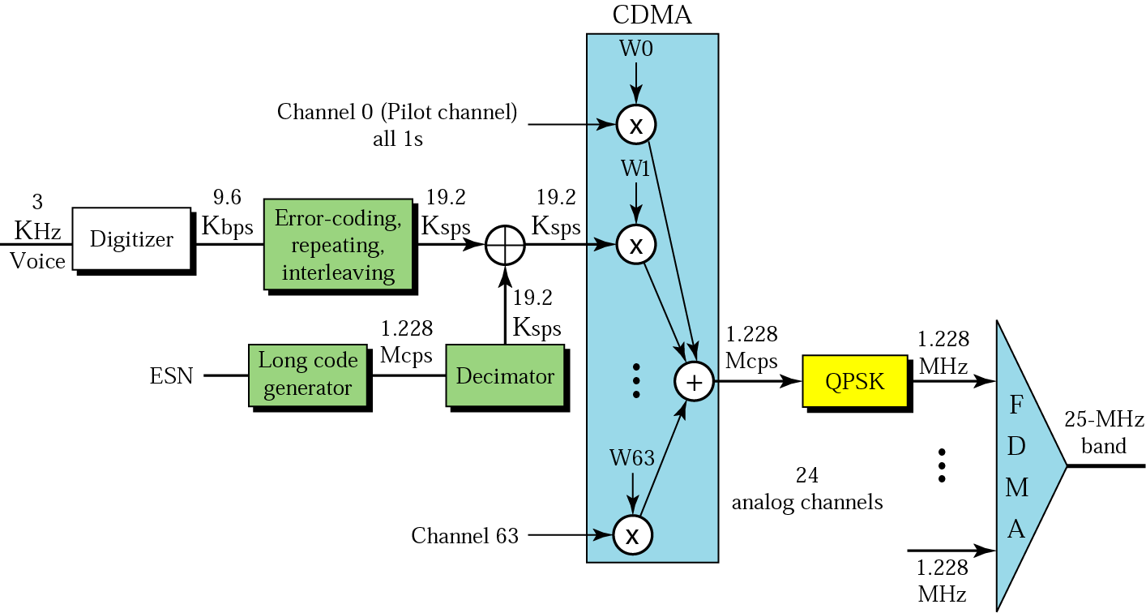
Figure 17.10 IS-95 forward transmission

Slide 16
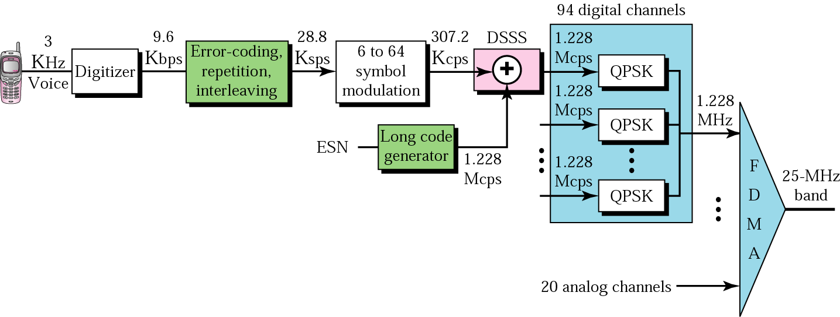
Figure 17.11 IS-95 reverse transmission

Slide 17
Note:
IS-95 is a digital cellular phone system using CDMA/DSSS and FDMA.

Slide 18
Note:
The main goal of third-generation cellular telephony is to provide universal personal communication.

Slide 19
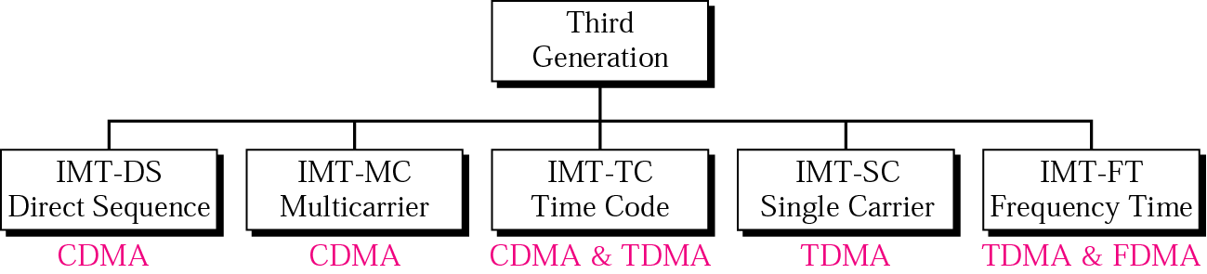
Figure 17.12 IMT-2000 radio interfaces

Slide 20
17.2 Satellite Networks
Orbits
Three Categories of Satellites
GEO Satellites
MEO Satellites
LEO Satellites

Slide 21
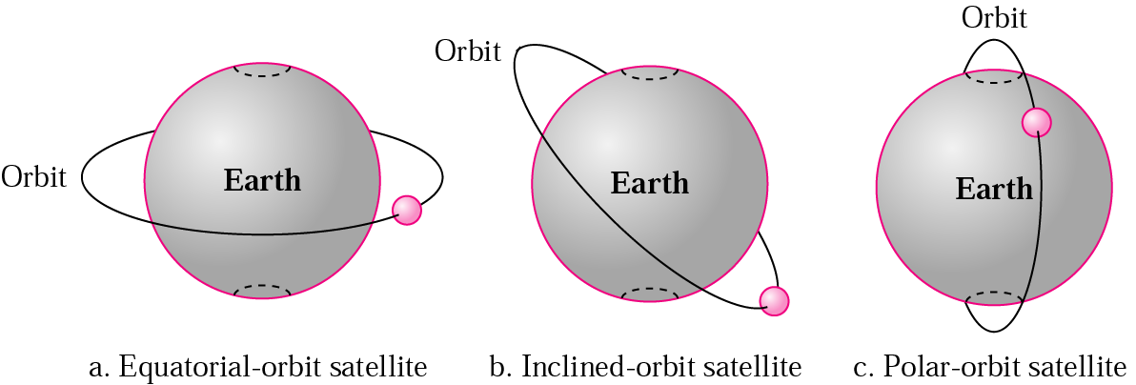
Figure 17.13 Satellite orbits

Slide 22
Example 1
What is the period of the moon according to Kepler’s law?
Solution
The moon is located approximately 384,000 km above the earth. The radius of the earth is 6378 km. Applying the formula, we get
Period = (1/100) (384,000 + 6378)^{1.5} = 2,439,090 s
= 1 month

Slide 23
Example 2
According to Kepler’s law, what is the period of a satellite that is located at an orbit approximately 35,786 km above the earth?
Solution
Applying the formula, we get
Period = (1/100) (35,786 + 6378)^{1.5} = 86,579 s = 24 h
A satellite like this is said to be stationary to the earth. The orbit, as we will see, is called a geosynchronous orbit.

Slide 24
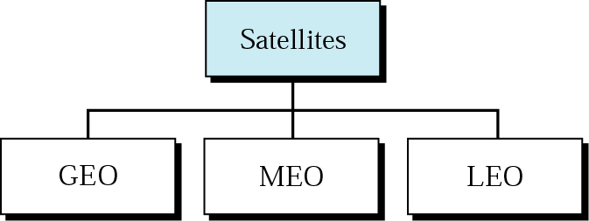
Figure 17.14 Satellite categories

Slide 25
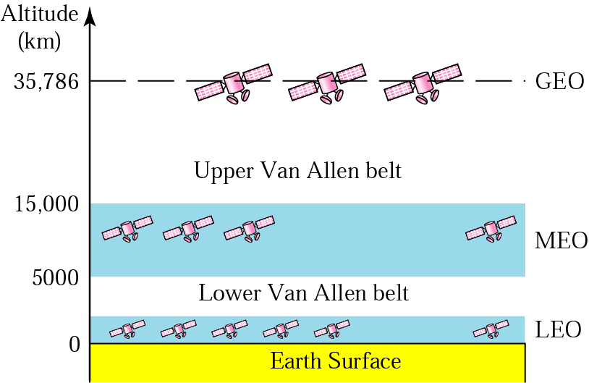
Figure 17.15 Satellite orbit altitudes

Slide 26
Table 17.1 Satellite frequency band
Band | Downlink, GHz | Uplink, GHz | Bandwidth, MHz
L | 1.5 | 1.6 | 15
S | 1.9 | 2.2 | 70
C | 4 | 6 | 500
Ku | 11 | 14 | 500
Ka | 20 | 30 | 3500

Slide 27
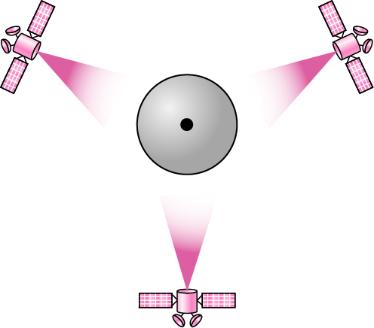
Figure 17.16 Satellites in geosynchronous orbit

Slide 28
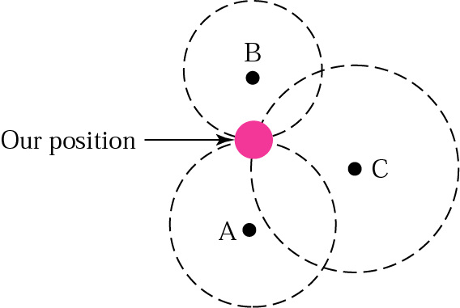
Figure 17.17 Triangulation

Slide 29
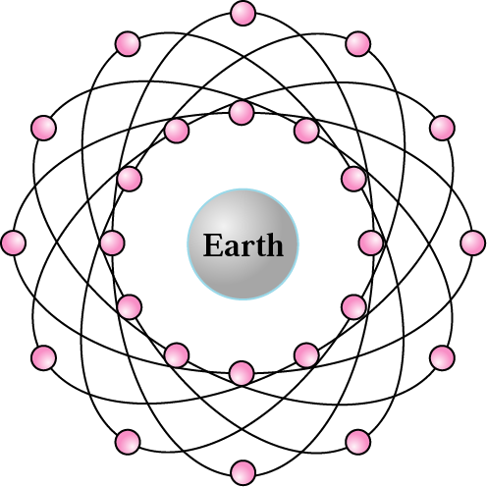
Figure 17.18 GPS

Slide 30
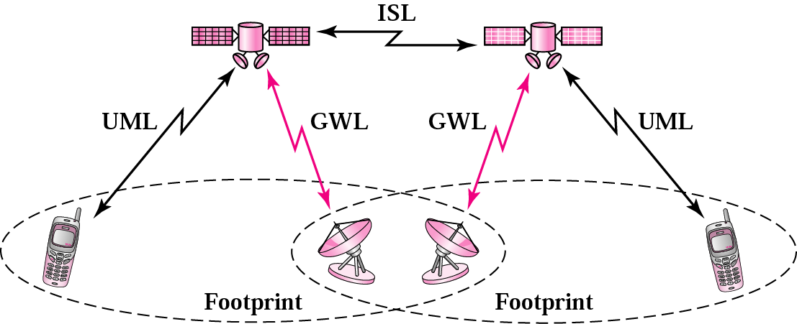
Figure 17.19 LEO satellite system

Slide 31
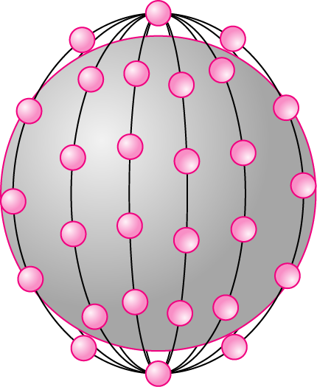
Figure 17.20 Iridium constellation

Slide 32
Note:
The Iridium system has 66 satellites in six LEO orbits, each at an
altitude of 750 km.

Slide 33
Note:
Iridium is designed to provide direct worldwide voice and data communication using handheld terminals, a service similar to cellular telephony but on a global scale.

Slide 34
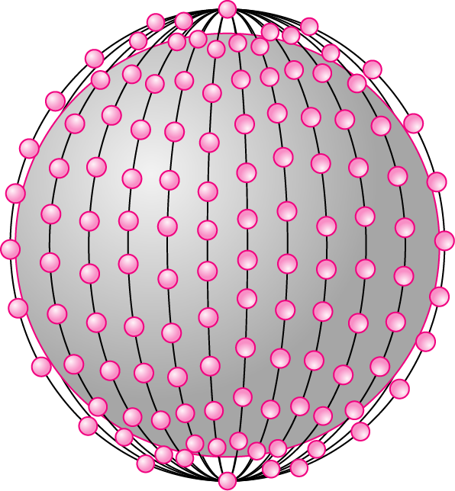
Figure 17.21 Teledesic

Slide 35
Note:
Teledesic has 288 satellites in 12 LEO orbits, each at an altitude of 1350 km.

