Slide 1
PART VI
Application Layer

Slide 2
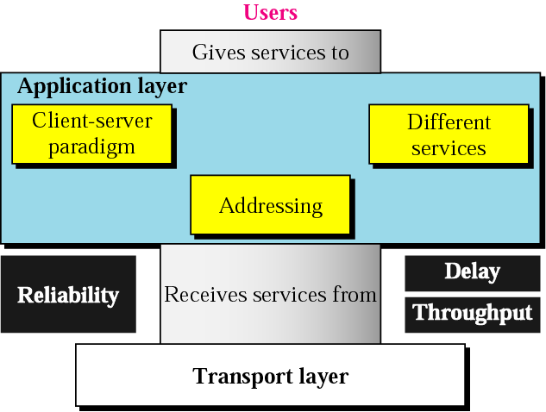
Position of application layer

Slide 3
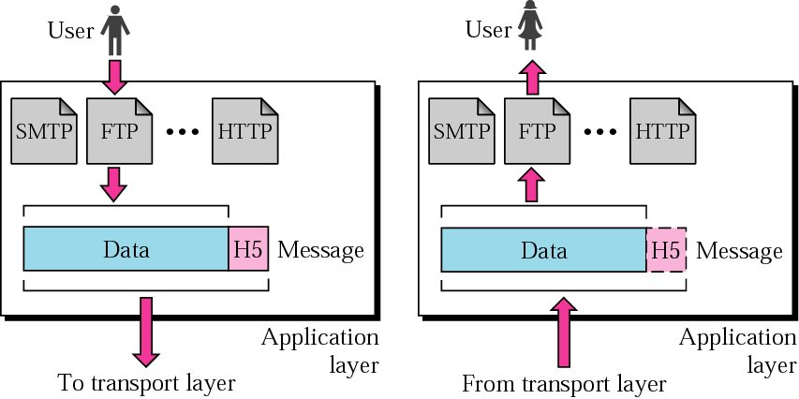
Network layer duties

Slide 4
Chapters
Chapter 24 Client-Server Model
Chapter 25 Domain Name System
Chapter 26 SMTP and FTP
Chapter 27 HTTP and WWW
Chapter 28 Multimedia

Slide 5
Chapter 24
Client-Server
Model:
Socket Interface

Slide 6
24.1 Client-Server Model
Relationship
Concurrency
Processes

Slide 7
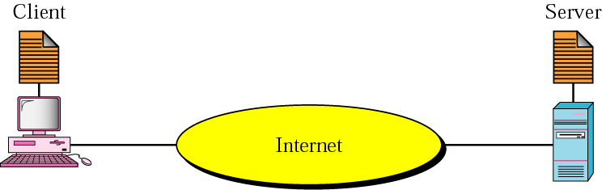
Figure 24.1 Client-server model

Slide 8
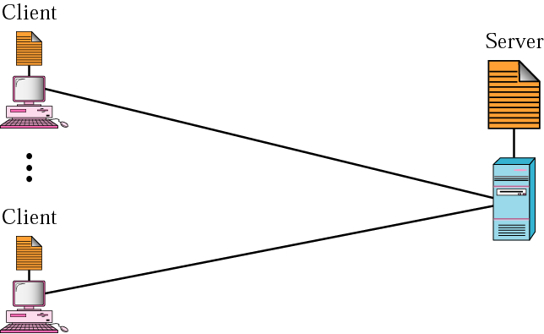
Figure 24.2 Client-server relationship

Slide 9
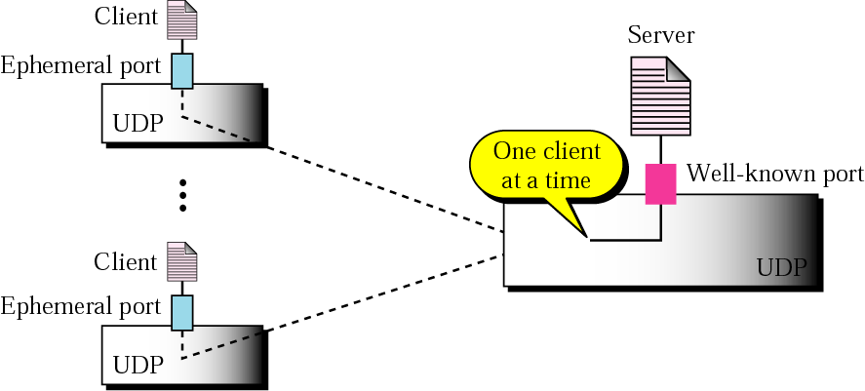
Figure 24.3 Connectionless iterative server

Slide 10
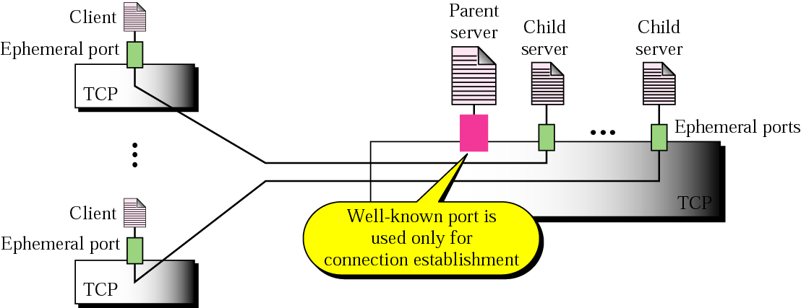
Figure 24.4 Connection-oriented concurrent server

Slide 11
24.2 Socket Interface
Sockets
Connectionless Iterative Server
Connection-Oriented Server

Slide 12
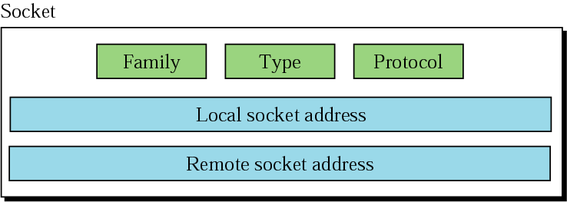
Figure 24.5 Socket structure

Slide 13
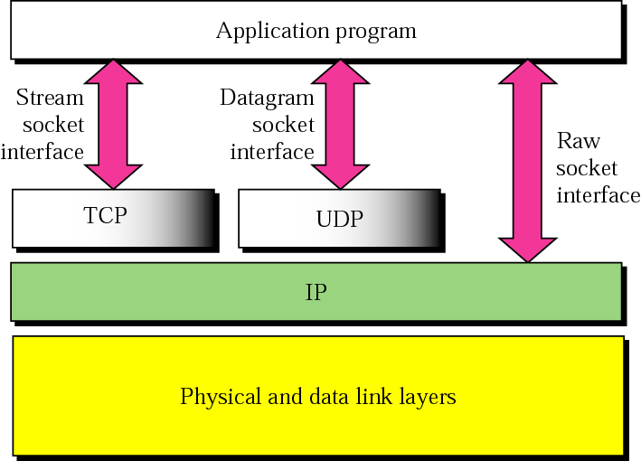
Figure 24.6 Socket types

Slide 14
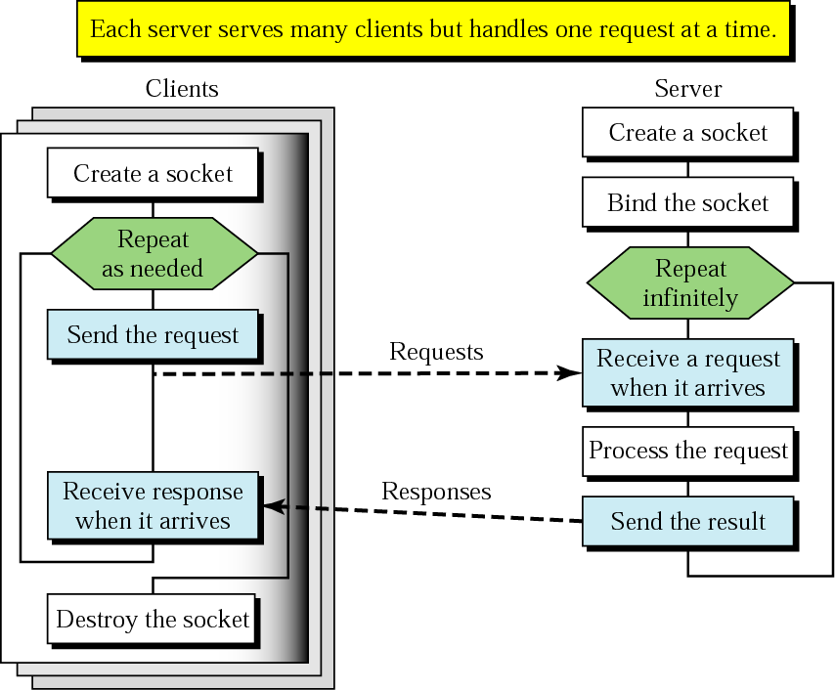
Figure 24.7 Socket interface for connectionless iterative server

Slide 15
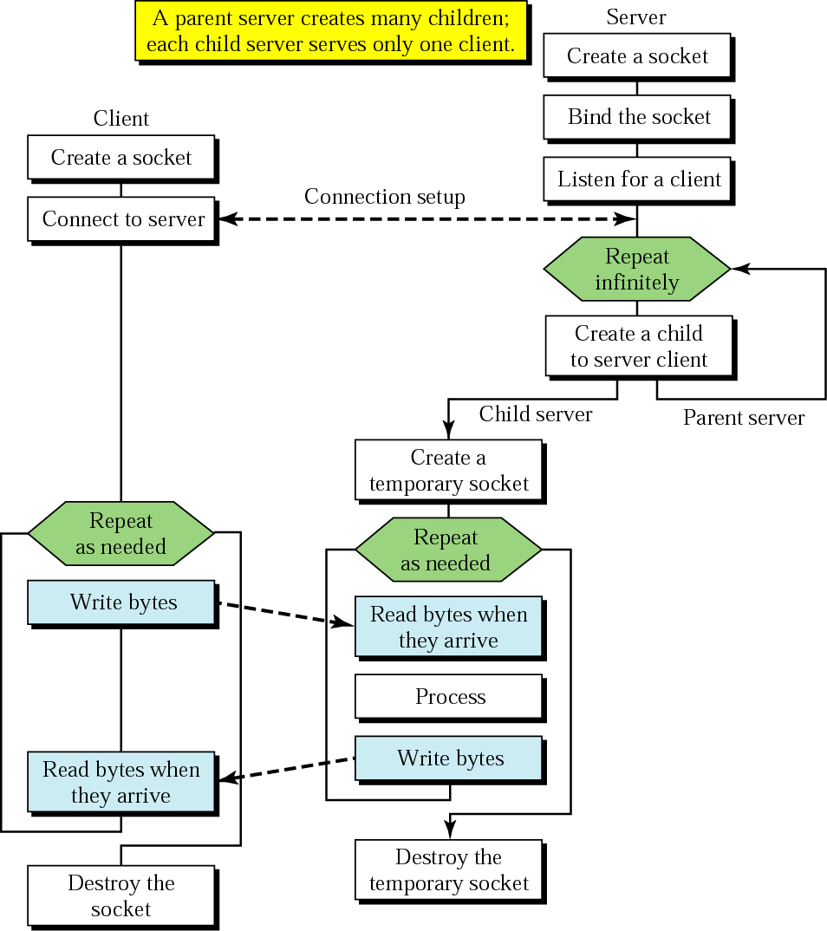
Figure 24.8 Socket interface for connection-oriented concurrent server

