Slide 1
Chapter 5
Analog
Transmission

Slide 2
5.1 Modulation of Digital Data
Digital-to-Analog Conversion
Amplitude Shift Keying (ASK)
Frequency Shift Keying (FSK)
Phase Shift Keying (PSK)
Quadrature Amplitude Modulation
Bit/Baud Comparison

Slide 3
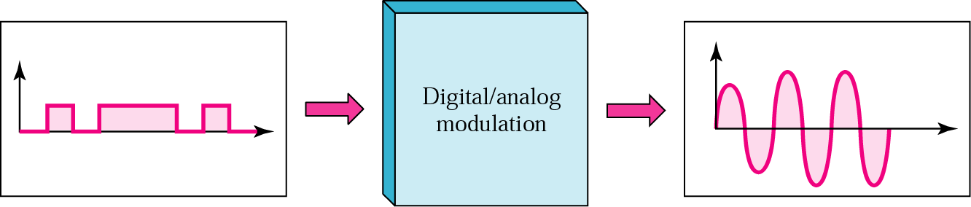
Figure 5.1 Digital-to-analog modulation

Slide 4
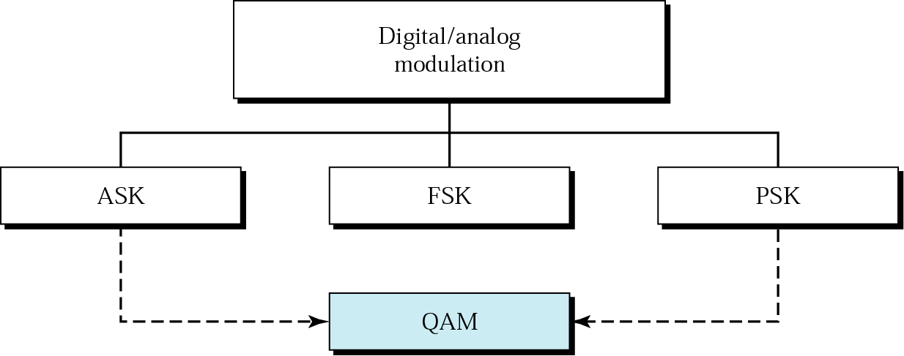
Figure 5.2 Types of digital-to-analog modulation

Slide 5

Note:
Bit rate is the number of bits per second. Baud rate is the number of signal units per second. Baud rate is less than or equal to the bit rate.

Slide 6
Example 1
An analog signal carries 4 bits in each signal unit. If 1000 signal units are sent per second, find the baud rate and the bit rate
Solution
Baud rate = 1000 bauds per second (baud/s)
Bit rate = 1000 x 4 = 4000 bps

Slide 7
Example 2
The bit rate of a signal is 3000. If each signal unit carries 6 bits, what is the baud rate?
Solution
Baud rate = 3000 / 6 = 500 baud/s

Slide 8
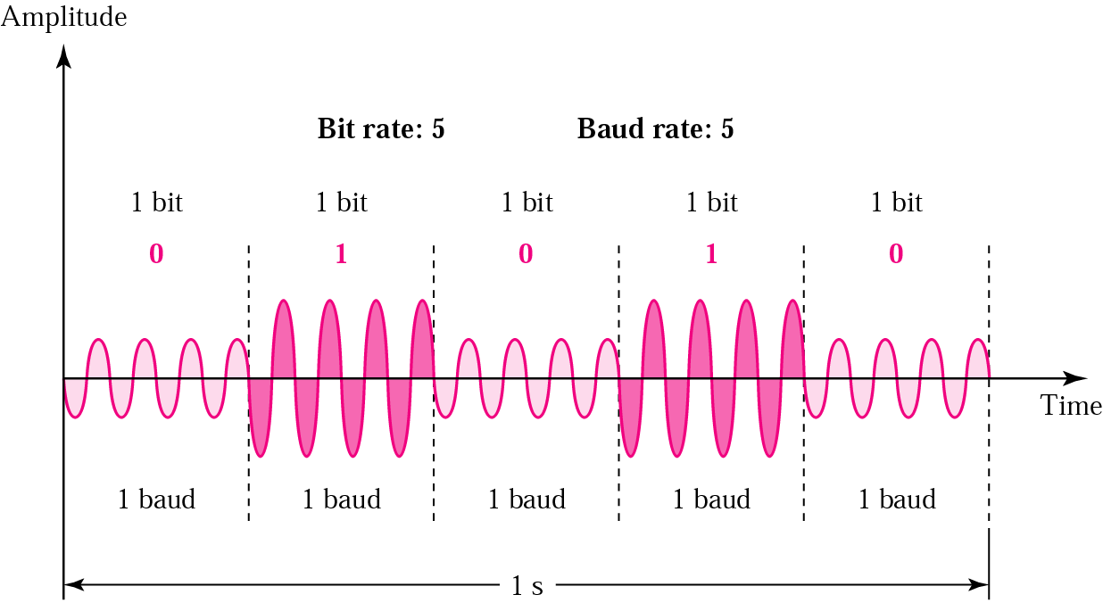
Figure 5.3 ASK

Slide 9
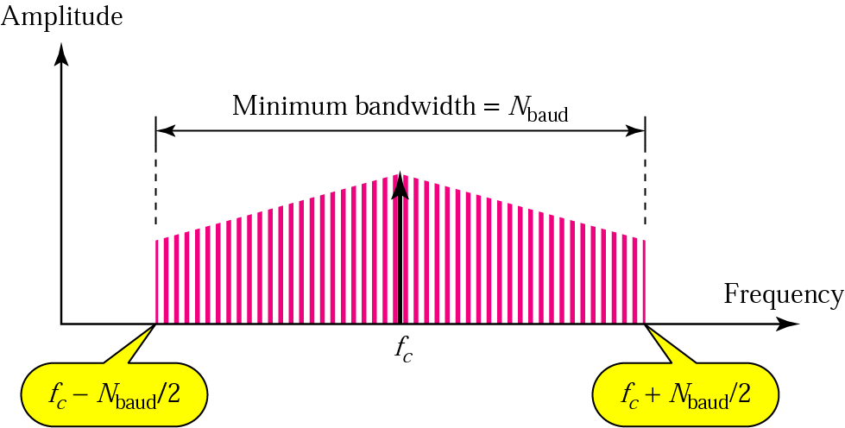
Figure 5.4 Relationship between baud rate and bandwidth in ASK

Slide 10
Example 3
Find the minimum bandwidth for an ASK signal transmitting at 2000 bps. The transmission mode is half-duplex.
Solution
In ASK the baud rate and bit rate are the same. The baud rate is therefore 2000. An ASK signal requires a minimum bandwidth equal to its baud rate. Therefore, the minimum bandwidth is 2000 Hz.

Slide 11
Example 4
Given a bandwidth of 5000 Hz for an ASK signal, what are the baud rate and bit rate?
Solution
In ASK the baud rate is the same as the bandwidth, which means the baud rate is 5000. But because the baud rate and the bit rate are also the same for ASK, the bit rate is 5000 bps.

Slide 12
Example 5
Given a bandwidth of 10,000 Hz (1000 to 11,000 Hz), draw the full-duplex ASK diagram of the system. Find the carriers and the bandwidths in each direction. Assume there is no gap between the bands in the two directions.
Solution
For full-duplex ASK, the bandwidth for each direction is
BW = 10000 / 2 = 5000 Hz
The carrier frequencies can be chosen at the middle of each band (see Fig. 5.5).
fc (forward) = 1000 + 5000/2 = 3500 Hz
fc (backward) = 11000 – 5000/2 = 8500 Hz

Slide 13
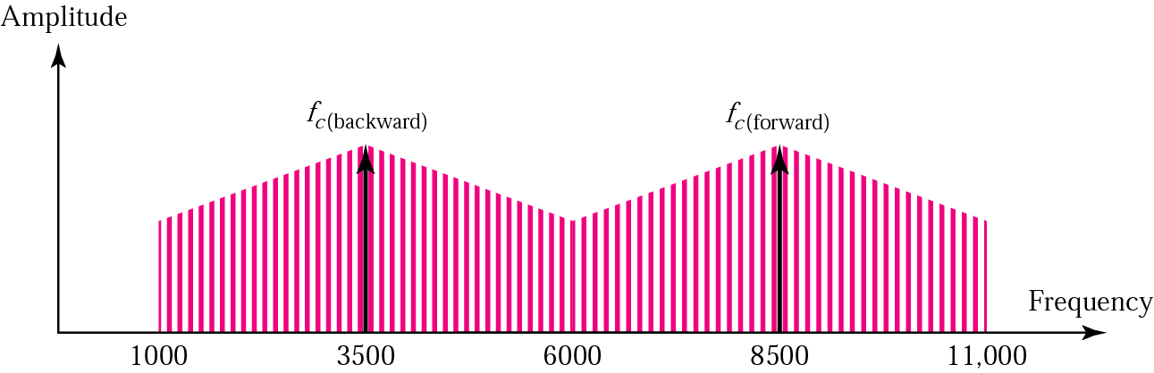
Figure 5.5 Solution to Example 5

Slide 14
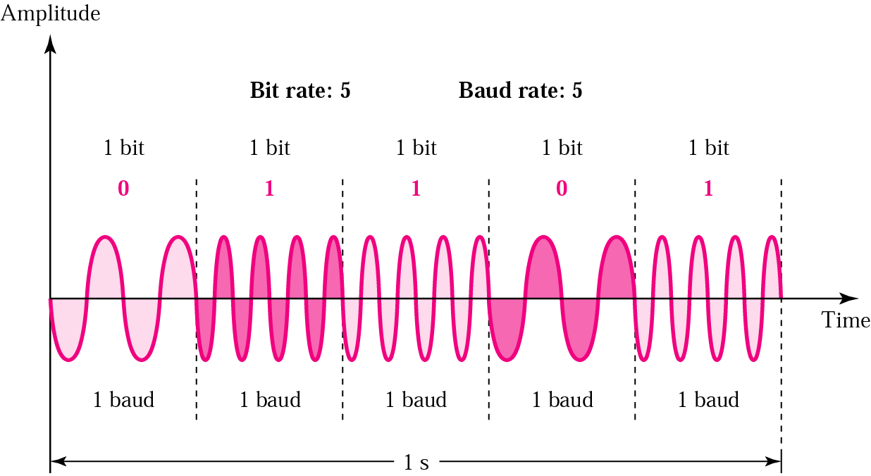
Figure 5.6 FSK

Slide 15
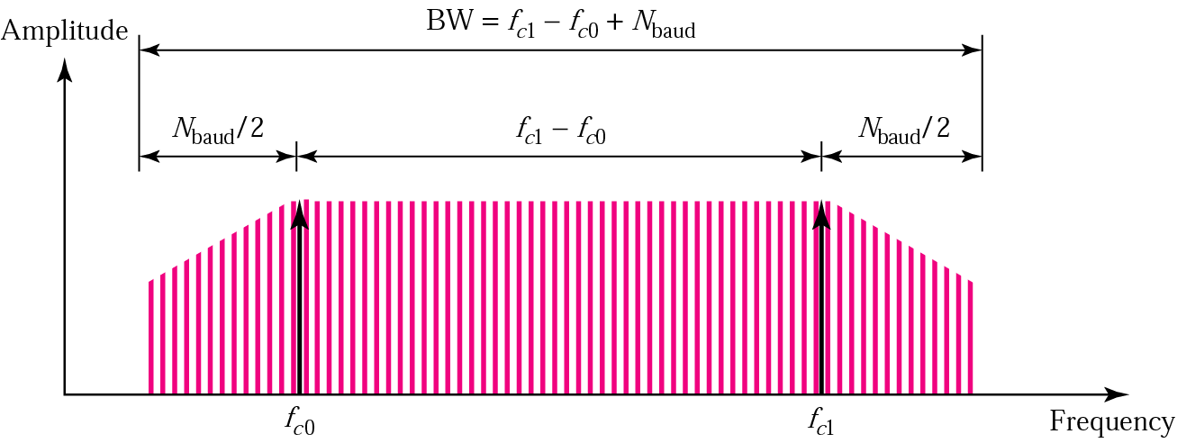
Figure 5.7 Relationship between baud rate and bandwidth in FSK

Slide 16
Example 6
Find the minimum bandwidth for an FSK signal transmitting at 2000 bps. Transmission is in half-duplex mode, and the carriers are separated by 3000 Hz.
Solution
For FSK
BW = baud rate + f_{c1} − f_{c0}
BW = bit rate + fc1 − fc0 = 2000 + 3000 = 5000 Hz

Slide 17
Example 7
Find the maximum bit rates for an FSK signal if the bandwidth of the medium is 12,000 Hz and the difference between the two carriers is 2000 Hz. Transmission is in full-duplex mode.
Solution
Because the transmission is full duplex, only 6000 Hz is allocated for each direction.
BW = baud rate + fc1 − fc0
Baud rate = BW − (fc1 − fc0 ) = 6000 − 2000 = 4000
But because the baud rate is the same as the bit rate, the bit rate is 4000 bps.

Slide 18
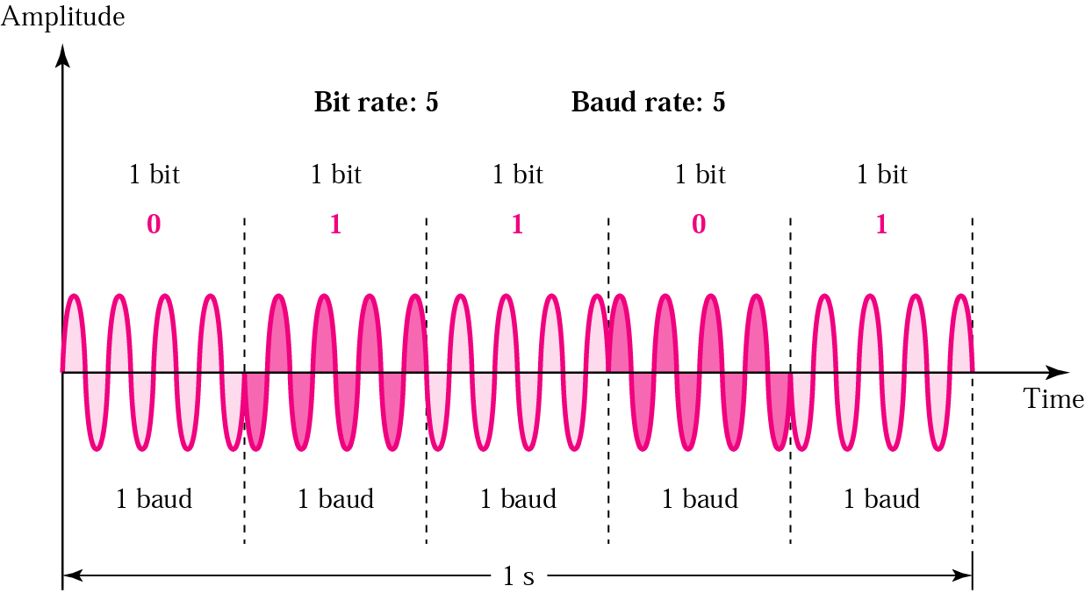
Figure 5.8 PSK

Slide 19
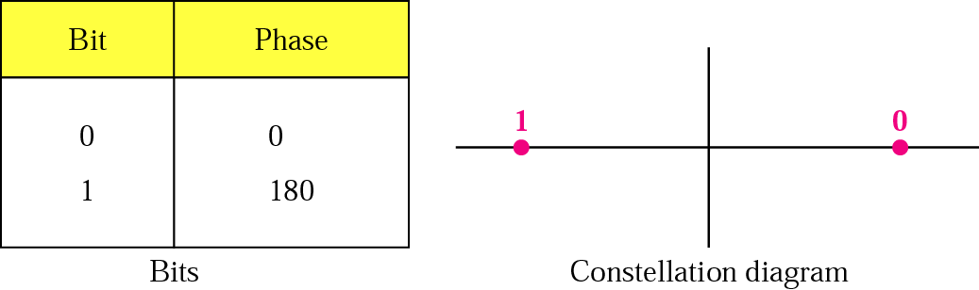
Figure 5.9 PSK constellation

Slide 20
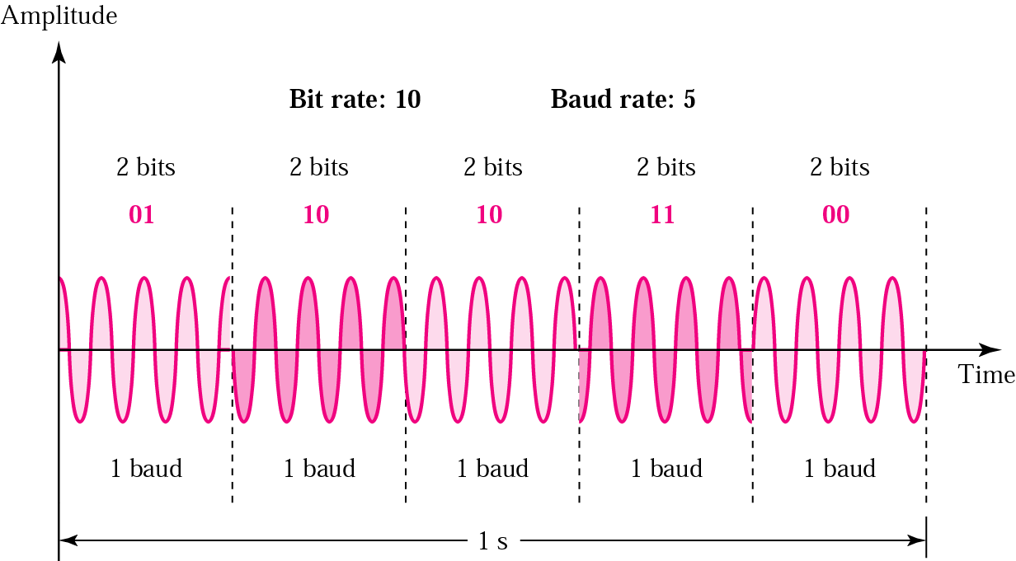
Figure 5.10 The 4-PSK method

Slide 21
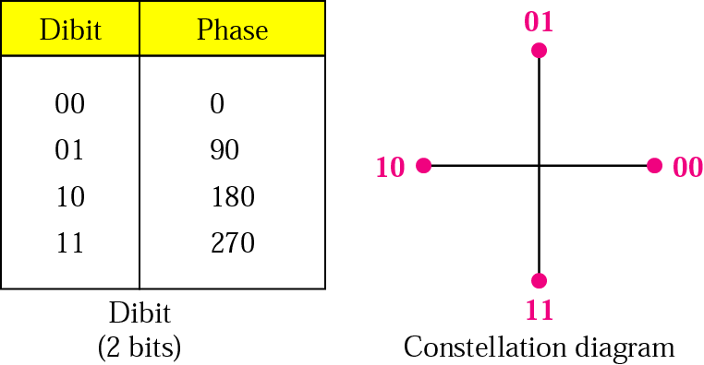
Figure 5.11 The 4-PSK characteristics

Slide 22
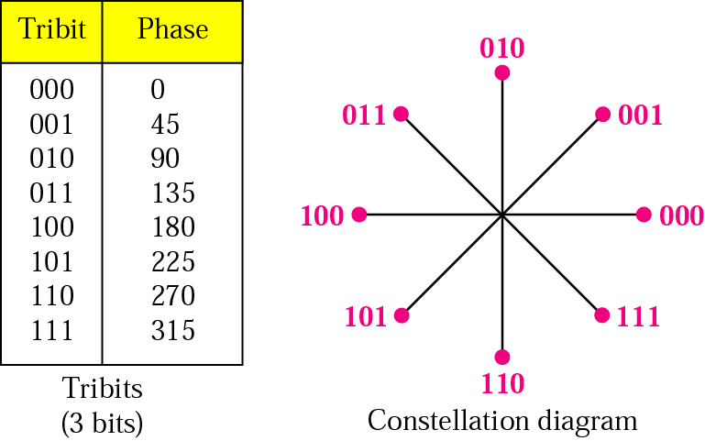
Figure 5.12 The 8-PSK characteristics

Slide 23
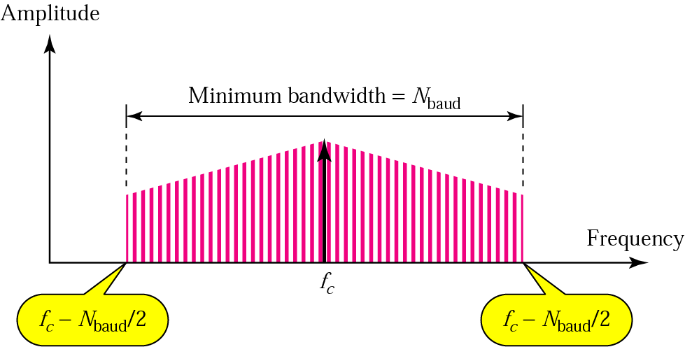
Figure 5.13 Relationship between baud rate and bandwidth in PSK

Slide 24
Example 8
Find the bandwidth for a 4-PSK signal transmitting at 2000 bps. Transmission is in half-duplex mode.
Solution
For PSK the baud rate is the same as the bandwidth, which means the baud rate is 5000. But in 8-PSK the bit rate is 3 times the baud rate, so the bit rate is 15,000 bps.

Slide 25
Example 9
Given a bandwidth of 5000 Hz for an 8-PSK signal, what are the baud rate and bit rate?
Solution
For PSK the baud rate is the same as the bandwidth, which means the baud rate is 5000. But in 8-PSK the bit rate is 3 times the baud rate, so the bit rate is 15,000 bps.

Slide 26
Note:
Quadrature amplitude modulation is a combination of ASK and PSK so that a maximum contrast between each signal unit (bit, dibit, tribit, and so on) is achieved.

Slide 27
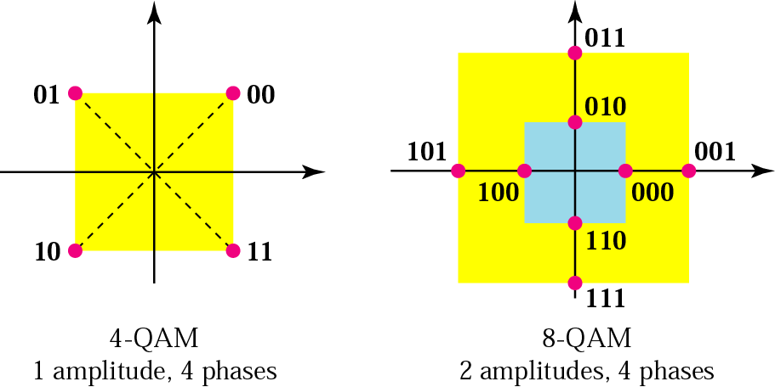
Figure 5.14 The 4-QAM and 8-QAM constellations

Slide 28
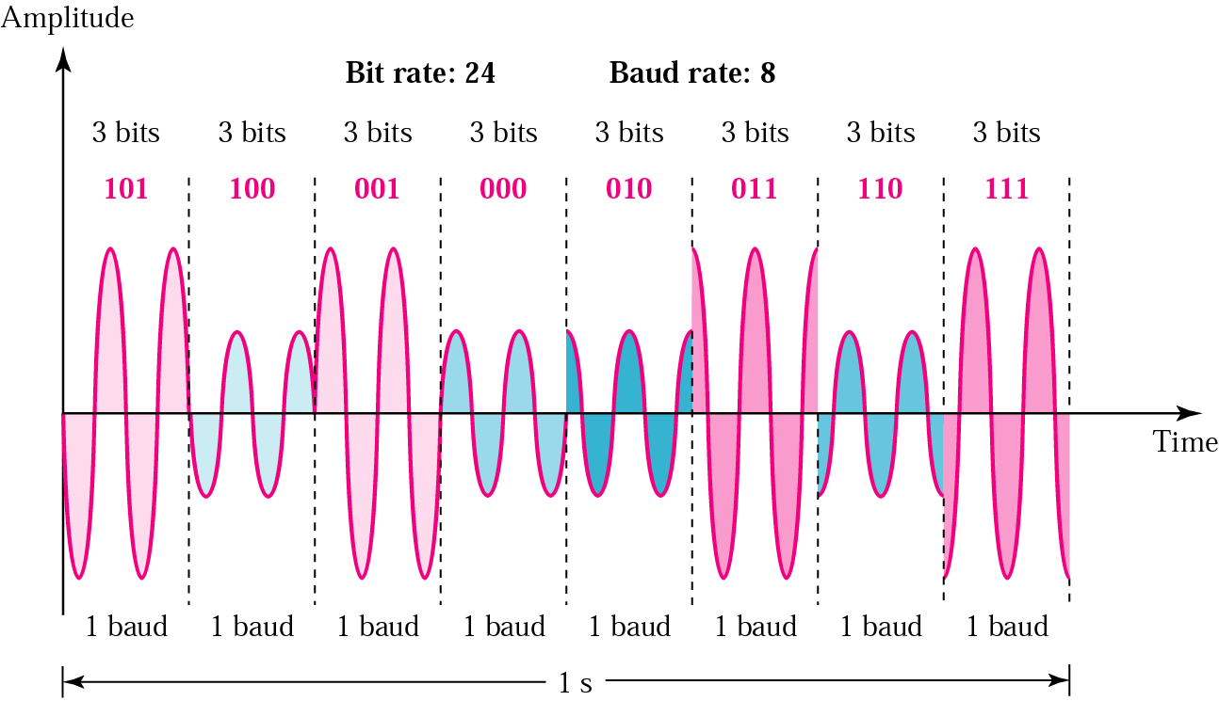
Figure 5.15 Time domain for an 8-QAM signal

Slide 29
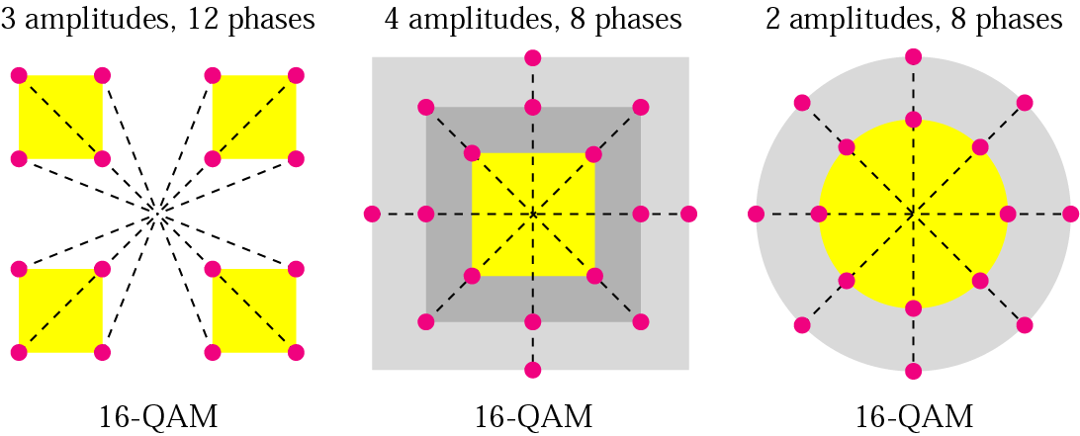
Figure 5.16 16-QAM constellations

Slide 30
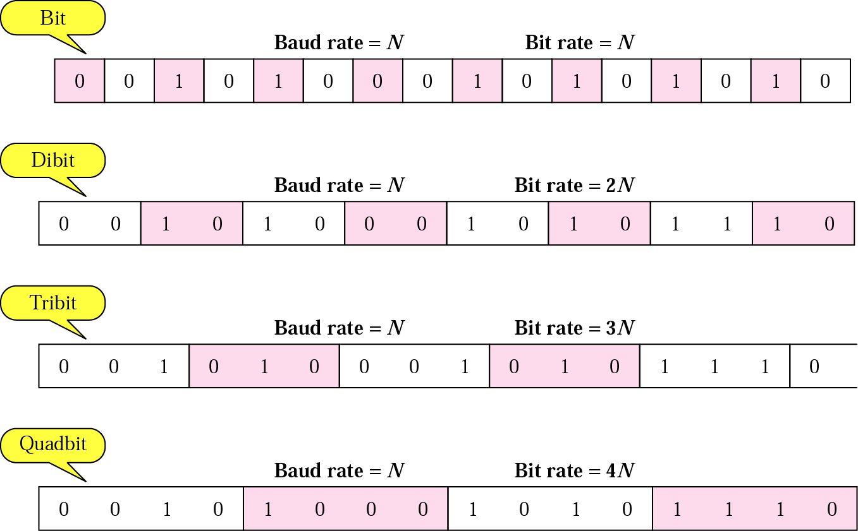
Figure 5.17 Bit and baud

Slide 31
Table 5.1 Bit and baud rate comparison
Modulation | Units | Bits/Baud | Baud rate | Bit Rate
ASK, FSK, 2-PSK | Bit | 1 | N | N
4-PSK, 4-QAM | Dibit | 2 | N | 2N
8-PSK, 8-QAM | Tribit | 3 | N | 3N
16-QAM | Quadbit | 4 | N | 4N
32-QAM | Pentabit | 5 | N | 5N
64-QAM | Hexabit | 6 | N | 6N
128-QAM | Septabit | 7 | N | 7N
256-QAM | Octabit | 8 | N | 8N

Slide 32
Example 10
A constellation diagram consists of eight equally spaced points on a circle. If the bit rate is 4800 bps, what is the baud rate?
Solution
The constellation indicates 8-PSK with the points 45 degrees apart. Since 2³ = 8, 3 bits are transmitted with each signal unit. Therefore, the baud rate is
4800 / 3 = 1600 baud

Slide 33
Example 11
Compute the bit rate for a 1000-baud 16-QAM signal.
Solution
A 16-QAM signal has 4 bits per signal unit since
log₂16 = 4.
Thus,
(1000)(4) = 4000 bps

Slide 34
Example 12
Compute the baud rate for a 72,000-bps 64-QAM signal.
Solution
A 64-QAM signal has 6 bits per signal unit since
log₂ 64 = 6.
Thus,
72000 / 6 = 12,000 baud

Slide 35
5.2 Telephone Modems
Modem Standards

Slide 36
Note:
A telephone line has a bandwidth of almost 2400 Hz for data transmission.

Slide 37
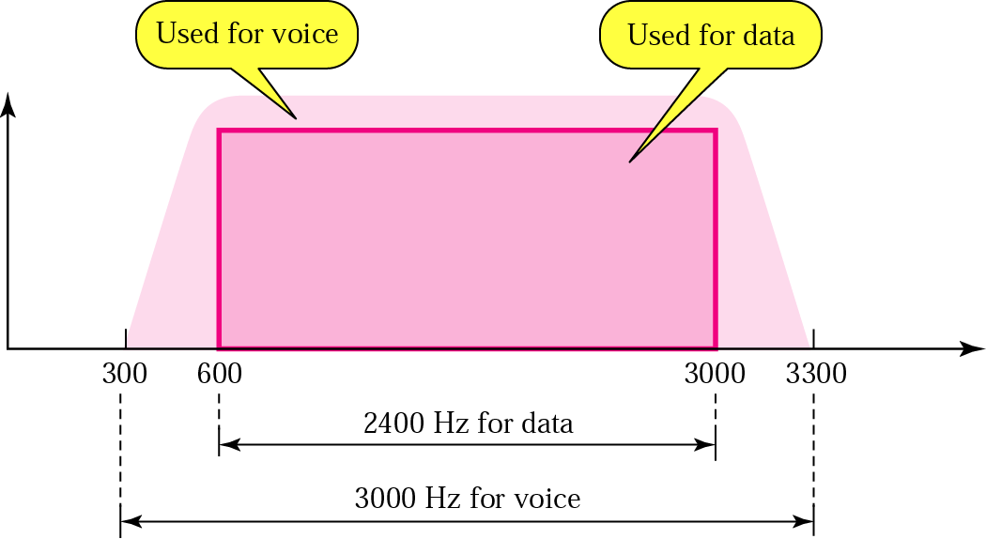
Figure 5.18 Telephone line bandwidth

Slide 38
Note:
Modem stands for modulator/demodulator.

Slide 39
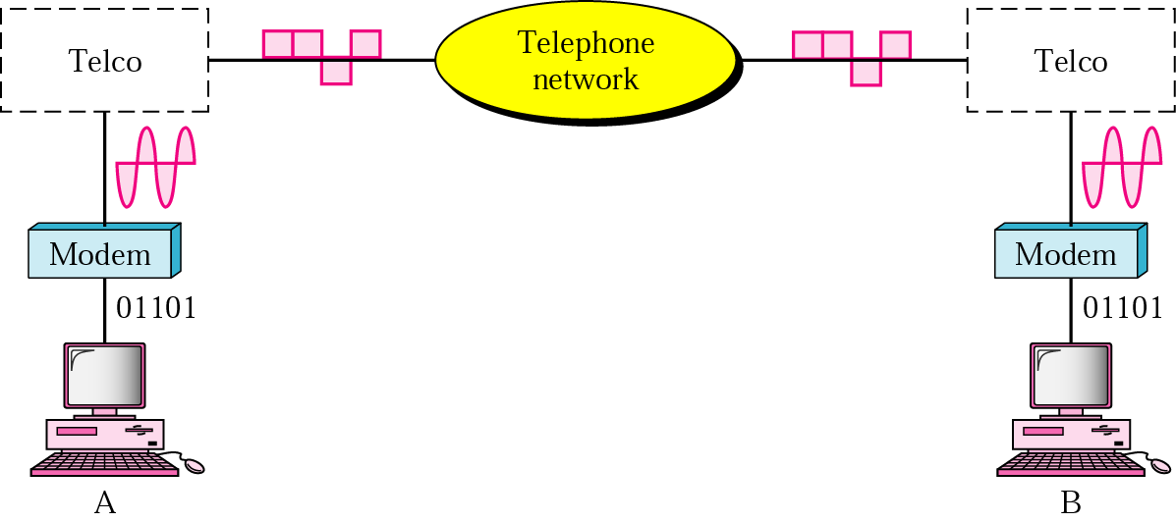
Figure 5.19 Modulation/demodulation

Slide 40
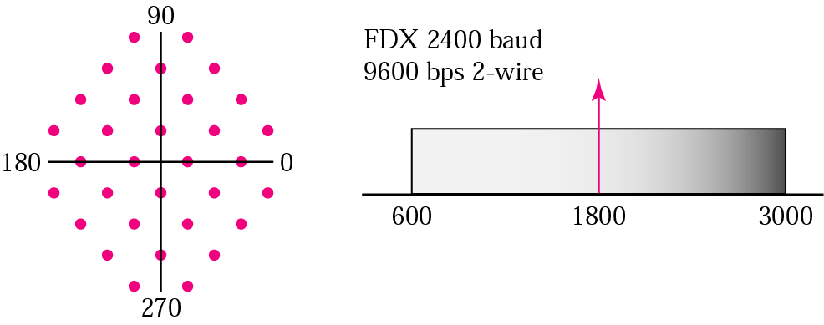
Figure 5.20 The V.32 constellation and bandwidth

Slide 41
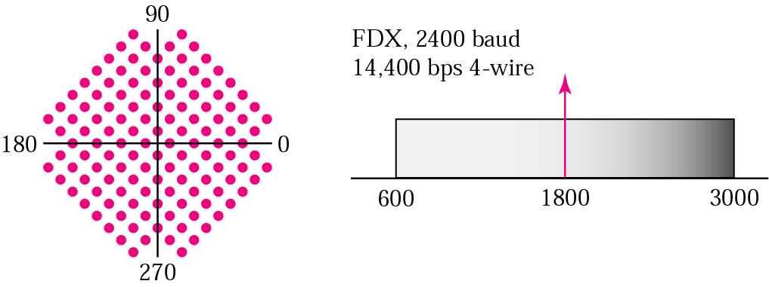
Figure 5.21 The V.32bis constellation and bandwidth

Slide 42
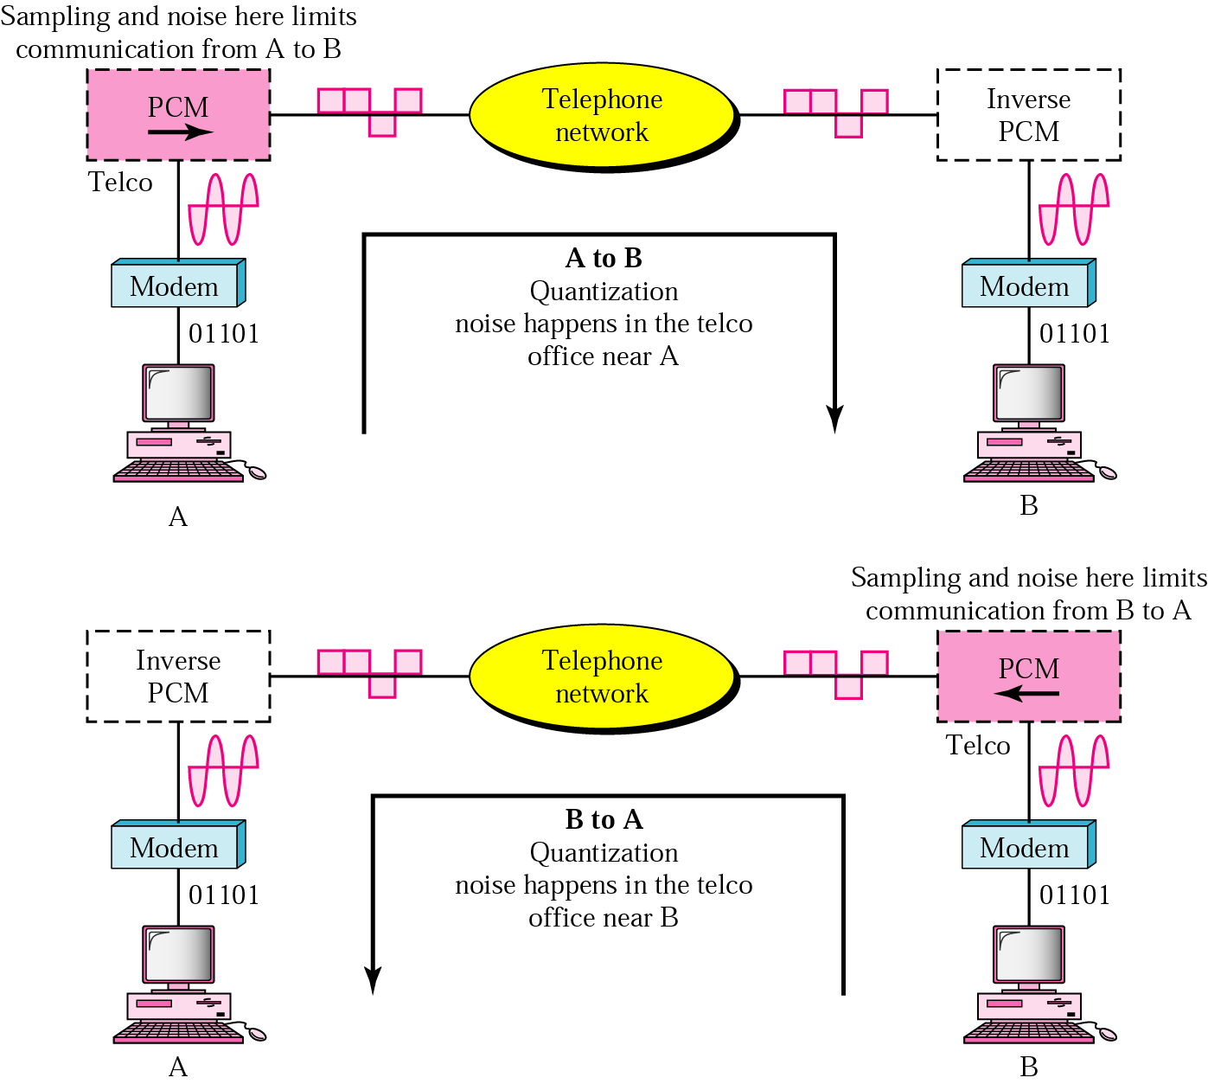
Figure 5.22 Traditional modems

Slide 43
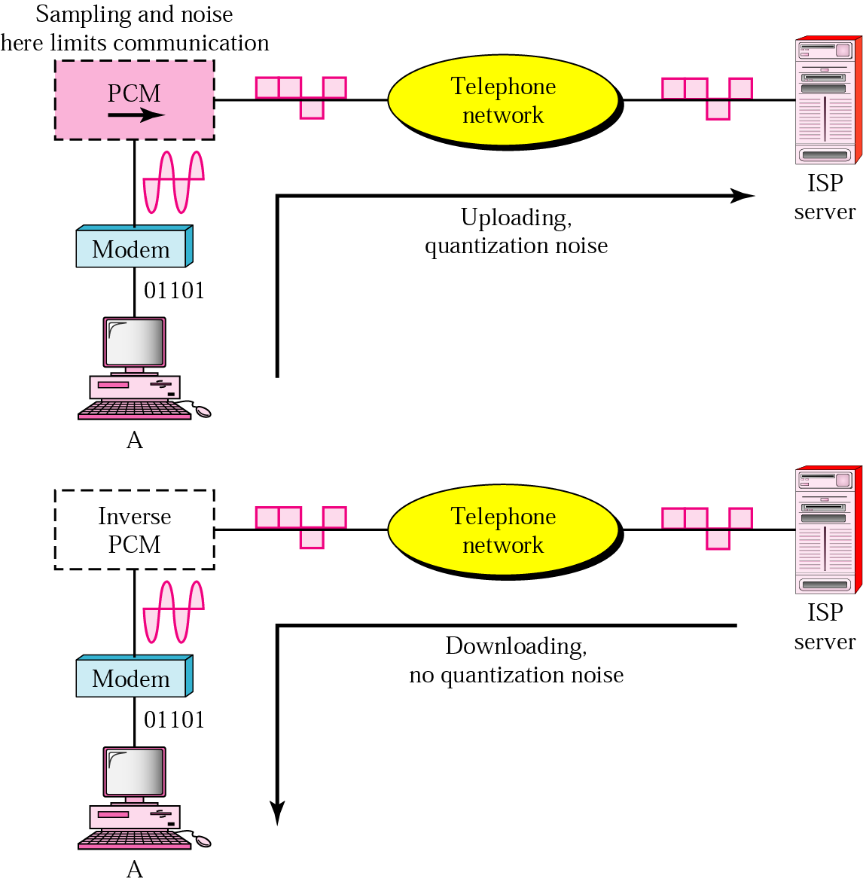
Figure 5.23 56K modems

Slide 44
5.3 Modulation of Analog Signals
Amplitude Modulation (AM)
Frequency Modulation (FM)
Phase Modulation (PM)

Slide 45
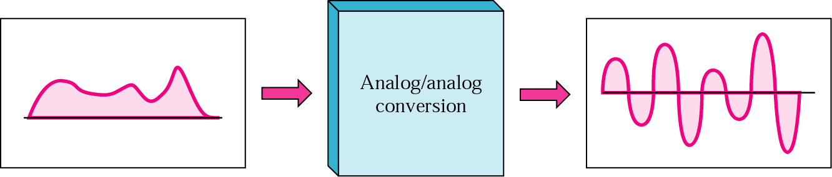
Figure 5.24 Analog-to-analog modulation

Slide 46
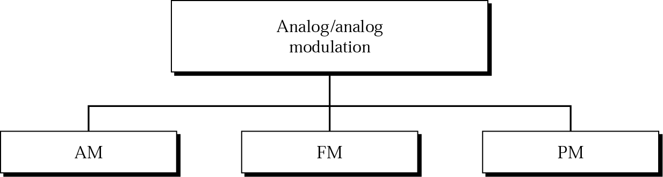
Figure 5.25 Types of analog-to-analog modulation

Slide 47
Note:
The total bandwidth required for AM can be determined from the bandwidth of the audio signal:
BWt = 2 x BWm.

Slide 48
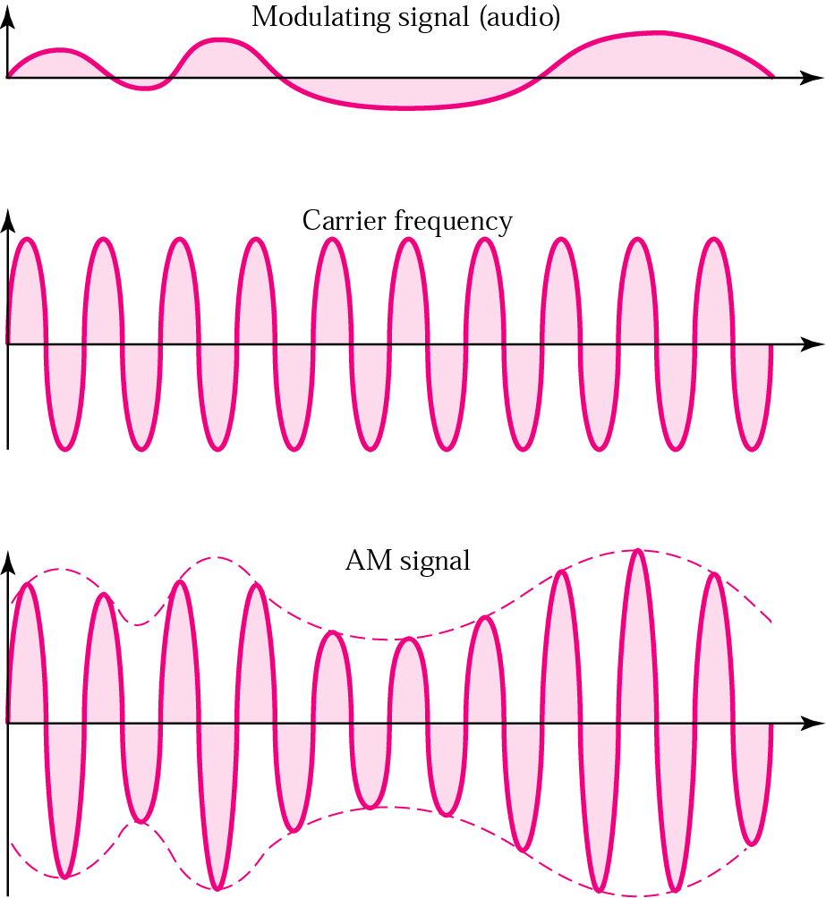
Figure 5.26 Amplitude modulation

Slide 49
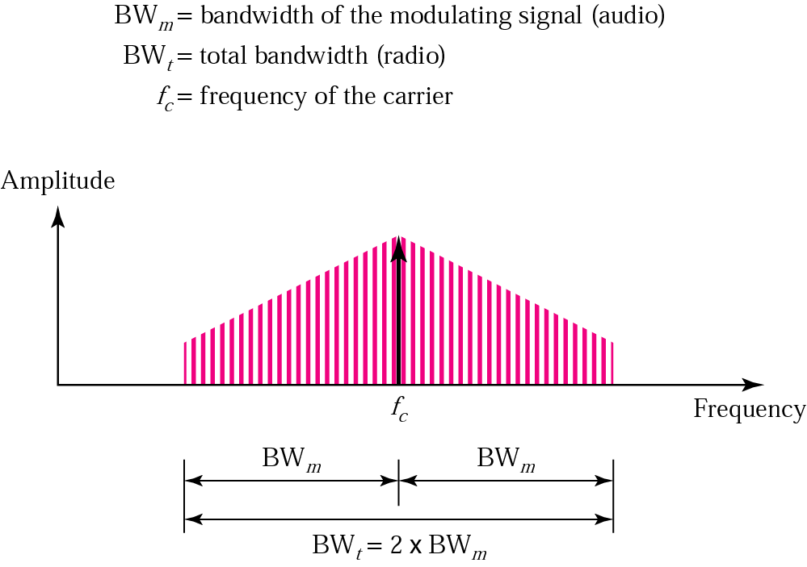
Figure 5.27 AM bandwidth

Slide 50
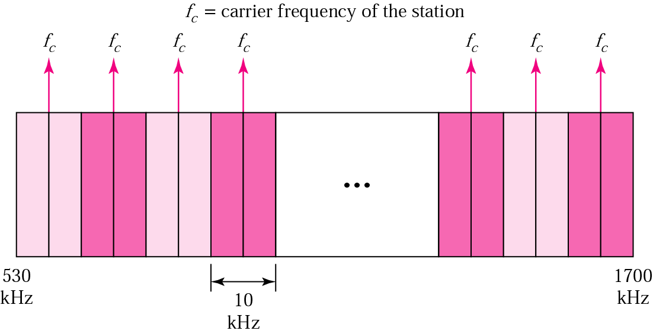
Figure 5.28 AM band allocation

Slide 51
Example 13
We have an audio signal with a bandwidth of 4 KHz. What is the bandwidth needed if we modulate the signal using AM? Ignore FCC regulations.
Solution
An AM signal requires twice the bandwidth of the original signal:
BW = 2 x 4 KHz = 8 KHz

Slide 52
Note:
The total bandwidth required for FM can be determined from the bandwidth of the audio signal:
BWt = 10 x BWm.

Slide 53
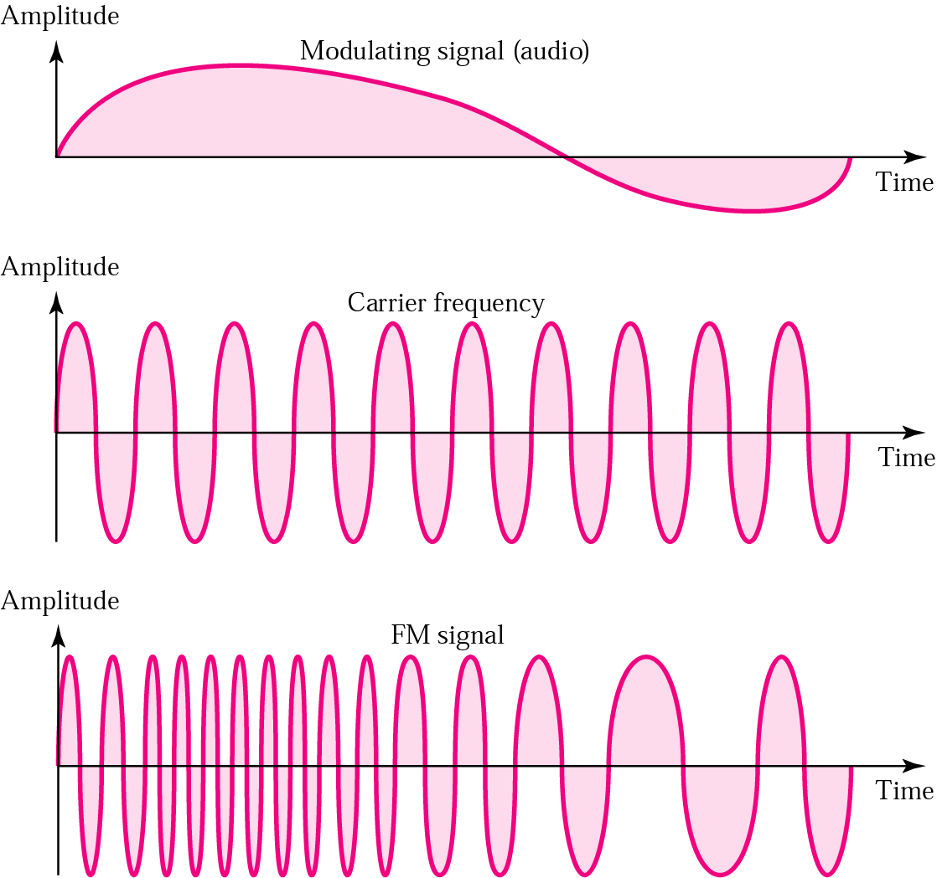
Figure 5.29 Frequency modulation

Slide 54
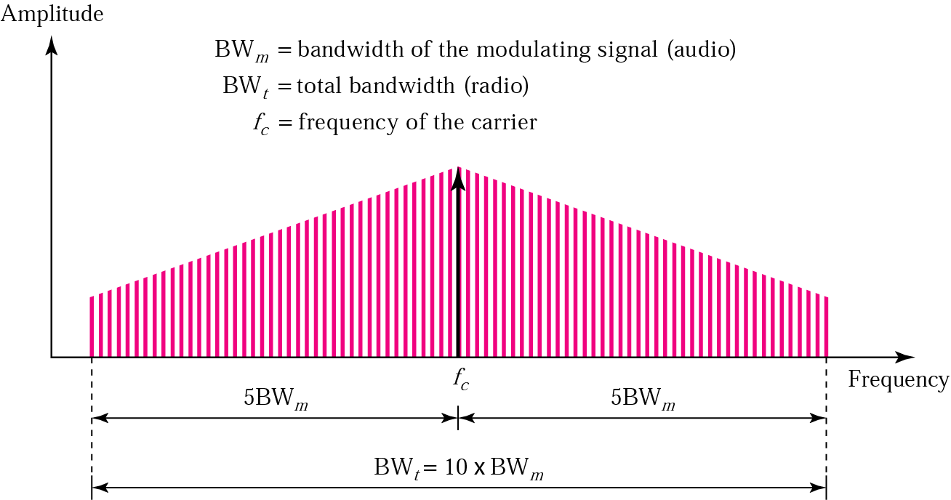
Figure 5.30 FM bandwidth

Slide 55
Note:
The bandwidth of a stereo audio signal is usually 15 KHz. Therefore, an FM station needs at least a bandwidth of 150 KHz. The FCC requires the minimum bandwidth to be at least 200 KHz (0.2 MHz).

Slide 56
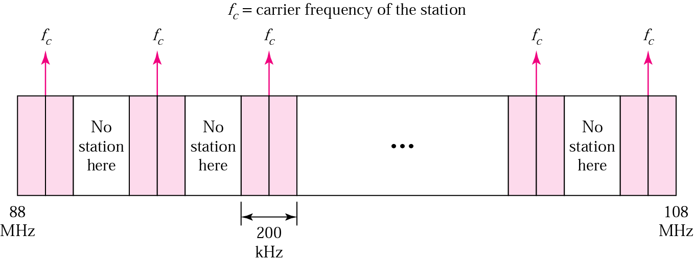
Figure 5.31 FM band allocation

Slide 57
Example 14
We have an audio signal with a bandwidth of 4 MHz. What is the bandwidth needed if we modulate the signal using FM? Ignore FCC regulations.
Solution
An FM signal requires 10 times the bandwidth of the original signal:
BW = 10 x 4 MHz = 40 MHz

