Slide 1
Chapter 27
HTTP
and
WWW

Slide 2
27.1 HTTP
Transaction
Request Message
Response Message
Headers

Slide 3

Note:
HTTP uses the services of TCP on well-known port 80.

Slide 4
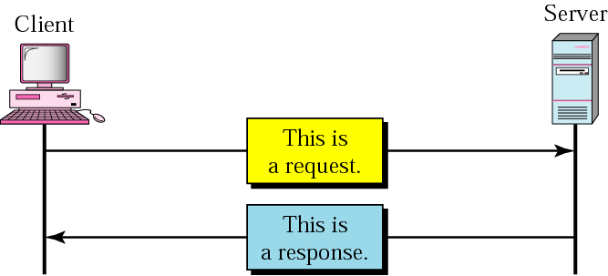
Figure 27.1 HTTP transaction

Slide 5
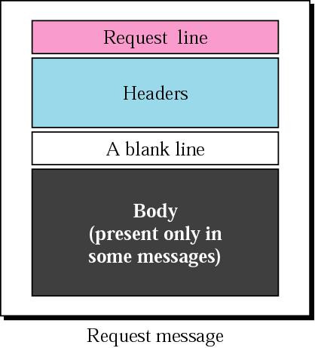
Figure 27.2 Request message

Slide 6
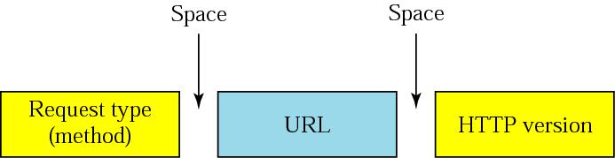
Figure 27.3 Request line

Slide 7
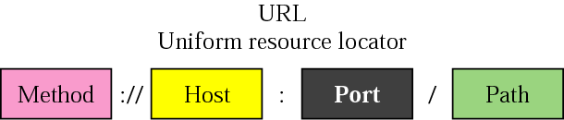
Figure 27.4 URL

Slide 8
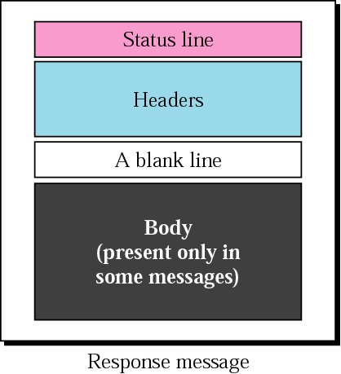
Figure 27.5 Response message

Slide 9
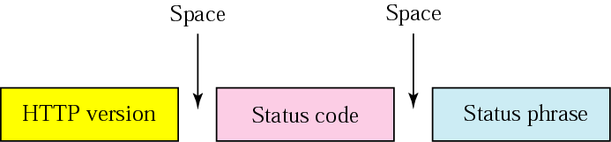
Figure 27.6 Status line

Slide 10
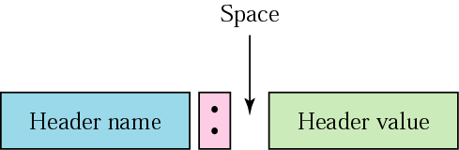
Figure 27.7 Header format

Slide 11
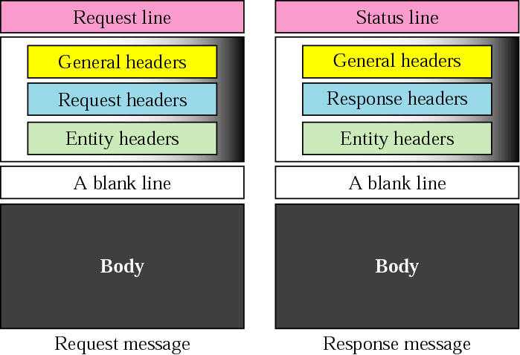
Figure 27.8 Headers

Slide 12
Example 1
This example retrieves a document. We use the GET method to retrieve an image with the path /usr/bin/image1. The request line shows the method (GET), the URL, and the HTTP version (1.1). The header has two lines that show that the client can accept images in GIF and JPEG format. The request does not have a body. The response message contains the status line and four lines of header. The header lines define the date, server, MIME version, and length of the document. The body of the document follows the header (see Fig. 27.9, next slide).

Slide 13
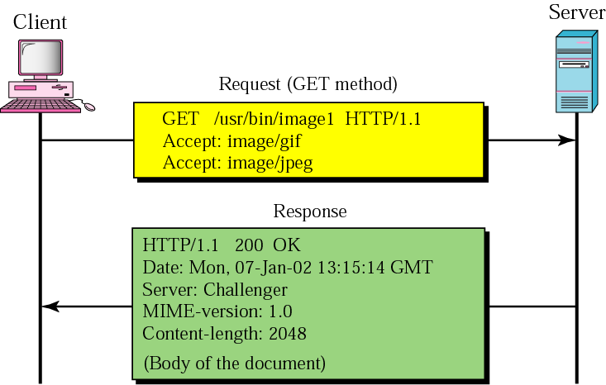
Figure 27.9 Example 1

Slide 14
Example 2
This example retrieves information about a document. We use the HEAD method to retrieve information about an HTML document (see the next section). The request line shows the method (HEAD), URL, and HTTP version (1.1). The header is one line showing that the client can accept the document in any format (wild card). The request does not have a body. The response message contains the status line and five lines of header. The header lines define the date, server, MIME version, type of document, and length of the document (see Fig. 27.10, next slide). Note that the response message does not contain a body.

Slide 15
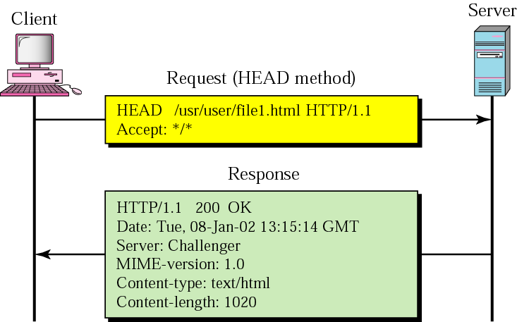
Figure 27.10 Example 2

Slide 16
Note:
HTTP version 1.1 specifies a persistent connection by default.

Slide 17
27.2 World Wide Web
Hypertext and Hypermedia
Browser Architecture
Static Document/HTML
Dynamic Document/CGI
Active Document/Java

Slide 18
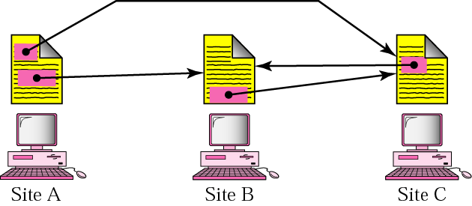
Figure 27.11 Distributed services

Slide 19
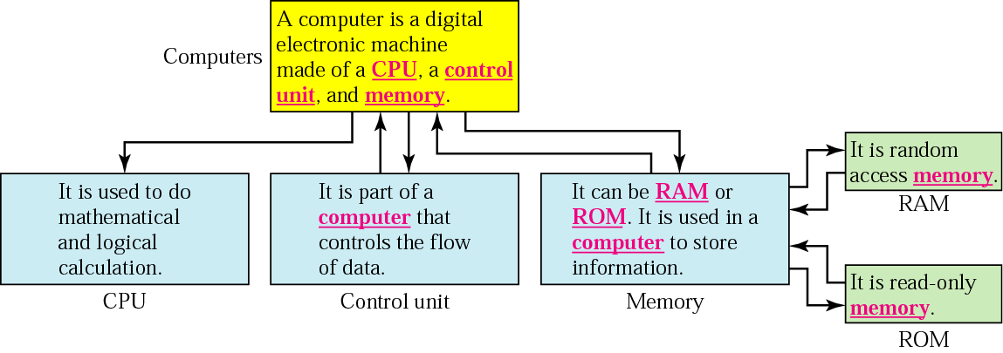
Figure 27.12 Hypertext

Slide 20
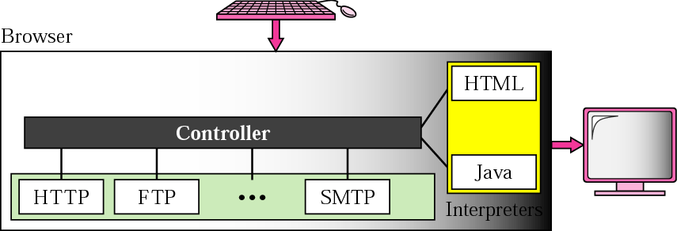
Figure 27.13 Browser architecture

Slide 21
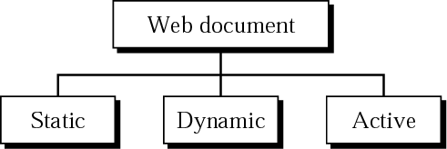
Figure 27.14 Categories of Web documents

Slide 22
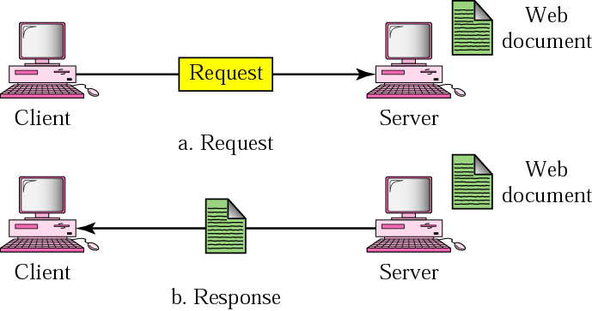
Figure 27.15 Static document

Slide 23
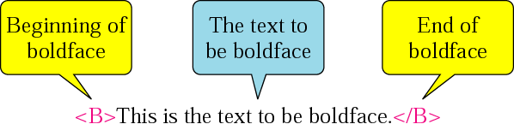
Figure 27.16 Boldface tags

Slide 24
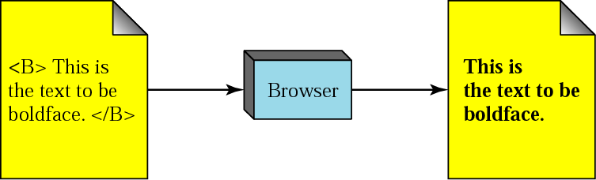
Figure 27.17 Effect of boldface tags

Slide 25
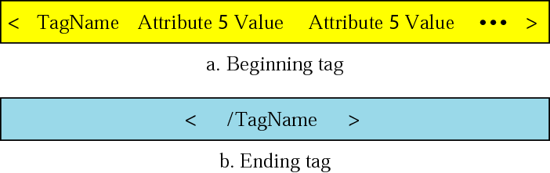
Figure 27.18 Beginning and ending tags

Slide 26
Table 27.1 Common tags
Beginning Tag | Ending Tag | Meaning
Skeletal Tags
<HTML> | </HTML> | Defines an HTML document
<HEAD> | </HEAD> | Defines the head of the document
<BODY> | </BODY> | Defines the body of the document
Title and Header Tags
<TITLE> | </TITLE> | Defines the title of the document
<Hn> | </Hn> | Defines the title of the document

Slide 27
Table 27.1 Common tags (continued)
Beginning Tag | Ending Tag | Meaning
Text Formatting Tags
<B> | </B> |  | Boldface
<I> | </I> |  | Italic
<U> | </U> |  | Underlined
<SUB> | </SUB> |  | Subscript
<SUP> | </SUP> |  | Superscript
Data Flow Tag
<CENTER> | </CENTER> |  | Centered
<BR> | </BR> |  | Line break

Slide 28
Table 27.1 Common tags (continued)
Beginning Tag | Ending Tag | Meaning
List Tags
<OL> | </OL> |  | Ordered list
<UL> | </UL> |  | Unordered list
<LI> | </LI> |  | An item in a list
Image Tag
<IMG> |  |  | Defines an image
Hyperlink Tag
<A> | </A> |  | Defines an address (hyperlink)
Executable Contents
<APPLET> | </APPLET> |  | The document is an applet

Slide 29
Example 3
This example shows how tags are used to let the browser format the appearance of the text.
<HTML>
<HEAD>
<TITLE> First Sample Document </TITLE>
</HEAD>
<BODY>
<CENTER>
<H1><B> ATTENTION </B></H1>
</CENTER>
You can get a copy of this document by:
<UL>
<LI> Writing to the publisher
<LI> Ordering online
<LI> Ordering through a bookstore
</UL>
</BODY>
</HTML>

Slide 30
Example 4
This example shows how tags are used to import an image and insert it into the text.
<HTML>
<HEAD>
<TITLE> Second Sample Document </TITLE>
</HEAD>
<BODY>
This is the picture of a book:
<IMG SRC="Pictures/book1.gif" ALIGN=MIDDLE>
</BODY>
</HTML>

Slide 31
Example 5
This example shows how tags are used to make a hyperlink to another document.
<HTML>
<HEAD>
<TITLE> Third Sample Document </TITLE>
</HEAD>
<BODY>
This is a wonderful product that can save you money and time.
To get information about the producer, click on
<A HREF="http://www.phony.producer">
Producer </A>
</BODY>
</HTML>

Slide 32
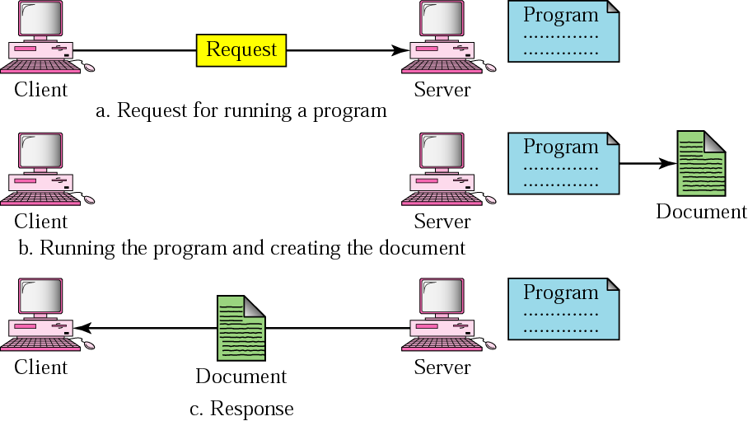
Figure 27.19 Dynamic document

Slide 33
Example 6
Example 6 is a CGI program written in Bourne shell script. The program accesses the UNIX utility (date) that returns the date and the time. Note that the program output is in plain text.
#!/bin/sh
# The head of the program
echo Content_type: text/plain
echo
# The body of the program
now='date'
echo $now
exit 0

Slide 34
Example 7
Example 7 is similar to Example 6 except that program output is in HTML.
#!/bin/sh
# The head of the program
echo Content_type: text/html
echo
# The body of the program
echo <HTML>
echo <HEAD><TITLE> Date and Time </TITLE></HEAD>
echo <BODY>
now='date'
echo <CENTER><B> $now </B></CENTER>
echo </BODY>
echo </HTML>
exit 0

Slide 35
Example 8
Example 8 is similar to Example 7 except that the program is written in Perl.
#!/bin/perl
# The head of the program
print "Content_type: text/html\n";
print "\n";
# The body of the program
print "<HTML>\n";
print "<HEAD><TITLE> Date and Time </TITLE></HEAD>\n";
print "<BODY>\n";
$now = 'date';
print "<CENTER><B> $now </B></CENTER>\n";
print "</BODY>\n";
print "</HTML>\n";
exit 0

Slide 36
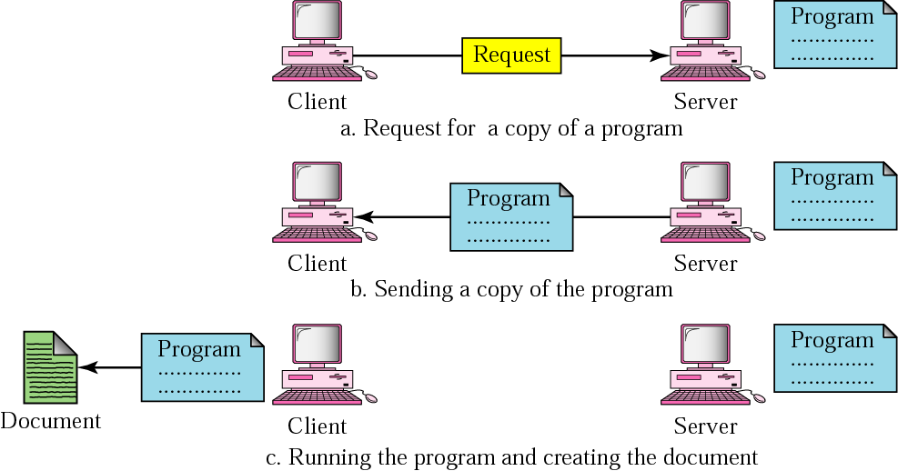
Figure 27.20 Active document

Slide 37
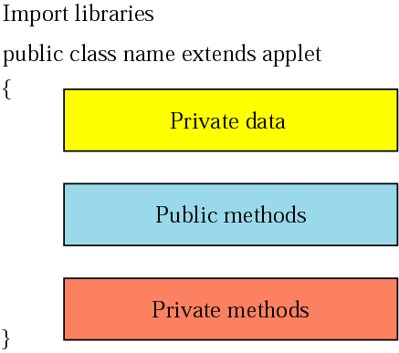
Figure 27.21 Skeleton of an applet

Slide 38
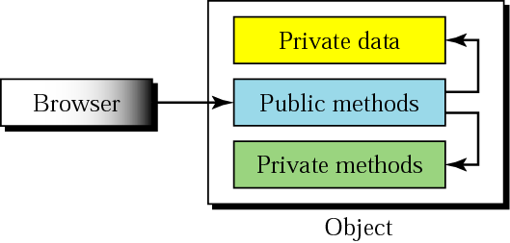
Figure 27.22 Instantiation of the object defined by an applet

Slide 39
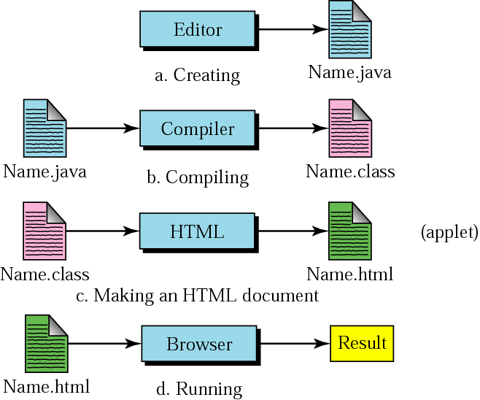
Figure 27.23 Creation and compilation

Slide 40
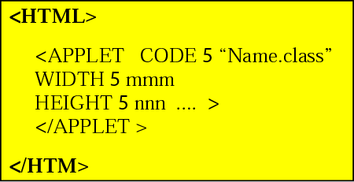
Figure 27.24 HTML document carrying an applet

Slide 41
Example 9
In this example, we first import two packages, java.awt and java.applet. They contain the declarations and definitions of classes and methods that we need. Our example uses only one publicly inherited class called First. We define only one public method, paint. The browser can access the instance of First through the public method paint. The paint method, however, calls another method called drawString, which is defined in java.awt.*.
import java.applet.*;
import java.awt.*;
public class First extends Applet
{
public void paint (Graphics g)
{
g.drawString ("Hello World", 100, 100);
}
}

Slide 42
Example 10
In this example, we modify the program in Example 9 to draw a line. Instead of method drawString, we use another method called drawLine. This method needs four parameters: the x and y coordinates at the beginning of the line and the x and y coordinates at the end of the line. We use 0, 0 for the beginning and 80, 90 for the end.
import java.applet.*;
import java.awt.*;
public class Second extends Applet
{
public void paint (Graphics g)
{
g.drawLine (0, 0, 80, 90);
}
}

