Slide 1
PART II
Physical Layer

Slide 2
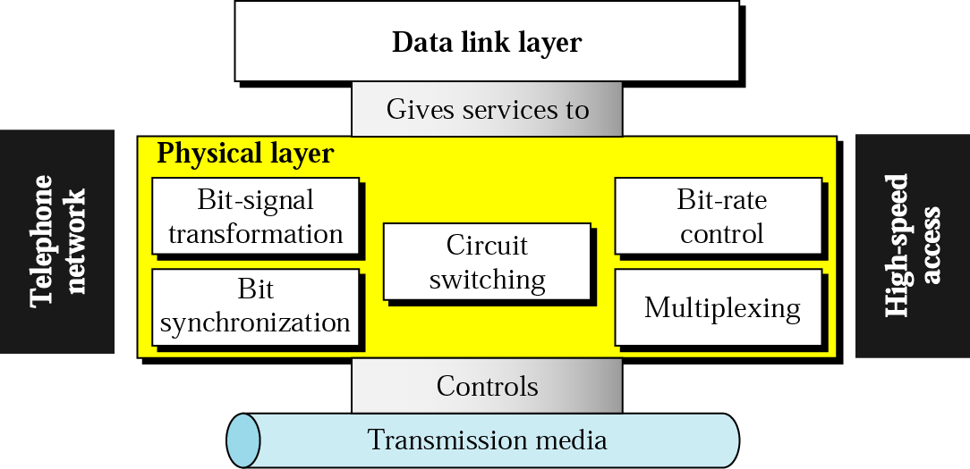
Position of the physical layer

Slide 3
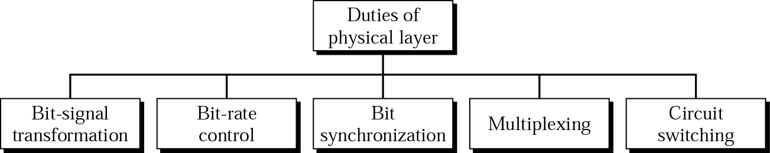
Services

Slide 4
Chapters
Chapter 3 Signals
Chapter 4 Digital Transmission
Chapter 5 Analog Transmission
Chapter 6 Multiplexing
Chapter 7 Transmission Media
Chapter 8 Circuit Switching and Telephone Network
Chapter 9 High Speed Digital Access

Slide 5
Chapter 3
Signals

Slide 6

Note:
To be transmitted, data must be transformed to electromagnetic signals.

Slide 7
3.1 Analog and Digital
Analog and Digital Data
Analog and Digital Signals
Periodic and Aperiodic Signals

Slide 8
Note:
Signals can be analog or digital. Analog signals can have an infinite number of values in a range; digital signals can have only a limited number of values.

Slide 9
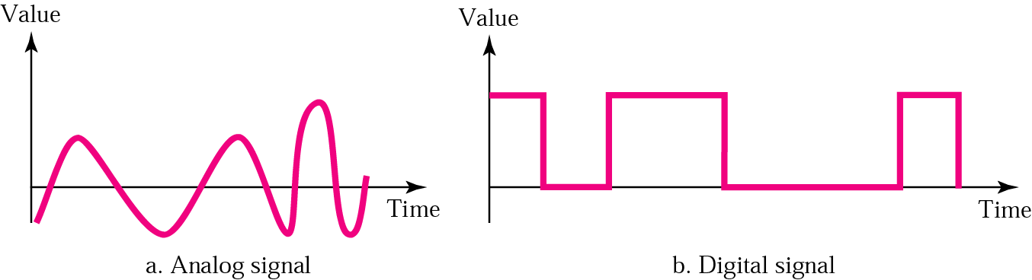
Figure 3.1 Comparison of analog and digital signals

Slide 10
Note:
In data communication, we commonly use periodic analog signals and aperiodic digital signals.

Slide 11
3.2 Analog Signals
Sine Wave
Phase
Examples of Sine Waves
Time and Frequency Domains
Composite Signals
Bandwidth

Slide 12
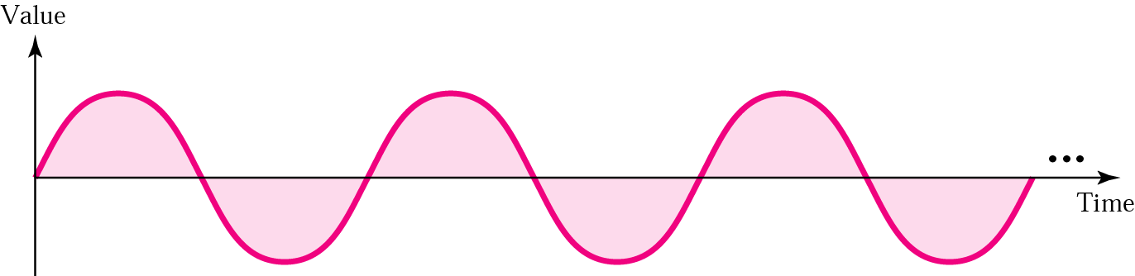
Figure 3.2 A sine wave

Slide 13
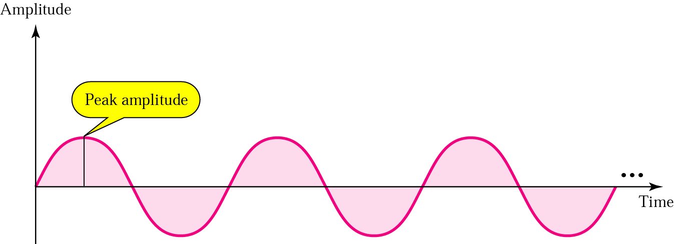
Figure 3.3 Amplitude

Slide 14
Note:
Frequency and period are inverses of each other.

Slide 15
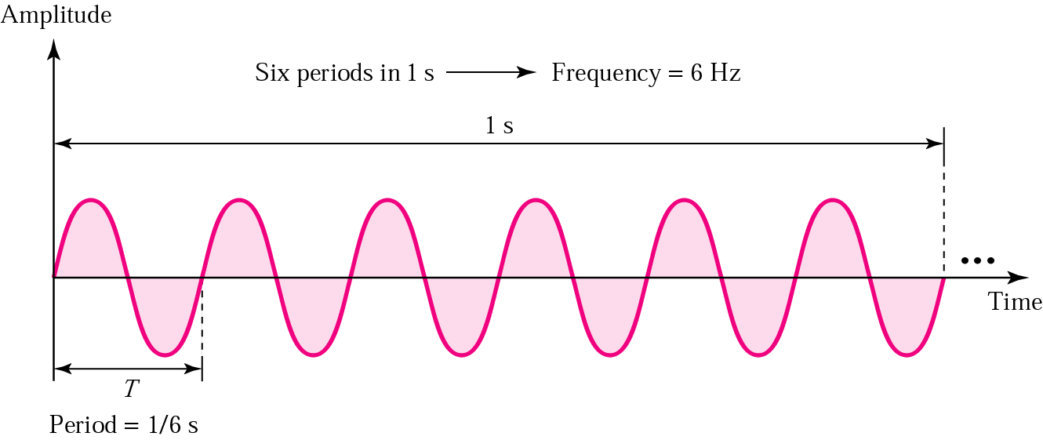
Figure 3.4 Period and frequency

Slide 16
Table 3.1 Units of periods and frequencies
Unit | Equivalent | Unit | Equivalent
Seconds (s) | 1 s | hertz (Hz) | 1 Hz
Milliseconds (ms) | 10^{–3} s | kilohertz (KHz) | 10³ Hz
Microseconds (ms) | 10^{–6} s | megahertz (MHz) | 10⁶ Hz
Nanoseconds (ns) | 10^{–9} s | gigahertz (GHz) | 10⁹ Hz
Picoseconds (ps) | 10^{–12} s | terahertz (THz) | 10¹² Hz

Slide 17
Example 1
Express a period of 100 ms in microseconds, and express the corresponding frequency in kilohertz.
Solution
From Table 3.1 we find the equivalent of 1 ms.We make the following substitutions:
100 ms = 100 × 10⁻³ s = 100 × 10⁻³ × 10⁶ μs = 10⁵ μs
Now we use the inverse relationship to find the frequency, changing hertz to kilohertz
100 ms = 100 × 10⁻³ s = 10⁻¹ s
f = 1/10⁻¹ Hz = 10 × 10⁻³ KHz = 10⁻² KHz

Slide 18
Note:
Frequency is the rate of change with respect to time. Change in a short span of time means high frequency. Change over a long span of time means low frequency.

Slide 19
Note:
If a signal does not change at all, its frequency is zero. If a signal changes instantaneously, its frequency is infinite.

Slide 20
Note:
Phase describes the position of the waveform relative to time zero.

Slide 21
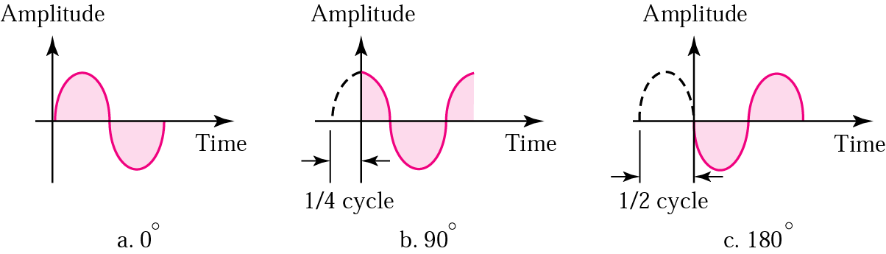
Figure 3.5 Relationships between different phases

Slide 22
Example 2
A sine wave is offset one-sixth of a cycle with respect to time zero. What is its phase in degrees and radians?
Solution
We know that one complete cycle is 360 degrees.
Therefore, 1/6 cycle is
(1/6) 360 = 60 degrees = 60 x 2π /360 rad = 1.046 rad

Slide 23
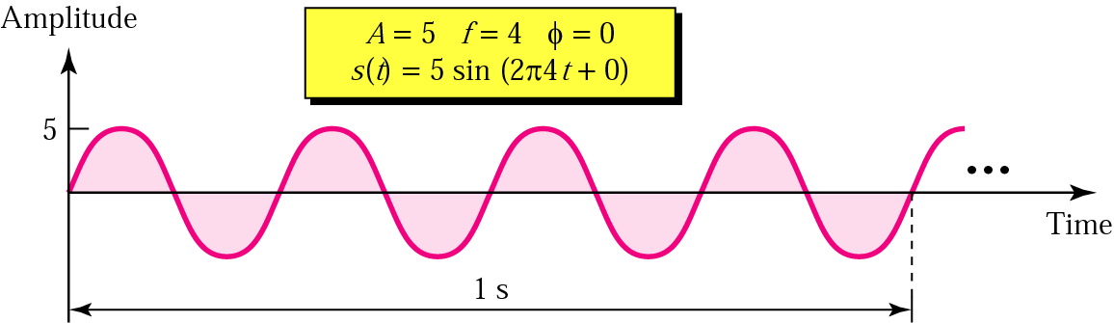
Figure 3.6 Sine wave examples

Slide 24
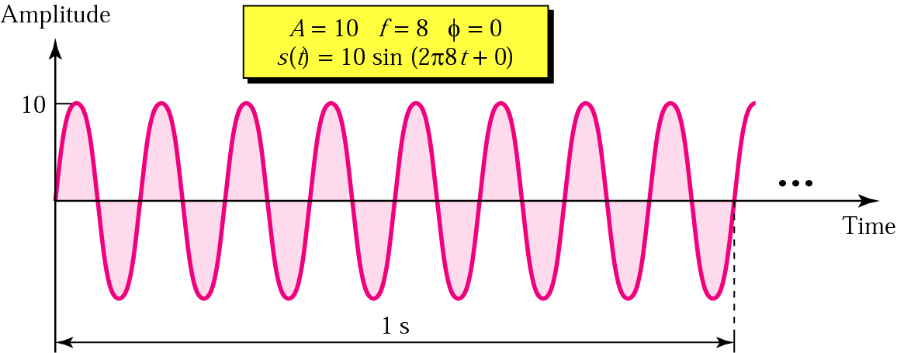
Figure 3.6 Sine wave examples (continued)

Slide 25
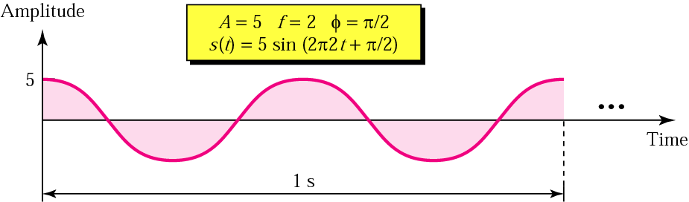
Figure 3.6 Sine wave examples (continued)

Slide 26
Note:
An analog signal is best represented in the frequency domain.

Slide 27
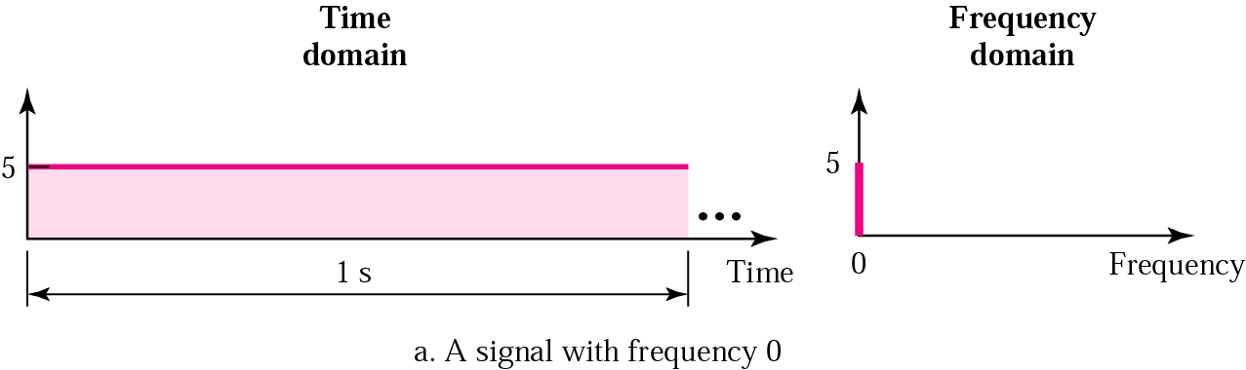
Figure 3.7 Time and frequency domains

Slide 28
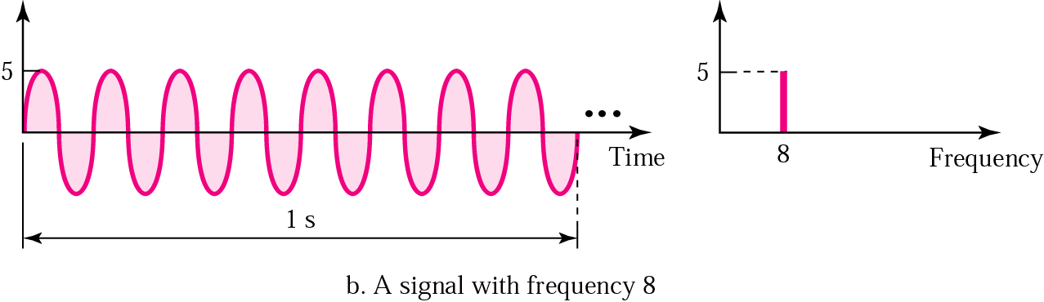
Figure 3.7 Time and frequency domains (continued)

Slide 29
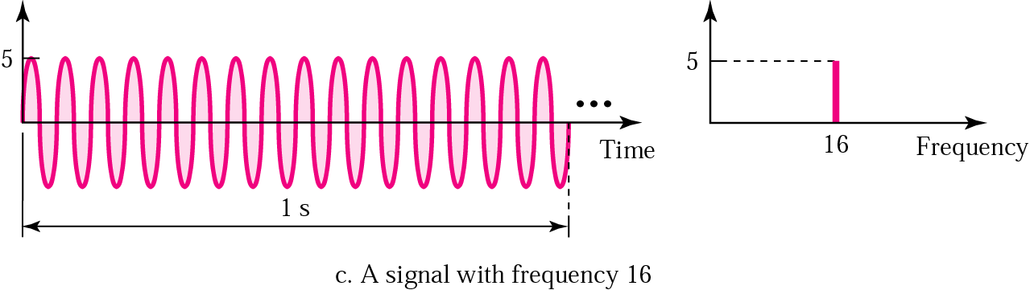
Figure 3.7 Time and frequency domains (continued)

Slide 30
Note:
A single-frequency sine wave is not useful in data communications; we need to change one or more of its characteristics to make it useful.

Slide 31
Note:
When we change one or more characteristics of a single-frequency signal, it becomes a composite signal made of many frequencies.

Slide 32
Note:
According to Fourier analysis, any composite signal can be represented as a combination of simple sine waves with different frequencies, phases, and amplitudes.

Slide 33
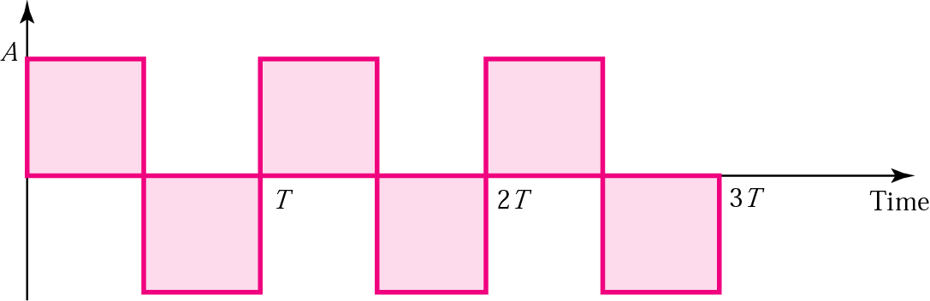
Figure 3.8 Square wave

Slide 34
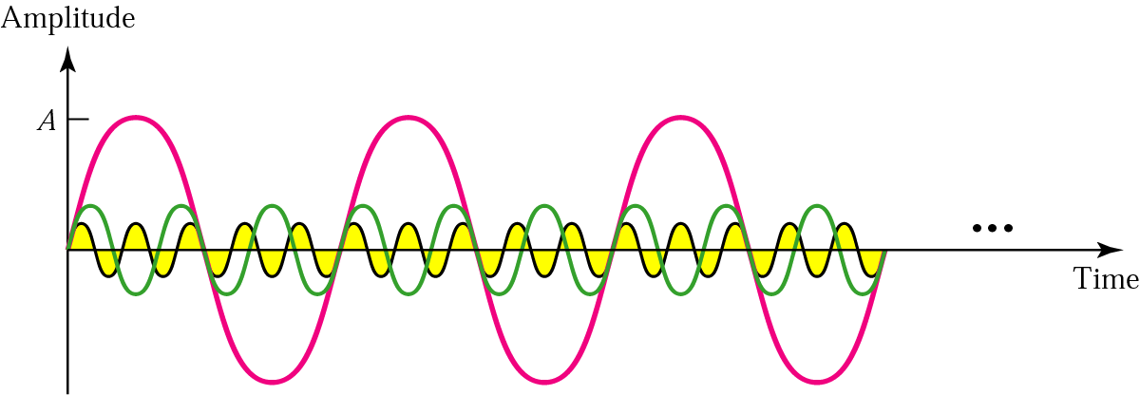
Figure 3.9 Three harmonics

Slide 35
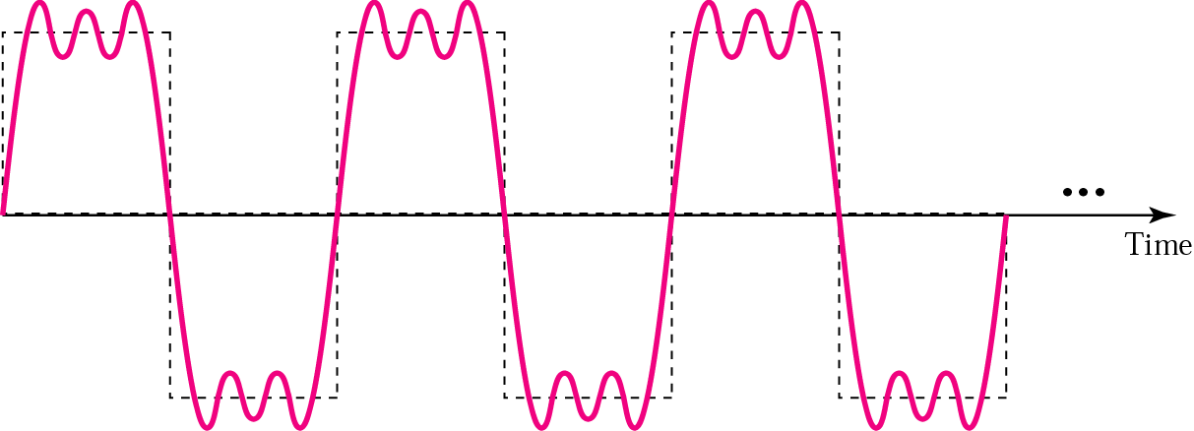
Figure 3.10 Adding first three harmonics

Slide 36
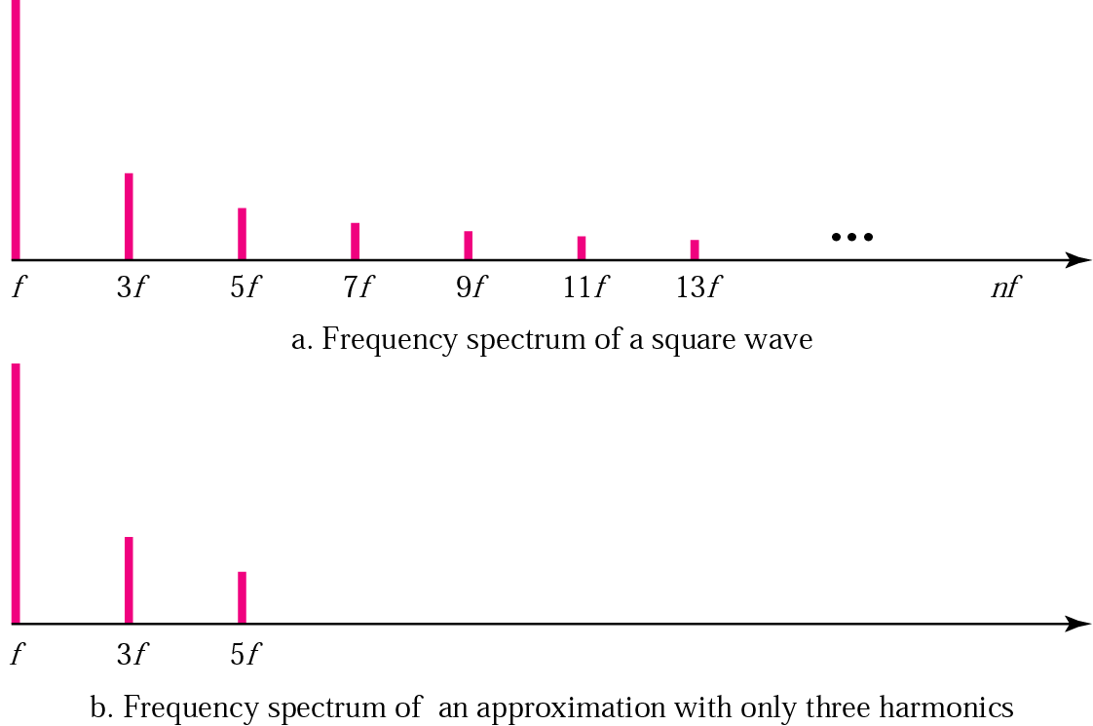
Figure 3.11 Frequency spectrum comparison

Slide 37
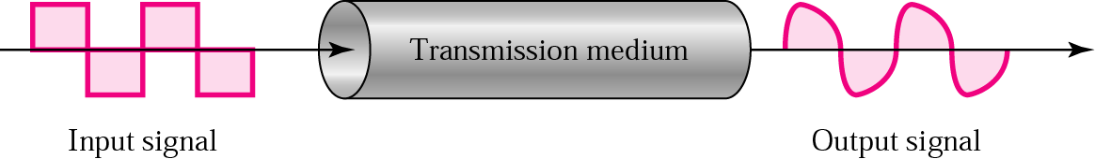
Figure 3.12 Signal corruption

Slide 38
Note:
The bandwidth is a property of a medium: It is the difference between the highest and the lowest frequencies that the medium can
satisfactorily pass.

Slide 39
Note:
In this book, we use the term bandwidth to refer to the property of a medium or the width of a single spectrum.

Slide 40
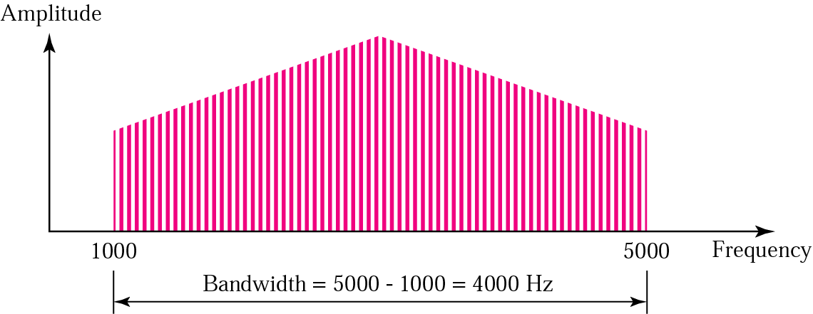
Figure 3.13 Bandwidth

Slide 41
Example 3
If a periodic signal is decomposed into five sine waves with frequencies of 100, 300, 500, 700, and 900 Hz, what is the bandwidth? Draw the spectrum, assuming all components have a maximum amplitude of 10 V.
Solution
B = f_{h} − f_{l} = 900 − 100 = 800 Hz
The spectrum has only five spikes, at 100, 300, 500, 700, and 900 (see Figure 13.4 )

Slide 42
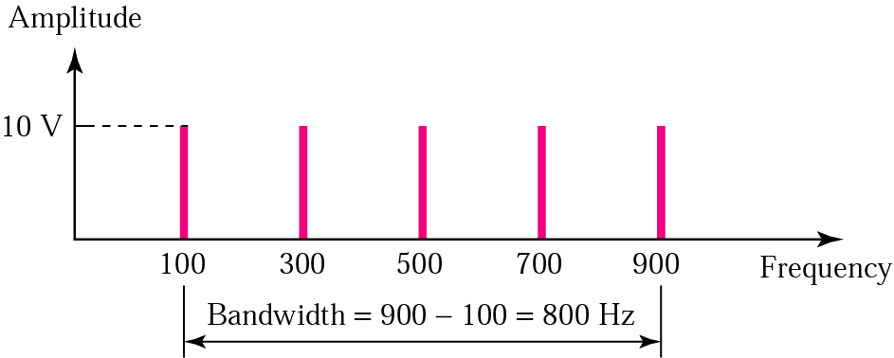
Figure 3.14 Example 3

Slide 43
Example 4
A signal has a bandwidth of 20 Hz. The highest frequency is 60 Hz. What is the lowest frequency? Draw the spectrum if the signal contains all integral frequencies of the same amplitude.
Solution
B = f_{h} − f_{l}
20 = 60 − f_{l}
f_{l} = 60 − 20 = 40 Hz

Slide 44
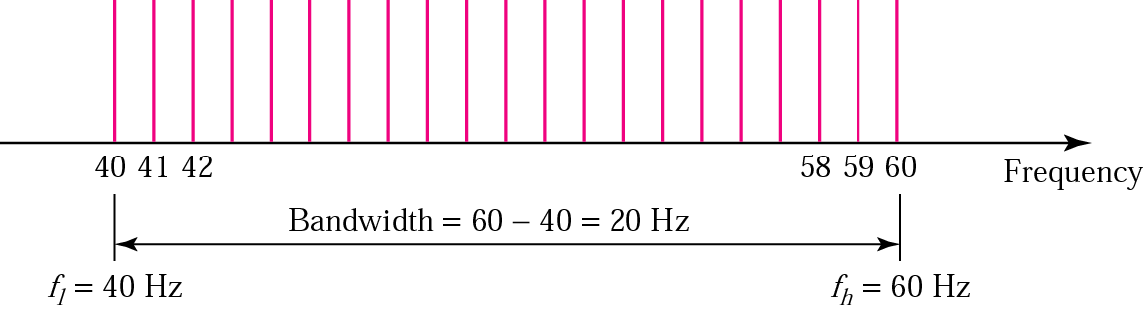
Figure 3.15 Example 4

Slide 45
Example 5
A signal has a spectrum with frequencies between 1000 and 2000 Hz (bandwidth of 1000 Hz). A medium can pass frequencies from 3000 to 4000 Hz (a bandwidth of 1000 Hz). Can this signal faithfully pass through this medium?
Solution
The answer is definitely no. Although the signal can have the same bandwidth (1000 Hz), the range does not overlap. The medium can only pass the frequencies between 3000 and 4000 Hz; the signal is totally lost.

Slide 46
3.3 Digital Signals
Bit Interval and Bit Rate
As a Composite Analog Signal
Through Wide-Bandwidth Medium
Through Band-Limited Medium
Versus Analog Bandwidth
Higher Bit Rate

Slide 47
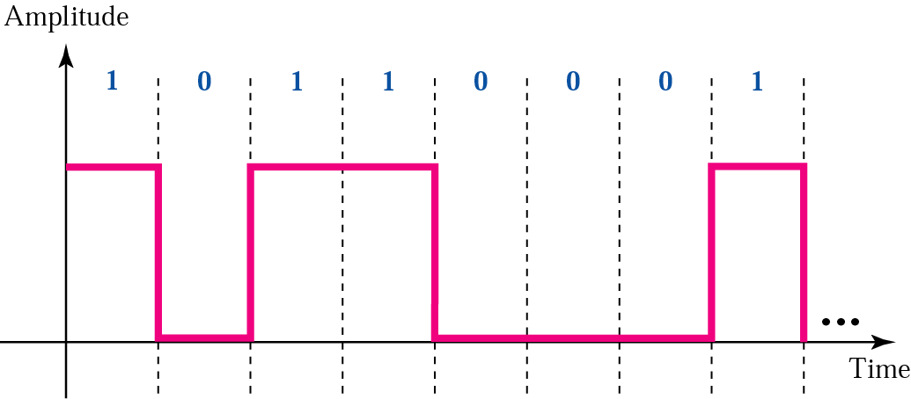
Figure 3.16 A digital signal

Slide 48
Example 6
A digital signal has a bit rate of 2000 bps. What is the duration of each bit (bit interval)
Solution
The bit interval is the inverse of the bit rate.
Bit interval = 1/ 2000 s = 0.000500 s
= 0.000500 x 10⁶ μs = 500 μs

Slide 49
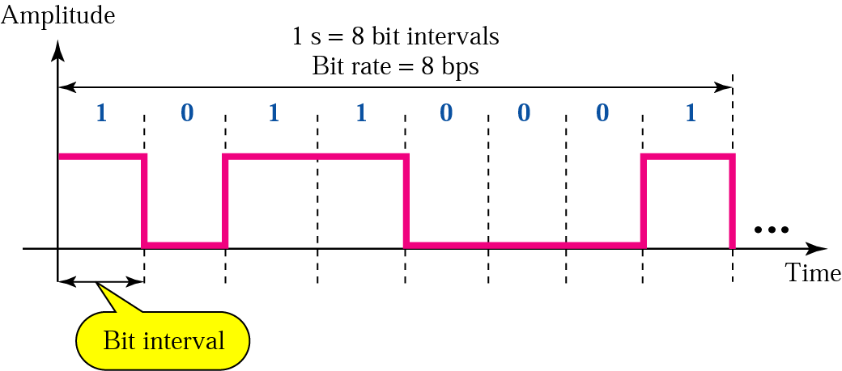
Figure 3.17 Bit rate and bit interval

Slide 50
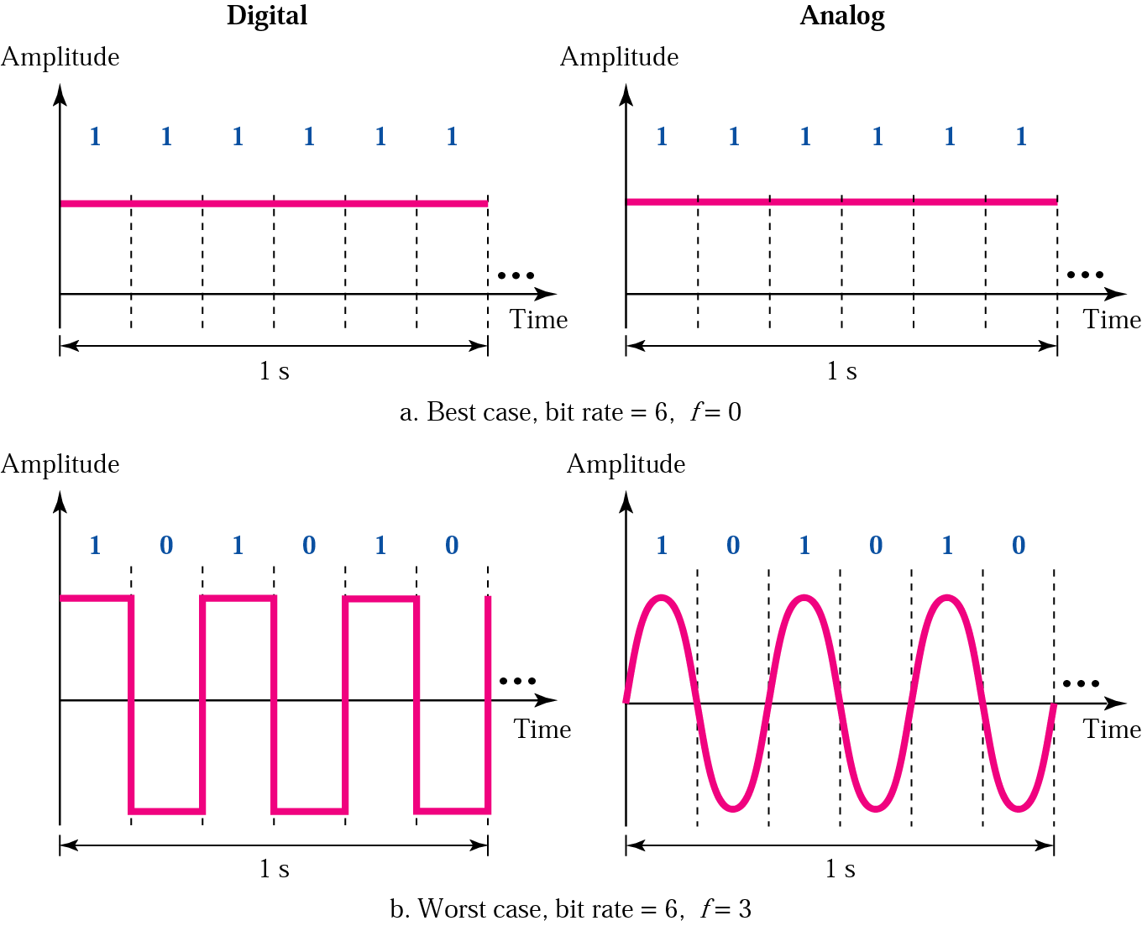
Figure 3.18 Digital versus analog

Slide 51
Note:
A digital signal is a composite signal with an infinite bandwidth.

Slide 52
Table 3.12 Bandwidth Requirement
Bit Rate | Harmonic 1 | Harmonics 1, 3 | Harmonics 1, 3, 5 | Harmonics 1, 3, 5, 7
1 Kbps | 500 Hz | 2 KHz | 4.5 KHz | 8 KHz
10 Kbps | 5 KHz | 20 KHz | 45 KHz | 80 KHz
100 Kbps | 50 KHz | 200 KHz | 450 KHz | 800 KHz

Slide 53
Note:
The bit rate and the bandwidth are proportional to each other.

Slide 54
3.4 Analog versus Digital
Low-pass versus Band-pass
Digital Transmission
Analog Transmission

Slide 55
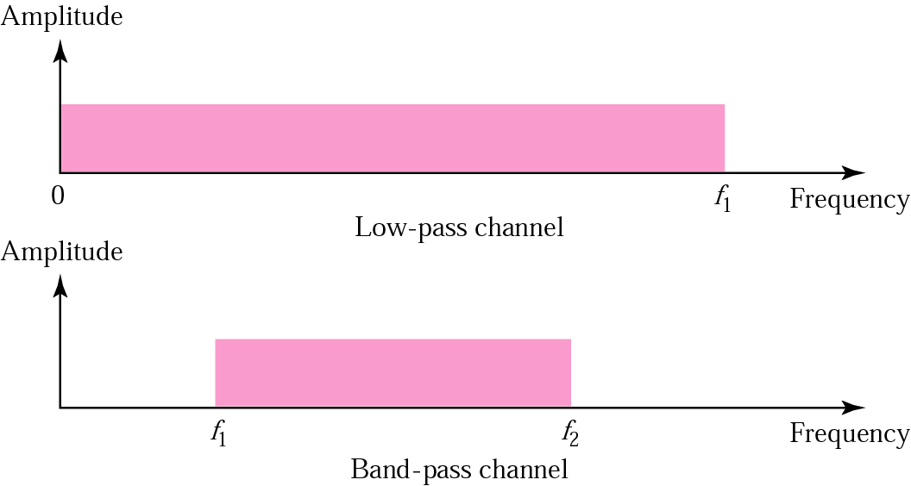
Figure 3.19 Low-pass and band-pass

Slide 56
Note:
The analog bandwidth of a medium is expressed in hertz; the digital bandwidth, in bits per second.

Slide 57
Note:
Digital transmission needs a
low-pass channel.

Slide 58
Note:
Analog transmission can use a band-pass channel.

Slide 59
3.5 Data Rate Limit
Noiseless Channel: Nyquist Bit Rate
Noisy Channel: Shannon Capacity
Using Both Limits

Slide 60
Example 7
Consider a noiseless channel with a bandwidth of 3000 Hz transmitting a signal with two signal levels. The maximum bit rate can be calculated as
Bit Rate = 2 × 3000 × log₂ 2 = 6000 bps

Slide 61
Example 8
Consider the same noiseless channel, transmitting a signal with four signal levels (for each level, we send two bits). The maximum bit rate can be calculated as:
Bit Rate = 2 x 3000 x log₂ 4 = 12,000 bps

Slide 62
Example 9
Consider an extremely noisy channel in which the value of the signal-to-noise ratio is almost zero. In other words, the noise is so strong that the signal is faint. For this channel the capacity is calculated as
C = B log₂ (1 + SNR) = B log₂ (1 + 0)
= B log₂ (1) = B × 0 = 0

Slide 63
Example 10
We can calculate the theoretical highest bit rate of a regular telephone line. A telephone line normally has a bandwidth of 3000 Hz (300 Hz to 3300 Hz). The signal-to-noise ratio is usually 3162. For this channel the capacity is calculated as
C = B log₂ (1 + SNR) = 3000 log₂ (1 + 3162)
= 3000 log₂ (3163)
C = 3000 × 11.62 = 34,860 bps

Slide 64
Example 11
We have a channel with a 1 MHz bandwidth. The SNR for this channel is 63; what is the appropriate bit rate and signal level?
Solution
First, we use the Shannon formula to find our upper limit.
C = B log₂ (1 + SNR) = 10⁶ log₂ (1 + 63) = 10⁶ log₂ (64) = 6 Mbps
Then we use the Nyquist formula to find the
number of signal levels.
4 Mbps = 2 × 1 MHz × log₂ L ➔ L = 4

Slide 65
3.6 Transmission Impairment
Attenuation
Distortion
Noise

Slide 66
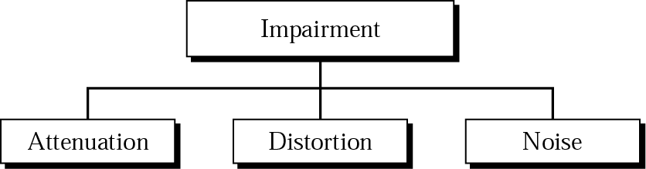
Figure 3.20 Impairment types

Slide 67
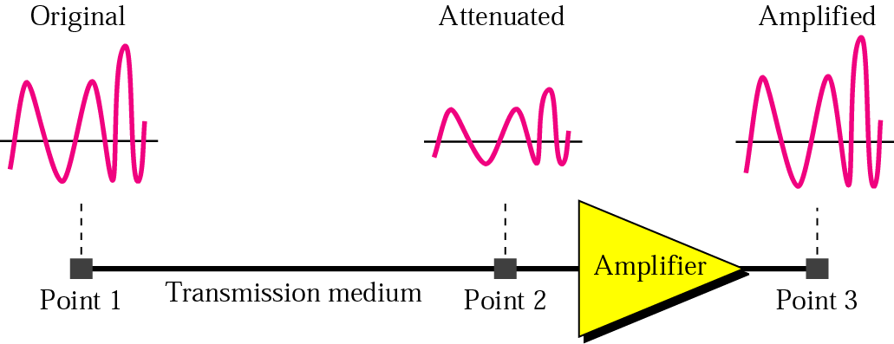
Figure 3.21 Attenuation

Slide 68
Example 12
Imagine a signal travels through a transmission medium and its power is reduced to half. This means that P2 = 1/2 P1. In this case, the attenuation (loss of power) can be calculated as
Solution
10 log₁₀ (P2/P1) = 10 log₁₀ (0.5P1/P1) = 10 log₁₀ (0.5)
= 10(–0.3) = –3 dB

Slide 69
Example 13
Imagine a signal travels through an amplifier and its power is increased ten times. This means that P2 = 10 ¥ P1. In this case, the amplification (gain of power) can be calculated as
10 log₁₀ (P2/P1) = 10 log₁₀ (10P1/P1)
= 10 log₁₀ (10) = 10 (1) = 10 dB

Slide 70
Example 14
One reason that engineers use the decibel to measure the changes in the strength of a signal is that decibel numbers can be added (or subtracted) when we are talking about several points instead of just two (cascading). In Figure 3.22 a signal travels a long distance from point 1 to point 4. The signal is attenuated by the time it reaches point 2. Between points 2 and 3, the signal is amplified. Again, between points 3 and 4, the signal is attenuated. We can find the resultant decibel for the signal just by adding the decibel measurements between each set of points.

Slide 71
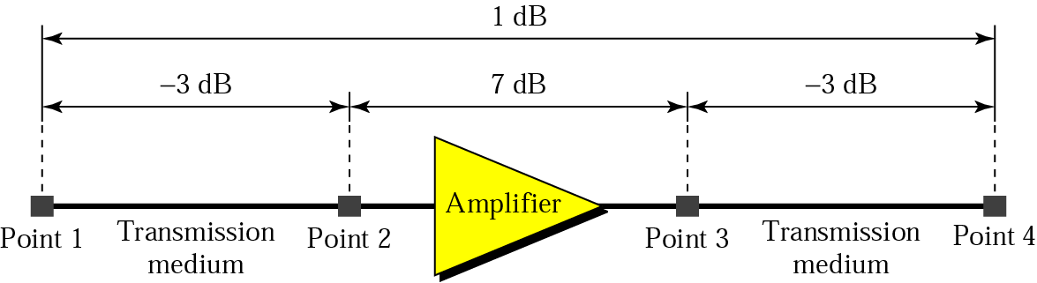
Figure 3.22 Example 14
dB = –3 + 7 – 3 = +1

Slide 72
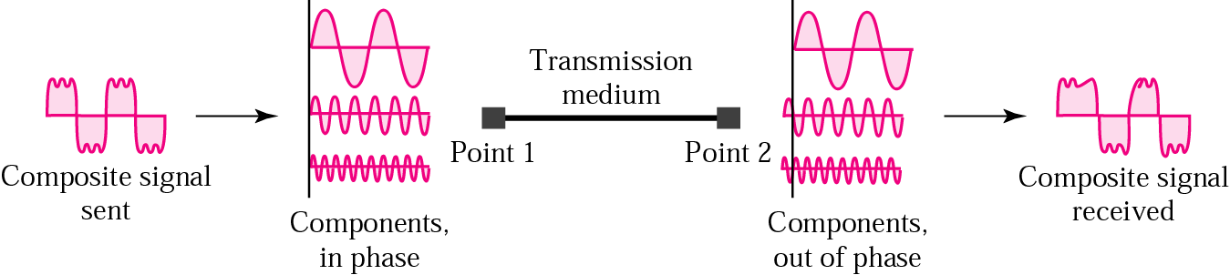
Figure 3.23 Distortion

Slide 73
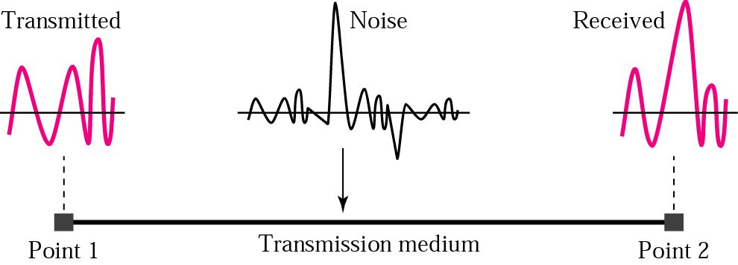
Figure 3.24 Noise

Slide 74
3.7 More About Signals
Throughput
Propagation Speed
Propagation Time
Wavelength

Slide 75
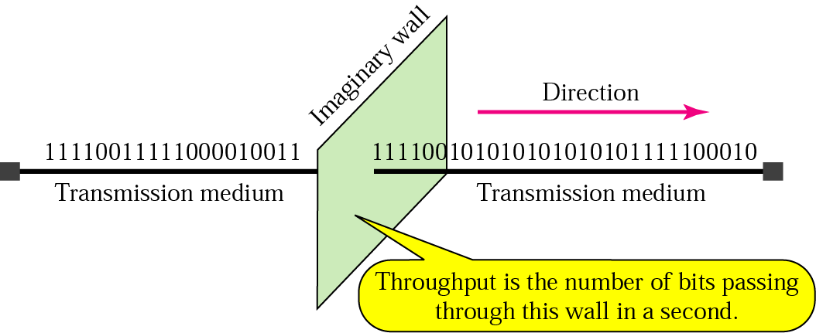
Figure 3.25 Throughput

Slide 76
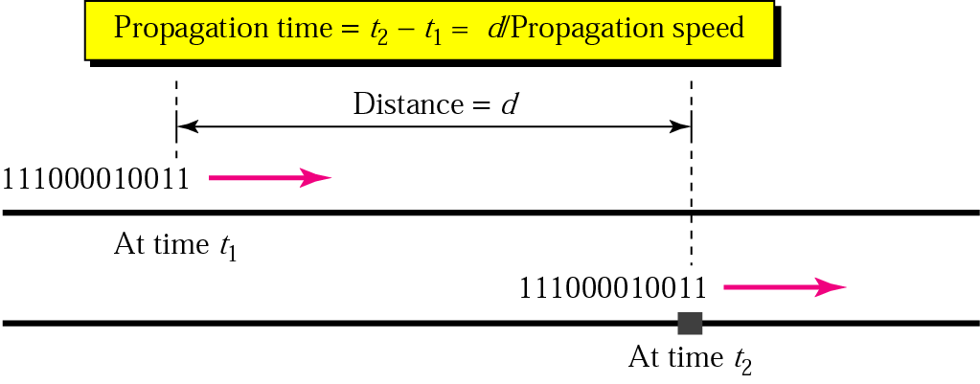
Figure 3.26 Propagation time

Slide 77
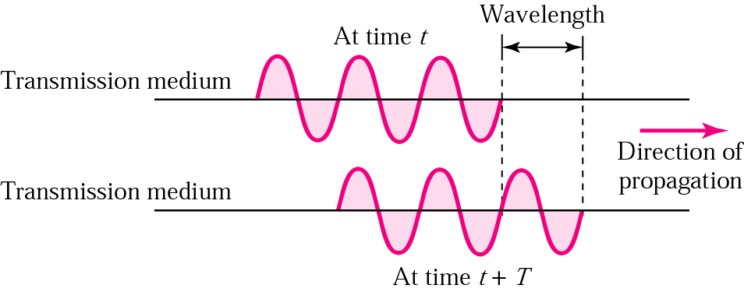
Figure 3.27 Wavelength

