Slide 1
Chapter 26
SMTP
and
FTP

Slide 2
26.1 Electronic Mail
Sending/Receiving Mail
Addresses
User Agent
MIME
Mail Transfer Agent
Mail Access Protocols

Slide 3
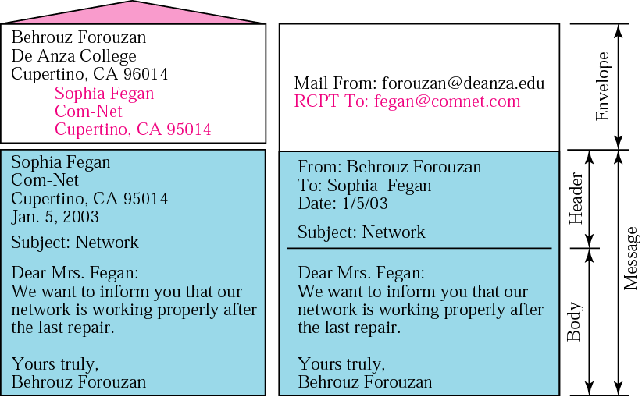
Figure 26.1 Format of an email

Slide 4
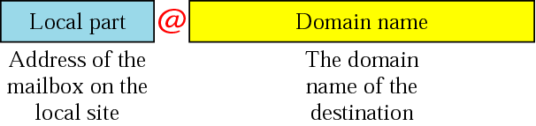
Figure 26.2 Email address

Slide 5
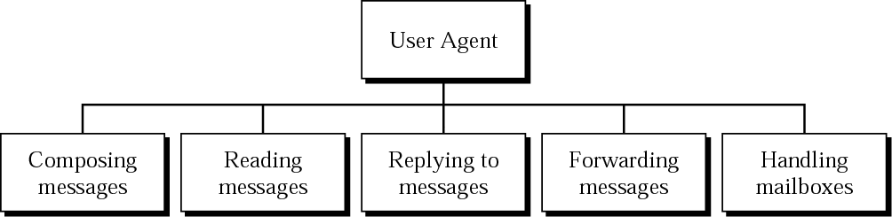
Figure 26.3 User agent

Slide 6

Note:
Some examples of command-driven user agents are mail, pine, and elm.

Slide 7
Note:
Some examples of GUI-based user agents are Eudora, Outlook, and Netscape.

Slide 8
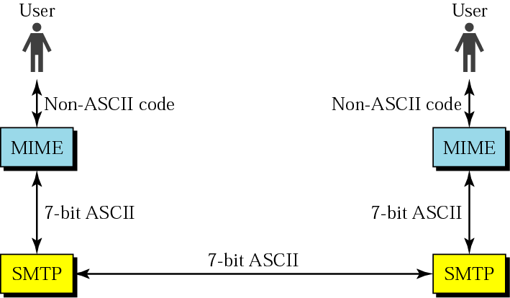
Figure 26.4 MIME

Slide 9
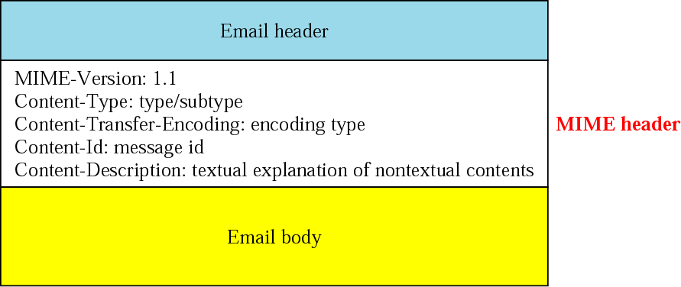
Figure 26.5 MIME header

Slide 10
Table 26.1 Data types and subtypes in MIME
Type | Subtype | Description
Text | Plain | Unformatted text
Multiport | Mixed | Body contains ordered parts of different data types
 | Parallel | Same as above, but no order
 | Digest | Similar to mixed, but the default is message/RFC822
 | Alternative | Parts are different versions of the same message
Message | RFC822 | Body is an encapsulated message
 | Partial | Body is a fragment of a bigger message
 | Ext. Body | Body is a reference to another message
Image | JPEG | Image is in JPEG
 | GIF | Video is in GIF format
Video | MPEG | Video is in MPEG format
Audio | Basic | Single-channel encoding of voice at 8 KHz
Application | PostScript | Adobe PostScript
 | Octet-Stream | General binary data (8-bit bytes)

Slide 11
Table 26.2 Content-transfer encoding
Category | Description
Type | ASCII characters and short lines
7bit | Non-ASCII characters and short lines
8bit | Non-ASCII characters with unlimited-length lines
Binary | 6-bit blocks of data are encoded into 8-bit ASCII characters
Base64 | Non-ASCII characters are encoded as an equal sign followed by an ASCII code

Slide 12
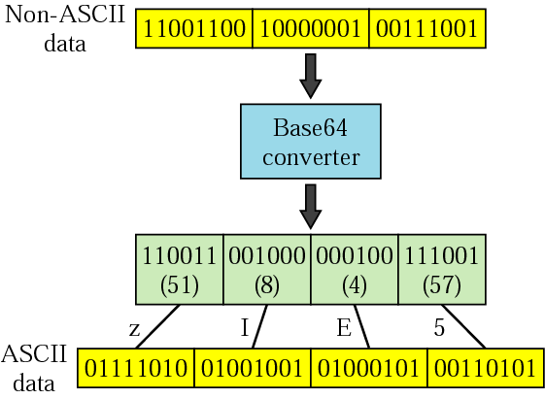
Figure 26. 6 Base64

Slide 13
Table 26.3 Base64 encoding table
Value | Code | Value | Code | Value | Code | Value | Code | Value | Code | Value | Code
0 | A | 11 | L | 22 | W | 33 | h | 44 | s | 55 | 3
1 | B | 12 | M | 23 | X | 34 | i | 45 | t | 56 | 4
2 | C | 13 | N | 24 | Y | 35 | j | 46 | u | 57 | 5
3 | D | 14 | O | 25 | Z | 36 | k | 47 | v | 58 | 6
4 | E | 15 | P | 26 | a | 37 | l | 48 | w | 59 | 7
5 | F | 16 | Q | 27 | b | 38 | m | 49 | x | 60 | 8
6 | G | 17 | R | 28 | c | 39 | n | 50 | y | 61 | 9
7 | H | 18 | S | 29 | d | 40 | o | 51 | z | 62 | +
8 | I | 19 | T | 30 | e | 41 | p | 52 | 0 | 63 | /
9 | J | 20 | U | 31 | f | 42 | q | 53 | 1
10 | K | 21 | V | 32 | g | 43 | r | 54 | 2

Slide 14
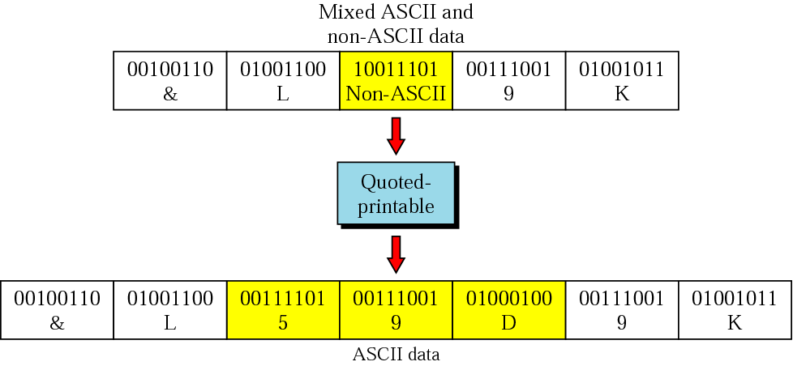
Figure 26.7 Quoted-printable

Slide 15
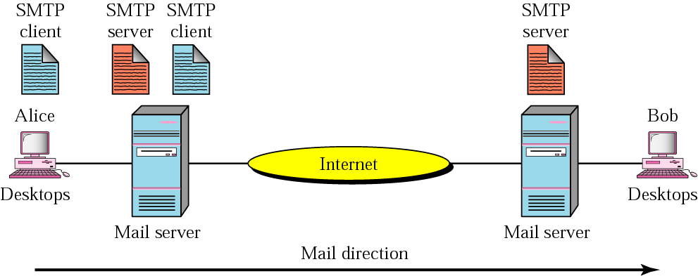
Figure 26.8 MTA client and server

Slide 16

Figure 26.9 Commands and responses

Slide 17
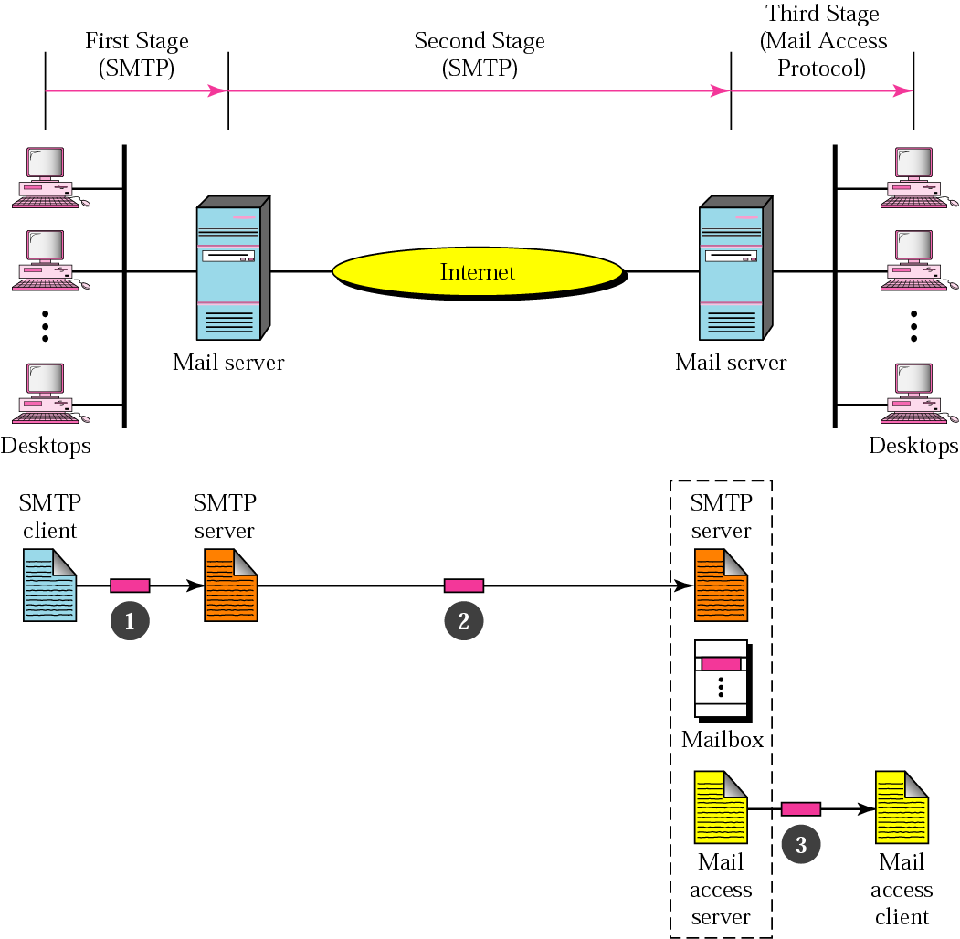
Figure 26.10 Email delivery

Slide 18
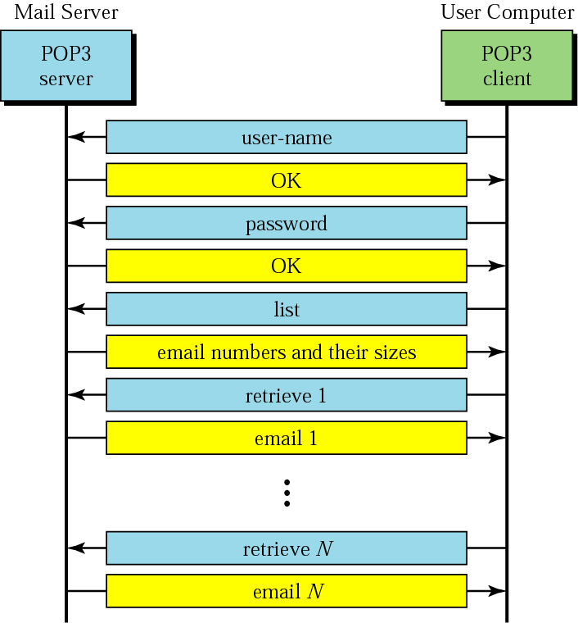
Figure 26.11 POP3

Slide 19
26.2 File Transfer
Connections
Communication
File Transfer
User Interface
Anonymous

Slide 20
Note:
FTP uses the services of TCP. It needs two TCP connections. The well-known port 21 is used for the control connection, and the well-known port 20 is used for the data connection.

Slide 21
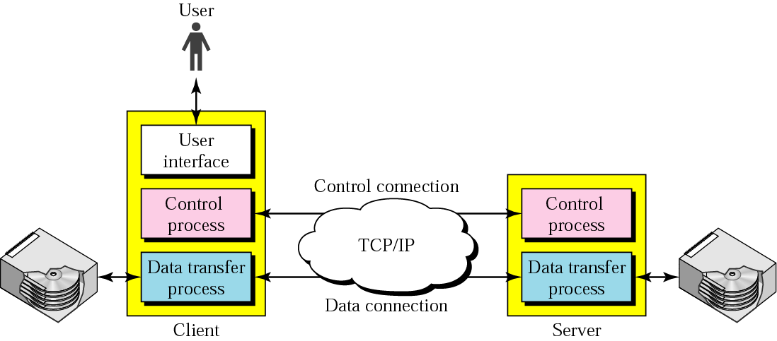
Figure 26.12 FTP

Slide 22
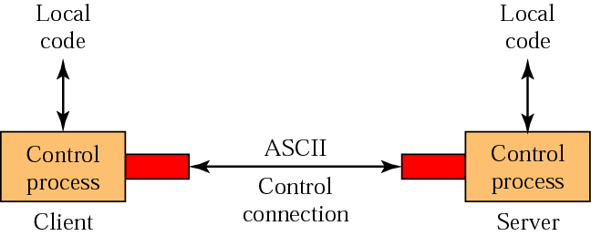
Figure 26.13 Using the control connection

Slide 23
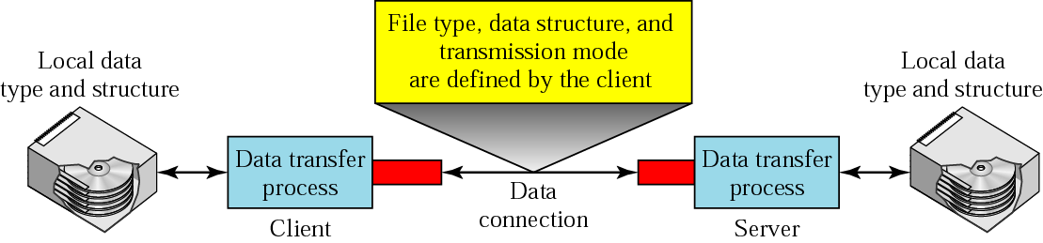
Figure 26.14 Using the data connection

Slide 24
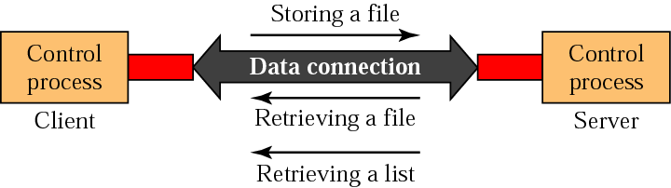
Figure 26.15 File transfer

Slide 25
Example 1
Figure 26.16 (next slide) shows an example of how a file is stored.
The control connection is created, and several control commands and responses are exchanged.
Data are transferred record by record.
A few commands and responses are exchanged to close the connection.

Slide 26
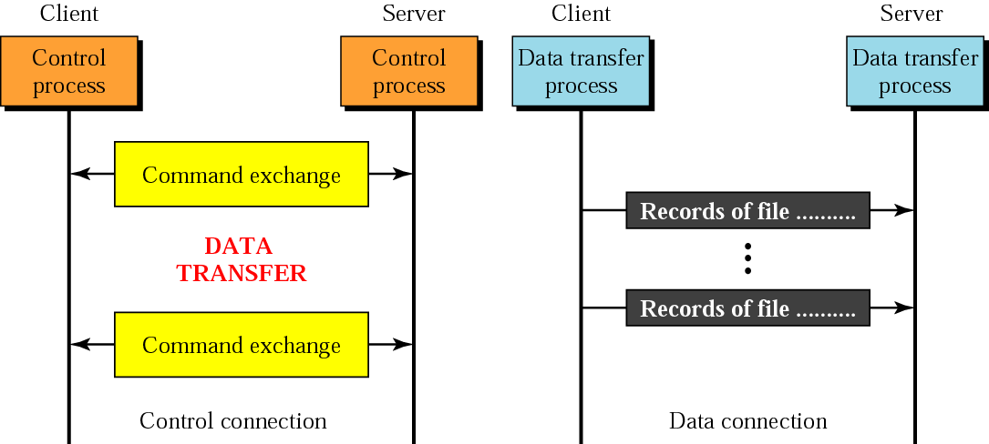
Figure 26.16 Example 1

Slide 27
Table 26.4 List of FTP commands in UNIX
Commands
!, $, account, append, ascii, bell, binary, bye, case, cd, cdup, close, cr, delete, debug, dir, discount, form, get, glob, hash, help, lcd, ls, macdef, mdelete, mdir, mget, mkdir, mls, mode, mput, nmap, ntrans, open, prompt, proxy, sendport, put, pwd, quit, quote, recv, remotehelp, rename, reset, rmdir, runique, send, status, struct, sunique, tenex, trace, type, user, verbose,?

Slide 28
Example 2
We show some of the user interface commands that accomplish the same task as in Example 1. The user input is shown in boldface. As shown below, some of the commands are provided automatically by the interface. The user receives a prompt and provides only the arguments.
$ ftp challenger.atc.fhda.edu
Connected to challenger.atc.fhda.edu
220 Server ready
Name: forouzan
Password: xxxxxxx
ftp > ls /usr/user/report
200 OK
150 Opening ASCII mode
...........
...........
226 transfer complete
ftp > close
221 Goodbye
ftp > quit

Slide 29
Example 3
We show an example of using anonymous FTP. We connect to internic.net, where we assume there are some public data available.
$ ftp internic.net
Connected to internic.net
220 Server ready
Name: anonymous
331 Guest login OK, send "guest" as password
Password: guest
ftp > pwd
257 '/' is current directory
ftp > ls
200 OK
150 Opening ASCII mode
bin
...
ftp > close
221 Goodbye
ftp > quit

