Slide 1
Chapter 15
Wireless
LANs

Slide 2
15.1 IEEE 802.11
Architecture
Physical Layer
MAC Layer
Addressing Mechanism

Slide 3
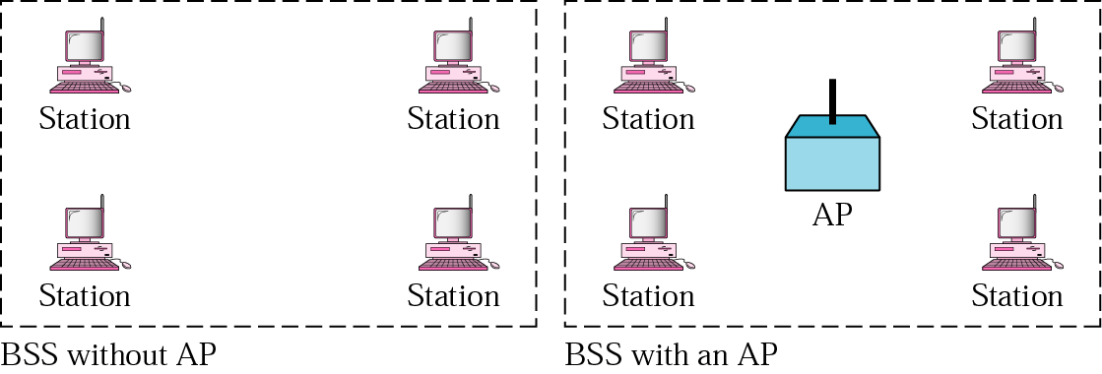
Figure 15.1 BSSs

Slide 4
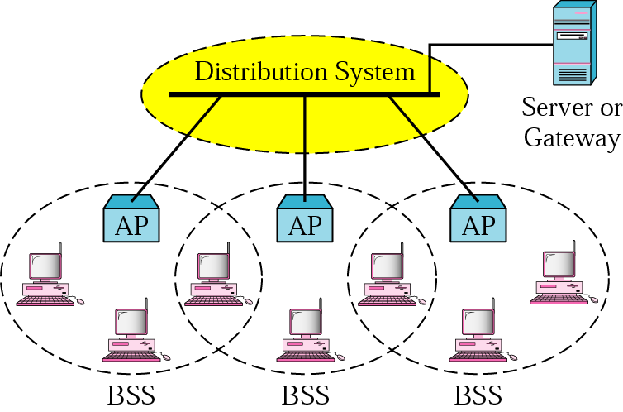
Figure 15.2 ESS

Slide 5
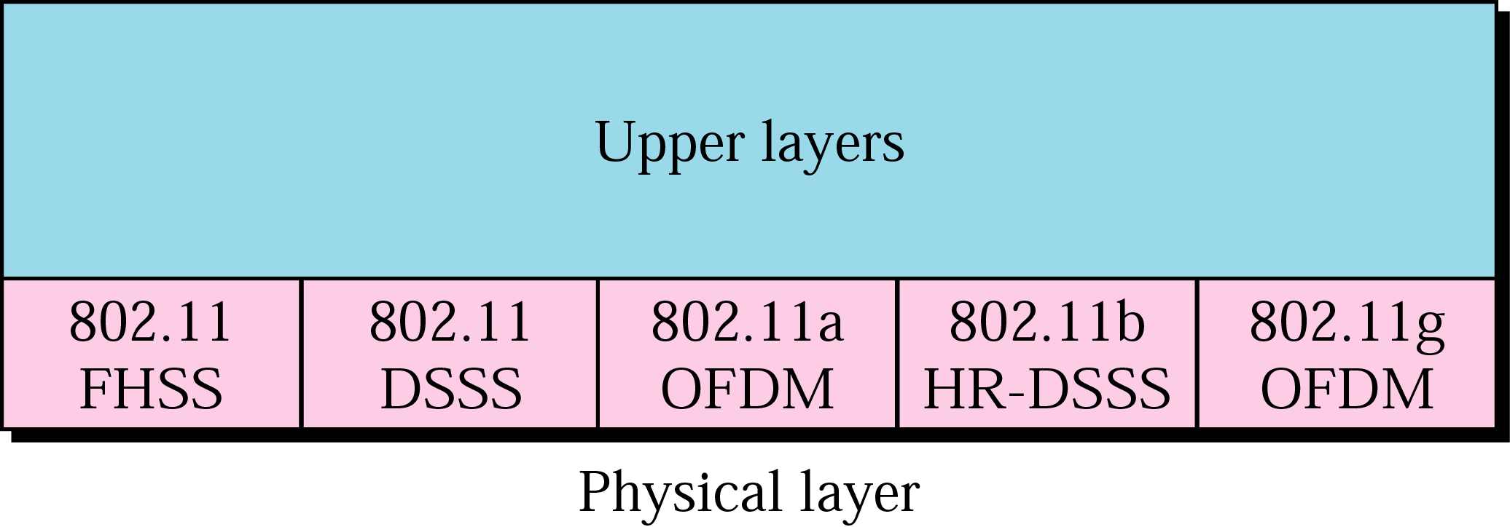
Figure 15.3 Physical layer specifications

Slide 6
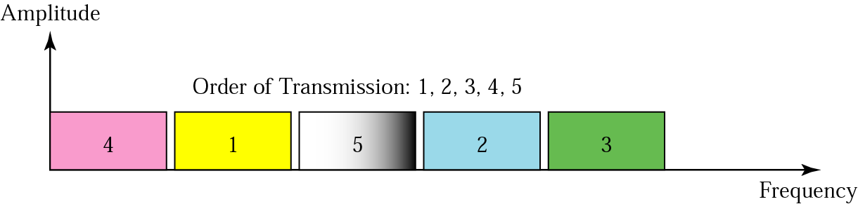
Figure 15.4 FHSS

Slide 7
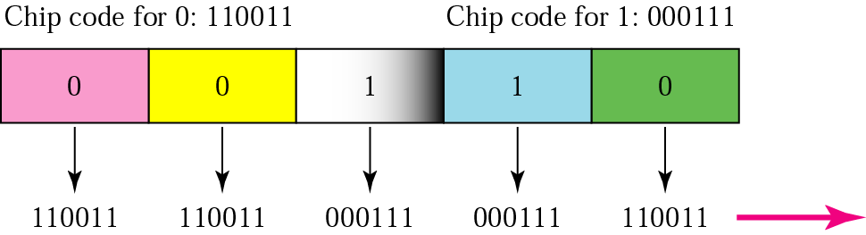
Figure 15.5 DSSS

Slide 8
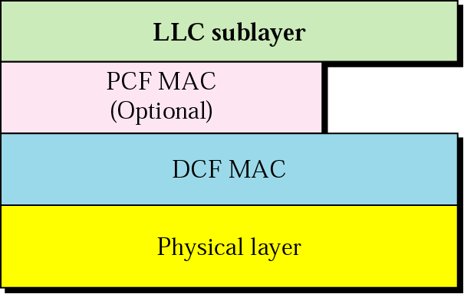
Figure 15.6 MAC layers in IEEE 802.11 standard

Slide 9
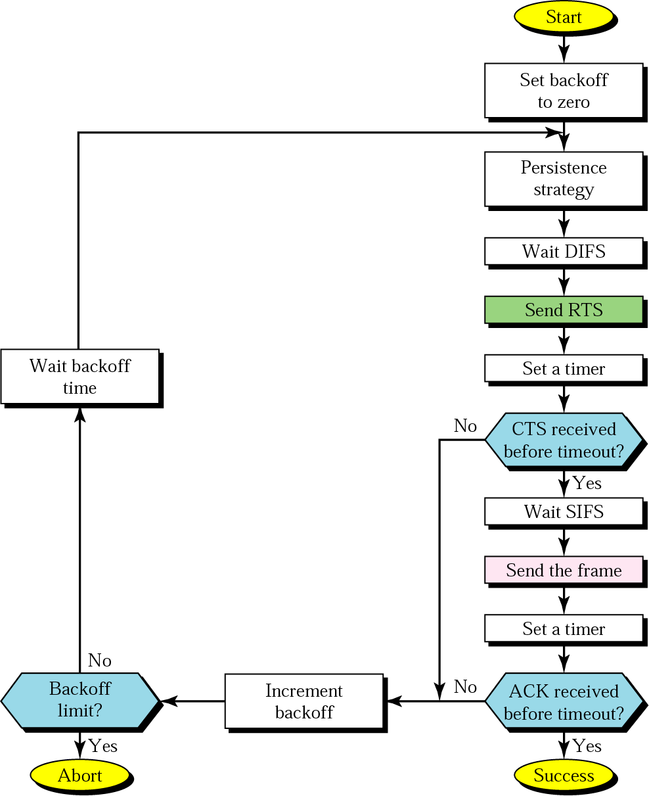
Figure 15.7 CSMA/CA flowchart

Slide 10
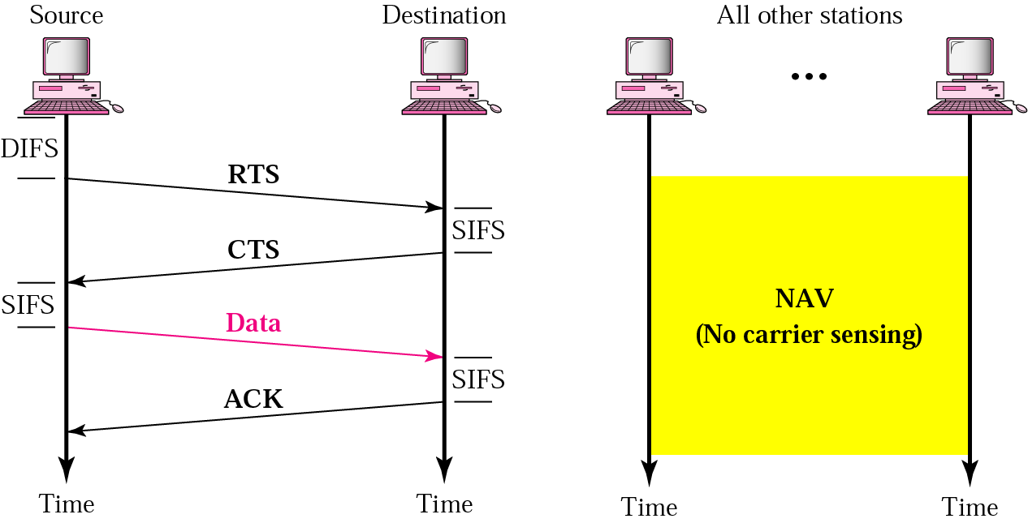
Figure 15.8 CSMA/CA and NAV

Slide 11
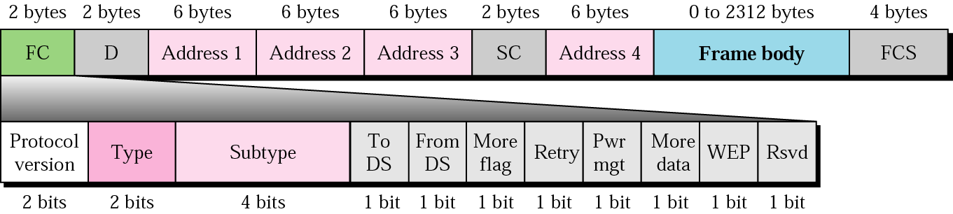
Figure 15.9 Frame format

Slide 12
Table 15.1 Subfields in FC field
Field | Explanation
Version | The current version is 0.
Type | Type of information: management (00), control (01), or data (10).
Subtype | Defines the subtype of each type (see ).
To DS | Defined later.
From DS | Defined later.
More flag | When set to 1, means more fragments.
Retry | When set to 1, means retransmitted frame.
Pwr mgt | When set to 1, means station is in power management mode.
More data | When set to 1, means station has more data to send.
WEP | Wired equivalent privacy. When set to 1, means encryption implemented.
Rsvd | Reserved.

Slide 13
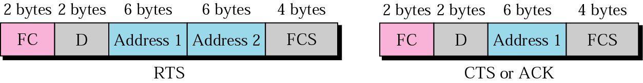
Figure 15.10 Control frames

Slide 14
Table 14.2 Values of subfields in control frames
Subtype | Meaning
1011 | Request to send (RTS)
1100 | Clear to send (CTS)
1101 | Acknowledgment (ACK)

Slide 15
Table 15.1 Subfields in FC field
To DS | From DS | Address 1 | Address 2 | Address 3 | Address 4
0 | 0 | Destination station | Source station | BSS ID | N/A
0 | 1 | Destination station | Sending AP | Source station | N/A
1 | 0 | Receiving AP | Source station | Destination station | N/A
1 | 1 | Receiving AP | Sending AP | Destination station | Source station

Slide 16
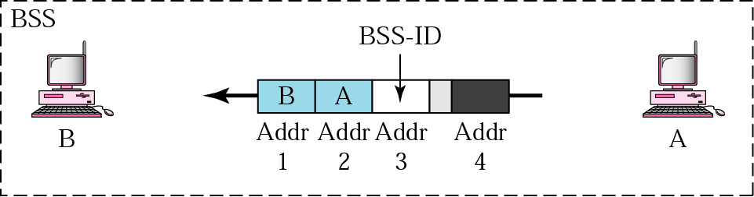
Figure 15.11 Addressing mechanism: case 1

Slide 17
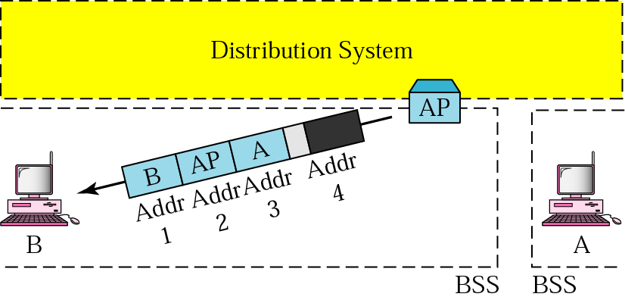
Figure 15.12 Addressing mechanism: case 2

Slide 18
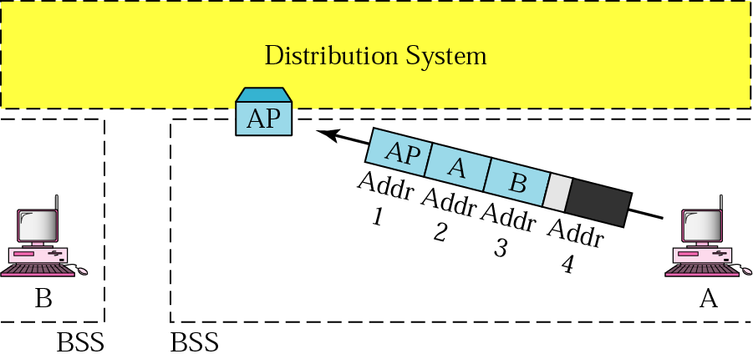
Figure 15.13 Addressing mechanism: case 3

Slide 19
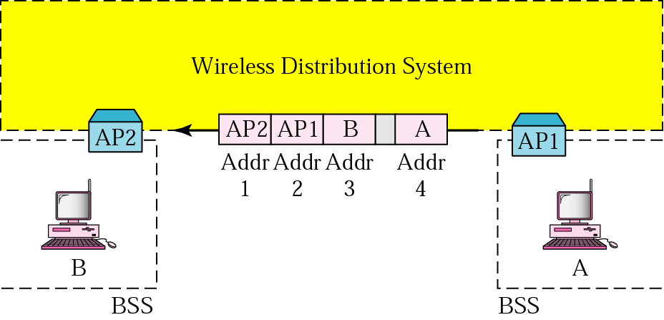
Figure 15.14 Addressing mechanism: case 4

Slide 20
15.2 Bluetooth
Architecture
Radio Layer
Baseband Layer
L2CAP Layer
Other Upper Layers

Slide 21
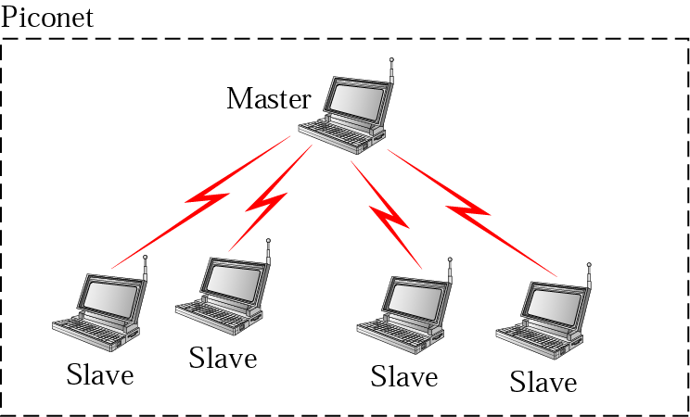
Figure 15.15 Piconet

Slide 22
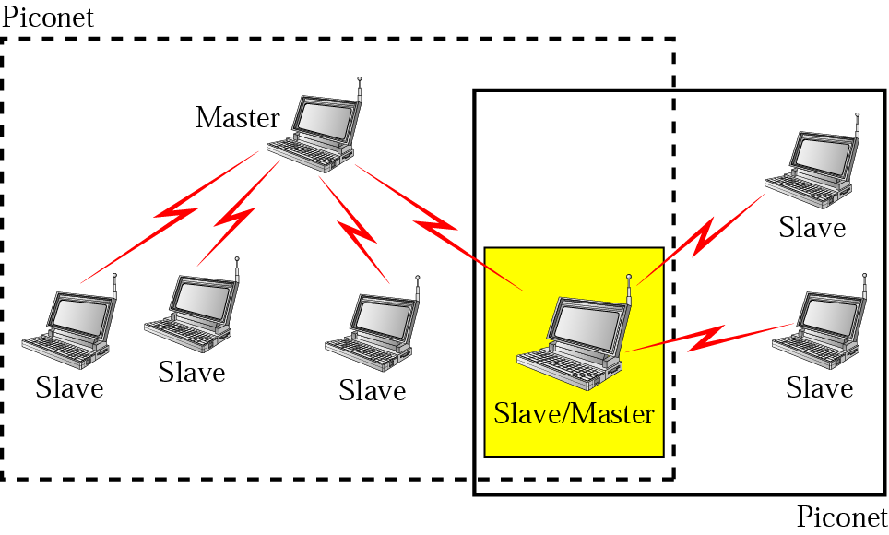
Figure 15.16 Scatternet

Slide 23
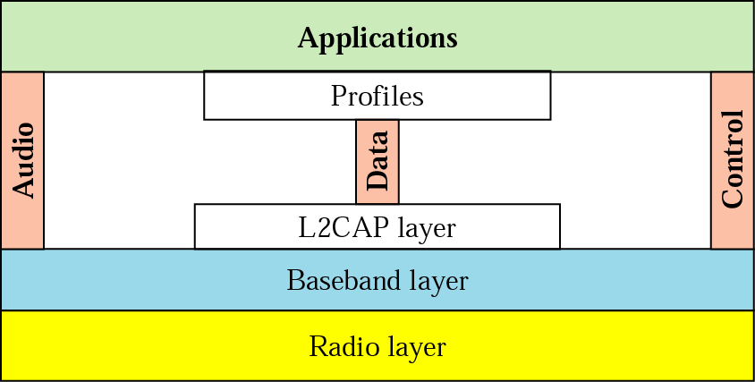
Figure 15.17 Bluetooth layers

Slide 24
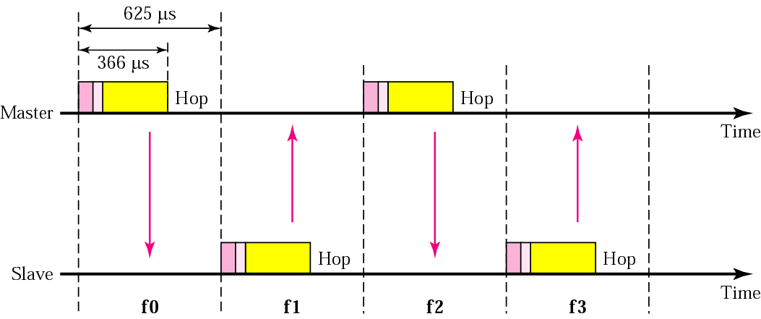
Figure 15.18 Single-slave communication

Slide 25
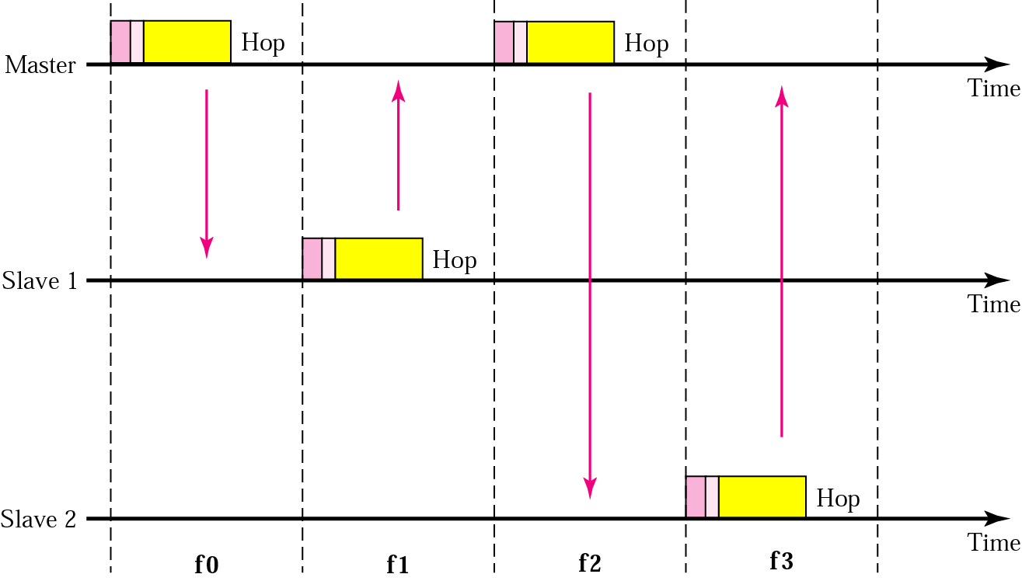
Figure 15.19 Multiple-slave communication

Slide 26
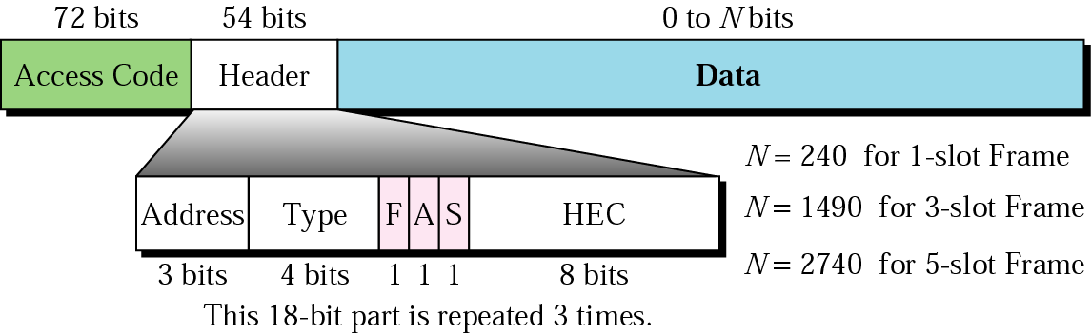
Figure 15.20 Frame format types

Slide 27
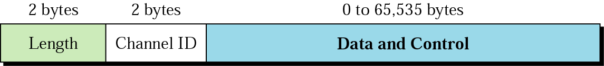
Figure 15.21 L2CAP data packet format

