Slide 1
Chapter 16
Connecting LANs,
Backbone Networks,
and Virtual LANs

Slide 2
16.1 Connecting Devices
Repeaters
Hubs
Bridges
Two-Layer Switches

Slide 3
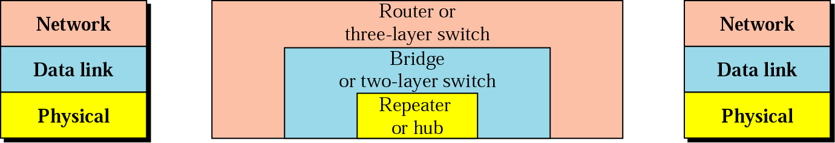
Figure 16.1 Connecting devices

Slide 4
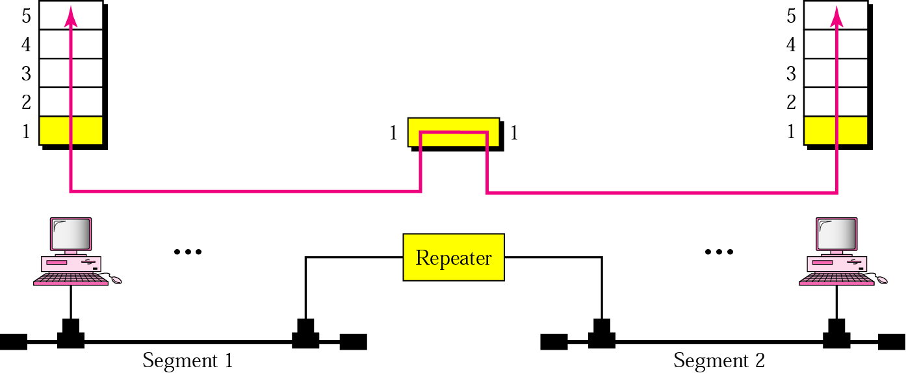
Figure 16.2 Repeater

Slide 5

Note:
A repeater connects segments of a LAN.

Slide 6
Note:
A repeater forwards every frame; it has no filtering capability.

Slide 7
Note:
A repeater is a regenerator,
not an amplifier.

Slide 8
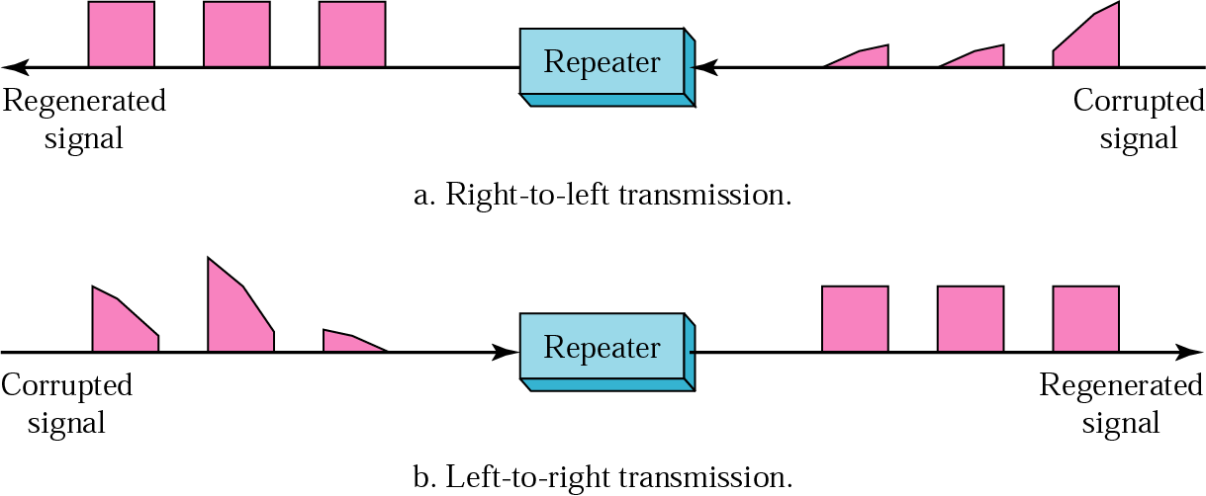
Figure 16.3 Function of a repeater

Slide 9
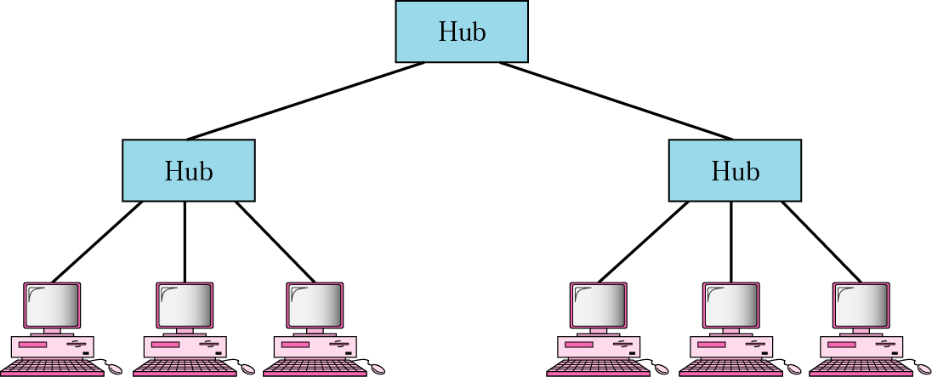
Figure 16.4 Hubs

Slide 10
Note:
A bridge has a table used in filtering decisions.

Slide 11
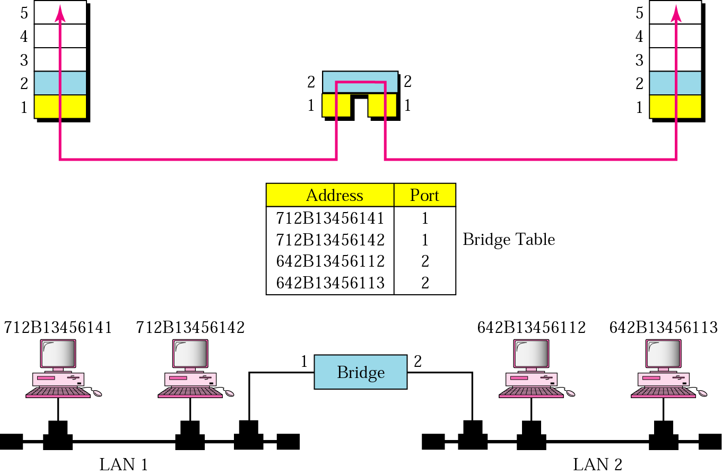
Figure 16.5 Bridge

Slide 12
Note:
A bridge does not change the physical (MAC) addresses in a frame.

Slide 13
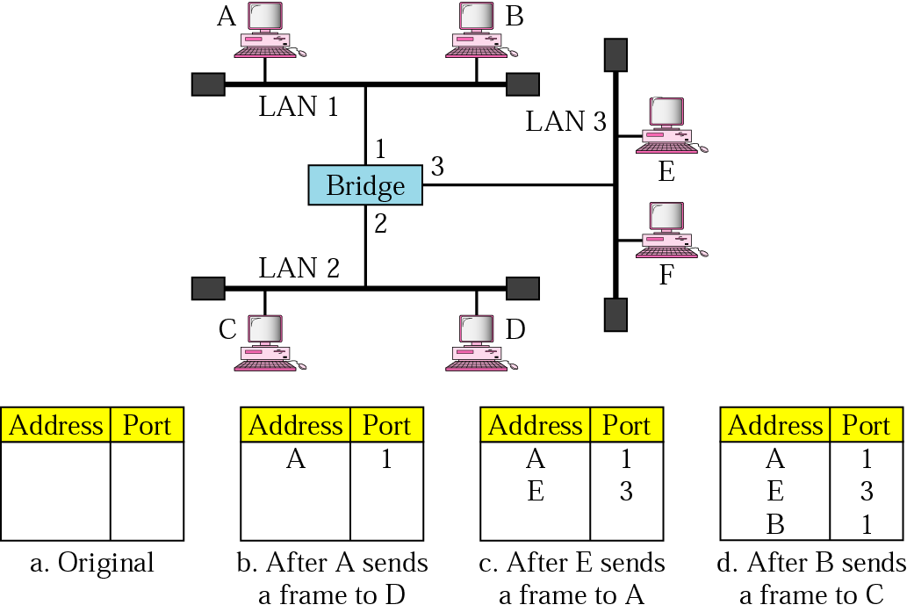
Figure 16.6 Learning bridge

Slide 14
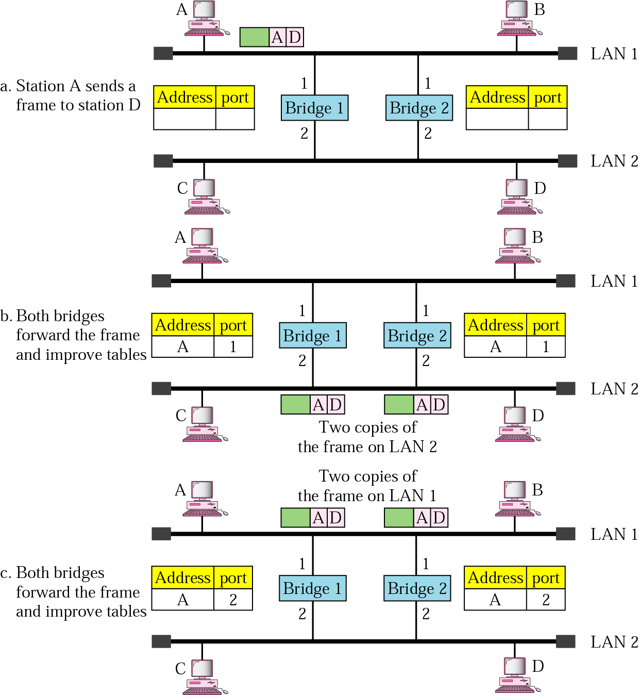
Figure 16.7 Loop problem

Slide 15
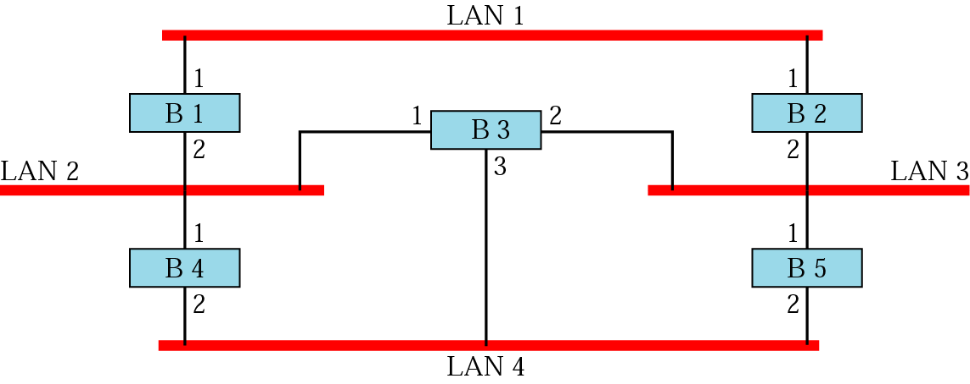
Figure 16.8 Prior to spanning tree application

Slide 16
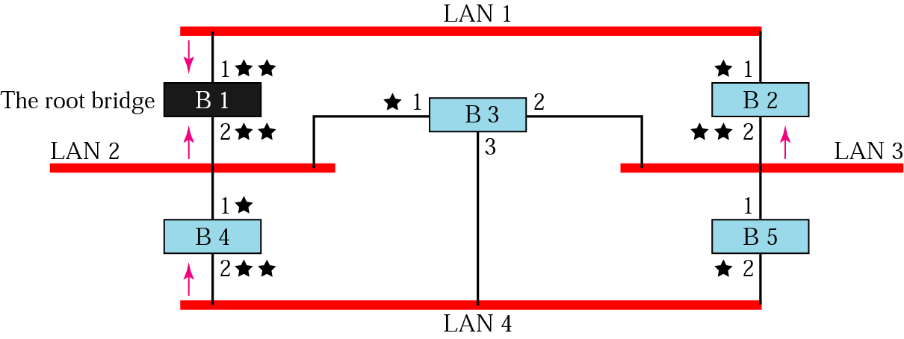
Figure 16.9 Applying spanning tree

Slide 17
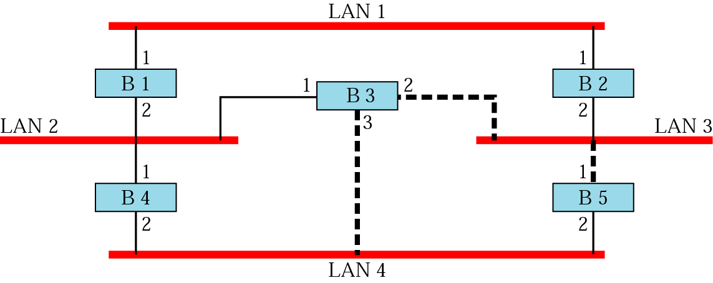
Figure 16.10 Forwarding ports and blocking ports

Slide 18
16.2 Backbone Networks
Bus Backbone
Star Backbone
Connecting Remote LANs

Slide 19
Note:
In a bus backbone, the topology of the backbone is a bus.

Slide 20
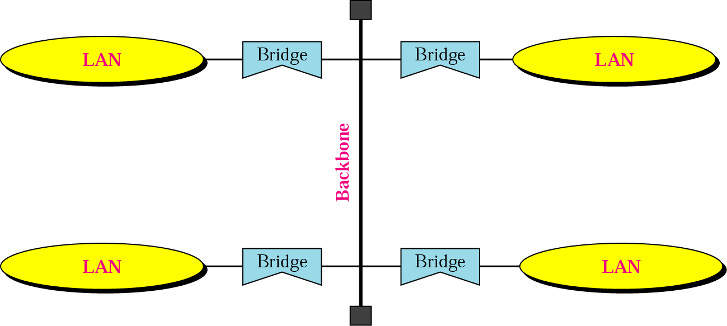
Figure 16.11 Bus backbone

Slide 21
Note:
In a star backbone, the topology of the backbone is a star; the backbone is just one switch.

Slide 22
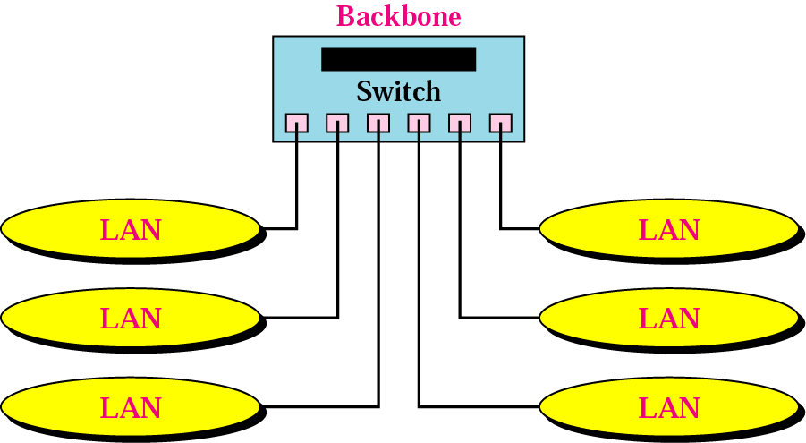
Figure 16.12 Star backbone

Slide 23
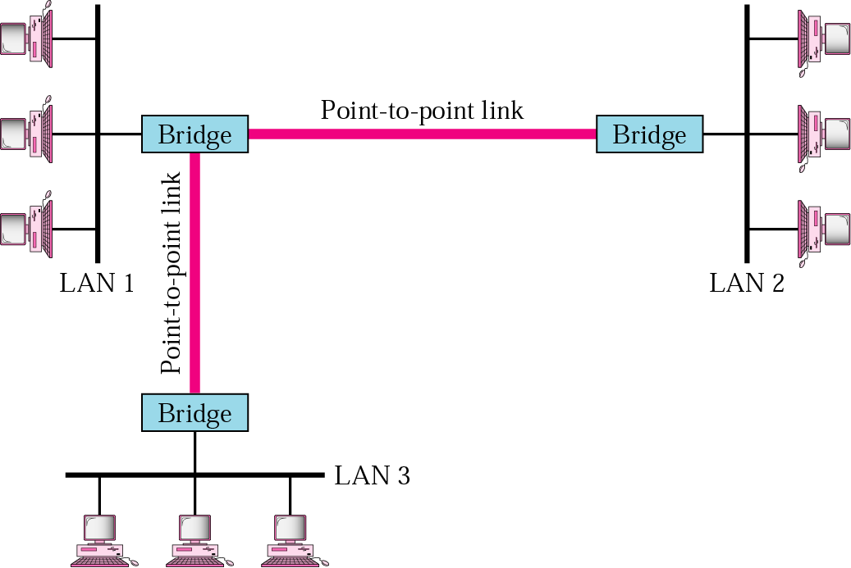
Figure 16.13 Connecting remote LANs

Slide 24
Note:
A point-to-point link acts as a LAN in a remote backbone connected by remote bridges.

Slide 25
16.3 Virtual LANs
Membership
Configuration
IEEE Standard
Advantages

Slide 26
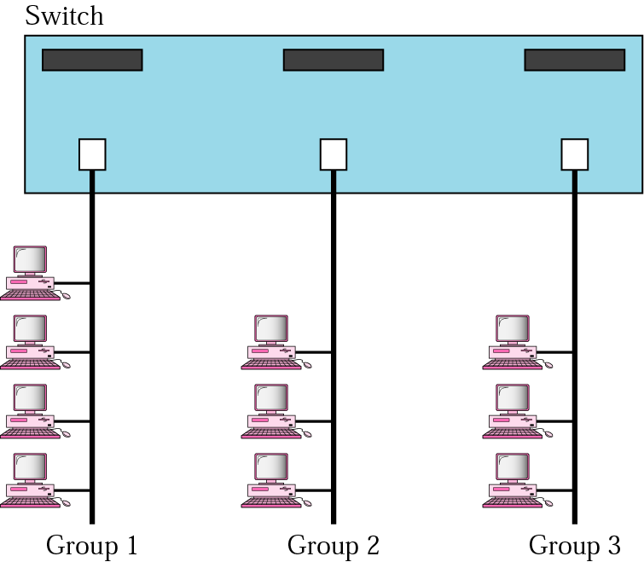
Figure 16.14 A switch connecting three LANs

Slide 27
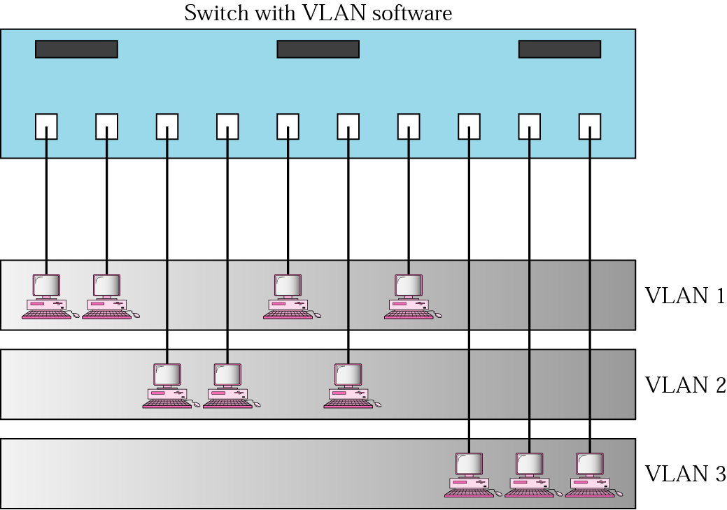
Figure 16.15 A switch using VLAN software

Slide 28
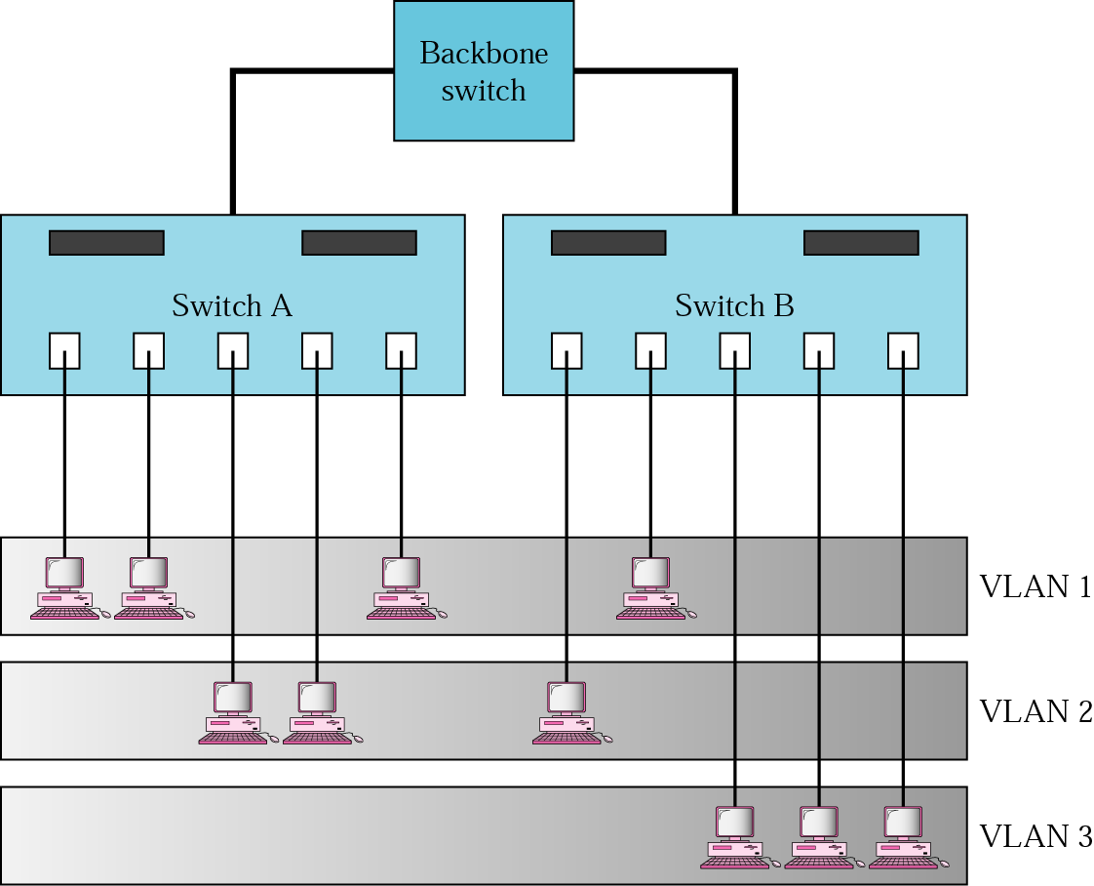
Figure 16.16 Two switches in a backbone using VLAN software

Slide 29
Note:
VLANs create broadcast domains.

