Slide 1
Chapter 14
Local Area
Networks:
Ethernet

Slide 2
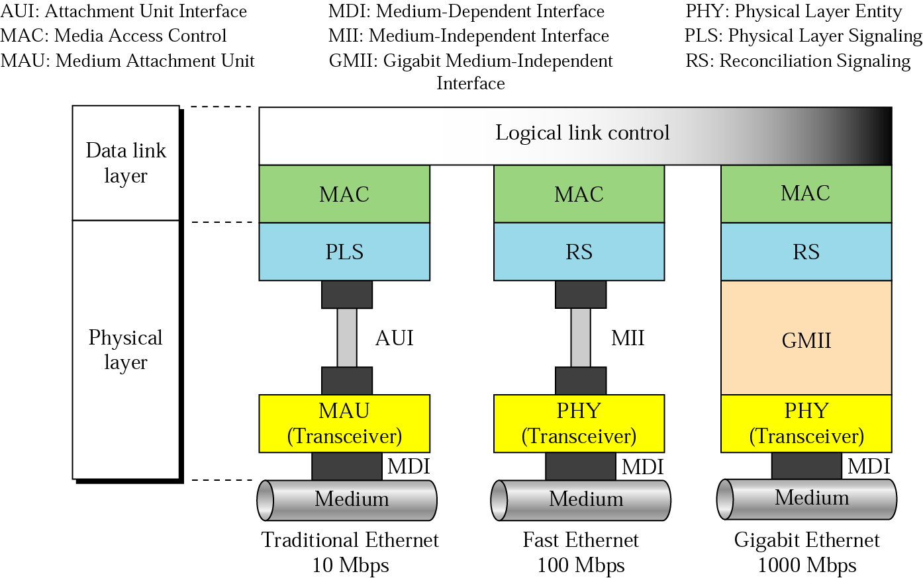
Figure 14.1 Three generations of Ethernet

Slide 3
14.1 Traditional Ethernet
MAC Sublayer
Physical Layer
Physical Layer Implementation
Bridged Ethernet
Switched Ethernet
Full-Duplex Ethernet

Slide 4
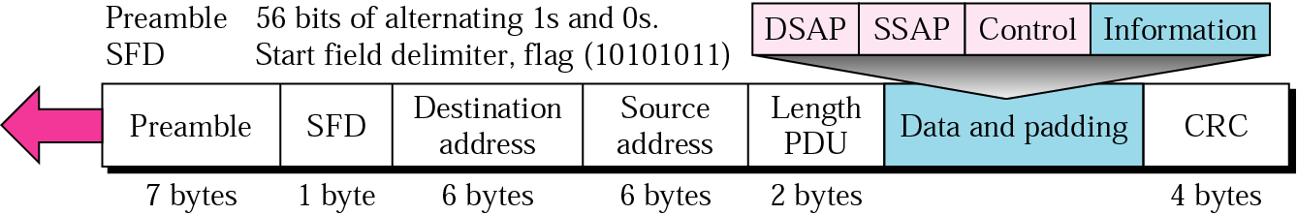
Figure 14.2 802.3 MAC frame

Slide 5
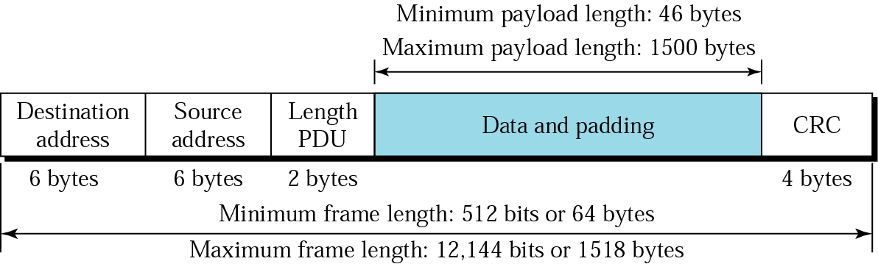
Figure 14.3 Minimum and maximum length

Slide 6

Figure 14.4 Ethernet addresses in hexadecimal notation

Slide 7
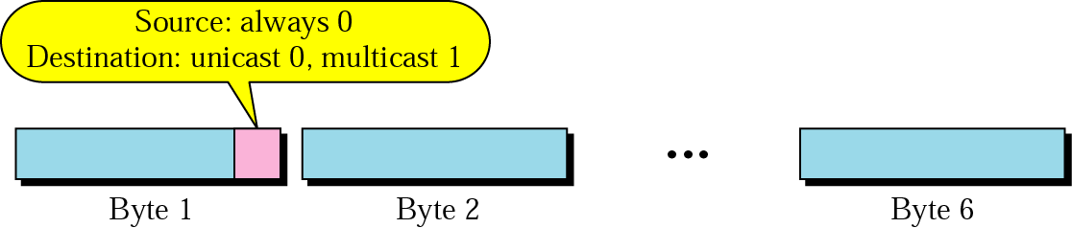
Figure 14.5 Unicast and multicast addresses

Slide 8
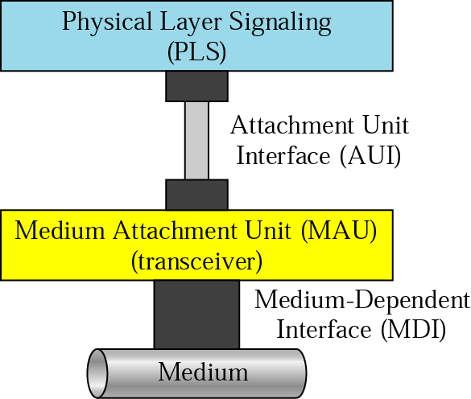
Figure 14.6 Physical layer

Slide 9
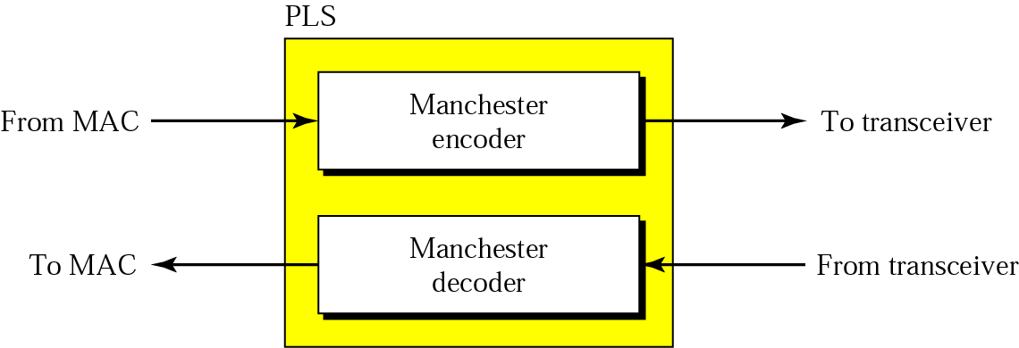
Figure 14.7 PLS

Slide 10
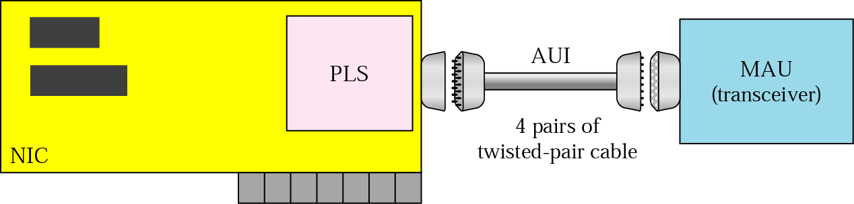
Figure 14.8 AUI

Slide 11
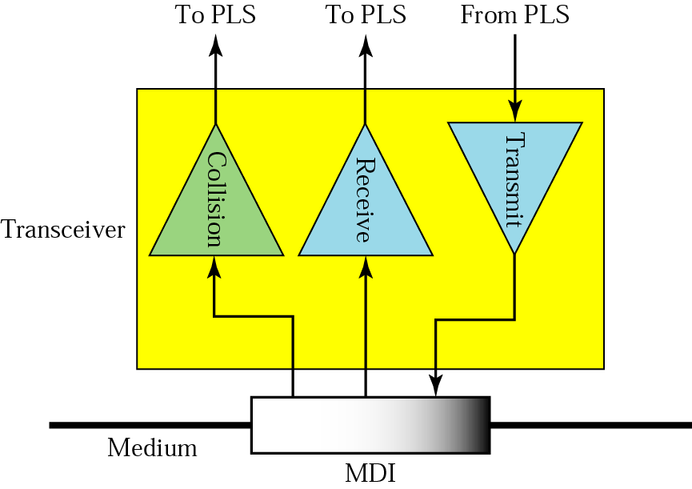
Figure 14.9 MAU (transceiver)

Slide 12
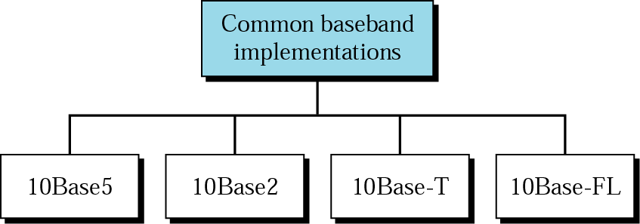
Figure 14.10 Categories of traditional Ethernet

Slide 13
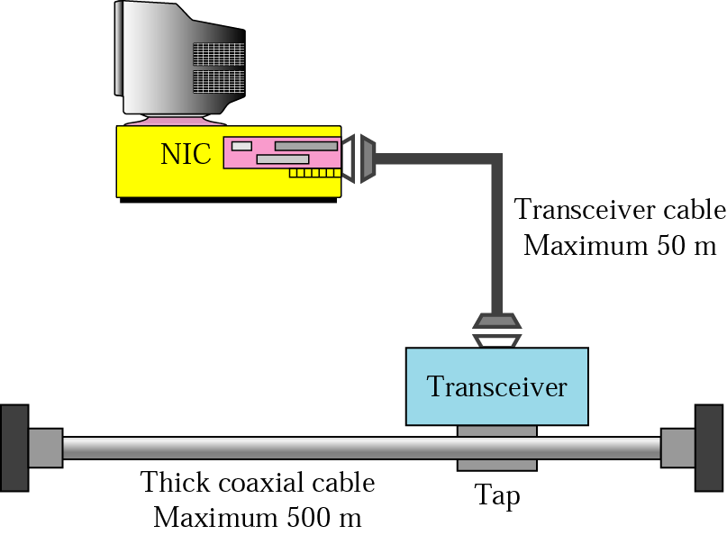
Figure 14.11 Connection of a station to the medium using 10Base5

Slide 14
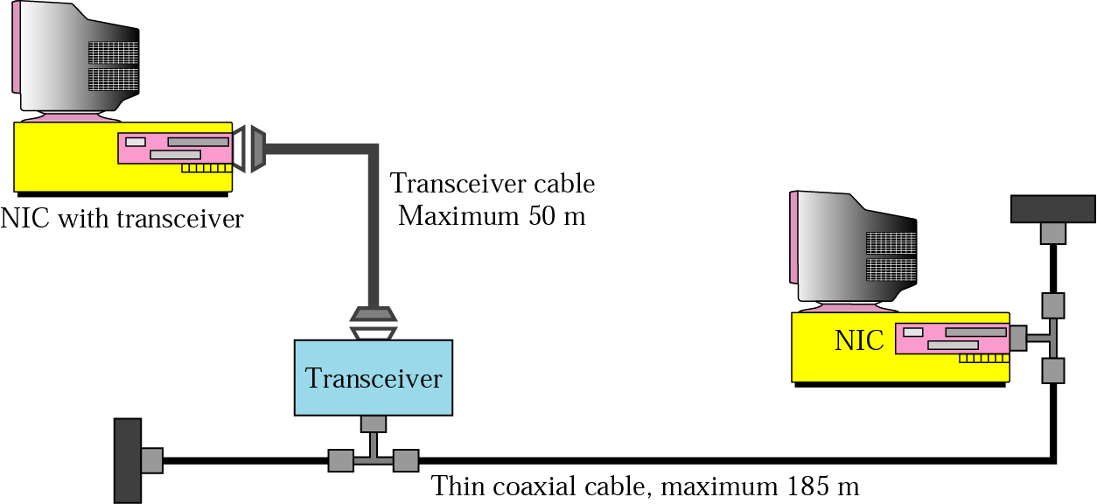
Figure 14.12 Connection of stations to the medium using 10Base2

Slide 15
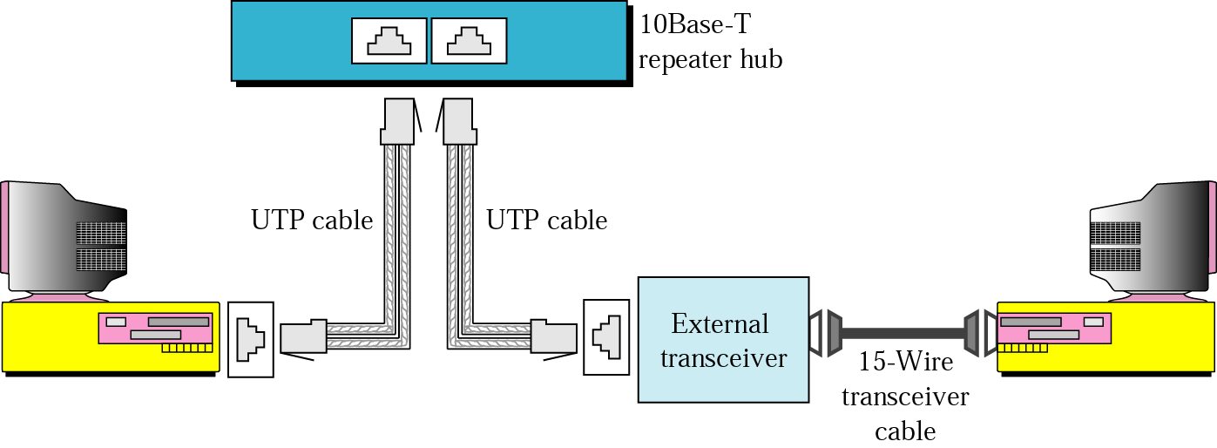
Figure 14.13 Connection of stations to the medium using 10Base-T

Slide 16
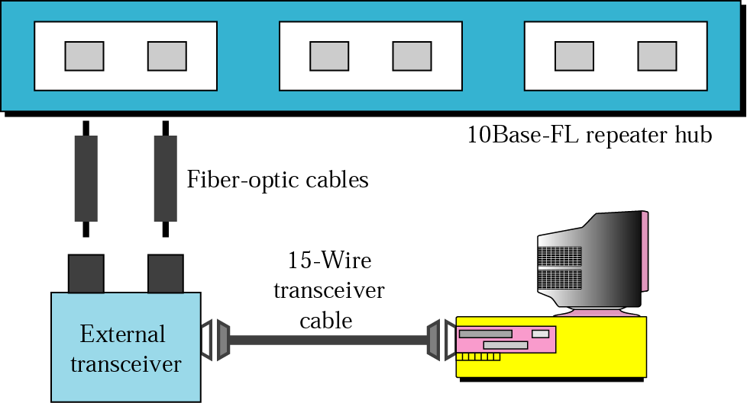
Figure 14.14 Connection of stations to the medium using 10Base-FL

Slide 17
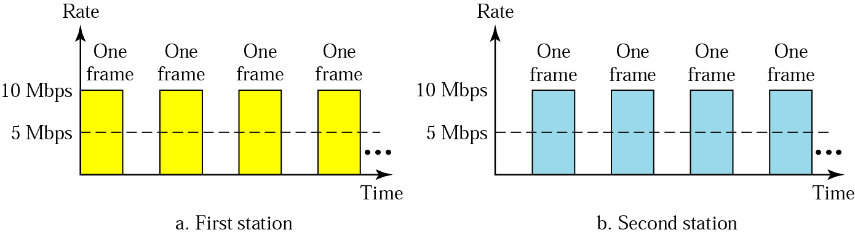
Figure 14.15 Sharing bandwidth

Slide 18
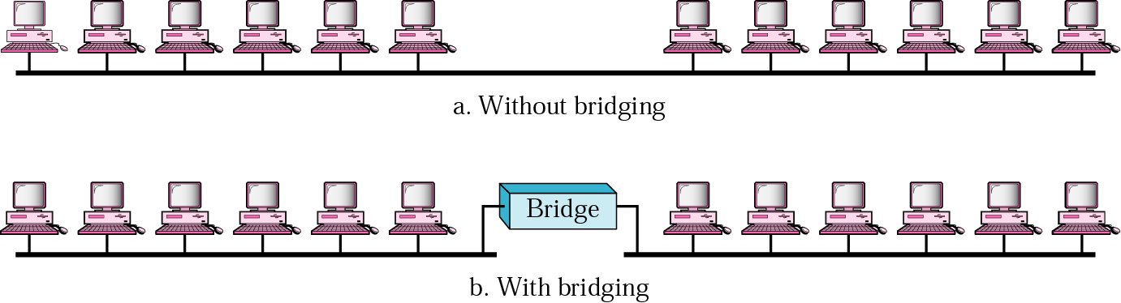
Figure 14.16 A network with and without a bridge

Slide 19
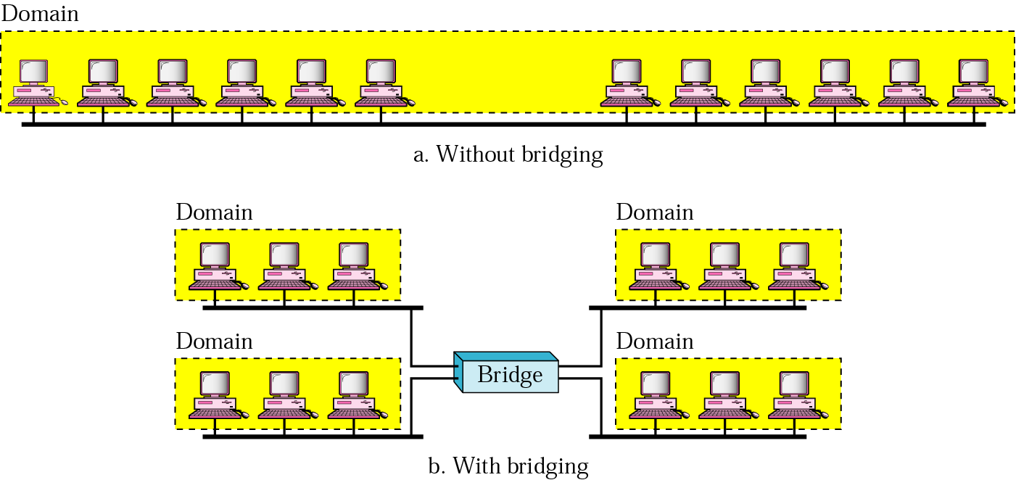
Figure 14.17 Collision domains in a nonbridged and bridged network

Slide 20
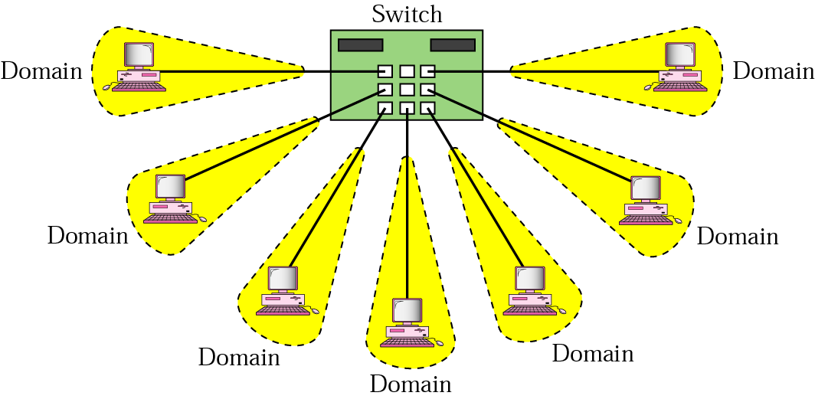
Figure 14.18 Switched Ethernet

Slide 21
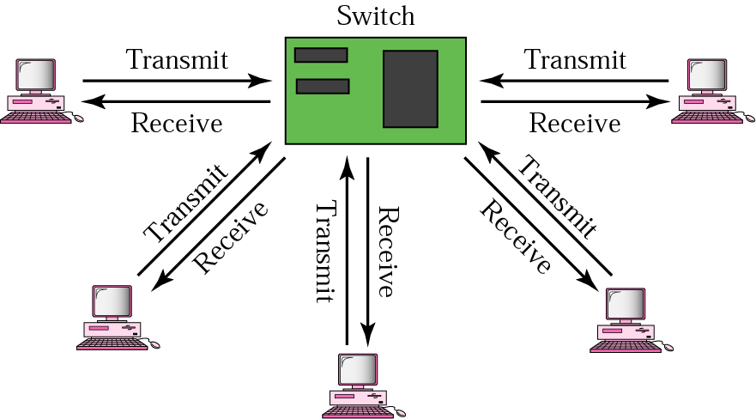
Figure 14.19 Full-duplex switched Ethernet

Slide 22
14.2 Fast Ethernet
MAC Sublayer
Physical Layer
Physical Layer Implementation

Slide 23
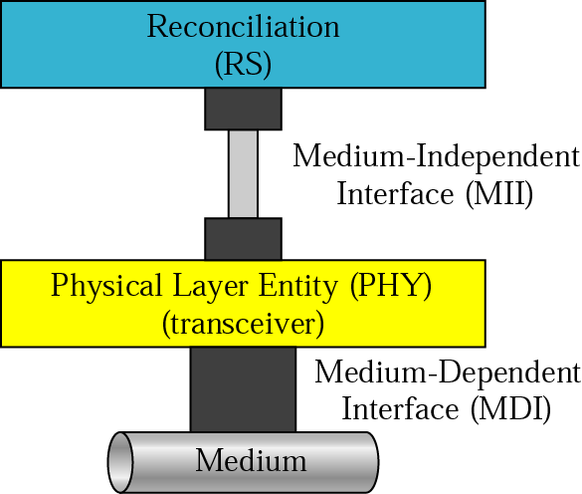
Figure 14.20 Fast Ethernet physical layer

Slide 24
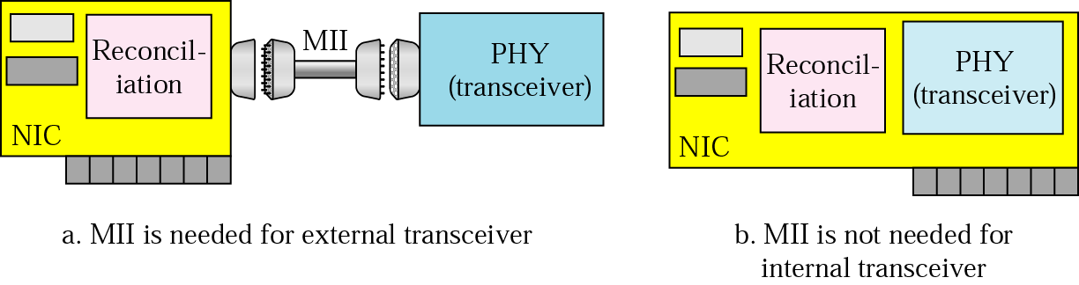
Figure 14.21 MII

Slide 25
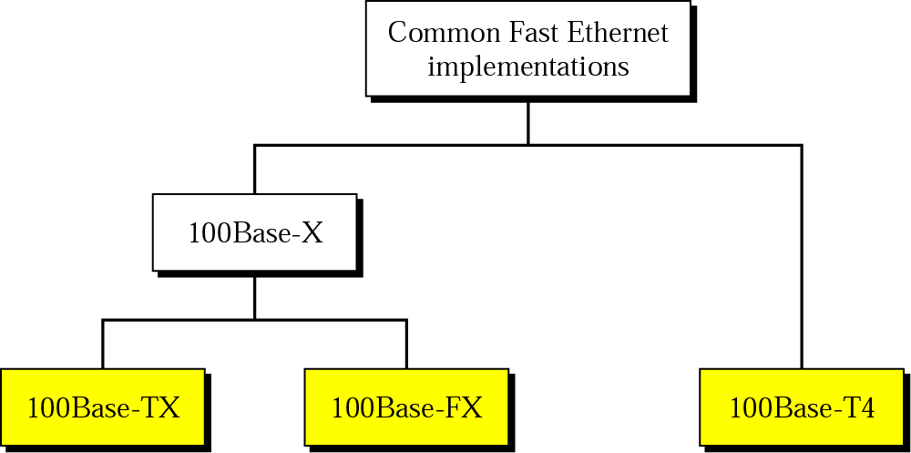
Figure 14.22 Fast Ethernet implementations

Slide 26
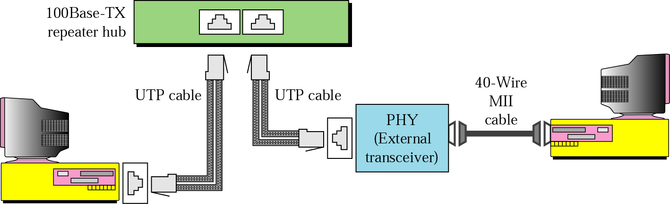
Figure 14.23 100Base-TX implementation

Slide 27
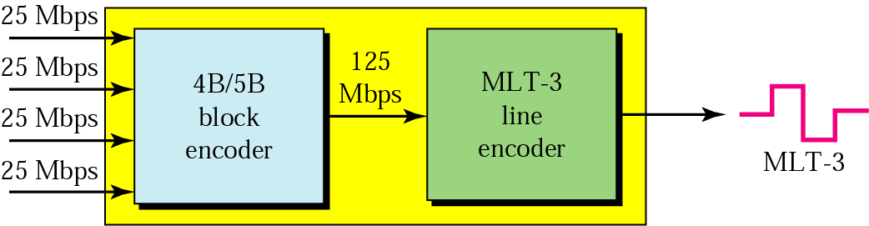
Figure 14.24 Encoding and decoding in 100Base-TX

Slide 28
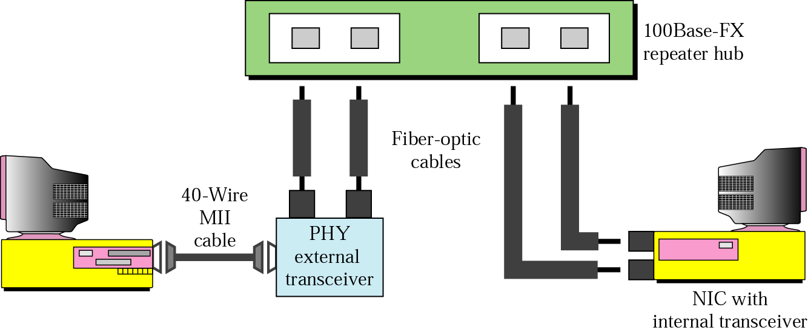
Figure 14.25 100Base-FX implementation

Slide 29
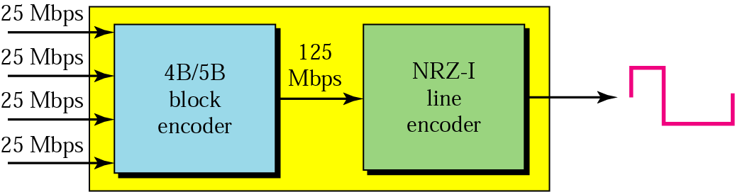
Figure 14.26 Encoding and decoding in 100Base-FX

Slide 30
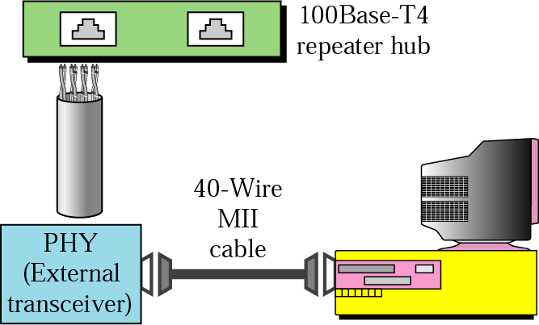
Figure 14.27 100Base-T4 implementation

Slide 31
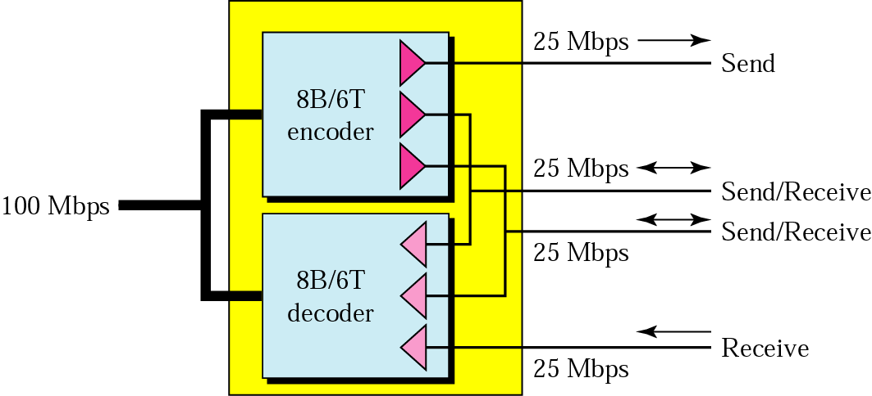
Figure 14.28 Using four wires in 100Base-T4

Slide 32
14.3 Gigabit Ethernet
MAC Sublayer
Physical Layer
Physical Layer Implementation

Slide 33
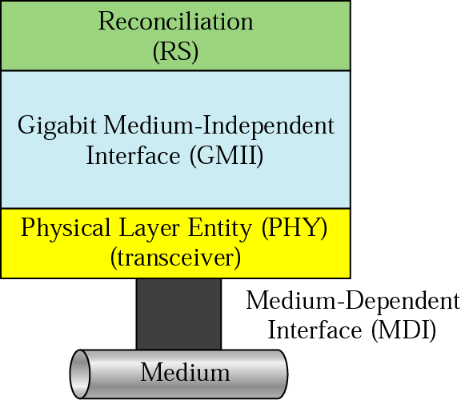
Figure 14.29 Physical layer in Gigabit Ethernet

Slide 34
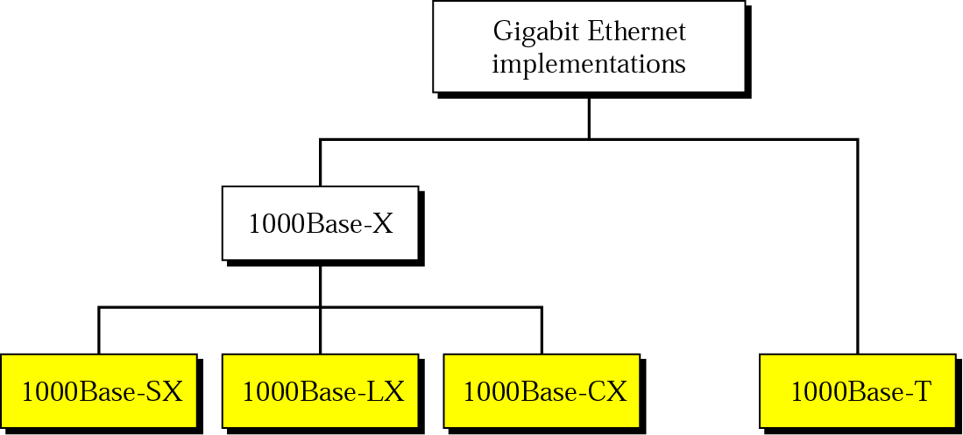
Figure 14.30 Gigabit Ethernet implementations

Slide 35
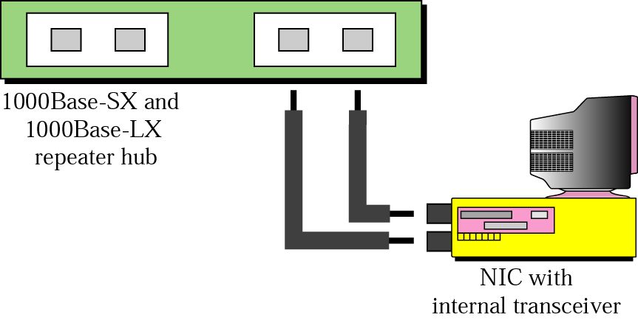
Figure 14.31 1000Base-X implementation

Slide 36
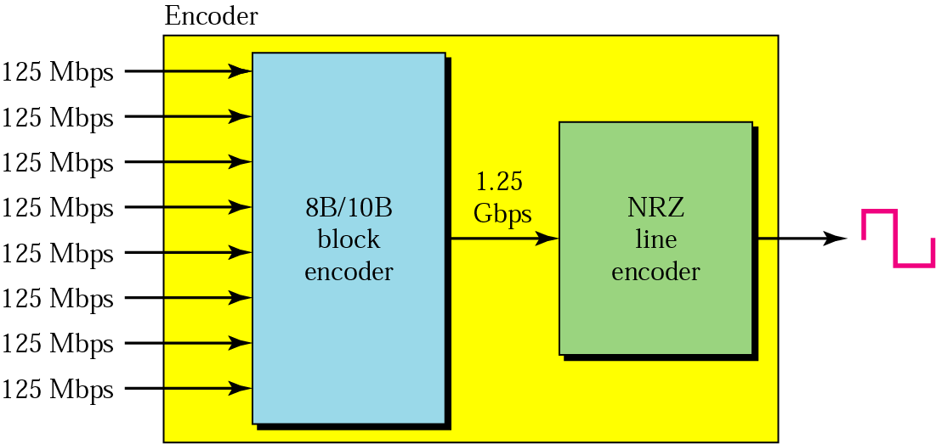
Figure 14.32 Encoding in 1000Base-X

Slide 37
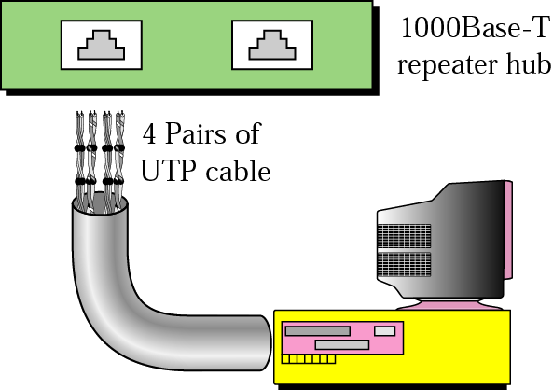
Figure 14.33 1000Base-T implementation

Slide 38
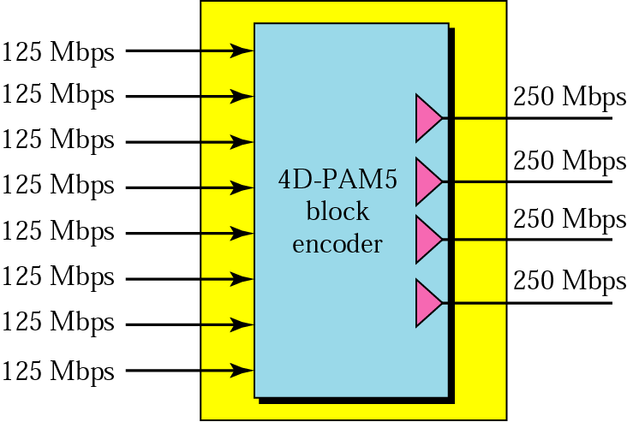
Figure 14.34 Encoding in 1000Base-T

