Slide 1
Chapter 28
Multimedia

Slide 2
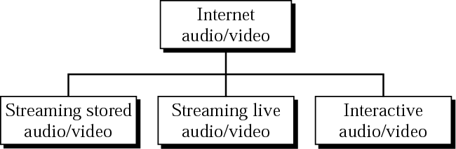
Figure 28.1 Internet audio/video

Slide 3

Note:
Streaming stored audio/video refers to on-demand requests for compressed audio/video files.

Slide 4
Note:
Streaming live audio/video refers to the broadcasting of radio and TV programs through the Internet.

Slide 5
Note:
Interactive audio/video refers to the use of the Internet for interactive audio/video applications.

Slide 6
28.1 Digitizing Audio and Video
Digitizing Audio
Digitizing Video

Slide 7
Note:
Compression is needed to send video over the Internet.

Slide 8
28.2 Audio/Video Compression
Audio Compression
Video Compression

Slide 9
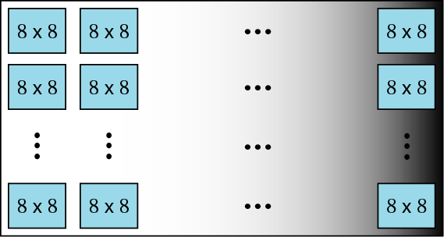
Figure 28.2 JPEG gray scale

Slide 10
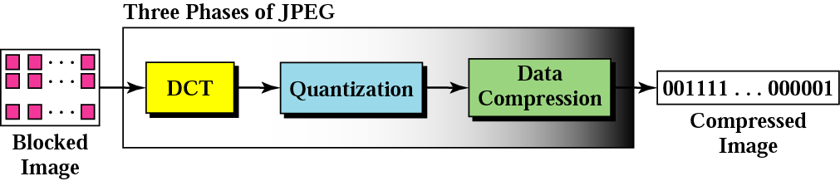
Figure 28.3 JPEG process

Slide 11
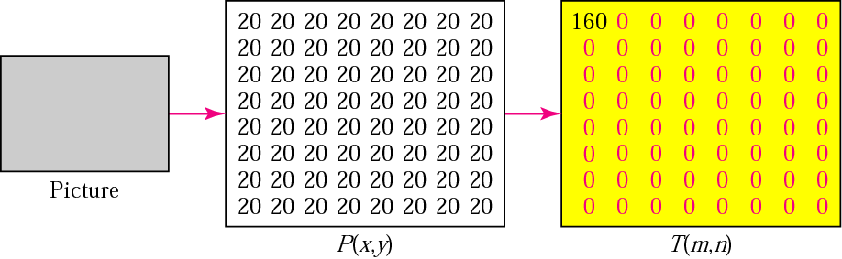
Figure 28.4 Case 1: uniform gray scale

Slide 12
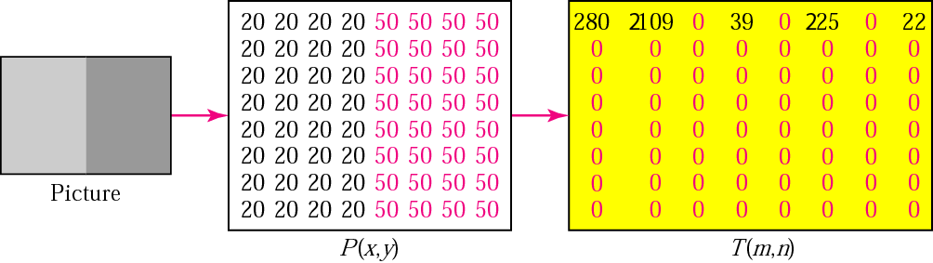
Figure 28.5 Case 2: two sections

Slide 13
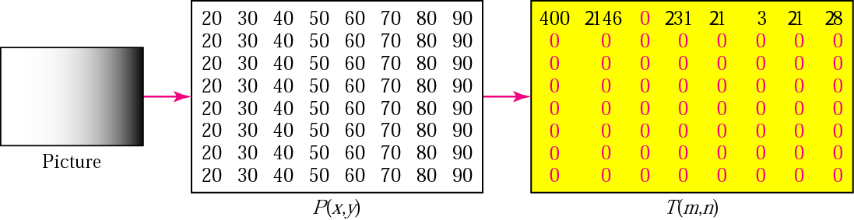
Figure 28.6 Case 3: gradient gray scale

Slide 14
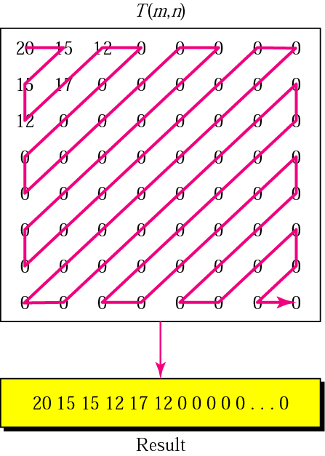
Figure 28.7 Reading the table

Slide 15
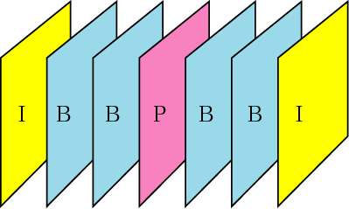
Figure 28.8 MPEG frames

Slide 16
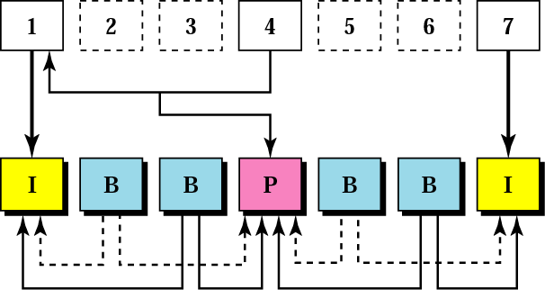
Figure 28.9 MPEG frame construction

Slide 17
28.3 Streaming Stored Audio/Video
First Approach
Second Approach
Third Approach
Fourth Approach

Slide 18
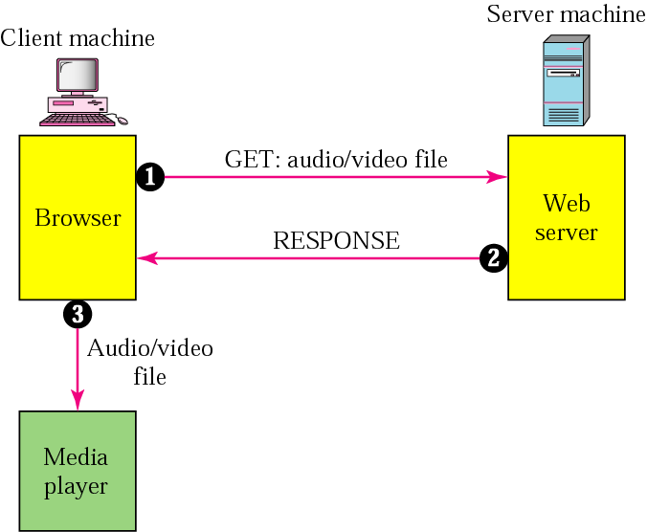
Figure 28.10 Using a Web server

Slide 19
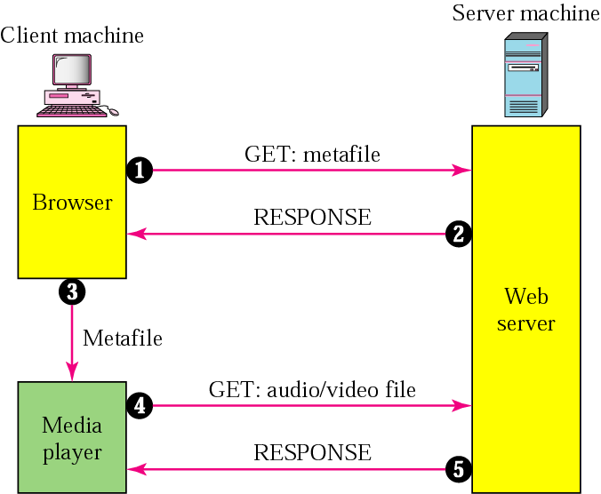
Figure 28.11 Using a Web server with a metafile

Slide 20
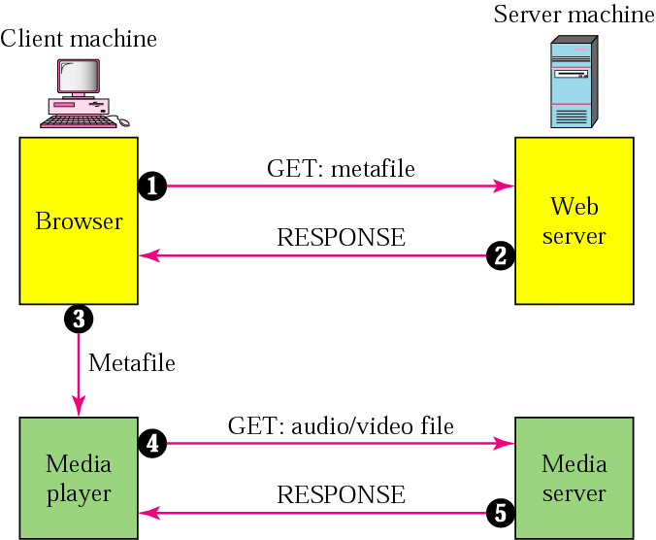
Figure 28.12 Using a media server

Slide 21
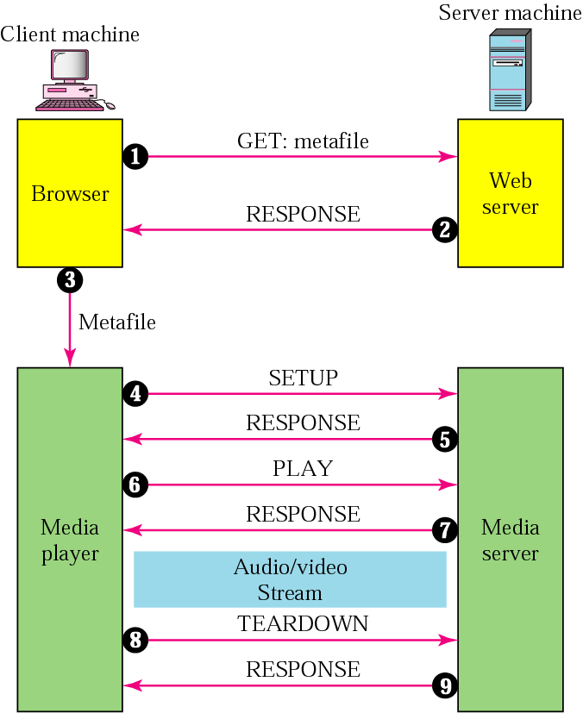
Figure 28.13 Using a media server and RTSP

Slide 22
28.4 Streaming Live Audio/Video
Broadcasting of live
audio/video over
the Internet

Slide 23
28.5 Interactive Audio/Video
Characteristics
RTP
RTCP

Slide 24
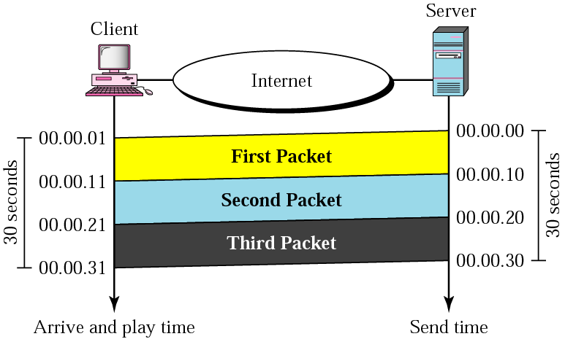
Figure 28.14 Time relationship

Slide 25
Note:
Jitter is introduced in real-time data by the delay between packets.

Slide 26
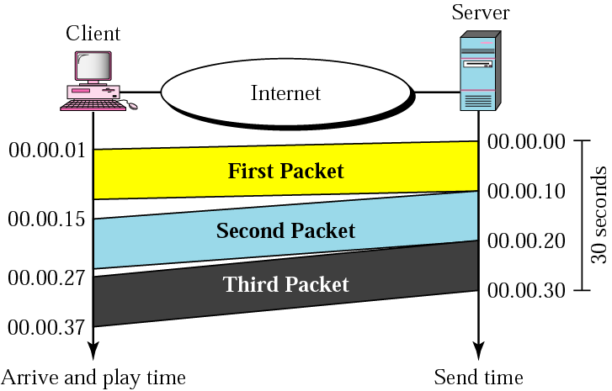
Figure 28.15 Jitter

Slide 27
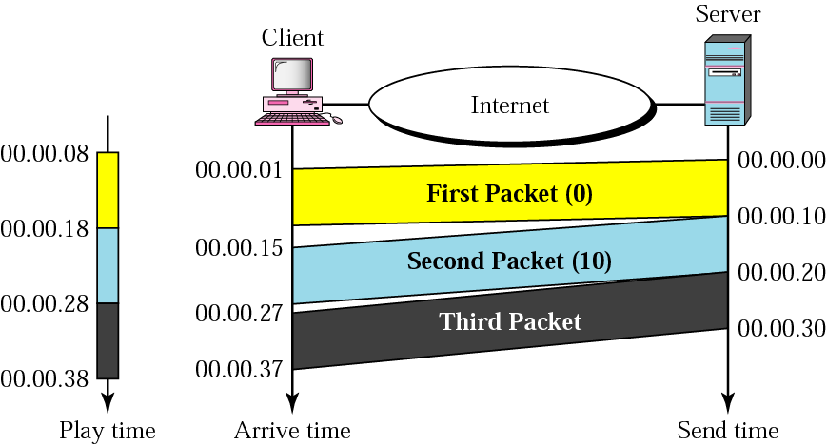
Figure 28.16 Timestamp

Slide 28
Note:
To prevent jitter, we can timestamp the packets and separate the arrival time from the playback time.

Slide 29
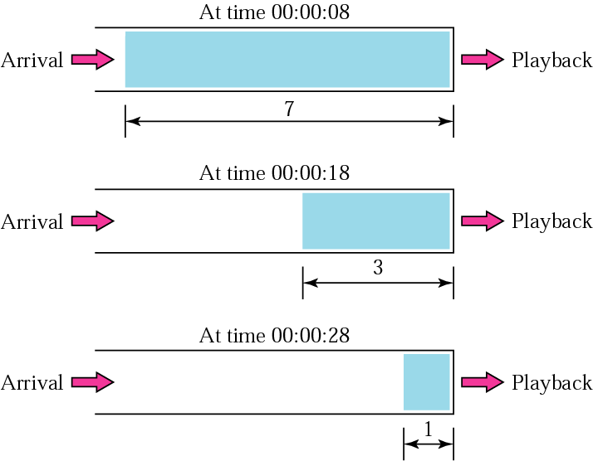
Figure 28.17 Playback buffer

Slide 30
Note:
A playback buffer is required for real-time traffic.

Slide 31
Note:
A sequence number on each packet is required for real-time traffic.

Slide 32
Note:
Real-time traffic needs the support of multicasting.

Slide 33
Note:
Translation means changing the encoding of a payload to a lower quality to match the bandwidth of the receiving network.

Slide 34
Note:
Mixing means combining several streams of traffic into one stream.

Slide 35
Note:
TCP, with all its sophistication, is not suitable for interactive multimedia traffic because we cannot allow retransmission of packets.

Slide 36
Note:
UDP is more suitable than TCP for interactive traffic. However, we need the services of RTP, another transport layer protocol, to make up for the deficiencies of UDP.

Slide 37
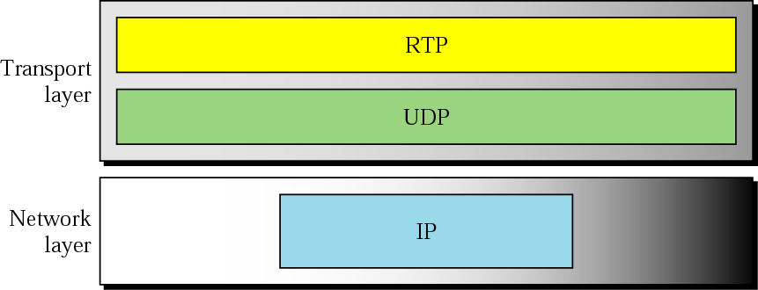
Figure 28.18 RTP

Slide 38
Note:
RTP uses a temporary even-numbered UDP port.

Slide 39
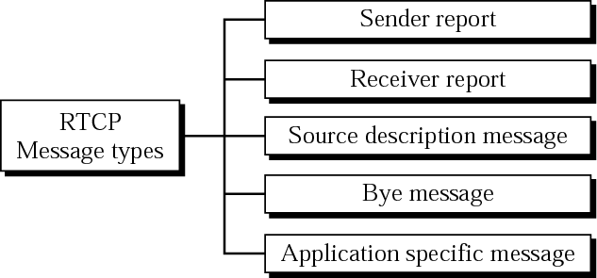
Figure 28.19 RTCP message types

Slide 40
Note:
RTCP uses an odd-numbered UDP port number that follows the port number selected for RTP.

Slide 41
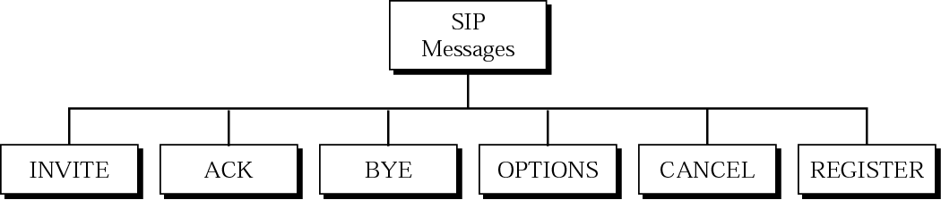
Figure 28.20 SIP messages

Slide 42
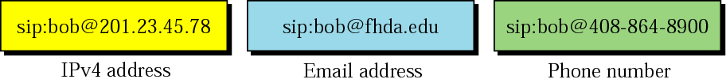
Figure 28.21 SIP formats

Slide 43
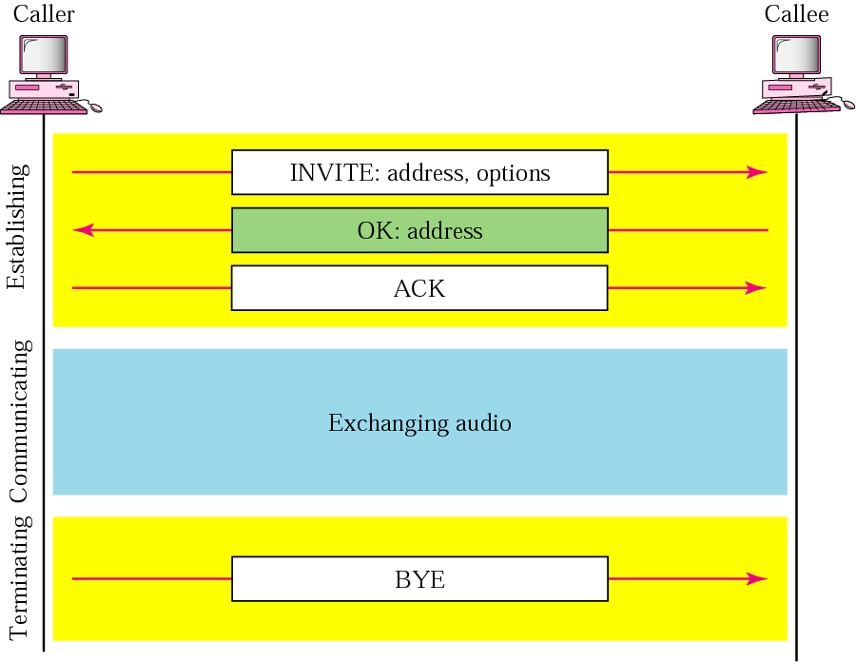
Figure 28.22 SIP simple session

Slide 44
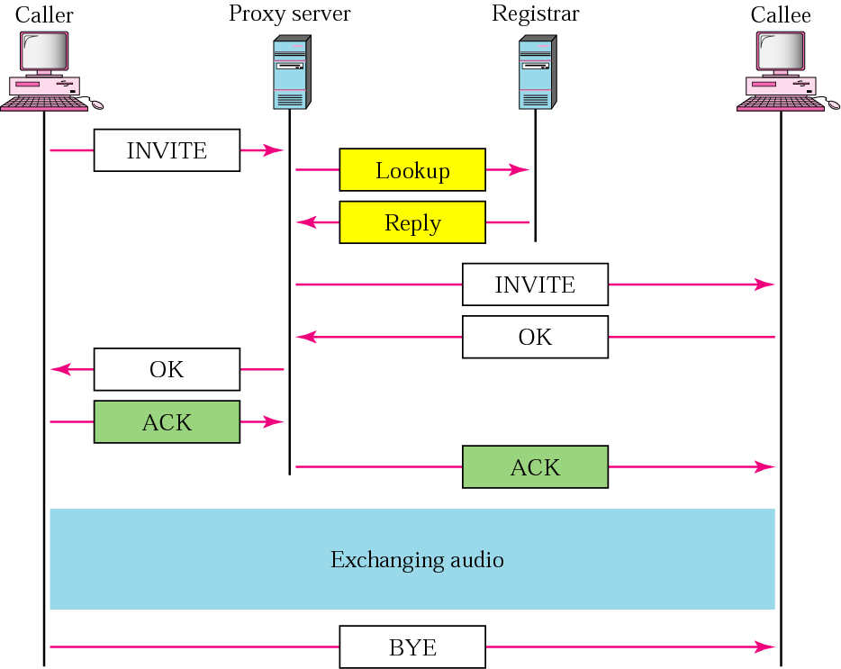
Figure 28.23 Tracking the callee

Slide 45
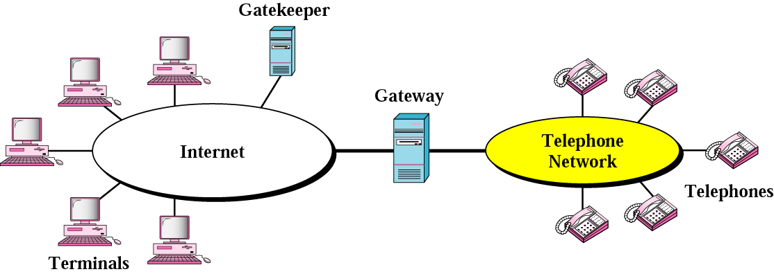
Figure 28.24 H.323 architecture

Slide 46
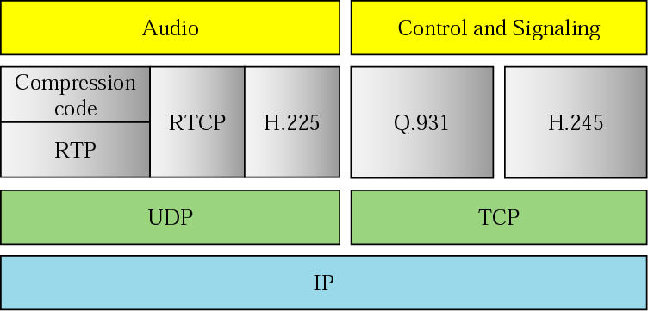
Figure 28.25 H.323 protocols

Slide 47
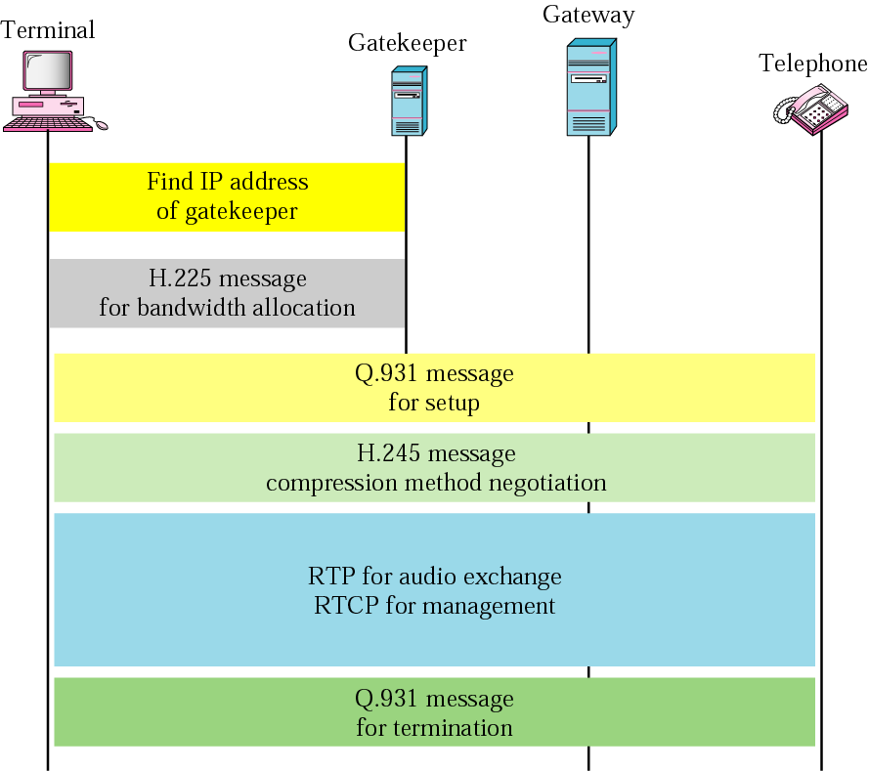
Figure 28.26 H.323 example

