Slide 1
Unit – 3 MULTIPLE ACCESS

Slide 2
Overview
Random access
  ALOHA,
    Pure ALOHA, Slotted ALOHA
  CSMA
  CSMA/CD
  CSMA/CA
Controlled access
  Reservation
  Polling
  Token Passing
Channelisation
  FDMA
  TDMA
  CDMA

Slide 3

Multiple Access
In data link control protocols (Simplest stop & ARQ…) it is assumed that there is dedicated link between the sender and receiver.
Data link layer divided into two functionality-oriented sublayers
Upper sublayer is responsible for data link (flow and error) control (LLC).
Lower sublayer is responsible for resolving access to the shared media (MAC).
Multiple access protocol coordinates to access the link (media)

Slide 4

Multiple Access
Many protocols have been devised to handle shared link and are mainly categorized into three groups

Slide 5
RANDOM ACCESS
In random access or contention methods, no station is superior to another station and none is assigned the control over another. No station permits, or does not permit, another station to send. At each instance, a station that has data to send uses a procedure defined by the protocol to make a decision on whether or not to send.
Two features gives the method its name:
  Transmission is random among stations.
  Stations compete with one another to access the medium.
Collision: an access conflict occurs when more than one station tries to send, as a result the frame will be either destroyed or modified.

Slide 6
ALOHA
Developed at the University of Hawaii (US) in early 1970 and designed for wireless LAN, but can be used on any shared medium.
Original ALOHA protocol is called pure ALOHA
A node sends the frame whenever it has a frame to send.
Medium is shared between the stations, there is possibility of collision between frames from different stations.
The ''frame time- Tfr '' denotes the amount of time needed to transmit the standard, fixed-length frame.
Vulnerable time : Time in which there is a possibility of collision.
Vulnerable time = 2 * Tfr

Slide 7

Pure ALOHA
Frames in a pure ALOHA network

Slide 8
ALOHA
A collision involves two more stations. If all the stations try to send their frames after the time-out, the frames will collide again.
To avoid collision stations will try again in random period, this time is the back-off time T_{B}.
The formula for T_{B} depends on the implementation.
Binary exponential back-off method is used.
Each retransmission a multiplier in the range 0 to 2^{k}-1 is randomly chosen and multiplied by T_{P} (Max propagation time) or T_{fr} (the average time required to send out a frame)
The value of K_{max} is usually chosen as 15

Slide 9

Pure ALOHA
Procedure for pure ALOHA protocol

Slide 10
Example
The stations on a wireless ALOHA network are a maximum of 600 km apart. If we assume that signals propagate at 3 × 10⁸ m/s, Then
Tp = (600 × 10⁵ ) / (3 × 10⁸ ) = 2 ms.
The value of T_{B} for different values of K .
For K = 1, the range is {0, 1} (0, 2^{K}-1). The station generates a random number 0 or 1. The value of T_{B} is 0 ms (0 × 2) or 2 ms (1 × 2)
For K = 2, the range is {0, 1, 2, 3} (0, 2^{K}-1) . The T_{B} can be 0, 2, 4, or 6 ms
For K = 3, the range is {0, 1, 2, 3, 4, 5, 6, 7}. The T_{B} can be 0, 2, 4, . . . , 14 ms

Slide 11

Vulnerable time for pure ALOHA protocol
Vulnerable time, in which there is possibility of collision.
A sends at time t, B has already sent frame between (t-T_{fr}) and t. The end B’s frame collide with beginning of A’s frame
C sends between time t and (t+T_{fr}), Here collision between station A and B
Vulnerable time =2*T_{fr}

Slide 12
Example
A pure ALOHA network transmits 200-bit frames on a shared channel of 200 kbps. What is the requirement to make this frame collision-free?
Solution
Average frame transmission time T_{fr} is 200 bits/200 kbps or 1 ms. The vulnerable time is 2 × 1 ms = 2 ms. This means no station should send later than 1 ms before this station starts transmission and no station should start sending during the one 1-ms period that this station is sending.

Slide 13
ALOHA
Throughput

Slide 14
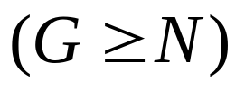
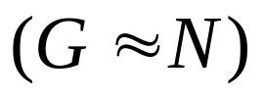

ALOHA
The ''frame time'' denotes the amount of time needed to transmit the standard, fixed-length frame.
Infinite population of users generates new frames according to a Poisson distribution with mean N frames per frame time.
In addition to the new frames, the stations also generate retransmissions of frames that previously suffered collisions.
Let us further assume that the probability of k transmission attempts per frame time, old and new combined, is also Poisson, with mean G per frame time.
At low load :
At high load G > N.

Slide 15
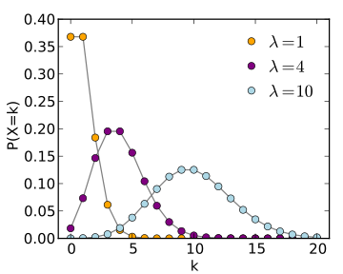
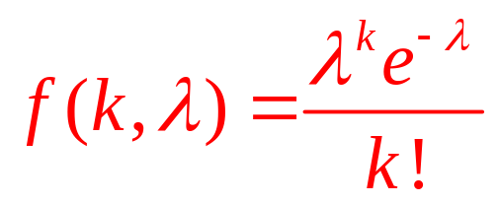
Poisson distribution
e is the base of the natural logarithm (e = 2.71828)
k is the number of occurrences of an event - the probability of which is given by the function
k! is the factorial of k
λ is a positive real number, equal to the expected number of occurrences
Some examples of such situations are
i) Telephone trunk lines with a large number of subscribers and the probability of telephone lines being available is very small.
ii) Traffic problems with repeated occurrence of events such as accidents whose probability is very small,
iii) Many industrial processes undergoing mass scale production with probability of events as 'faults' or 'breakdowns' being very small, etc.

Slide 16
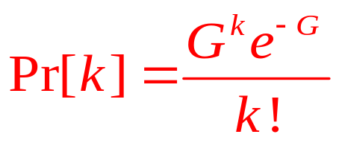
ALOHA
G is the average frames generated by the system during T_{fr}
Under all loads, the Throughput, S, is:
The offered load, G, times the probability, P₀, of a transmission succeeding
S = GP₀, where P₀ is the probability that a frame does not suffer a collision.
The probability that k frames are generated during a given frame time by the Poisson distribution:
Probability of zero frames: e^{-G}
In an interval two frames number of frames generated is 2G
Probability that no other traffic during vulnerable period
P₀= e^{-2G}
S = G e^{-2G}

Slide 17
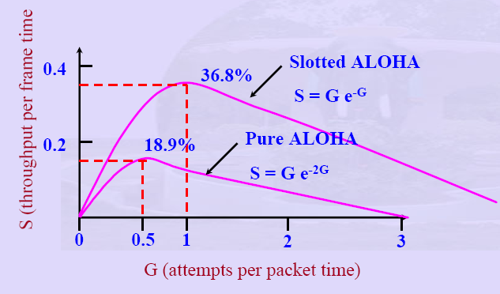
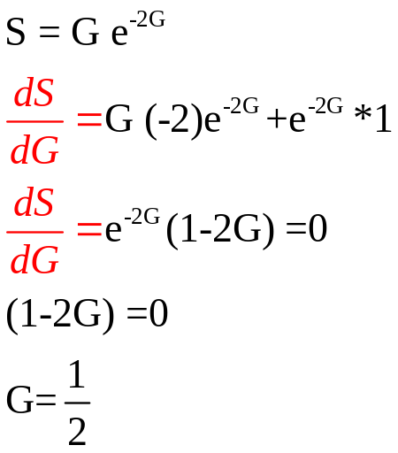
ALOHA
The maximum throughput occurs at G = 0.5, with S = 1/2e, which is about 0.184. In other words, the best we can hope for is a channel utilization of 18 percent.

Slide 18
The throughput for pure ALOHA is
S = G × e ^{−2G} .
The maximum throughput
S_{max} = 0.184 when G= (1/2).

Slide 19
Example
A pure ALOHA network transmits 200-bit frames on a shared channel of 200 kbps. What is the throughput if the system (all stations together) produces
a. 1000 frames per second b. 500 frames per second
c. 250 frames per second.
Solution
The frame transmission time is 200/200 kbps or 1 ms.
If the system creates 1000 frames per second, this is 1
frame per millisecond. The load is 1 (G=1000*1ms=1). In this case S = G× e^{−2 G} or S = 0.135 (13.5 percent). This means that the throughput is 1000 × 0.135 = 135 frames. Only 135 frames out of 1000 will probably survive.

Slide 20
Example
b. If the system creates 500 frames per second, this is
(1/2) frame per millisecond. The load is G=500*1ms=0.5. In
this case S = G × e ^{−2G} or S = 0.184 (18.4 percent). This
means that the throughput is 500 × 0.184 = 92 and that
only 92 frames out of 500 will probably survive. Note
that this is the maximum throughput case,
percentagewise.
c. If the system creates 250 frames per second, this is (1/4)
frame per millisecond. The load is 250*1ms=0.25. In this
case S = G × e −^{2G} or S = 0.152 (15.2 percent). This means
that the throughput is 250 × 0.152 = 38. Only 38
frames out of 250 will probably survive.

Slide 21
ALOHA
Slotted ALOHA

Slide 22

Slotted ALOHA: Assumptions
Slotted ALOHA
All frames are of same size.
Time is divided into slots of size L/R seconds time (equal size slots)
  R: Time to transmit 1 frame
Start to transmit frames only at beginning of slots
Nodes are synchronized so that each node knows when the slots begin.
If two or more frames collide in a slot, then all the nodes detect the collision event before the slot ends.

Slide 23
Slotted ALOHA: Operation
Slotted ALOHA
when node obtains fresh frame, it transmits in next slot
If no collision is detected , node can send new frame in next slot
If collision, node retransmits frame in each subsequent slot with prob. p until success
Vulnerable time = T_{fr}
The number of collisions is reduced. And hence, the performance become much better compared to Pure Aloha.

Slide 24

Slotted ALOHA
Frames in a slotted ALOHA network

Slide 25

Slotted ALOHA
Vulnerable time for slotted ALOHA protocol

Slide 26
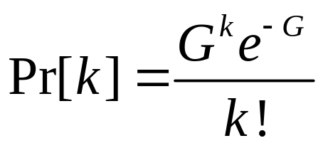
Slotted ALOHA
Under all loads, the throughput, S, is just the offered load, G, times the probability, P₀, of a transmission succeeding—that is,
S = GP₀, where P₀ is the probability that a frame does not suffer a collision.
The probability that k frames are generated during a given frame time by the Poisson distribution:
Probability of zero frames: e^{-G}
In an interval one frame long – number of frames generated is G
Probability that no other traffic during vulnerable period
P₀= e^{-G}
S = G e^{-G}

Slide 27
Slotted ALOHA
The throughput for slotted ALOHA is
S = G × e^{−G} .
The maximum throughput
S_{max} = 0.368 when G = 1.

Slide 28
Example
A slotted ALOHA network transmits 200-bit frames on a shared channel of 200 kbps. What is the throughput if the system (all stations together) produces
a. 1000 frames per second b. 500 frames per second
c. 250 frames per second.
Solution
The frame transmission time is 200/200 kbps or 1 ms.
a. If the system creates 1000 frames per second, this is 1
frame per millisecond. The load is 1. In this case
S = G× e^{−G} or S = 0.368 (36.8 percent). This means
that the throughput is 1000 × 0.0368 = 368 frames.
Only 386 frames out of 1000 will probably survive.

Slide 29
Example
b. If the system creates 500 frames per second, this is
(1/2) frame per millisecond. The load is (1/2). In this
case S = G × e^{−G} or S = 0.303 (30.3 percent). This
means that the throughput is 500 × 0.0303 = 151.
Only 151 frames out of 500 will probably survive.
c. If the system creates 250 frames per second, this is (1/4)
frame per millisecond. The load is (1/4). In this case
S = G × e ^{−G} or S = 0.195 (19.5 percent). This means
that the throughput is 250 × 0.195 = 49. Only 49
frames out of 250 will probably survive.

Slide 30
CSMA
CSMA

Slide 31
Carrier Sense Multiple Access (CSMA)
To minimize the collision CSMA was developed, chance of collision was reduced
Station senses the channel before accessing medium.
The possibility of collision still exists because of propagation delay

Slide 32

Carrier Sense Multiple Access (CSMA)
Space/time model of the collision in CSMA
B
Area where Cs signal

Slide 33

Carrier Sense Multiple Access (CSMA)
Vulnerable time in CSMA

Slide 34


Carrier Sense Multiple Access (CSMA) persistence methods
1- persistence method:
If the channel is idle it sends its frame immediately with probability 1
Collision occurs, two or more stations may find the line idle and send their frames immediately

Slide 35
Carrier Sense Multiple Access (CSMA) persistence methods
Nonpersistent- method:
If the line is idle it sends its frame immediately.
If the line is busy it waits random amount of time and then senses the line again.
Reduces the collision because it is unlikely that two or more stations will wait the same amount of time and retry

Slide 36
Carrier Sense Multiple Access (CSMA) persistence methods
P-persistent- method:
It applies to slotted channels.
It senses the channel, If it is idle, it transmits with a probability p.
With a probability q = 1 - p, it waits for the next slot.
  If that slot is idle, it goes to step 1
  If the line is busy it act as though collision has occurred and uses the back off procedure .

Slide 37

Carrier Sense Multiple Access (CSMA) persistence methods
Behavior of three persistence methods

Slide 38

Carrier Sense Multiple Access (CSMA) persistence methods
Flow diagram for three persistence methods

Slide 39
CSMA/CD
CSMA/CD

Slide 40
Carrier Sense Multiple Access with collision detection (CSMA/CD)
Abort their transmissions as soon as they detect a collision
Waits a random period of time, and then tries again, assuming that no other station has started transmitting in the meantime.
Frame transmission time must be two times the maximum propagation time: Tfr = 2 × Tp
Energy levels: zero, Normal Abnormal.

Slide 41

Carrier Sense Multiple Access with collision detection (CSMA/CD)
Collision of the first bit in CSMA/CD
A transmits for a duration t4-t1
C transmits for a duration t3-t2

Slide 42

Carrier Sense Multiple Access with collision detection (CSMA/CD)
Collision and abortion in CSMA/CD
Once the entire frame is sent station does not keep a copy of the frame
Tfr=2Tp

Slide 43

Carrier Sense Multiple Access with collision detection (CSMA/CD)
Flow diagram for the CSMA/CD

Slide 44

Carrier Sense Multiple Access with collision detection (CSMA/CD)
Energy level during transmission, idleness, or collision

Slide 45
Example
A network using CSMA/CD has a bandwidth of 10 Mbps. If the maximum propagation time (including the delays in the devices and ignoring the time needed to send a jamming signal, as we see later) is 25.6 μs, what is the minimum size of the frame?
Solution
The frame transmission time is T_{fr} = 2 × T_{p} = 51.2 μs. This means, in the worst case, a station needs to transmit for a period of 51.2 μs to detect the collision. The minimum size of the frame is 10 Mbps × 51.2 μs = 512 bits or 64 bytes. This is actually the minimum size of the frame for Standard Ethernet.

Slide 46
CSMA/CA
CSMA/CA

Slide 47
Carrier Sense Multiple Access with collision Avoidance (CSMA/CA)
When there is collision the station receives two signals: its own and the signal transmitted by a second station.
In wired N/W received signal is the same as the sent signal (Losses are less).
In wireless N/W much of the sent energy is lost in transmission (Transmission Losses).
Avoid collision on wireless network because they cannot be detected.

Slide 48
Carrier Sense Multiple Access with collision Avoidance (CSMA/CA)
When channel is free waits for period of time called the interframe space or IFS.
After IFS time the station still waits to a time equal to the contention time
Contention window is an amount of time divided into slots.

Slide 49

Carrier Sense Multiple Access with collision Avoidance (CSMA/CA)
Timing in CSMA/CA

Slide 50
Carrier Sense Multiple Access with collision Avoidance (CSMA/CA)
In CSMA/CA, the IFS can also be used to define the priority of a station or a frame.

Slide 51
Carrier Sense Multiple Access with collision Avoidance (CSMA/CA)
In CSMA/CA, if the station finds the channel busy, it does not restart the timer of the contention window;
it stops the timer and restarts it when the channel becomes idle.

Slide 52

Flow diagram for CSMA/CA

Slide 53
CONTROLLED ACCESS
In controlled access, the stations consult one another to find which station has the right to send. A station cannot send unless it has been authorized by other stations.
Reservation
Polling
Token Passing

Slide 54
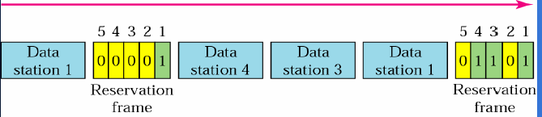

Reservation access method
A station must make a reservation before sending data
Time is divided into intervals
  A reservation frame proceeds each time interval
  Number of stations and number of time slots in the reservation frame are equal
  Each time slot belongs to a particular station

Slide 55

Reservation access method

Slide 56
Polling
Devises are categorized into:
  Primary station (PS)
  Secondary station (SS)
All data exchange must go through the primary station
Primary station controls the link and initiates the session
Secondary station obey the instructions of PS.
PS polls stations
  Asking SS if they have something to send
PS select a SS
  Telling it to get ready to receive data

Slide 57
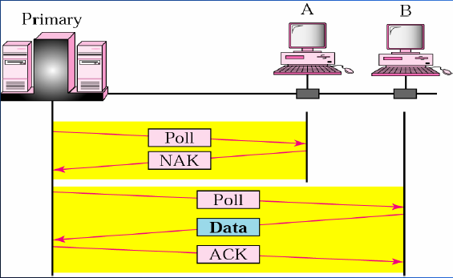
Poll procedure
Polling

Slide 58
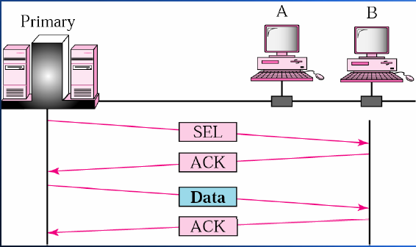
Select procedure
Polling

Slide 59

Polling
Select and poll functions in polling access method

Slide 60
Token passing
Stations in a network are organized in a logical ring, for each station, there is a predecessor and a successor
For a station to access the channel, it must posses a token (special packet) that gives the station the right to access the channel and send its data
Once the station has finished its task, the token will then be passed to the successor (next station)
The station cannot send data until it receives the token again in the next round
Token management is necessary
  Every station is limited in the time of token possession
  Token must be monitored to ensure no lose or destroyed
  Assign priorities to the stations and to the types of data transmitted
  To make low-priority stations release the token to high priority stations

Slide 61
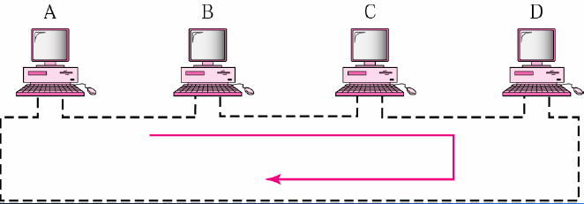
Token passing procedure

Slide 62

Token passing procedure
Logical Ring
  in a token passing network, stations do not have to be physically connected in a ring; the ring can be a logical one.

Slide 63
CHANNELIZATION
Channelization is a multiple-access method in which the available bandwidth of a link is shared in time, frequency, or through code, between different stations. In this section, we discuss three channelization protocols.
Frequency-Division Multiple Access (FDMA)
Time-Division Multiple Access (TDMA)
Code-Division Multiple Access (CDMA)

Slide 64
Frequency-division multiple access (FDMA)
In FDMA, the available bandwidth
of the common channel is divided into bands that are separated by guard bands.

Slide 65

Frequency-division multiple access (FDMA)

Slide 66
Time-division multiple access (TDMA)
In TDMA, the bandwidth is just one channel that is timeshared between different stations.

Slide 67

Time-division multiple access (TDMA)

Slide 68
Code-Division Multiple Access (CDMA)
In CDMA, one channel carries all transmissions simultaneously.

Slide 69

Code-Division Multiple Access (CDMA)
Simple idea of communication with code

Slide 70
Code-Division Multiple Access (CDMA)
Chip sequences

Slide 71
Code-Division Multiple Access (CDMA)
Data representation in CDMA

Slide 72

Code-Division Multiple Access (CDMA)
Sharing channel in CDMA

Slide 73

Code-Division Multiple Access (CDMA)
Digital signal created by four stations in CDMA

Slide 74

Code-Division Multiple Access (CDMA)
Decoding of the composite signal for one in CDMA

Slide 75

Code-Division Multiple Access (CDMA)
General rule and examples of creating Walsh tables

Slide 76
Code-Division Multiple Access (CDMA)
The number of sequences in a Walsh table needs to be N = 2^{m}.

Slide 77
Example
Find the chips for a network with
a. Two stations b. Four stations
Solution
We can use the rows of W2 and W4 in Figure 12.29:
a. For a two-station network, we have
[+1 +1] and [+1 −1].
b. For a four-station network we have
[+1 +1 +1 +1], [+1 −1 +1 −1],
[+1 +1 −1 −1], and [+1 −1 −1 +1].

Slide 78
Example
What is the number of sequences if we have 90 stations in our network?
Solution
The number of sequences needs to be 2^{m}. We need to choose m = 7 and N = 2⁷ or 128. We can then use 90
of the sequences as the chips.

Slide 79
Example
Prove that a receiving station can get the data sent by a specific sender if it multiplies the entire data on the channel by the sender’s chip code and then divides it by the number of stations.
Solution
Let us prove this for the first station, using our previous four-station example. We can say that the data on the channel
D = (d1 ⋅ c1 + d2 ⋅ c2 + d3 ⋅ c3 + d4 ⋅ c4).
The receiver which wants to get the data sent by station 1 multiplies these data by c1.

Slide 80
Example
Prove that a receiving station can get the data sent by a specific sender if it multiplies the entire data on the channel by the sender’s chip code and then divides it by the number of stations.
Solution
Let us prove this for the first station, using our previous four-station example. We can say that the data on the channel
D = (d1 ⋅ c1 + d2 ⋅ c2 + d3 ⋅ c3 + d4 ⋅ c4).
The receiver which wants to get the data sent by station 1 multiplies these data by c1.

Slide 81
Example
A group of N stations share a 56-kbps pure ALOHA channel. Each station outputs a 1000-bit frame on an average of once every 100 sec, even if the previous one has not yet been sent (e.g., the stations can buffer outgoing frames). What is the maximum value of N?
With pure ALOHA the usable bandwidth is 0.184 × 56 kbps = 10.3 kbps.
Each station requires 10 bps, so N = 10300/10 = 1030 stations

Slide 82
Example
Consider the delay of pure ALOHA versus slotted ALOHA at low load. Which one is less? Explain your answer.
With pure ALOHA, transmission can start instantly. At low load, no collisions are expected so the transmission is likely to be successful. With slotted ALOHA, it has to wait for the next slot. This introduces half a slot time of
delay.

Slide 83
Example
Ten thousand airline reservation stations are competing for the use of a single slotted ALOHA channel. The average station makes 18 requests/hour. A slot is 125 μsec. What is the approximate total channel load?
Total No. of stations=10,000
Average requset/station=18 req/hr (1req/200sec)
Total No of requests=18*1000=18000 req/hr
Or 50 requests/sec
Each terminal makes one request every 200 sec, for a total load of 50 requests/sec. Hence G = 50/8000 = 1/160.

Slide 84
Example
A large population of ALOHA users manages to generate 50 requests/sec, including both originals and retransmissions. Time is slotted in units of 40 msec.
  What is the chance of success on the first attempt?
  What is the probability of exactly k collisions and then a success?
  What is the expected number of transmission attempts needed?
  Solution
With G = 2 the Poisson law gives a probability of e⁻².
(1 − e^{−G})^{k}e−^{G} = 0.135 × 0.865k .
The expected number of transmissions is e^{G} = 7.4.

Slide 85
Example
Measurements of a slotted ALOHA channel with an infinite number of users show that 10 percent of the slots are idle.
  What is the channel load, G?
  What is the throughput?
  Is the channel underloaded or overloaded?
Solution:
From the Poisson law again, P₀ = e^{−G}, so G = −lnP₀ = −ln 0.1 = 2.3.
Using S = Ge^{−G} with G = 2.3 and e^{−G} = 0.1, S = 0.23.
Whenever G > 1 the channel is overloaded, so it is overloaded.

Slide 86
Example
In an infinite-population slotted ALOHA system, the mean number of slots a station waits between a collision and its retransmission is 4. Plot the delay versus throughput curve for this system.
The number of transmissions is E = eG. The E events are separated by E − 1 intervals of four slots each, so the delay is 4(eG − 1). The throughput is given by S = Ge−G. Thus, we have two parametric equations, one for delay and one
for throughput, both in terms of G. For each G value it is possible to find the corresponding delay and throughput, yielding one point on the curve.

Slide 87
Example
A 1-km-long, 10-Mbps CSMA/CD LAN (not 802.3) has a propagation speed of 200 m/μsec. Repeaters are not allowed in this system. Data frames are 256 bits long, including 32 bits of header, checksum, and other overhead. The first bit slot after a successful transmission is reserved for the receiver to capture the channel in order to send a 32-bit acknowledgement frame. What is the effective data rate, excluding overhead, assuming that there are no collisions?
The round-trip propagation time of the cable is 10 μsec. A complete transmission has six phases:
transmitter seizes cable (10 μsec)
transmit data (25.6 μsec)
Delay for last bit to get to the end (5.0 μsec)
receiver seizes cable (10 μsec) acknowledgement sent (3.2 μsec)
Delay for last bit to get to the end (5.0 μsec)
The sum of these is 58.8 μsec. In this period, 224 data bits are sent, for a rate of about 3.8 Mbps.

Slide 88
Example
Consider building a CSMA/CD network running at 1 Gbps over a 1-km cable with no repeaters. The signal speed in the cable is 200,000 km/sec. What is the minimum frame size?
For a 1-km cable, the one-way propagation time is 5 μsec, so 2τ = 10 μsec.
To make CSMA/CD work, it must be impossible to transmit an entire frame
in this interval. At 1 Gbps, all frames shorter than 10,000 bits can be completely
transmitted in under 10 μsec, so the minimum frame is 10,000 bits or
1250 bytes

Slide 89
Example
Consider building a CSMA/CD network running at 1 Gbps over a 1-km cable with no repeaters. The signal speed in the cable is 200,000 km/sec. What is the minimum frame size?
For a 1-km cable, the one-way propagation time is 5 μsec, so 2τ = 10 μsec.
To make CSMA/CD work, it must be impossible to transmit an entire frame
in this interval. At 1 Gbps, all frames shorter than 10,000 bits can be completely
transmitted in under 10 μsec, so the minimum frame is 10,000 bits or
1250 bytes

