Slide 1
Chapter 18
Virtual Circuit
Switching:
Frame Relay
and
ATM

Slide 2
18.1 Virtual Circuit Switching
Global Addressing
Virtual Circuit Identifier
Three Phases
Data Transfer Phase
Setup Phase
Teardown Phase

Slide 3
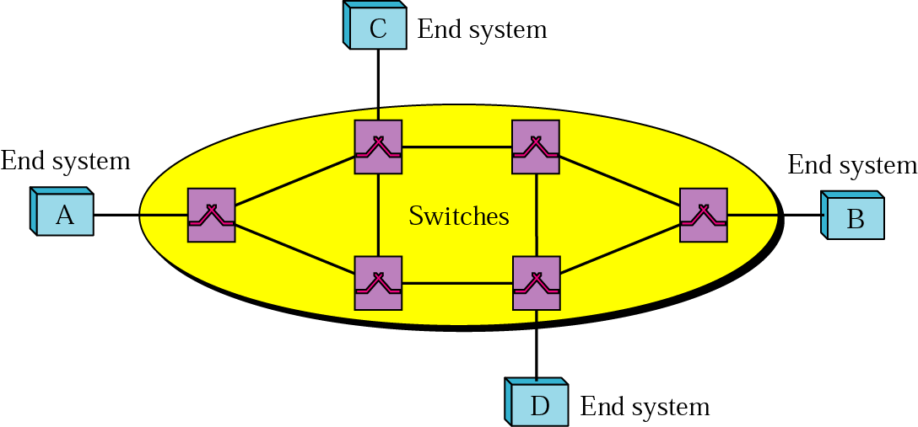
Figure 18.1 Virtual circuit wide area network

Slide 4
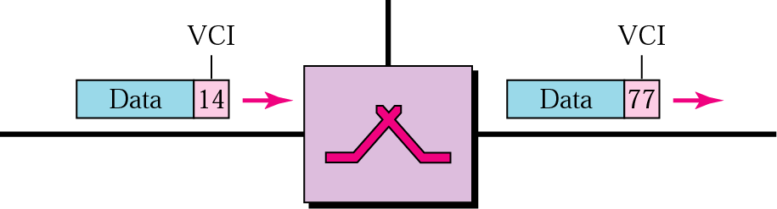
Figure 18.2 VCI

Slide 5
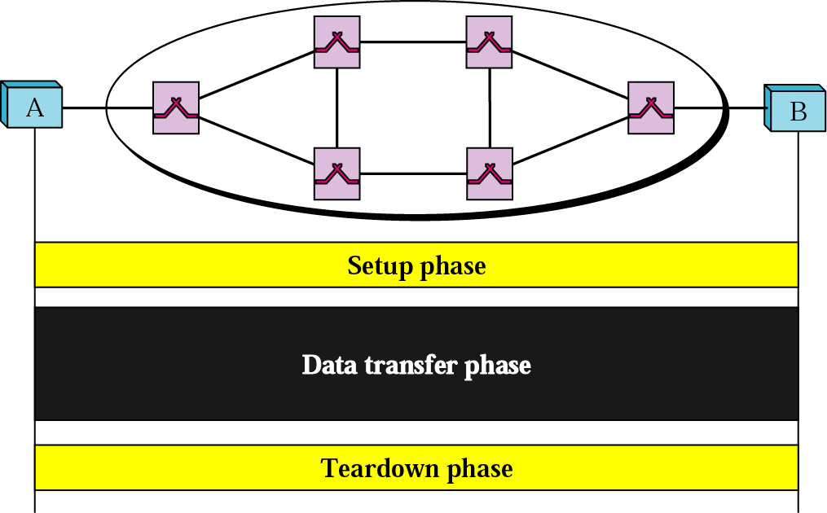
Figure 18.3 VCI phases

Slide 6
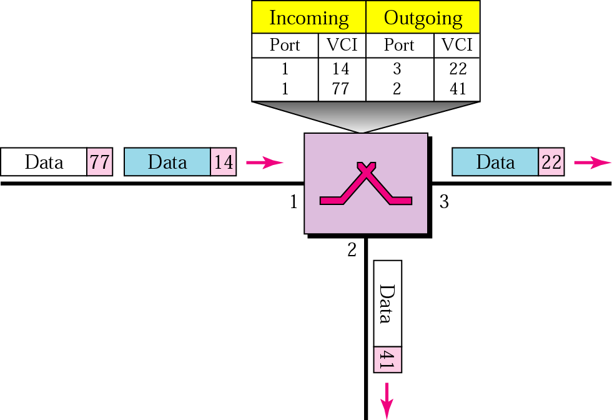
Figure 18.4 Switch and table

Slide 7
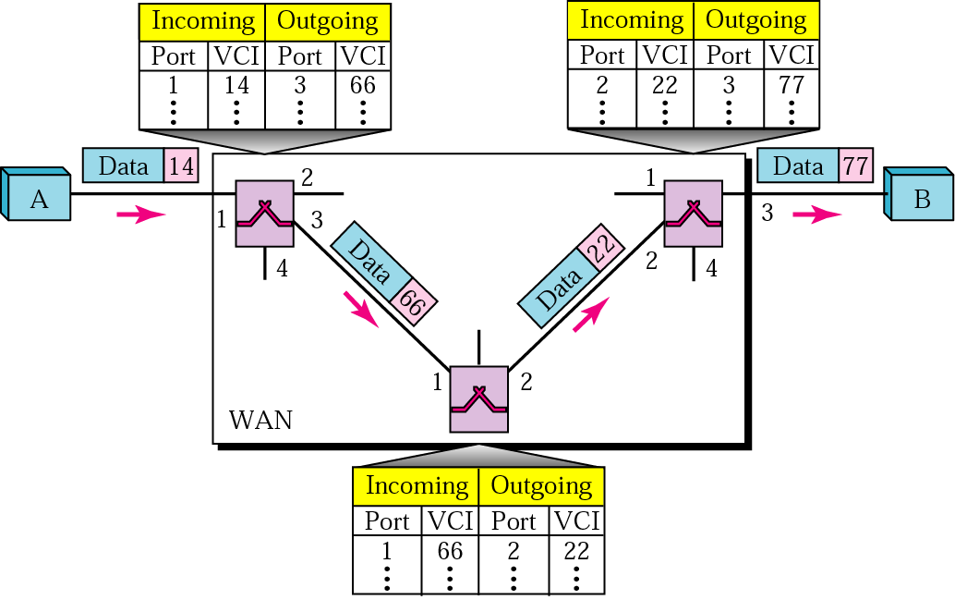
Figure 18.5 Source-to-destination data transfer

Slide 8
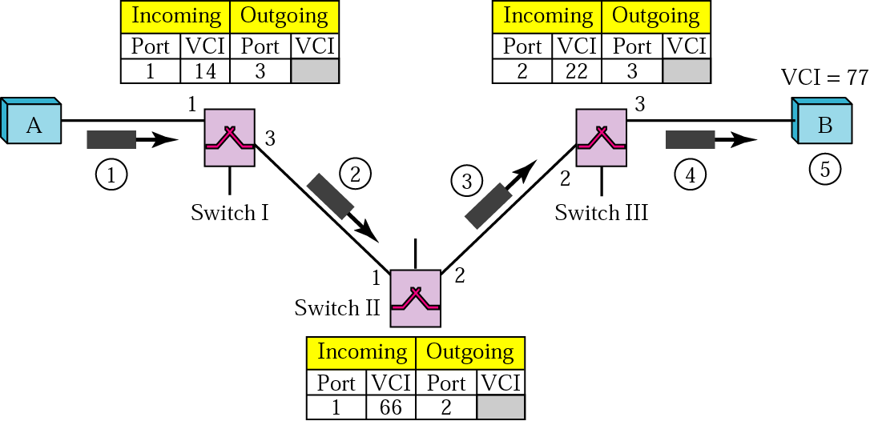
Figure 18.6 SVC setup request

Slide 9
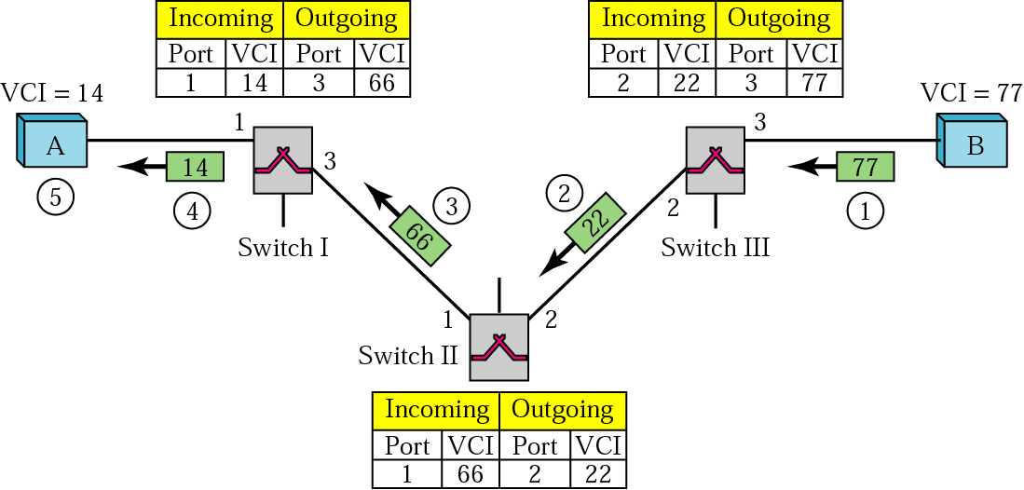
Figure 18.7 SVC setup acknowledgment

Slide 10
18.2 Frame Relay
Architecture
Frame Relay Layers
FRAD
VOFR
LMI

Slide 11
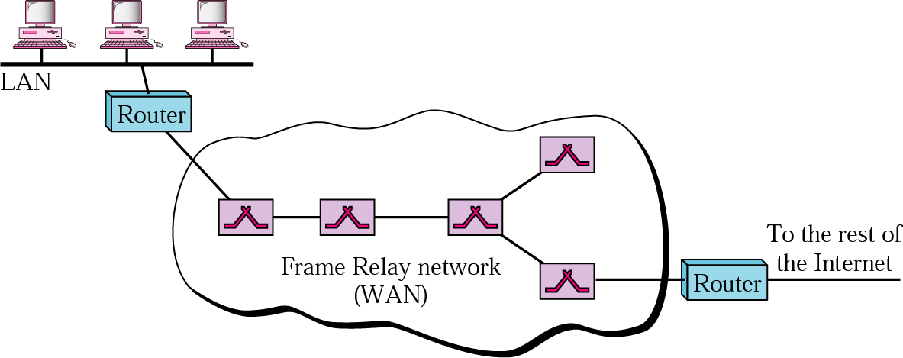
Figure 18.8 Frame Relay network

Slide 12

Note:
VCIs in Frame Relay are called DLCIs.

Slide 13
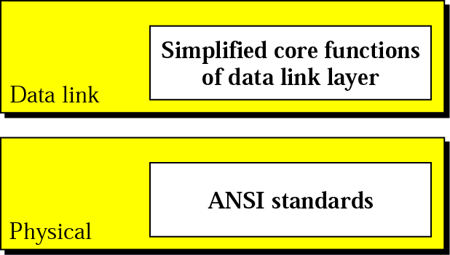
Figure 18.9 Frame Relay layers

Slide 14
Note:
Frame Relay operates only at the physical and data link layers.

Slide 15
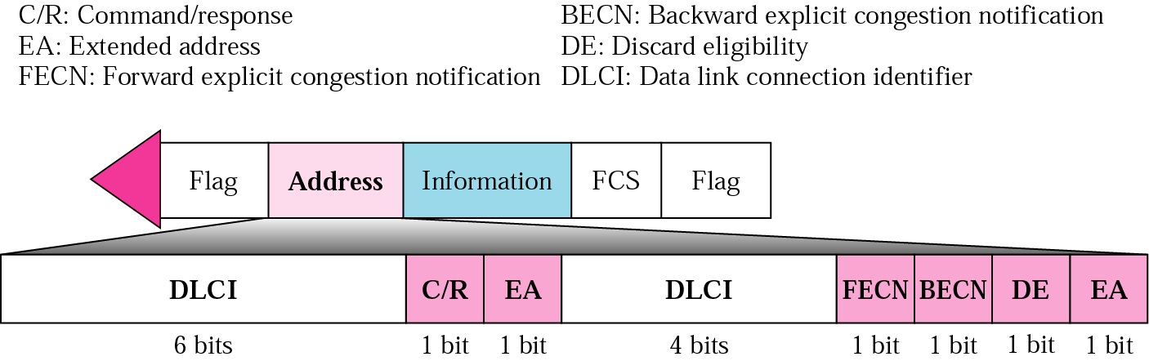
Figure 18.10 Frame Relay frame

Slide 16
Note:
Frame Relay does not provide flow or error control; they must be provided by the upper-layer protocols.

Slide 17
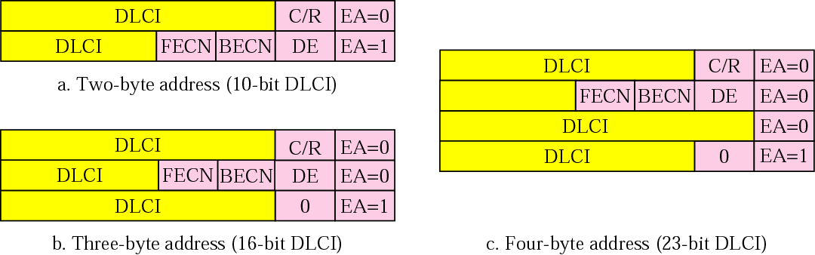
Figure 18.11 Three address formats

Slide 18
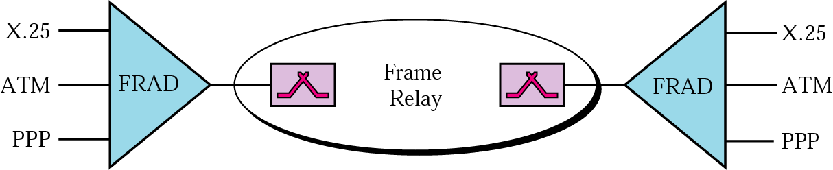
Figure 18.12 FRAD

Slide 19
18.3 ATM
Design Goals
Problems
Architecture
Switching
Layers

Slide 20
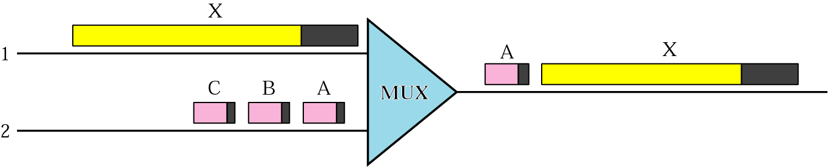
Figure 18.13 Multiplexing using different frame sizes

Slide 21
Note:
A cell network uses the cell as the basic unit of data exchange. A cell is defined as a small, fixed-sized
block of information.

Slide 22
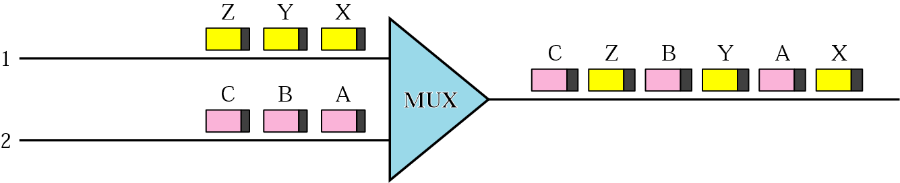
Figure 18.14 Multiplexing using cells

Slide 23
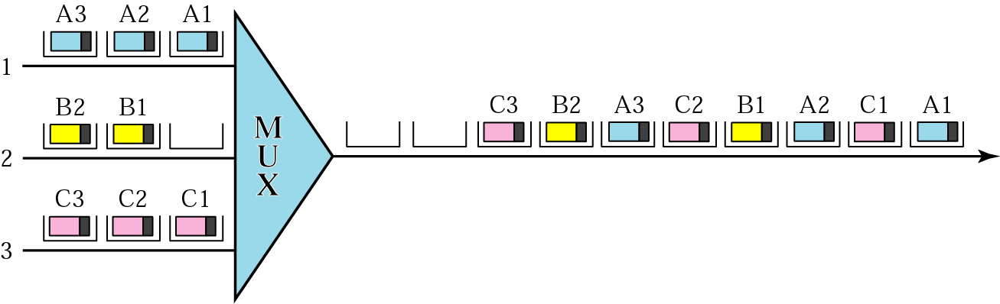
Figure 18.15 ATM multiplexing

Slide 24
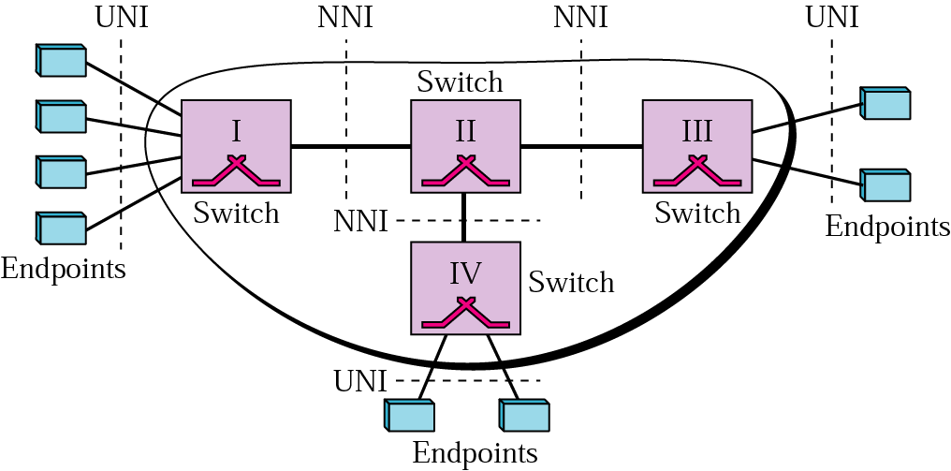
Figure 18.16 Architecture of an ATM network

Slide 25
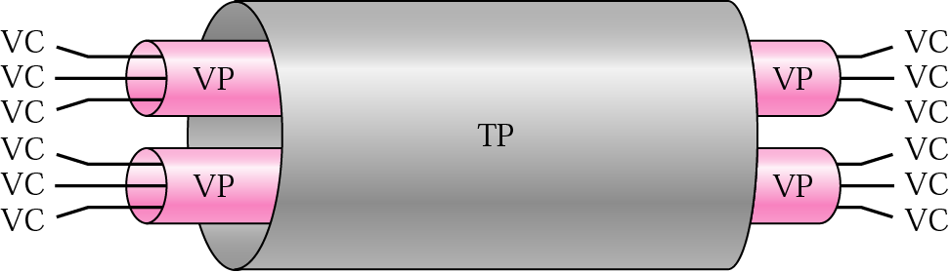
Figure 18.17 TP, VPs, and VCs

Slide 26
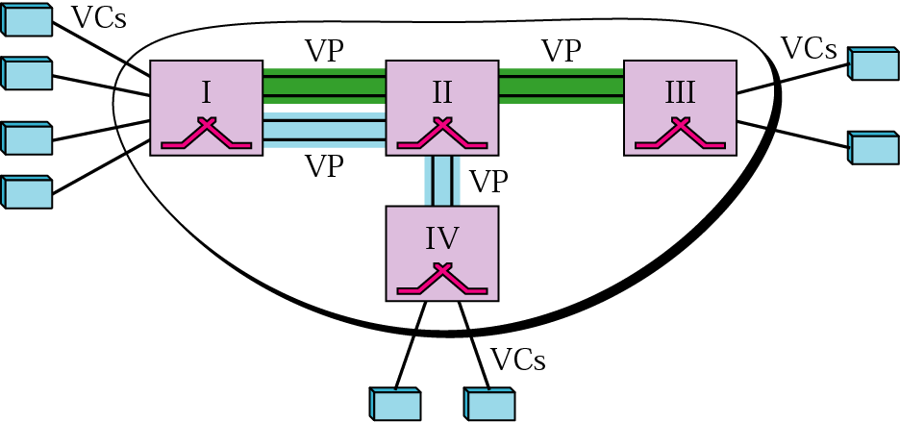
Figure 18.18 Example of VPs and VCs

Slide 27
Note:
Note that a virtual connection is defined by a pair of numbers:
the VPI and the VCI.

Slide 28
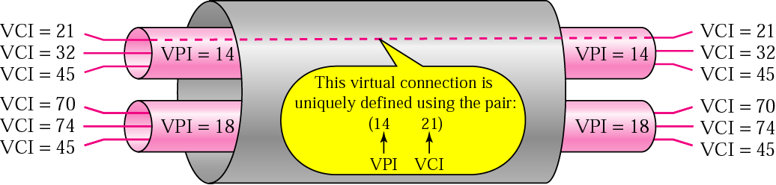
Figure 18.19 Connection identifiers

Slide 29
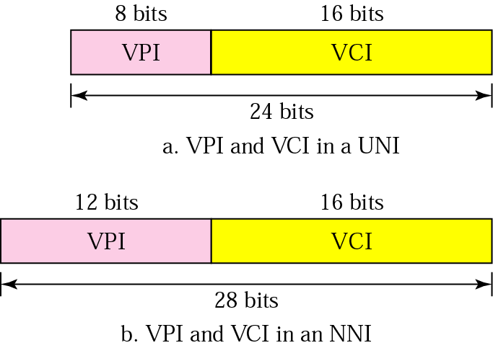
Figure 18.20 Virtual connection identifiers in UNIs and NNIs

Slide 30
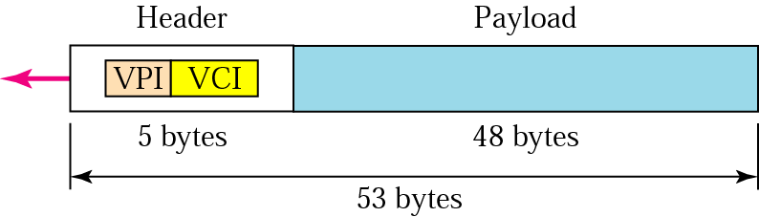
Figure 18.21 An ATM cell

Slide 31
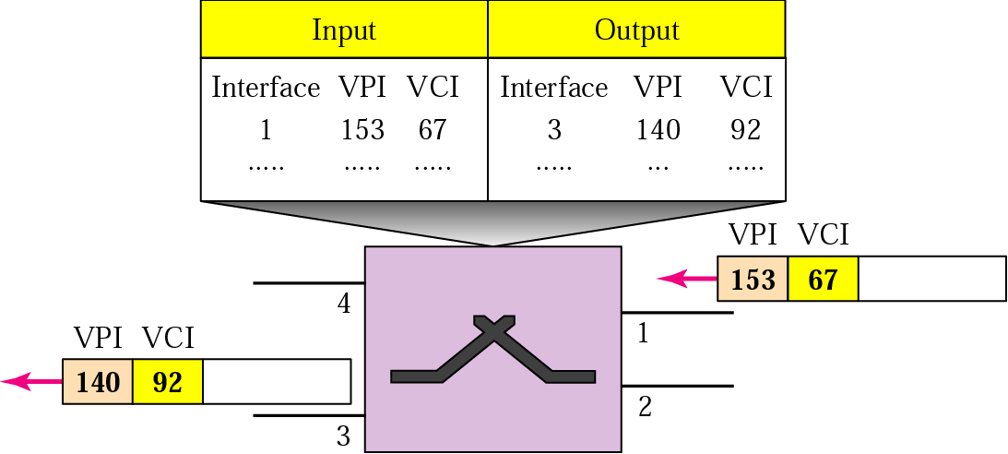
Figure 18.22 Routing with a switch

Slide 32
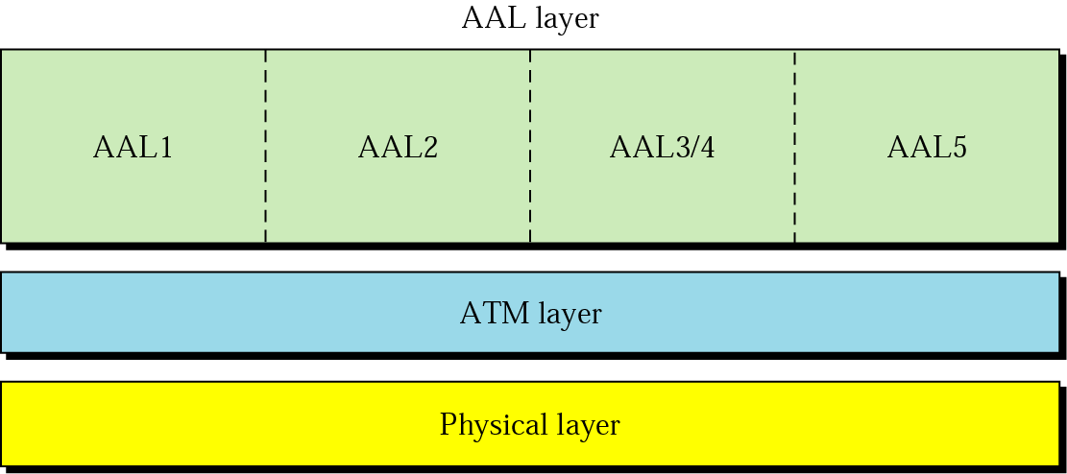
Figure 18.23 ATM layers

Slide 33
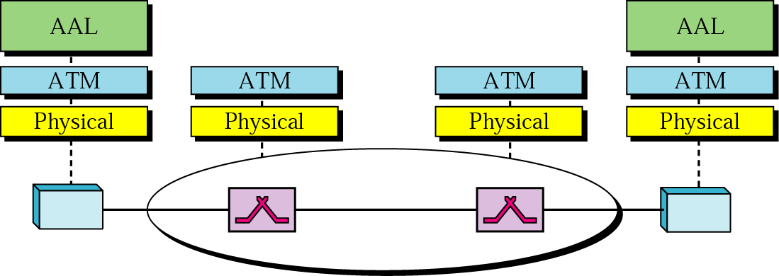
Figure 18.24 ATM layers in endpoint devices and switches

Slide 34
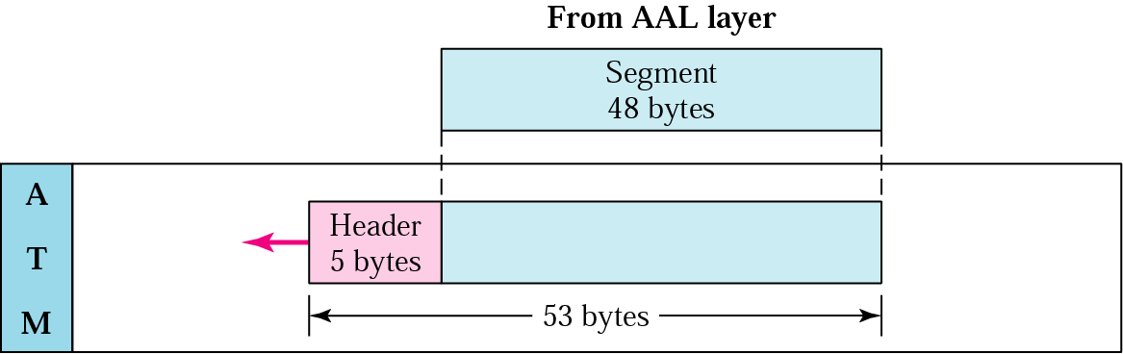
Figure 18.25 ATM layer

Slide 35
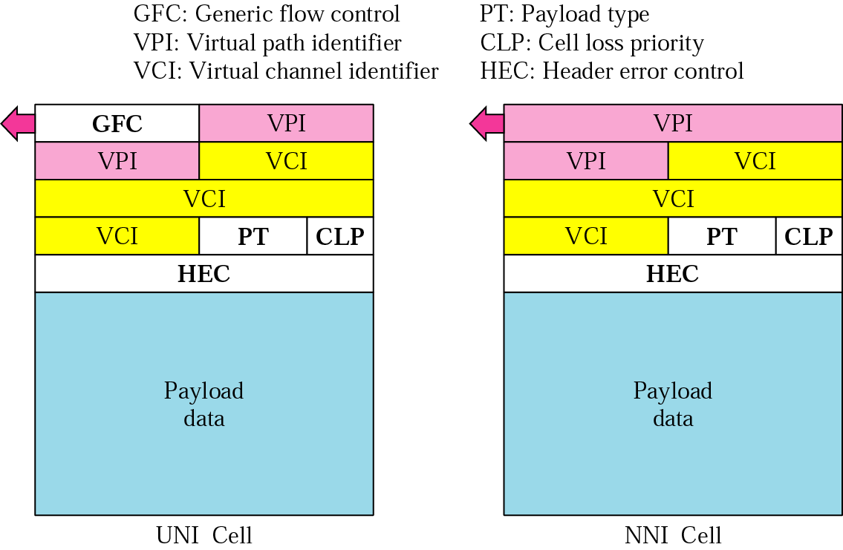
Figure 18.26 ATM headers

Slide 36
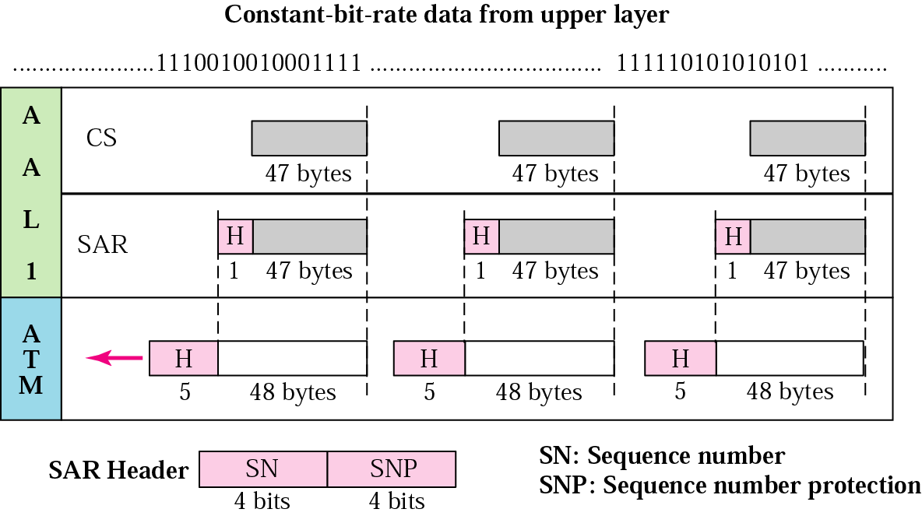
Figure 18.27 AAL1

Slide 37
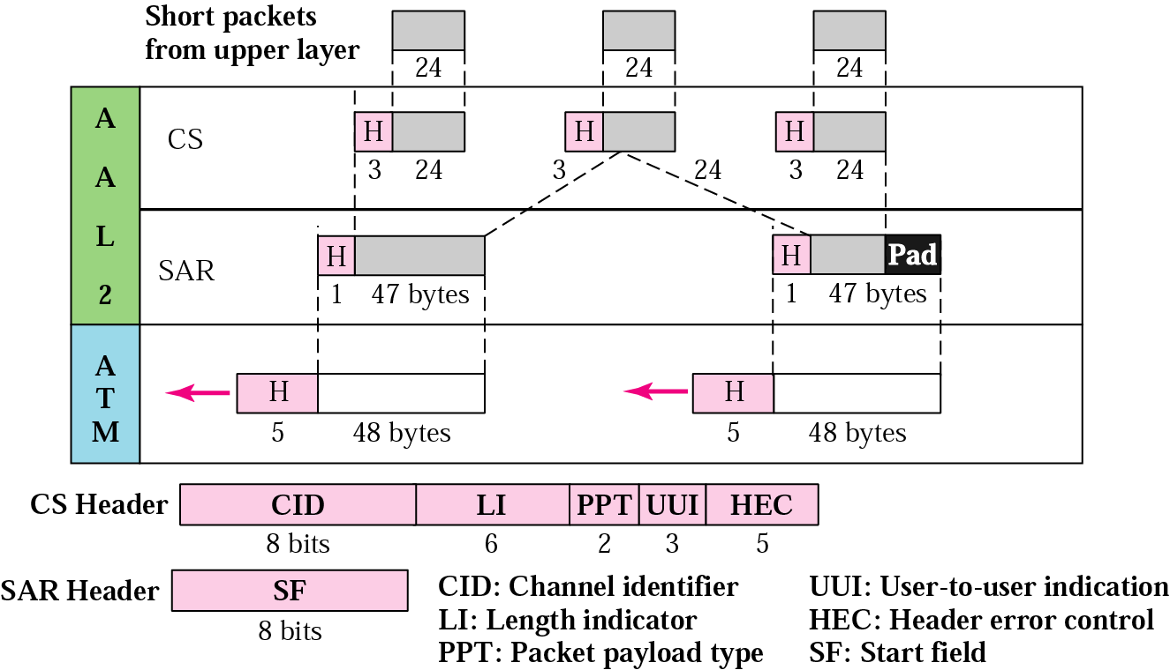
Figure 18.28 AAL2

Slide 38
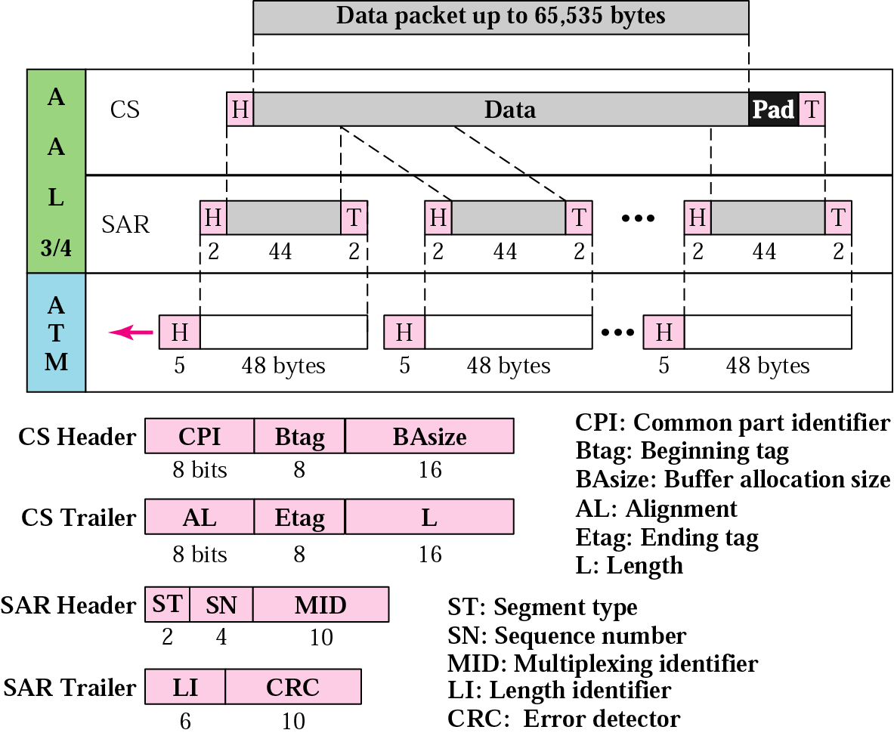
Figure 18.29 AAL3/4

Slide 39
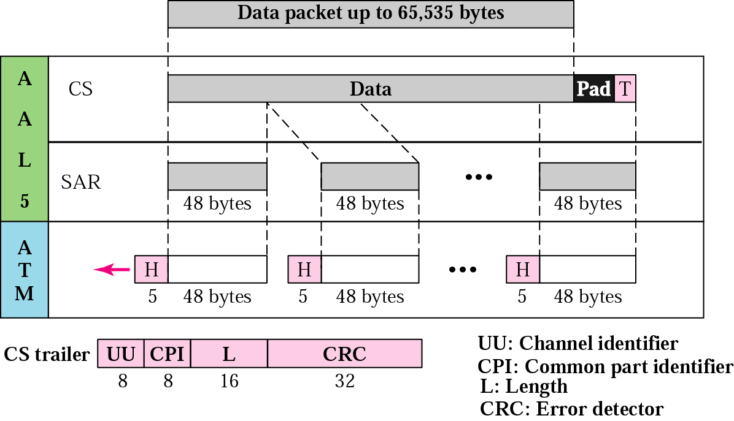
Figure 18.30 AAL5

