Slide 1
Chapter 4
Digital
Transmission

Slide 2
4.1 Line Coding
Some Characteristics
Line Coding Schemes
Some Other Schemes

Slide 3
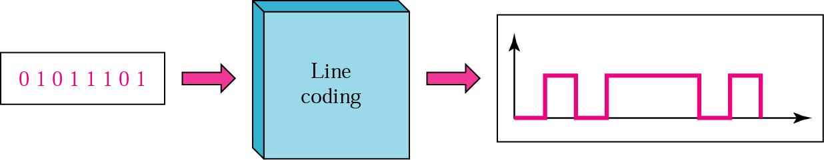
Figure 4.1 Line coding

Slide 4
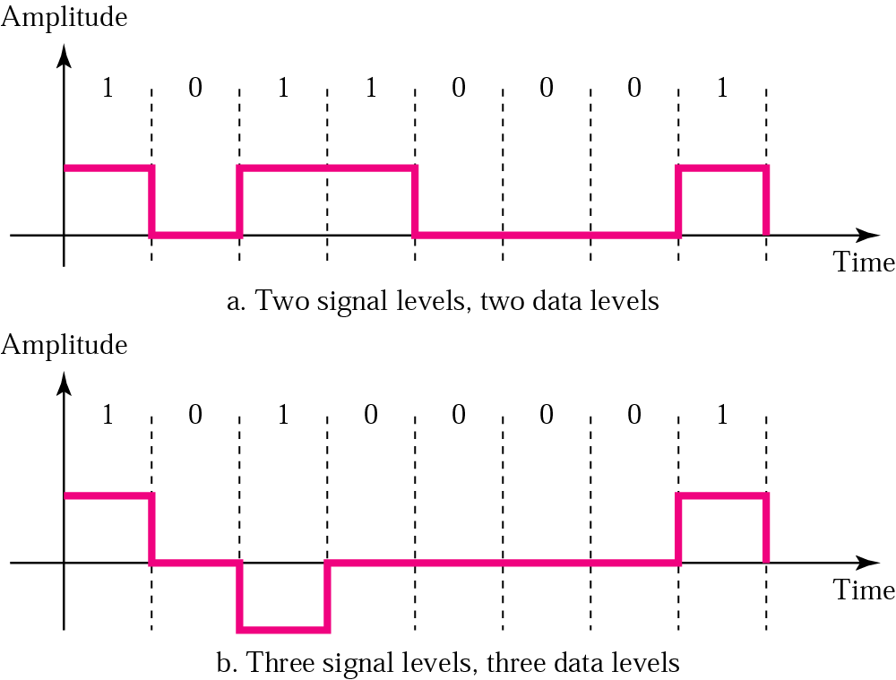
Figure 4.2 Signal level versus data level

Slide 5
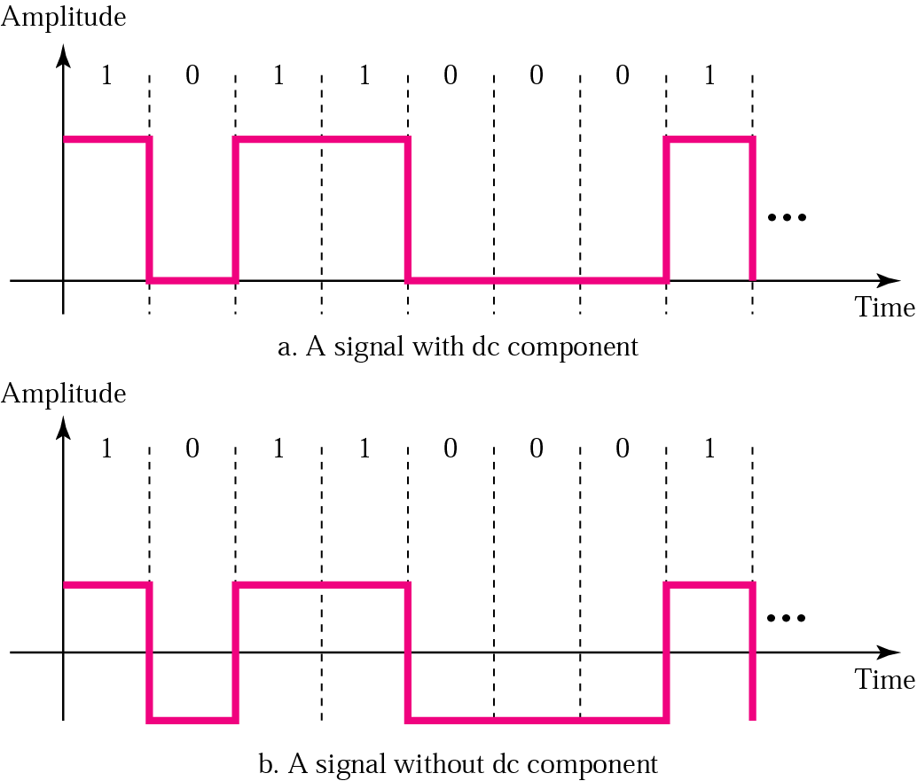
Figure 4.3 DC component

Slide 6
Example 1
A signal has two data levels with a pulse duration of 1 ms. We calculate the pulse rate and bit rate as follows:
Pulse Rate = 1/ 10⁻³= 1000 pulses/s
Bit Rate = Pulse Rate x log₂ L = 1000 x log₂ 2 = 1000 bps

Slide 7
Example 2
A signal has four data levels with a pulse duration of 1 ms. We calculate the pulse rate and bit rate as follows:
Pulse Rate = = 1000 pulses/s
Bit Rate = PulseRate x log₂ L = 1000 x log₂ 4 = 2000 bps

Slide 8
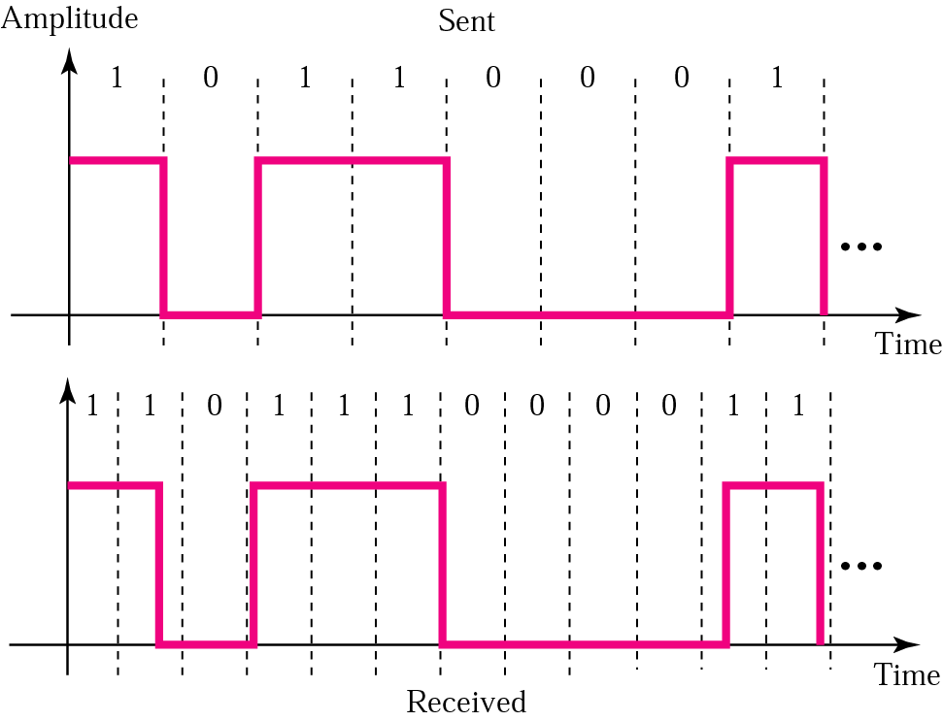
Figure 4.4 Lack of synchronization

Slide 9
Example 3
In a digital transmission, the receiver clock is 0.1 percent faster than the sender clock. How many extra bits per second does the receiver receive if the data rate is 1 Kbps? How many if the data rate is 1 Mbps?
Solution
At 1 Kbps:
1000 bits sent ➔1001 bits received➔1 extra bps
At 1 Mbps:
1,000,000 bits sent ➔1,001,000 bits received➔1000 extra bps

Slide 10
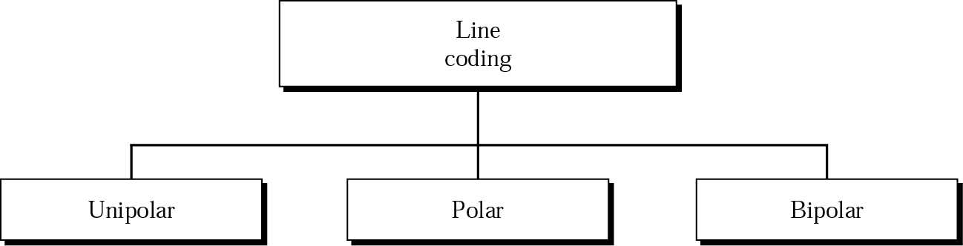
Figure 4.5 Line coding schemes

Slide 11

Note:
Unipolar encoding uses only one voltage level.

Slide 12
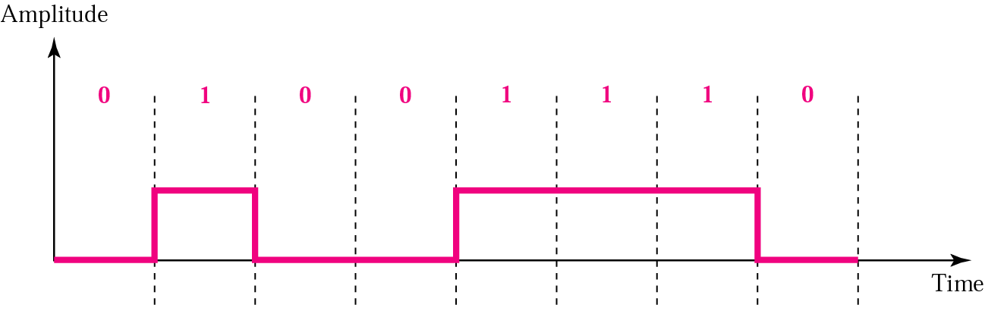
Figure 4.6 Unipolar encoding

Slide 13
Note:
Polar encoding uses two voltage levels (positive and negative).

Slide 14
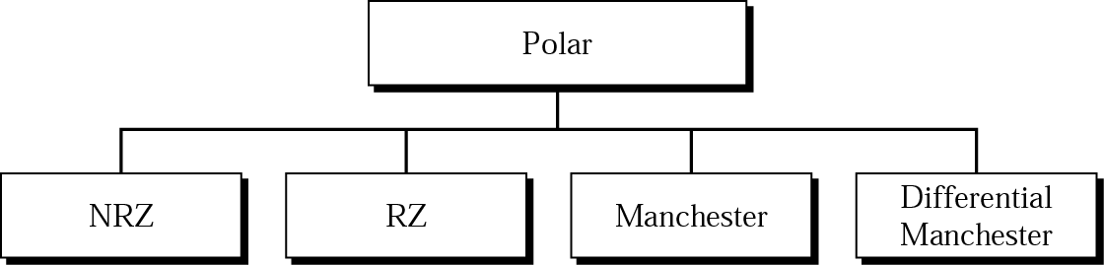
Figure 4.7 Types of polar encoding

Slide 15
Note:
In NRZ-L the level of the signal is dependent upon the state of the bit.

Slide 16
Note:
In NRZ-I the signal is inverted if a 1 is encountered.

Slide 17
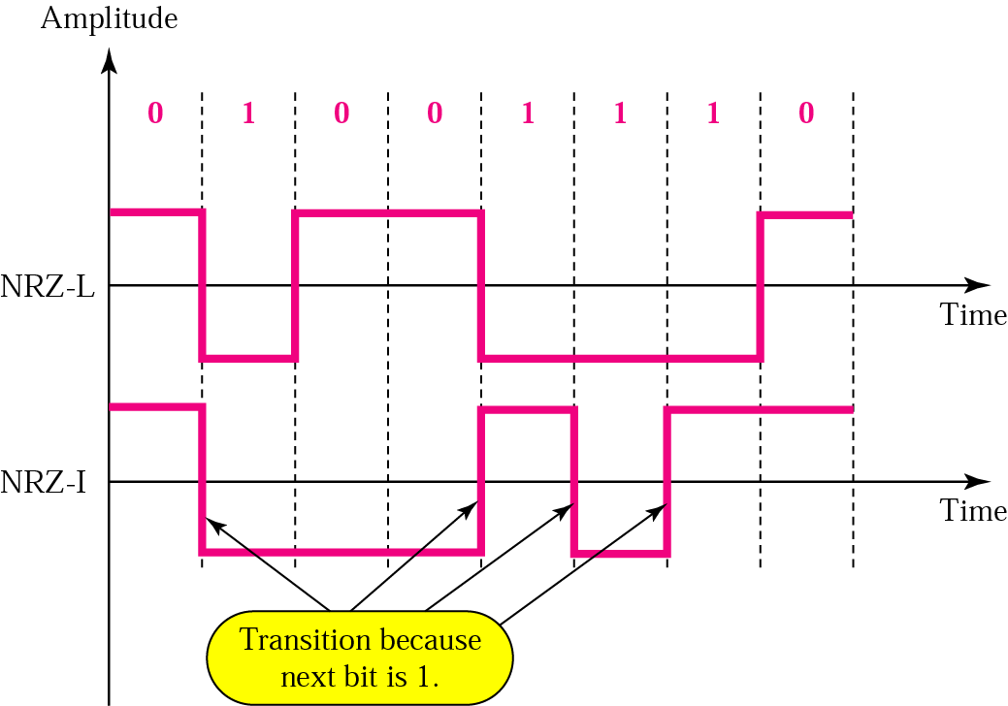
Figure 4.8 NRZ-L and NRZ-I encoding

Slide 18
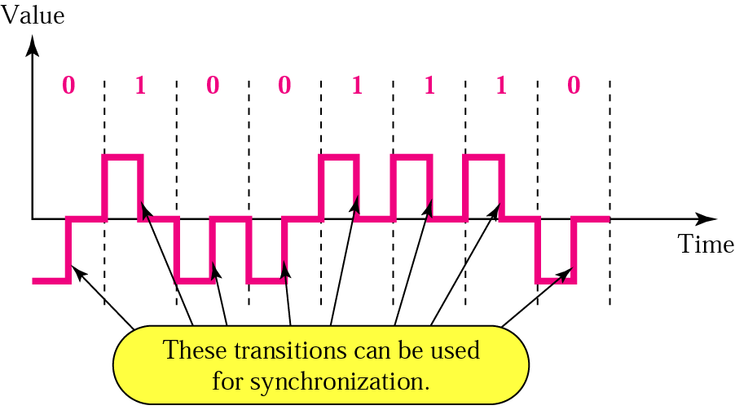
Figure 4.9 RZ encoding

Slide 19
Note:
A good encoded digital signal must contain a provision for synchronization.

Slide 20
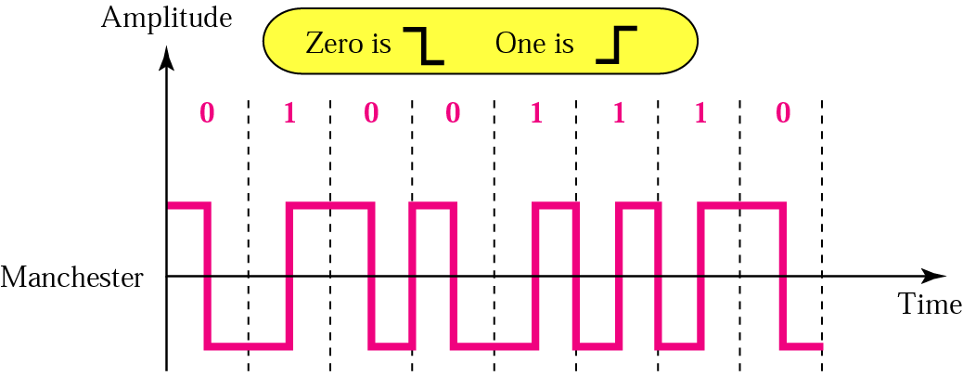
Figure 4.10 Manchester encoding

Slide 21
Note:
In Manchester encoding, the transition at the middle of the bit is used for both synchronization and bit representation.

Slide 22
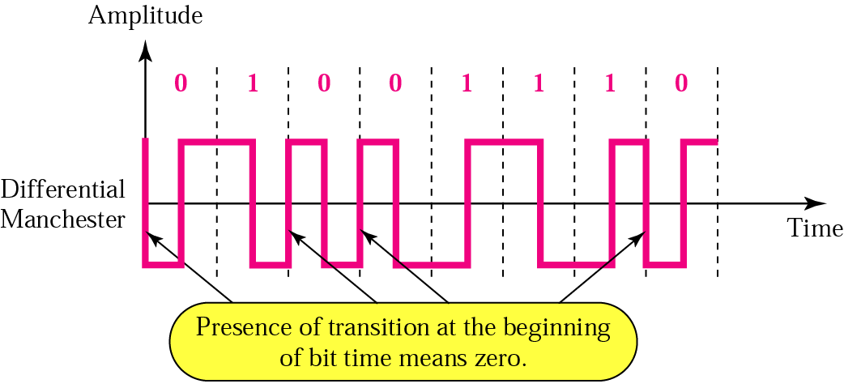
Figure 4.11 Differential Manchester encoding

Slide 23
Note:
In differential Manchester encoding, the transition at the middle of the bit is used only for synchronization.
The bit representation is defined by the inversion or noninversion at the beginning of the bit.

Slide 24
Note:
In bipolar encoding, we use three levels: positive, zero,
and negative.

Slide 25
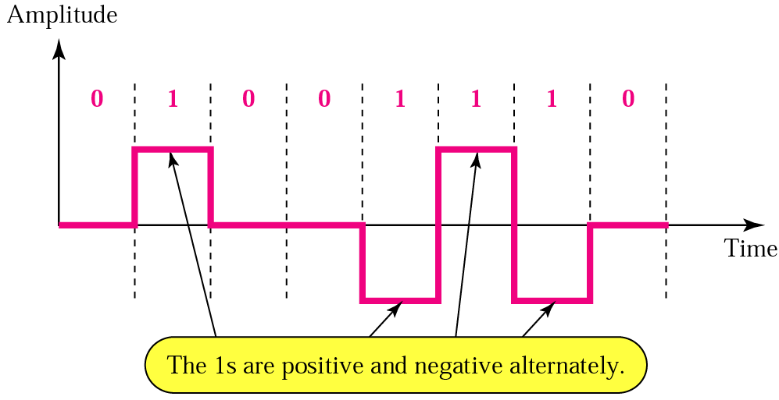
Figure 4.12 Bipolar AMI encoding

Slide 26
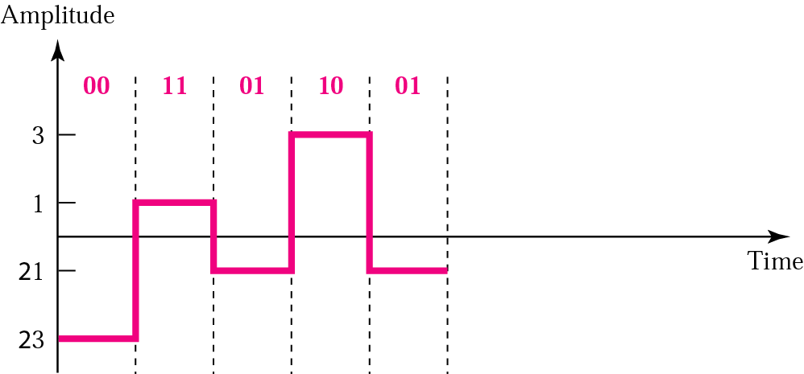
Figure 4.13 2B1Q

Slide 27
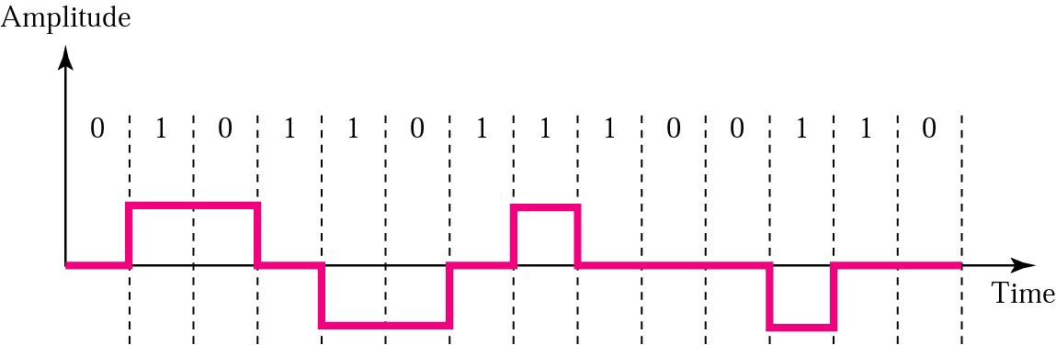
Figure 4.14 MLT-3 signal

Slide 28
4.2 Block Coding
Steps in Transformation
Some Common Block Codes

Slide 29
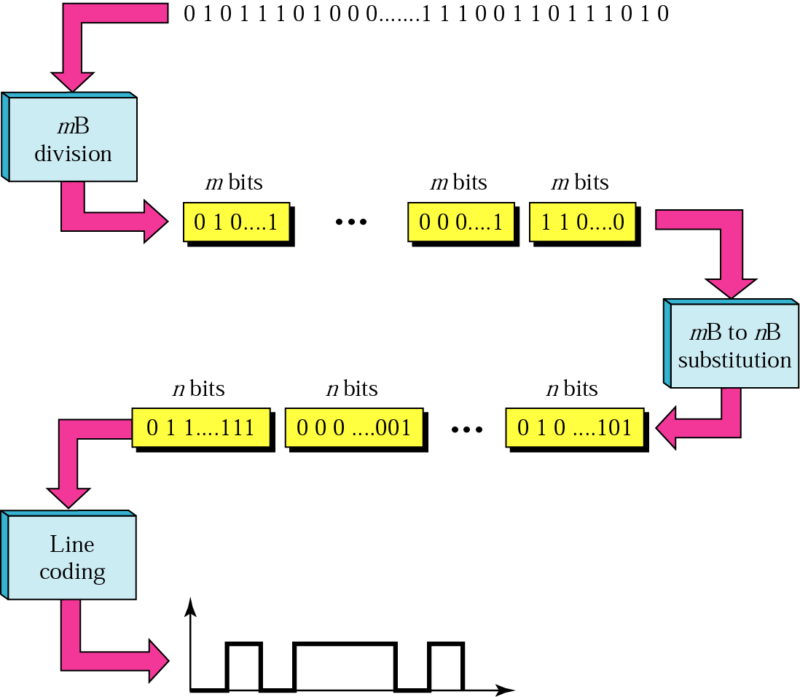
Figure 4.15 Block coding

Slide 30
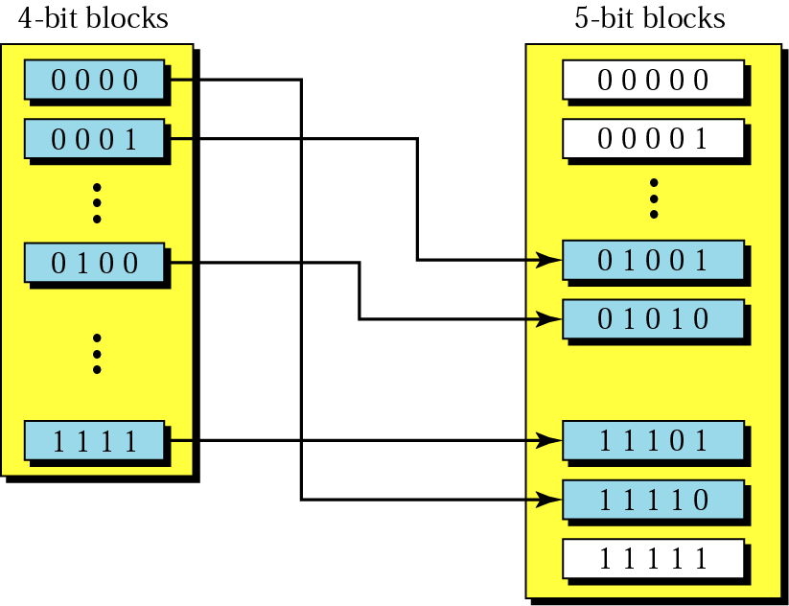
Figure 4.16 Substitution in block coding

Slide 31
Table 4.1 4B/5B encoding
Data | Code | Data | Code
0000 | 11110 | 1000 | 10010
0001 | 01001 | 1001 | 10011
0010 | 10100 | 1010 | 10110
0011 | 10101 | 1011 | 10111
0100 | 01010 | 1100 | 11010
0101 | 01011 | 1101 | 11011
0110 | 01110 | 1110 | 11100
0111 | 01111 | 1111 | 11101

Slide 32
Table 4.1 4B/5B encoding (Continued)
Data | Code
Q (Quiet) | 00000
I (Idle) | 11111
H (Halt) | 00100
J (start delimiter) | 11000
K (start delimiter) | 10001
T (end delimiter) | 01101
S (Set) | 11001
R (Reset) | 00111

Slide 33
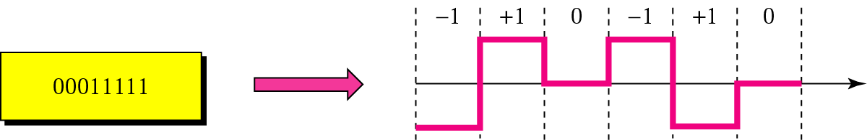
Figure 4.17 Example of 8B/6T encoding

Slide 34
4.3 Sampling
Pulse Amplitude Modulation
Pulse Code Modulation
Sampling Rate: Nyquist Theorem
How Many Bits per Sample?
Bit Rate

Slide 35
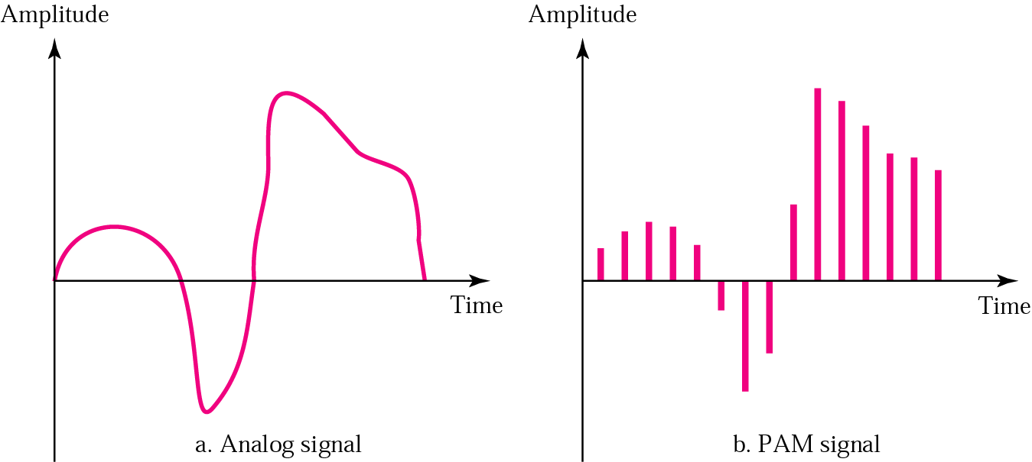
Figure 4.18 PAM

Slide 36
Note:
Pulse amplitude modulation has some applications, but it is not used by itself in data communication. However, it is the first step in another very popular conversion method called
pulse code modulation.

Slide 37
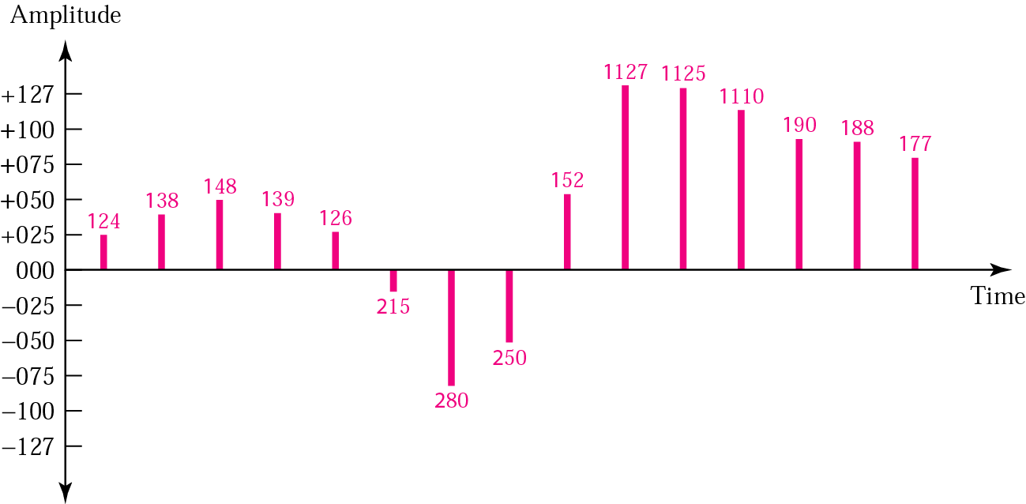
Figure 4.19 Quantized PAM signal

Slide 38
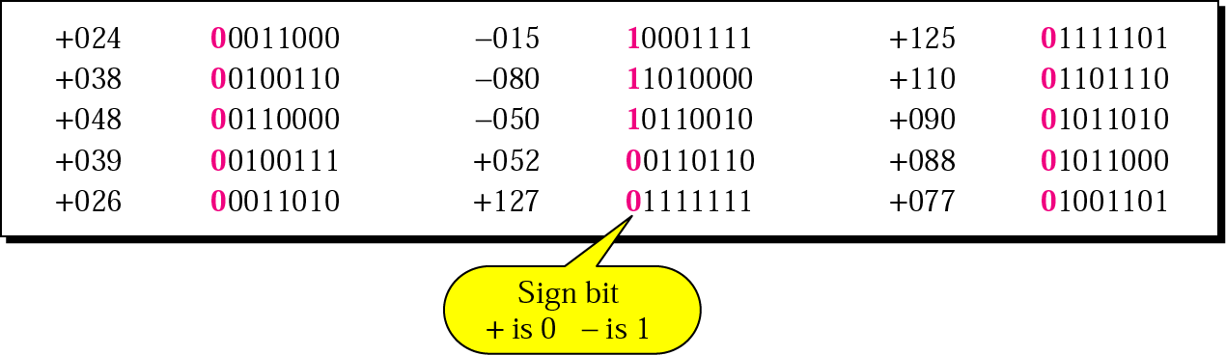
Figure 4.20 Quantizing by using sign and magnitude

Slide 39
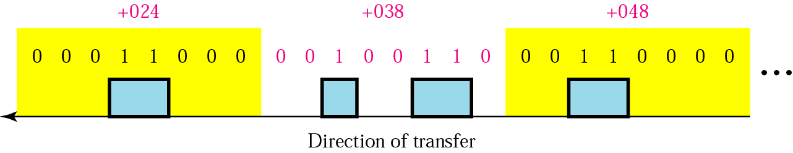
Figure 4.21 PCM

Slide 40
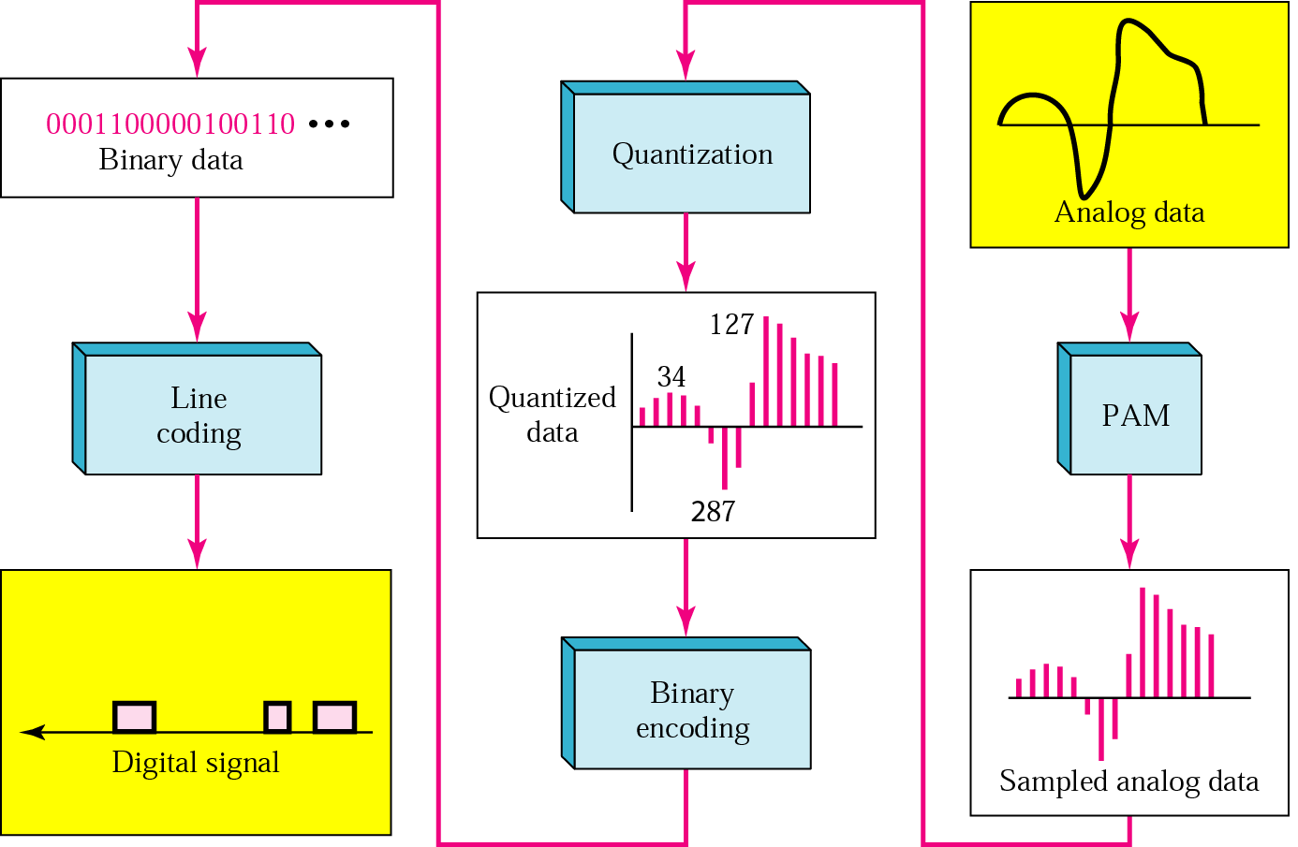
Figure 4.22 From analog signal to PCM digital code

Slide 41
Note:
According to the Nyquist theorem, the sampling rate must be at least 2 times the highest frequency.

Slide 42
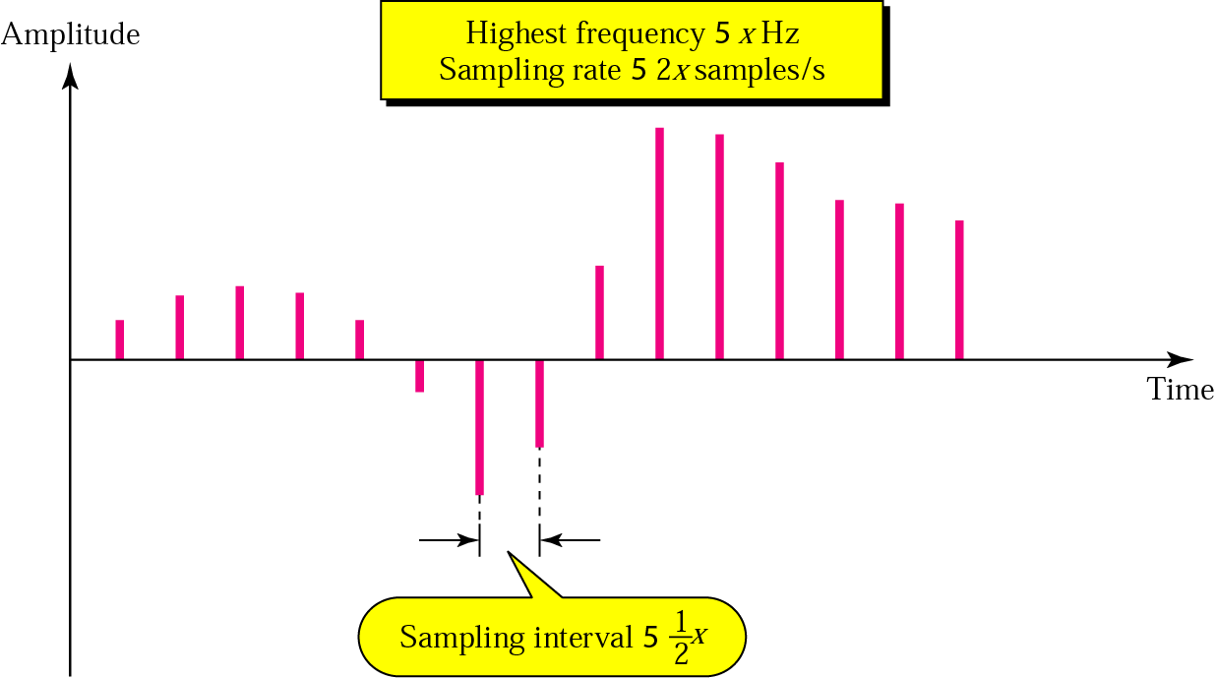
Figure 4.23 Nyquist theorem

Slide 43
Example 4
What sampling rate is needed for a signal with a bandwidth of 10,000 Hz (1000 to 11,000 Hz)?
Solution
The sampling rate must be twice the highest frequency in the signal:
Sampling rate = 2 x (11,000) = 22,000 samples/s

Slide 44
Example 5
A signal is sampled. Each sample requires at least 12 levels of precision (+0 to +5 and -0 to -5). How many bits should be sent for each sample?
Solution
We need 4 bits; 1 bit for the sign and 3 bits for the value. A 3-bit value can represent 2³ = 8 levels (000 to 111), which is more than what we need. A 2-bit value is not enough since 2² = 4. A 4-bit value is too much because 2⁴ = 16.

Slide 45
Example 6
We want to digitize the human voice. What is the bit rate, assuming 8 bits per sample?
Solution
The human voice normally contains frequencies from 0 to 4000 Hz.
Sampling rate = 4000 x 2 = 8000 samples/s
Bit rate = sampling rate x number of bits per sample
= 8000 x 8 = 64,000 bps = 64 Kbps

Slide 46
Note:
Note that we can always change a band-pass signal to a low-pass signal before sampling. In this case, the sampling rate is twice the bandwidth.

Slide 47
4.4 Transmission Mode
Parallel Transmission
Serial Transmission

Slide 48
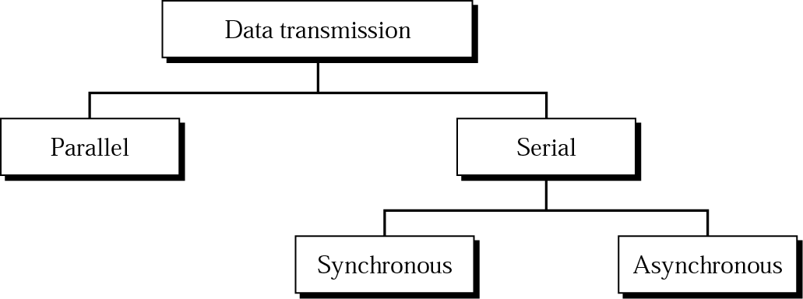
Figure 4.24 Data transmission

Slide 49
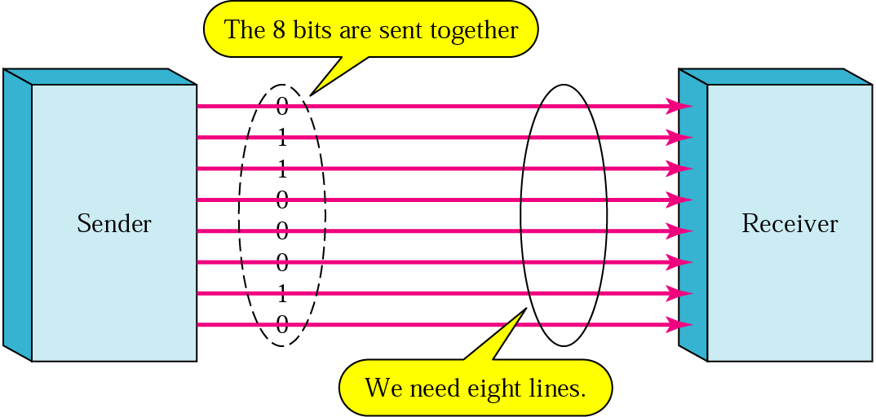
Figure 4.25 Parallel transmission

Slide 50
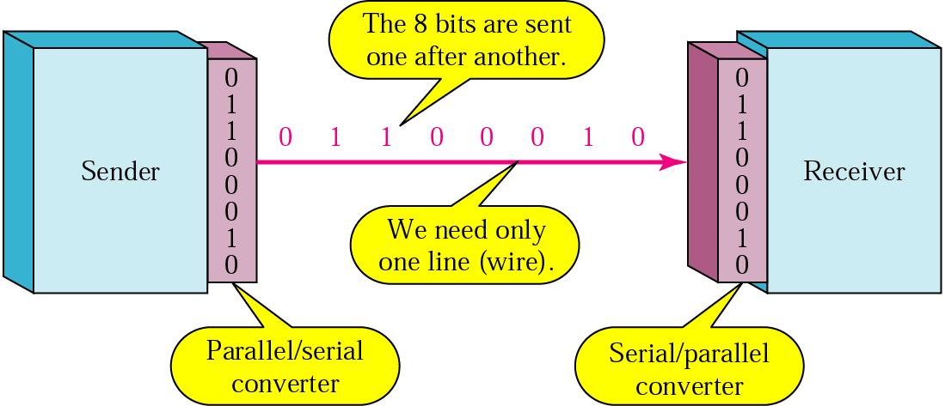
Figure 4.26 Serial transmission

Slide 51
Note:
In asynchronous transmission, we send 1 start bit (0) at the beginning and 1 or more stop bits (1s) at the end of each byte. There may be a gap between each byte.

Slide 52
Note:
Asynchronous here means “asynchronous at the byte level,” but the bits are still synchronized; their durations are the same.

Slide 53
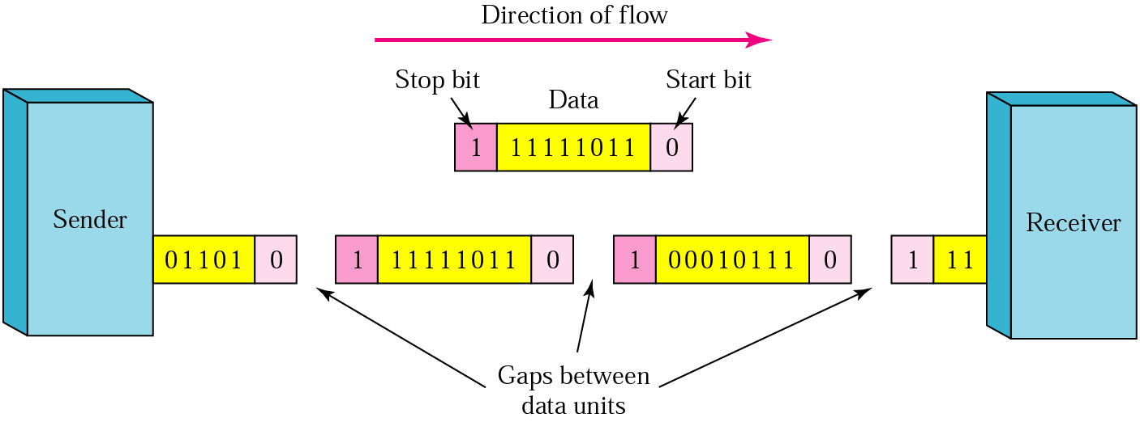
Figure 4.27 Asynchronous transmission

Slide 54
Note:
In synchronous transmission,
we send bits one after another without start/stop bits or gaps.
It is the responsibility of the receiver to group the bits.

Slide 55
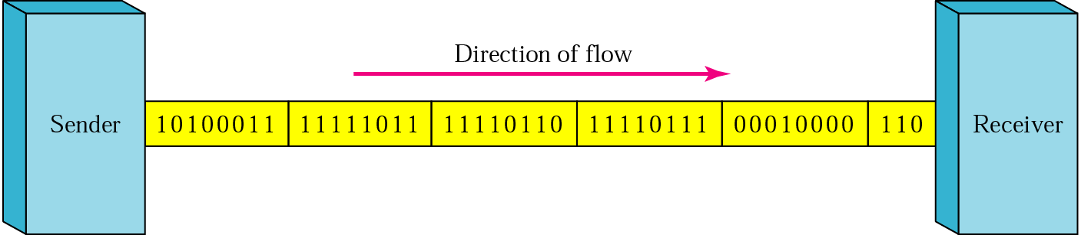
Figure 4.28 Synchronous transmission

