Slide 1
Chapter 9
High-Speed
Digital Access:
DSL, Cable Modem,
and SONET

Slide 2
9.1 DSL Technology
ADSL
Other DSL Technologies

Slide 3

Note:
ADSL is an asymmetric communication technology designed for residential users; it is not suitable for businesses.

Slide 4
Note:
The existing local loops can handle bandwidths up to 1.1 MHz.

Slide 5
Note:
ADSL is an adaptive technology. The system uses a data rate based on the condition of the local loop line.

Slide 6
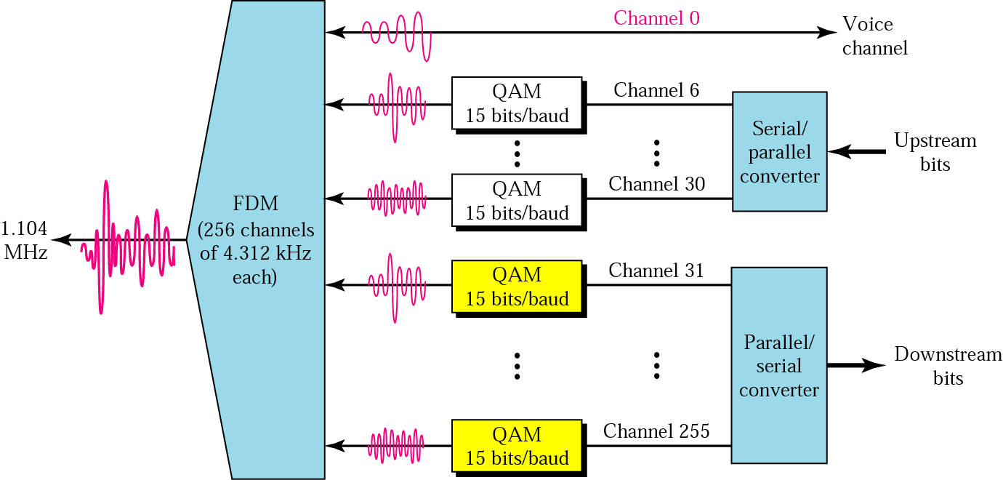
Figure 9.1 DMT

Slide 7
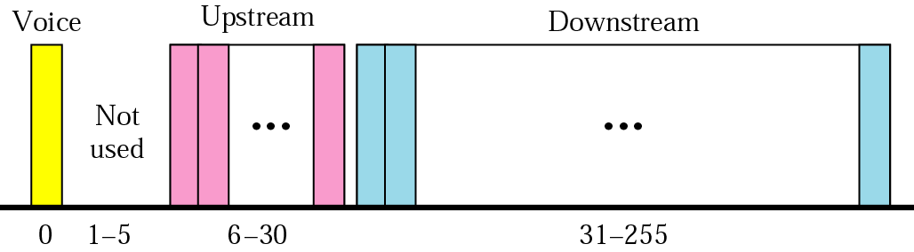
Figure 9.2 Bandwidth division

Slide 8
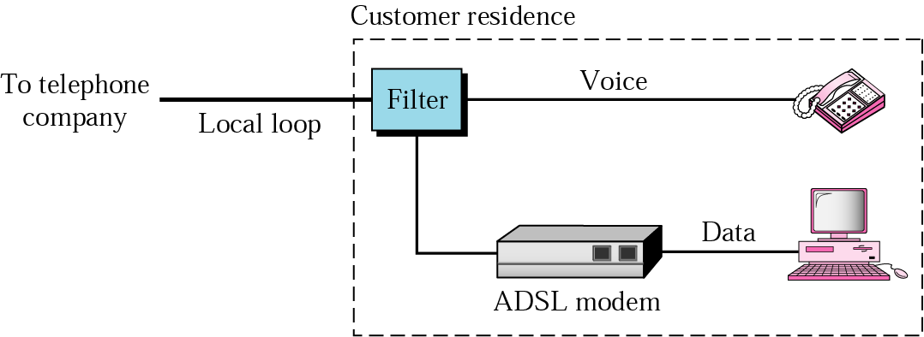
Figure 9.3 ADSL modem

Slide 9
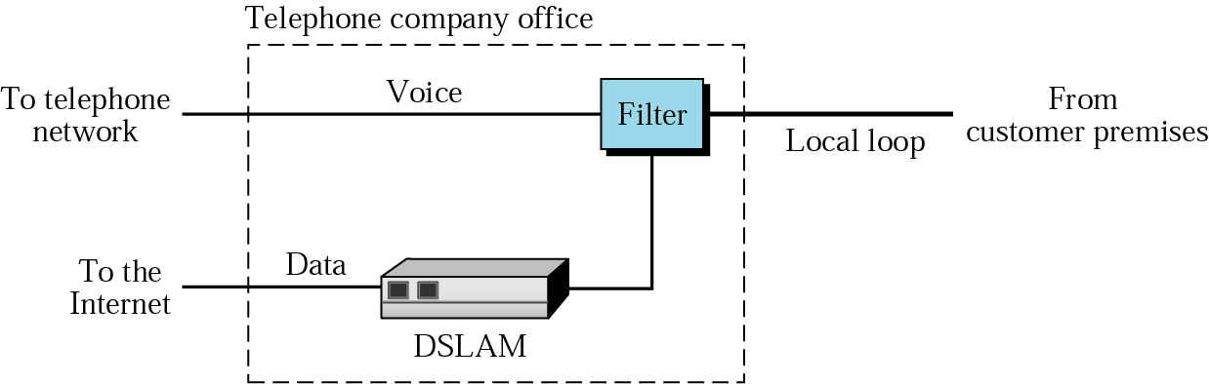
Figure 9.4 DSLAM

Slide 10
9.2 Cable Modem
Traditional Cable Networks
HFC Network
Sharing
CM and CMTS
DOCSIS

Slide 11
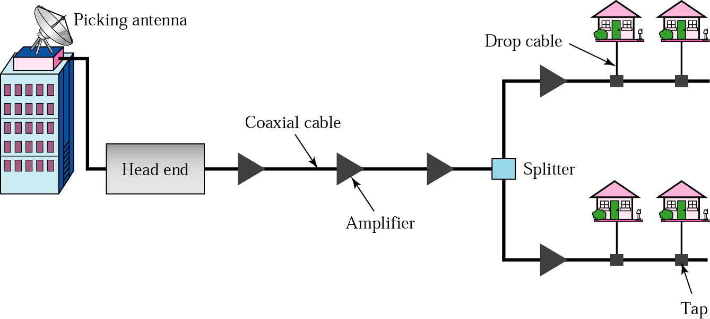
Figure 9.5 Traditional cable TV network

Slide 12
Note:
Communication in the traditional cable TV network is unidirectional.

Slide 13
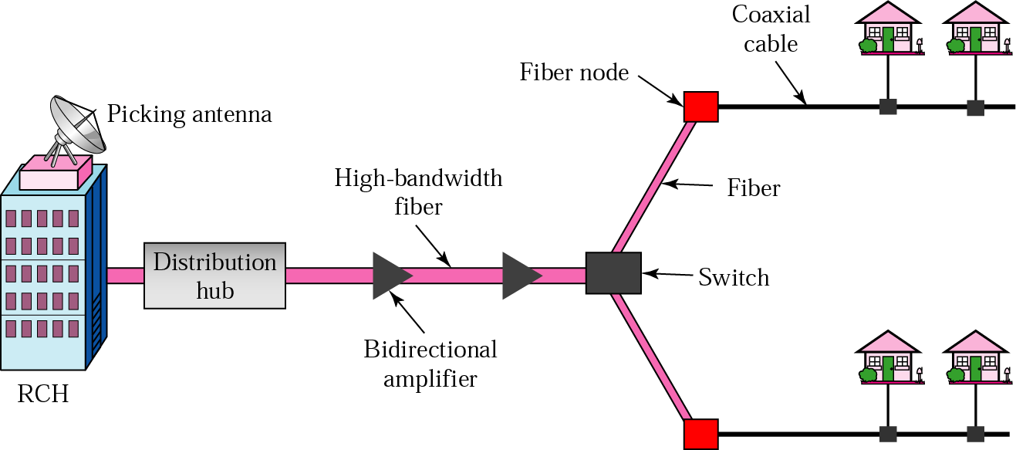
Figure 9.6 HFC network

Slide 14
Note:
Communication in an HFC cable TV network can be bidirectional.

Slide 15
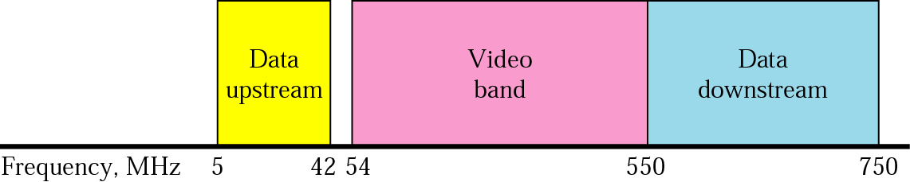
Figure 9.7 Coaxial cable bands

Slide 16
Note:
Downstream data are modulated using the 64-QAM modulation technique.

Slide 17
Note:
The theoretical downstream data rate is 30 Mbps.

Slide 18
Note:
Upstream data are modulated using the QPSK modulation technique.

Slide 19
Note:
The theoretical upstream data rate is 12 Mbps.

Slide 20
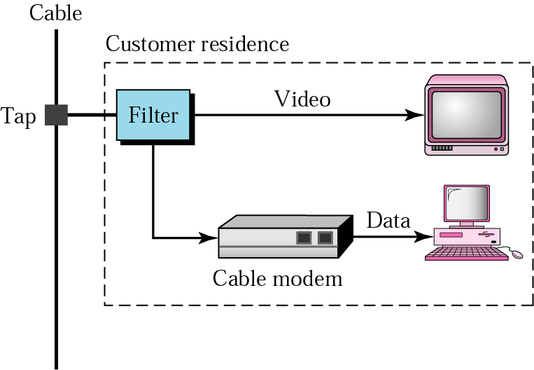
Figure 9.8 Cable modem

Slide 21
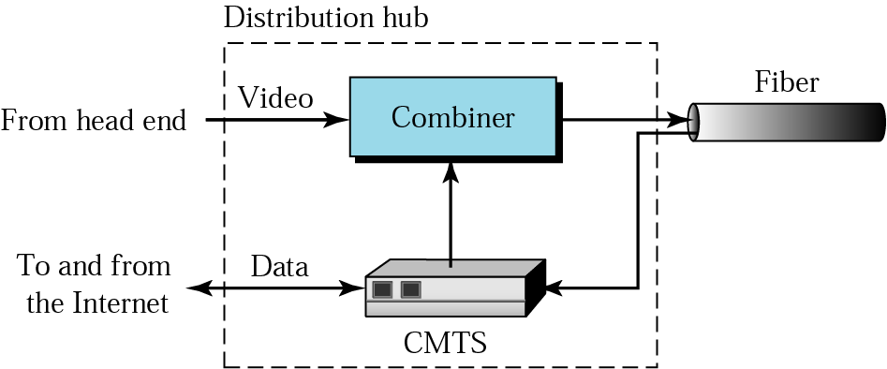
Figure 9.9 CMTS

Slide 22
9.3 SONET
SONET Devices
SONET Frame
Frame Transmission
Synchronous Transport Signals
STS-1
Virtual Tributaries
Higher-Rate Service

Slide 23
Note:
SONET is a synchronous TDM system controlled by a master clock.

Slide 24
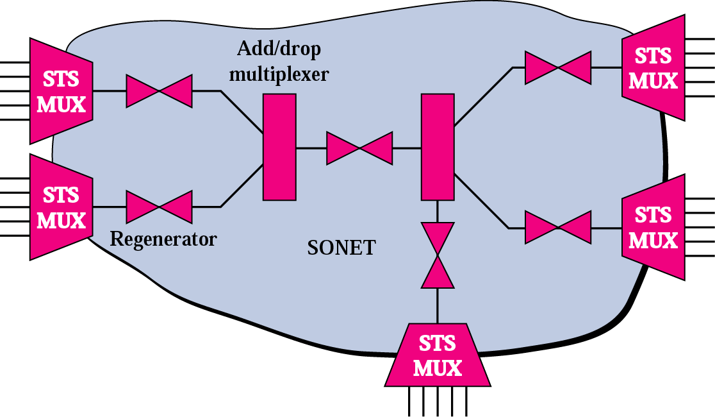
Figure 9.10 A SONET

Slide 25
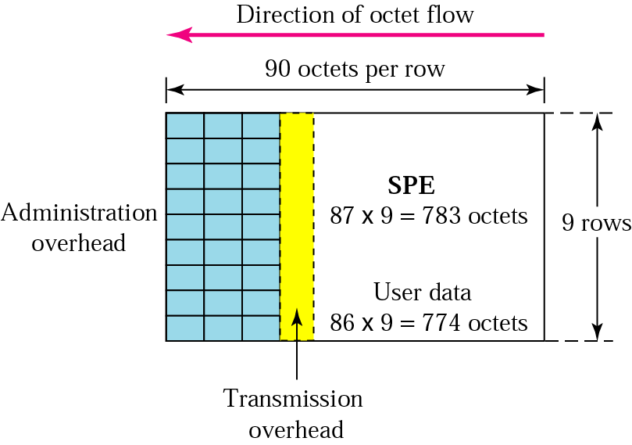
Figure 9.11 Frame format

Slide 26
Table 9.1 SONET rates
STS | OC | Rate (Mbps) | SPE (Mbps) | User (Mbps)
STS-1 | OC-1 | 51.84 | 50.12 | 49.536
STS-3 | OC-3 | 155.52 | 150.336 | 148.608
STS-9 | OC-9 | 466.56 | 451.008 | 445.824
STS-12 | OC-12 | 622.08 | 601.344 | 594.432
STS-18 | OC-18 | 933.12 | 902.016 | 891.648
STS-24 | OC-24 | 1244.16 | 1202.688 | 1188.864
STS-36 | OC-36 | 1866.23 | 1804.032 | 1783.296
STS-48 | OC-48 | 2488.32 | 2405.376 | 2377.728
STS-192 | OC-192 | 9953.28 | 9621.604 | 9510.912

Slide 27
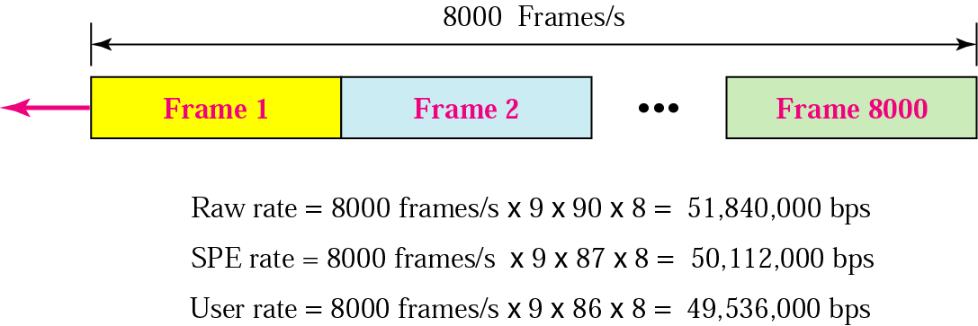
Figure 9.12 Data rate

Slide 28
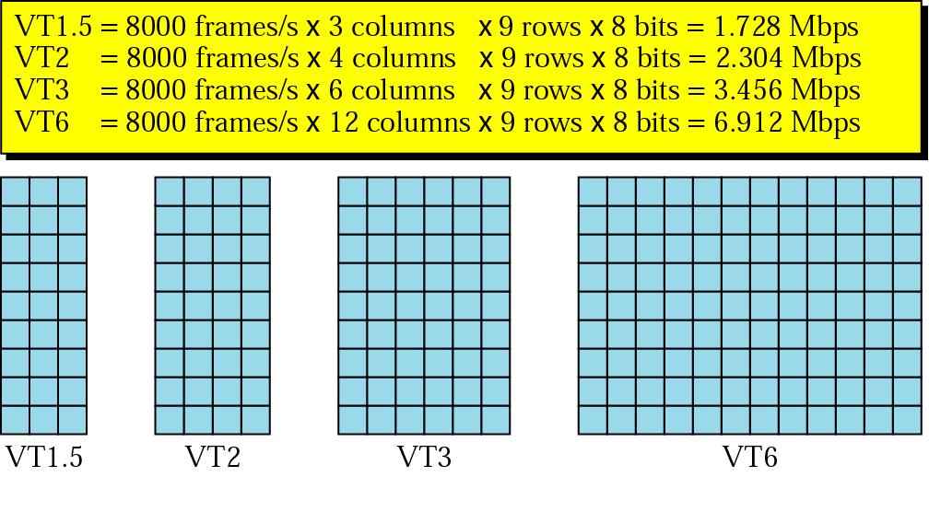
Figure 9.13 VT types

Slide 29
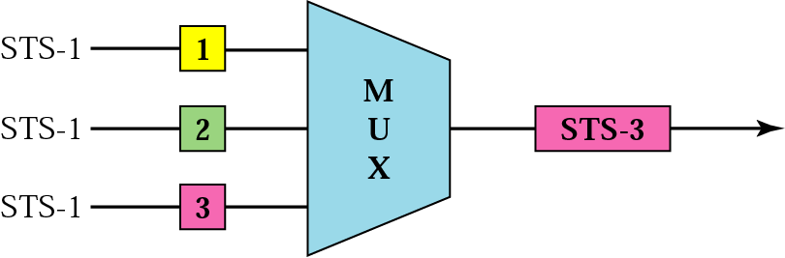
Figure 9.14 STS multiplexing

