Slide 1
MEDICINE SHOP
Management System
Database project
Submitted By:
Labanya Saha (21201059)
Md Al-Amin (21201061)
Md Mehadi Islam (21201065)
Jannatun Saumoon (21201066)
Paria Chowdury(21201067)

Slide 2

What is the medicine store management system?
Medicine Store Management System, refers to software designed to help a pharmacy or drug store list, sell, prescription and manage different aspects, including customer information.

Slide 3
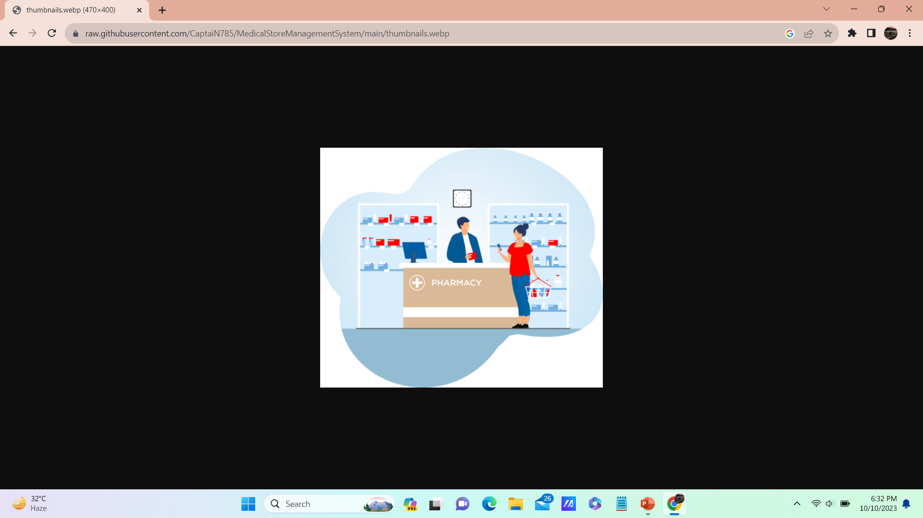
MISSION-
"Our Mission is to improve the quality of life and health of individuals and communities by providing , accessible, and affordable medicine and health care
services."

Slide 4
What is the medicine store management system offer?
Inventory Management
Customer Management
Medecine Details
Payment Details
Reports

Slide 5
Inventory Management
Stock Tracking
Batch Tracking:
Supplier Management:
Customer Details
Customer ID
Customer Name
Customer Contact Number
Medicine Details
Medicine Name
Medicine Price
Medicine Availability
Medicine Quantity
Payment Details
Payment Id
Payment Amount
Payment Method
Customer Id

Slide 6
Reports
Sales Reports
Profit Analysis
Demand
Sources
XAMPP
MySQL
RDMS
db-book & many more

Slide 7


