Slide 1

Medicine Shop Management System
Database project
Submitted By:
Labanya Saha (21201059)
Md Al-Amin (21201061)
Md Mehadi Islam (21201065)
Jannatun Saumoon (21201066)
Paria Chowdury(21201067)
Course Code: CSE 212
Course Title: Database System Lab
Course Teacher: Molla Rashied Hussein

Slide 2

INTRODUCTION:
The Medical shop management system database is a
database design for managing medical shop and
events.
Admin is able to add, view, edit, update or delete data.
It enables the admin to register a medicine for the
Store , stores their details into the database, the price and the quantity and other things.

Slide 3
Project Description
The Medicine Store Management System is a comprehensive software solution designed to streamline and optime the operations of a pharmaceutical store. This system offers features such as inventory management, sales tracking prescription management, and atomer records, it allows pharmacy carers and staff to efficiently manage their inventury serve customers better, and ensure compliance with regulations.
Key Features:
Patient management: Track patient demographics, medical history, prescriptions, and appointments.
Prescription management: Process and manage prescriptions, including filling, dispensing, and tracking refills.
Inventory management: Track inventory levels, reorder points, and expiration dates for medications and other products.
Financial management: Process payments, generate reports, and manage insurance claims.

Slide 4
Entities:
Patient Person who receives medical care from a pharmacy.
Doctor Medical professional who prescribes medications to patients.
Pharmacy Business that sells medications and other healthcare products.
Medicine Drug or substance used to treat or prevent disease.
Prescription Written or electronic order from a doctor to a pharmacist to dispense a specific medication to a specific patient.
Relationship Sets:
Patient – Prescription: One patient can have many prescriptions.
Doctor – Prescription: One doctor can prescribe many prescriptions.

Slide 5
Pharmacy – Prescription: One prescription can be filled at one pharmacy.
Medication – Prescription: One prescription is for one medication.
Pharmacy – Medication: One pharmacy can sell many medications.
Medication – Pharmacy: One medication can be sold by many pharmacies.
ATTRIBUTES :
Employee:
customer_name
employee_shift
job_title

Slide 6
Customer:
customer_gender
customer_age
customer_contact
customer_address
Manufacturer:
manufacturer_address
manufacturer_contact
Medicine:
medicine_type
medicine_quantity
medicine_price
expiry_date
Prescription:
prescription_date
Counter:
seller_id
Pharmacy:
seller_name
pharmacy_contact
pharmacy_address

Slide 7
ATTRIBUTES :
Patient
Patient_ID (primary key)
Patient_name
Patient_date_of_birth
Patient_address
Patient_contact_number
Pharmacy
Pharmacy_ID (primary key)
Pharmacy_name
Pharmacy_address
Pharmacy_contact_number
Pharmacy_license_number
Doctor
Doctor_ID (primary key)
Doctor_name
Doctor_speciality
Doctor_qualification
Doctor_experience
Doctor_contact_number

Slide 8
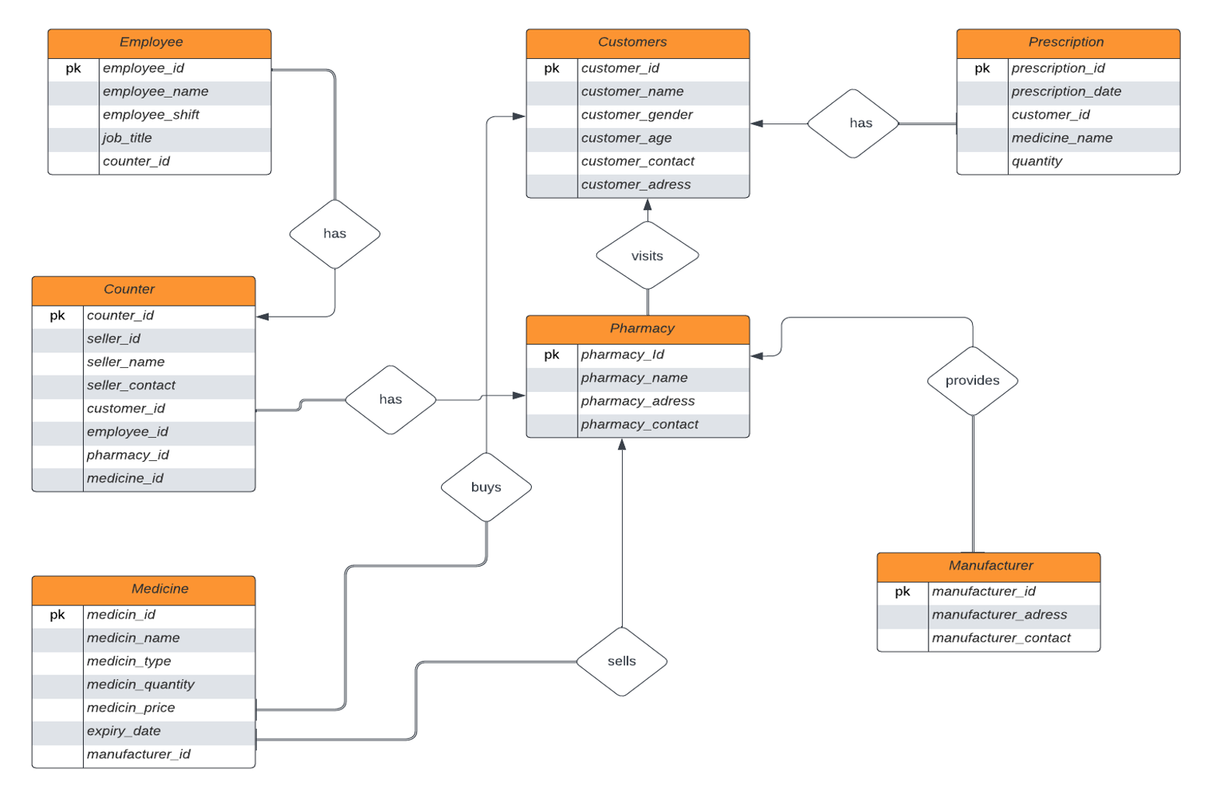
ER DIAGRAM

Slide 9
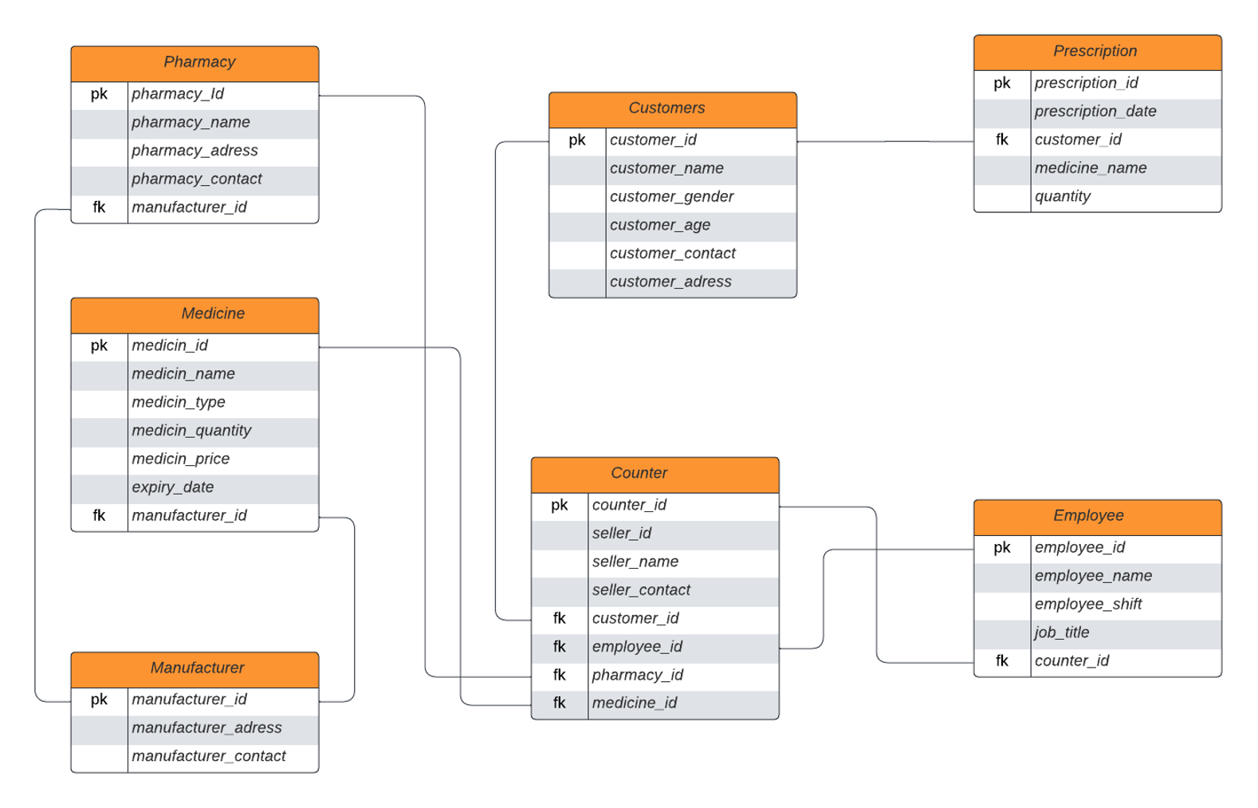
SCHEMA DIAGRAM

Slide 10
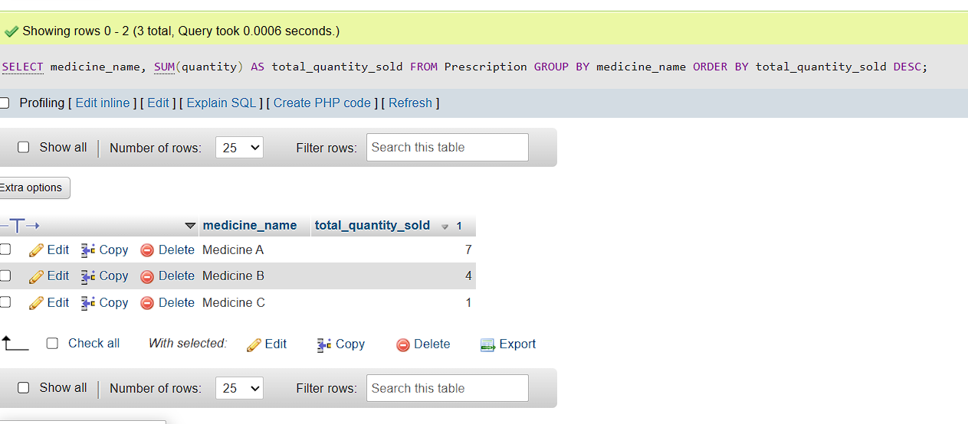
1.Find out the top-selling medicines:
This query identifies the top-selling medicines based on the quantity sold.
SELECT medicine_name, SUM(quantity) AS total_quantity_sold
FROM Prescription
GROUP BY medicine_name
ORDER BY total_quantity_sold DESC;

Slide 11
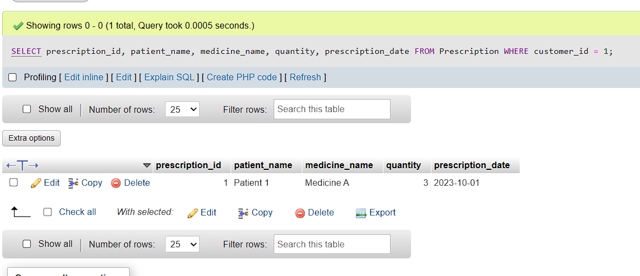
2.Retrieve prescription details for a specific customer:
This query allows you to retrieve prescription details for a particular customer based on their name or customer ID.
SELECT prescription_id,
patient_name,
medicine_name,
quantity,
prescription_date
FROM Prescription
WHERE customer_id = 1;

Slide 12
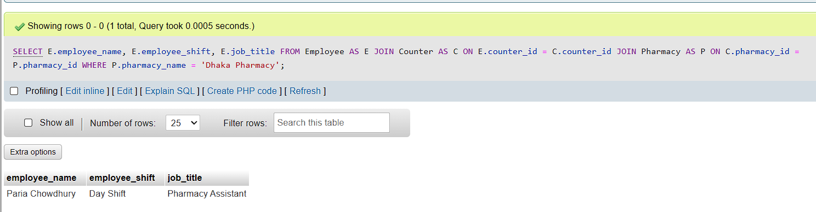
3.Retrieve employee information for a specific pharmacy:
This query provides information about employees working at a specific pharmacy.
SELECT E.employee_name,
E.employee_shift,
E.job_title
FROM Employee AS E
JOIN Counter AS C ON E.counter_id = C.counter_id
JOIN Pharmacy AS P ON C.pharmacy_id = P.pharmacy_id
WHERE P.pharmacy_name = 'Dhaka Pharmacy';

Slide 13
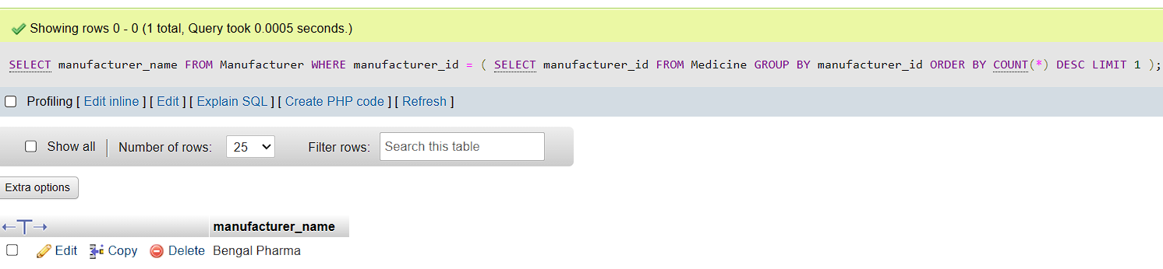
4.Find the manufacturer with the highest number of medicines:
This query identifies the manufacturer with the most medicines in the shop.
SELECT manufacturer_name
FROM Manufacturer
WHERE manufacturer_id = (
SELECT manufacturer_id
FROM Medicine
GROUP BY manufacturer_id
ORDER BY COUNT(*) DESC
LIMIT 1
);

Slide 14
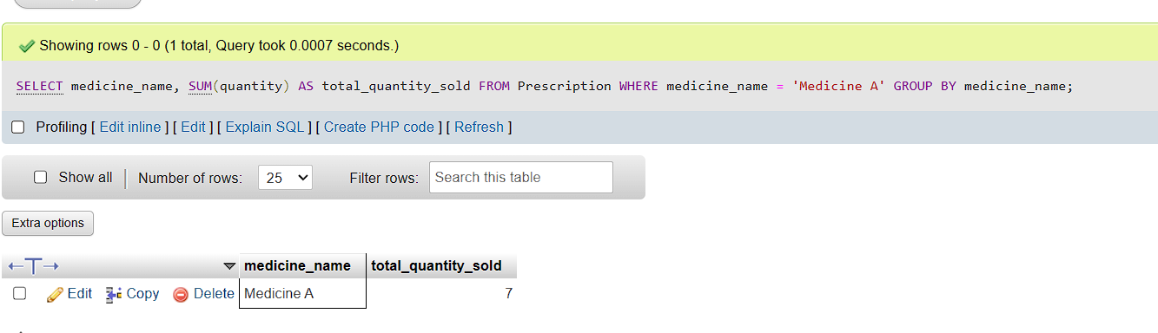
5.Find the total quantity of a specific medicine sold:
This query calculates the total quantity sold for a specific medicine.
SELECT medicine_name, SUM(quantity) AS total_quantity_sold
FROM Prescription
WHERE medicine_name = 'Medicine A'
GROUP BY medicine_name;

Slide 15


