Slide 1
MEDICINE SHOP
Management System
Database project
Submitted By:
Labanya Saha (21201059)
Md Al-Amin (21201061)
Md Mehadi Islam (21201065)
Jannatun Saumoon (21201066)
Paria Chowdury(21201067)

Slide 2
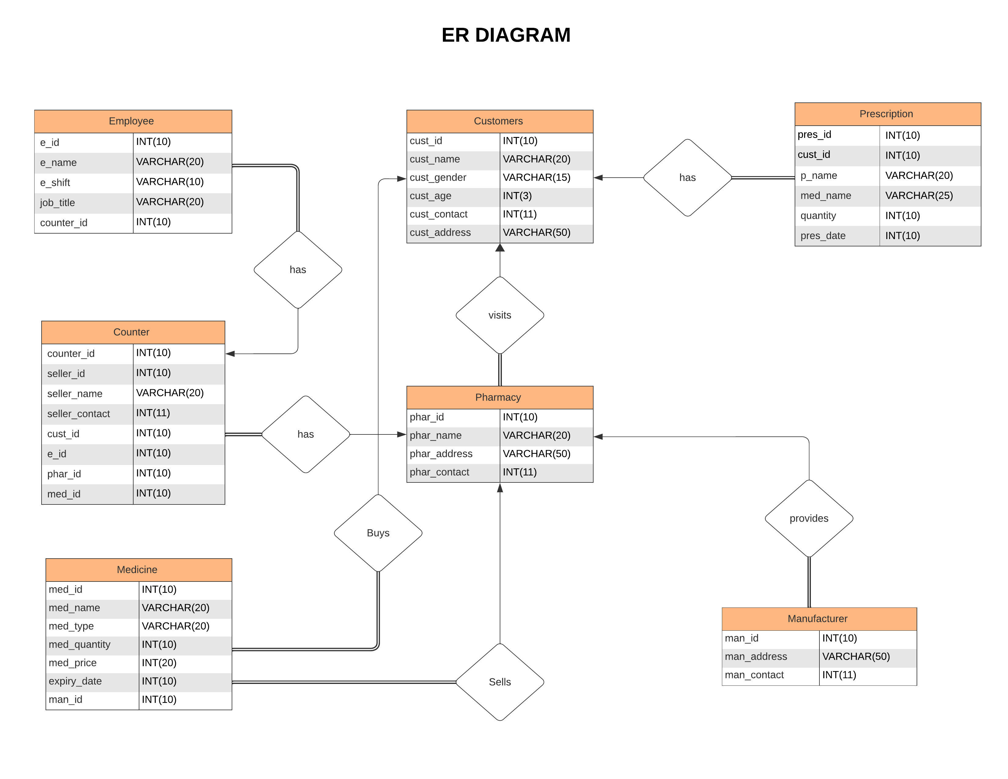

Slide 3
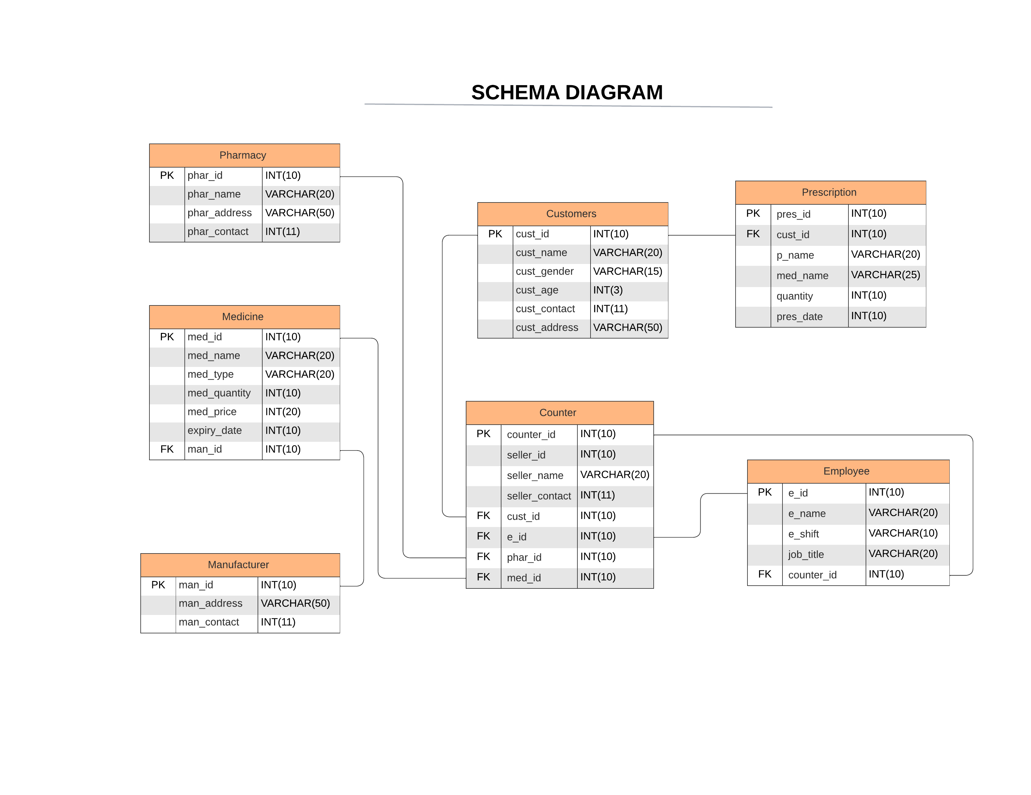

Slide 4


