Slide 1
Arithmetic Logic Unit
COURSE CODE:CSE210
COURSE TITLE:DIGITAL LOGIC & SYSTEM DESIGN LAB
Submitted to
Shammi Akter
Assistant Professor
Department of CSE
Submitted by
Name:Labanya Saha
Roll No:59
Sec:B(B1)
Regestration Num:21201059
4-bit ALU using logic gates

Slide 2
Table of contents
1)What is an ALU
2)Instruments
3)Input and output ofALU
4)Logic expression and diagram
5)Logic Table
6)Full Circuit
7)Discussion

Slide 3
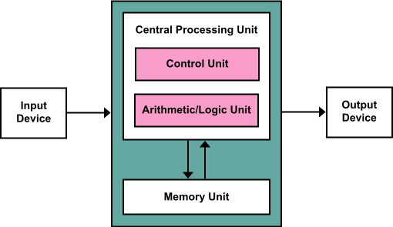
Arithmetic Logic Unit
In computing ,an arithmetic logic unit is a combination
digital circuit that performs arithmetic and logical
operations on integer binary numbers.So,4 bit ALU
takes 4 bit binary numbers and
performs various operatons based on
selsector input combination.It
represents a fundamental building
block of the centeral Processing
Unit of a computer.

Slide 4
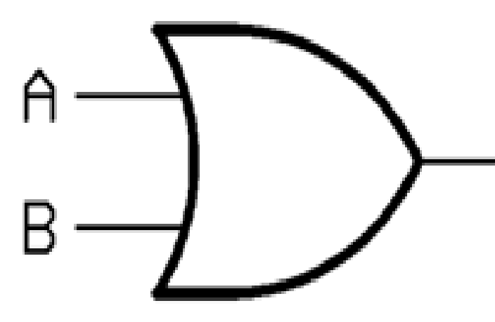
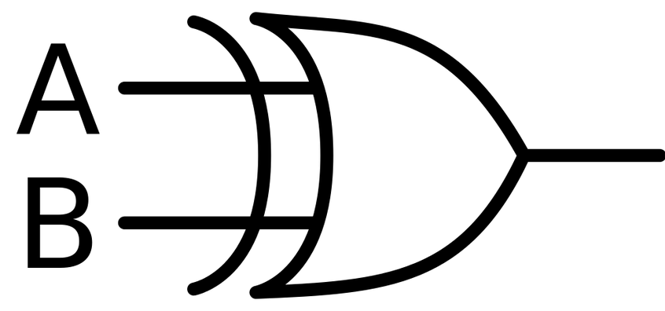
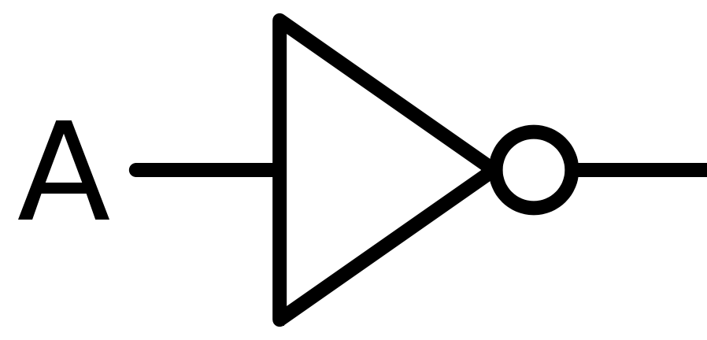
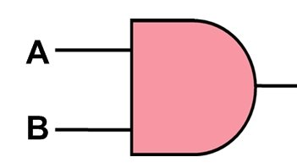
Instruments:
1.AND GATE(IC#7408) 2.OR GATE (IC#7432) 3.X-OR GATE (IC# 7486) 4.NOT GATE(IC#7404)
WE ALSO NEED SWITCHES TO INPUT AND DISPLAYS TO SEE THE OUTPUT

Slide 5
INPUTS AND OUTPUTS OF ARITHMETIC LOGIC UNIT
INPUT:
2-4-bits number:
A(A3 A2 A1 A0)
B(B3 B2 B1 B0)
Selector inputs:
S2 S1 S0
Carry
Cin
OUTPUT:
(Cout F3 F2 F1 F0)

Slide 6
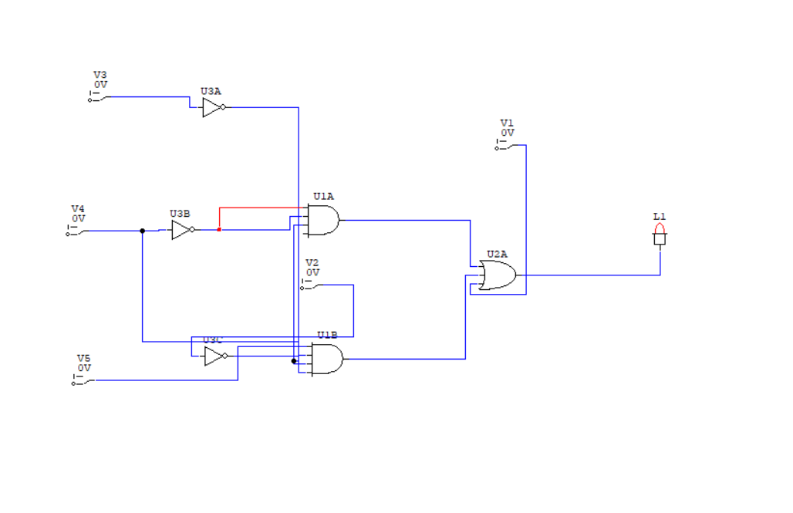
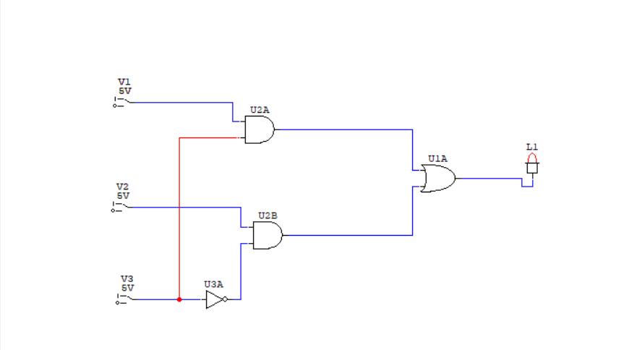
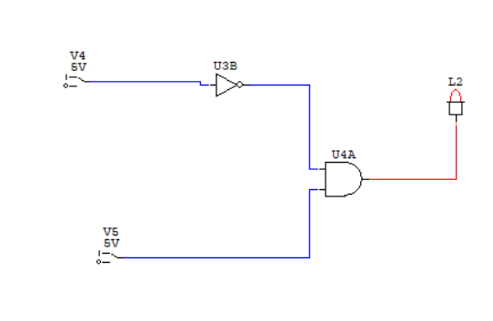
BIT ALU WITH PARALLEL ADDER (IC#7483)
Xi+Ai+S2.S1’.S0’.Bi+S2.S0’.Bi’
Yi=S0.Bi+S1.Bi’
Zi=S2’.Ci
Here i=0,1,2,3

Slide 7
ARITHMETIC OPERATION
LOGICAL OPERATION
1)Transfer
2)Increment
3)Addition
4)Add with Carry
5)Add Ai with Bi
6)Subtraction
7)Decrement
8)Transfer
1)OR
2)XOR
3)AND
4)NOT
The difference combination of select inputs corresponds to different functions

Slide 8
Functional Table of the Designed Arithmetic Logic Unit
Selection
Output Function
S2
S1
S3
Cin
0 0 0 0 F=A Transfer A
0 0 0 1 F =A+1 Increment A
0 0 1 0 F=A+B Addition
0 0 1 1 F=A+B+1 Addition with Carry
0 1 0 0 F=A-B-1 Substraction with Borrow
0 1 0 1 F=A-B Substraction
0 1 1 0 F=A-1 Decrement A
0 1 1 1 F=A Transfer A
0 0 X F=A+B OR
1 0 1 X F =A⊕ B XOR
1 0 X F=AB AND
1 1 1 X F=A’ NOT

Slide 9
TRANSFER
If A=12(decimal)=1100(in binary)
And B=6(decimal)=0110(in binary)
When S2=S1=S0=Ci=0;
Xi=Ai+S2.S1’.S0.Bi+S2.S1.S0’.Bi’=Ai
Yi=S0.Bi+S1.Bi+S1.Bi’=0
Zi=S2’.Ci=0
Fi=Ai
So,the output is 1100=Ai
Increment
And when S2=S1=S0=0,Ci=1;
Xi=Ai+S2.S1’.S0’.Bi+S2.S1.S0’.Bi’=Ai
Yi=S0.Bi+S1.Bi’=0
Z1=S2.Ci=1
Fi=Ai+1
Then,
1100+1=1101
So,the output is 1011=Ai+1
Addition
If A=1100,B=0110
When S2=S1=0,S0=1,Ci=0;
Xi=Ai+S2.S1’.S0’.Bi+S2.S1.S0’.Bi’=Ai
Yi=S0.Bi+S1.Bi’=Bi
Zi=S2’.Ci=0
Fi=Ai+Bi
Then,
1100+0110=10010
So,the output is 10010
So,the output is 10010=Ai+Bi

Slide 10
Add A with B'
If A = 1100, B = 0110
Then, B' = 1001
When S2=0,S1=1,S0=0,Ci=0
Xi = Ai + S2. S1’. S0’. Bi + S2 .S1.
S0’. Bi’=Ai
Yi = S0. Bi + S1.Bi’=Bi`
Zi = S2’.Ci=0
Fi= Ai + Bi'
Then,
1100 + 1001 = 1101
So, the output is 10101 = Ai+Bi'
Add with Carry
And when S2=S1=0,S0=1,Ci=1
Xi = Ai + S2. S1’. S0’. Bi + S2 .S1.
S0’. Bi’=Ai
Yi = S0. Bi + S1.Bi’=Bi
Zi = S2’.Ci=1
Fi=Ai+Bi+1
Then,
1100 + 0110 = 10010
10010 + 1 = 10011
So, the output is 10011 = Ai+Bi+1

Slide 11
Subtraction
If A = 1100, B = 0110
Then, B' = 1001
And when S2=0,S1=1,S0=0,Ci=1
Xi = Ai + S2. S1’. S0’. Bi + S2 .S1.
S0’. Bi’=Ai
Yi = S0. Bi + S1.Bi’=Bi`
Zi = S2’.Ci=1
Fi = Ai+Bi'+1
= Ai-Bi
Then,
1100 + (1001+1) = 10110
So, the output is 10110 = Ai-Bi
Decrement
When S2=0,S1=1,S0=1,Ci=0
Xi = Ai + S2. S1’. S0’. Bi + S2 .S1.
S0’. Bi’=Ai
Yi = S0. Bi + S1.Bi’=1(1111)
Zi = S2’.Ci=0
Fi = Ai + 1 = Ai + 1111
1100 + 1111 = 11011
So, the output is 11011

Slide 12
Transfer
And when S2=0,S1=1,S0=1,Ci=1
Xi = Ai + S2. S1’. S0’. Bi + S2 .S1.
S0’. Bi’=Ai
Yi = S0. Bi + S1.Bi’=1=1111
Zi = S2’.Ci=1
Fi = Ai+1111+1
1100 + 1111 = 11011
11011 + 1 = 11010
So, the output is 11000
OR
If A=1100, B=0110
When S2=1,S1=0,S0=1
Xi = Ai + S2. S1’. S0’. Bi + S2 .S1.
S0’.Bi’ = Ai+Bi
Yi = S0. Bi + S1.Bi’=0
Zi = S2’.Ci=0
Fi = Ai OR Bi = Ai+Bi
1100 + 0110 = 1010
So, the output is 1110

Slide 13
XOR
If A=1100, B=0110
And when S2=1,S1=0,S0=1
Xi = Ai + S2. S1’. S0’. Bi + S2 .S1.
S0’. Bi’=Ai
Yi = S0. Bi + S1.Bi’=Bi
Zi = S2’.Ci=0
Fi = Ai XOR Bi
1100 XOR 0110 = 0010
So, the output is 1010
AND
If A = 1100, B = 0110
When S2=1,S1=1,S0=0
Xi = Ai + S2. S1’. S0’. Bi + S2 .S1.
S0’. Bi’ = Ai + Bi`
Yi = S0. Bi + S1.Bi’ = Bi`
Zi = S2’.Ci=0
Fi = Ai AND Bi = Ai.Bi
1100 AND 0110 = 0100
So, the output is 0100
And the carry is 1
NOT
If A = 1100
And when S2=1,S1=1,S0=1
Xi = Ai + S2. S1’. S0’. Bi + S2 .S1.
S0’. Bi’=Ai
Yi = S0. Bi + S1.Bi’=1
Zi = S2’.Ci=0
Fi = Ai`
1100 NOT = 0011
So, the output is 0011
And the carry is 1

Slide 14
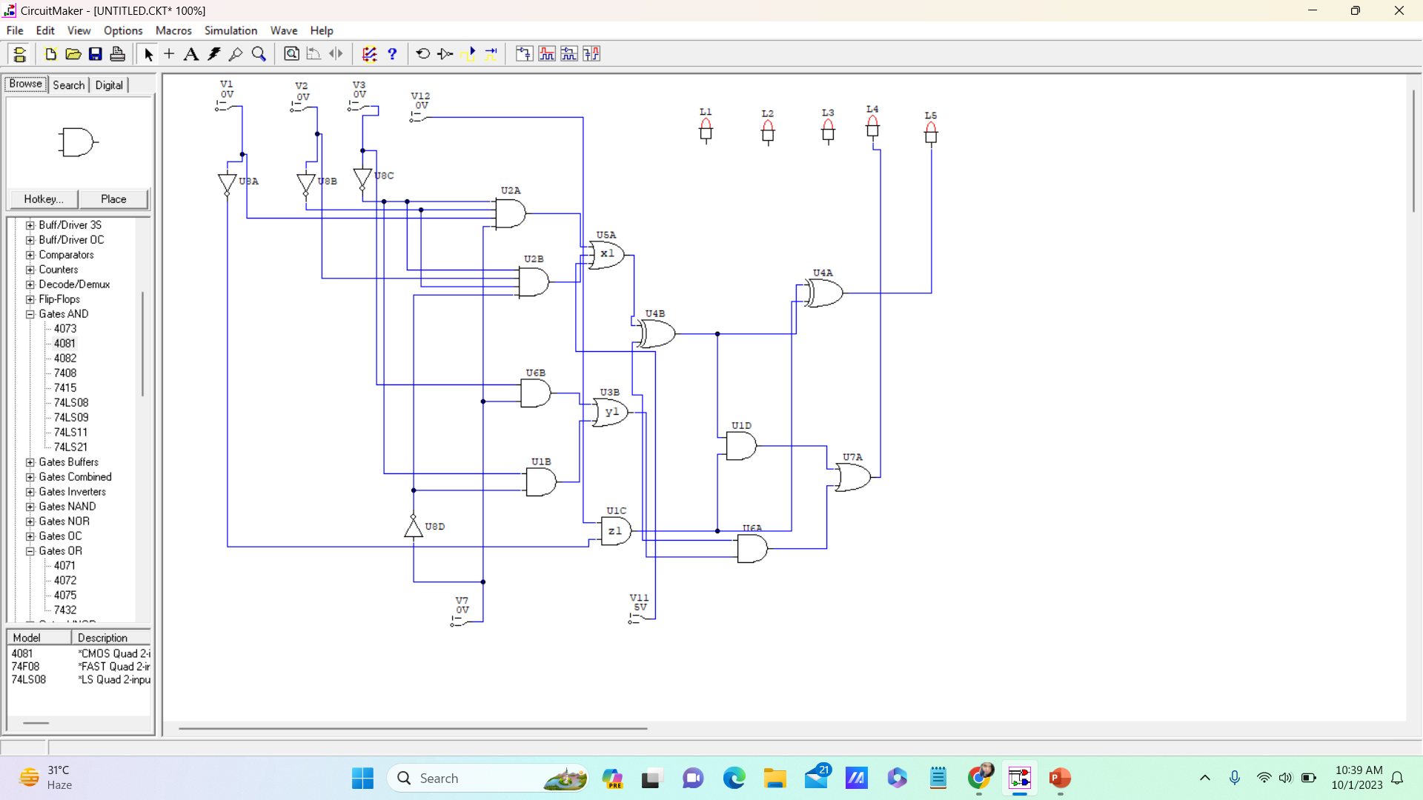
DESIGN 1 BIT ALU

Slide 15
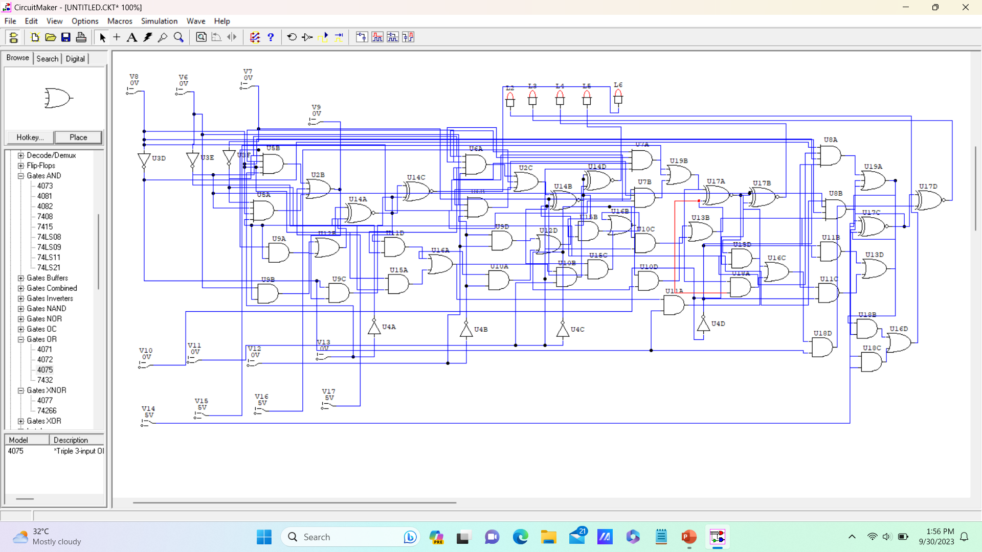
4 bit ALU CIRCUIT DIAGRAM

Slide 16

THANK YOU

