Slide 1
CSE 315
Subject: Soil Moisture Sensor
Submitted To:
A.S.Zaforullah Momtaz
Assistant Professor,CSE
UAP
Submitted By:
Labanya Saha
Roll No:59
Reg Num:21201059
Sec:B

Slide 2
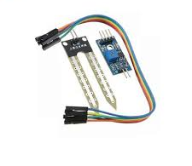
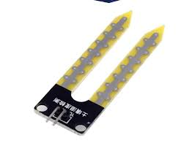
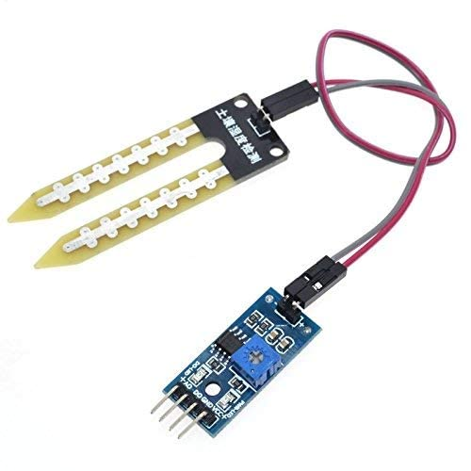
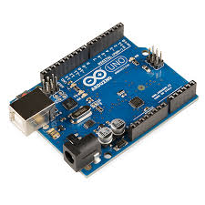
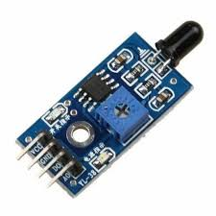
Componenets Need:
*Arduino UNO
*HL-69 Rain Sensor
*BreadBoard
*2 x 220 ohm Resistor
*2 x LEDs
*Jumper Wires
Fig 2: YL-69(Probebs)
Fig 1: Soil Moisture Sensor
YL69(PROBES)CONNECTED TO YL38(INTERFACE)
Fig 3:Arduino UNO
Fig 4: YL-38 (Interface)

Slide 3
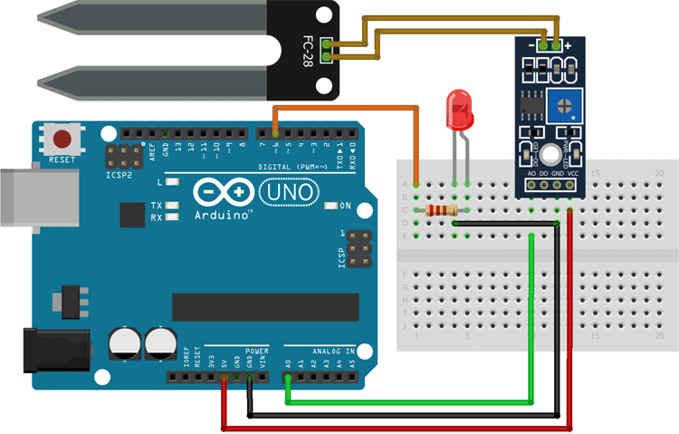
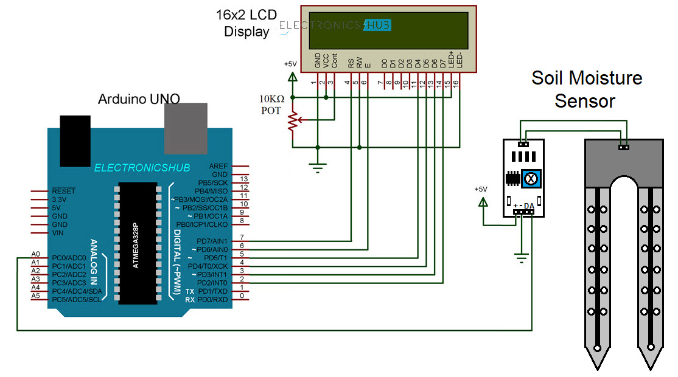
Working Principal:
A soil moisture sensor works by measuring the
Electrical resistance or capacitance of the soil.When the soil is wet,it conducts electricity better,lowering resistance or changing caoacitance.The sensor detects this change and converts it into a voltage or signal or signal that represents the soil misture level
FIG 6: Soil Moisture Sensor Connected To Arduino

Slide 4
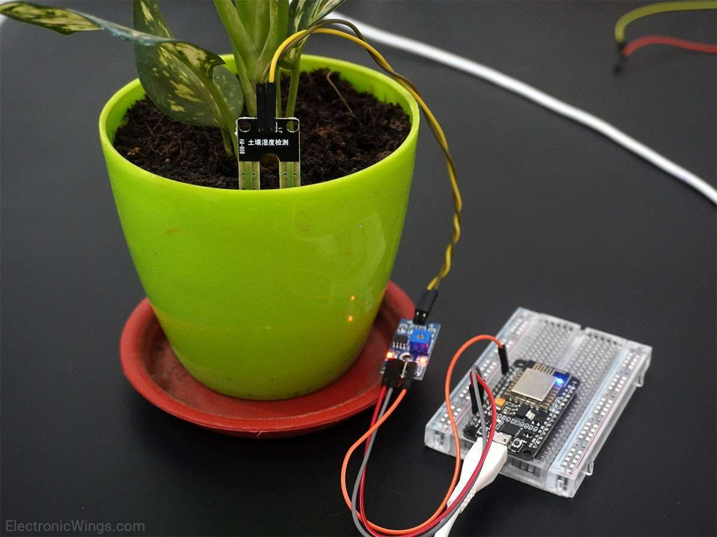
void setup(){
Serial.begin(9600);
}
Void loop(){
Int sensoValue = analogRead(40);Serial.Println(sensor value)
Delay(400)
}
Light up when moisture detected

Slide 5
THANK YOU

