Slide 1


Lending Club Case Study
Caption
Caption
Group Members :
Akankshya Abhilipsa
Labeeb Ali Koleth
Akankshya Abhilipsa

Slide 2
Problem Statement
Caption
A consumer finance company specialises in lending various types of loans to urban customers. When the company receives a loan application, it has to make a decision for loan approval based on the applicant’s profile. Two types of risks are associated with the bank’s decision:
If the applicant is likely to repay the loan, then not approving the loan results in a loss of business to the company.
If the applicant is not likely to repay the loan, i.e. he/she is likely to default, then approving the loan may lead to a financial loss for the company.
The aim is to identify patterns which indicate if a person is likely to default, which may be used for taking actions such as denying the loan, reducing the amount of loan, lending (to risky applicants) at a higher interest rate, etc.

Slide 3
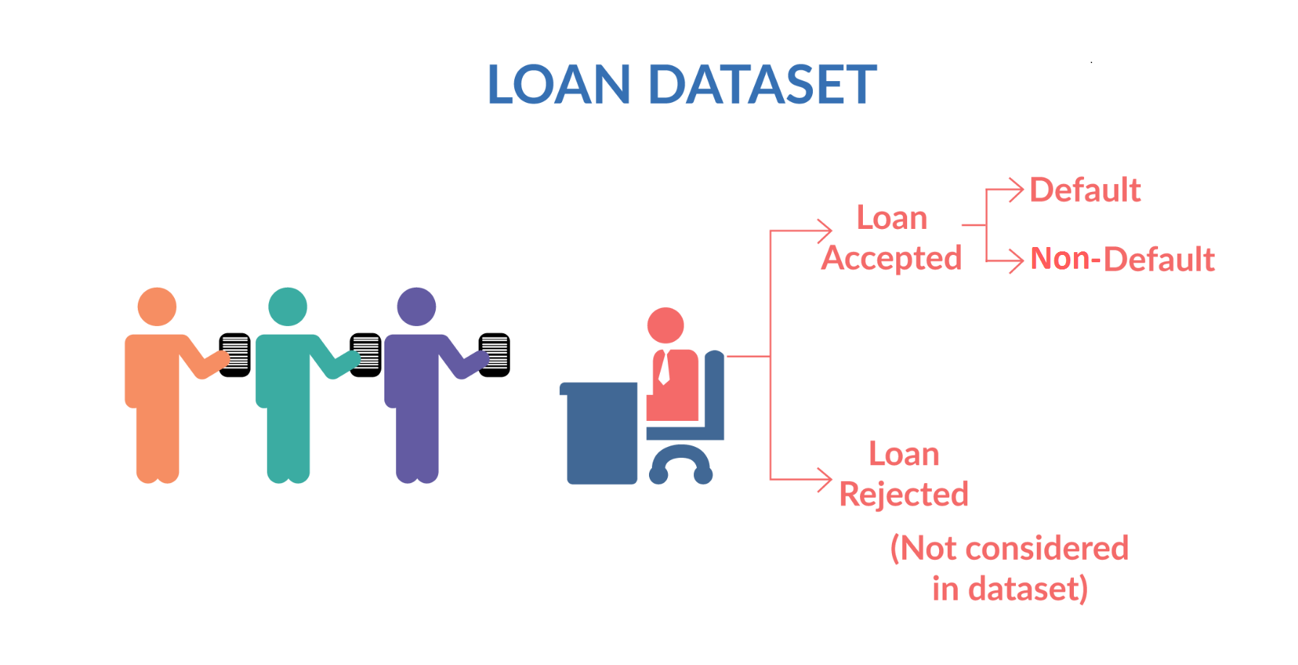
Caption
Caption
When a person applies for a loan, there are two types of decisions that could be taken by the company:
Loan accepted: If the company approves the loan, there are 3 possible scenarios described below:
Fully paid: Applicant has fully paid the loan (the principal and the interest rate)
Current: Applicant is in the process of paying the instalments, i.e. the tenure of the loan is not yet completed. These candidates are not labelled as ‘defaulted’.
Charged-off: Applicant has not paid the instalments in due time for a long period of time, i.e. he/she has defaulted on the loan
Loan rejected: The company had rejected the loan (because the candidate does not meet their requirements etc.). Since the loan was rejected, there is no transactional history of those applicants with the company and so this data is not available with the company (and thus in this dataset)

Slide 4
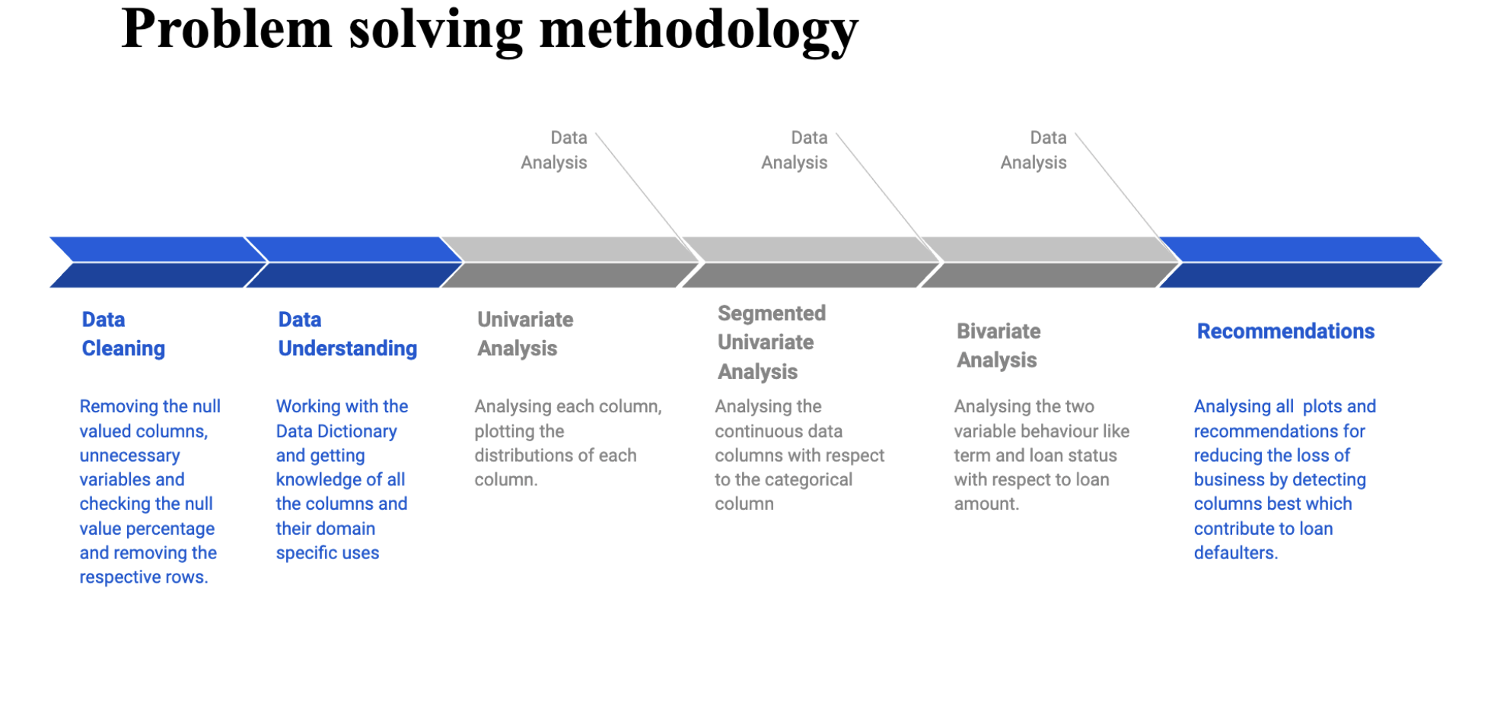
Caption
Caption
Caption

Slide 5
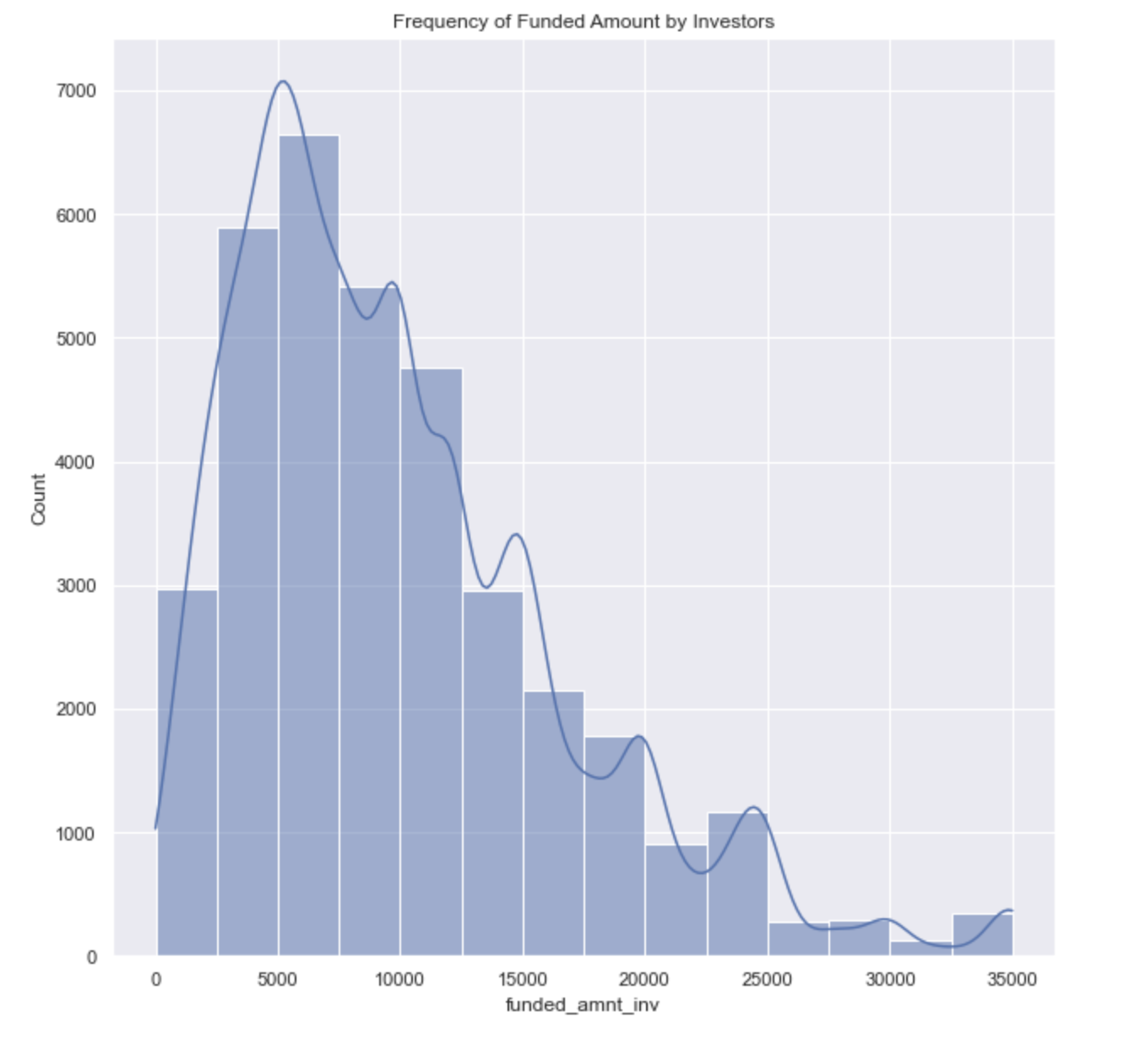
Univariate Analysis
Caption
Caption
1. Frequency of Funded Amount by Investors
The histogram indicates that most of the funding was between 2500 - 10000 range.

Slide 6
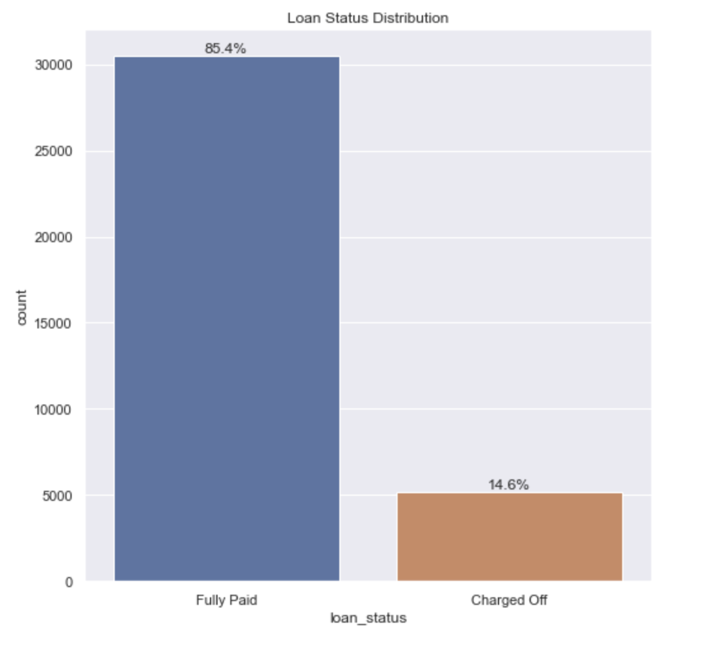
Caption
Caption
2. Loan Status Distribution
The count plot indicates that 85.4% of the loans approved was Fully Paid and a 14.6% of loans was defaulted
Caption

Slide 7
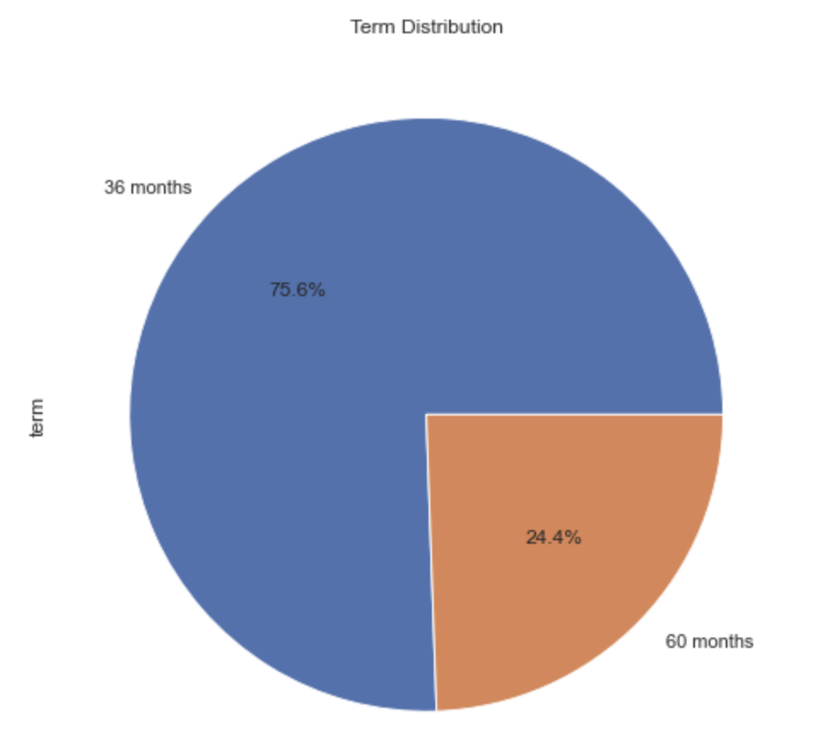
Caption
Caption
3. Term Distribution
The pie chart shows that around 75.6% of loans was taken under 36 months term and 24.4% under 60 months term
Caption

Slide 8
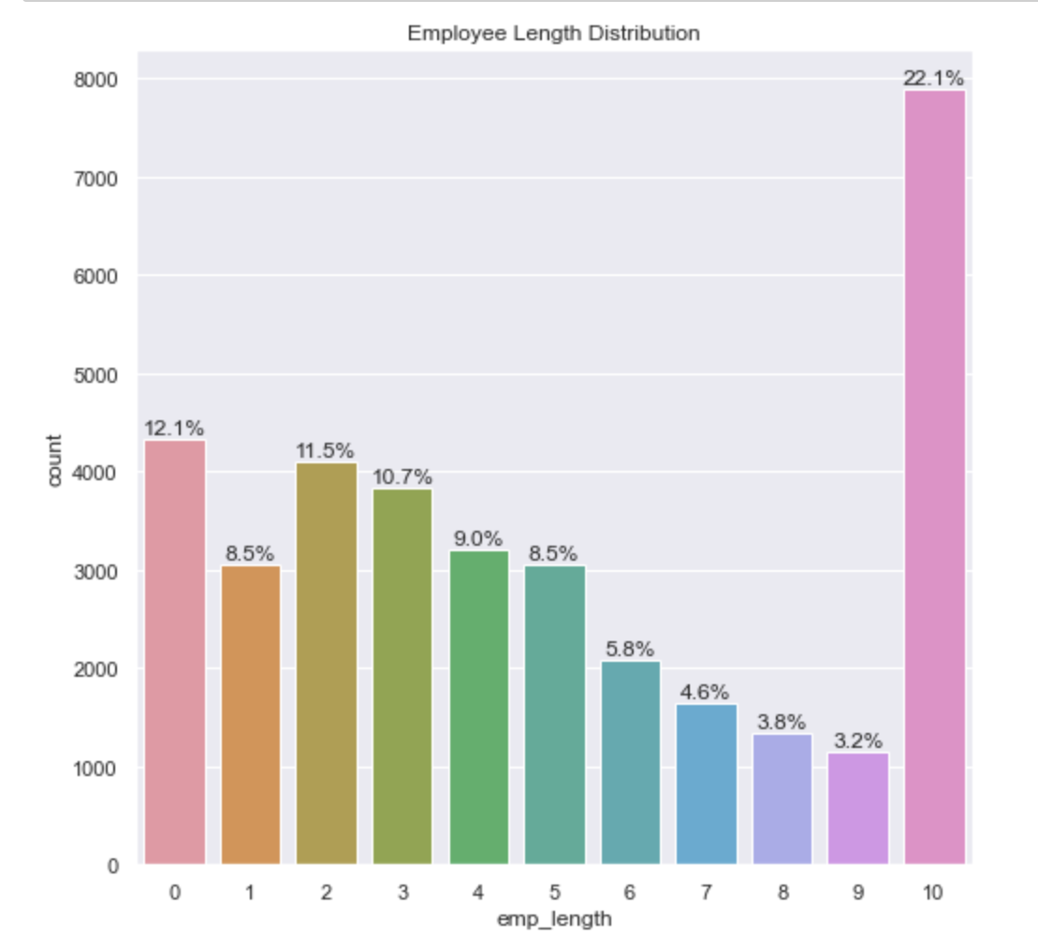
Caption
Caption
4. Employee Length Distribution
Around 22% of the total loan are taken by people who had 10+ Years of employee length, indicating that people tend to take loans more on a later stage of life.
Caption

Slide 9
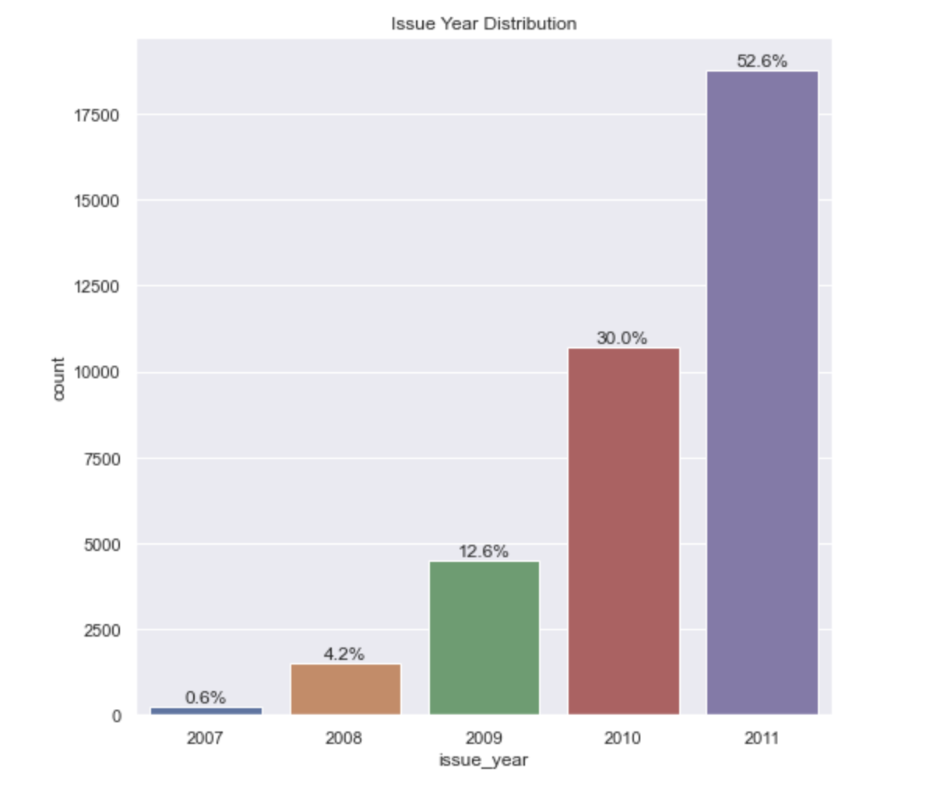
Caption
Caption
5. Issue Year Distribution
The loan issued increased drastically year by year, 2011 has over 50% of all issued loans. This can be due to several reasons.
Life Getting Tougher Over Years
Recession in 2011
LC became popular over the years
Caption

Slide 10
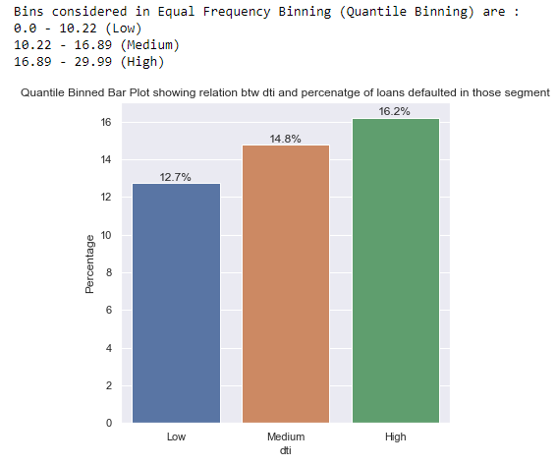
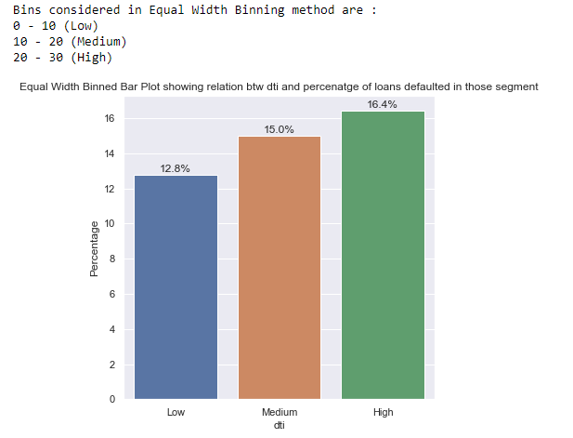
Segmented Univariate Analysis
Caption
Caption
1. Relation btw segmented dti vs defaulted percentage in the respective category

Slide 11
Caption
Caption
The above 2 plots indicate a relationship btw dti and the Percentage of defaulters in each segment, binned in 2 different methods Equal Width Binning and Quantile Binning show almost similar patterns.
From the analysis of 2 binning methods one can conclude that as the dti increases chances of defaulting also increases
So lending out loans to higher dti applications can be reduced

Slide 12
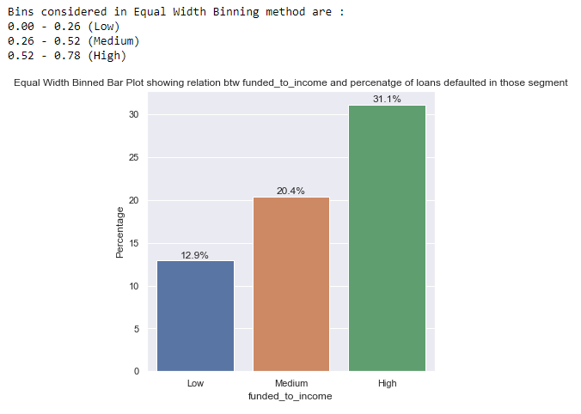
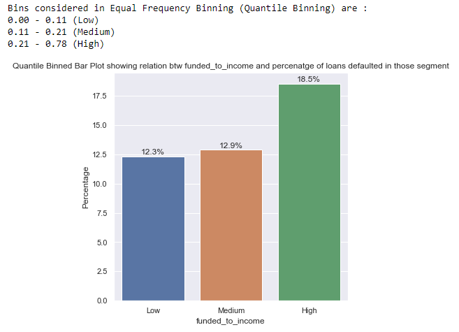
Caption
Caption
2. Relation btw segmented funded_to_income vs defaulted percentage in the respective category

Slide 13
Caption
Caption
The above 2 plots indicating the relationship btw funded_to_income and the Percentage of defaulters in each segment, binned in 2 different methods Equal Width Binning and Quantile Binning show almost similar patterns.
From the analysis of 2 binning methods one can conclude that as the funded_to_income increases chances of defaulting also increases
From the plot generated using Equal Width Binning, it’s clear that almost 31.1% of loans got defaulted whose funded_to_income ratio was above 0.52
So lending out loans to higher funded_to_income ratio applications can be reduced

Slide 14
Inferences from Univariate Analysis
Caption
Caption
Majority of the Loan Amount Requested/Sanctioned falls between 2500 - 10000 range.
85.4% of the loans approved were Fully Paid and 14.6% of loans were defaulted.
Around 22% of the total loans are taken by people who had 10+ Years of employee length, indicating that people tend to take loans more at a later stage of life.
Term Distribution Pie chart shows that around 75.6% of loans were taken under 36 months term and 24.4% under 60 months term
The loan issued increased drastically year by year, 2011 had over 50% of all issued loans. This can be due to several reasons.
1. Life Getting Tougher Over Years
2. Recession in 2011
3. LC became popular over the years

Slide 15
Continuation :
Caption
Caption
1) dti vs loan_status
From dti vs Loan Status analysis, binned in 2 different methods Equal Width Binning and Quantile Binning show almost similar patterns, that as the dti increases chances of defaulting also increases
2) funded_to_income vs loan_status
Similar analysis was made from the relationship btw funded_to_income vs loan_status, binned in 2 different methods Equal Width Binning and Quantile Binning.
From the analysis of 2 binning methods one can conclude that as the funded_to_income increases chances of defaulting also increases
From the plot generated using Equal Width Binning for funded_to_income vs loan_status, its clear that almost 31.1% of loans defaulted whose funded_to_income ratio was above 0.52
Loan Status vs Funded To Income Ratio, the Box plot gives a slight indication that most of the defaulters fall on a high f_to_i ratio value, whereas the majority of the Fully Paid is on the lower ratio end

Slide 16
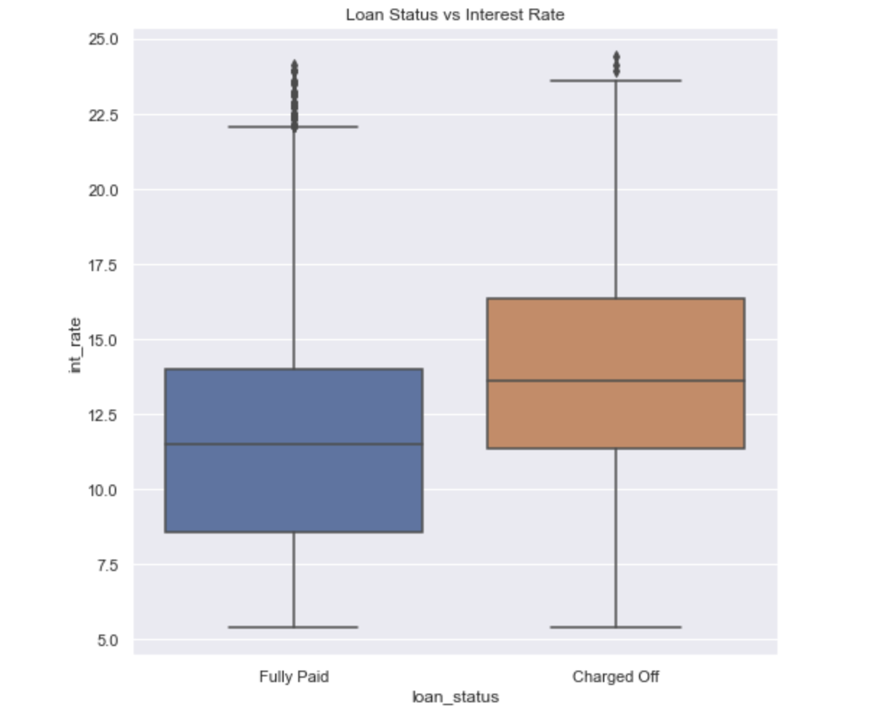
Bivariate Analysis
Caption
Caption
1. Loan Status vs Interest Rate
Loan Status vs Interest Rate Box plot gives a strong indication that most of the defaulters tend to fall on higher interest rates when compared to non-defaulters.
Caption

Slide 17
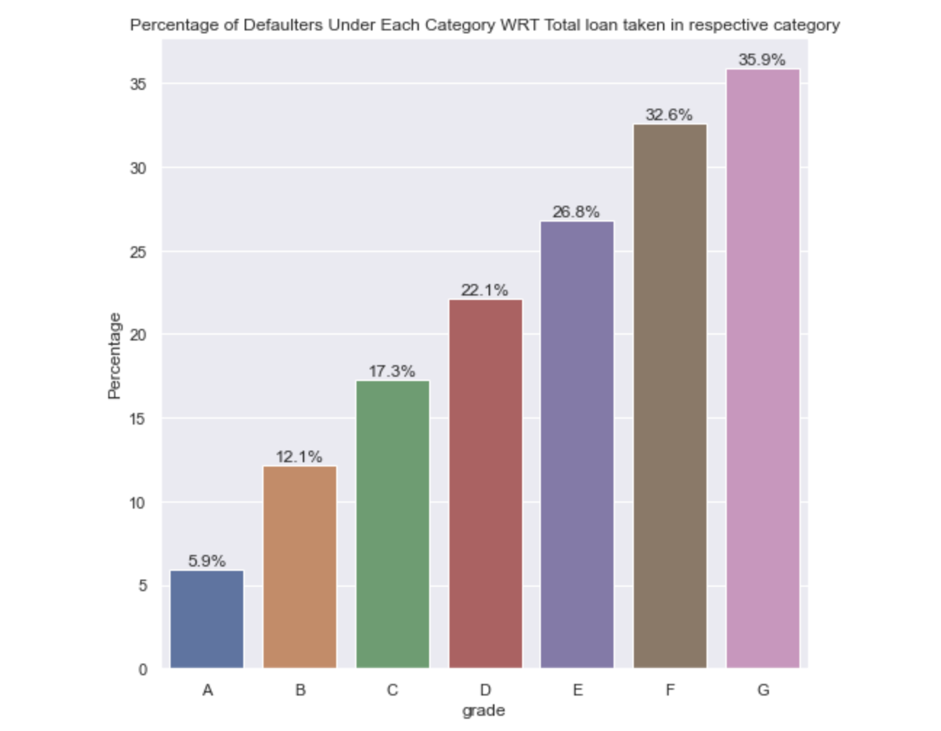
Caption
Caption
Percentage of Defaulters Under Each Grade wrt Total loan taken in respective grades
The bar plot gives a clear conclusion/insight that the higher the grade at which the loans are taken, the more the chance of defaulting.
Around 36% of the loan takers under the G category have defaulted
The above box plot of Loan Status vs Interest Rate also indicates the same, that the higher the interest rates higher the chance of defaulting
Grades and Interest Rate are closely linked, as the interest rate increases, grades increase and vice versa, indicating that Grades are a bucketed version of the interest rate
Hence from these 2 plots, we can conclude that the loans taken under high interest rates or grades tend to default more than the others.
Caption

Slide 18
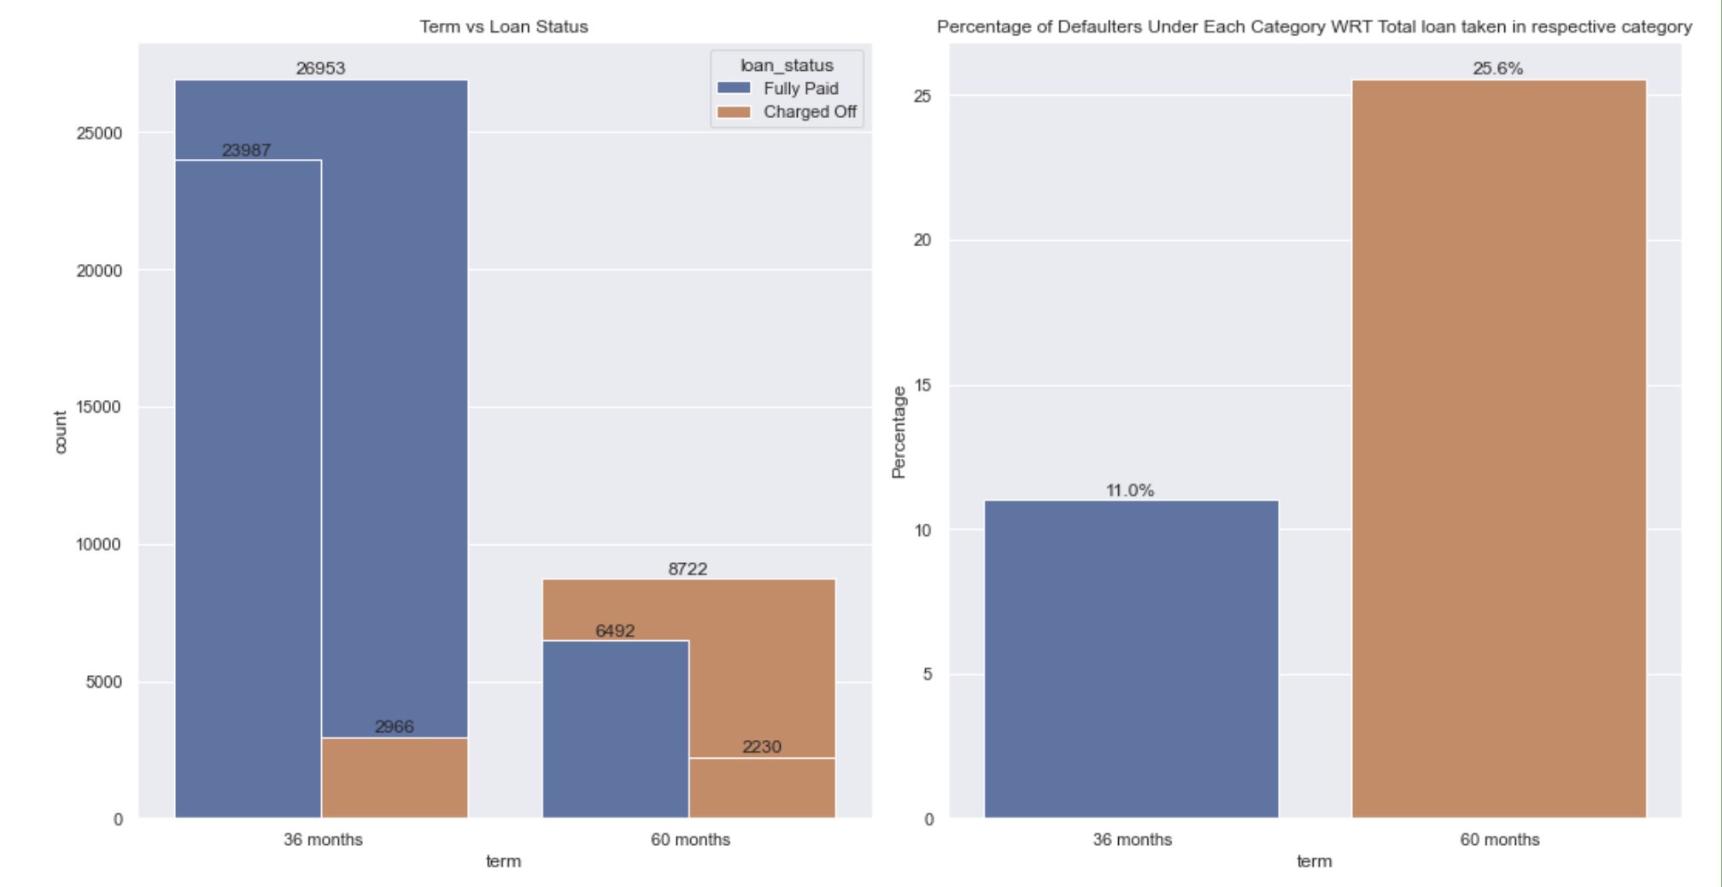
Caption
Caption
2. Term vs Loan Status (Count/Percentage)
From the count plot for Term vs Loan Status, it is clear that out of 8722 who opted for 60 Months as term 2230 has defaulted, which means around 25.6 %, whereas for those who opted 36 Months only 2966 out of 26953 defaulted, that’s just 11%
The Percentage of Defaulters Under Each Category WRT Total loan taken in respective category shows the same information as percentage values in a bar plot.
This gives a clear indication that people who opted for longer duration installments are going to default more, than people who opted for shorter duration
So always insist on lending money for a shorter duration.
Caption

Slide 19
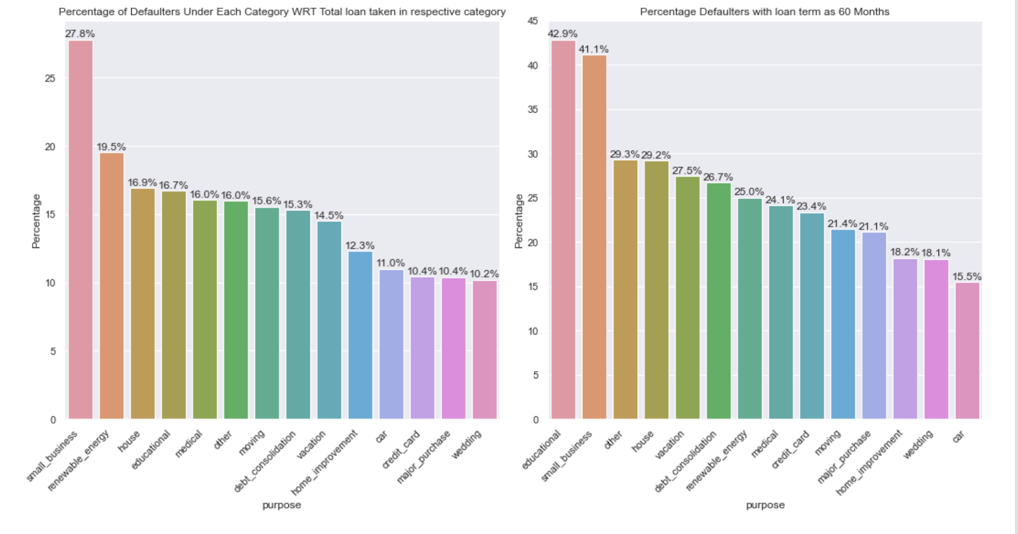
Caption
Caption
3. Purpose vs Loans Defaulted Under that purpose
The analysis, with purpose vs loan_status gives interesting insights.
27.8% of loans taken for small_business end up as defaulters. This might be because of the failure of the business
Another insight is that loans taken under 60 months as term and purpose as educational and small_business show very high default rates of about 42%
So lending loans for purposes such as education and small_business for longer terms of 60 months have a very huge chance of defaulting
There is another inference that, the majority of loans taken for small_business, are taken under high interest, G Grade, and longer-term 60 Months, resulting in high chances of defaulting.
Caption

Slide 20
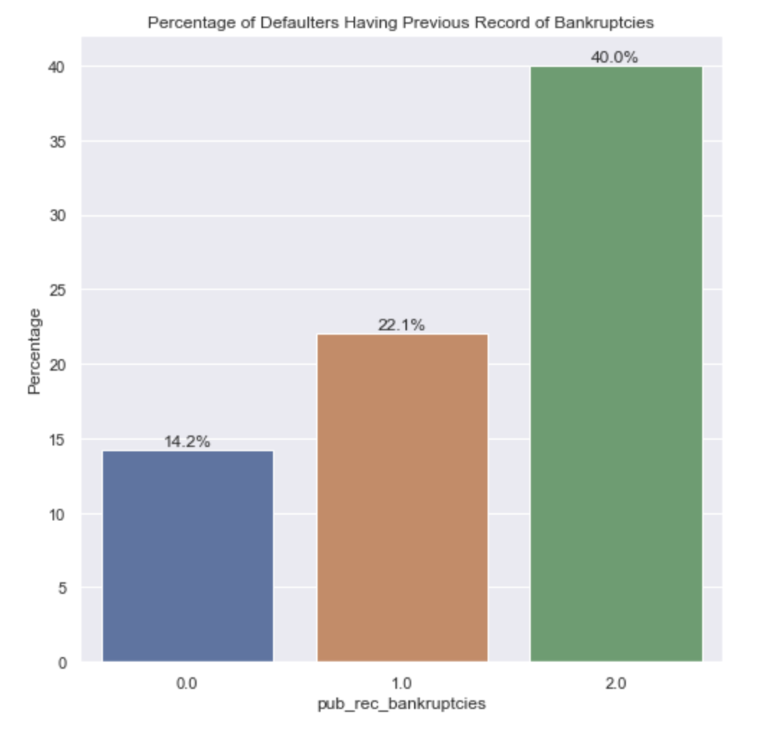
Caption
Caption
4. Record of Bankruptcies vs Loans Defaulted In Percentage
The bar plot of pub_rec_bankruptcies vs percentage of defaulters shows an indication that people having previous records of bankruptcies tend to repeat that in the future.
40% of those who take loans with a history of bankruptcies of 2 tend to default.
So it’s better not to provide loans for those having previous records of bankruptcies.
Caption

Slide 21
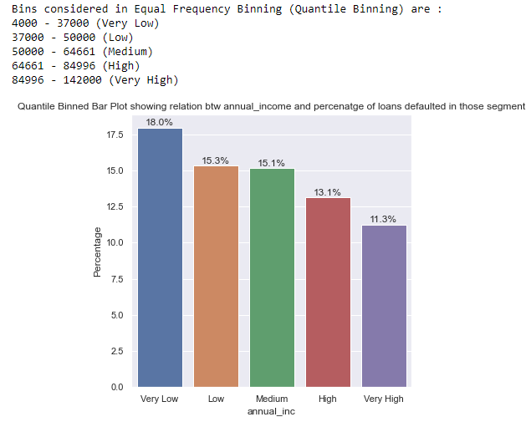
Caption
Caption
5. Annual Income vs Loans Defaulted In Percentage
The bar plot indicating the relationship btw annual_income and the Percentage of defaulters in each segment, binned using the Quantile Binning technique shows some interesting analysis.
Most of the defaulters lie in the lowest income range
There is a trend that as the annual_inc decreases chances of defaulting increases

Slide 22
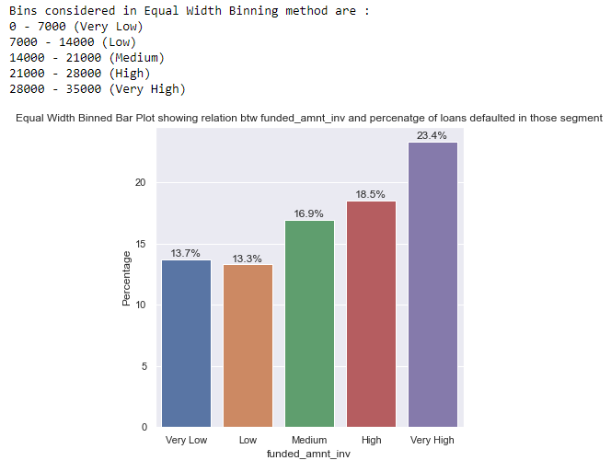
Caption
Caption
6. Funded Amount By Investors vs Loans Defaulted In that segment in Percentage
The plot indicating the relationship btw funded_amnt_inv and the Percentage of defaulters in each segment, binned using the Equal Width Binning technique shows some interesting analysis.
Most of the High Funded loans are the ones most tend to default
There is a trend that as the funded amount by investors increases chances of defaulting increases

Slide 23
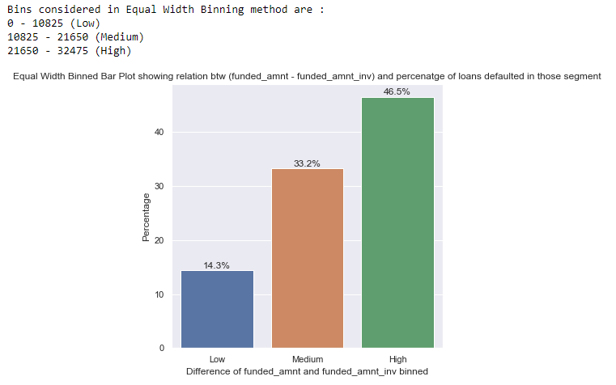
Caption
Caption
7. Difference of Funded Amount and Funded amount by investors vs Loans Defaulted In that segment in Percentage
The plot indicates relationship btw difference of funded_amnt and funded_amnt_inv, and the Percentage of defaulters in each segment, binned using the Equal Width Binning technique shows a very interesting analysis.
So if the difference btw the approved amount from LC and the amount funded by investors increases, means the tendency for that loan to default is very high
For loans which had a difference in approved amount from LC and amount funded by investors greater than 21.6K, around 46.5% of such loans was defaulted

Slide 24
Inferences from Bivariate Analysis
Caption
Caption
1) Loan Status vs Interest Rate
Loan Status vs Interest Rate Box plot gives a strong indication that most of the defaulters tend to fall on higher interest rates when compared to non-defaulters.
The Percentage of Defaulters Under Each Category WRT Grade bar plot gives a clear conclusion/insight that the higher the grade at which the loans are taken, the more the chance of defaulting.
Around 36% of the loan takers under G category has defaulted
Grade/Sub Grade is linked to Interest rate, The Higher the grade higher the interest rate
2) Term vs loan_status
People who opted for longer duration installments i.e. 60 months are going to default more, than people who opted for shorter duration i.e. 36 months
From Term vs Loan Status Analysis, it’s clear that out of 8722 who opted for 60 Months as term 2230 has defaulted, which means around 25.6 %, whereas, for those who opted 36 Months only 2966 out of 26953 defaulted, that’s just 11%
3) Purpose vs loan_status
From Purpose vs Loan_status analysis, it’s clear that 27.8% of loans taken for small_business end up as defaulters. This might be because of the failure of the business.
Another insight is that loans taken under 60 months as term and purpose as educational and small_business show very high default rates of about 42%

Slide 25
Continuation :
Caption
Caption
4) Annual Income vs Loans Defaulted In that segment in Percentage
From Annual Income vs Loan Status analysis, it was found that as annual_inc decreases chances of defaulting increases
5) Funded Amount By Investors vs Loans Defaulted In that segment in Percentage
From Funded_amnt_inv vs loan_status analysis, it was found that as the funded amount by investors increases chances of defaulting increases
6) Record of Bankruptcies vs Loans Defaulted In that segment in Percentage
pub_rec_bankruptcies vs percentage of defaulters shows an indication that people having previous records of bankruptcies tend to repeat that in the future.
Around 40% of those who take loans with a history of bankruptcies of 2 tend to default.
7) Difference of Funded Amount and Funded amount by investors vs Loans Defaulted In that segment in Percentage
Analyzing the relationship btw the difference of funded_amnt and funded_amnt_inv, and the Percentage of defaulters in each segment, binned using the Equal Width Binning technique shows a very interesting analysis.
So if the difference btw the approved amount from LC and the amount funded by investors increases, means the tendency for that loan to default is very high
For loans that had a difference in approved amount from LC and amount funded by investors greater than 21.6K, around 46.5% of such loans were defaulted

Slide 26
Thank You !
Caption
Caption
Akankshya Abhilipsa

