Slide 1
Lighting and Shading
Computer Graphics

Slide 2
Lighting & Shading
Approximate physical reality
Ray tracing:
  Follow light rays through a scene
  Accurate, but expensive (off-line)
Radiosity:
  Calculate surface inter-reflection approximately
  Accurate, especially interiors, but expensive (off-line)
Phong Illumination model :
  Approximate only interaction light, surface, viewer
  Relatively fast (on-line), supported in OpenGL

Slide 3
Ray Tracing

Slide 4
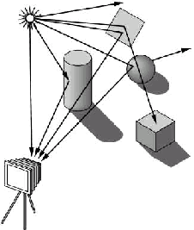
Forward Ray Tracing
Lights emit photon
Follow the photons
  Trace Path (Ray)
  Bounce off objects
    Reflect, refract, attenuate
  When a ray enters eye
    Calculate intersection with view plane.
    Accumulate color in the pixel
Expensive
  Many rays will not intersect view plane

Slide 5
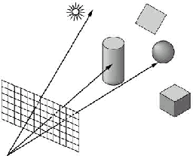
Backward Ray Tracing
Ray-casting: one ray from center of projection through each pixel in image plane
Illumination
  Phong (local as before)
  Shadow rays
  Specular reflection
  Specular transmission
(3) and (4) require recursion

Slide 6
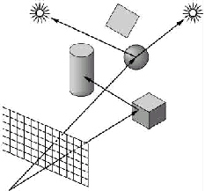
Shadow Rays
Determine if light “really” hits surface point
Cast shadow ray from surface point to light
If shadow ray hits opaque object, no contribution
Improved diffuse reflection

Slide 7
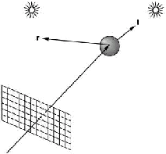
Reflection & Transmission Rays
Reflection Rays
  Calculate specular component of illumination
  Compute reflection ray
  Call ray tracer recursively to determine color
  Add contributions
Transmission ray
  Analogue for transparent or translucent surface
  Use Snell’s laws for refraction

Slide 8
Ray Casting
Simplest case of ray tracing
  Required as first step of recursive ray tracing
Basic ray-casting algorithm
  For each pixel (x,y) fire a ray from COP through (x,y)
  For each ray & object calculate closest intersection
  For closest intersection point p
    Calculate surface normal
    For each light source, calculate and add contributions
Critical operations
  Ray-surface intersections
  Illumination calculation

Slide 9
Radiosity Methods

Slide 10
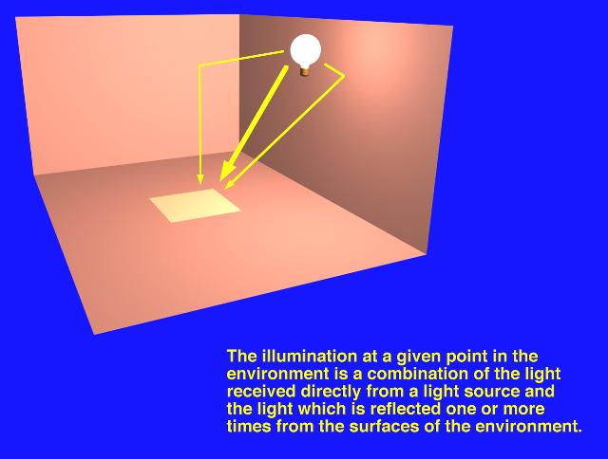
Radiosity – concepts

Slide 11
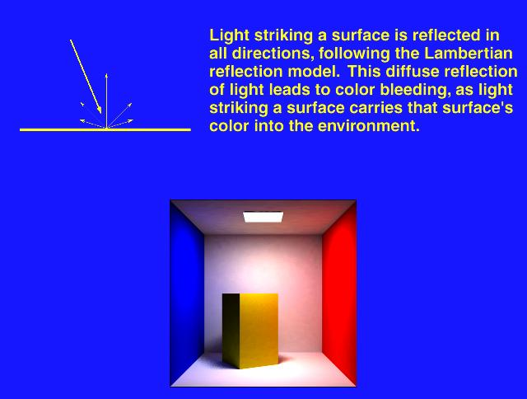
Radiosity – concepts

Slide 12
Radiosity
Radiosity:
  The rate at which energy leaves a surface
  Radiosity = (Emitted energy)+(Reflected energy)
  Light sources are not treated differently in radiosity – every surface is a light source.
Radiosity method:
  First determine all the light interactions in an environment in a view-independent way
  Visible-surface determination and interpolative shading is used to obtain view dependent image.

Slide 13
Classical Radiosity Method
Divide surfaces into patches (elements)
Model light transfer between patches as system of linear equations
Important assumptions:
  Reflection and emission are diffuse
    Recall: diffuse reflection is equal in all directions
    So radiance is independent of direction
  No participating media (no fog)
  No transmission (only opaque surfaces)
  Radiosity is constant across each element
  Solve for R, G, B separately

Slide 14
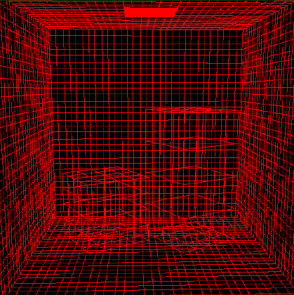
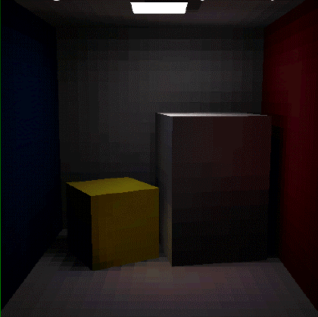
Radiosity Example
Wire-frame model
Resulting Image

Slide 15
Radiosity Pipeline
Scene Geometry
Reflectance property
Form Factor
Calculation
Solution of
Radiosity eqn
Visualization
Radiosity Image
Viewing Condition

Slide 16
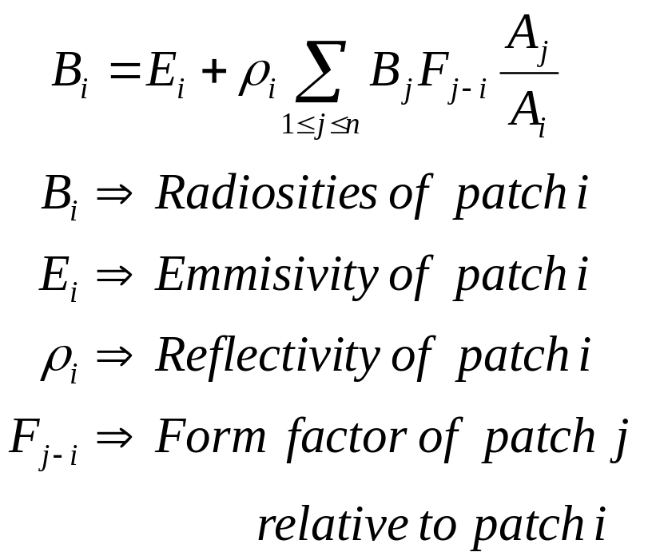
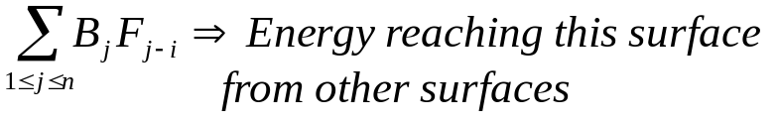
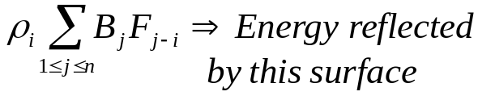
Radiosity Equations
Radiosity = amount of energy leaving a surface per unit area, per unit time ( W / m2 ).
Form factor_{i–j} = ratio of energy leaving surface j that arrives at surface i.
The Radiosity problem :
  Estimate the form factors
  Solve for the entire scene.
Surface patch i

Slide 17
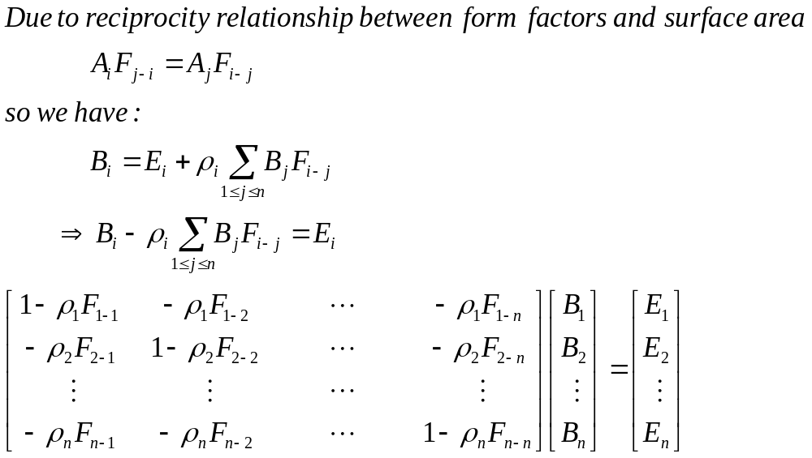
Radiosity Equations

Slide 18
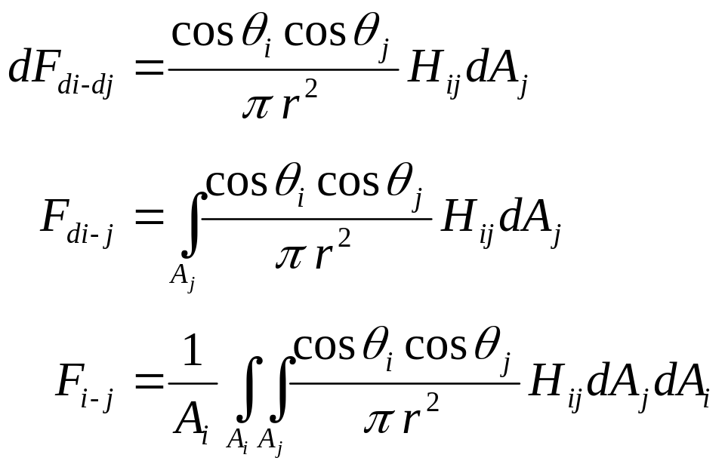
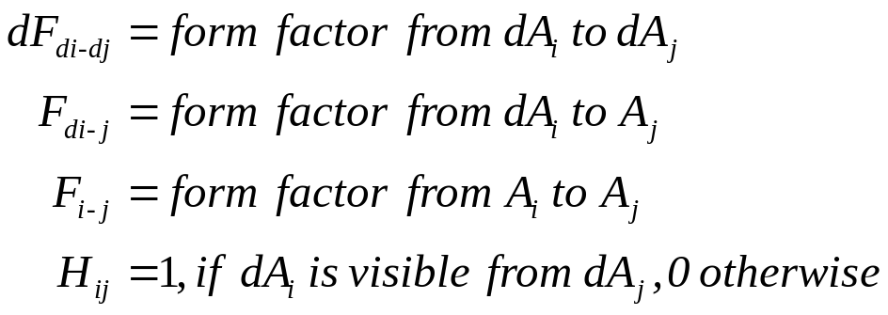
Calculating Form Factor
The form factor from differential surface dA_{i} to dA_{j} is:

Slide 19

Geometric Ingredients
Three ingredients
  Normal vector m at point P of the surface
  Vector v from P to the viewers eye
  Vector s from P to the light source
m
v
s
P

Slide 20
Types of Light Sources
Ambient light: no identifiable source or direction
Diffuse light - Point: given only by point
Diffuse light - Direction: given only by direction
Spot light: from source in direction
  Cut-off angle defines a cone of light
  Attenuation function (brighter in center)
Light source described by a luminance
  Each color is described separately
  I = [I r I g I b ] T (I for intensity)
  Sometimes calculate generically (applies to r, g, b)

Slide 21
Ambient Light
Global ambient light
  Independent of light source
  Lights entire scene
Local ambient light
  Contributed by additional light sources
  Can be different for each light and primary color
Computationally inexpensive

Slide 22
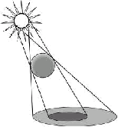
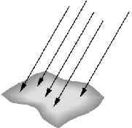
Diffuse Light
Point Source
  Given by a point
  Light emitted equally in all directions
  Intensity decreases with square of distance
  Point source [x y z 1]^{T}
Directional Source
  Given by a direction
  Simplifies some calculations
  Intensity dependents on angle between surface normal and direction of light
  Distant source [x y z 0]^{T}

Slide 23
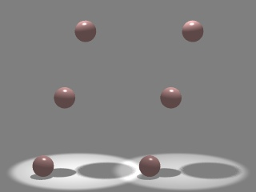
Spot Lights
Spotlights are point sources whose intensity falls off directionally.
  Requires color, point
  direction, falloff
  parameters
α
d
β
P
Intensity at P = I cos^{ε}(β)

Slide 24
Phong illumination model
Based on modeling surface reflection as a combination of the following components:
Emission
Used to model objects that glow
Ambient Reflection
A simple way to model indirect reflection
Diffuse Reflection
The illumination produced by dull smooth surfaces
Specular Reflection
The bright spots appearing on smooth shiny surfaces

Slide 25
Diffuse Reflection
Ideal diffuse reflection
  An ideal diffuse reflector, at the microscopic level, is a very rough surface (real-world example: chalk)
  Because of these microscopic variations, an incoming ray of light is equally likely to be reflected in any direction over the hemisphere
  What does the reflected intensity depend on?

Slide 26

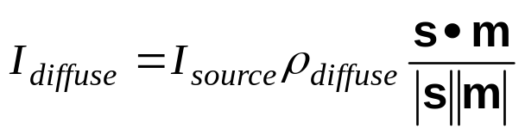
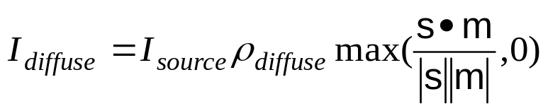
Computing Diffuse Reflection
Independent of the angle between m and v
Does depend on the direction s (Lambertian surface)
Therefore, the diffuse component is:
Diffuse Reflection Coefficient
Adjustment for ‘inside’ face

Slide 27
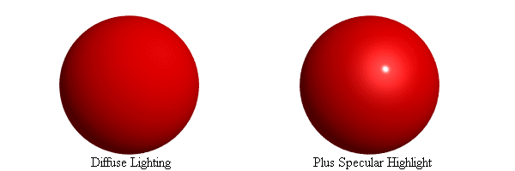
Specular Reflection
Shiny surfaces exhibit specular reflection
  Polished metal
  Glossy car finish
A light shining on a specular surface causes a bright spot known as a specular highlight
Where these highlights appear is a function of the viewer’s position, so specular reflectance is view dependent

Slide 28
Specular Reflection
Perfect specular reflection (perfect mirror)
  Snell’s law
The smoother the surface, the closer it becomes to a perfect mirror
Non-perfect specular reflection: Phong Model
  most light reflects according to Snell’s Law
  as we move from the ideal reflected ray, some light is still reflected

Slide 29
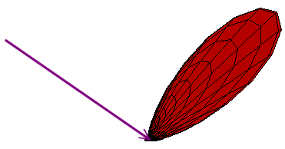
Non-Ideal Specular Reflectance: Phong Model
An illustration of this angular falloff
m
s
r
θ

Slide 30
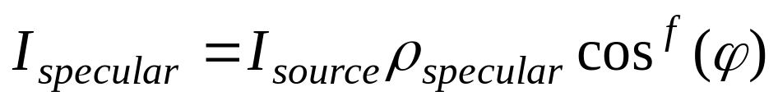
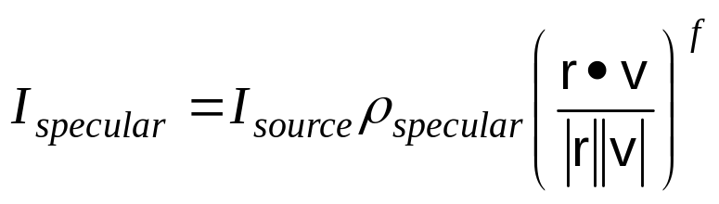
Phong Lighting
The Specular Intensity, according to Phong model:
Shininess factor
m
s
r
θ
φ
v
Specular Reflection Coefficient

Slide 31
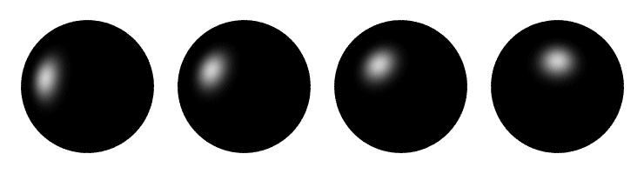
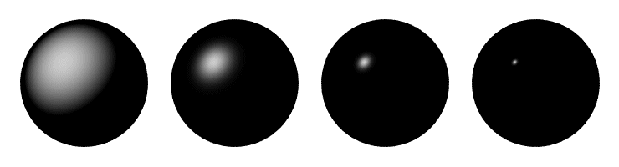
Phong Lighting Examples
These spheres illustrate the Phong model as s and f are varied:

Slide 32
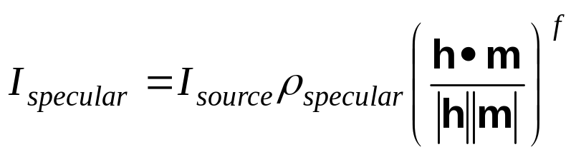
Blinn and Torrence Variation
In Phong Model, r need to be found
  computationally expensive
Instead, halfway vector h = s + v is used
  angle between m and h measures the falloff of intensity
m
s
h
β
v

Slide 33
Combining Everything
Simple analytic model:
  diffuse reflection +
  specular reflection +
  ambient
Surface

Slide 34
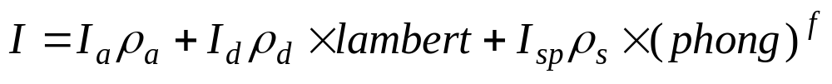
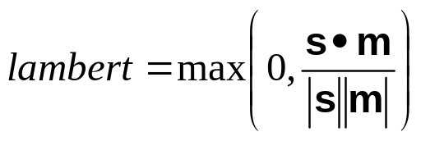
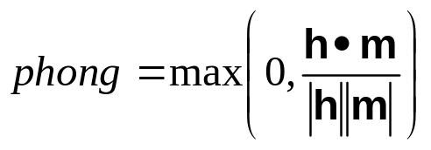
The Final Combined Equation
Single light source:
m
Viewer
r
θ
θ
s
φ
v

Slide 35
Adding Color
Consider R, G, B components individually
Add the components to get the final color of reflected light

Slide 36
Shading Models

Slide 37
Applying Illumination
We have an illumination model for a point on a surface
Assuming that our surface is defined as a mesh of polygonal facets, which points should we use?

Slide 38



Polygon Shading
Types of Shading Model
Flat Shading
Smooth Shading
Gouraud Shading
Phong Shading

Slide 39
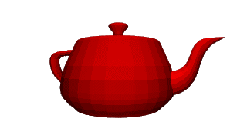
Flat Shading
For each polygon
  Determines a single intensity value
  Uses that value to shade the entire polygon
Assumptions
  Light source at infinity
  Viewer at infinity
  The polygon represents the actual surface being modeled

Slide 40
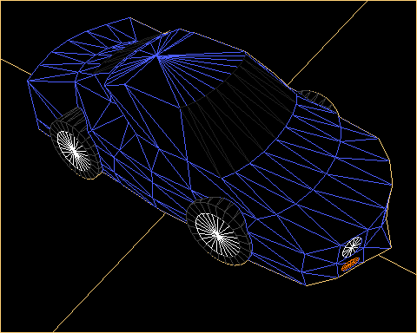
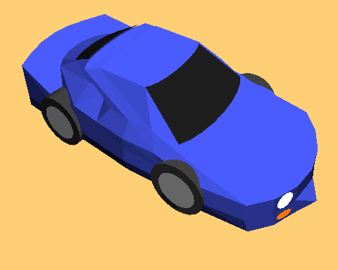
Flat Shading
Flat Shading
Wire-frame Model

Slide 41
Smooth Shading
Introduce vertex normals at each
vertex
  Usually different from facet normal
  Used only for shading
  Think of as a better approximation of the real surface that the polygons approximate
Two types
  Gouraud Shading
  Phong Shading (do not confuse with Phong Lighting Model)

Slide 42
Gouraud Shading
This is the most common approach
  Perform Phong lighting at the vertices
  Linearly interpolate the resulting colors over faces
    Along edges
    Along scanlines

Slide 43
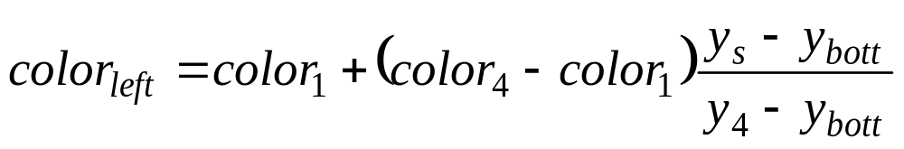
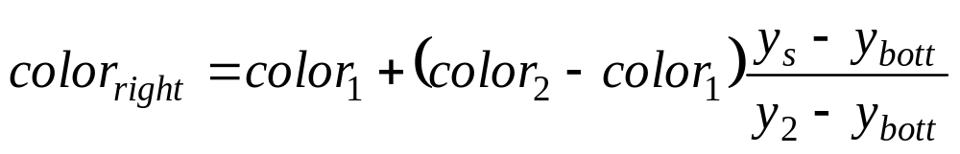
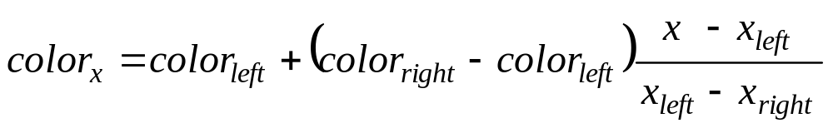
Gouraud Shading
y_{top}
color₃
y₄
color₄
color₂
y_{s}
y_{bott}
color₁
x_{left}
x_{right}

Slide 44
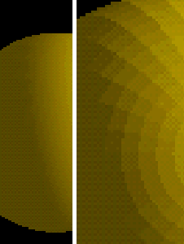
Gouraud Shading
Vertex 1
I = 0.2
0.35
0.50
0.65
Vertex 2
I =0.8
0.3
0.85
0.4
0.9
0.5
0.95
I = 0.6
Vertex 4
I = 1.0
Vertex 3

Slide 45
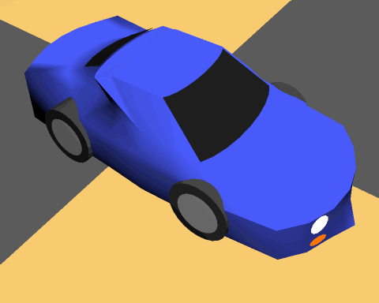
Gouraud Shading
Wire-frame Model
Flat Shading
Gouraud Shading

Slide 46
Gouraud Shading
Artifacts
  Often appears dull
  Lacks accurate specular component
    If included, will be averaged over entire polygon
C₁
C₃
C₂
Can’t shade the spot light

Slide 47
Phong Shading
Interpolate normal vectors at each pixel
m₃
m₄
m_{right}
m₂
m_{left}
m
y_{s}
m₁
x

Slide 48
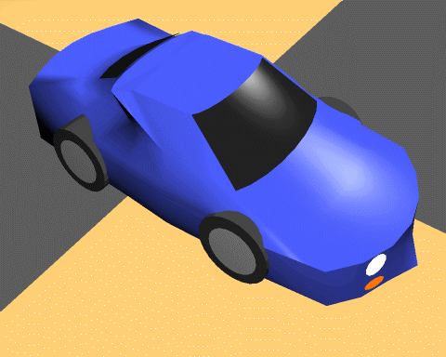
Phong Shading
Wire-frame Model
Flat Shading
Gouraud Shading
Phong Shading

Slide 49
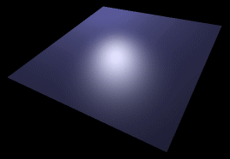
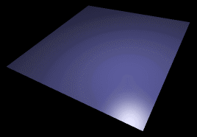
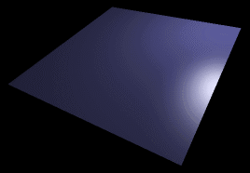
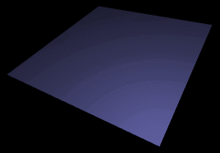
Phong vs Gouraud Shading
If a highlight does not fall on a vertex
Gouraud shading may miss it completely,
but Phong shading does not.

Slide 50
Shading Models (Direct lighting)
Flat Shading
  Compute Phong lighting once for entire polygon
Gouraud Shading
  Compute Phong lighting at the vertices and interpolate lighting values across polygon
Phong Shading
  Interpolate normals across polygon and perform Phong lighting across polygon

Slide 51
Lighting in OpenGL

Slide 52
Lighting in OpenGL [1/2]
Enabling shading
  glShadeModel(GL_FLAT)
  glShadeModel(GL_SMOOTH); // Gouraud Shading only
Using light sources
  Up to 8 light sources
  To create a light
    GLfloat light0_position[] = { 600, 40, 600, 1.0};
    glLightfv(GL_LIGHT0, GL_POSITION, light0_position);
    glEnable(GL_LIGHT0);
    glEnable(GL_LIGHTING);

Slide 53
Lighting in OpenGL [2/2]
  Changing light properties
    GLfloat light0_ambient[] = { 0.4, 0.1, 0.0, 1.0 };
    GLfloat light0_diffuse[] = { 0.9, 0.3, 0.3, 1.0 };
    GLfloat light0_specular[] = { 0.0, 1.0, 1.0, 1.0 };
    glLightfv(GL_LIGHT0, GL_AMBIENT, light0_ambient);
    glLightfv(GL_LIGHT0, GL_DIFFUSE, light0_diffuse);
    glLightfv(GL_LIGHT0, GL_SPECULAR, light0_specular);

