Slide 1
CSE 4278 Computer Graphics
Clipping
Cohen Sutherland Algorithm (Line)
Cyrus-Back Algorithm (Line)
Sutherland-Hodgeman Algorithm (Polygon)
Cohen Sutherland Algorithm (3d)

Slide 2
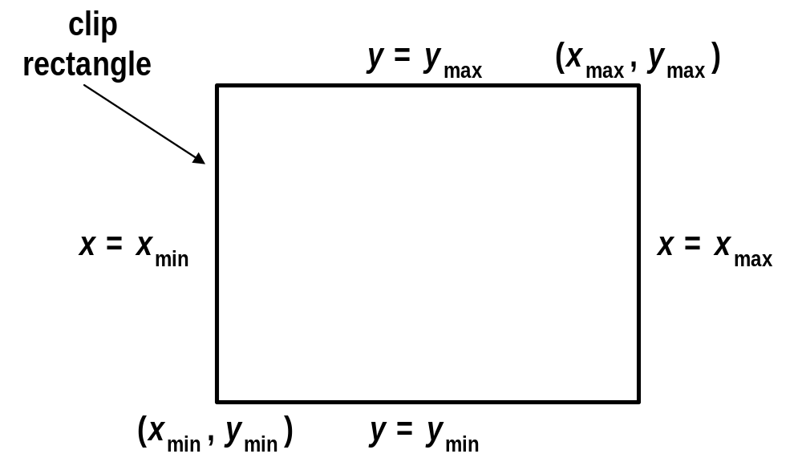
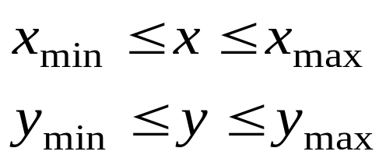
Point Clipping
For a point (x,y) to be inside the clip rectangle:

Slide 3
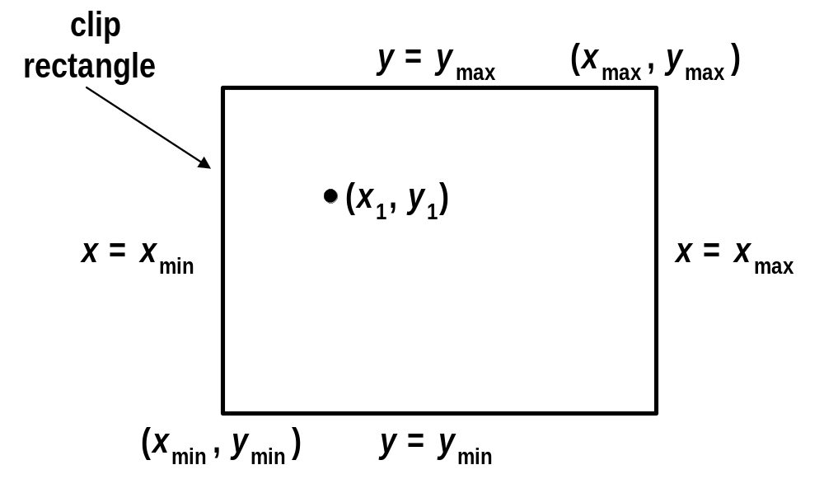
Point Clipping
For a point (x,y) to be inside the clip rectangle:

Slide 4
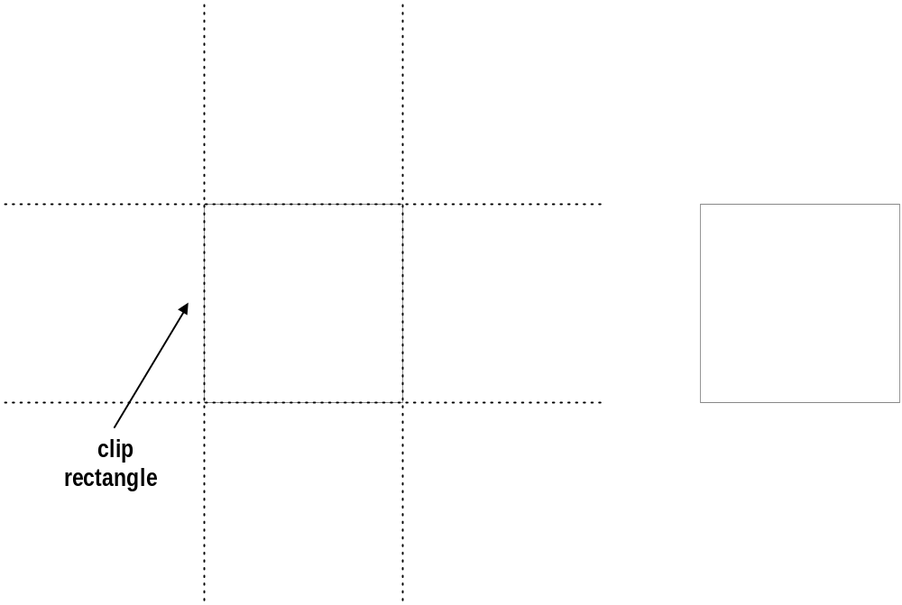
Line Clipping
Cases for clipping lines

Slide 5
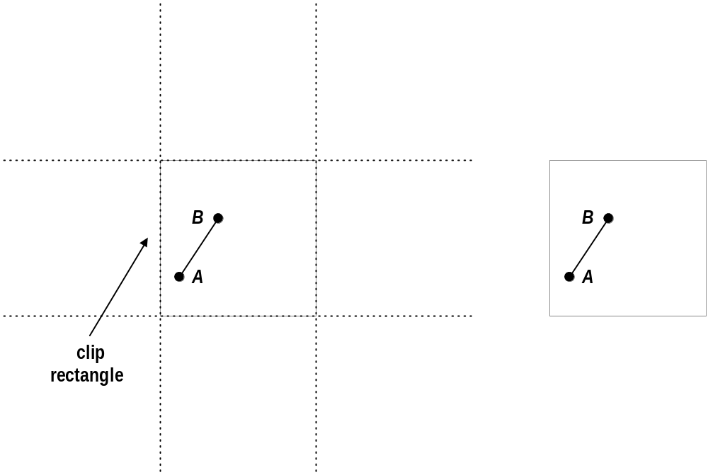
Line Clipping
Cases for clipping lines

Slide 6
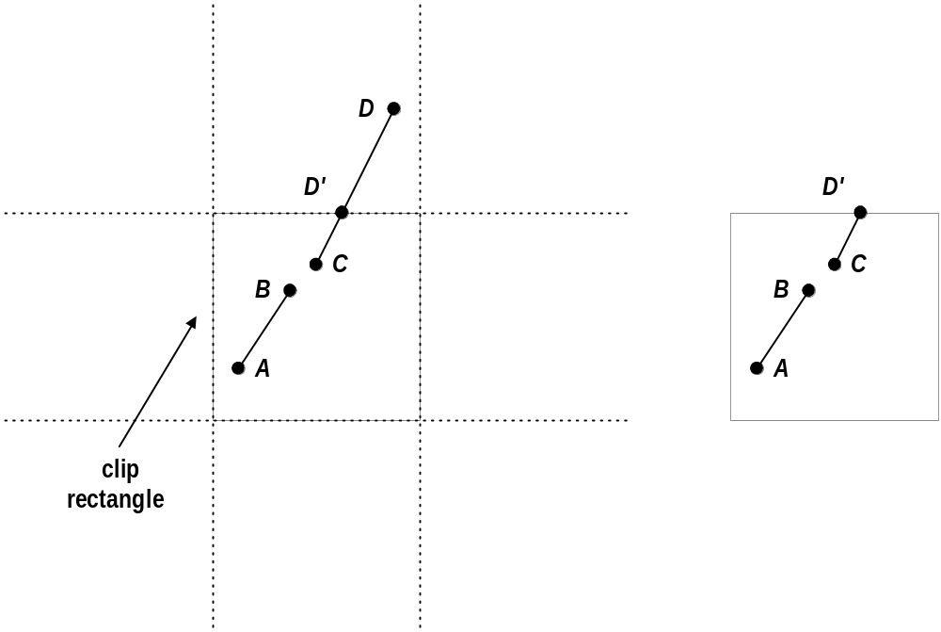
Line Clipping
Cases for clipping lines

Slide 7
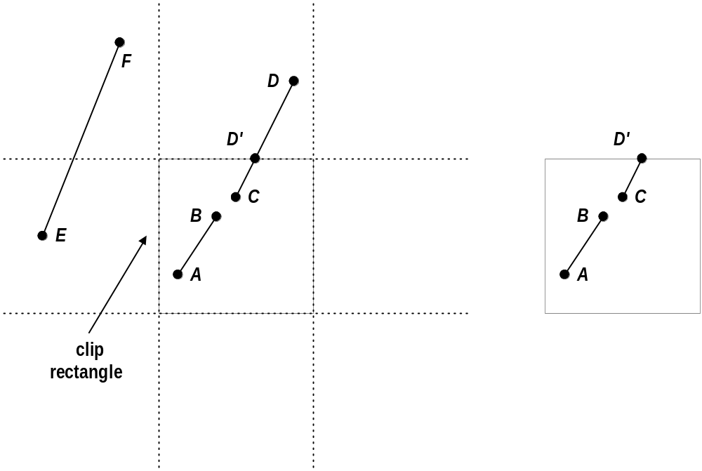
Line Clipping
Cases for clipping lines

Slide 8
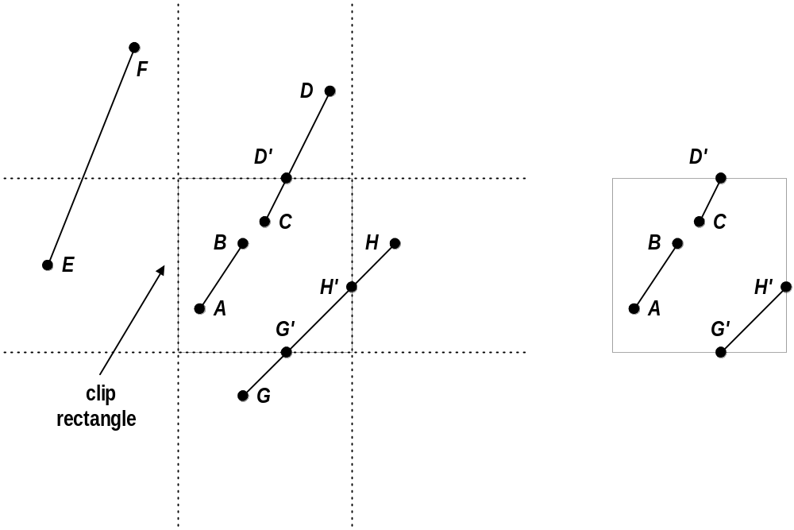
Line Clipping
Cases for clipping lines

Slide 9
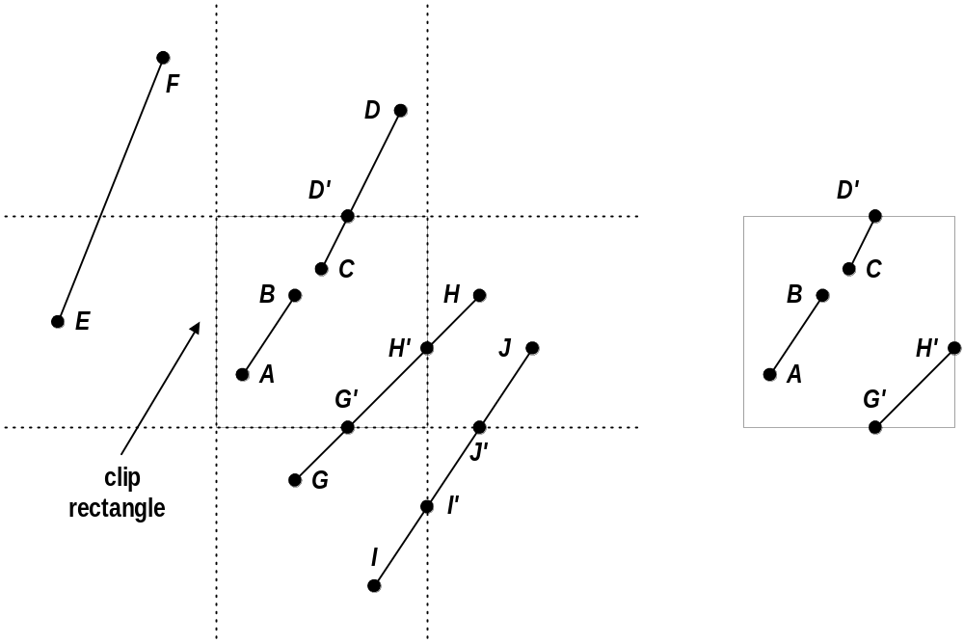
Line Clipping
Cases for clipping lines

Slide 10
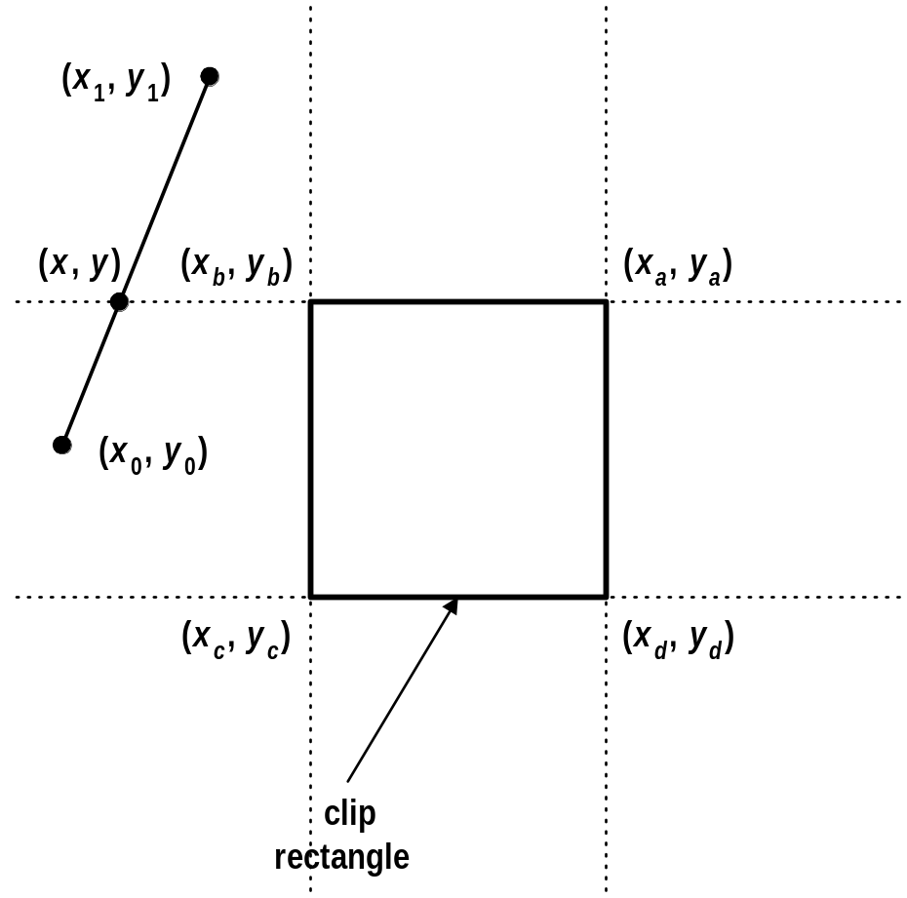
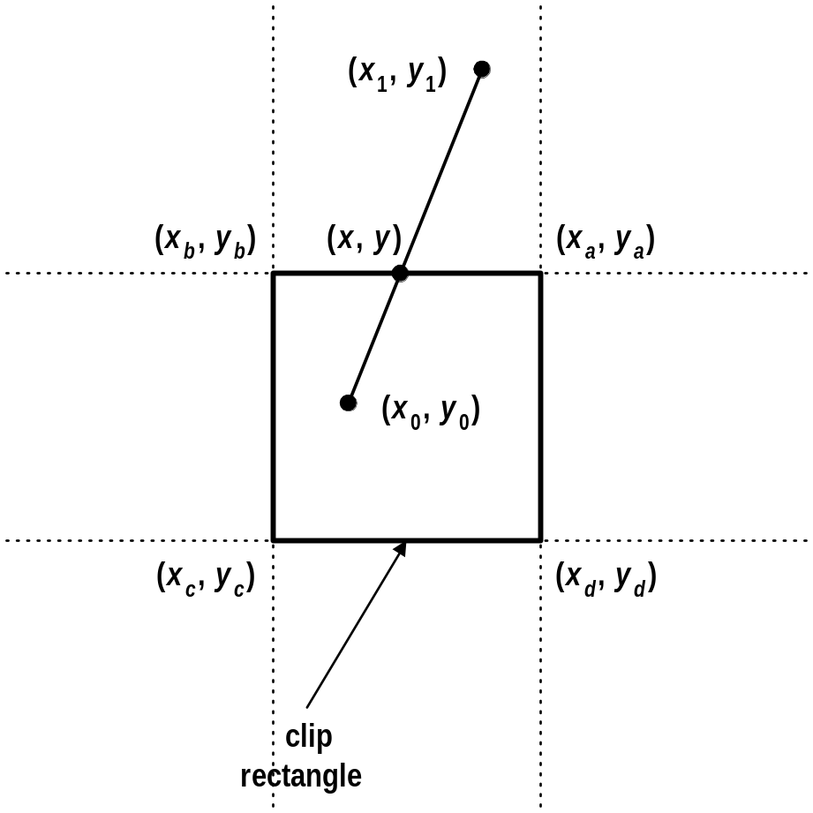
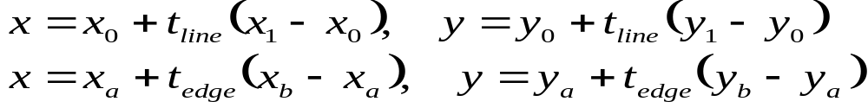
Line Clipping
Clipping Lines by Solving Simultaneous Equations

Slide 11

Cohen-Sutherland Algorithm
The Cohen-Sutherland Line-Clipping Algorithm performs initial tests on a line to determine whether intersection calculations can be avoided.
  First, end-point pairs are checked for Trivial Acceptance.
  If the line cannot be trivially accepted, region checks are done for Trivial Rejection.
  If the line segment can be neither trivially accepted or rejected, it is divided into two segments at a clip edge, so that one segment can be trivially rejected.
  These three steps are performed iteratively until what remains can be trivially accepted or rejected.

Slide 12
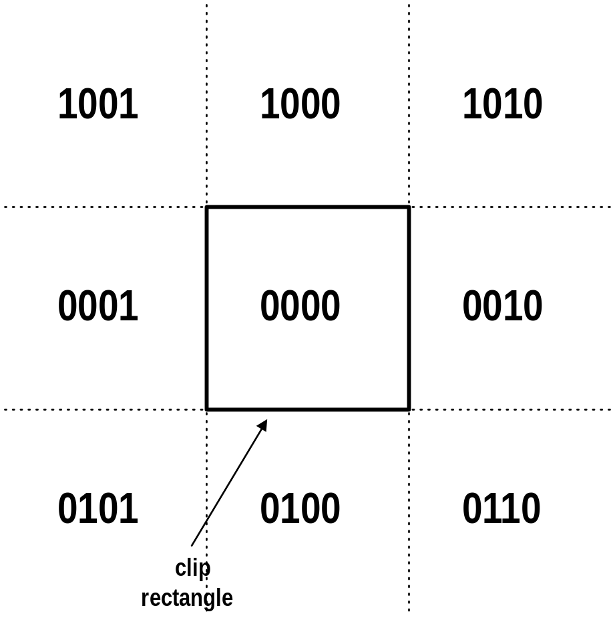
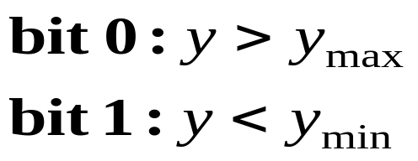
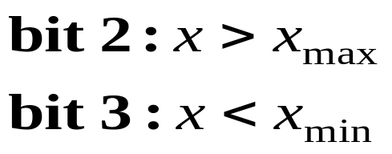
Cohen-Sutherland Algorithm
Region outcodes

Slide 13
Cohen-Sutherland Algorithm
A line segment can be trivially accepted if the outcodes of both the endpoints are zero.
A line segment can be trivially rejected if the logical AND of the outcodes of the endpoints is not zero.
A key property of the outcode is that bits that are set in nonzero outcode correspond to edges crossed.

Slide 14
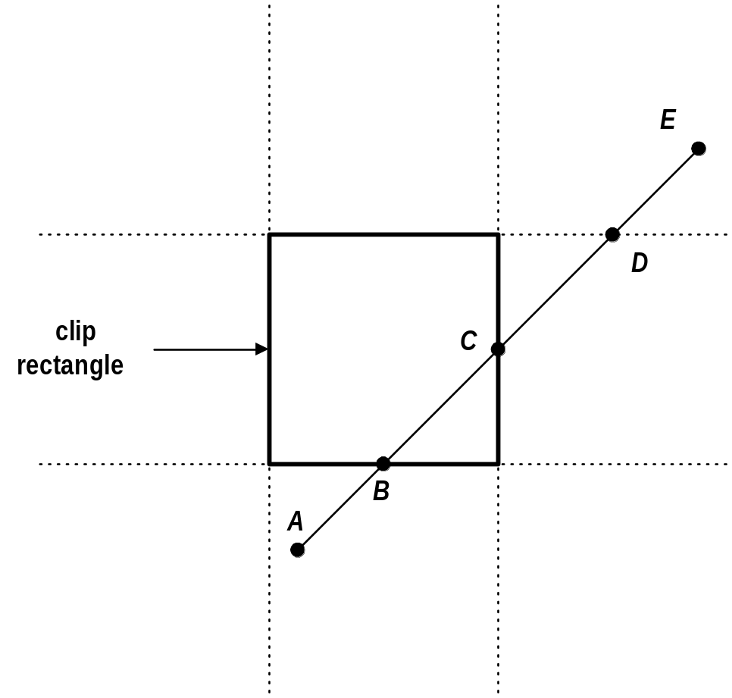
Cohen-Sutherland Algorithm
An Example

Slide 15
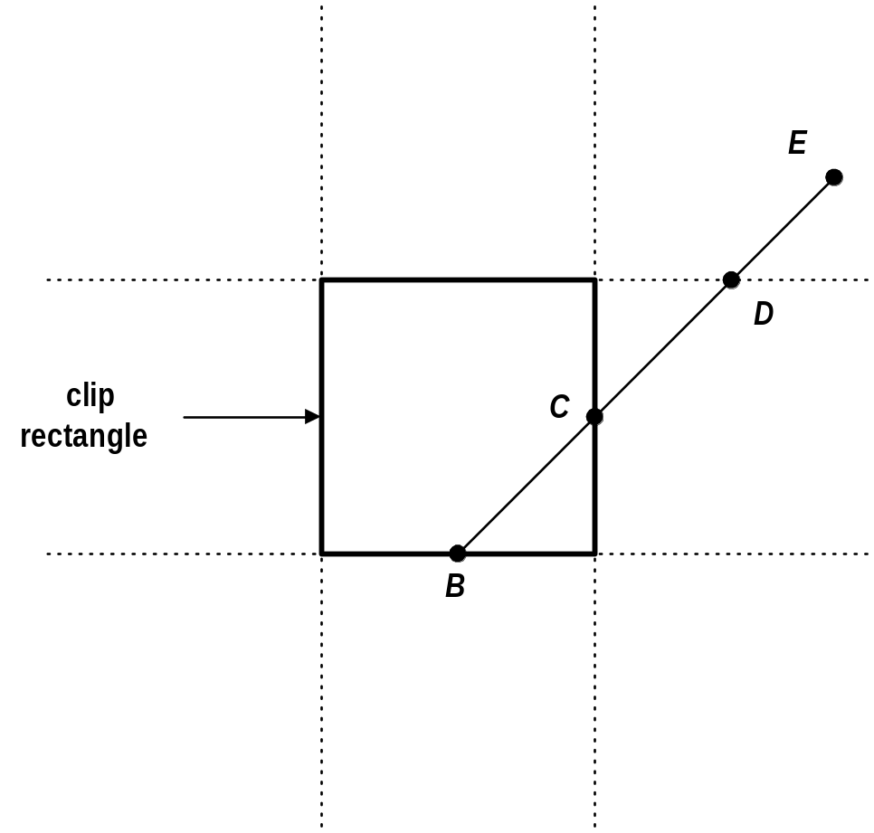
Cohen-Sutherland Algorithm
An Example

Slide 16
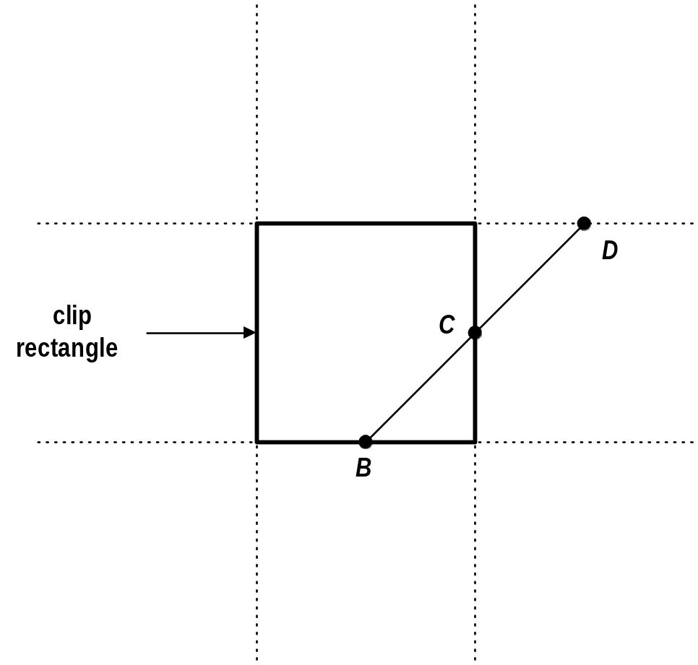
Cohen-Sutherland Algorithm
An Example

Slide 17
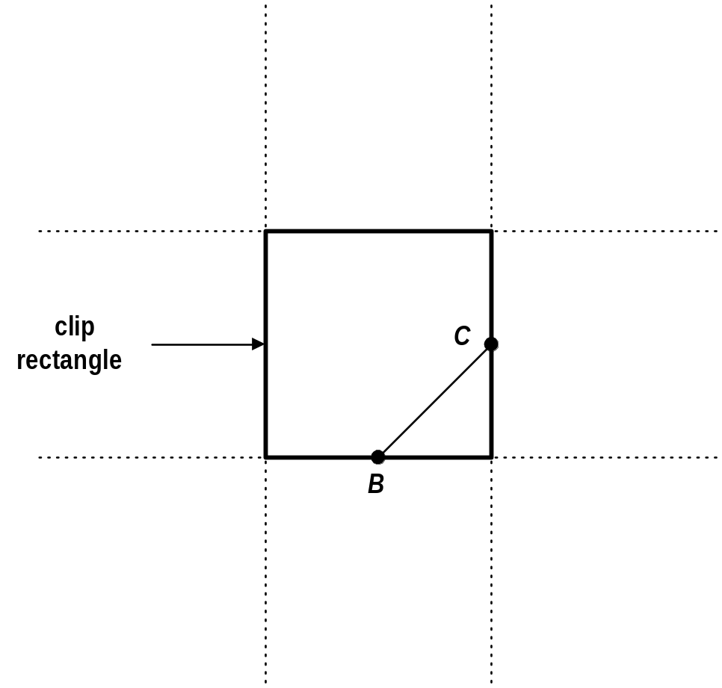
Cohen-Sutherland Algorithm
An Example

Slide 18
Parametric Line-Clipping
(1) This fundamentally different (from Cohen-Sutherland algorithm) and generally more efficient algorithm was originally published by Cyrus and Beck.
(2) Liang and Barsky later independently developed a more efficient algorithm that is especially fast in the special cases of upright 2D and 3D clipping regions.They also introduced more efficient trivial rejection tests for general clip regions.

Slide 19
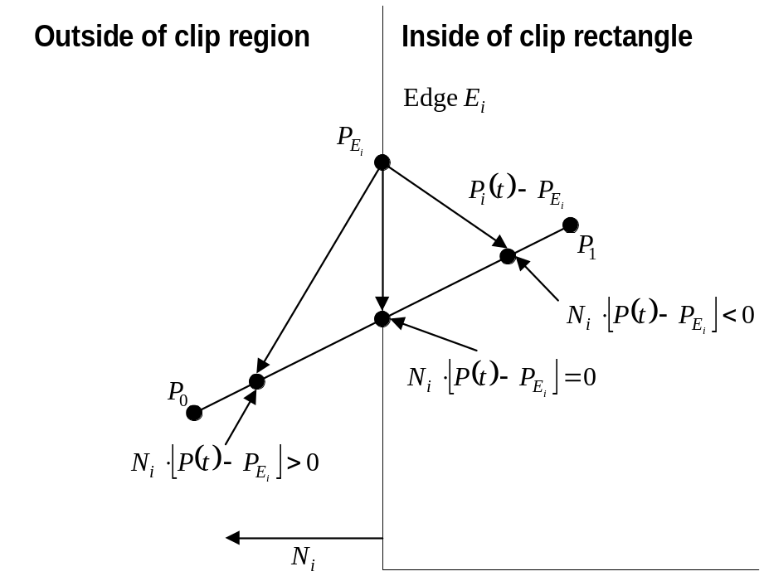

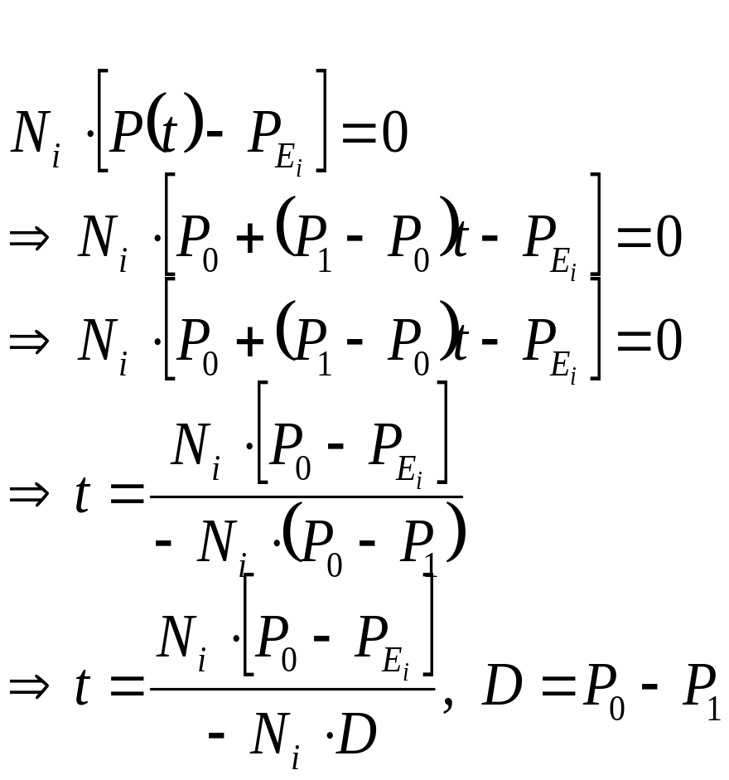
The Cyrus-Back Algorithm

Slide 20
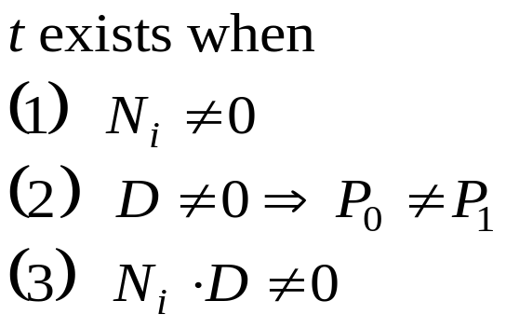
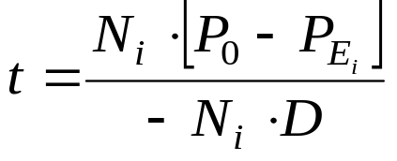
The Cyrus-Back Algorithm

Slide 21
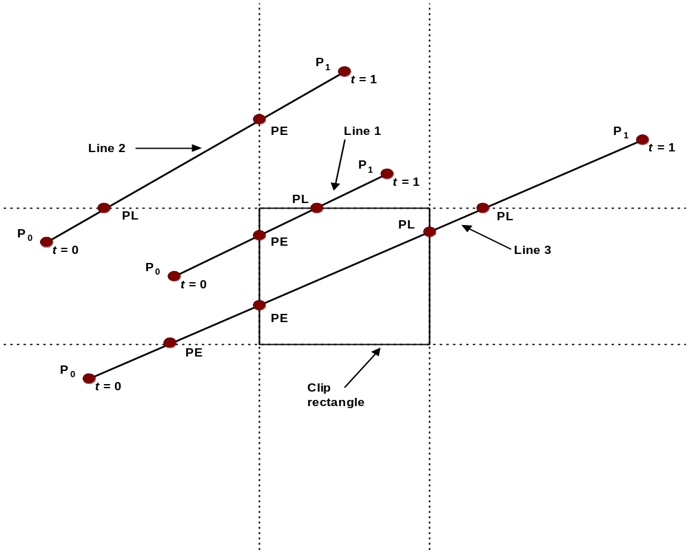
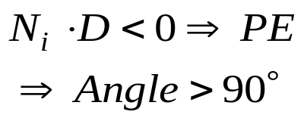
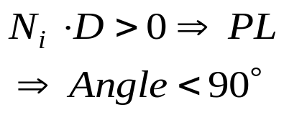
The Cyrus-Back Algorithm
PE = Potentially Entering
PL = Potentially Leaving

Slide 22
The Cyrus-Back Algorithm
Precalculate N_{i} and P_{Ei} for each edge
for (each line segment to be clipped) {
if (P₁ == P₀)
line is degenerated, so clip as a point;
else {
t_{E} = 0; t_{L} = 1;
for (each candidate intersection with a clip edge) {
if (N_{i} • D != 0) { /* Ignore edges parallel to line */
calculate t;
use sign of N_{i} • D to categorize as PE or PL;
if (PE) t_{E} = max(t_{E} , t);
if (PL) t_{L} = min(t_{L} , t);
}
}
if (t_{E} > t_{L}) return NULL;
else return P(t_{E}) and P(t_{L}) as true clip intersection;
}
}

Slide 23
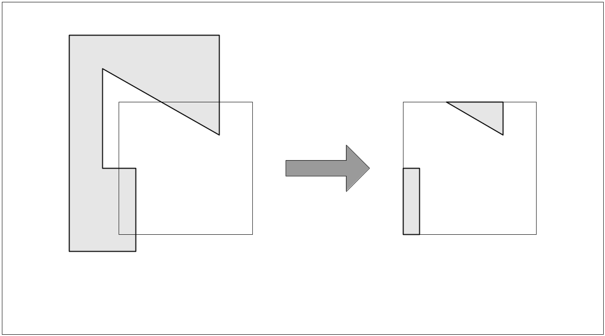
Polygon Clipping
Example

Slide 24
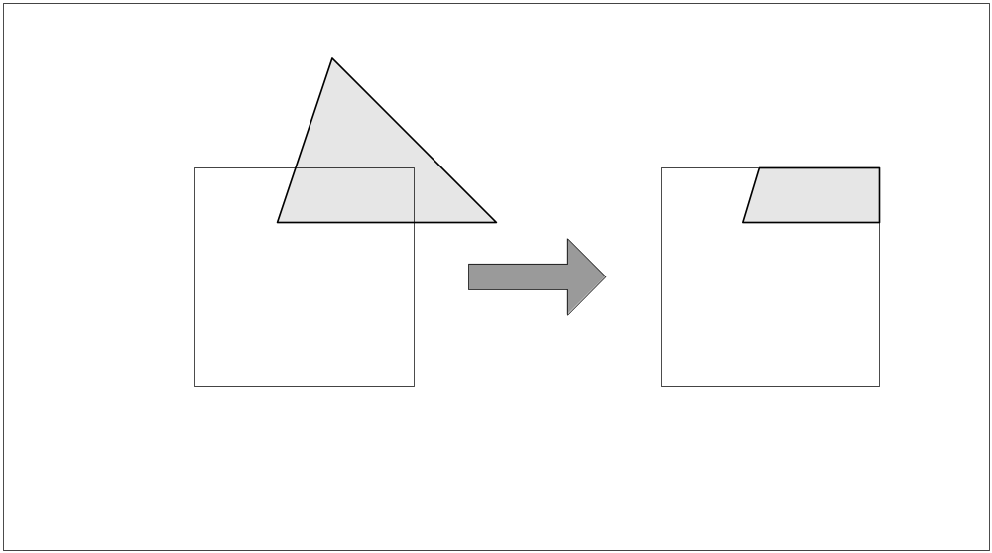
Polygon Clipping
Example

Slide 25
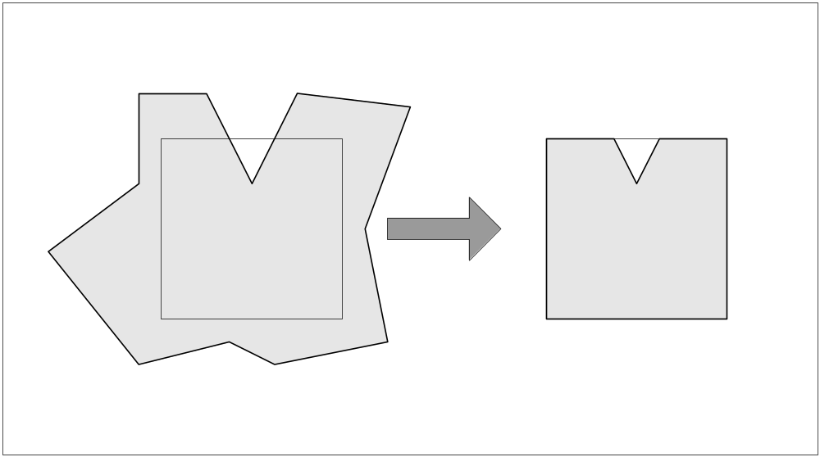
Polygon Clipping
Example

Slide 26
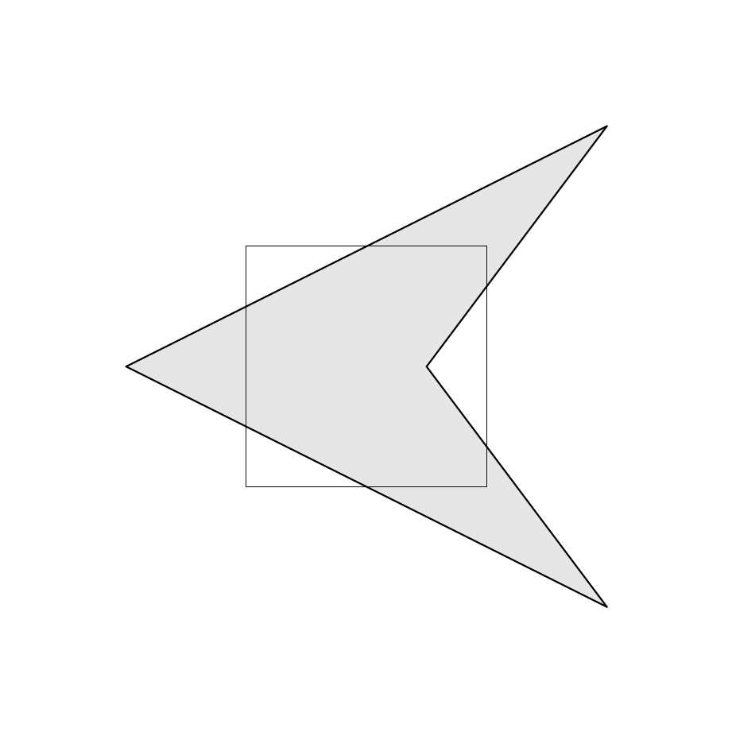
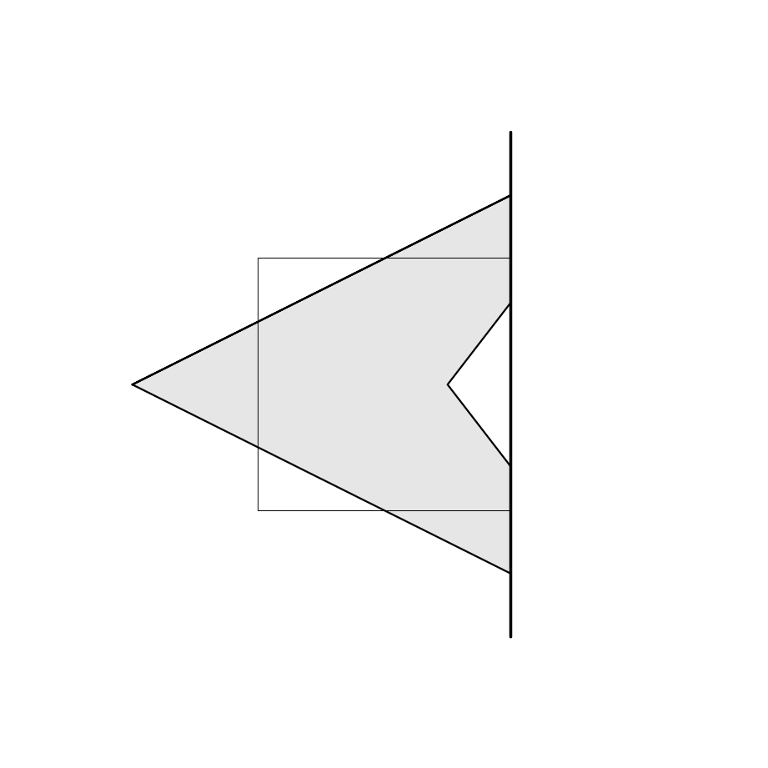
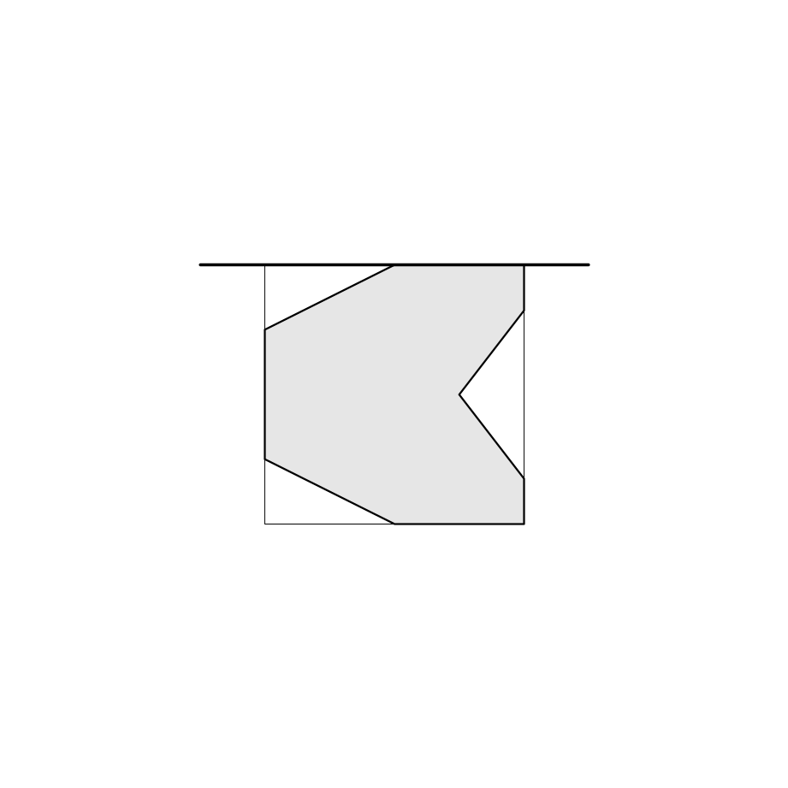
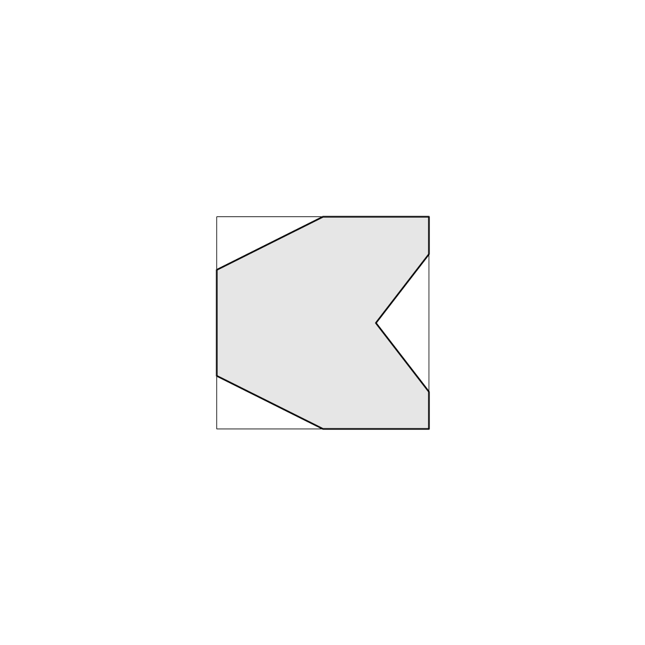
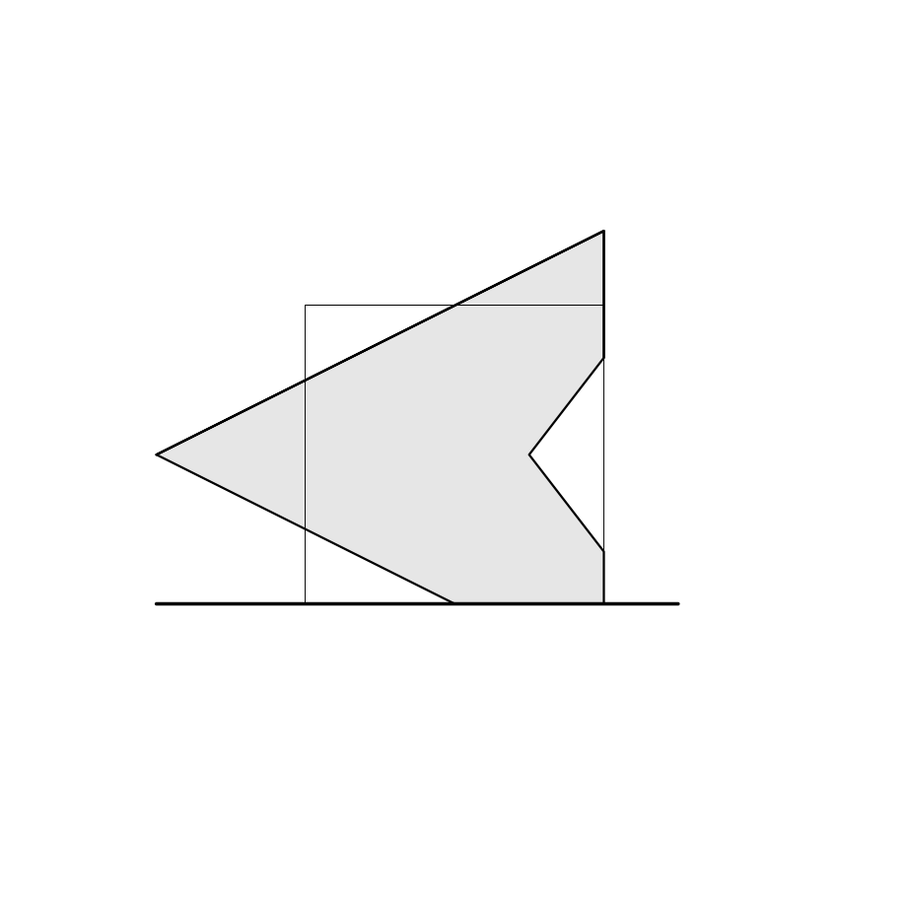
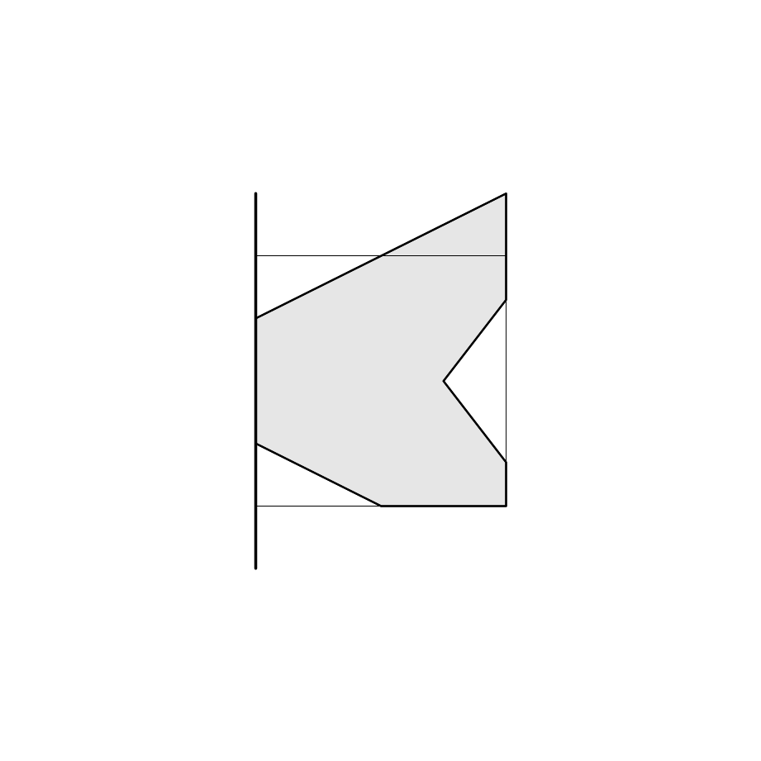
Sutherland-Hodgeman Algo.
Clip Against Bottom Clipping Boundary
Clip Against Right Clipping Boundary
Clip Against Top Clipping Boundary
The Clipped Polygon
Clip Against Left Clipping Boundary
Initial Condition

Slide 27
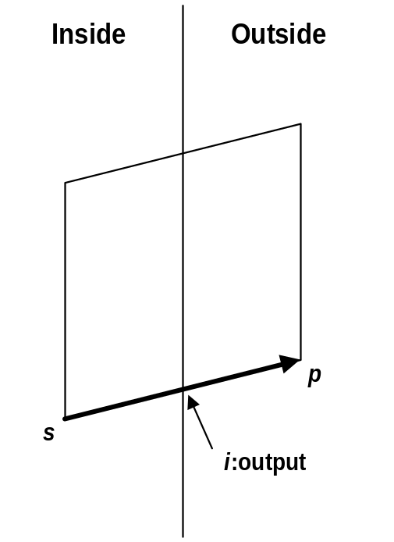
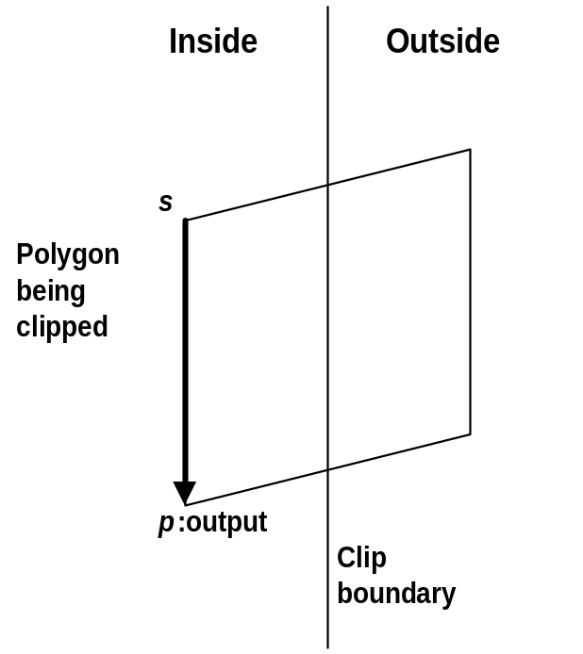
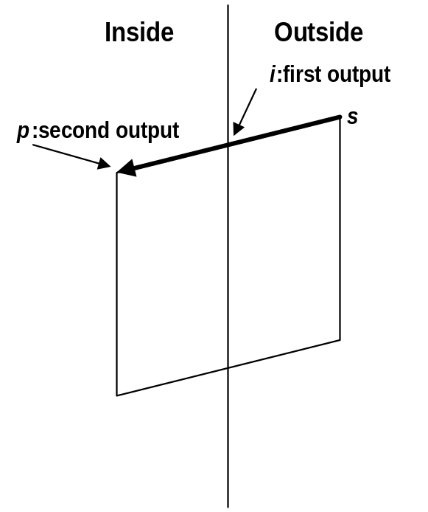
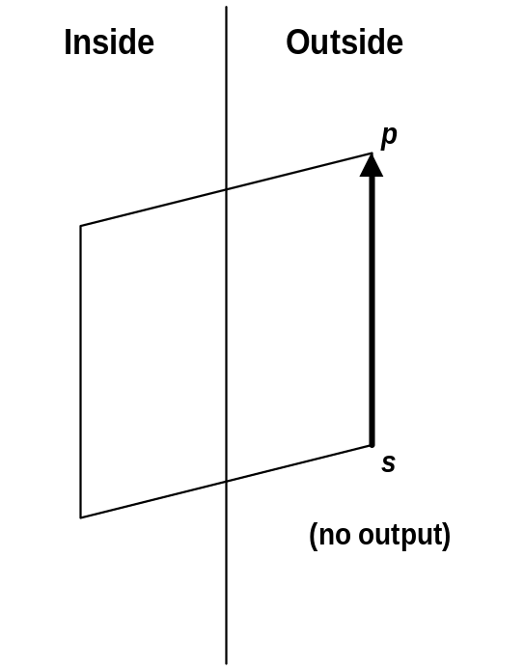
4 Cases of Polygon Clipping
Case 2
Case 1
Case 3
Case 4

Slide 28
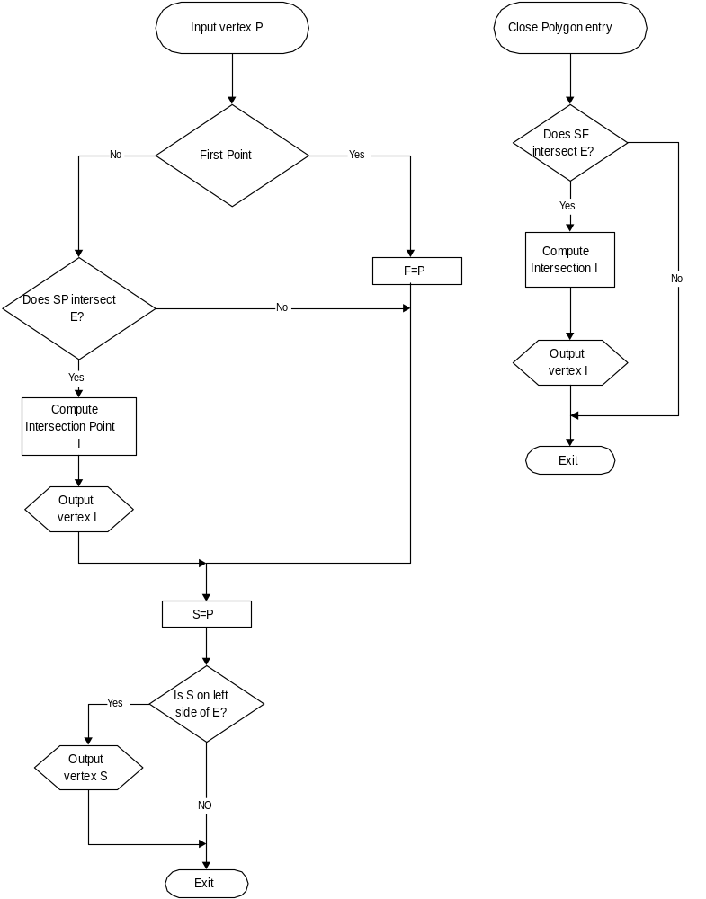
Algorithm

Slide 29
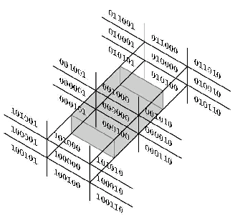
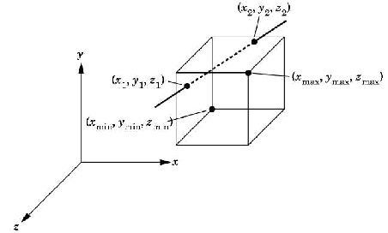
3D Clipping
Both the Cohen-Sutherland and Cyrus-Beck clipping algorithm readily extend to 3D.
For Cohen-Sutherland algorithm use two extra-bit in outcode for incorporating z < z_{min} and z > z_{max} regions

Slide 30
Thank You

