Slide 1
Computer Graphics
Chapter 5 & 6
2D and 3D Modeling Transformations
Md. Raihan ul Masood
Asso. Prof. and Head, CSE, NUB

Slide 2
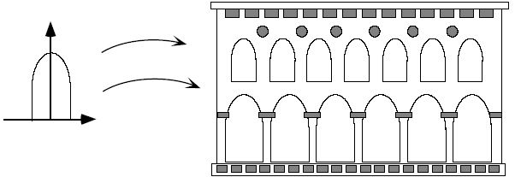
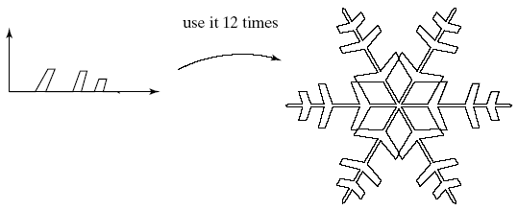
Why Transformations

Slide 3
Transforming Points and Objects
y
y
T
Q
T
Q
P
O
P
x
x
z

Slide 4
2D Modeling Transformations

Slide 5
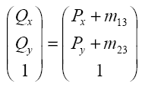
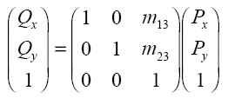
Basic Transformations: Translation
x = x + 4

Slide 6
Basic Transformations: Scaling
× 2
X × 2, Y × 0.5
Scaling about the origin

Slide 7
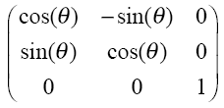
Basic Transformations: Rotation
Q
P
θ
Q_{x} = P_{x} cos(θ) - P_{y} sin(θ)
Q_{y} = P_{x} sin(θ) + P_{y} cos(θ)
Rotation about the origin

Slide 8

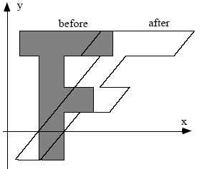

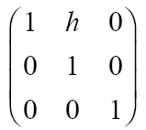
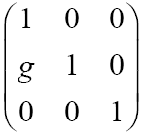


Basic Transformations: Shearing
Shear along x
Shear along y

Slide 9
Notations
Translation: T(dx,dy)
Scaling: S(sx,sy)
Rotation: R(θ)
Shearing: SH_{x}(h), SH_{y}(g)
Mirror Reflections: M_{x}, M_{y}

Slide 10
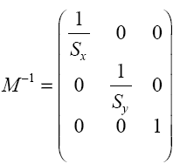
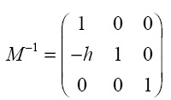
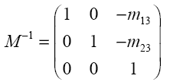
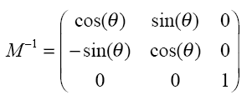
Inverse of a Transformation
Shearing
Scaling
Translation
Rotation

Slide 11
Composing Transformations
Q
T₁
T₂
P
W = T2(Q) = T2(T1(P))
W
T

Slide 12
Transformations are NOT commutative
Commutative Compositions:
M₁ | M₂
Translate | Translate
Scale | Scale
Rotate | Rotate
Uniform Scale | Rotate
Some non-commutative compositions:
Non-uniform scale, Rotate
Translate, Scale
Rotate, Translate
Translation, Rotation
Rotation, Translation

Slide 13
Example Composed Transformations
Rotating about an Arbitrary Point
Q
Step 1: Translate V to origin
y
Step 2: Rotate θ degrees
P
Step 3: Translate origin to V
Q
V
P
x
M = T(Vx,Vy)*R(θ)*T(-Vx,-Vy)

Slide 14
Example Composed Transformations
Reflection about a Tilted Line
Step 1: Translate (0,b) to origin
Step 2: Rotate -θ degrees
Step 3: Mirror reflect about X-axis
(0,b)
(0,b)
(0,b)
(0,b)
(0,b)
(0,b)
Step 4: Rotate θ degrees
Step 5: Translate origin to (0,b)
M = T(0,b)*R(θ)*M_{x}*R(-θ)*T(0,-b)

Slide 15
3D Modeling Transformations

Slide 16
Orientation
Thumb points to +ve Z-axis
Fingers show +ve rotation from X to Y axis

Slide 17
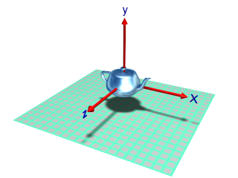
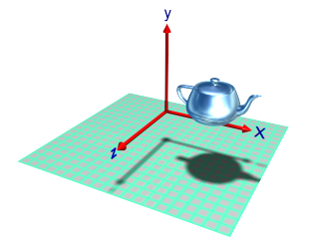
3D Translations

Slide 18
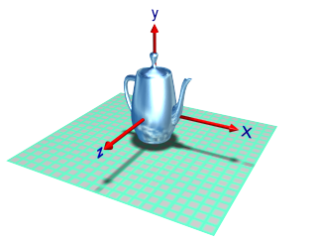
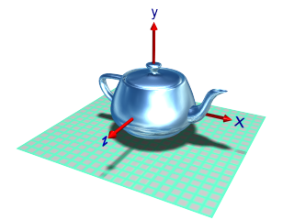
3D Scaling
Original
scale Y axis
scale all axes

Slide 19
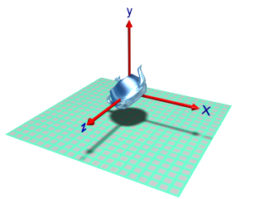
3D Rotations
Rotation about z-axis (z-roll)

Slide 20
3D Rotations
y-roll
x-roll

Slide 21
Composite Transformations – 3D
Some of the composite transformations to be studied are:
A_{V} = Aligning a vector V with the vector k
A_{V,N}= aligning a vector V with a vector N
R_{θ,L}= rotation about an axis L( V, P )

Slide 22
A_{V} : aligning vector V with k
A_{v} =
R_{θ,i}

Slide 23
A_{V} : aligning vector V with k
A_{v} =
R_{-ϕ,j} *
R_{θ,i}

Slide 24
A_{V} : aligning vector V with vector N
A_{V}⁻¹ = A_{V}^{T}
A_{V,N} = A_{N}⁻¹ * A_{V}

Slide 25
Composed Transformations – 3D
Rotation about an axis
y
u
Q
β
P
Φ
θ
x
z
R_{u}(β) = R_{y}(-θ)*R_{z}(Φ)*R_{x}(β)*R_{z}(-Φ)*R_{y}(θ)

Slide 26
M_{N,P} : Mirror reflection
Let the plane be represented by plane normal N and a point P in that plane
N
z
P
x
y

Slide 27
M_{N,P} : Mirror reflection
Let the plane be represented by plane normal N and a point P in that plane
Translate P to the origin
z
N
P
x
y
M_{N,P} =
T_{-P}

Slide 28
M_{N,P} : Mirror reflection
Let the plane be represented by plane normal N and a point P in that plane
Translate P to the origin
z
2. Align N with vector k
N
P
x
y
M_{N,P} =
A_{N} *
T_{-P}

Slide 29
M_{N,P} : Mirror reflection
Let the plane be represented by plane normal N and a point P in that plane
Translate P to the origin
z
2. Align N with vector k
N
3. Reflect w.r.t xy-plane
P
x
y
M_{N,P} =
S_{1,1,-1} *
A_{N} *
T_{-P}

Slide 30
M_{N,P} : Mirror reflection
Let the plane be represented by plane normal N and a point P in that plane
Translate P to the origin
z
2. Align N with vector k
3. Reflect w.r.t xy-plane
x
4. Reverse step 2
y
M_{N,P} =
A_{N}⁻¹ *
S_{1,1,-1} *
A_{N} *
T_{-P}

Slide 31
M_{N,P} : Mirror reflection
Let the plane be represented by plane normal N and a point P in that plane
Translate P to the origin
N
z
2. Align N with vector k
P
3. Reflect w.r.t xy-plane
x
4. Reverse step 2
y
5. Reverse step 1
M_{N,P} =
T_{-P}⁻¹ *
A_{N}⁻¹ *
S_{1,1,-1} *
A_{N} *
T_{-P}

Slide 32
Further Composition
Translate points in fig. 1 into points in fig 2 such that:
P₁ is at Origin
P₁P₂ is along positive z-axis
P₁P₃ lies in positive y-axis half of yz plane
The Composite Transform must have
Translation of P₁ to Origin ⇒ T
Some Combination of Rotations ⇒ R
y
y
y
T
R
x
x
z
Fig. 1
x
z
Fig. 2
z

Slide 33
TRANSFORMATION DETAILS

Slide 34
Transformation?
Transformation: Mapping from one point x to another unique point A(x)
Linear Transformation: A transformation A is linear providing the following two conditions
For all c and all x, A(cx) = cA(x)
For all x and y, A(x+y) = A(x) + A(y)
Ex: A1: <x, y> → <-y,x>
Translation Rotation Scaling Shearing
Which one is not linear transformation?

Slide 35
Transformation
Affine Transformation:A transformation A is affine provided it can be written as the composition of a translation and a linear transformation. That is, provided it can be written in the form A = T(u).B,
for some Translation T
and some linear transformation B.
In other words, a transformation A is affine if it equals
A(x) = B(x) + u

Slide 36
Transformation
One important property of Linear Transformation
Linear Transformations can be represented as Matrix.
Let, i = <1, 0 > and j = <0,1> and x = <x1,x2>
i.e. x = ix1 + jx2
Let, Linear transformation A transforms i to u and j to v.
i.e. u = A(i) and v = A(j) and u = <u1,u2> , v = <v1,v2>
So, A(x) = A(ix1+jx2) = x1A(i) + x2A(j) = x1u + x2v
=<x1u1+x2v1 , x1u2+x2v2>

Slide 37

Transformation
A(x) = <x1u1+x2v1 , x1u2+x2v2>
Important fact: The columns of a matrix M are the images of i and j under M. That is to say, the first column of M is equal to Mi and the second column of M is equal to Mj.

Slide 38
Transformation
Representing translation by matrix multiplication.
Composite transformation is difficult if not represented by matrix multiplication.
Homogenous co-ordinate system.
Affine transformations cannot be represented by just matrix multiplication if we use ordinary co-ordinate system. We must use homogenous co-ordinate system.

Slide 39
Homogeneous Co-ordinates
P_{2d} is a projection of P_{h} onto the w = 1 plane
So an infinite number of points correspond to : they constitute the whole line (tx, ty, tw)
w
P_{h}(x,y,w)
w=1
P_{2d}(x,y,1)
y
x

Slide 40
Properties of Affine Transformation
Affine Transformation preserves
Affine Combinations of Points
Lines and Planes
Parallelism of Lines and Planes
Relative Ratios

Slide 41
Rigid Transformations
A transformation is called rigid if and only if it preserves both
1. Distances between points, and
2. Angles between lines.
Rigid Linear Transformation ???
Orthogonal Transformation
For any orthogonal Matrix Inv(B) = tr(B)

Slide 42
Changing Coordinate Frame
Transforming Points (Premultiply)
M = M₃ x M₂ x M₁
Transforming Coordinate System (Postmultiply)
M = M₁ x M₂ x M₃

Slide 43
Transformations in OpenGL

Slide 44
Transformations in OpenGL
OpenGL uses 3 stacks to maintain transformation matrices:
Model & View transformation matrix stack
Projection matrix stack
Texture matrix stack
You can load, push and pop the stack
The top most matrix from each stack is applied to all graphics primitive until it is changed
M
N
Graphics
Primitives
(P)
Output
N•M•P
Model-View
Matrix Stack
Projection
Matrix Stack

Slide 45
General Transformation Commands
Specify current matrix (stack) :
void glMatrixMode(GLenum mode)
Mode : GL_MODELVIEW, GL_PROJECTION, GL_TEXTURE
Initialize current matrix.
void glLoadIdentity(void)
Sets the current matrix to 4X4 identity matirx
void glLoadMatrix{f|d}(cost TYPE *M)
Sets the current matrix to 4X4 matrix specified by M
Note: current matrix ⇒ Top most matrix of the current
matrix stack
C
B
A
glLoadIdentity
glLoadMatrix(M)
I
B
A
M
B
A

Slide 46
General Transformation Commands
Concatenate Current Matrix:
void glMultMatrix(const TYPE *M)
Multiplies current matrix C, by M. i.e. C = C*M
Caveat: OpenGL matrices are stored in column major order.
Best use utility function glTranslate, glRotate, glScale for common transformation tasks.

Slide 47
Transformations and OpenGL®
Each time an OpenGL transformation M is called, the current MODELVIEW matrix C is altered:
glTranslatef(1.5, 0.0, 0.0);
glRotatef(45.0, 0.0, 0.0, 1.0);

Slide 48
Sample Instance Transformation
glMatrixMode(GL_MODELVIEW);
glLoadIdentity();
glTranslatef(...);
glRotatef(...);
glScalef(...);
gluCylinder(...);

Slide 49
Thinking About Transformations
There is a World Coordinate System where:
All objects are defined
Transformations are in World Coordinate space
Two Different Views
As a Global System
Objects moves but coordinates stay the same
Think of transformation in reverse order as they appear in code
As a Local System
Objects moves and coordinates move with it
Think of transformation in same order as they appear in code

Slide 50
Order of Transformation T•R
glLoadIdentity();
glMultiMatrixf( T);
glMultiMatrixf( R);
draw_ the_ object( v);
v’ = ITRv
Local View
Translate Object
Then Rotate
Global View
Rotate Object
Then Translate

