Slide 1
Vector Tools for
Computer Graphics
AND
Projection

Slide 2
Vector Tools for Computer Graphics
Two branches of Mathematics
  Vector Analysis
  Transformation
Why Vectors?

Slide 3
Basic Definitions
Points specify location in space (or in the plane).
Vectors have magnitude and direction (like velocity).
Points ≠ Vectors

Slide 4
Basics of Vectors
v
Vector as displacement:
v is a vector from point P to point Q.
P
v
Q
The difference between two points is a vector: v = Q - P
Another way:
The sum of a point and a vector is a point : P + v = Q
Q
P
v

Slide 5
Operations on Vectors
Two operations
Addition
a + b
a = (3,5,8), b = (-1,2,-4)
a + b = (2,7,4)
Multiplication be scalars
sa
a = (3,-5,8), s = 5
5a = (15,-25,40)
operations are done componentwise

Slide 6
Operations on vectors
Addition
b
a+ b
a+ b
b
a
a
Multiplication by scalar
a
2a
-a

Slide 7
Operations on vectors
Subtraction
a-c
a-c
a
a
a
c
-c
c

Slide 8
Linear Combination of Vectors
Definition
Linear combination of m vectors v₁, v₂, …, v_{m}:
w = a₁v₁ + a₂ v₂ + …+ a_{m}v_{m}
where a₁,a₂,…a_{m} are scalars.
Types
Affine Combination
a₁ + a₂ + …+ a_{m} = 1
Examples:
3a + 2b - 4c
(1- t)a + (t)b
Convex Combination
a₁ + a₂ + …+ a_{m} = 1
and a_{i} ≥ 0, for i = 1,…m.
Example: .3a + .2b + .5c

Slide 9
Convex Combination of Vectors
v2
a(v2-v1)
v
v3
v1
v2
v1

Slide 10
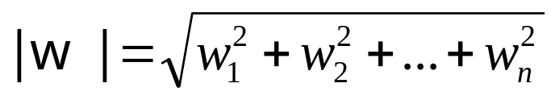
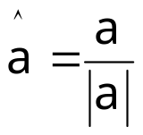
Properties of vectors
Length or size
w = (w₁,w₂,…,w_{n})
Unit vector
The process is called normalizing
Used to refer direction
The standard unit vectors: i = (1,0,0), j = (0,1,0) and k = (0,0,1)

Slide 11
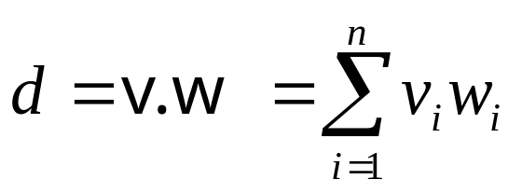
Dot Product
The dot product d of two vectors v = (v₁,v₂,…,v_{n}) and w = (w₁,w₂,…w_{n}):
Properties
Symmetry: a·b = b·a
Linearity: (a+c) ·b = a·b + c·b
Homogeneity: (sa) ·b = s(a·b)
|b|² = b·b

Slide 12
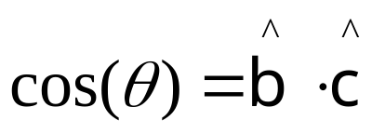
Application of Dot Product
Angle between two vectors:
y
c
b
θ
Φ_{c}
Φ_{b}
x
Two vectors b and c are perpendicular (orthogonal/normal) if
b·c = 0

Slide 13
2D “perp” Vector
Which vector is perpendicular to the 2D vector a = (a_{x},a_{y})?
Let a = (a_{x},a_{y}).
Then
a┴ = (-a_{y},a_{x})
is the counterclockwise perpendicular to a.
a┴
a
-a┴
a
What about 3D case?

Slide 14
Applications: Orthogonal Projection
C
C
c
Mv┴
c
L
v┴
A
v
Kv
v
A

Slide 15
Applications: Reflections
n
n
a
r
a
r
θ₁
θ₂
m
-m
e
e

Slide 16
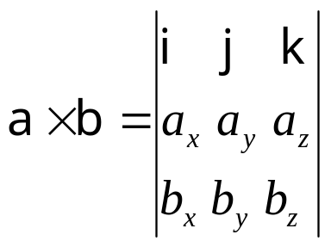
Cross Product
Also called vector product.
Defined for 3D vectors only.

Slide 17
Application: Finding Normal to a Plane
y
b
P₁
P₃
a
P₂
x
z
axb
Geometric Interpretation of Cross Product

Slide 18
Representation of
Vectors and Points

Slide 19
Coordinate Frame
b
P
v
O
a
c

Slide 20
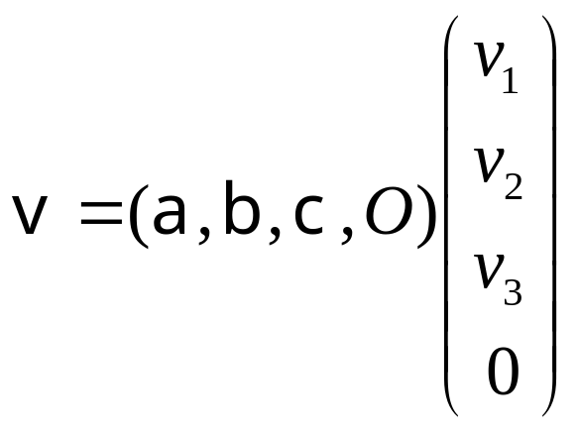
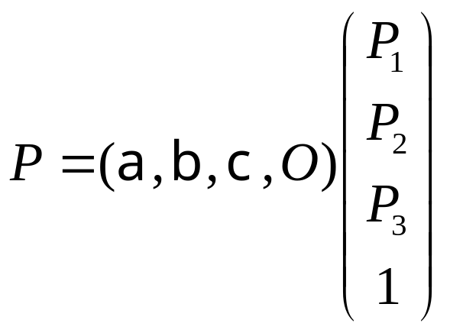
Homogeneous Representation
Basic objects: a,b,c,O
Represent points and vectors using these objects

Slide 21
Affine Combinations of Points
Linear combination of two points P and R:
E = fP + gR
If the system is shifter by U
P’ = P + U
R’ = R + U
E’ = fP’ + gR’ = fP + gR + (f+g)U
NOT a valid point, unless f + g = 1
Example: 0.3P+0.7R is a valid point, but P + R is not.
any affine combination of points is a legitimate point

Slide 22
Affine Combinations of Points [contd]
P₁+P₂
P₁
P₁+P₂
(P₁+P₂)/2
P₂

Slide 23
Point + Vector = Affine Comb of Points
Let,
P = A = t v and v = B – A
Therefore,
P = A + t (B – A)
=> P = t B + (1 – t) A.
“Tweening”
See Hill 4.5.4
Linear Interpolation

Slide 24
Representing Lines
Line
Line segment
Ray
3 types of representations:
Two point form
Parametric representation
Point normal form

Slide 25
Parametric Representation of a Line
y
t > 1
B
b
t = 1
C
t = 0
t < 0
x

Slide 26
Point Normal Form of a Line
n
B
R
C

Slide 27
All in One : Representations of Line
B = C - n┴
Point
Normal
Two Point
{C, n}
{C, B}
n = (B – C) ┴
b = - n┴
B = C + b
n = b┴
b = B – C
Parametric
{C, b}

Slide 28
Planes in 3D
3 fundamental forms
  Three-point form
  Parametric representation
  Point normal form

Slide 29
Parametric Representation of Plane
C
b
a

Slide 30
Point Normal Form of a Plane
n
B

Slide 31
Projection

Slide 32
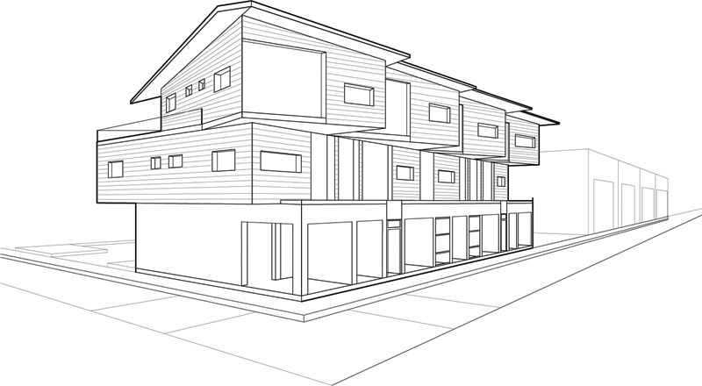
Projection

Slide 33
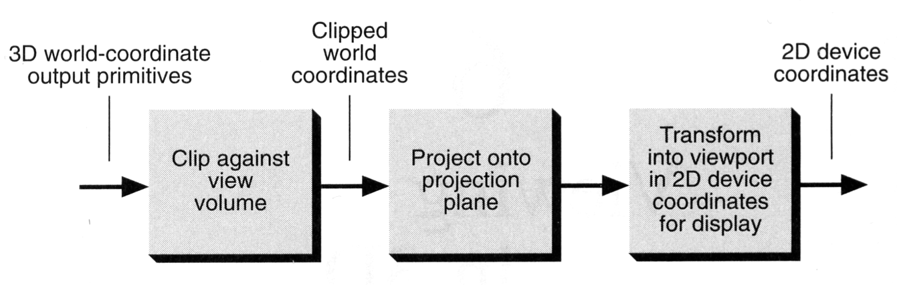
Projection
Conceptual model of 3D viewing process

Slide 34
Projection
In general, projections transform points in a coordinate system of dimension n into points in a coordinate system of dimension less than n.
We shall limit ourselves to the projection from 3D to 2D.
We will deal with planar geometric projections where:
  The projection is onto a plane rather than a curved surface
  The projectors are straight lines rather than curves

Slide 35
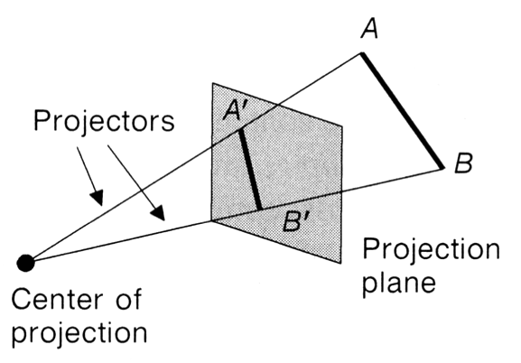
Projection
key terms…
  Projection from 3D to 2D is defined by straight projection rays (projectors) emanating from the 'center of projection', passing through each point of the object, and intersecting the 'projection plane' to form a projection.

Slide 36
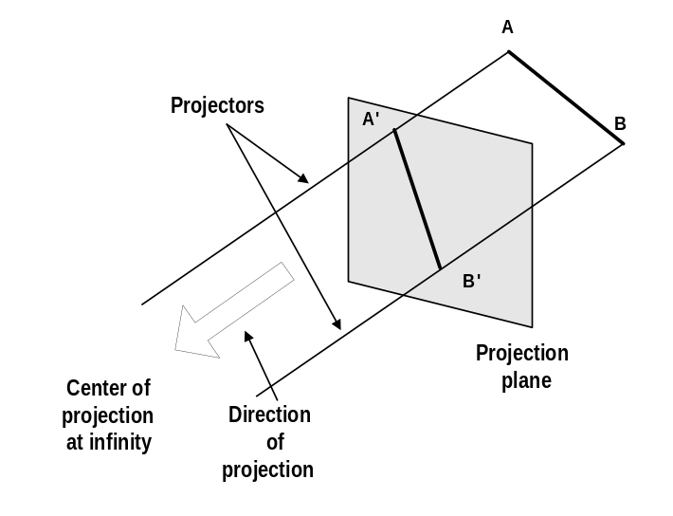
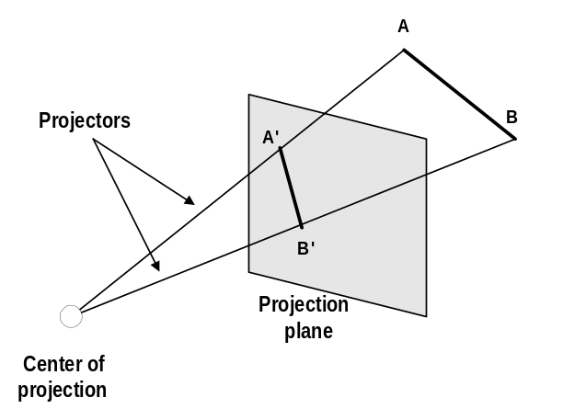
Planer Geometric Projection
2 types of projections
  perspective and parallel.
Key factor is the center of projection.
  if distance to center of projection is finite : perspective
  if infinite : parallel
Perspective projection
Parallel projection

Slide 37
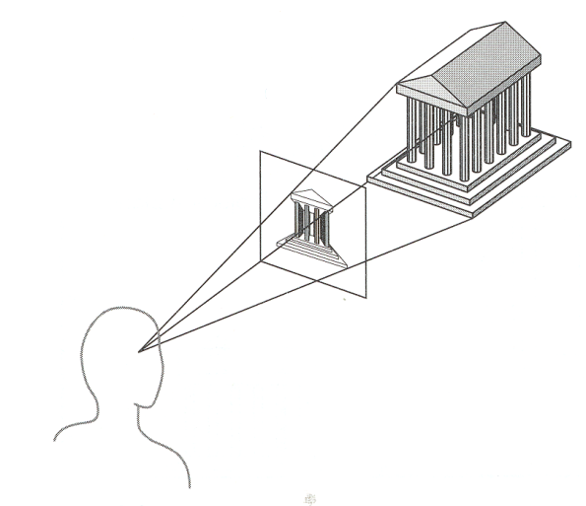
Perspective v Parallel
Perspective:
  visual effect is similar to human visual system...
  has 'perspective foreshortening'
    size of object varies inversely with distance from the center of projection.
  Parallel lines do not ingeneral project to parallel lines
  angles only remain intact for faces parallel to projection plane.

Slide 38
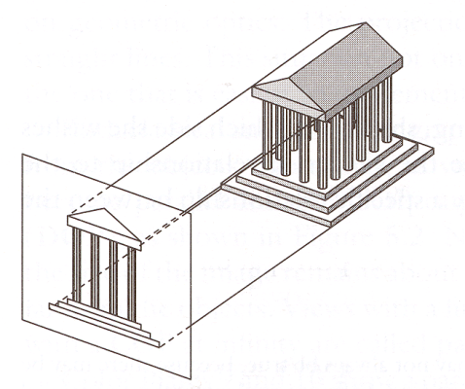
Perspective v Parallel
Parallel:
  less realistic view because of no foreshortening
  however, parallel lines remain parallel.
  angles only remain intact for faces parallel to projection plane.

Slide 39
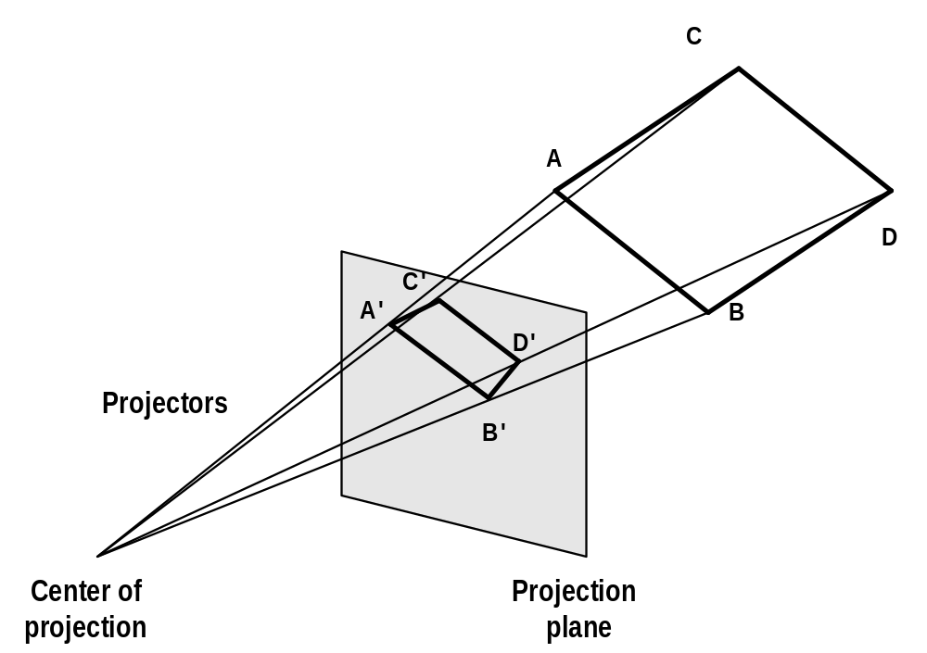
Perspective projection- anomalies
Perspective foreshortening The farther an object is from COP the smaller it appears
Perspective foreshortening

Slide 40
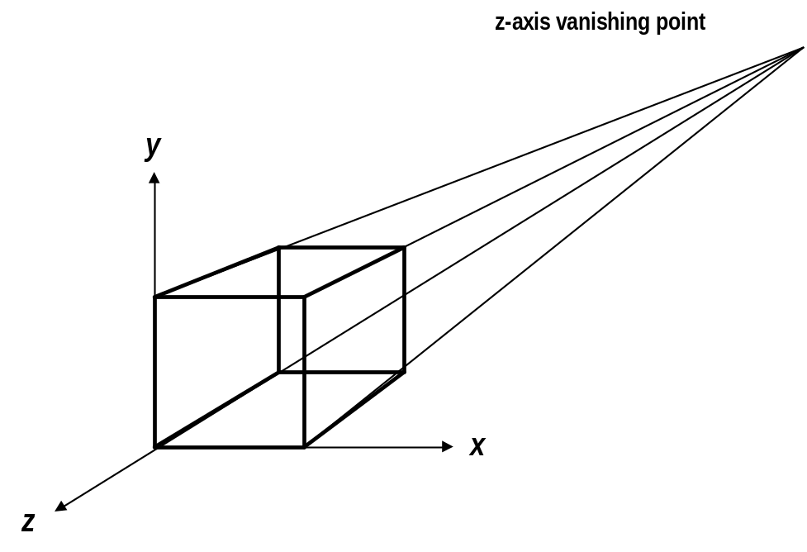
Perspective projection- anomalies
Vanishing Points: Any set of parallel lines not parallel to the view plane appear to meet at some point.
  There are an infinite number of these, 1 for each of the infinite amount of directions line can be oriented
Vanishing point

Slide 41
Vanishing Point
Vanishing Point
COP
View Plane

Slide 42
Vanishing Point
If a set of lines are parallel to one of the three axes, the vanishing point is called an axis vanishing point (Principal Vanishing Point).
  There are at most 3 such points, corresponding to the number of axes cut by the projection plane
One-point:
  One principle axis cut by projection plane
  One axis vanishing point
Two-point:
  Two principle axes cut by projection plane
  Two axis vanishing points
Three-point:
  Three principle axes cut by projection plane
  Three axis vanishing points

Slide 43
Vanishing Point

Slide 44
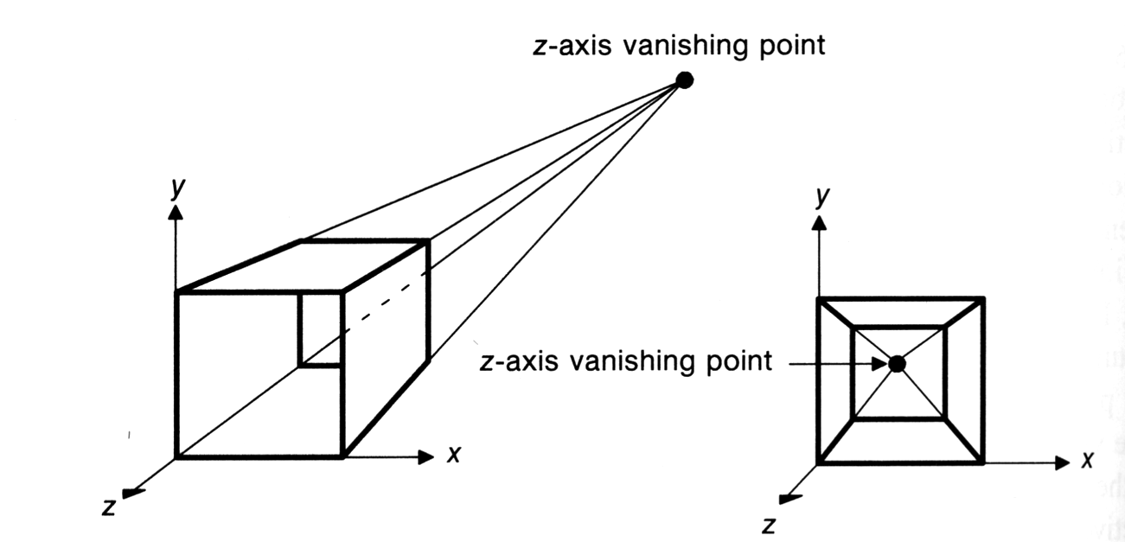
Vanishing Point
One point perspective projection of a cube
  X and Y parallel lines do not converge

Slide 45
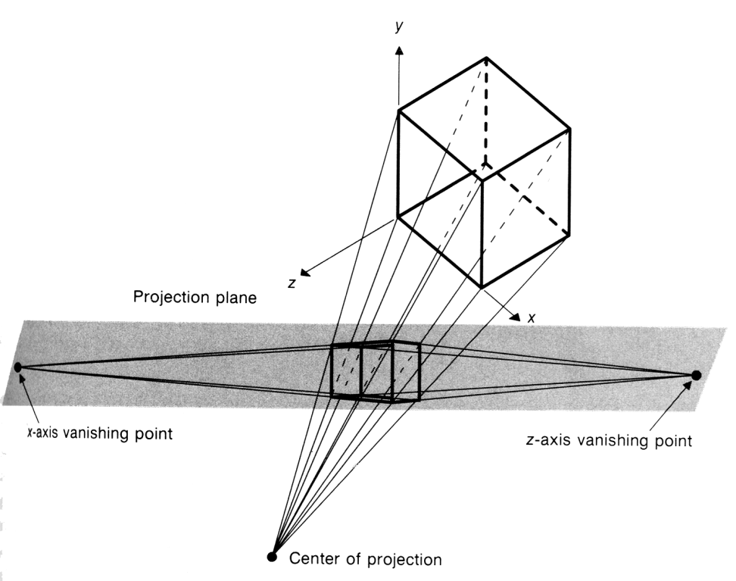
Vanishing Point
Two-point perspective projection:
  This is often used in architectural, engineering and industrial design drawings.
  Three-point is used less frequently as it adds little extra realism to that offered by two-point perspective projection.

Slide 46
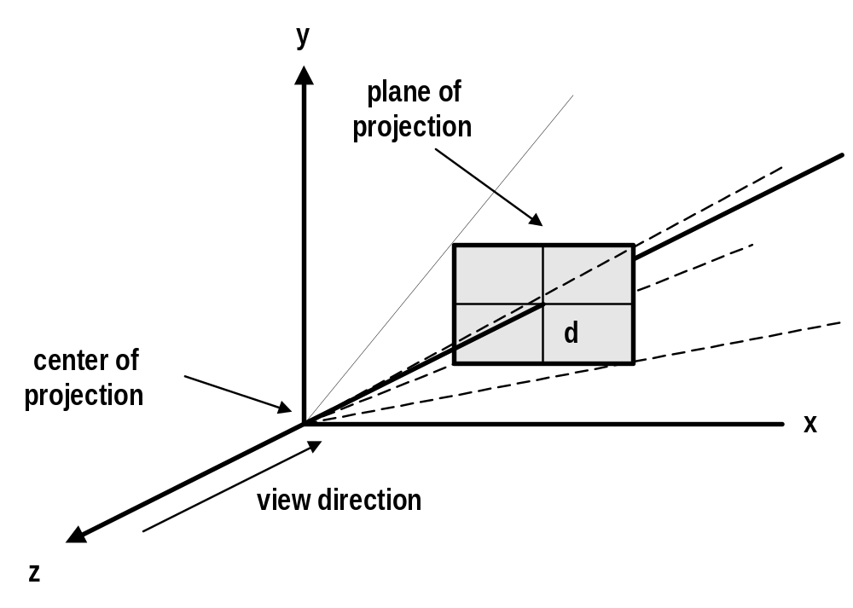
Projective Transformation
Settings for perspective projection

Slide 47
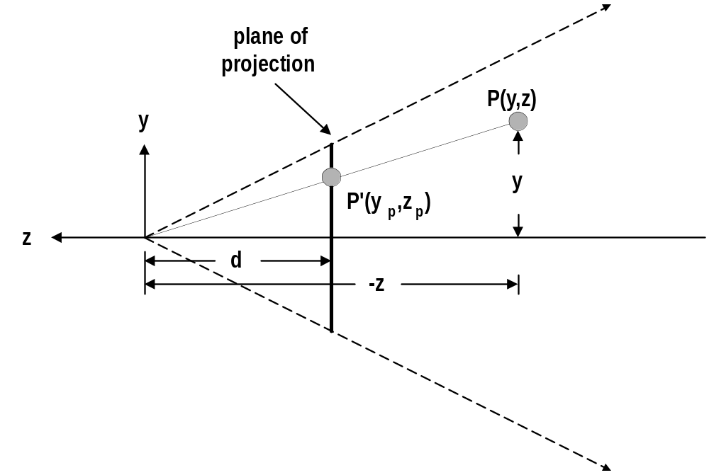
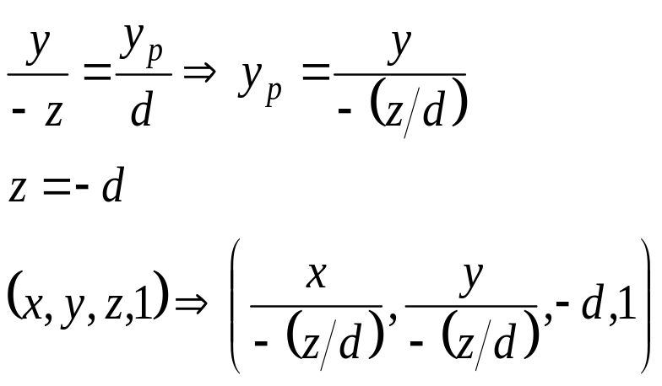
Projective Transformation

Slide 48
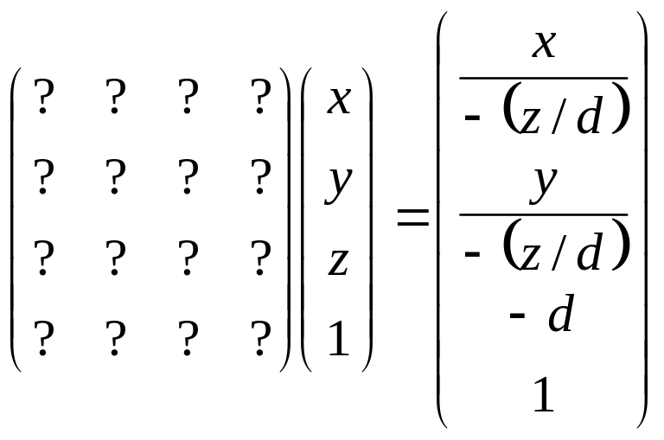
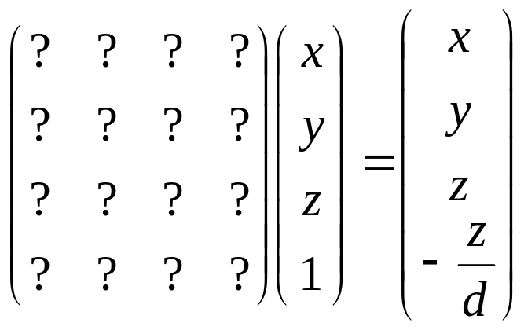
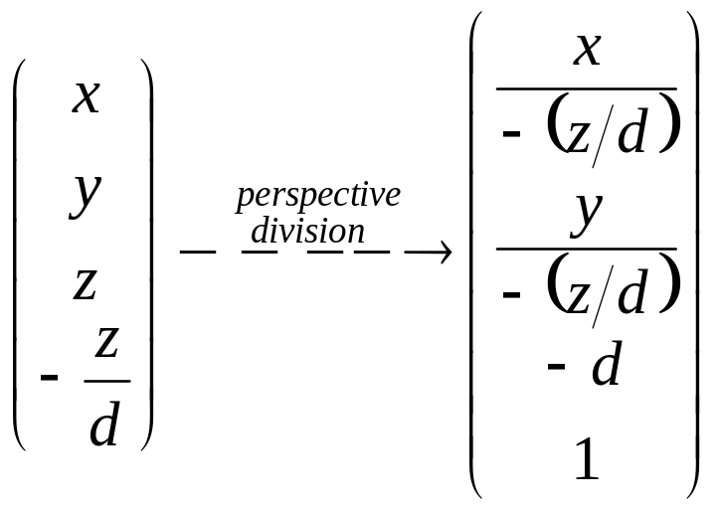
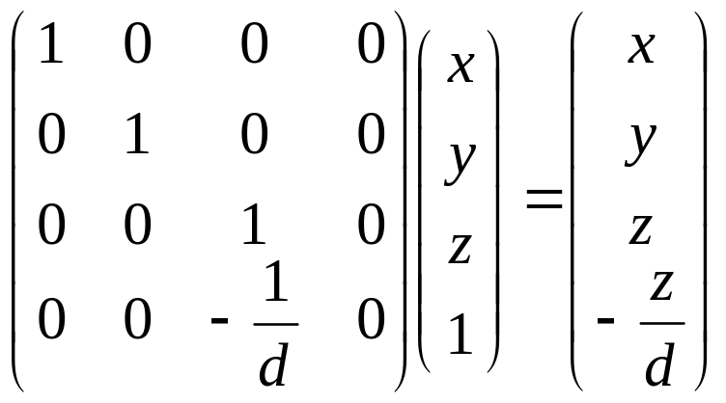
Projective Transformation

Slide 49

Parallel projection
2 principle types:
  orthographic and oblique.
Orthographic :
  direction of projection = normal to the projection plane.
Oblique :
  direction of projection != normal to the projection plane.

Slide 50
Orthographic projection
Orthographic (or orthogonal) projections:
  front elevation, top-elevation and side-elevation.
  all have projection plane perpendicular to a principle axes.
Useful because angle and distance measurements can be made...
However, As only one face of an object is shown, it can be hard to create a mental image of the object, even when several view are available

Slide 51
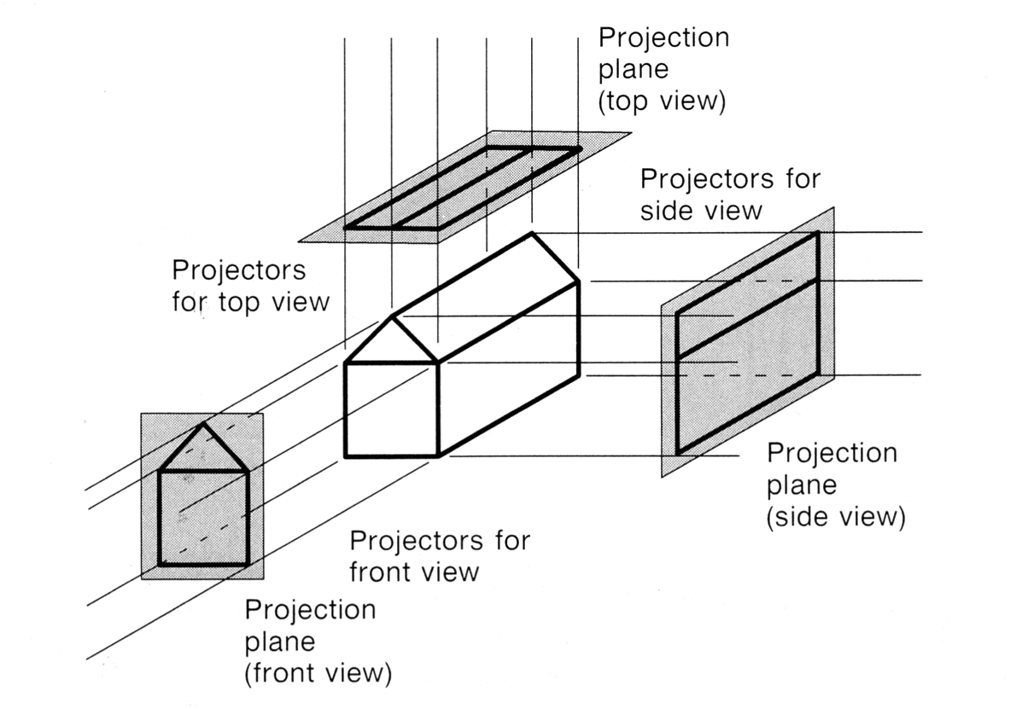
Orthographic projection

Slide 52
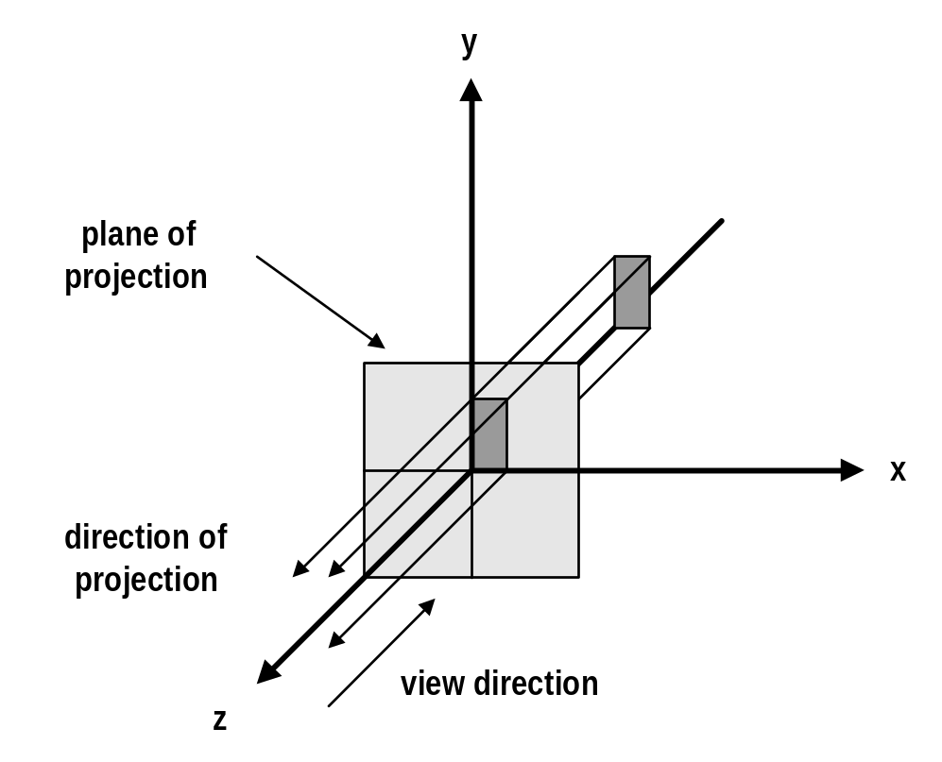
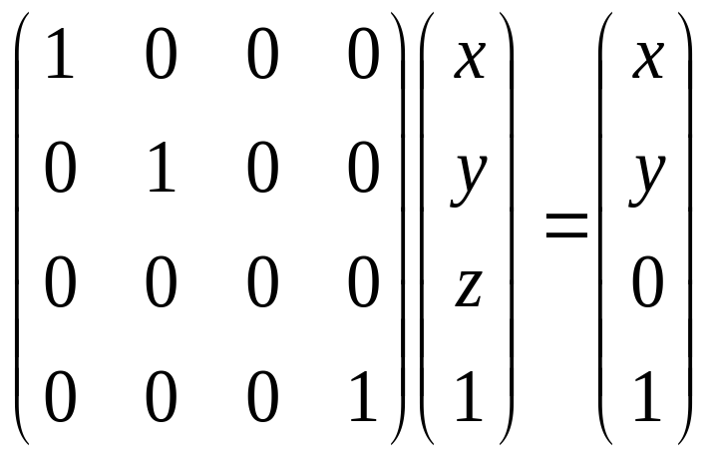
Orthogonal Projection Matrix

Slide 53
Axonometric projection
Axonometric Projections use projection planes that are not normal to a principal axis.On the basis of projection plane normal N = (dx, dy, dz) subclasses are:
  Isometric : | dx | = | dy | = | dz | i.e. N makes equal angles with all principal axes.
  Dimetric : | dx | = | dy |
  Trimetric : | dx | != | dy | != | dz |

Slide 54



Axonometric vs Perspective
Axonometric projection shows several faces of an object at once like perspective projection.
But the foreshortening is uniform rather than being related to the distance from the COP.
Isometric proj
Projection Plane

Slide 55
Oblique parallel projection
Oblique parallel projections
  Objects can be visualized better then with orthographic projections
  Can measure distances, but not angles
    * Can only measure angles for faces of objects parallel to the plane
2 common oblique parallel projections:
  Cavalier and Cabinet

Slide 56
Oblique parallel projection
Projection Plane
Projector
Projection Plane Normal

Slide 57
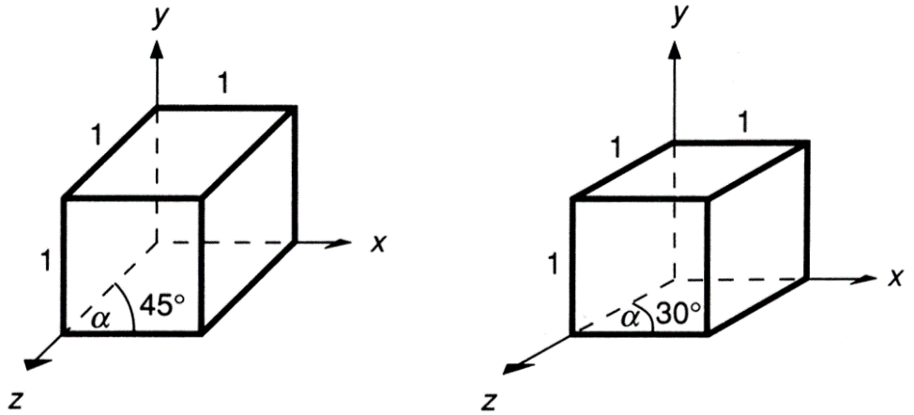
Oblique parallel projection
Cavalier:
  The direction of the projection makes a 45 degree angle with the projection plane.
  There is no foreshortening

Slide 58
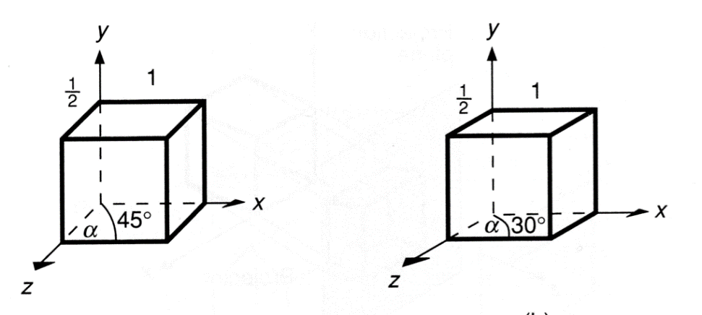
Oblique parallel projection
Cabinet:
  The direction of the projection makes a 63.4 degree angle with the projection plane. This results in foreshortening of the z axis, and provides a more “realistic” view

Slide 59
Oblique parallel projection
Cavalier, cabinet and orthogonal projections can all be specified in terms of (α, β) or (α, λ) since
  tan(β) = 1/λ
λ sin(α)
P׳(λ cos(α), λ sin(α),0)
β
λ
α
P=(0, 0, 1)
λ cos(α)

Slide 60
Oblique parallel projection
λ=1 | β = 45 | Cavalier projection | α = 0 - 360
λ=0.5 | β = 63.4 | Cabinet projection | α = 0 – 360
λ=0 | β = 90 | Orthogonal projection | α = 0 – 360

Slide 61





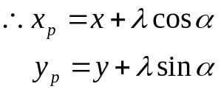
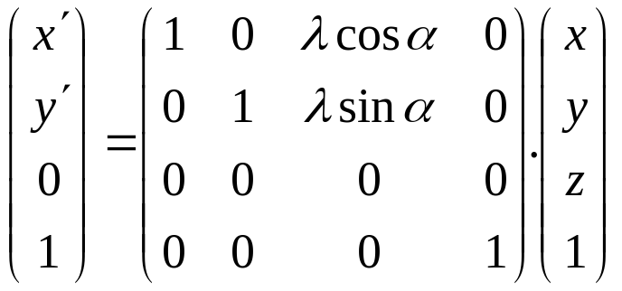
Oblique parallel projection
PP‘ = (λ cos(α), λ sin(α),-1) = DOP
Proj(P) = (λ cos(α), λ sin(α),0)
Generally
  multiply by z and allow for (non-zero) x and y
x ‘ = x + z λcos α
y‘ = y + z λsin α

Slide 62
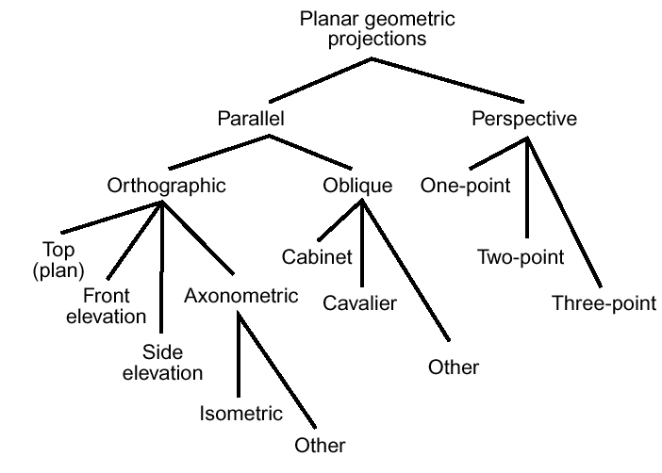
Taxonomy of Projection

