Slide 1
Team no: 19
Name: Labiba Tasfiya Jeba
ID: 22266028
Course: ADVANCED SYNTACTIC PATTERN RECOGNITION

Slide 2
An Interactive Interpretability System for Breast Cancer Screening with
Deep Learning
Yuzhe Lu* Adam Perer†

Slide 3
ABSTRACT
Deep learning methods have developed as an effective tool for medical image processing.
But there black-box nature may be hampered real world decision making.
The authors propose an interactive system to assist radiologists with breast cancer screening.
Take advantage of user interactions progressively to provide finer grained explainability reports with little labeling costs.

Slide 4
INTRODUCTION
Deep learning such as convolutional neural networks (CNNs) develop high-performing models for breast cancer screening.
The deployment of CNNs in medical domain has some difficulties. Such as- CNN's blackbox nature.
To overcome this problem some approach are being taken.
1. Saliency maps
2. Network dissection and integrate it into radiologists’ workflow assisted
by deep learning models.

Slide 5
DATASET
Dataset has multiple imaging views stored in DICOM format.
The authors build a binary classifier by using patch-based model.

Slide 6
MODEL
Modified VGG16 model, which is a classic convolutional neural network (CNN), to accept single-channel input.
Split the dataset into train, validation, and test set with a 8:1:1 ratio
Use cross entropy loss and trained the model using stochastic gradient descent.

Slide 7
SYSTEM DESIGN
Challenge: Shear number
Solution: Network Dissection methodology

Slide 8
DESIGN GOALS
Goal 1: Query Neuron’s Learned Representations
1. Activation Map
2. Query Metric
Goal 2: Label Meaningful Neurons for Explanation
1.Label Groups of Neurons
2.Generate Explainability Reports

Slide 9
DESIGN GOALS
Goal 3: Decode Semantic Connections of Neurons
1. Neuron Embedding
2. Dimension Reduction for Visualization
Goal 4: Label Meaningful Neurons for Explanation
1.Label Groups of Neurons
2.Generate Explainability Reports

Slide 10
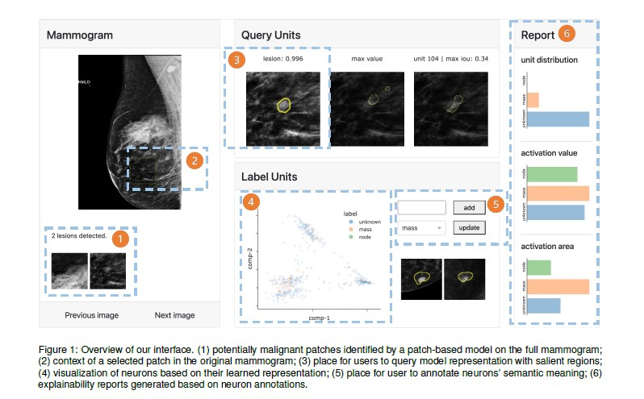
INTERFACE WORKFLOW

Slide 11
CONCLUSION
Actively query relevant learned representations.
provide annotations to groups of neurons with minimal effort.
Leverage user annotations
Lacks extensive evaluations.

Slide 12
REFERENCE
[1] R. Agarwal, O. Diaz, X. Lladó, M. H. Yap, and R. Martí. Automatic
mass detection in mammograms using deep convolutional neural networks.
Journal of Medical Imaging, 6(3):031409, 2019.
[2] D. Bau, B. Zhou, A. Khosla, A. Oliva, and A. Torralba. Network
dissection: Quantifying interpretability of deep visual representations.
In Proceedings of the IEEE conference on computer vision and pattern
recognition, pp. 6541–6549, 2017.
[3] D. Bau, J.-Y. Zhu, H. Strobelt, A. Lapedriza, B. Zhou, and A. Torralba.
Understanding the role of individual units in a deep neural network.
Proceedings of the National Academy of Sciences, 117(48):30071–
30078, 2020.

Slide 13
REFERENCE
[4] A. Boggust, B. Hoover, A. Satyanarayan, and H. Strobelt. Shared
interest: Measuring human-ai alignment to identify recurring patterns
in model behavior. In CHI Conference on Human Factors in Computing
Systems, pp. 1–17, 2022.
[5] F. Cheng, D. Liu, F. Du, Y. Lin, A. Zytek, H. Li, H. Qu, and K. Veeramachaneni.
Vbridge: Connecting the dots between features and data
to explain healthcare models. IEEE Transactions on Visualization and
Computer Graphics, 28(1):378–388, 2021.
[6] F. Hohman, H. Park, C. Robinson, and D. H. P. Chau. S ummit: Scaling
deep learning interpretability by visualizing activation and attribution
summarizations. IEEE transactions on visualization and computer
graphics, 26(1):1096–1106, 2019.

Slide 14
REFERENCE
[7] P. T. Inc. Collaborative data science, 2015.
[8] D. P. Kingma and J. Ba. Adam: A method for stochastic optimization.
arXiv preprint arXiv:1412.6980, 2014.
[9] B. C. Kwon, M.-J. Choi, J. T. Kim, E. Choi, Y. B. Kim, S. Kwon, J. Sun,
and J. Choo. Retainvis: Visual analytics with interpretable and interactive
recurrent neural networks on electronic medical records. IEEE
Transactions on Visualization and Computer Graphics, 25(1):299–309,
2019. doi: 10.1109/TVCG.2018.2865027
[10] R. Liaw, E. Liang, R. Nishihara, P. Moritz, J. E. Gonzalez, and I. Stoica.
Tune: A research platform for distributed model selection and training.
arXiv preprint arXiv:1807.05118, 2018.
[11] M. Liu, J. Shi, Z. Li, C. Li, J. Zhu, and S. Liu. Towards better analysis of
deep convolutional neural networks. IEEE transactions on visualization
and computer graphics, 23(1):91–100, 2016.

Slide 15
REFERENCE
[12] H. Park, N. Das, R. Duggal, A. P. Wright, O. Shaikh, F. Hohman,
and D. H. P. Chau. Neurocartography: Scalable automatic visual
summarization of concepts in deep neural networks. IEEE Transactions
on Visualization and Computer Graphics, 28(1):813–823, 2021.
[13] A. Paszke, S. Gross, F. Massa, A. Lerer, J. Bradbury, G. Chanan,
T. Killeen, Z. Lin, N. Gimelshein, L. Antiga, et al. Pytorch: An
imperative style, high-performance deep learning library. Advances in
neural information processing systems, 32, 2019.
[14] D. Ribli, A. Horváth, Z. Unger, P. Pollner, and I. Csabai. Detecting
and classifying lesions in mammograms with deep learning. Scientific
reports, 8(1):1–7, 2018.
[15] K. Simonyan and A. Zisserman. Very deep convolutional networks for
large-scale image recognition. arXiv preprint arXiv:1409.1556, 2014.

Slide 16
REFERENCE
[16] J. Towns, T. Cockerill, M. Dahan, I. Foster, K. Gaither, A. Grimshaw,
V. Hazlewood, S. Lathrop, D. Lifka, G. D. Peterson, et al. Xsede:
accelerating scientific discovery. Computing in science & engineering,
16(5):62–74, 2014.
[17] J.Wu, B. Zhou, D. Peck, S. Hsieh, V. Dialani, L. Mackey, and G. Patterson.
Deepminer: Discovering interpretable representations for mammogram
classification and explanation. arXiv preprint arXiv:1805.12323,
2018.
[18] N. Wu, J. Phang, J. Park, Y. Shen, Z. Huang, M. Zorin, S. Jastrz˛ebski,
T. Févry, J. Katsnelson, E. Kim, et al. Deep neural networks improve radiologists’
performance in breast cancer screening. IEEE transactions
on medical imaging, 39(4):1184–1194, 2019.

Slide 17
REFERENCE
[19] Z. Zhao, P. Xu, C. Scheidegger, and L. Ren. Human-in-the-loop
extraction of interpretable concepts in deep learning models. IEEE
Transactions on Visualization and Computer Graphics, 28(1):780–790,
2021.
[20] B. Zhou, A. Khosla, A. Lapedriza, A. Oliva, and A. Torralba. Learning
deep features for discriminative localization. In Proceedings of the
IEEE conference on computer vision and pattern recognition, pp. 2921–
2929, 2016

Slide 18
Thank you!!!!

