Slide 1

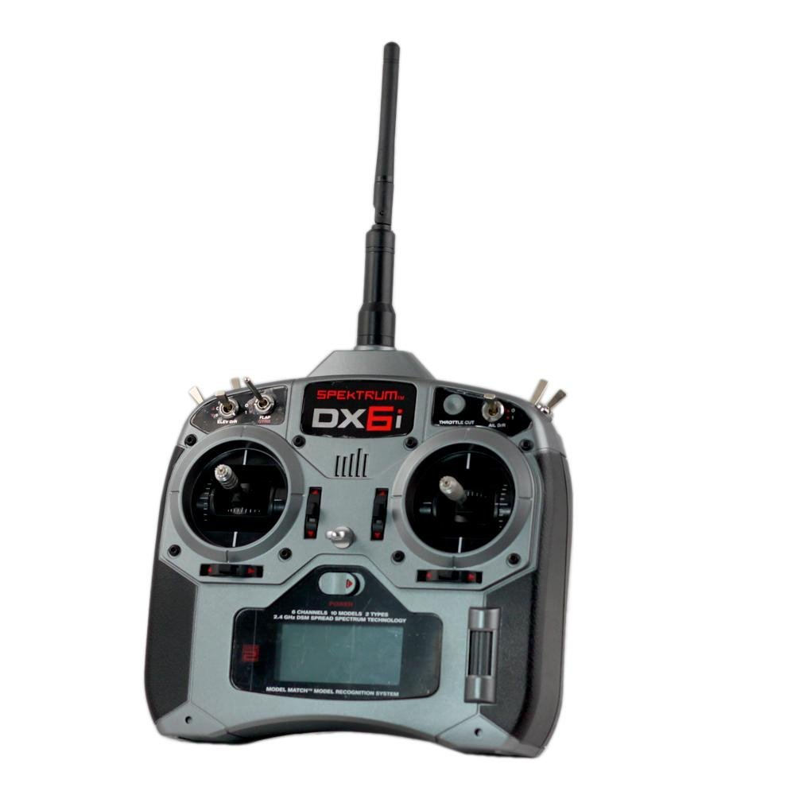

Brushless
Motor
ESC
EPOSMote
Wireless Sensor
Network
Brushless
Motor
ESC
EPOSMote
Brushless
Motor
ESC
EPOSMote
Brushless
Motor
ESC
EPOSMote
Central
EPOSMote
I2C Bus
RC
Transceiver
Remote Controller
Accelerometer
Gyroscope

