Slide 1
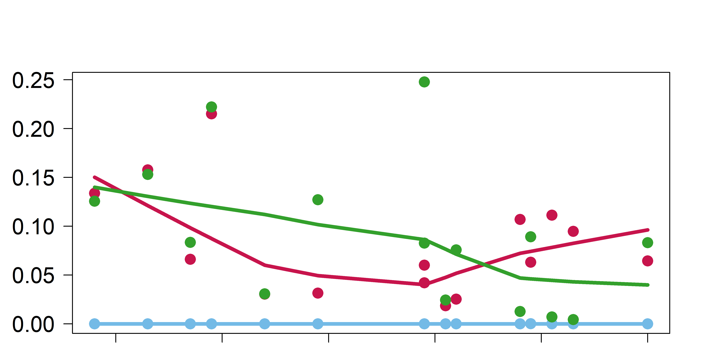
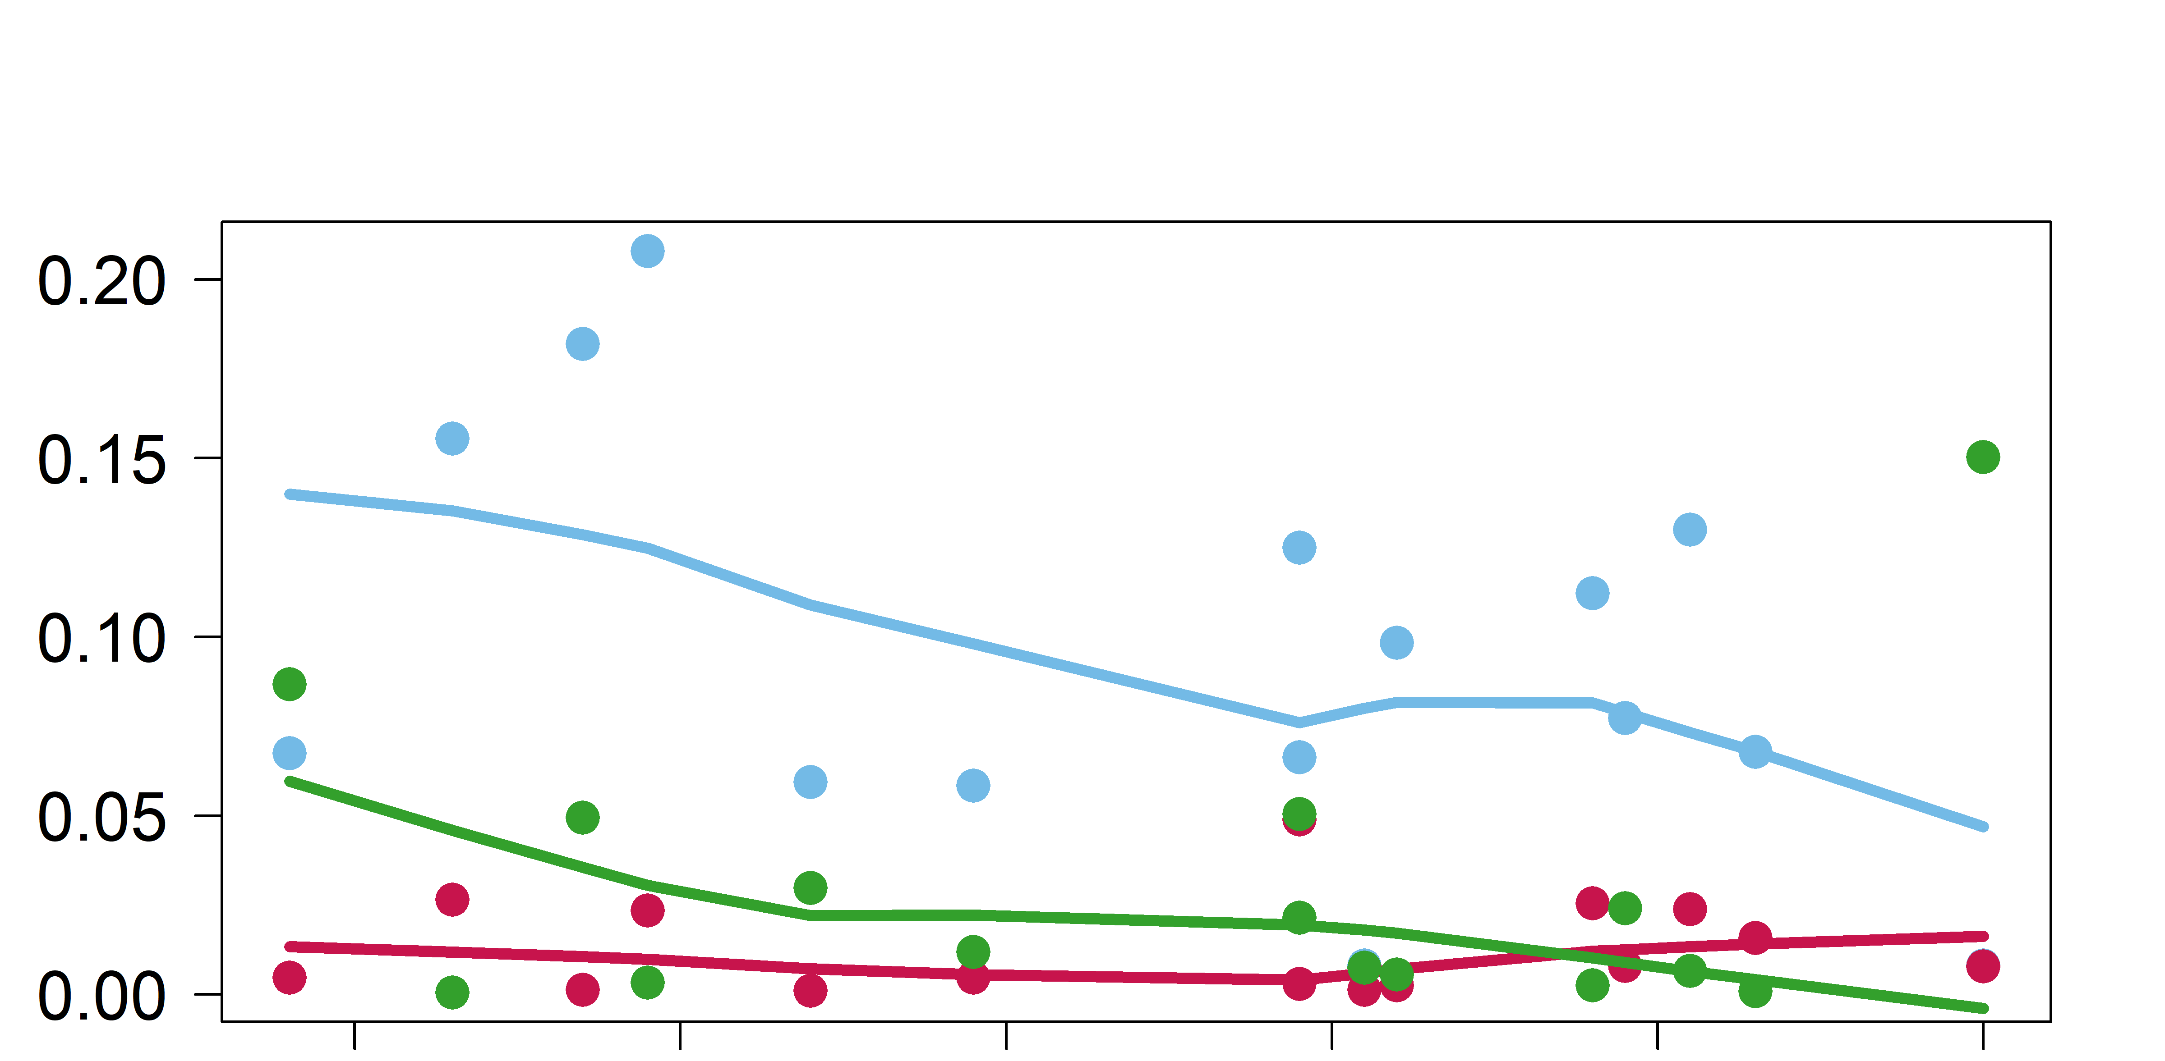
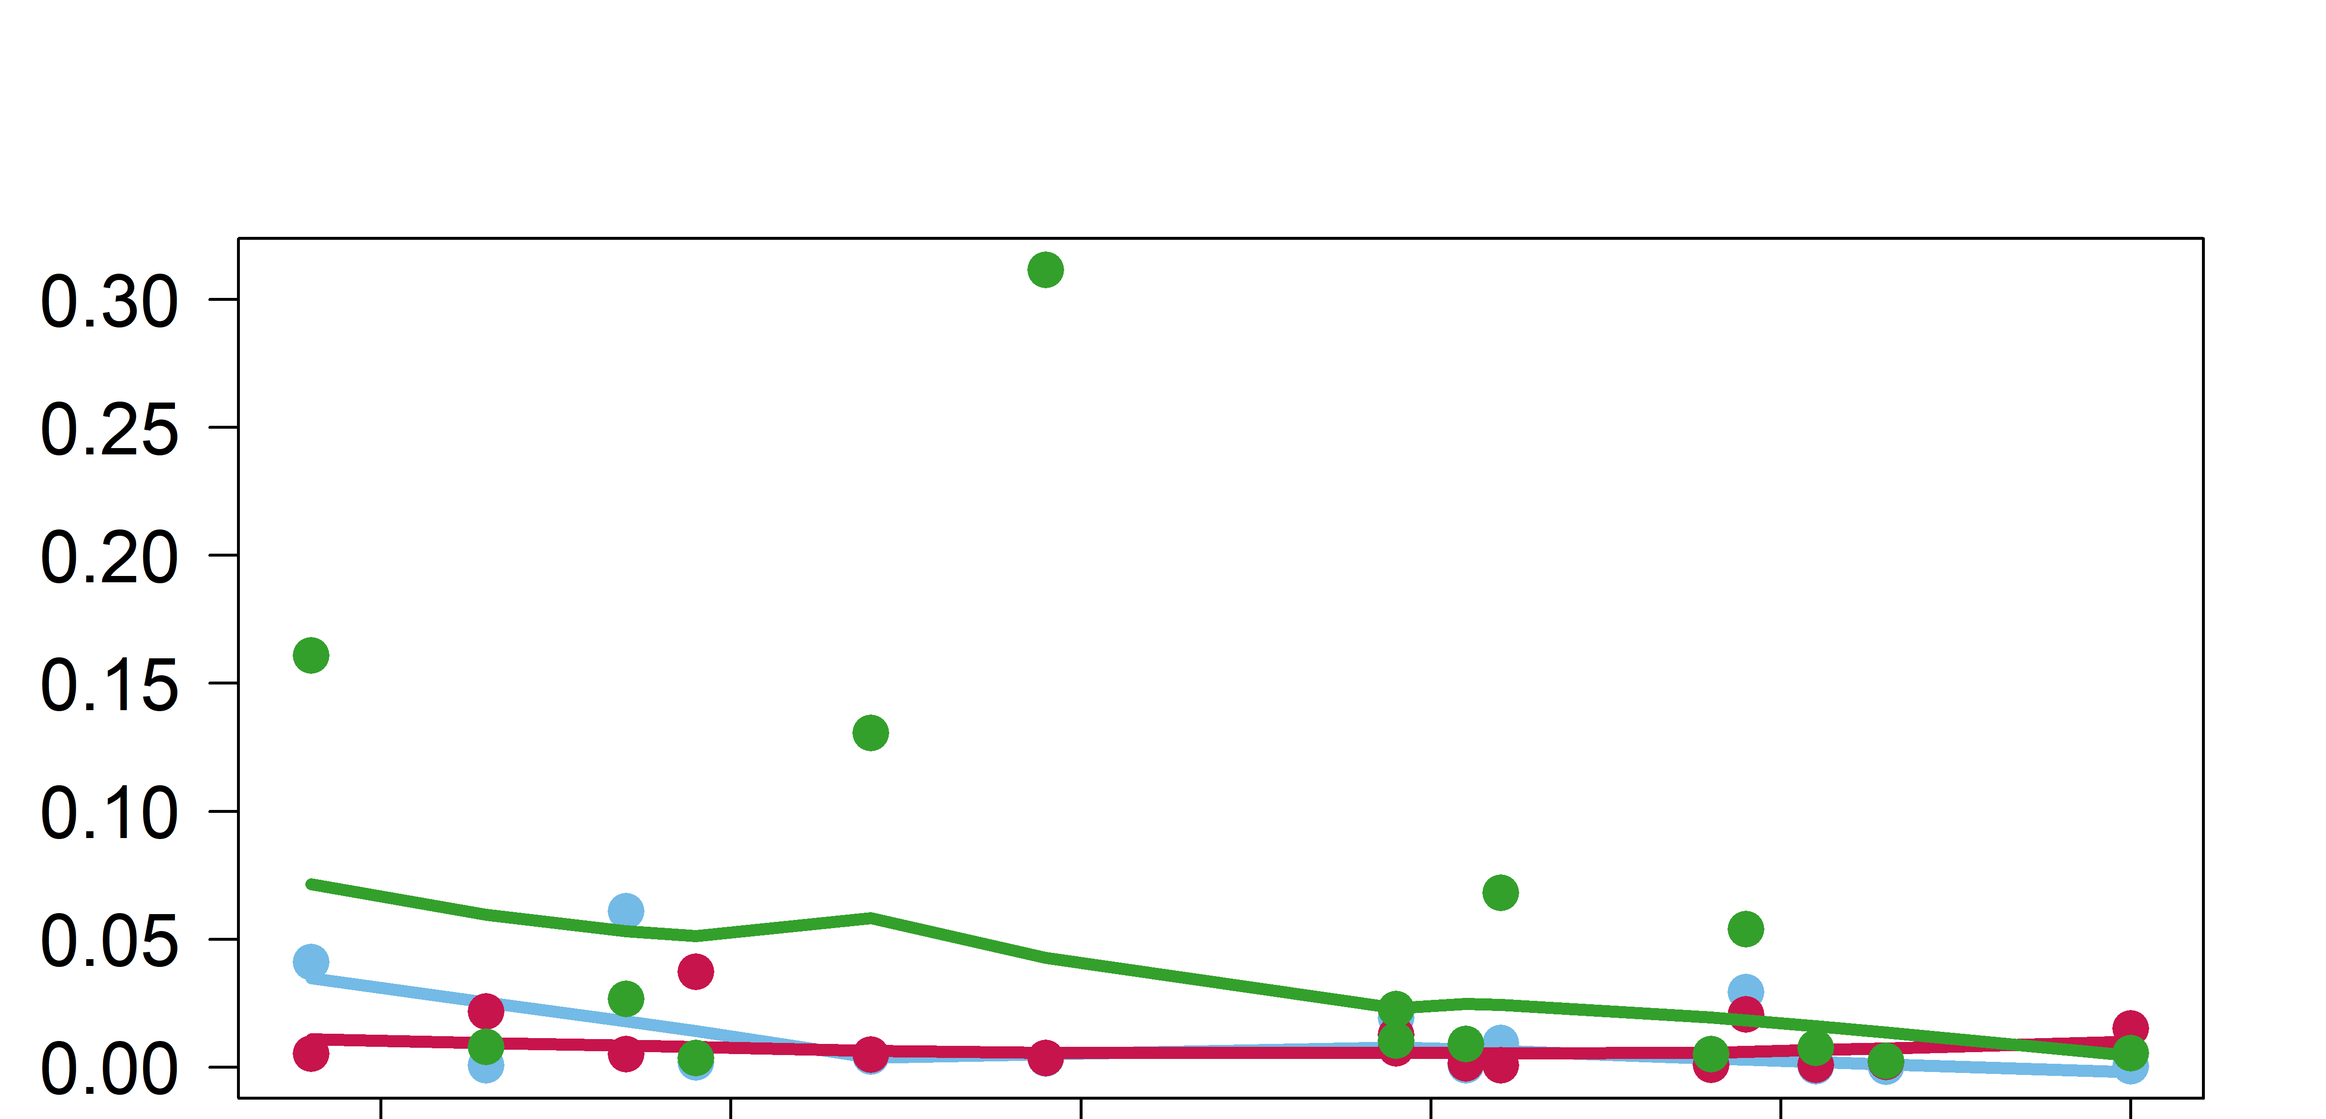
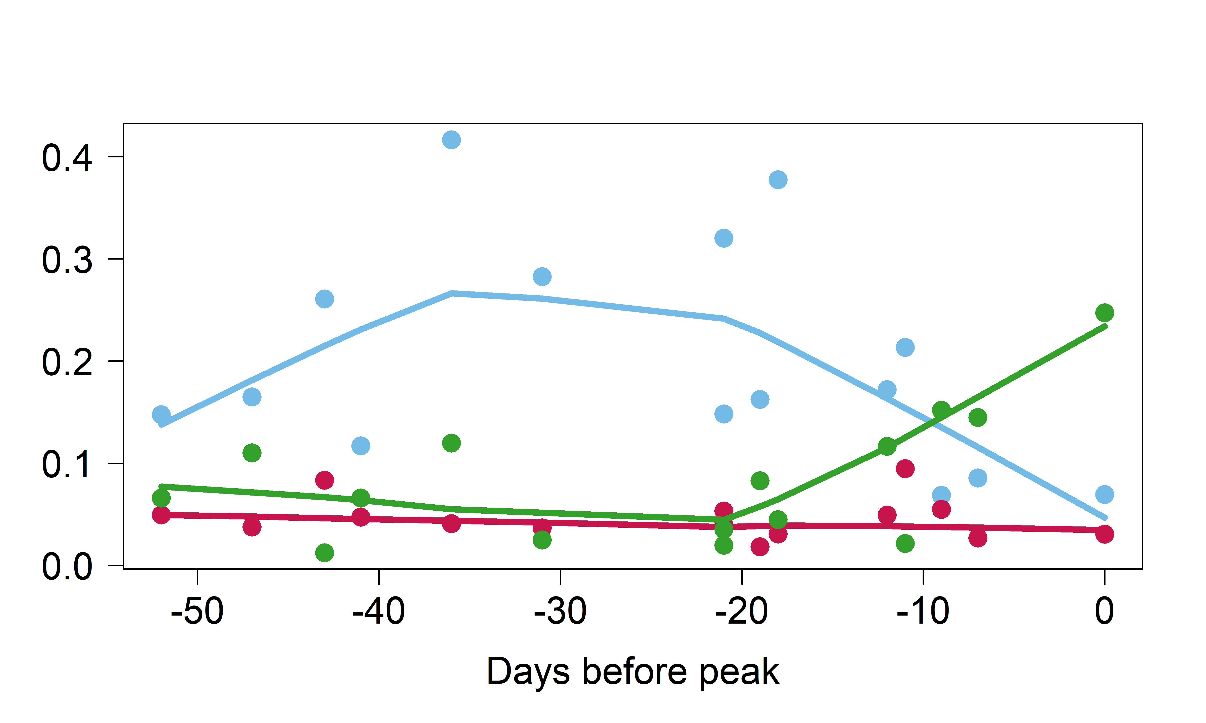
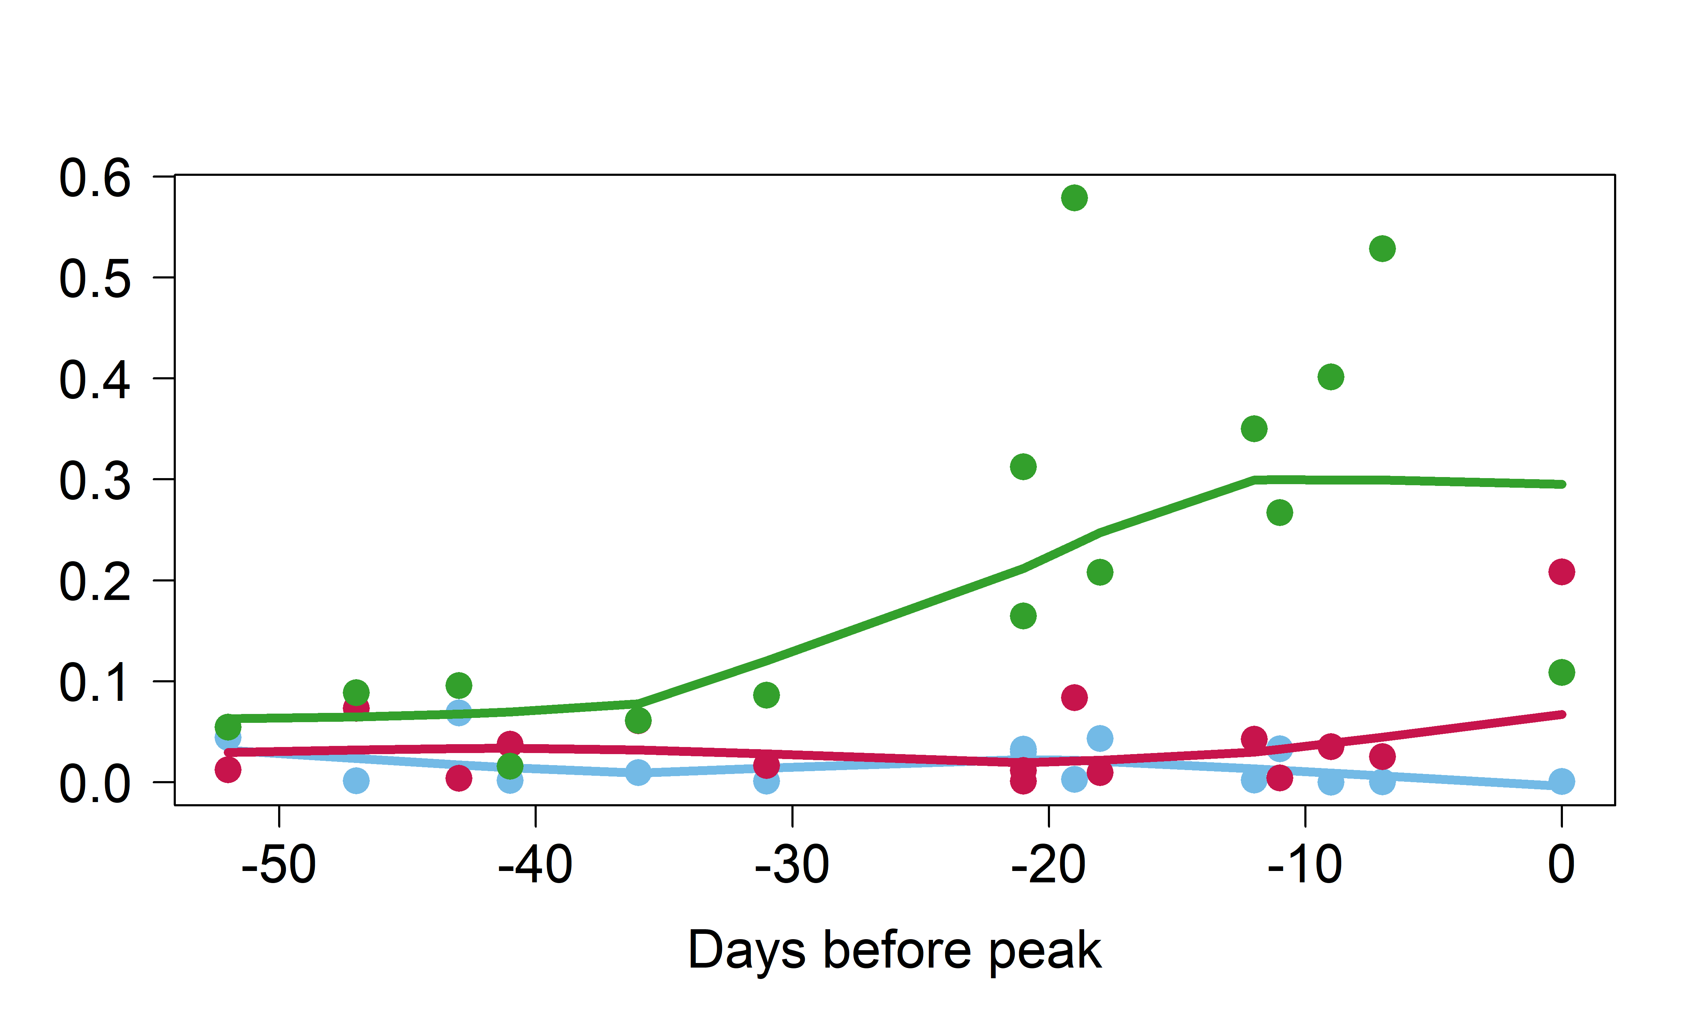
0.2-2 μm
10-20 μm
Proportion
2-5 μm
>20 μm
Proportion
5-10 μm
Days before peak
Proportion
Autotrophs
Mixotrophs
Heterotrophs
Days before peak

