Slide 1
#-
#-
Water mass
Year
Taxonomic composition
Feeding strategy
Size (5 classes)
17 %**
36 %**
29 %**
12 %**
31 %**
26 %**

Slide 2
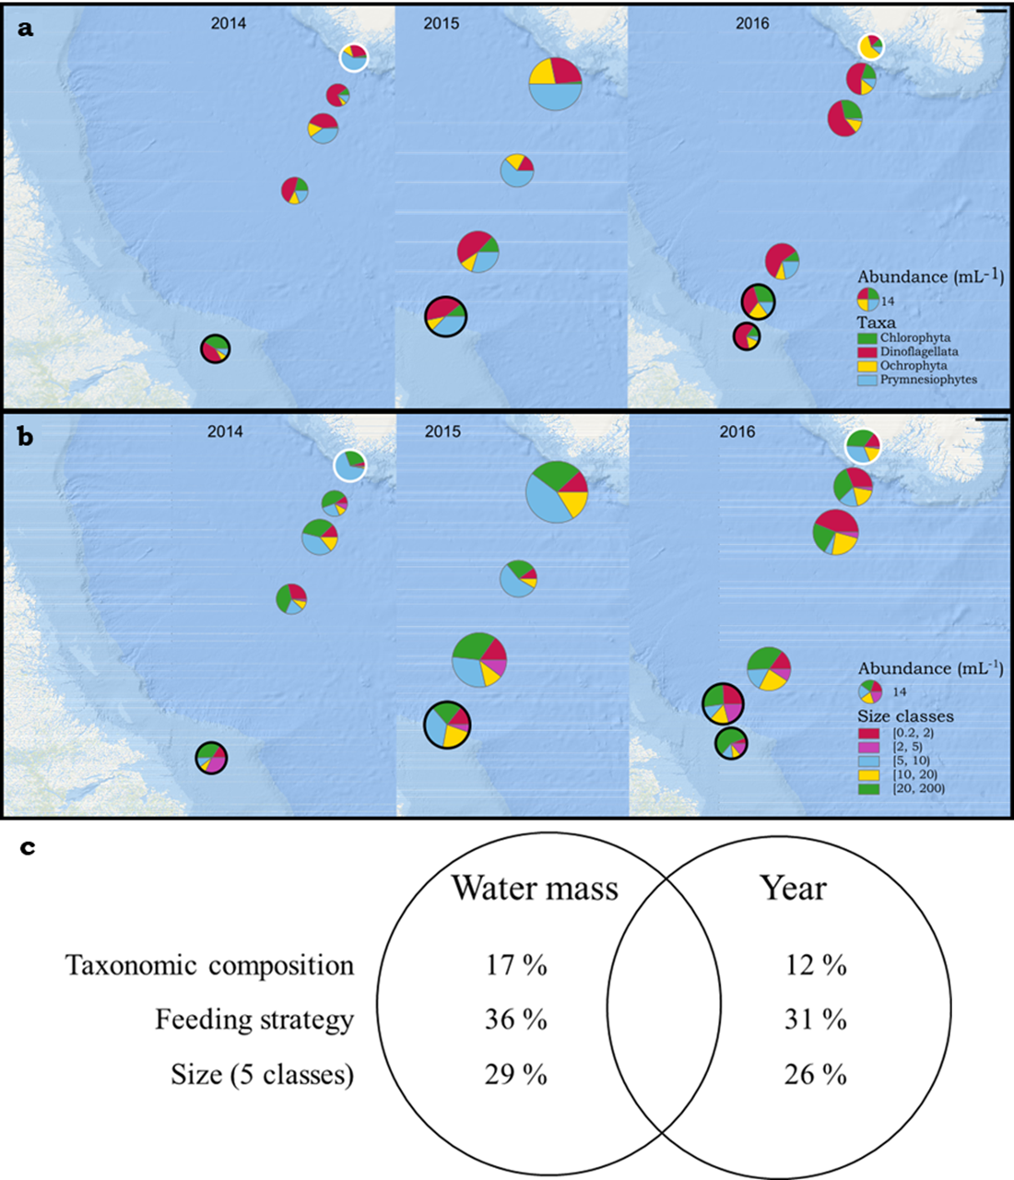
#-
#-
Water mass
Year
Taxonomic composition
Feeding strategy
Size (5 classes)
17 %**
36 %**
29 %**
12 %**
31 %**
26 %**

