Slide 1

Bringing together Brazilian soil scientists to share soil data
Alessandro Samuel-Rosa (Federal University of Technology – Paraná)
and 53 collaborators
21st World Congress of Soil Science
Brazilian Soil Science Society, Rio de Janeiro, Brazil
Tuesday 14 August 2018 – Reconciling pedometrics and pedology

Slide 2
Collaborators
Samuel-Rosa et al. (2018) Bringing together Brazilian soil scientists to share soil data
Ricardo Simão Diniz Dalmolin, Paulo Ivonir Gubiani, Stanley Robson de Medeiros Oliveira, Wenceslau Geraldes Teixeira, João Herbert Moreira Viana, Eloi Ribeiro, Carlos Gustavo Tornquist, Lúcia Helena Cunha dos Anjos, José João Lelis Leal de Souza, Marta Vasconcelos Ottoni, Paula Suélen Corrêa de Medeiros, Diego José Gris, Nícolas Augusto Rosin, Jean Michel Moura Bueno, Humberto Gonçalves dos Santos, Eliseu José Weber, Carlos Alberto Flores, Elias Mendes Costa, Ronaldo Pereira de Oliveira, José Maria Filippini Alba, João Chrisóstomo Pedroso Neto, Fabrício de Araújo Pedron, João Henrique Caviglione, Gustavo Souza Valladares, Carmem Sueze Silva Miranda, José Alexandre Melo Demattê, José Marques Júnior, Diego Silva Siqueira, Renato Eleoterio de Aquino, Nelida Elizabet Quiñonez Silvero, Aline Marques Genú, Tiago Broetto, Luciano Campos Cancian, Pablo Miguel, Jovani Zalamena, André Carnieletto Dotto, Jaime Antonio de Almeida, José Miguel Reichert, Gustavo Ribas Curcio, Leonardo Santos Collier, Waldir de Carvalho Junior, Ademir Fontana, Aline Pacobahyba de Oliveira, Eduardo Saldanha Vogelmann, Fábio Joel Kochem Mallmann, Gustavo de Mattos Vasques, Igo Fernando Lepsch, Jessé Rodrigo Fink, João Carlos Ker, Leandro Souza da Silva, Pedro Luiz de Freitas, Wanderlei Bieluczyk, Tales Tiecher
21st World Congress of Soil Science
Brazilian Soil Science Society, Rio de Janeiro, Brazil
Tuesday 14 August 2018 – Reconciling pedometrics and pedology

Slide 3
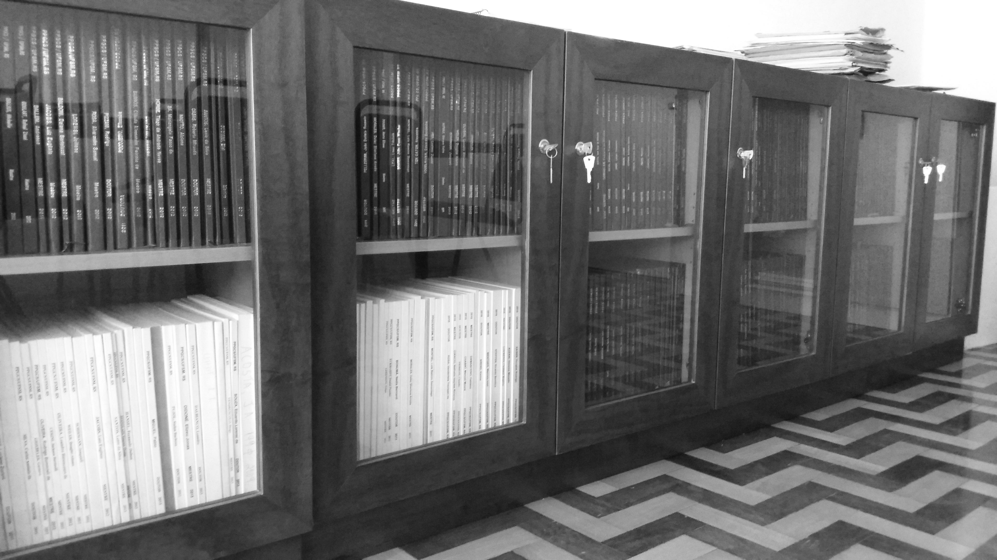
Samuel-Rosa et al. (2018) Bringing together Brazilian soil scientists to share soil data
21st World Congress of Soil Science
Brazilian Soil Science Society, Rio de Janeiro, Brazil
Tuesday 14 August 2018 – Reconciling pedometrics and pedology

Slide 4
Samuel-Rosa et al. (2018) Bringing together Brazilian soil scientists to share soil data
Free Brazilian Repository
for Open Soil Data (febr)
21st World Congress of Soil Science
Brazilian Soil Science Society, Rio de Janeiro, Brazil
Tuesday 14 August 2018 – Reconciling pedometrics and pedology

Slide 5
Samuel-Rosa et al. (2018) Bringing together Brazilian soil scientists to share soil data
Costs
Freedom
Free Brazilian Repository
for Open Soil Data (febr)
21st World Congress of Soil Science
Brazilian Soil Science Society, Rio de Janeiro, Brazil
Tuesday 14 August 2018 – Reconciling pedometrics and pedology

Slide 6
Samuel-Rosa et al. (2018) Bringing together Brazilian soil scientists to share soil data
Legislation
Costs
Freedom
Responsibility
Free Brazilian Repository
for Open Soil Data (febr)
21st World Congress of Soil Science
Brazilian Soil Science Society, Rio de Janeiro, Brazil
Tuesday 14 August 2018 – Reconciling pedometrics and pedology

Slide 7
Samuel-Rosa et al. (2018) Bringing together Brazilian soil scientists to share soil data
Legislation
Costs
Freedom
Responsibility
Free Brazilian Repository
for Open Soil Data (febr)
Specificity
Community
21st World Congress of Soil Science
Brazilian Soil Science Society, Rio de Janeiro, Brazil
Tuesday 14 August 2018 – Reconciling pedometrics and pedology

Slide 8
Samuel-Rosa et al. (2018) Bringing together Brazilian soil scientists to share soil data
Legislation
Costs
Freedom
Responsibility
Free Brazilian Repository
for Open Soil Data (febr)
Specificity
FAIR
Community
21st World Congress of Soil Science
Brazilian Soil Science Society, Rio de Janeiro, Brazil
Tuesday 14 August 2018 – Reconciling pedometrics and pedology

Slide 9




Structure
Samuel-Rosa et al. (2018) Bringing together Brazilian soil scientists to share soil data
Spreadsheets
Easiness/Familiarity
Individualized management
Google Drive
Google Sheets
21st World Congress of Soil Science
Brazilian Soil Science Society, Rio de Janeiro, Brazil
Tuesday 14 August 2018 – Reconciling pedometrics and pedology

Slide 10


Structure
Samuel-Rosa et al. (2018) Bringing together Brazilian soil scientists to share soil data
Spreadsheets
Easiness/Familiarity
Individualized management
Google Drive
Google Sheets
Data model (tables)
dataset (id)
observations (x, y, t)
layers (z)
metadata (methods)
history (version)
21st World Congress of Soil Science
Brazilian Soil Science Society, Rio de Janeiro, Brazil
Tuesday 14 August 2018 – Reconciling pedometrics and pedology

Slide 11


Standards
Samuel-Rosa et al. (2018) Bringing together Brazilian soil scientists to share soil data
Metadata schema
Consistent description and identification of datasets based on soil science community and basic government standards
21st World Congress of Soil Science
Brazilian Soil Science Society, Rio de Janeiro, Brazil
Tuesday 14 August 2018 – Reconciling pedometrics and pedology

Slide 12

Standards
Samuel-Rosa et al. (2018) Bringing together Brazilian soil scientists to share soil data
Metadata schema
Consistent description and identification of datasets based on soil science community and basic government standards
Naming conventions
Soil variables → column names
  ph_h2o_25: soil pH determined using a soil:water ratio of 1:2.5
  ph_kcl_25, ph_kcl_10, ph_cacl2_25
21st World Congress of Soil Science
Brazilian Soil Science Society, Rio de Janeiro, Brazil
Tuesday 14 August 2018 – Reconciling pedometrics and pedology

Slide 13
Search
Samuel-Rosa et al. (2018) Bringing together Brazilian soil scientists to share soil data
Targeted search
JavaScript library jQuery
www.ufsm.br/febr/search
Global visualization
JavaScript library Leaflet
www.ufsm.br/febr/view
Metadata catalog
Static HTML pages
www.ufsm.br/febr/catalog/
21st World Congress of Soil Science
Brazilian Soil Science Society, Rio de Janeiro, Brazil
Tuesday 14 August 2018 – Reconciling pedometrics and pedology

Slide 14
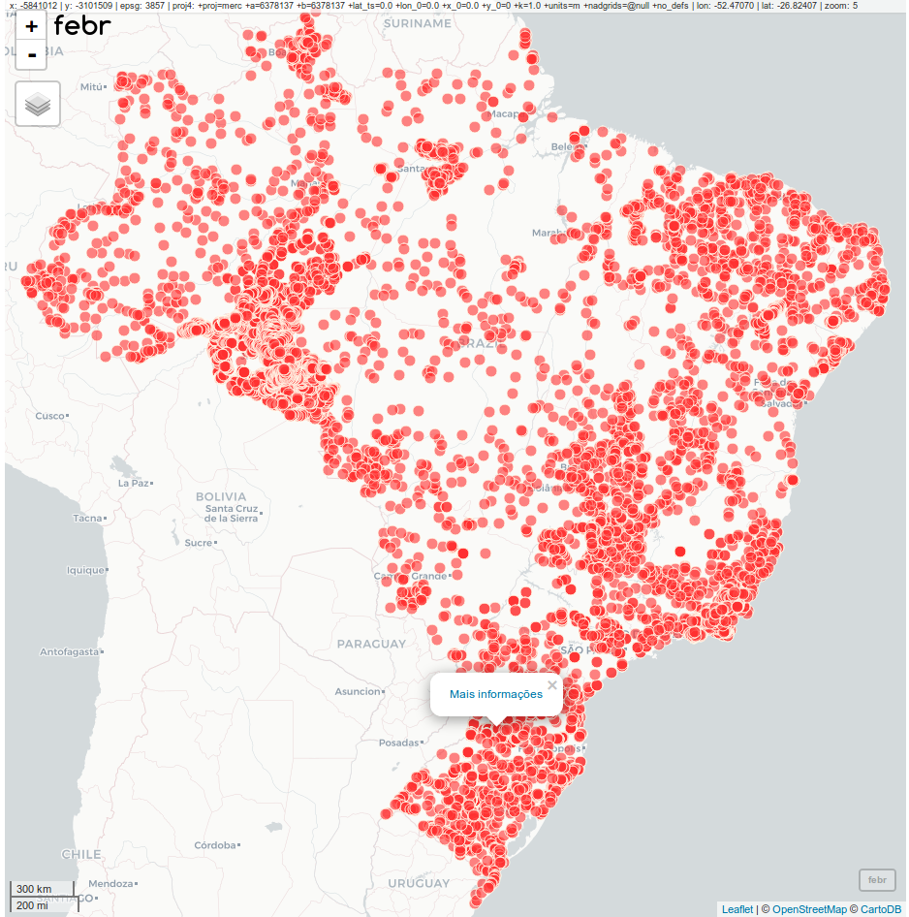
Samuel-Rosa et al. (2018) Bringing together Brazilian soil scientists to share soil data
232 datasets
14 477 soil observations
21st World Congress of Soil Science
Brazilian Soil Science Society, Rio de Janeiro, Brazil
Tuesday 14 August 2018 – Reconciling pedometrics and pedology

Slide 15

Download
Samuel-Rosa et al. (2018) Bringing together Brazilian soil scientists to share soil data
Google Sheets
XLSX, ODS, PDF, HTML, CSV, and TSV
21st World Congress of Soil Science
Brazilian Soil Science Society, Rio de Janeiro, Brazil
Tuesday 14 August 2018 – Reconciling pedometrics and pedology

Slide 16


Download
Samuel-Rosa et al. (2018) Bringing together Brazilian soil scientists to share soil data
Google Sheets
XLSX, ODS, PDF, HTML, CSV, and TSV
R-package febr
Select dataset, table, variable; standardization + harmonization
# Installation
install.packages("febr");library(febr)
# One line to download all data from a dataset
dts <‐ febr(dataset = "ctb0629", variable = "all")
21st World Congress of Soil Science
Brazilian Soil Science Society, Rio de Janeiro, Brazil
Tuesday 14 August 2018 – Reconciling pedometrics and pedology

Slide 17



Support
Samuel-Rosa et al. (2018) Bringing together Brazilian soil scientists to share soil data
Website + Blog
Users: www.ufsm.br/febr
Documentation
Users: febr-team.github.io/febr-package/
Maintainers: www.ufsm.br/febr/book/
Discussion group
Users & Maintainers: febr-forum@googlegroups.com
21st World Congress of Soil Science
Brazilian Soil Science Society, Rio de Janeiro, Brazil
Tuesday 14 August 2018 – Reconciling pedometrics and pedology

Slide 18
Challenges
Samuel-Rosa et al. (2018) Bringing together Brazilian soil scientists to share soil data
What problems do you have in sharing datasets?
46% → Organising data in a presentable, useful way
37% → Unsure about copyright, licensing
33% → Which repository to use?
26% → Lack of time
19% → Costs
Stuart et al. Whitepaper: Practical challenges for researchers in data sharing. Springer Nature, Figshare, 2018. 30 p. DOI:10.6084/m9.figshare.5975011
21st World Congress of Soil Science
Brazilian Soil Science Society, Rio de Janeiro, Brazil
Tuesday 14 August 2018 – Reconciling pedometrics and pedology

Slide 19




Future
Samuel-Rosa et al. (2018) Bringing together Brazilian soil scientists to share soil data
Following 3 years:
Consolidate project and partnerships
Continue data rescue
Consolidate standards
Start planning the next phase
21st World Congress of Soil Science
Brazilian Soil Science Society, Rio de Janeiro, Brazil
Tuesday 14 August 2018 – Reconciling pedometrics and pedology

Slide 20


Future
Samuel-Rosa et al. (2018) Bringing together Brazilian soil scientists to share soil data
Following 3 years:
Consolidate project and partnerships
Continue data rescue
Consolidate standards
Start planning the next phase
Next phase – two fronts:
1. Soil data rescue
Collaboration (Google Sheets)
2. Soil data sharing
Management system for data storage and distribution
21st World Congress of Soil Science
Brazilian Soil Science Society, Rio de Janeiro, Brazil
Tuesday 14 August 2018 – Reconciling pedometrics and pedology

Slide 21





Bringing together Brazilian soil scientists to share soil data
alessandrorosa@utfpr.edu.br
febr-forum@googlegroups.com
www.ufsm.br/febr/
21st World Congress of Soil Science
Brazilian Soil Science Society, Rio de Janeiro, Brazil
Tuesday 14 August 2018 – Reconciling pedometrics and pedology

