Slide 1
January 21, 2025
MODULARITY GROUP
Boolean Networks in Biology
Sai Bavisetty
Postdoctoral Associate
Laboratory for Systems Medicine
Division of Pulmonary, Critical care and Sleep medicine
COLLEGE of MEDICINE

Slide 2
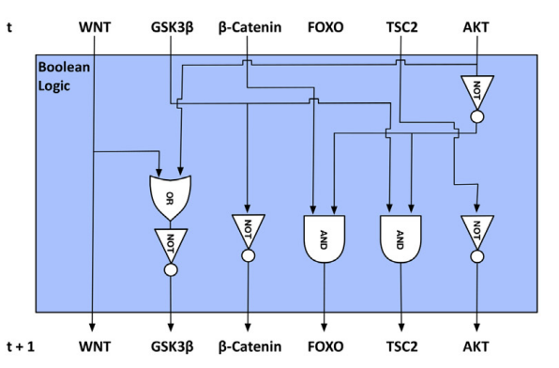
Definition 1:
A Boolean network (synchronous) is a circuit with n input and n outputs where the outputs at T=t are the input at T=t+1
Example:
2

Slide 3
Definition 2:
A Boolean Network (synchronous) on n nodes is a map f:{0,1}^{n} {0,1}^{n}
Example:
00
01
10
11
00
01
10
11
A Boolean Network on 2 nodes
3

Slide 4
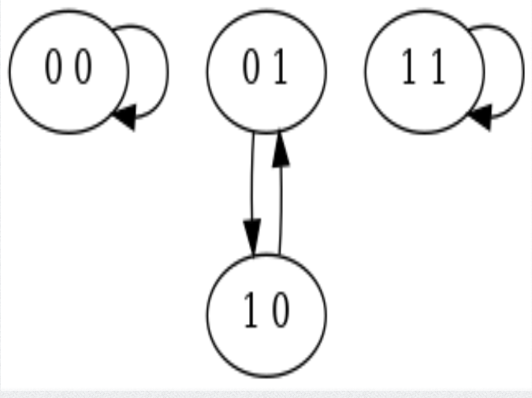
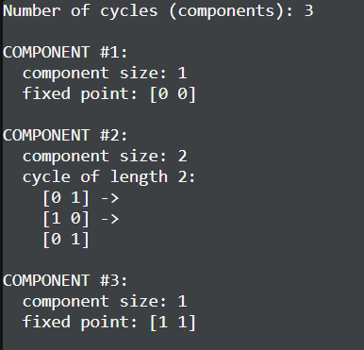
Dynamics of a Network
Dynamics of a Boolean network is often encoded as a State graph
State graph:
Vertices = {0,1}^{n}
Edges = (s_{i} , s_{j}) if the state s_{i} updates to s_{j}
Example:
# Example Boolean Model
NUMBER OF VARIABLES: 2
NUMBER OF STATES : 2
M = B
B = M
4

Slide 5
Biological interpretation of State graph
Modelling assumptions:
Attractors of the state graph are the phenotypes of the system
“Robust” attractors are the biologically feasible attractors
Potential Questions/Issues:
What is a robust attractor?
State space explosion : The state graph is too big (2^{n}) once n>30. Can we still compute the attractors?
5

Slide 6
Lac Operon
An Operon is a region of the DNA that has genes that are transcribed together.
Lac Operon is required for transport and metabolism of Lactose in E. coli.
When a host consumes milk, E. coli encounters lactose
In the presence of glucose and lactose, glucose is the preferred source
6

Slide 7
How Lac Operon works
Lactose (L) is brought into the cell by the lac permease (P)
β−galactosidase (B) converts lactose (L) into allolactose (A)
Allolactose (A) binds to the lac repressor (R)
This allows RNA Polymerase to start transcription and mRNA (M) encoding the lac genes is produced.
mRNA (M) gets translated to β−galactosidase (B) and lac permease (P) and more lactose is brought into the cell. (The operon is ON.)
Eventually, all lactose (L) is used up, so there will be no more allolactose (A). The lac repressor (R) can now bind to the DNA, so mRNA transcription stops. (The operon is OFF.)
Note: There is quite a bit more to this story. For instance, there is also a pathway by which Glucose represses transcription indirectly!
7

Slide 8
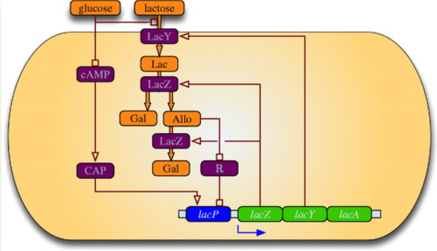
Gene Regulatory Network of Lac Operon
8

Slide 9

A Boolean Model for the Lac Operon
For our model, we will have the following nodes
M: mRNA , with the update rule $f_{M}=A$
B: β−galactosidase , with the update rule $f_{B}=M$
A: allolactose , with the update rule $f_{A}=A or (L and B)$
L: intracellular lactose , with the update rule $f_{L}=P or (L and \overline{B})$
P: lac permease (transporter protein), with the update rule $f_{P}=M$
Assumptions:
Extracellular lactose is available and extracellular glucose is unavailable
9

Slide 10
Simulating using Cyclone
Simulating using cyclone:
# Lac Operon Example
NUMBER OF VARIABLES: 5
NUMBER OF STATES : 2
M = A
B = M
A = A or (L and B)
L = P or (L and (not B))
P = M
10

Slide 11
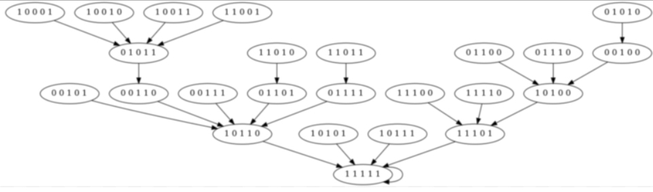
Simulating using Cyclone
This is the attractor corresponding to Lac Open being ON
11

Slide 12
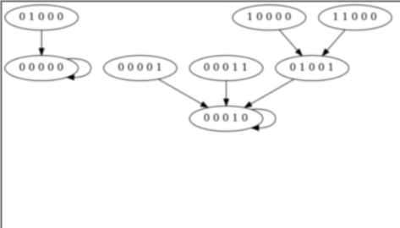
Simulating using Cyclone
These are the attractors where the Lac Operon is OFF
But they don’t make sense!
The fixed point (M,B,A,L,P) = (0,0,0,0,0) should not happen with lactose present but not glucose
The fixed point (M,B,A,L,P) = (0,0,0,1,0) is not biologically feasible: it would describe a scenario where the bacterium does not metabolize intracellular lactose.
12

Slide 13
Advantages
Easy to simulate small networks
Few hyperparameters (no rate constants etc)
Disadvantages
Hard to simulate large networks
How do we analyze robustness of our model? Will our predictions change drastically with small perturbations?
Need a better theoretical understanding!
13

Slide 14
Wiring Diagram
M
M = A
B = M
A = A or (L and B)
L = P or (L and (not B))
P = M
A
B
L
P
14

Slide 15
Linear Networks
Linear networks are Boolean Networks where all updates only use XOR gates.
A linear network is completely determined by its wiring diagram
Theorem : The state space of a linear Network is a product of 2-trees and cycles. Furthermore, the number of cycles and depth of trees is completely determined by the spectral theory of the adjacency matrix of the wiring diagram. (see Hernández Toledo, R. A. (2005). Linear Finite Dynamical Systems.)
15

Slide 16
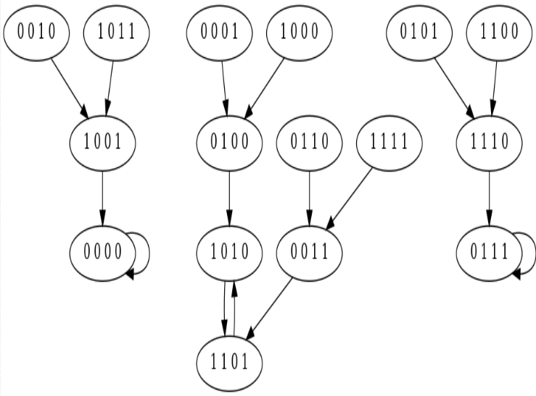
Linear Networks Examples
#Linear Boolean Network Example 1
NUMBER OF VARIABLES: 4
NUMBER OF STATES : 2
A = C XOR B
B = D XOR A
C = B
D = C
16

Slide 17
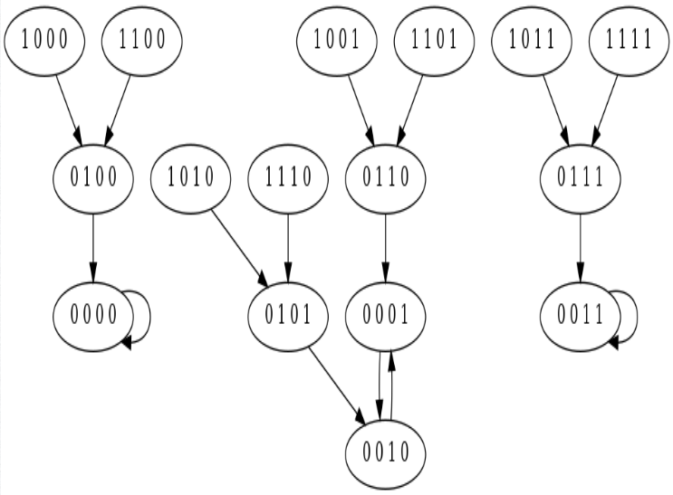
Linear Networks Examples
#Linear Boolean Network Example 2
NUMBER OF VARIABLES: 4
NUMBER OF STATES : 2
A = 0
B = A
C = D
D = C
17

Slide 18
Linear Networks Examples
State space of example 1
State space of example 2
18
Notes:
Remark that after an isomorphism, this network is equivalent to a product of two networks.

Slide 19
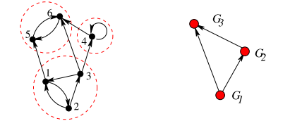
Strongly connected components
A strongly connected component is the maximal subgraph such that there is a directed path from every vertex in the subgraph to every other vertex.
Given any wiring diagram, we can construct a DAG of strongly connected component.
19

Slide 20
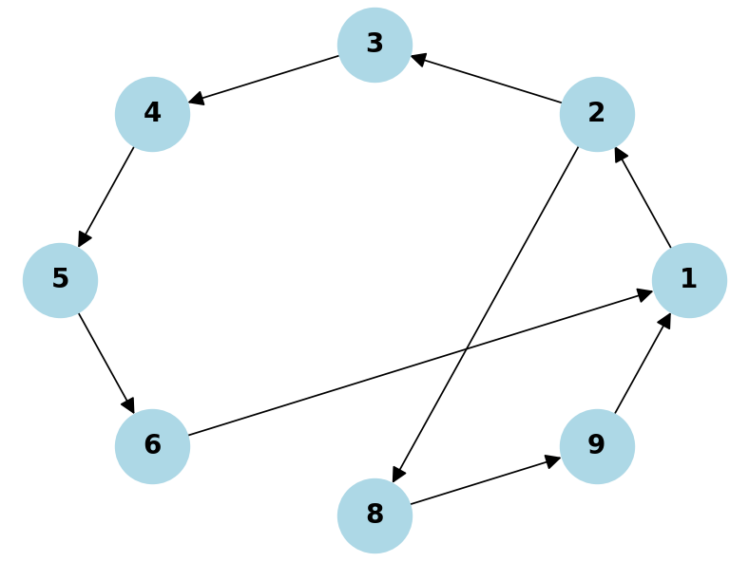
Loop Number
The loop number of a strongly connected graph is the greatest common
divisor of the lengths of its simple (no repeated vertices) directed cycles.
Example:
Graph with loop number 2
20

Slide 21
Conjunctive Networks
Conjunctive networks are Boolean Networks where all updates only use AND gates.
A conjunctive network is completely determined by its wiring diagram
Theorem : Given a strongly connected conjunctive network on n nodes, the number of attractors and their lengths is completely determined by the loop number of the network. Furthermore, the height is O(n²).
(see Jarrah AS, Laubenbacher R, Veliz-Cuba A. The dynamics of conjunctive and disjunctive Boolean network models.)
21

Slide 22
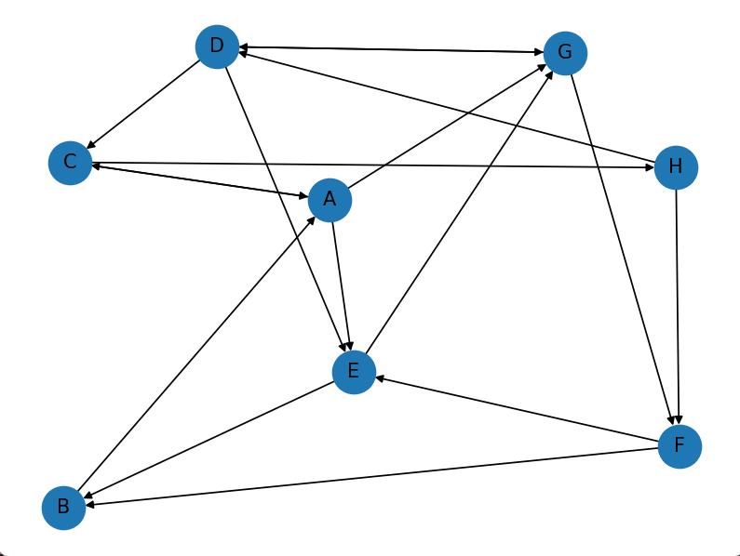
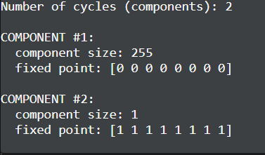
Conjunctive Networks Example
# Example Conjunctive Network
NUMBER OF VARIABLES: 8
NUMBER OF STATES : 2
A = B and C
C = A and D
B = E and F
D = G and H
E = D and A and F
F = G and H
G = A and D and E
H = C
One SCC, Loop Number =1
22

Slide 23
What happens if there is more than 1 SCC?
Theorem : For a conjunctive network, the topology of the DAG of SCCs gives a lower and upper bound for the number of attractors and their lengths. Moreover, the lower bound is sharp.
(see Jarrah AS, Laubenbacher R, Veliz-Cuba A. The dynamics of conjunctive and disjunctive Boolean network models.)
Can we do something similar for more general networks?
23

Slide 24
Modularity
Main Idea: Break the network into SCCs. Simulate upstream to the steady state and then simulate the downstream.
Theorem: If F is a semidirect product of two networks A and B, then the steady states of F are a semidirect product of attractors of A and B.
Kadelka Claus, Wheeler Matthew, Veliz-Cuba Alan, Murrugarra David and Laubenbacher Reinhard. Modularity of biological systems: a link between structure and function.
24

Slide 25
Open Problems
What is the biological interpretation of the modules?
How does the topology influence the dynamics?
What are the design principles to improve robustness will maintaining phenotypical variability?
Which attractors are biologically meaningful?
How do we analyze “robustness” of our model? Will our predictions change drastically with small “biological perturbations”?
25

Slide 26
Thank you!
26

Slide 27
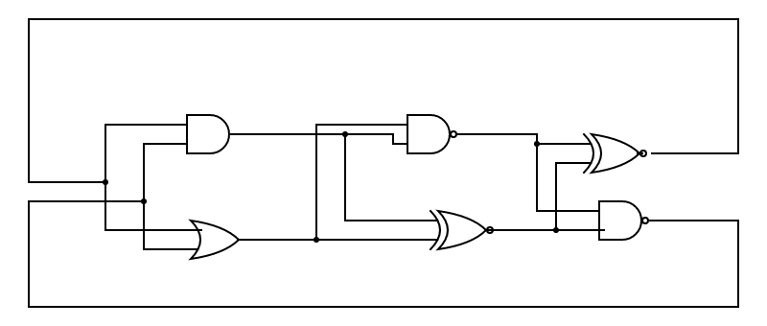
27

Slide 28
The loop number of a strongly connected graph is the greatest common
divisor of the lengths of its simple (no repeated vertices) directed cycles.
Example:
Graph with loop number 2
28

