Slide 1
Linear and Hierarchical Linear Models
Mixed Models, and Multilevel Models, GLMMs, etc… Camila Pacheco Katrín Björnsdóttir

Slide 2
Today
Linear Models
What are hierarchical linear models
Identify situations in which the use of mixed effects is appropriate
Implement basic linear mixed models (LMM) with R
Break
Practice

Slide 3
Required Material
https://github.com/lacapary/BIO503/

Slide 4
Required Material
You are required to have downloaded and installed
install.packages(c("lme4", "ggeffects", "stargazer" ))

Slide 5
Required Material
Do not hesitate to ask questions!

Slide 6
Linear models
What is a linear model?

Slide 7
Linear models
What is a linear model?
Mathematical tool used to describe relationships between response variable and explanatory variable.
In the simplest form is expressed as:
$Y=β_{0}+β_{1}X+ε$.

Slide 8
Linear models
Some simple examples:
Does soil nitrogen content influence plant productivity?
Model: $\text{Plant biomass}=β_{0}+β_{1}*\text{Soil nitrogen}+ε$

Slide 9
Linear models
Some simple examples:
Does soil nitrogen content influence plant productivity?
Model: $\textbf{\textcolor{red}{Plant biomass}} = \beta_0 + \beta_1 \cdot \text{Soil nitrogen} + \varepsilon$

Slide 10
Linear models
Some simple examples:
Does soil nitrogen content influence plant productivity?
Model: $\text{Plant biomass} = \beta_0 + \beta_1 \cdot \textbf{\textcolor{red}{Soil nitrogen}} + \varepsilon$

Slide 11
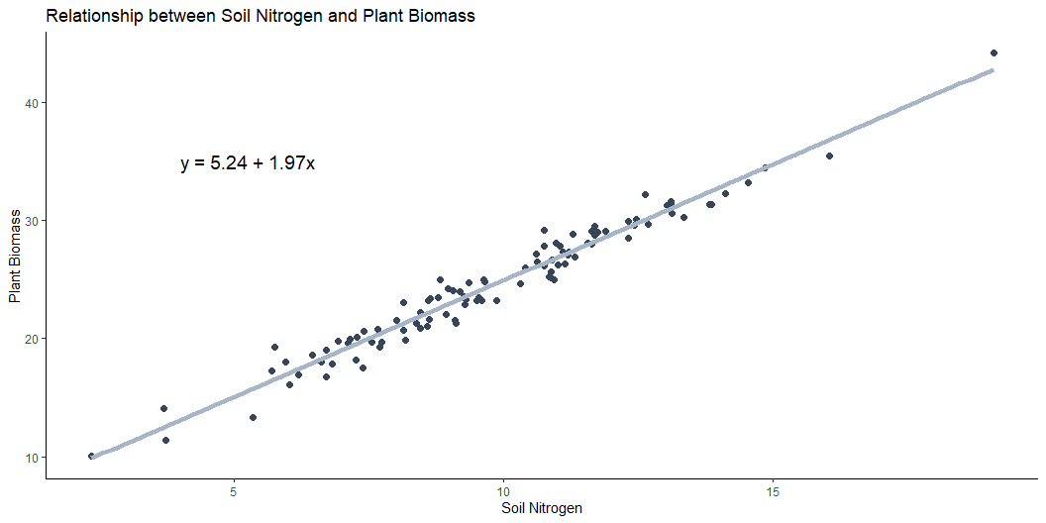
Linear models

Slide 12
Linear models
Why do we use linear models in ecology?

Slide 13
Linear models
Why do we use linear models in ecology?
Ecological systems are complex, but linear models give us a simplified framework to ask and answer key ecological questions.
They are:
✅ Simple and interpretable: Linear models are easy to understand and communicate. ✅ Flexible: Can be extended to include multiple predictors or transformations. ✅ Hypothesis testing: Quantifies relationships based on ecological theory. ✅ Give data-driven insight: Help test ecological hypotheses with real-world data. ✅ Foundation for advanced models: Build towards more advanced models.

Slide 14

Data for this part of the session

Slide 15
Coding Club Mixed models

Slide 16
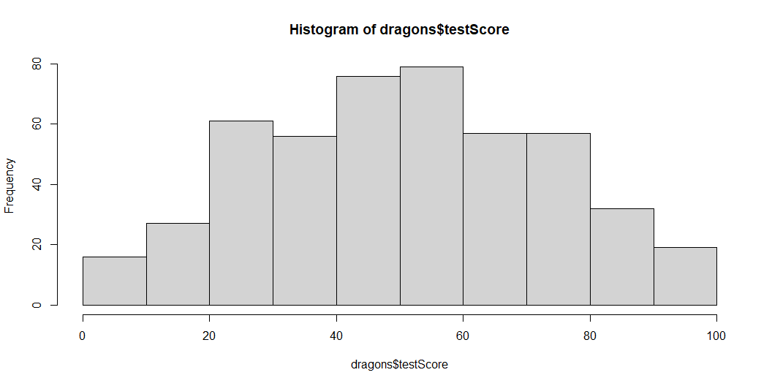
Explore the data
library(tidyverse) load("CC-Linear-mixed-models/dragons.RData") head(dragons)
testScore bodyLength mountainRange site 1 16.147309 165.5485 Bavarian a 2 33.886183 167.5593 Bavarian a 3 6.038333 165.8830 Bavarian a 4 18.838821 167.6855 Bavarian a 5 33.862328 169.9597 Bavarian a 6 47.043246 168.6887 Bavarian a
hist(dragons$testScore)

Slide 17
Linear models
Now lets visualize the relationship using ggplot (notice how we only included stat`smooth to our original scatter plot).
p<-iris %>% ggplot(aes( x = Petal.Length, y = Petal.Width, color = Species)) + # to assign a color to each group geom_point() + stat_smooth(method = "lm", aes(fill = Species, colour = Species)) + labs( x = "Petal length (cm)", y = "Petal width (cm)")

Slide 18
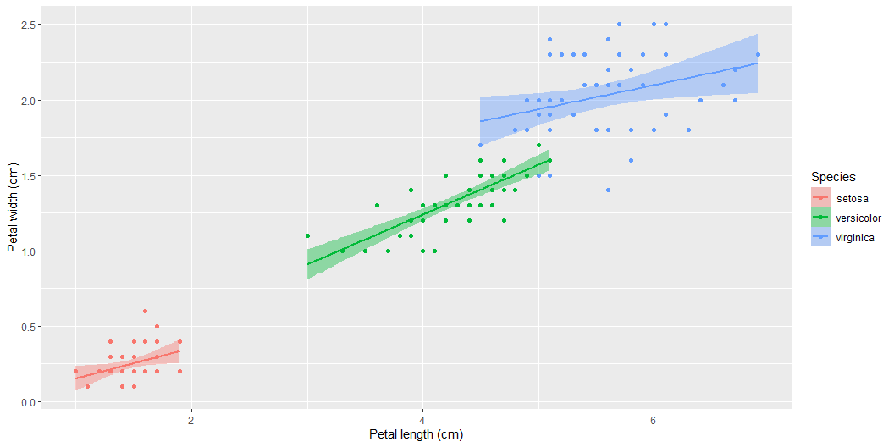
Linear models

Slide 19
Linear models
In the previous plot we just made we used the default ggplot settings. Although this is a great looking plot, we can make it even better since ggplot has a lot of power in customization, here is one example but feel free to play around with this, it can actually be quite satisfying when you get the hang of it.
p<-iris %>% ggplot(aes( x = Petal.Length, y = Petal.Width, color = Species # to assign a color to each group )) + geom_point(size = 3) + # to plot a scatter plot stat_smooth(method = "lm", aes(fill = Species, colour = Species), linewidth = 1.5) + #add a linear fit for each species scale_color_manual(name = "Species", values = c("#023d79", "#faa307", "#3f5426")) + #add manually selected colors to the points of different species scale_fill_manual(name = "Species", values = c("#023d79", "#faa307", "#3f5426")) + #add manually selected colors to the linear fit for each species labs( x = "Petal length (cm)", #x axis label y = "Petal width (cm)" #y axis label ) + theme_bw()+ #theme within the ggplot2 package (different themes available, f.ex. theme_classic, theme_minimal) theme(axis.text.x = element_text(size = 10), #use the theme function to customize axis text, label test, legends etc. axis.text.y = element_text(size = 10), axis.title.x = element_text(size = 14, face = "plain"), axis.title.y = element_text(size = 14, face = "plain"), panel.grid.major.x = element_blank(), panel.grid.minor.x = element_blank(), panel.grid.minor.y = element_blank(), panel.grid.major.y = element_blank(), plot.margin = unit(c(0.5, 0.5, 0.5, 0.5), units = , "cm"), plot.title = element_text(size = 20, vjust = 1, hjust = 0.5), legend.text = element_text(size = 12, face = "italic"), legend.position = "right")

Slide 20
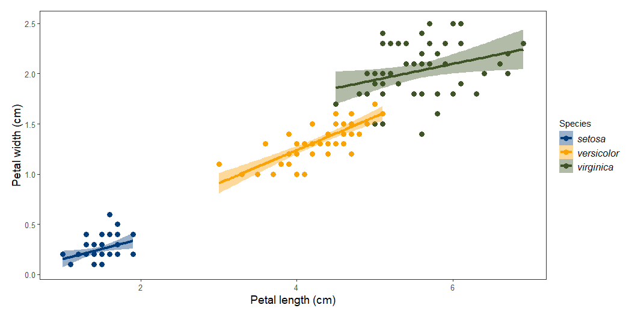
Linear models

Slide 21
Generalize linear models
Get familiar with different data distributions Here is a brief summary of the data distributions you might encounter most often.
Gaussian - Continuous data (normal distribution and homoscedasticity assumed)
Poisson - Count abundance data (integer values, zero-inflated data, left-skewed data)
Binomial - Binary variables (TRUE/FALSE, 0/1, presence/absence data)
Choosing the right statistical test for your analysis is an important step about which you should think carefully.

Slide 22
Generalize linear models
lm which
lm which

Slide 23
Generalize linear models
Syntax for a model with poisson (count) distribution
glm(y ~ x, family = poisson, data = df)
Syntax for a model with binomial distribution
glm(y ~ x, family = binomial, data = df)

Slide 24
Hierarchical Linear Models

Slide 25
Ecological and biological data can be complex!
Hierarchical structure in the data
Many covariates and grouping factors
Unbalanced study/experimental design

Slide 26
What is Independence Assumption?
A linear regression model assumes that :
Any other data point does not influence each data point in a dataset
We are NOT referring to your independent and responses variable
Ideally we want them to be correlated it
We are referring withing the variable

Slide 27
Diagnosis of dependence?
Think about how the data were collected.
Are there clusters in my data?
For example:
Are there data from individual species clustered within sampling area?

Slide 28
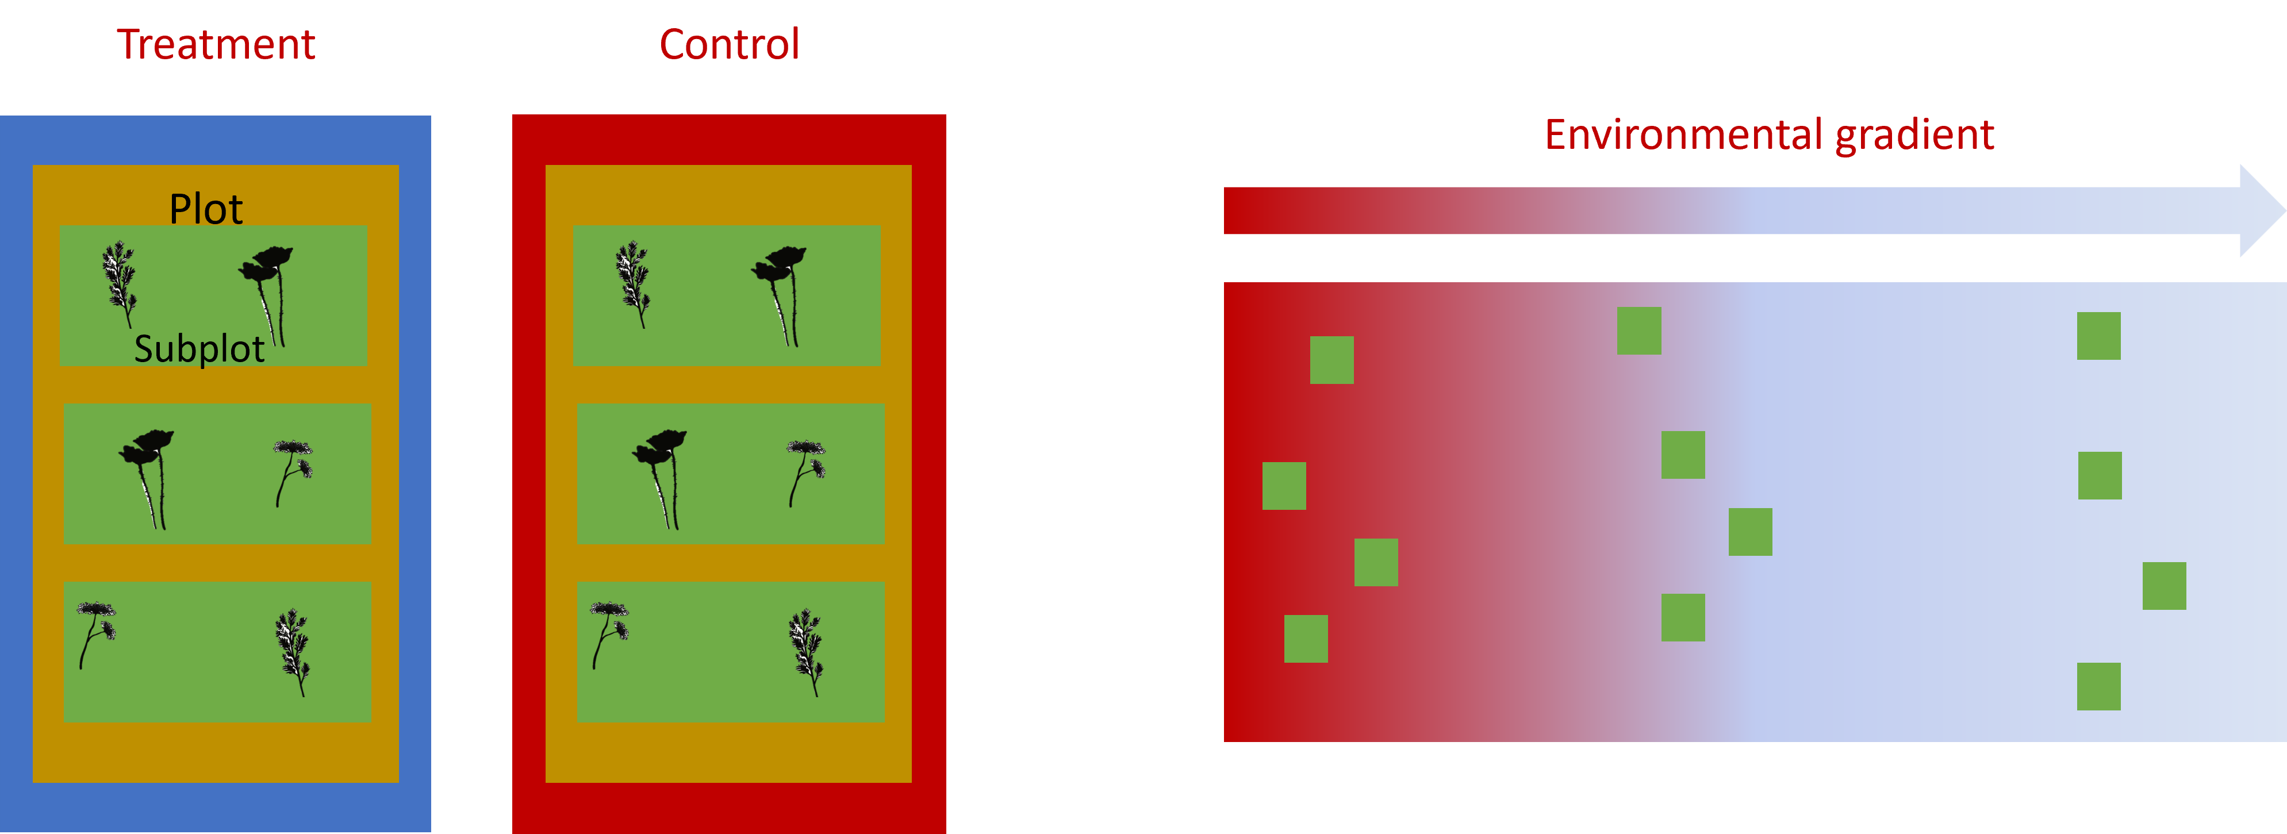
Hierarchical structres example

Slide 29
Hierarchical structres in ecology
Grouping factors: populations, species, sites
Sample sizes: Species area relationship
Time: Might take repeated measurements of the same plant in time
Space: the closer the similar

Slide 30
How could we analyze this data?
We need to explicitly account for the correlated nature of the data
The random effects structure will aid correct inference about fixed effects, depending on which level of the system’s hierarchy is being manipulated.
What is random effects ?
What is fixed effects?
When to used them ?

Slide 31
When to used them ?
You will need to used random and fixed effects every time your data has a Hierarchical structure.
It’s important to not that this difference has little to do with the variables themselves, and a lot to do with your research question!
What is just variation (“noise”) that you need to control for?

Slide 32
Fixed effects : deterministic processes
They are like drivers, categories or groups that you think might directly influence the outcome you’re studying.
They’re called “fixed” because you’re interested in the specific levels of these categories.
"I want to know how these different things (fixed effects) affect the outcome."
levels of a factor (qualitative variable)
a predictor (quantitative variable)

Slide 33
Random effects : stochastic processes
Name random doesn’t have much to do with mathematical randomness
They are like grouping factors for which we are trying to control
You’re not interested in the specific effect of these factors themselves
but we know that they might be influencing the patterns we see
"I want to know how these factors (random effects) contribute to the overall variation in the outcome."
They are always categorical

Slide 34
Scaling the data
It is good practice to standardize your explanatory variables before proceeding so that they have a mean of zero (“centering”) and standard deviation of one (“scaling”).
If two variables in the same model have very different scales, the mixed model will likely return a convergence error when trying to compute the parameters.
dragons<- dragons |> mutate(bodyLength2=scale(bodyLength,center = TRUE, scale = TRUE))

Slide 35
Research question
Is the test score affected by body length?

Slide 36
Linear model
basic.lm <- lm(testScore ~ bodyLength2, data = dragons) summary(basic.lm)
Call: lm(formula = testScore ~ bodyLength2, data = dragons) Residuals: Min 1Q Median 3Q Max -56.962 -16.411 -0.783 15.193 55.200 Coefficients: Estimate Std. Error t value Pr(>|t|) (Intercept) 50.3860 0.9676 52.072 <2e-16 *** bodyLength2 8.9956 0.9686 9.287 <2e-16 *** --- Signif. codes: 0 '***' 0.001 '**' 0.01 '*' 0.05 '.' 0.1 ' ' 1 Residual standard error: 21.2 on 478 degrees of freedom Multiple R-squared: 0.1529, Adjusted R-squared: 0.1511 F-statistic: 86.25 on 1 and 478 DF, p-value: < 2.2e-16

Slide 37
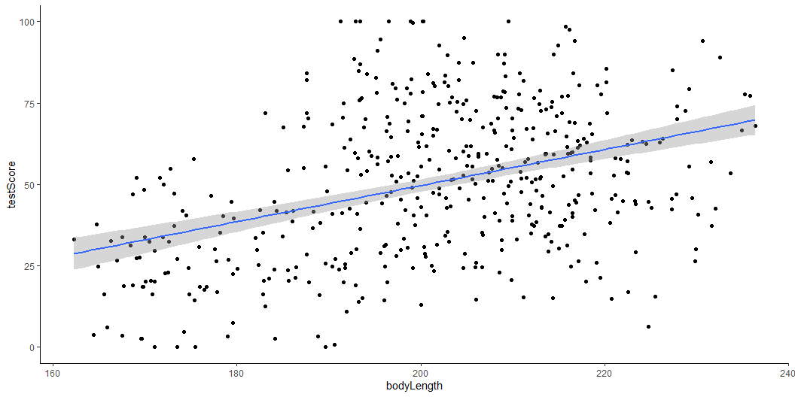
Linear model
(prelim_plot <- ggplot(dragons, aes(x = bodyLength, y = testScore)) + geom_point() + geom_smooth(method = "lm"))+ theme_classic()

Slide 38
it seems like bigger dragons do better in our intelligence test. That seems a bit odd: size shouldn’t really affect the test scores.

Slide 39
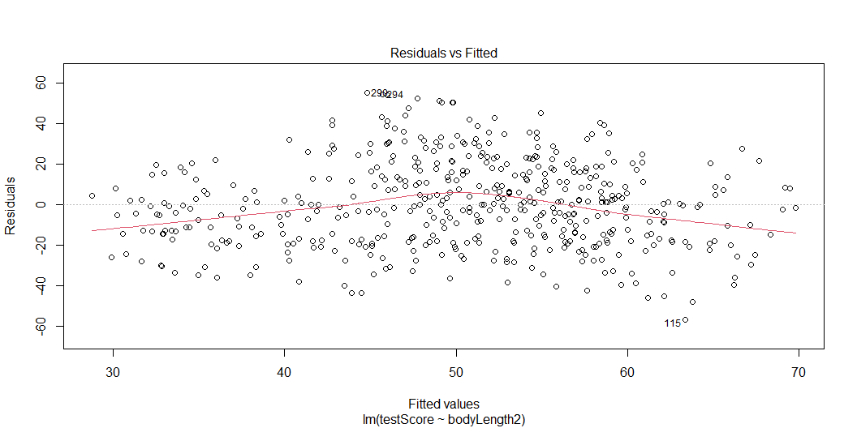
Assumptions check
plot(basic.lm)

Slide 40
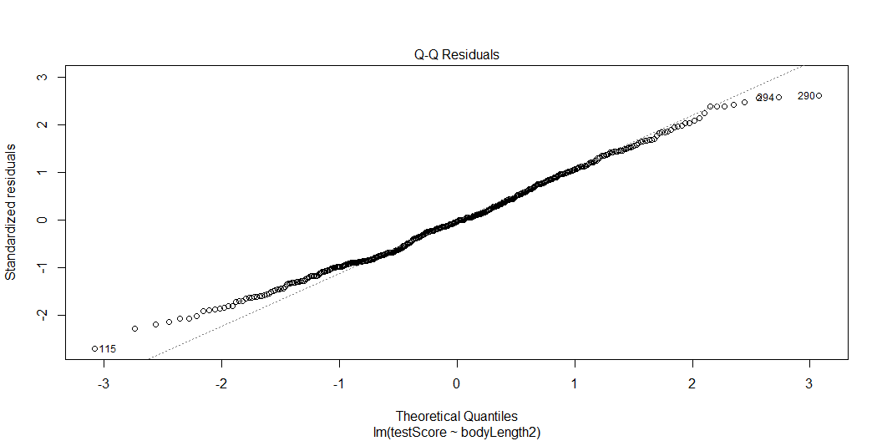

Slide 41
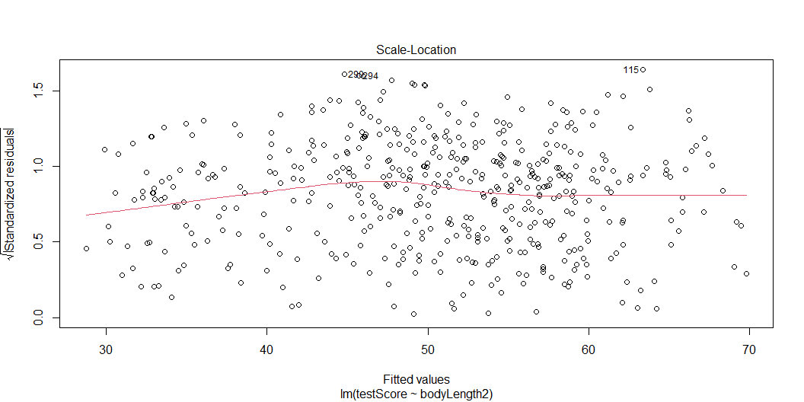

Slide 42
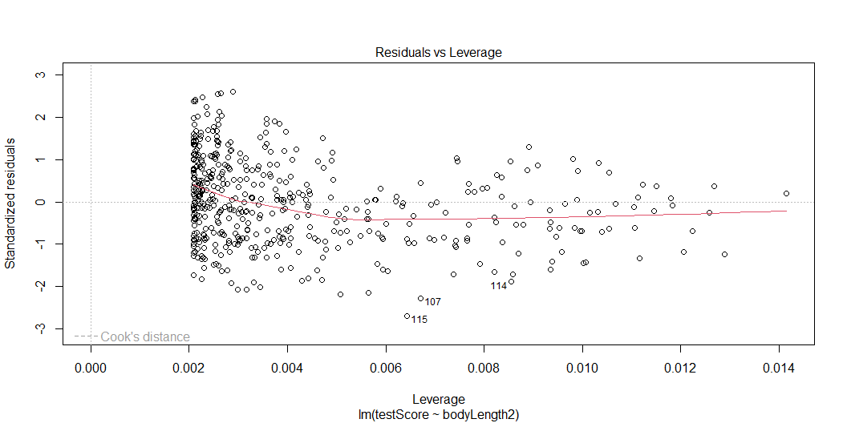

Slide 43
Assumptions check
Are our data independent?

Slide 44
Assumptions check
Data description: The data were collected from multiple samples from eight mountain ranges.
It’s perfectly plausible that the data from within each mountain range are more similar to each other than the data from different mountain ranges
they are Hierarchical!

Slide 45
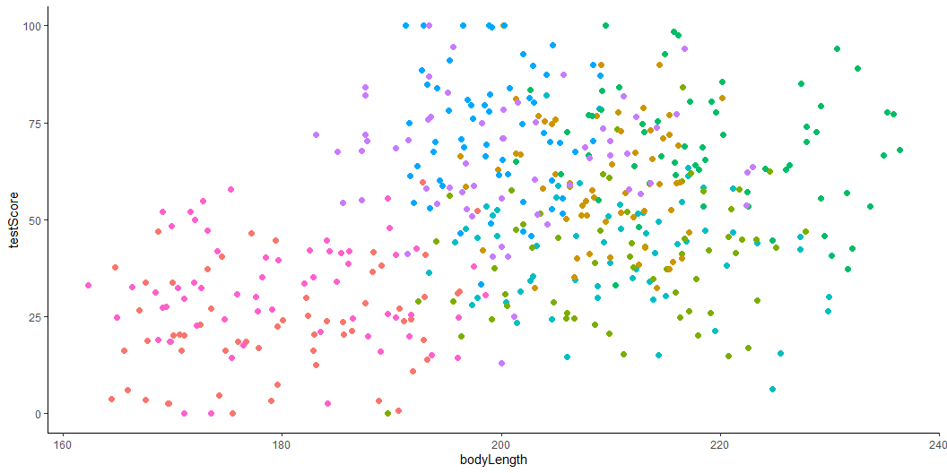
Assumptions check
(colour_plot <- ggplot(dragons, aes(x = bodyLength, y = testScore, colour = mountainRange)) + geom_point(size = 2) + theme_classic() + theme(legend.position = "none"))

Slide 46
How to implement mixed models in R?
Step 1: Model building
Step 2: Model validation
Step 3: Model interpretation
Step 4: Model visualization

Slide 47
Step 1: Model building
Hierarchical linear models do is they essentially fit a separate regression line for each and every cluster.

Slide 48
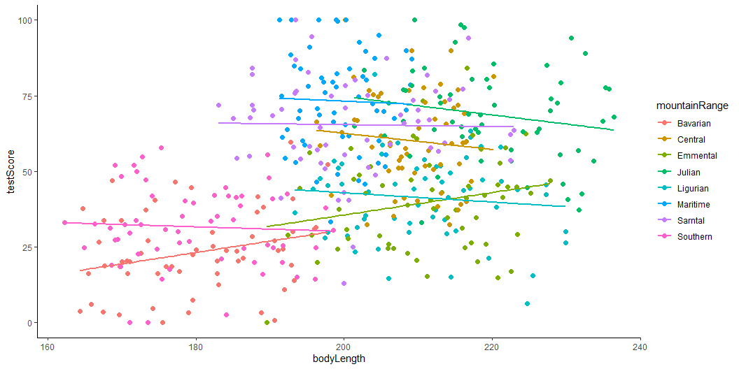
Step 1: Model building Dragons
(colour_plot <- ggplot(dragons, aes(x = bodyLength, y = testScore, colour = mountainRange)) + geom_point(size = 2) + geom_smooth(method = "lm",se=FALSE)+ theme_classic() )

Slide 49
Step 1: Model building
Hierarchical linear models do is they essentially fit a separate regression line for each and every cluster. And then estimates what we call the Fixed slope. Average slope between x and y across my clusters.
Mathematically speaking it is more complicated than that.

Slide 50
Step 1: Model building Dragons
library(lme4) #"linear mixed model" function from lme4 package mixed.lmer <- lmer(testScore ~ bodyLength2 + (1|mountainRange), #random effect data = dragons, REML = TRUE #estimation method other method ML but it has a bias ) summary(mixed.lmer)
Linear mixed model fit by REML ['lmerMod'] Formula: testScore ~ bodyLength2 + (1 | mountainRange) Data: dragons REML criterion at convergence: 3985.6 Scaled residuals: Min 1Q Median 3Q Max -3.4815 -0.6513 0.0066 0.6685 2.9583 Random effects: Groups Name Variance Std.Dev. mountainRange (Intercept) 339.7 18.43 Residual 223.8 14.96 Number of obs: 480, groups: mountainRange, 8 Fixed effects: Estimate Std. Error t value (Intercept) 50.3860 6.5517 7.690 bodyLength2 0.5377 1.2750 0.422 Correlation of Fixed Effects: (Intr) bodyLength2 0.000

Slide 51
Step 1: Model building Dragons
Factor | Variance
Mountain range | 339.7
Residuals | 223.8
Body length | ?
Mountain ranges are clearly important: they explain a lot of variation:

Slide 52
(339.7/(339.7 + 223.8) )* 100
[1] 60.28394
Variance Body length
100-60.28
[1] 39.72

Slide 53
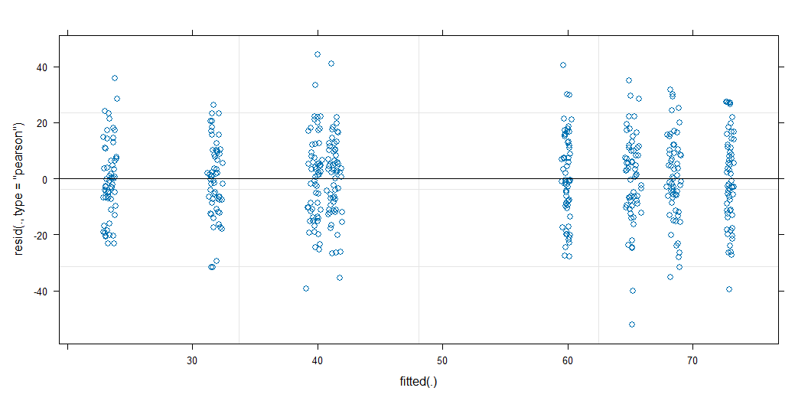
Step 2: Model validation Dragons
Assumptions check
plot(mixed.lmer)

Slide 54
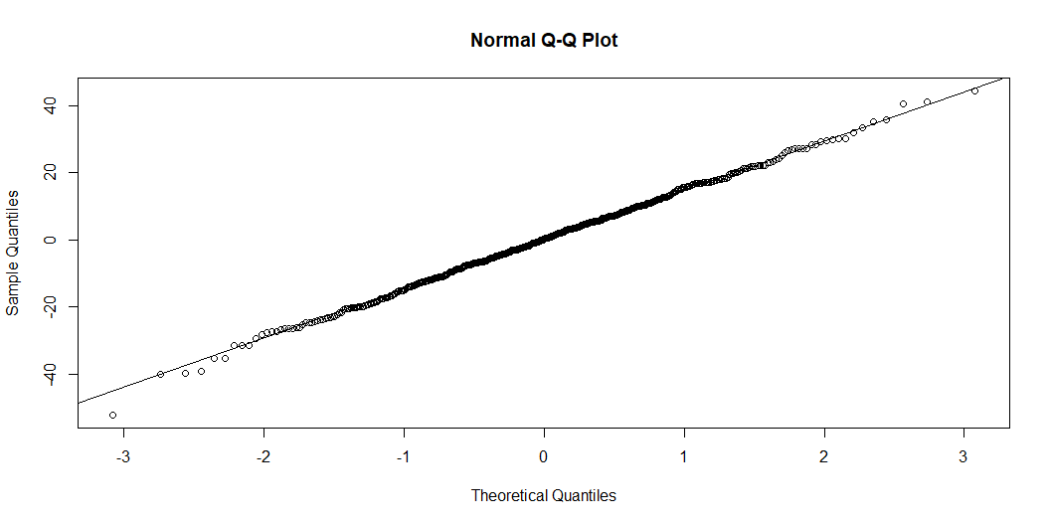
qqnorm(resid(mixed.lmer)) qqline(resid(mixed.lmer))

Slide 55
Step 1: Model building Nesting
Example:
10 control | 10 experimental
3 years
Each season
20 beds
50 seedlings
5 leaves
5 leaves x 50 seedlings x 20 beds x 4 seasons x 3 years = 60 000 measurements per treatment

Slide 56
Step 1: Model building Nesting
Effect of treatment in leaf length
leafLength ~ treatment
Pseudoreplication
Massively increasing sampling size
Better model
leafLength ~ treatment + (1|Bed/Plant/Leaf)
What about the crossed effects ?
Crossed (or partially crossed) random factors that do not represent levels in a hierarchy.
This account for the fact that all plants in the experiment, regardless of the fixed (treatment) effect, may have experienced a very hot summer in the second year.
leafLength ~ treatment + (1|Bed/Plant/Leaf) + (1|Season)

Slide 57
Step 1: Model building Dragons Nesting
mixed.lmer2 <- lmer(testScore ~ bodyLength2+ (1|mountainRange/site), data = dragons) summary(mixed.lmer2)
Linear mixed model fit by REML ['lmerMod'] Formula: testScore ~ bodyLength2 + (1 | mountainRange/site) Data: dragons REML criterion at convergence: 3970.4 Scaled residuals: Min 1Q Median 3Q Max -3.2425 -0.6752 -0.0117 0.6974 2.8812 Random effects: Groups Name Variance Std.Dev. site:mountainRange (Intercept) 23.09 4.805 mountainRange (Intercept) 327.56 18.099 Residual 208.58 14.442 Number of obs: 480, groups: site:mountainRange, 24; mountainRange, 8 Fixed effects: Estimate Std. Error t value (Intercept) 50.386 6.507 7.743 bodyLength2 0.831 1.681 0.494 Correlation of Fixed Effects: (Intr) bodyLength2 0.000
mixed.lmer3 <- lmer(testScore ~ bodyLength2 +(1|mountainRange) + (1|mountainRange:site), data = dragons) summary(mixed.lmer3)
Linear mixed model fit by REML ['lmerMod'] Formula: testScore ~ bodyLength2 + (1 | mountainRange) + (1 | mountainRange:site) Data: dragons REML criterion at convergence: 3970.4 Scaled residuals: Min 1Q Median 3Q Max -3.2425 -0.6752 -0.0117 0.6974 2.8812 Random effects: Groups Name Variance Std.Dev. mountainRange:site (Intercept) 23.09 4.805 mountainRange (Intercept) 327.56 18.099 Residual 208.58 14.442 Number of obs: 480, groups: mountainRange:site, 24; mountainRange, 8 Fixed effects: Estimate Std. Error t value (Intercept) 50.386 6.507 7.743 bodyLength2 0.831 1.681 0.494 Correlation of Fixed Effects: (Intr) bodyLength2 0.000

Slide 58
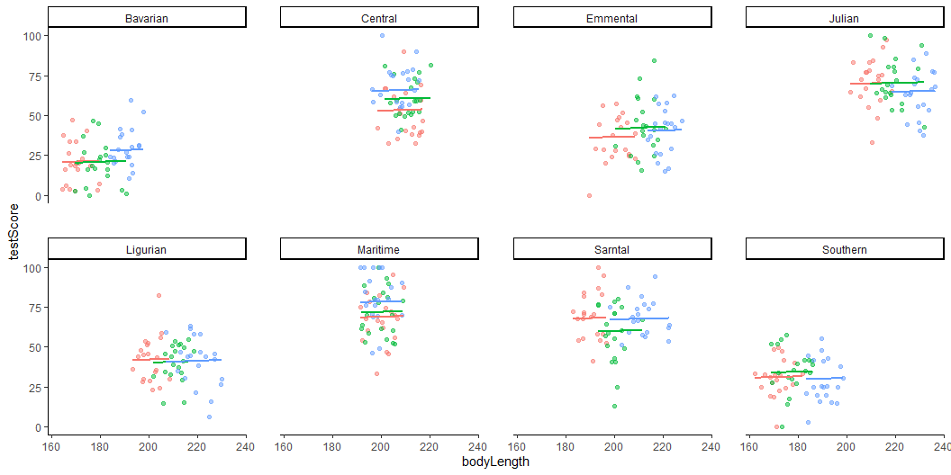
Step 1: Model building Dragons Nesting

Slide 59
Random slopes and Random intercept
A random-intercept model recognizes that each cluster might have its own starting point (intercept), but keeps the slope constant among them. So in our example we acknowledge that some populations may be smarter or dumber to begin with.
Lets say we expect that dragons in all mountain ranges do not exhibit the same relationship between body length and intelligence (rando, slope)

Slide 60
Random slopes and Random intercept
We only need to make one change to our model to allow for random slopes as well as intercept, and that’s adding the fixed variable into the random effect brackets:
mixed.ranslope <- lmer(testScore ~ bodyLength2 + (1 + bodyLength2|mountainRange/site), data = dragons) summary(mixed.ranslope)
Linear mixed model fit by REML ['lmerMod'] Formula: testScore ~ bodyLength2 + (1 + bodyLength2 | mountainRange/site) Data: dragons REML criterion at convergence: 3968.4 Scaled residuals: Min 1Q Median 3Q Max -3.2654 -0.6737 -0.0200 0.6931 2.8432 Random effects: Groups Name Variance Std.Dev. Corr site:mountainRange (Intercept) 19.8156 4.4515 bodyLength2 0.7178 0.8472 1.00 mountainRange (Intercept) 310.9691 17.6343 bodyLength2 6.1119 2.4722 -1.00 Residual 208.5025 14.4396 Number of obs: 480, groups: site:mountainRange, 24; mountainRange, 8 Fixed effects: Estimate Std. Error t value (Intercept) 51.4263 6.3408 8.110 bodyLength2 0.6691 1.8729 0.357 Correlation of Fixed Effects: (Intr) bodyLength2 -0.461 optimizer (nloptwrap) convergence code: 0 (OK) boundary (singular) fit: see help('isSingular')

Slide 61
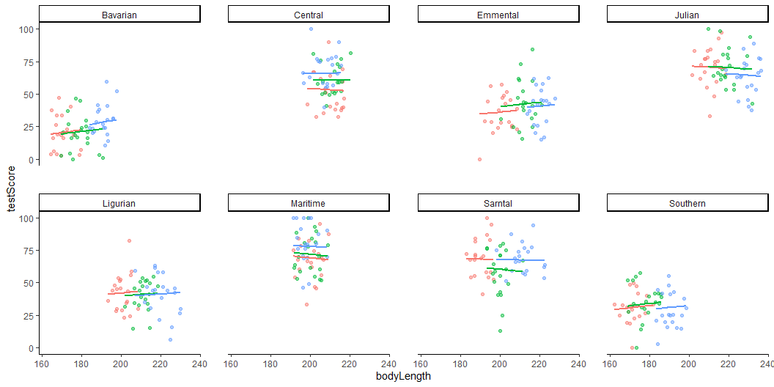
Random slopes and Random intercept

Slide 62
Step 3: Model interpretation
library(stargazer) stargazer(mixed.lmer2, digits = 3, type="text", star.cutoffs = c(0.05, 0.01, 0.001), digit.separator = "")
================================================= Dependent variable: ----------------------------- testScore ------------------------------------------------- bodyLength2 0.831 (1.681) Constant 50.386*** (6.507) ------------------------------------------------- Observations 480 Log Likelihood -1985.195 Akaike Inf. Crit. 3980.389 Bayesian Inf. Crit. 4001.258 ================================================= Note: *p<0.05; **p<0.01; ***p<0.001

Slide 63
Step 4. Visualization
library(ggeffects) # Extract the prediction data frame pred.mm <- ggpredict(mixed.lmer2, terms = c("bodyLength2")) # this gives overall predictions for the model head(pred.mm)
# Predicted values of testScore bodyLength2 | Predicted | 95% CI -------------------------------------- -3 | 47.89 | 31.72, 64.07 -2 | 48.72 | 34.33, 63.12 -1 | 49.56 | 36.35, 62.76 0 | 50.39 | 37.60, 63.17 1 | 51.22 | 38.01, 64.42 2 | 52.05 | 37.66, 66.44 Adjusted for: * site = 0 (population-level) * mountainRange = 0 (population-level)

Slide 64
Step 4. Visualization
# Plot the predictions p<-ggplot(pred.mm) + # slope geom_line(aes(x = x, y = predicted)) + # error band geom_ribbon( aes( x = x, ymin = predicted - std.error, ymax = predicted + std.error ), fill = "lightgrey", alpha = 0.5 ) + # adding the raw data (scaled values) geom_point(data = dragons, aes(x = bodyLength2, y = testScore, colour = mountainRange)) + labs(x = "Body Length (indexed)", y = "Test Score", title = "Body length does not affect intelligence in dragons") + theme_minimal()

Slide 65
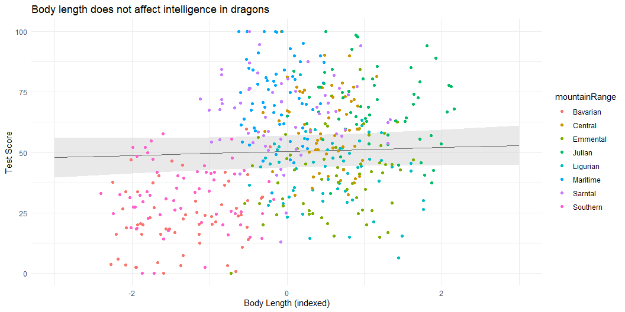
Step 4. Visualization

Slide 66
Step 4. Visualization
p<- ggpredict(mixed.lmer2, terms = c("bodyLength2", "mountainRange"), type = "random") %>% plot(show_ci = FALSE) + labs(x = "Body Length", y = "Test Score", title = "Effect of body size on intelligence in dragons") + theme_minimal()

Slide 67
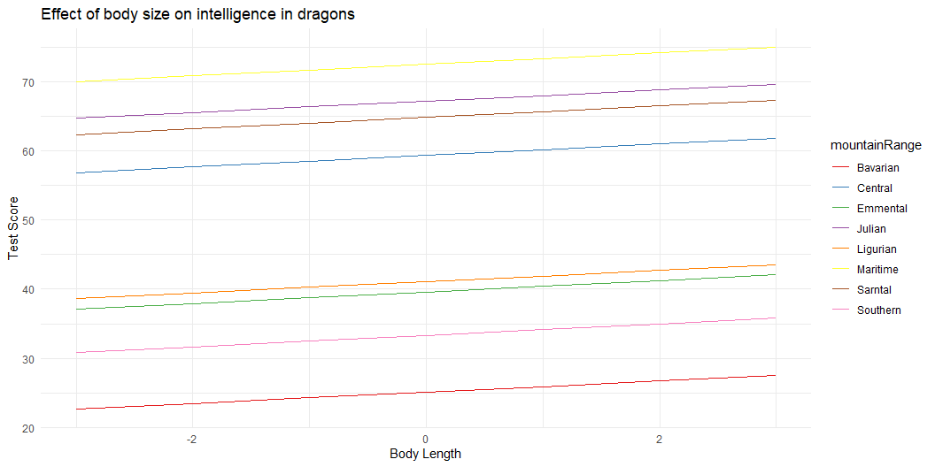
Step 4. Visualization

Slide 68
Additional ressources
Popular libraries for (G)LMMs:
Frequentist : nlme, lme4, glmmTMB
Bayesian : brms, rstan, rstanarm, MCMCglmm
Nice visualization : link
Most of the material comes from : Coding Club

Slide 69

BREAK

Slide 70
Exercise
Now let’s practice …

Slide 71
ITEX
We will be using a dataset from the ITEX network.
ITEX is a long-term warming experiment that uses standardized protocols to examine impacts of warming on Arctic ecosystems.
Established in the 1990s - vegetation monitoring over three decades.
Uses a simple method that is easy to establish in the field - open top chambers

Slide 72
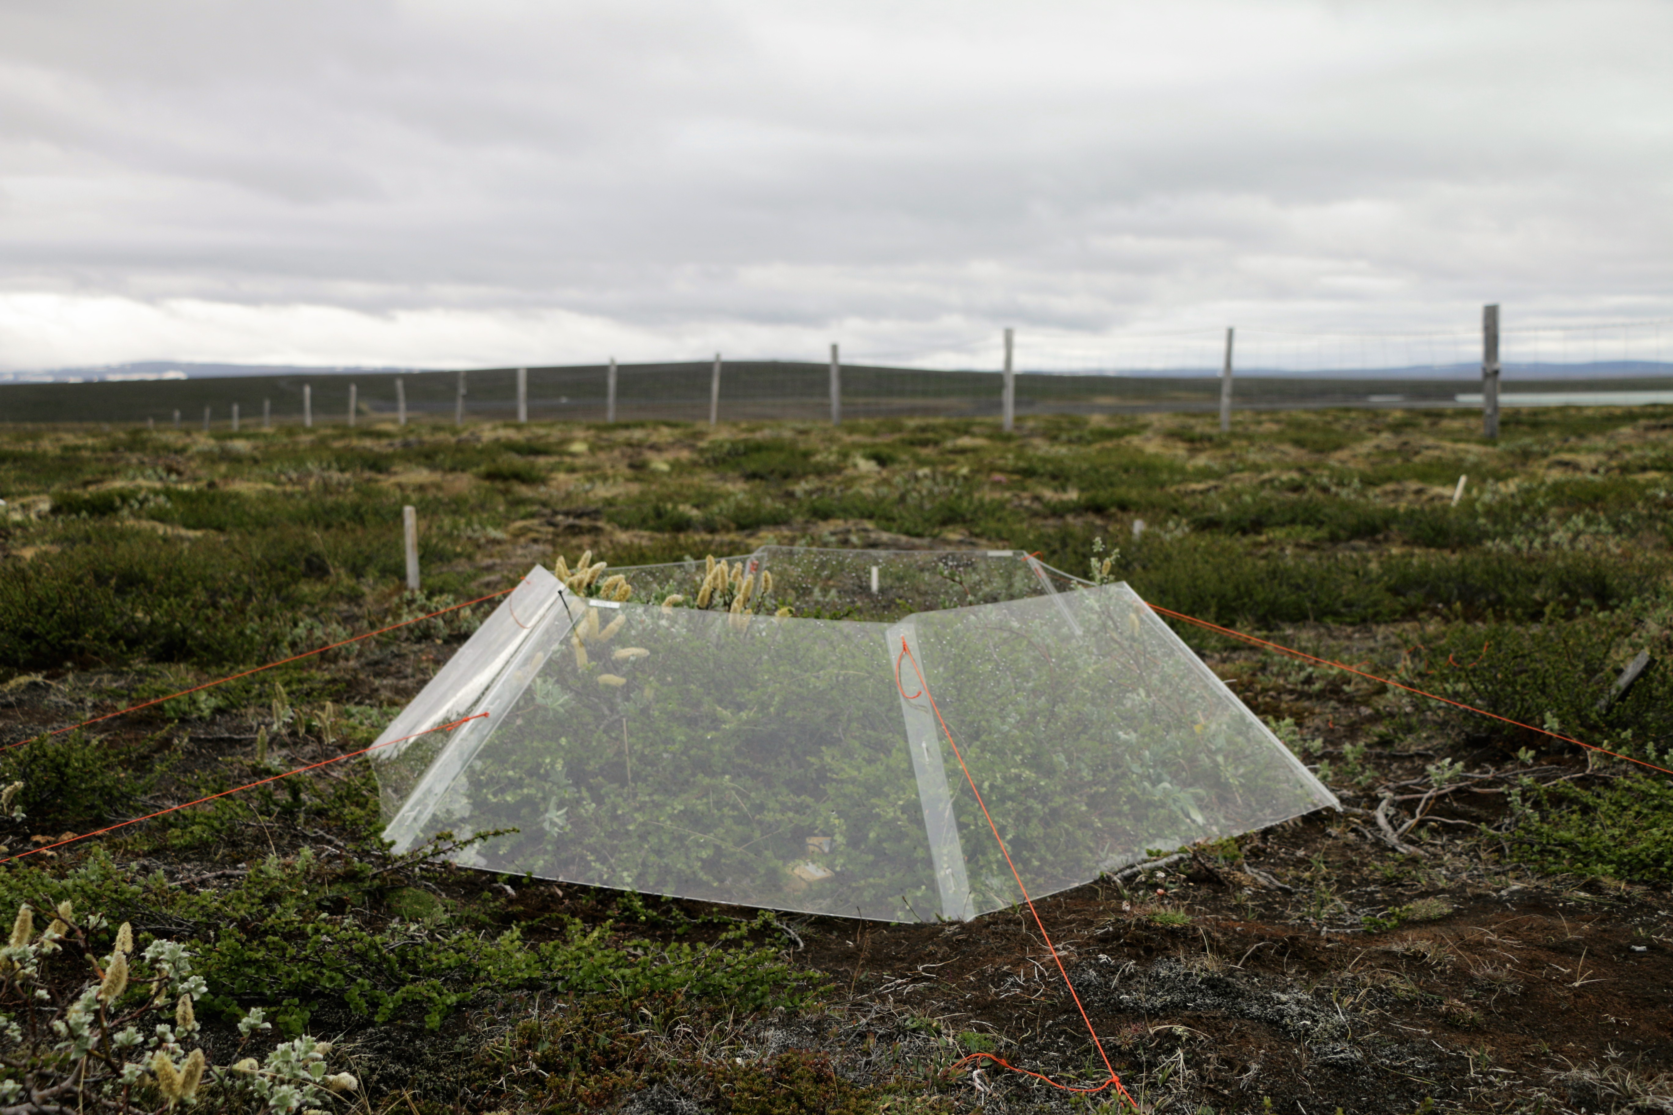
ITEX

Slide 73
Let’s look at the data
itex <- read_csv("Data/ITEX_diversity_data.csv")
head(itex)
# A tibble: 6 × 11 ...1 SITE SUBSITE PLOT YEAR TRTMT Latitude WarmQuarterTemp SppRich <dbl> <chr> <chr> <chr> <dbl> <chr> <dbl> <dbl> <dbl> 1 1 ALEXFIORD ALEXFIORD:… Cas.… 2007 CTL 78.9 25.6 9 2 2 ALEXFIORD ALEXFIORD:… Cas.… 2007 CTL 78.9 25.6 9 3 3 ALEXFIORD ALEXFIORD:… Cas.… 2007 CTL 78.9 25.6 7 4 4 ALEXFIORD ALEXFIORD:… Cas.… 2007 CTL 78.9 25.6 8 5 5 ALEXFIORD ALEXFIORD:… Cas.… 2007 CTL 78.9 25.6 6 6 6 ALEXFIORD ALEXFIORD:… Cas.… 2007 CTL 78.9 25.6 10 # ℹ 2 more variables: `row_number()` <dbl>, PlotTemp <dbl>
length(unique(itex$SITE)) #this code tells you how many different samples we have within the SITE column
[1] 24
unique(itex$SITE) #you can also do this and then it gives you the name of all samples within the SITE column
[1] "ALEXFIORD" "ANWR" "ATQASUK" "AUDKULUHEIDI" "BARROW" [6] "BROOKS" "BYLOT" "DOVRE" "ENDALEN" "FAROE" [11] "GAVIA" "KLUANE" "KYTALYK" "LATNJA" "NIWOT" [16] "QHI" "SADVENT" "STEPSTONES" "TAISETSU" "THINGVELLIR" [21] "TIBET" "TOOLIK" "TORNGATS" "VALBERCLA"

Slide 74
Exercises
Ex. 1 - Using the ITEX diversity dataset, what is the relationship between diversity and temperature across sites?
Think about what will be the response variable, what to include as fixed effects and what to include as a random effect.
Does the summary output correspond to the structure of the data? Think about how the data was sampled and how you structured your model.
Ex. 2 - What is the relationship between diversity and temperature WITHIN sites?
Think about how to restructure your model based on the new question.

