Slide 1


Slide 2
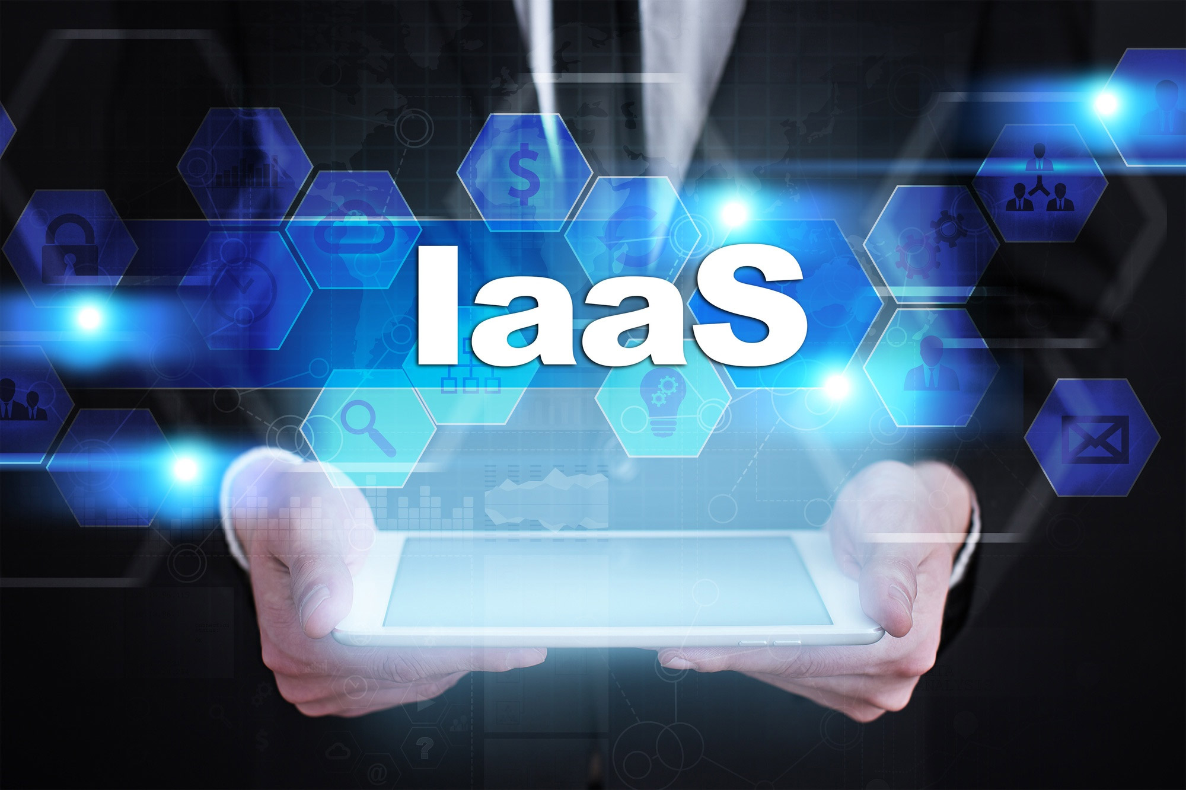

Slide 3
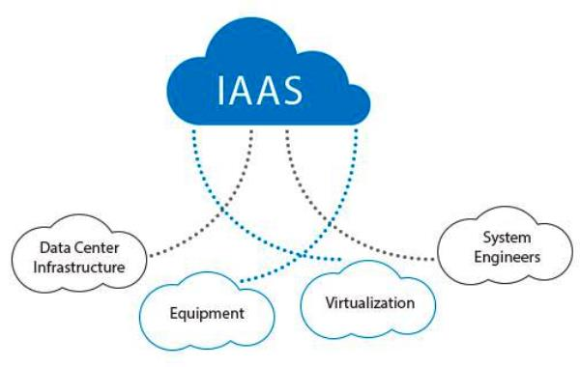
IAAS(Infrastructure as a service)
Iaas is also known as Hardware as a Service (HaaS). It is one of the layers of the cloud computing platform. It allows customers to outsource their IT infrastructures such as servers, networking, processing, storage, virtual machines, and other resources. Customers access these resources on the Internet using a pay-as-per use model.

Slide 4
Characteristics of IAAS:
Virtual machines with pre-installed software.
Virtual machines with pre-installed operating systems such as Windows, Linux, and Solaris.
On-demand availability of resources
Allows to store copies of particular data at different locations.
The computing resources can be easily scaled up and down.

Slide 5
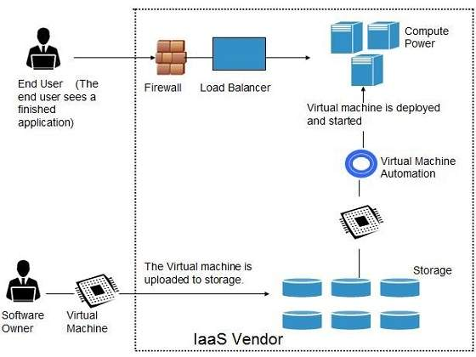
Working of IAAS

Slide 6
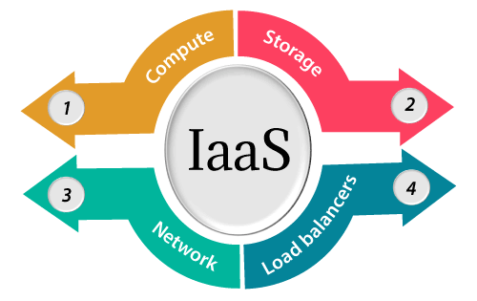
IAAS provider provides the following services:
Compute: Computing as a Service includes virtual central processing units and virtual main memory for the Vms that is provisioned to the end- users.
Storage: IaaS provider provides back-end storage for storing files.
Network: Network as a Service (NaaS) provides networking components such as routers, switches, and bridges for the Vms.
Load balancers: It provides load balancing capability at the infrastructure layer.

Slide 7
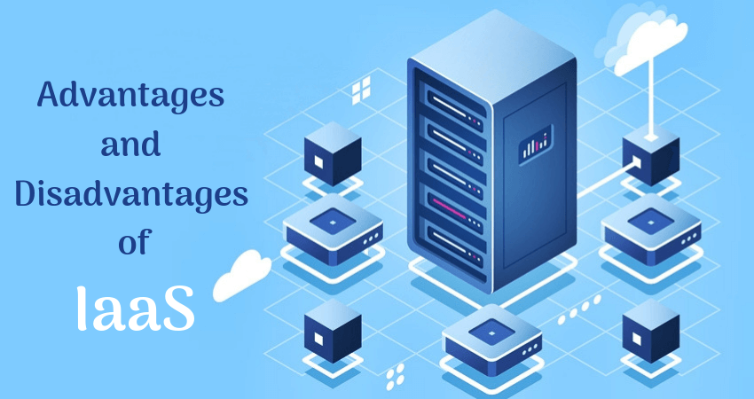

Slide 8
Advantages of IaaS cloud computing layer
Shared infrastructure
IaaS allows multiple users to share the same physical infrastructure.
Web access to the resources
Iaas allows IT users to access resources over the internet.
Pay-as-per-use model: IaaS providers provide services based on the pay-as-per-use basis. The users are required to pay for what they have used.
Focus on the core business: IaaS providers focus on the organization's core business rather than on IT infrastructure.
On-demand scalability: On-demand scalability is one of the biggest advantages of IaaS. Using IaaS, users do not worry about to upgrade software and troubleshoot the issues related to hardware components.

Slide 9
Disadvantages of IaaS cloud computing layer
Security
Security is one of the biggest issues in IaaS. Most of the IaaS providers are not able to provide 100% security.
Maintenance & Upgrade
Although IaaS service providers maintain the software, but they do not upgrade the software for some organizations.
Interoperability issues
It is difficult to migrate VM from one IaaS provider to the other, so the customers might face problem related to vendor lock-in.

Slide 10
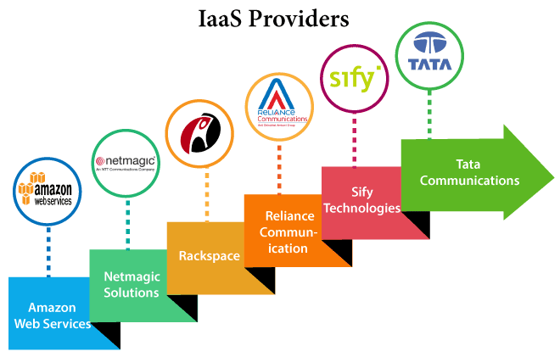
Top Iaas Providers who are providing IaaS cloud computing platform

Slide 11
IaaS Vendor | Iaas Solution | Details
Amazon Web Services | Elastic, Elastic Compute Cloud (EC2) MapReduce, Route 53, Virtual Private Cloud, etc. | The cloud computing platform pioneer, Amazon offers auto scaling, cloud monitoring, and load balancing features as part of its portfolio.
Netmagic Solutions | Netmagic IaaS Cloud | Netmagic runs from data centers in Mumbai, Chennai, and Bangalore, and a virtual data center in the United States. Plans are underway to extend services to West Asia.
Rackspace | Cloud servers, cloud files, cloud sites, etc. | The cloud computing platform vendor focuses primarily on enterprise-level hosting services.
Reliance Communications | Reliance Internet Data Center | RIDC supports both traditional hosting and cloud services, with data centers in Mumbai, Bangalore, Hyderabad, and Chennai. The cloud services offered by RIDC include IaaS and SaaS.
Sify Technologies | Sify IaaS | Sify's cloud computing platform is powered by HP's converged infrastructure. The vendor offers all three types of cloud services: IaaS, PaaS, and SaaS.
Tata Communications | InstaCompute | InstaCompute is Tata Communications' IaaS offering. InstaCompute data centers are located in Hyderabad and Singapore, with operations in both countries.

Slide 12


